Slide 1
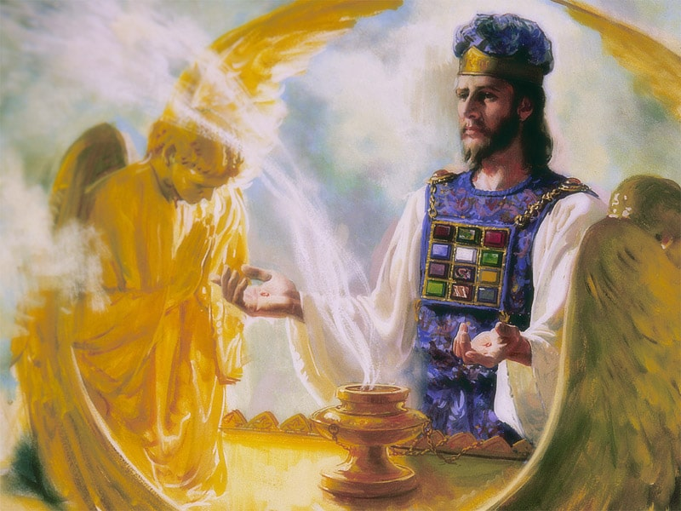
The Sanctuary pt 54: The Day of Atonement 1

Slide 2
A Final Word on the Antitypical Trumpets
“The proclamation of the first, second, and third angels’ messages has been located by the word of inspiration. Not a peg or pin is to be removed. No human authority has any more right to change the location of these messages than to substitute the New Testament for the Old. The Old Testament is the gospel in figures and symbols. The New Testament is the substance. One is as essential as the other. The Old Testament presents lessons from the lips of Christ, and these lessons have not lost their force in any particular. The first and second messages were given in 1843 and 1844, and we are now under the proclamation of the third; but all three of the messages are still to be proclaimed. It is just as essential now as ever before that they shall be repeated to those who are seeking for the truth. By pen and voice we are to sound the proclamation, to the third angel’s message. There cannot be a third without the first and second. These messages we are to give to the world in publications, in discourses, showing in the line of prophetic history the things that have been, and the things that will be.”—Manuscript 32, 1896

Slide 4
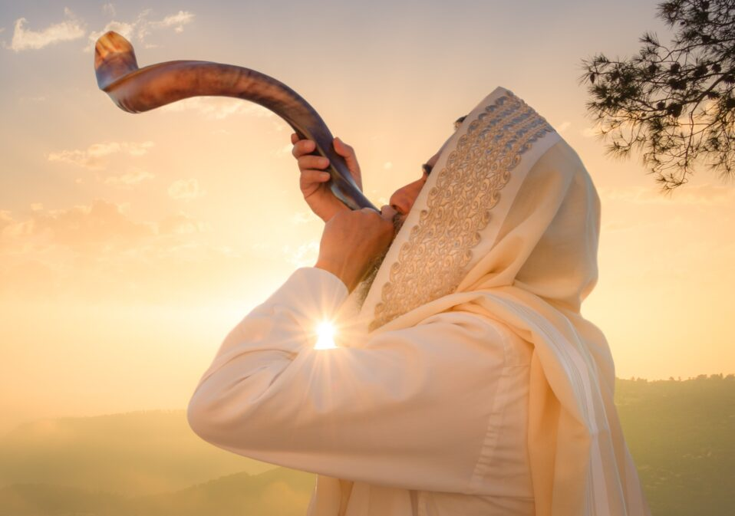
What We will Study Today:
What Happened during this feast
What it meant for ancient Israel and What it means for us today
It’s prophetic fulfillment

Slide 5
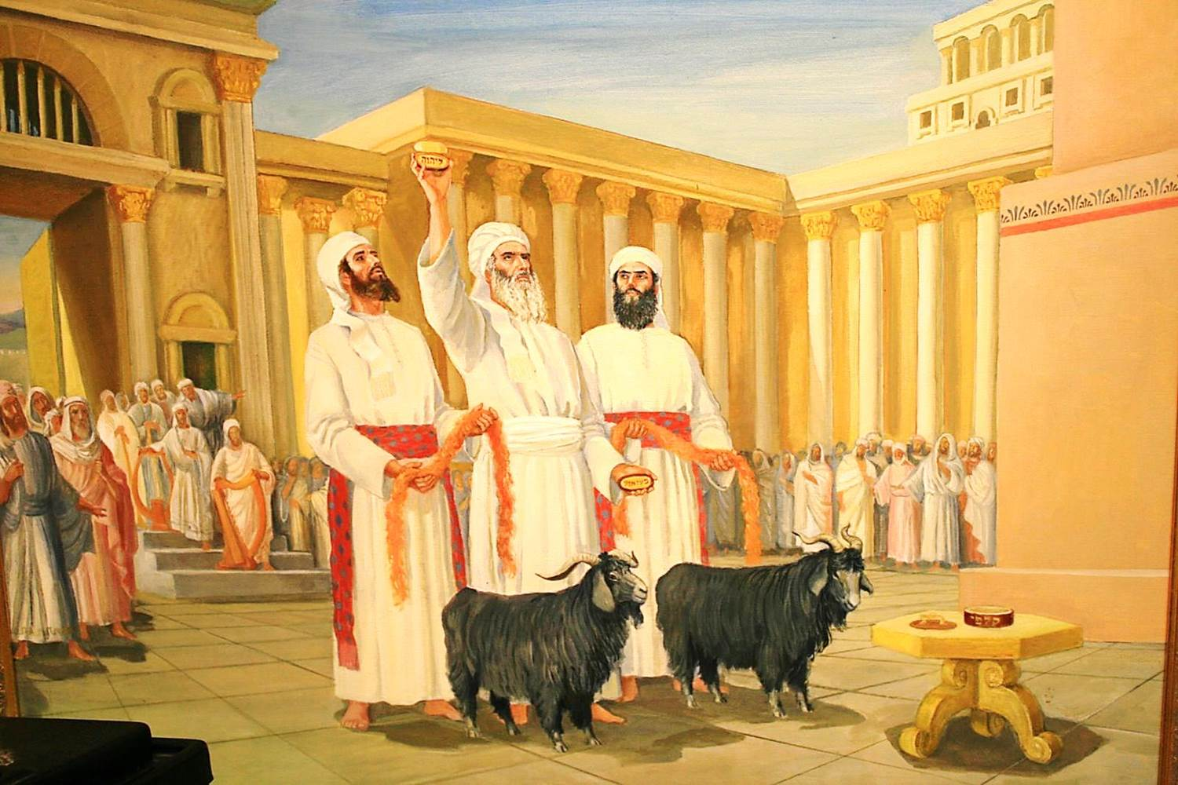
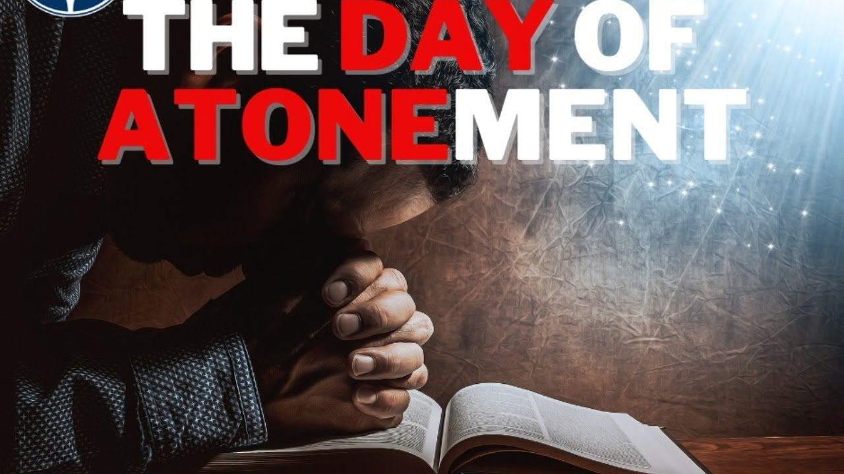
Starting at the Feast of Trumpets
“The first ten days of Tishri grew to be the ten penitential days of the year, intended to bring about a perfect change in heart, and to make Israel like newborn creatures, . . . the culmination being reached on the Day of Atonement when religion’s greatest gift, God’s condoning mercy, was to be offered to man. . . . The idea developed also in Jewish circles that on the first of Tishri, the sacred New Year’s Day and the anniversary of creation, man’s doings were judged and his destiny was decided; and that on the tenth of Tishri the decree of heaven was sealed”—Jewish Encyclopedia, “Atonement”, vol. 2, p. 281

Slide 6
The Jewish Encyclopedia Continues…
“God, seated on His throne to judge the world, at the same time Judge, Pleader, Expert, and Witness, openeth the Book of Records; it is read, every man’s signature being found therein. The great trumpet is sounded; a still, small voice is heard; the angels shudder, saying, this is the day of judgment: for His very ministers are not pure before God. As a shepherd mustereth his flock, causing them to pass under his rod, so doth God cause every living soul to pass before Him to fix the limit of every creature’s life and to foreordain its destiny. On New Year’s Day the decree is written; on the Day of Atonement it is sealed who shall live and who are to die, etc. But penitence, prayer, and charity may avert the evil decree.”—Jewish Encyclopedia, “Atonement, Day of”, vol.2, p. 286

Slide 7
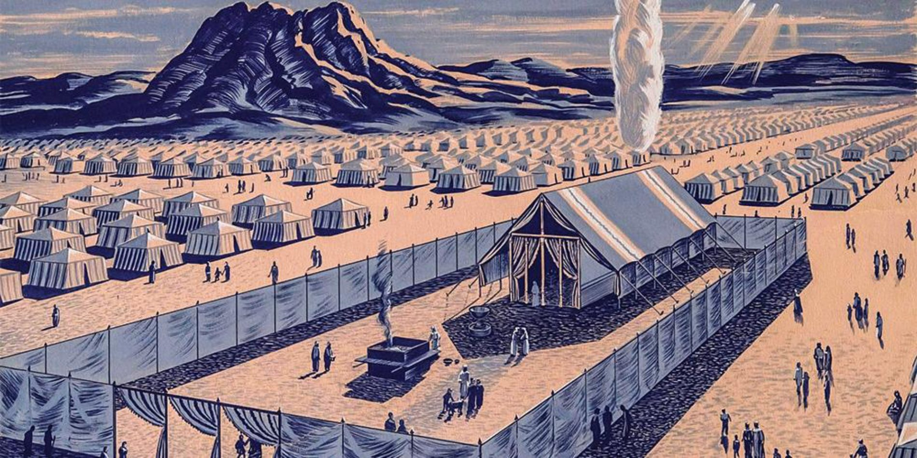
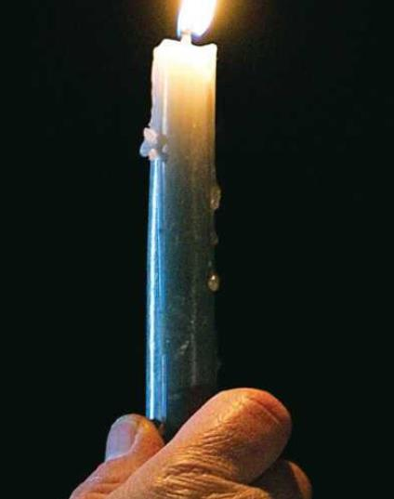
Leviticus 23 Summary…
Lev. 23:26-32 “And the Lord spake unto Moses, saying, Also on the tenth day of this seventh month there shall be a day of atonement: it shall be an holy convocation unto you; and ye shall afflict your souls, and offer an offering made by fire unto the Lord. And ye shall do no work in that same day: for it is a day of atonement, to make an atonement for you before the Lord your God. For whatsoever soul it be that shall not be afflicted in that same day, he shall be cut off from among his people. And whatsoever soul it be that doeth any work in that same day, the same soul will I destroy from among his people. Ye shall do no manner of work: it shall be a statute for ever throughout your generations in all your dwellings. It shall be unto you a sabbath of rest, and ye shall afflict your souls: in the ninth day of the month at even, from even unto even, shall ye celebrate your sabbath.”

Slide 8
“Afflict Your Souls” Meant…
Afflict: 6031 anah (an-naw’): afflict, humble, force, exercised, sin, troubled, weakened, 1) to be occupied, be busied with 2) to afflict, oppress, humble, be afflicted, be bowed down 1) to be put down, become low 2) to be depressed, be downcast
Soul: 5315 nephesh (neh’-fesh): soul, self, life, creature, person, appetite, mind, living being, desire, emotion, passion 1a) that which breathes, the breathing substance or being, soul, the inner being of man 1b) living being 1c) living being (with life in the blood) 1d) the man himself, self, person or individual 1e) the seat of the appetites 1f) seat of emotions and passions 1g) activity of the mind
“To humble/afflict/bowdown yourself/mind/heart/appetite/passion to the will of God.”

Slide 9
Modern Day “Affliction of the Soul”
“I saw some, with strong faith and agonizing cries, pleading with God. Their countenances were pale and marked with deep anxiety, expressive of their internal struggle. Firmness and great earnestness was expressed in their countenances; large drops of perspiration fell from their foreheads. Now and then their faces would light up with the marks of God’s approbation, and again the same solemn, earnest, anxious look would settle upon them. Evil angels crowded around, pressing darkness upon them to shut out Jesus from their view, that their eyes might be drawn to the darkness that surrounded them, and thus they be led to distrust God and murmur against Him. Their only safety was in keeping their eyes directed upward. Angels of God had charge over His people, and as the poisonous atmosphere of evil angels was pressed around these anxious ones, the heavenly angels were continually wafting their wings over them to scatter the thick darkness. As the praying ones continued their earnest cries, at times a ray of light from Jesus came to them, to encourage their hearts and light up their countenances. Some, I saw, did not participate in this work of agonizing and pleading. They seemed indifferent and careless. They were not resisting the darkness around them, and it shut them in like a thick cloud. The angels of God left these and went to the aid of the earnest, praying ones. I saw angels of God hasten to the assistance of all who were struggling with all their power to resist the evil angels and trying to help themselves by calling upon God with perseverance. But His angels left those who made no effort to help themselves, and I lost sight of them.” EW, 269-270

Slide 10
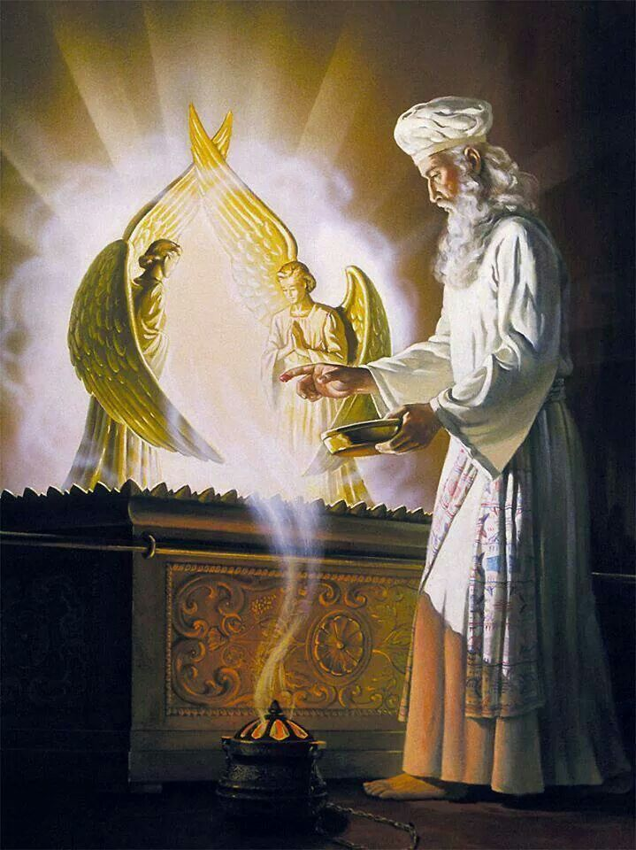
Leviticus 16
Lev. 16:1-7 “And the Lord spake unto Moses after the death of the two sons of Aaron, when they offered before the Lord, and died; And the Lord said unto Moses, Speak unto Aaron thy brother, that he come not at all times into the holy place within the vail before the mercy seat, which is upon the ark; that he die not: for I will appear in the cloud upon the mercy seat. Thus shall Aaron come into the holy place: with a young bullock for a sin offering, and a ram for a burnt offering. He shall put on the holy linen coat, and he shall have the linen breeches upon his flesh, and shall be girded with a linen girdle, and with the linen mitre shall he be attired: these are holy garments; therefore shall he wash his flesh in water, and so put them on. And he shall take of the congregation of the children of Israel two kids of the goats for a sin offering, and one ram for a burnt offering. And Aaron shall offer his bullock of the sin offering, which is for himself, and make an atonement for himself, and for his house. And he shall take the two goats, and present them before the Lord at the door of the tabernacle of the congregation.”

Slide 11
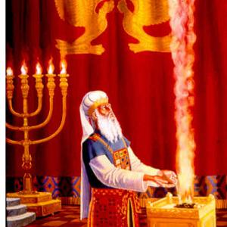
Sin Transferred to Priesthood…
Lev. 6:25-26 “Speak unto Aaron and to his sons, saying, This is the law of the sin offering: In the place where the burnt offering is killed shall the sin offering be killed before the Lord: it is most holy. The priest that offereth it for sin shall eat it: in the holy place shall it be eaten, in the court of the tabernacle of the congregation.”

Slide 12
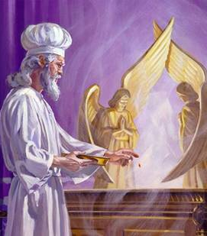
Leviticus 16 Continues
Lev. 16:8-14 “And Aaron shall cast lots upon the two goats; one lot for the Lord, and the other lot for the scapegoat. And Aaron shall bring the goat upon which the Lord's lot fell, and offer him for a sin offering. But the goat, on which the lot fell to be the scapegoat, shall be presented alive before the Lord, to make an atonement with him, and to let him go for a scapegoat into the wilderness. And Aaron shall bring the bullock of the sin offering, which is for himself, and shall make an atonement for himself, and for his house, and shall kill the bullock of the sin offering which is for himself: And he shall take a censer full of burning coals of fire from off the altar before the Lord, and his hands full of sweet incense beaten small, and bring it within the vail: And he shall put the incense upon the fire before the Lord, that the cloud of the incense may cover the mercy seat that is upon the testimony, that he die not: And he shall take of the blood of the bullock, and sprinkle it with his finger upon the mercy seat eastward; and before the mercy seat shall he sprinkle of the blood with his finger seven times.”

Slide 13
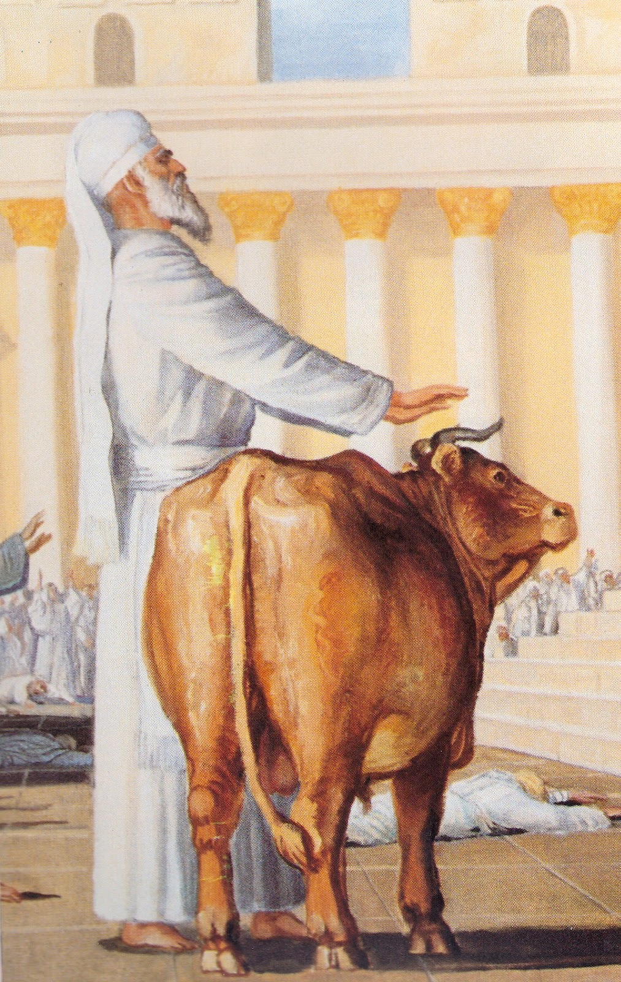
What is Atonement in the Bible?
First Way: Knowledge of Sin and Repentance, Confession, Substitutional Sacrifice, Forgiveness and Mediation
Lev. 4:20-21 “And he shall do with the bullock as he did with the bullock for a sin offering, so shall he do with this: and the priest shall make an atonement for them, and it shall be forgiven them. And he shall carry forth the bullock without the camp, and burn him as he burned the first bullock: it is a sin offering for the congregation.”

Slide 14
What is Atonement in the Bible?
Second Way: Judgment and Sentence
Num. 25:6-13 “And, behold, one of the children of Israel came and brought unto his brethren a Midianitish woman in the sight of Moses, and in the sight of all the congregation of the children of Israel, who were weeping before the door of the tabernacle of the congregation. And when Phinehas, the son of Eleazar, the son of Aaron the priest, saw it, he rose up from among the congregation, and took a javelin in his hand; And he went after the man of Israel into the tent, and thrust both of them through, the man of Israel, and the woman through her belly. So the plague was stayed from the children of Israel. And those that died in the plague were twenty and four thousand. And the Lord spake unto Moses, saying, Phinehas, the son of Eleazar, the son of Aaron the priest, hath turned my wrath away from the children of Israel, while he was zealous for my sake among them, that I consumed not the children of Israel in my jealousy. Wherefore say, Behold, I give unto him my covenant of peace: And he shall have it, and his seed after him, even the covenant of an everlasting priesthood; because he was zealous for his God, and made an atonement for the children of Israel.”

Slide 15
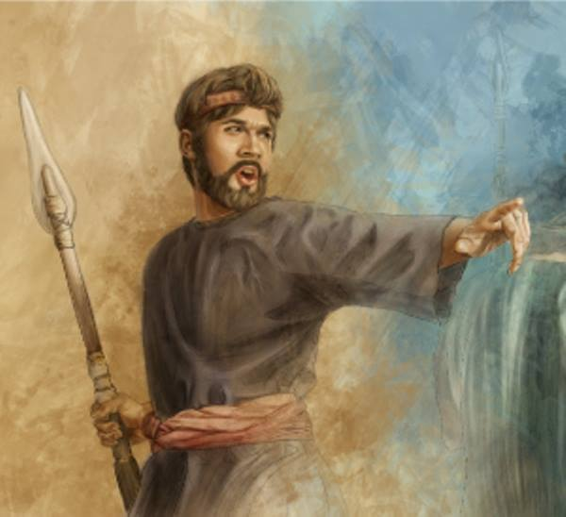

Slide 16
Leviticus 16 Goes On
Lev. 16:15-17 “Then shall he kill the goat of the sin offering, that is for the people, and bring his blood within the vail, and do with that blood as he did with the blood of the bullock, and sprinkle it upon the mercy seat, and before the mercy seat: And he shall make an atonement for the holy place, because of the uncleanness of the children of Israel, and because of their transgressions in all their sins: and so shall he do for the tabernacle of the congregation, that remaineth among them in the midst of their uncleanness. And there shall be no man in the tabernacle of the congregation when he goeth in to make an atonement in the holy place, until he come out, and have made an atonement for himself, and for his household, and for all the congregation of Israel.”

Slide 17
The Tabernacle was “Unclean”???
“Both ceremonies alike symbolized the transfer of the sin from the penitent to the sanctuary. Such was the work that went on day by day throughout the year. The sins of Israel being thus transferred to the sanctuary, the holy places were defiled, and a special work became necessary for the removal of the sins. God commanded that an atonement be made for each of the sacred apartments, as for the altar, to "cleanse it, and hallow it from the uncleanness of the children of Israel." Leviticus 16:19. Once a year, on the great Day of Atonement, the priest entered the most holy place for the cleansing of the sanctuary. The work there performed completed the yearly round of ministration. On the Day of Atonement two kids of the goats were brought to the door of the tabernacle, and lots were cast upon them, "one lot for the Lord, and the other lot for the scapegoat." The goat upon which the first lot fell was to be slain as a sin offering for the people. And the priest was to bring his blood within the veil, and sprinkle it upon the mercy seat. "And he shall make an atonement for the holy place, because of the uncleanness of the children of Israel, and because of their transgression in all their sins; and so shall he do for the tabernacle of the congregation, that remaineth among them in the midst of their uncleanness.“ PP, p. 355

Slide 18
Leviticus 16 Goes On
Lev. 16:18-21 “And he shall go out unto the altar that is before the Lord, and make an atonement for it; and shall take of the blood of the bullock, and of the blood of the goat, and put it upon the horns of the altar round about. And he shall sprinkle of the blood upon it with his finger seven times, and cleanse it, and hallow it from the uncleanness of the children of Israel. And when he hath made an end of reconciling the holy place, and the tabernacle of the congregation, and the altar, he shall bring the live goat: And Aaron shall lay both his hands upon the head of the live goat, and confess over him all the iniquities of the children of Israel, and all their transgressions in all their sins, putting them upon the head of the goat, and shall send him away by the hand of a fit man into the wilderness:”

Slide 19
Lev. 16:22-28 “And the goat shall bear upon him all their iniquities unto a land not inhabited: and he shall let go the goat in the wilderness. And Aaron shall come into the tabernacle of the congregation, and shall put off the linen garments, which he put on when he went into the holy place, and shall leave them there: And he shall wash his flesh with water in the holy place, and put on his garments, and come forth, and offer his burnt offering, and the burnt offering of the people, and make an atonement for himself, and for the people. And the fat of the sin offering shall he burn upon the altar. And he that let go the goat for the scapegoat shall wash his clothes, and bathe his flesh in water, and afterward come into the camp. And the bullock for the sin offering, and the goat for the sin offering, whose blood was brought in to make atonement in the holy place, shall one carry forth without the camp; and they shall burn in the fire their skins, and their flesh, and their dung. And he that burneth them shall wash his clothes, and bathe his flesh in water, and afterward he shall come into the camp.”

Slide 20
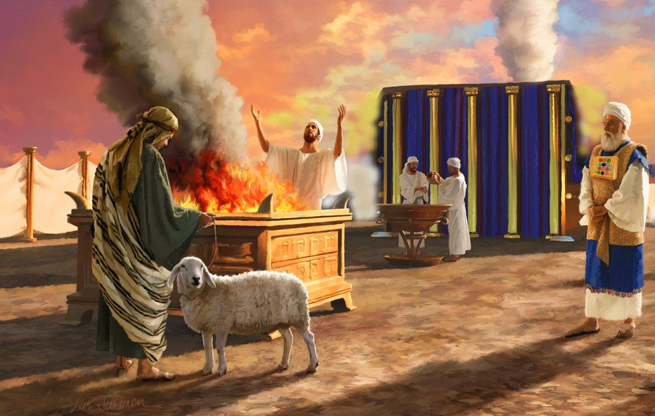
Atonement is More than the Cross!?!
“The intercession of Christ in man's behalf in the sanctuary above is as essential to the plan of salvation as was His death upon the cross. By His death He began that work which after His resurrection He ascended to complete in heaven.” GC, pg. 489

Slide 21
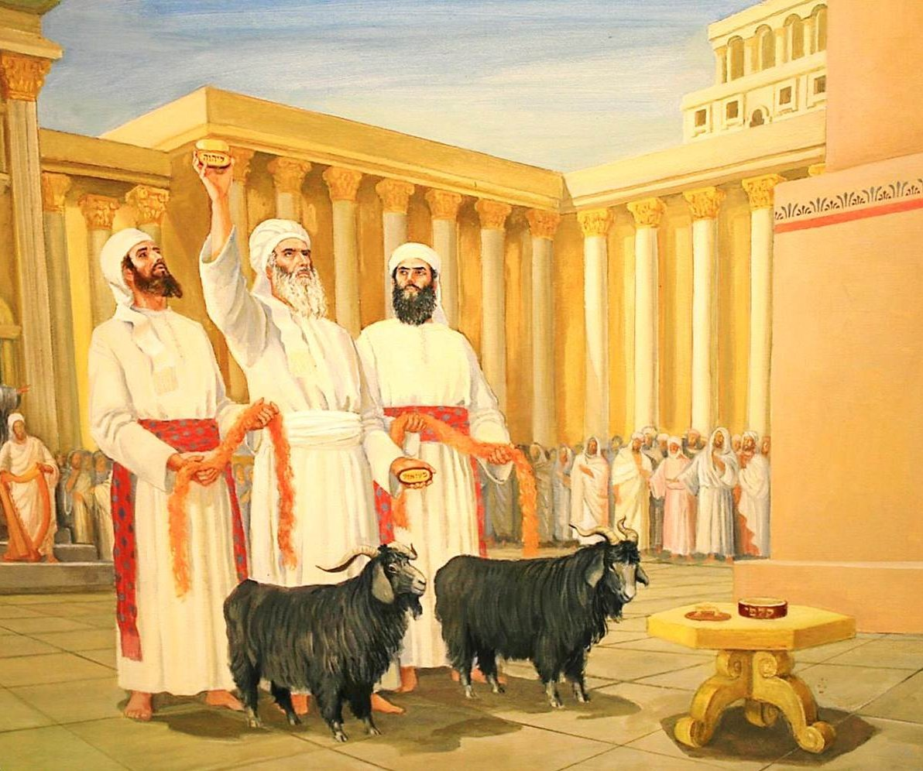

Slide 22
Who/What Are Represented by the Goats?
“In the great day of final award, the dead are to be "judged out of those things which were written in the books, according to their works." Revelation 20:12. Then by virtue of the atoning blood of Christ, the sins of all the truly penitent will be blotted from the books of heaven. Thus the sanctuary will be freed, or cleansed, from the record of sin. In the type, this great work of atonement, or blotting out of sins, was represented by the services of the Day of Atonement—the cleansing of the earthly sanctuary, which was accomplished by the removal, by virtue of the blood of the sin offering, of the sins by which it had been polluted. As in the final atonement the sins of the truly penitent are to be blotted from the records of heaven, no more to be remembered or come into mind, so in the type they were borne away into the wilderness, forever separated from the congregation. Since Satan is the originator of sin, the direct instigator of all the sins that caused the death of the Son of God, justice demands that Satan shall suffer the final punishment. Christ's work for the redemption of men and the purification of the universe from sin will be closed by the removal of sin from the heavenly sanctuary and the placing of these sins upon Satan, who will bear the final penalty. So in the typical service, the yearly round of ministration closed with the purification of the sanctuary, and the confessing of the sins on the head of the scapegoat.” PP, p. 357-358

Slide 23
Biblical Proof of this????
Rev. 20:1-3 “And I saw an angel come down from heaven, having the key of the bottomless pit and a great chain in his hand. And he laid hold on the dragon, that old serpent, which is the Devil, and Satan, and bound him a thousand years, And cast him into the bottomless pit, and shut him up, and set a seal upon him, that he should deceive the nations no more, till the thousand years should be fulfilled: and after that he must be loosed a little season.”

Slide 24
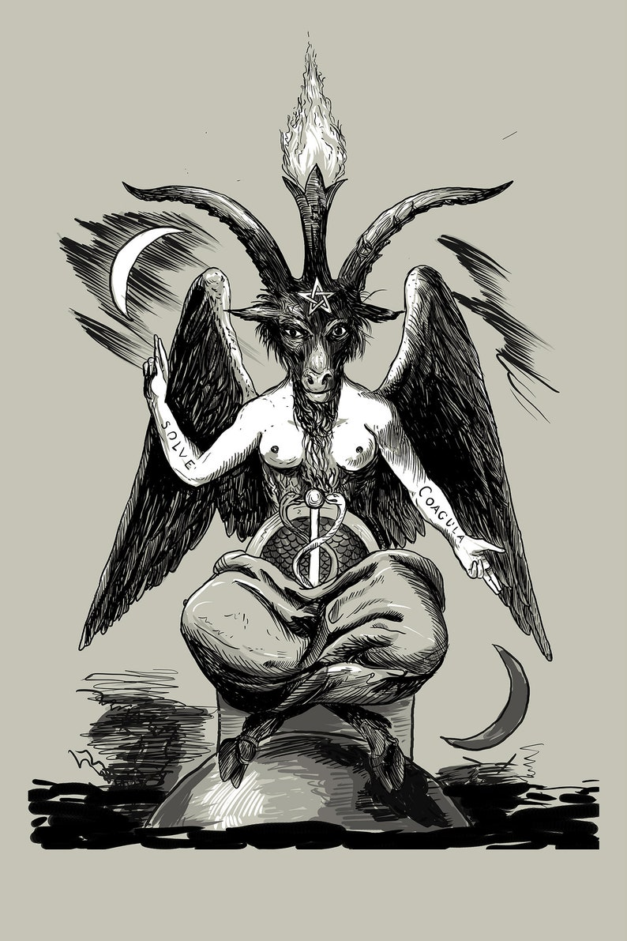
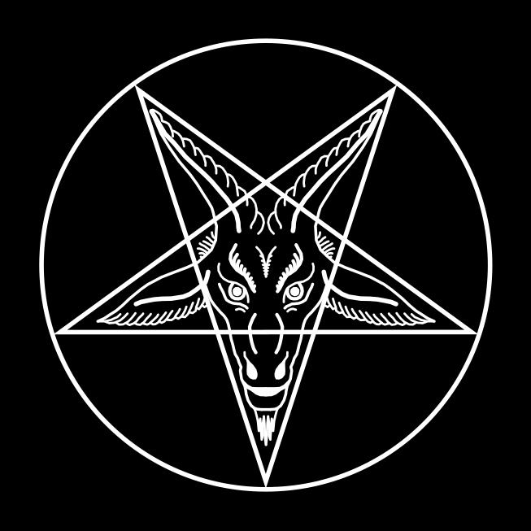
Satan Knows He is the “other” goat

Slide 25
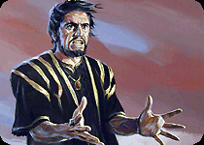
A Final Word
“Thus in the ministration of the tabernacle, and of the temple that afterward took its place, the people were taught each day the great truths relative to Christ's death and ministration, and once each year their minds were carried forward to the closing events of the great controversy between Christ and Satan, the final purification of the universe from sin and sinners.” PP, p. 358

Slide 26
Finishing Up Leviticus
Lev. 16:29-34 “And this shall be a statute for ever unto you: that in the seventh month, on the tenth day of the month, ye shall afflict your souls, and do no work at all, whether it be one of your own country, or a stranger that sojourneth among you: For on that day shall the priest make an atonement for you, to cleanse you, that ye may be clean from all your sins before the Lord. It shall be a sabbath of rest unto you, and ye shall afflict your souls, by a statute for ever. And the priest, whom he shall anoint, and whom he shall consecrate to minister in the priest's office in his father's stead, shall make the atonement, and shall put on the linen clothes, even the holy garments: And he shall make an atonement for the holy sanctuary, and he shall make an atonement for the tabernacle of the congregation, and for the altar, and he shall make an atonement for the priests, and for all the people of the congregation. And this shall be an everlasting statute unto you, to make an atonement for the children of Israel for all their sins once a year. And he did as the Lord commanded Moses.”

Slide 27
Sin to Be Put Away in the Day of Atonement
“Those who are living upon the earth when the intercession of Christ shall cease in the sanctuary above are to stand in the sight of a holy God without a mediator. Their robes must be spotless, their characters must be purified from sin by the blood of sprinkling. Through the grace of God and their own diligent efforts, they must be conquerors in the battle with evil. While the investigative judgment is going forward in heaven, while the sins of penitent believers are being removed from the sanctuary, there is to be a special work of purification, of putting away sin, among God's people on earth.” R&H, January 17, 1907

Slide 28
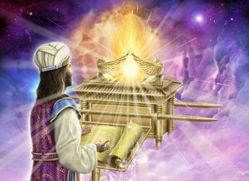
The Hour of His Judgment
Dan. 8:14 “And he said unto me, Unto two thousand and three hundred days; then shall the sanctuary be cleansed.”---ended in 1844
Lev. 16:15-16 “Then shall he kill the goat of the sin offering, that is for the people, and bring his blood within the vail, and do with that blood as he did with the blood of the bullock, and sprinkle it upon the mercy seat, and before the mercy seat: And he shall make an atonement for the holy place, because of the uncleanness of the children of Israel, and because of their transgressions in all their sins: and so shall he do for the tabernacle of the congregation, that remaineth among them in the midst of their uncleanness.”

Slide 29
