Slide 1
Jesus Life, pt. 17 “Near Deadly Homecoming”

Slide 2
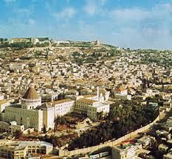
No Place Like Home
For some of us, there is no place like home! For some of us, home is not a place to be cherished! For Jesus, His two homecomings back to Nazareth were anything but inviting. He understood, by experience, the bitter pill of rejection on the home front!

Slide 3
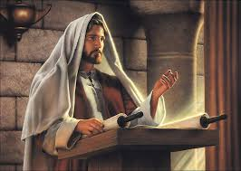
Things Looked So Bright
Multitudes were flocking about Him. Whether it was in the synagogue’s around Galilee, or at the seaside, or on the mountain slopes, everywhere people wanted to see Him, to touch Him, to hear Him speak! The work in Galilee appeared so bright, but one dark spot was Jesus’ visit to His hometown of Nazareth! It started on the Sabbath.

Slide 4
Wrong View of Prophecy!
“During His childhood and youth, Jesus had worshiped among His brethren in the synagogue at Nazareth. Since the opening of His ministry He had been absent from them, but they had not been ignorant of what had befallen Him. As He again appeared among them, their interest and expectation were excited to the highest pitch. Here were the familiar forms and faces of those whom He had known from infancy. Here were His mother, His brothers and sisters, and all eyes were turned upon Him as He entered the synagogue upon the Sabbath day, and took His place among the worshipers. In the regular service for the day, the elder read from the prophets, and exhorted the people still to hope for the Coming One, who would bring in a glorious reign, and banish all oppression. He sought to encourage his hearers by rehearsing the evidence that the Messiah's coming was near. He described the glory of His advent, keeping prominent the thought that He would appear at the head of armies to deliver Israel.” DA, pg. 236

Slide 5
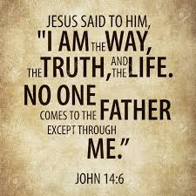
Jesus and Truth go together!
Some would tell us today that it doesn’t matter what we believe. It is only about Jesus. It sure made a difference in Nazareth what they believed!
Somehow, the truth and Jesus are made mutually exclusive. This is an awful misrepresentation of the Bible and of Jesus! Jesus is the Truth (John 14:6) and the two go hand in hand. You can not divide the truth of Scripture from Jesus!

Slide 6
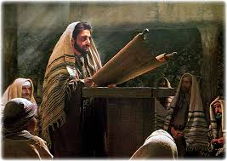
“And he came to Nazareth, where he had been brought up: and, as his custom was, he went into the synagogue on the sabbath day, and stood up for to read. And there was delivered unto him the book of the prophet Esaias. And when he had opened the book, he found the place where it was written, The Spirit of the Lord is upon me, because he hath anointed me to preach the gospel to the poor; he hath sent me to heal the brokenhearted, to preach deliverance to the captives, and recovering of sight to the blind, to set at liberty them that are bruised, To preach the acceptable year of the Lord.” Luke 4:16-19

Slide 7
Amen and Amen!
“Jesus stood before the people as a living expositor of the prophecies concerning Himself. Explaining the words He had read, He spoke of the Messiah as a reliever of the oppressed, a liberator of captives, a healer of the afflicted, restoring sight to the blind, and revealing to the world the light of truth. His impressive manner and the wonderful import of His words thrilled the hearers with a power they had never felt before. The tide of divine influence broke every barrier down; like Moses, they beheld the Invisible. As their hearts were moved upon by the Holy Spirit, they responded with fervent amens and praises to the Lord.” DA, pg. 237

Slide 8
It Started Off so Well!
People were rejoicing. Their hearts were thrilled by His preaching! They were shouting ‘amens’ and ‘preach it, brother’. As long as Jesus preached the message and did not apply it to the time in which He lived, all was well. As soon as He applied it to that time, all hell broke loose!

Slide 9
This Day is this Fulfilled!
“But when Jesus announced, “This day is this scripture fulfilled in your ears,” they were suddenly recalled to think of themselves, and of the claims of Him who had been addressing them. They, Israelites, children of Abraham, had been represented as in bondage. They had been addressed as prisoners to be delivered from the power of evil; as in darkness, and needing the light of truth. Their pride was offended, and their fears were roused. The words of Jesus indicated that His work for them was to be altogether different from what they desired. Their deeds might be investigated too closely. Notwithstanding their exactness in outward ceremonies, they shrank from inspection by those clear, searching eyes. Who is this Jesus? they questioned. He who had claimed for Himself the glory of the Messiah was the son of a carpenter, and had worked at His trade with His father Joseph. They had seen Him toiling up and down the hills, they were acquainted with His brothers and sisters, and knew His life and labors. They had seen Him develop from childhood to youth, and from youth to manhood. Although His life had been spotless, they would not believe that He was the Promised One.” DA, pg. 237

Slide 10
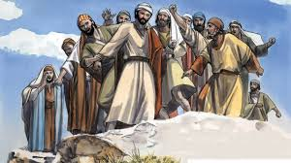
Hit Too Close to Home!
“Our standing before God depends, not upon the amount of light we have received, but upon the use we make of what we have. Thus even the heathen who choose the right as far as they can distinguish it are in a more favorable condition than are those who have had great light, and profess to serve God, but who disregard the light, and by their daily life contradict their profession. The words of Jesus to His hearers in the synagogue struck at the root of their self-righteousness, pressing home upon them the bitter truth that they had departed from God and forfeited their claim to be His people. Every word cut like a knife as their real condition was set before them. They now scorned the faith with which Jesus had at first inspired them. They would not admit that He who had sprung from poverty and lowliness was other than a common man.” DA, pg. 239

Slide 11
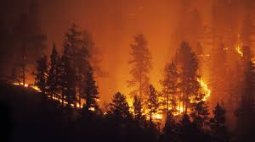
Why People Hate Ellen White
You can not read Desire of Ages and not say with the Library of Congress, “That is the greatest book ever written on the life of Christ.” You can not read her works and not see the power therein. What rankles people is her applying it to our day. Like in Christ’s day, folk do not want it applied too closely to them. This is the reason for the Satanic fury that stirs people to hate her works!

Slide 12
This Brought Down Hell on Christ That Day!
“And he said unto them, Ye will surely say unto me this proverb, Physician, heal thyself: whatsoever we have heard done in Capernaum, do also here in thy country. And he said, Verily I say unto you, No prophet is accepted in his own country. But I tell you of a truth, many widows were in Israel in the days of Elias, when the heaven was shut up three years and six months, when great famine was throughout all the land; But unto none of them was Elias sent, save unto Sarepta, a city of Sidon, unto a woman that was a widow. And many lepers were in Israel in the time of Eliseus the prophet; and none of them was cleansed, saving Naaman the Syrian. And all they in the synagogue, when they heard these things, were filled with wrath, And rose up, and thrust him out of the city, and led him unto the brow of the hill whereon their city was built, that they might cast him down headlong. But he passing through the midst of them went his way,” Luke 4:23-30

Slide 13
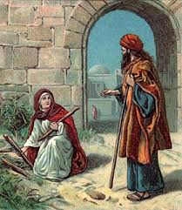
Many Widows in Israel
“ The servants whom God had chosen for a special work were not allowed to labor for a hardhearted and unbelieving people. But those who had hearts to feel and faith to believe were especially favored with evidences of His power through the prophets. In the days of Elijah, Israel had departed from God. They clung to their sins, and rejected the warnings of the Spirit through the Lord's messengers. Thus they cut themselves off from the channel by which God's blessing could come to them. The Lord passed by the homes of Israel, and found a refuge for His servant in a heathen land, with a woman who did not belong to the chosen people. But this woman was favored because she had followed the light she had received, and her heart was open to the greater light that God sent her through His prophet.” DA, pg. 238

Slide 14
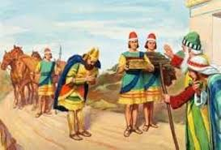
“It was for the same reason that in Elisha's time the lepers of Israel were passed by. But Naaman, a heathen nobleman, had been faithful to his convictions of right, and had felt his great need of help. He was in a condition to receive the gifts of God's grace. He was not only cleansed from his leprosy, but blessed with a knowledge of the true God. Our standing before God depends, not upon the amount of light we have received, but upon the use we make of what we have. Thus even the heathen who choose the right as far as they can distinguish it are in a more favorable condition than are those who have had great light, and profess to serve God, but who disregard the light, and by their daily life contradict their profession.” DA, pg. 239

Slide 15
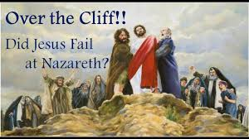
Time For Jesus to Leave-Permanently
“ The assembly broke up, and laying hands upon Jesus, they thrust Him from the synagogue, and out of the city. All seemed eager for His destruction. They hurried Him to the brow of a precipice, intending to cast Him down headlong. Shouts and maledictions filled the air. Some were casting stones at Him, when suddenly He disappeared from among them. The heavenly messengers who had been by His side in the synagogue were with Him in the midst of that maddened throng. They shut Him in from His enemies, and conducted Him to a place of safety. So angels protected Lot, and led him out safely from the midst of Sodom. So they protected Elisha in the little mountain city. When the encircling hills were filled with the horses and chariots of the king of Syria, and the great host of his armed men, Elisha beheld the nearer hill slopes covered with the armies of God,—horses and chariots of fire round about the servant of the Lord. “ DA, pg. 240

Slide 16
God Help Us!
“Oh, how Christ longed to open to Israel the precious treasures of the truth! But such was their spiritual blindness that it was impossible to reveal to them the truths relating to His kingdom. They clung to their creed and their useless ceremonies when the truth of Heaven awaited their acceptance. They spent their money for chaff and husks, when the bread of life was within their reach. Why did they not go to the word of God, and search diligently to know whether they were in error? The Old Testament Scriptures stated plainly every detail of Christ's ministry, and again and again He quoted from the prophets, and declared, “This day is this scripture fulfilled in your ears.” If they had honestly searched the Scriptures, bringing their theories to the test of God's word, Jesus need not have wept over their impenitence. He need not have declared, “Behold, your house is left unto you desolate.” Luke 13:35. They might have been acquainted with the evidence of His Messiahship, and the calamity that laid their proud city in ruins might have been averted. But the minds of the Jews had become narrowed by their unreasoning bigotry. The lessons of Christ revealed their deficiencies of character, and demanded repentance. If they accepted His teachings, their practices must be changed, and their cherished hopes relinquished. In order to be honored by Heaven, they must sacrifice the honor of men. If they obeyed the words of this new rabbi, they must go contrary to the opinions of the great thinkers and teachers of the time. Truth was unpopular in Christ's day. It is unpopular in our day.” DA, pgs. 241,242

