Slide 1
FOR MEN ONLY

Slide 2
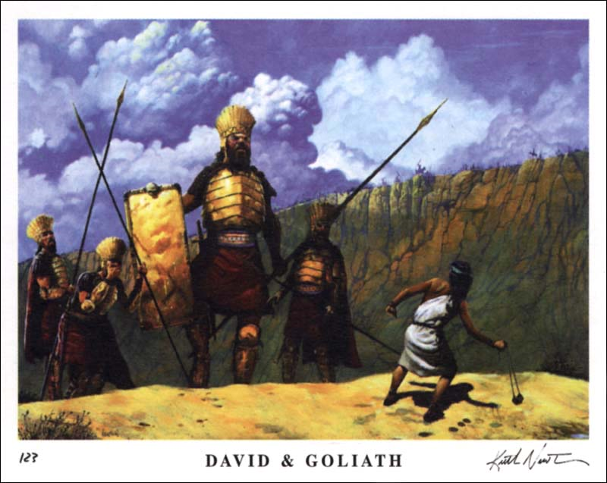
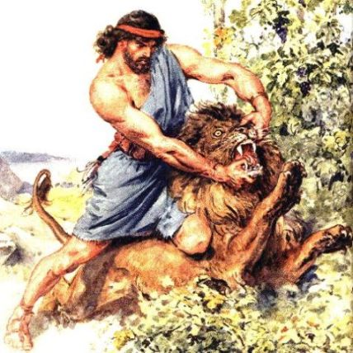
How the Mighty are Fallen

Slide 3
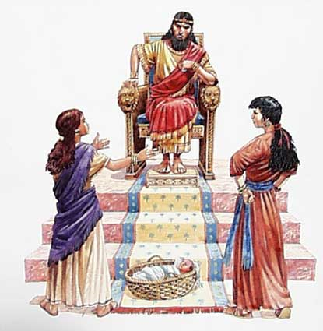
One Thing in Common
David
Samson
Solomon
Herod
E.J. Wagoneer
The list could go on and on. They lived in different era’s, but still had one thing in common…They fell for the charms of beautiful women!!!

Slide 4
Counsel
My son, attend unto my wisdom, and bow thine ear to my understanding: That thou mayest regard discretion, and that thy lips may keep knowledge. For the lips of a strange woman drop as an honeycomb, and her mouth is smoother than oil: But her end is bitter as wormwood, sharp as a two-edged sword. Her feet go down to death; her steps take hold on hell. Lest thou shouldest ponder the path of life, her ways are moveable, that thou canst not know them. Hear me now therefore, O ye children, and depart not from the words of my mouth. Remove thy way far from her, and come not nigh the door of her house: Lest thou give thine honour unto others, and thy years unto the cruel: Lest strangers be filled with thy wealth; and thy labours be in the house of a stranger; And thou mourn at the last, when thy flesh and thy body are consumed,” Proverbs 5:1-11

Slide 5

The Case of the Frog
Frogs are very adaptable creatures. In this way, they are much like humans.
250 degrees- make the adjustment/ feel good.
300 degrees-make the adjustment/feel good.
350 degrees-it is getting hot, but make the adjustment/feel good.
400-450 degrees-the frog is boiled; never knew what hit him!!!

Slide 6
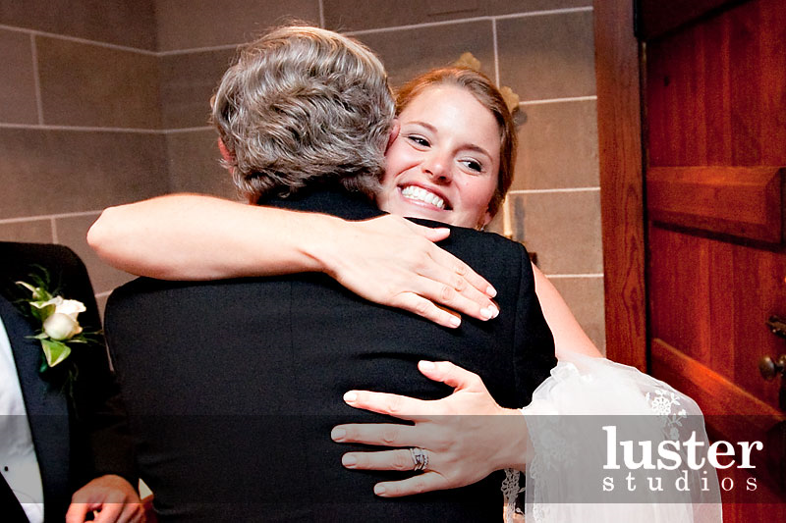
Be Smart!!: Don’t Start
1. Hands off.
2. Stop hugging other women.
3. No physical stuff unless engaged and then only holding hands.
"Jesus is honored or dishonored by the words and deportment of His professed followers. The heart must be kept pure and holy, for out of it are the issues of life. If the heart is purified through the obedience to the truth, there will be no selfish preferences, no corrupt motives. There will be no partiality, no hypocrisy; love-sick sentimentalism, whose blighting influence has been felt in all our institutions, will not be developed. Strict guard must be kept, that this curse shall not poison or corrupt our health institutions.-- Ellen G. White, SpTB16 1.3,

Slide 7
Beware!!!!
“Young girls who have not been properly educated at home, and who are wanting in reserve, modesty, and decorum, come to the institution to receive treatment. . . They have practiced evasion and deception and will continue the same course at the institute if they can do so without being discovered. They are ready to flirt with young men; and some who are bearing responsibilities, who should have set them a better example, because of their long Christian experience, engage in the same folly. Some of the young ladies belonging to the health institute accept the attentions of strangers who are of as little worth as themselves--men who are corrupted. This familiarity will be carried on, if allowed, until the influence of the institution is injured. Even if the parties go from the place a secret correspondence is often kept up between them, while the parents of the girl are in ignorance of the matter. The guardians of the institution must maintain a high standard, and watch carefully the young entrusted to them by their parents, whether as patients, as helpers in the various departments, or as learners. When young men and women work together, a sympathy is created among them which frequently grows into sentimentalism. If the guardians are indifferent to these matters, lasting injury will be done to these souls, and the high moral tone of the institution will be compromised.”
SpTB16 2.3

Slide 8

What is Next?
“They must be chaste and so free from the trait of defilement that they can correct these evils and bring the poor souls up to the Bible standard of purity. The only safety for men and women, married or unmarried, is to shun love-sick sentimentalism, and all undue familiarity. These things have produced great evil in the world. {SpTB16 4.1}

Slide 9
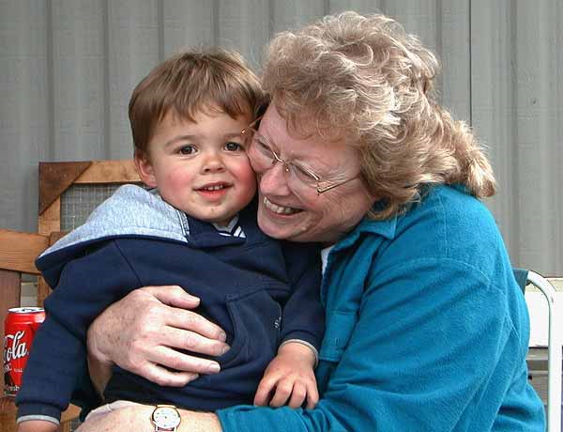
Loving Grandma
Be wise. This is fine. Dealing with members of the opposite sex, that are in our vicinity of age, is the issue. We aren’t talking about grandma’s or women way older or younger than we are!!

Slide 10
Very Clear
“ Our probation is short, at best. We have no time to spend in indulging corrupt impulses. The familiarity of married men with married women and young girls is disgusting in the sight of God and holy angels. The forwardness of young girls, in placing themselves in the company of young men, hanging around where they are at work, entering into conversation with them, talking common, idle talk, is belittling to womanhood. It lowers them, even in the estimation of those who themselves do such things.” {SpTB16 6.1}
” There is a positive necessity for reform in all our institutions. All frivolity, all undue attention of men and women, must be condemned and discontinued. Some, even married men, who have indulged in this trifling familiarity, have endeavored to excuse themselves, and escape censure by claiming that they have done no moral wrong. Was it no moral wrong to jest, joke, and pay flattering attentions to young women? Are you not starting in their minds a train of thought which it is impossible for you to change? Do you not by your levity and coquetry, sanction such conduct? You who hold positions of trust, and claim to be Christians, do you not give countenance to a familiarity which leads to sin?”
SpTB16 6.2

Slide 11

Husbands, Love Your Wives…
“Submitting yourselves one to another in the fear of God. Wives, submit yourselves unto your own husbands, as unto the Lord. For the husband is the head of the wife, even as Christ is the head of the church: and he is the savior of the body. Therefore as the church is subject unto Christ, so let the wives be to their own husbands in every thing…. Ephesians 5

Slide 12
Continued
“Husbands, love your wives, even as Christ also loved the church, and gave himself for it; That he might sanctify and cleanse it with the washing of water by the word, That he might present it to himself a glorious church, not having spot, or wrinkle, or any such thing; but that it should be holy and without blemish. So ought men to love their wives as their own bodies. He that loveth his wife loveth himself.” Eph. 5:21-28

Slide 13
Well, Gentlemen…..
1. Make sure you keep track of all the things you are doing.
2. Make sure your wife is keeping up with your grocery list of helpful things.
3. If she isn’t, you know what to do!!
4. Make her miserable until she gets into line.
5. You are the man of the house.
6. Assert your authority and demand that she submit.
7. That is what the Bible says………………………………

Slide 14

Husbands love your wives
This isn’t about reforming the women. This is about our duty and privilege to our wives. Our responsibility is “Husbands, love your wives, even as Christ also loved the church, and gave himself for it”
How much love did Christ show for His church? How far did He go? How much was He willing to give for us? How many tally sheets did He keep toward us?

Slide 15

She is such a ----------------------
Yea, but you don’t know what a blankity, blank, blank, she is. She doesn’t do the. She leaves the clothes piled… When I get home, it looks like she has been sitting on her beep, beep all day long.
“But God commendeth his love toward us, in that, while we were yet sinners, Christ died for us.” Romans 5:8

Slide 16
Husbands should be careful, attentive, constant, faithful, and compassionate. They should manifest love and sympathy. If they fulfill the words of Christ their love will not be of a base, earthly, sensual character, that will lead to the destruction of their own bodies, and bring upon their wives debility and disease. They will not indulge in the gratification of base passions, while ringing in the ears of their wives that they must be subject to the husband in everything. {21MR 215.3}
When the husband has the nobility of character, purity of heart, elevation of mind, that every true Christian must possess, it will be made manifest in the marriage relation. If he has the mind of Christ he will not be a destroyer of the body, but will be full of tender love, seeking to reach the highest standard in Christ. He will seek to keep his wife in health and courage. He will strive to speak words of comfort, to create an atmosphere of peace in the home circle. {21MR 215.4}
If the husband is tyrannical, exacting, critical of the actions of his wife, he cannot hold her respect and affection, and the marriage relation will become odious to her. She will not love her husband, because he does not try to make himself loveable. The Lord Jesus has not been correctly represented in His relation to the church by many husbands in their relation to their wives, for they do not keep the way of the Lord. They declare that their wives must be subject to them in everything. {21MR 215.5}

Slide 17
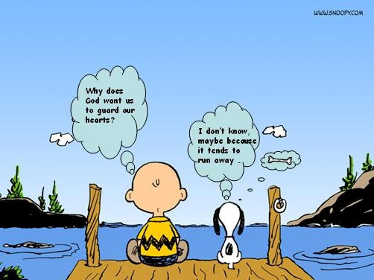
Don’t Ever Say or Think
1. This marriage was a mistake. I should have never married you.
2. I wish you were submissive and attractive like so and so.
3. I sure wish I was married to that Christian lady. Things would be so much better.
4. The grass isn’t greener on the other side.

Slide 18

Guard Your Heart
” Let those who stand as husbands study the words of Christ, not to find out how complete must be the subjection of the wife, but how he may have the mind of Christ, and become purified, refined, and fit to be the lord of his household. All wicked passions must be overcome, and the love which Christ has exercised toward His church must be symbolized in the family circle. Husbands who are husbands in deed and in truth will do those things which make for peace. The fruit of Christian love will be seen in the courtesy, in the holy, tender affection that is manifested in the home. “{21MR 216.5}

Slide 19
Keep it
“Oh, be careful little eyes what you see Oh, be careful little eyes what you see For the Father up above Is looking down in love Oh, be careful little eyes what you see What appears to be harmless glance? Can turn to romance And homes are divided Feelings that should never have been Awakened within Tearing the heart in two Listen, I beg of you Guard your Heart Guard your Heart Don't trade it for treasure Don't give it away Guard your Heart Guard your Heart As a payment for pleasure It's high price to pay For a soul that remains sincere with conscience clear Guard your Heart The human heart is easily swayed And often betrayed at the hand of emotion You dare not leave the outcome to chance You must choose in advance Or live with the agony Such needless tragedy Guard your Heart Guard your Heart Don't trade it for treasure Don't give it away Guard your Heart Guard your Heart As a payment for pleasure It's high price to pay Guard your Heart Guard your Heart Don't trade it for treasure Don't give it away Guard your Heart Guard your Heart.”

