Slide 1
Why We Are Where We Are!
Derailed

Slide 2
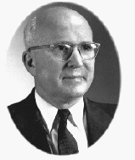
Leroy Froom
This prolific writer of SDA literature, along with Roy Allan Anderson, were instrumental in derailing the SDA movement. These two men have brought such horrible confusion and dismay; only eternity can sort the mess!

Slide 3
Background
Through the 1940’s, Seventh day Adventists were considered a cult. This was to change. A conference president in Pennsylvania, T. E. Unruh, was listening to a radio program done by Donald Barnhouse, a prominent evangelical in America. Unruh was impressed and contacted Barnhouse. Through this contact, Barnhouse got access to SDA’s a few years later when his famous son-in-law, Walter Martin, was preparing a book on cults in America. Barnhouse and Martin started meeting with SDA leaders in the mid 1950’s and the results were disastrous for SDA’s.

Slide 4
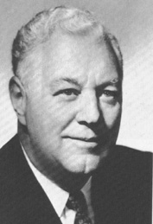
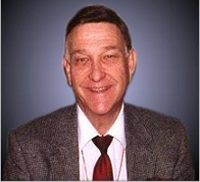
Barnhouse and Martin

Slide 5
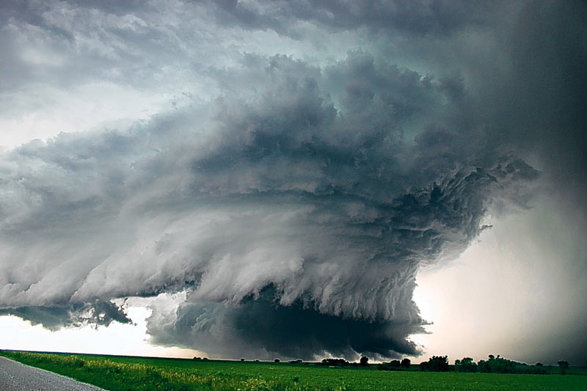
The Onslaught
When the meetings began, Martin, wanting to deal fairly with SDA’s, had a list of some 40 questions concerning what SDA’s believed. The major points of great significance centered around four key doctrines of SDA’s.

Slide 6
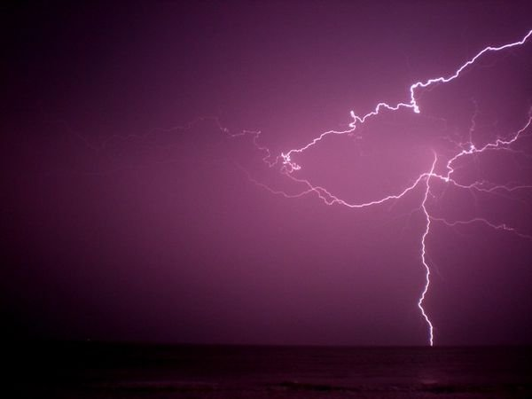
Four Major Points
1. What nature did Christ take when He became a man?
2. Was the atonement finished at the cross or was Christ continuing the atonement in heaven?
3. What was Ellen White’s role in Adventism?
4. What about the Sabbath, Sunday, the remnant, and the end of time?

Slide 7
The Snow Ball Descends
Because the teachings of SDA’s are so closely intertwined, if you move one peg, then the whole thing begins to unravel. Notice with the concept of the atonement. If atonement was finished at the cross, then:
1. 1844, Daniel 8:14, and Christ’s work in the Most Holy Place are voided.
2. The 10 commandments in the Most Holy Place are not important.
3. The raising up of a people at that time of 1844 is wrong, irrelevant, and unnecessary.
4. Ellen White has to be a false prophet because she stated that Christ started an important work at that time.
5. If atonement is declared complete at the cross, then 7th day Adventism has no reason for existence and is of the devil. No true SDA would ever make such a claim! The snow ball descends!!

Slide 8
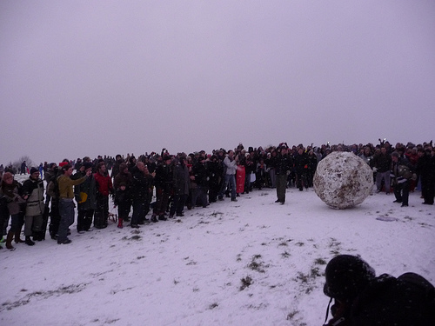
Adventism is Butchered
Leroy Froom and Roy Allan Anderson declared to the evangelicals that truly atonement was finished at the cross. From these meetings in the mid 1950’s came a book called Questions on Doctrine in which they declared this very lie and they tried to use Ellen White to back it up!

Slide 9
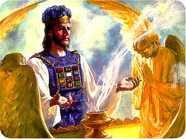
The Truth about the atonement
The Bible and SOP are very clear that Christ’s death was utterly crucial in the plan of salvation. However, as great as it was, it was part of the atonement process. Christ’s work as man’s high priest, according to inspiration, is just as important.

Slide 10
Atonement
“And if any one of the common people sin through ignorance, while he doeth somewhat against any of the commandments of the LORD concerning things which ought not to be done, and be guilty; Or if his sin, which he hath sinned, come to his knowledge: then he shall bring his offering, a kid of the goats, a female without blemish, for his sin which he hath sinned. And he shall lay his hand upon the head of the sin offering, and slay the sin offering in the place of the burnt offering. And the priest shall take of the blood thereof with his finger, and put it upon the horns of the altar of burnt offering, and shall pour out all the blood thereof at the bottom of the altar. And he shall take away all the fat thereof, as the fat is taken away from off the sacrifice of peace offerings; and the priest shall burn it upon the altar for a sweet savour unto the LORD; and the priest shall make an atonement for him, and it shall be forgiven him.” Leviticus 4:27-31

Slide 11
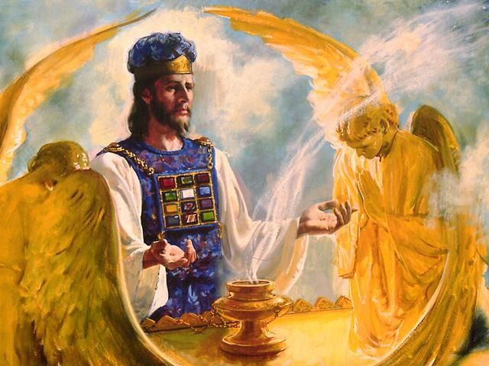
Christ’s Intercession
“The intercession of Christ in man's behalf in the sanctuary above is as essential to the plan of salvation as was His death upon the cross. By His death He began that work which after His resurrection He ascended to complete in heaven. We must by faith enter within the veil, "whither the forerunner is for us entered." Hebrews 6:20. There the light from the cross of Calvary is reflected. There we may gain a clearer insight into the mysteries of redemption.” GC. Pg.489

Slide 12
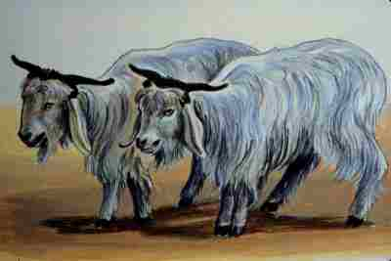
The Day
“Also on the tenth day of this seventh month there shall be a day of atonement: it shall be an holy convocation unto you; and ye shall afflict your souls, and offer an offering made by fire unto the LORD. And ye shall do no work in that same day: for it is a day of atonement, to make an atonement for you before the LORD your God. For whatsoever soul it be that shall not be afflicted in that same day, he shall be cut off from among his people.” Lev. 23:27-29

Slide 13
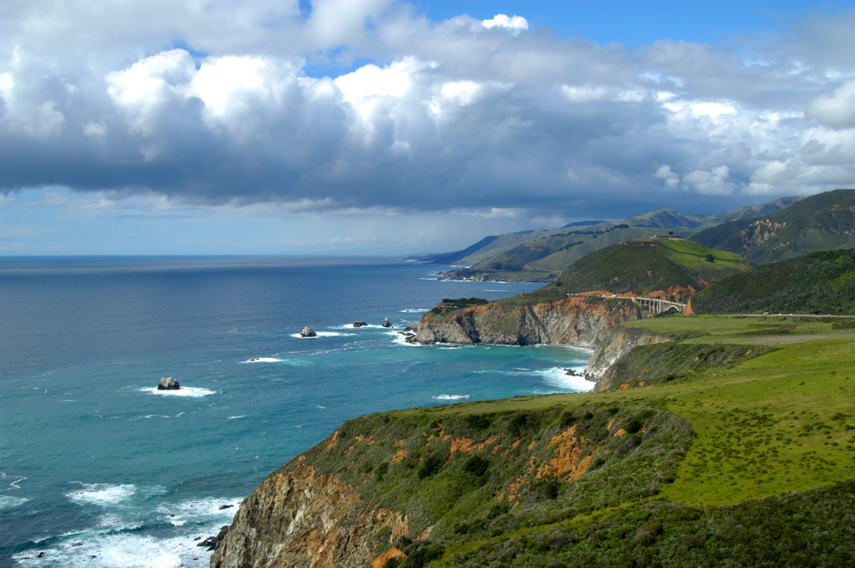
Taking care of sin
Atonement means taking care of the sin problem. Through sacrifice, mediation, and cleansing; every phase is a part of taking care of the sin problem.
“And he shall have it, and his seed after him, even the covenant of an everlasting priesthood; because he was zealous for his God, and made an atonement for the children of Israel.” Numbers 25:13

Slide 14
Taking Care of the Sin Problem
“Then there was a famine in the days of David three years, year after year; and David inquired of the LORD. And the LORD answered, It is for Saul, and for his bloody house, because he slew the Gibeonites. And the king called the Gibeonites, and said unto them; (now the Gibeonites were not of the children of Israel, but of the remnant of the Amorites; and the children of Israel had sworn unto them: and Saul sought to slay them in his zeal to the children of Israel and Judah.) Wherefore David said unto the Gibeonites, What shall I do for you? and wherewith shall I make the atonement, that ye may bless the inheritance of the LORD? And the Gibeonites said unto him, We will have no silver nor gold of Saul, nor of his house; neither for us shalt thou kill any man in Israel. And he said, What ye shall say, that will I do for you. And they answered the king, The man that consumed us, and that devised against us that we should be destroyed from remaining in any of the coasts of Israel,” 2Samuel 21:1-5

Slide 15
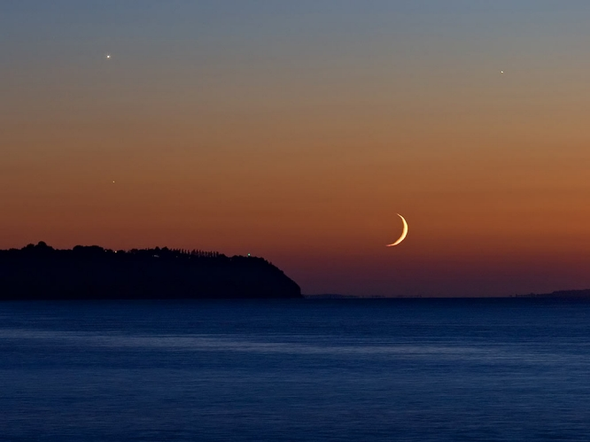
Is Atonement Happening Right Now?
Is the sin problem resolved in the universe? Is the sin problem resolved in this world? In this town? In your life? Do you still struggle with temptation? With anger? With the lusts of the flesh? If we can answer yes to any of these questions, then atonement is still taking place!

Slide 16
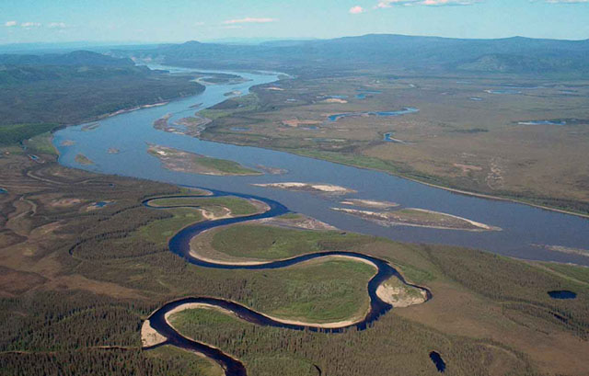
Diverting the Course
The assault on the idea of atonement challenged the very rationale for SDAdventism. Without it, Adventism has no reason to exist. Martin went for the jugular vein and Froom/Anderson embraced the destruction of Adventism!! Since Ellen White wrote of on going atonement since 1844, her prophetic gift immediately came under attack. And the dominoes started to fall!!

Slide 17

Next was the Nature of Christ
In the book ‘Questions on Doctrine, Froom declared “Although born in the flesh, He was nevertheless God, and was exempt from the inherited passions and pollutions that corrupt the natural descendants of Adam. “ QOD, pg. 383
Froom states that Christ took a nature like Adam before he fell. When Christ was here on earth, He had a perfect nature like Adam’s when he was in Eden. The Bible and SOP have never taught this!

Slide 18
Seed of Abraham
“Forasmuch then as the children are partakers of flesh and blood, he also himself likewise took part of the same; that through death he might destroy him that had the power of death, that is, the devil; And deliver them who through fear of death were all their lifetime subject to bondage. For verily he took not on him the nature of angels; but he took on him the seed of Abraham. Wherefore in all things it behoved him to be made like unto his brethren, that he might be a merciful and faithful high priest in things pertaining to God, to make reconciliation for the sins of the people. For in that he himself hath suffered being tempted, he is able to succour them that are tempted. “ Hebrews 2:14-18

Slide 19

Sinful Flesh
“For what the law could not do, in that it was weak through the flesh, God sending his own Son in the likeness of sinful flesh, and for sin, condemned sin in the flesh: That the righteousness of the law might be fulfilled in us, who walk not after the flesh, but after the Spirit.” Romans 8:3,4

Slide 20
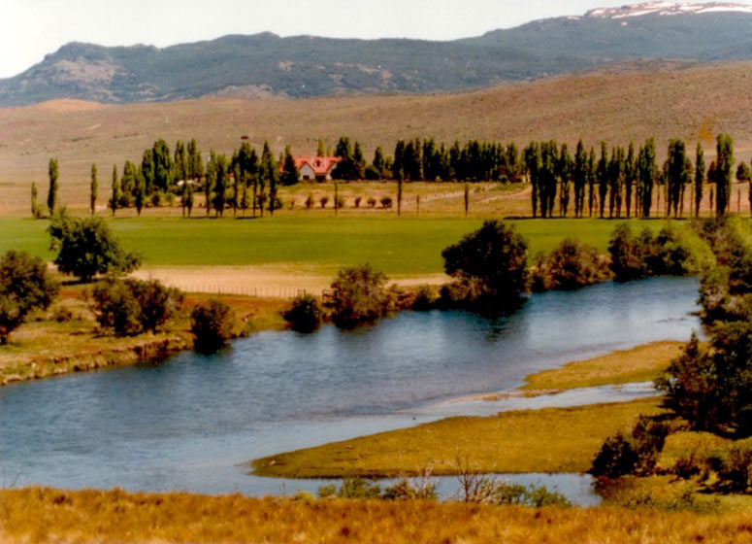
He overcame; so can we
Christ came in our sinful flesh, came under the same temptations that we experience, but never once yielded to sin. He overcame in our flesh in order that He can enable us to overcome in our flesh.
“Who did no sin, neither was guile found in his mouth: Who, when he was reviled, reviled not again; when he suffered, he threatened not; but committed himself to him that judgeth righteously: Who his own self bare our sins in his own body on the tree, that we, being dead to sins, should live unto righteousness: by whose stripes ye were healed.” 1Peter 2:22-24

Slide 21
1958 Sabbath School Lesson
In the SS lessons of 1958, the study was over the book of Revelation, the portion on Revelation 13 was left out entirely! From this time, SDA’s have become tongue-tied as far as who the beasts are in Revelation 13!
William Johnson-Editor-Adventist Review-1994,1995 ‘Saints Victory in the End-time’ “To interpret the sea monster of Revelation 13 as the papacy seems somewhat out of keeping with the spirit of the times. In an age when Christianity in general faces the onslaughts of secularism and when among Christians ecumenism has become popular, the interpretation smacks of narrowness and bigotry.” Shocking………………………………………

Slide 22
Seduction of God’s People
"Although it is true that there was a period in the life of the Seventh-day Adventist Church when the denomination took a distinctly anti-Roman Catholic viewpoint...that attitude on the church's part was nothing more than a manifestation of widespread anti-popery among conservative Protestant denominations in the early part of this century and the latter part of the last, and which has now been consigned to the historical trash heap so far as the Seventh-day Adventist Church is concerned." (Neal C. Wilson, past president of the Seventh-day Adventist General Conference, Court Transcript of United States vs the Seventh-day Adventist Church, Equal Employment Opportunity Commission vs the Pacific Press Publishing Association and the General Conference, Reply Brief for Defendants, p 4, Civil Case #74-2025 CBR, presided over by Judge Charles B. Renfrew, U.S. District Court, San Francisco, California, 1974-1975.)

Slide 23
Vandeman’s Vomit
George Vandeman “These were dark ages for the church. How could Christians be so intolerant of their brothers and sisters in Christ? Jesus had predicted that those who killed His followers would sincerely think they were serving God…It is not for us to question our medieval ancestors…Nor must we overlook the good done by the church. Throughout the world, monasteries provided care for orphans, widows, and the sick. And all of us owe appreciation to the church of the Middle Ages for preserving the Scriptures.” Vandeman, The Rise and Fall of the Anti-Christ, pages 54,55

Slide 24
Dumb Dogs that will not Bark
Associate Editor of the Review, Myron Widmer “I was surprised and delighted to learn that the Bible is the sole textbook during the pope’s visit and the World Youth Day activities. What a wonderful opportunity for so many young people to hear the gospel message straight from God’s Word…Or might a better understanding be that God is working through this pope to open doors for Catholics to the great truths of Scripture concerning salvation by faith in Christ?”…I can only wonder if in these last days He is using some very unexpected sources to encourage many individuals (especially Catholics) in search for truth.” Review and Herald, September 9,23,and 30, 1993

Slide 25
You Decide
A dear lady in Portland, back in 2004, stood up in a meeting and told this story…………………..
We have work to do……………………………………….
“Behold, I will make them of the synagogue of Satan, which say they are Jews, and are not, but do lie; behold, I will make them to come and worship before thy feet, and to know that I have loved thee. Because thou hast kept the word of my patience, I also will keep thee from the hour of temptation, which shall come upon all the world, to try them that dwell upon the earth. Behold, I come quickly: hold that fast which thou hast, that no man take thy crown.” Revelation 3:9-11

