Slide 1
What is the Difference Between Mormons, Jehovah’s Witnesses, and Seventh-day Adventists? pt 22

Slide 2
Reasons To Stay Away From Flesh Foods
Meat is more corrupted and toxic (carcinogen 2014 WHO) than ever before, we have to be wiser about what we eat lest we destroy the temple God has given us (1 Cor. 3:16-17, 1 Cor. 10:31, Rom. 8:22, Hos. 4:1-3)
Meat is served with the blood (Ez. 33:25, Acts 15:20)
Meat is full of antibiotics, steroids, & preservatives-- fish farms produce fish so sickly that they have to dye the fish meat more vibrant colors
The animals used for food are more than mistreated, they are tortured, boiled alive, shot with nail guns (see Earthlings Documentary)
The businesses that make meat for food are corrupt—fishing vessels use human trafficking (see Seaspiracy Documentary)
Fake meats use cancer cell to create their products—they are FDA approved, soon you won’t know (or be permitted to know) what you are really eating
Back to Eden…. (Rev. 21:1-4, Eden—Rev. 2:7, Rev. 22:2, Rev. 22:14)
Do you Think This is What God Meant When He Said You Could Eat Meat?

Slide 3
1905: “Tea and coffee do not nourish the system. Their effect is produced before there has been time for digestion and assimilation, and what seems to be strength is only nervous excitement” (Ministry of Healing, p. 326)--------1967 "Illness otherwise unexplained may be caused by excessive ingestion of xantine cocoa alkaloids, including those in coffee, tea, cocoa, and those in some popular beverages.“--H. A. Riemann, Journal of the American Medical Associator

Slide 4
John Harvey Kellogg
“Dr. John Harvey Kellogg, in his prime is without any question the most competent and most important witness to Ellen White’s teachings in the field of health. He was a physician and surgeon well trained in scientific lines, having studied both in America and Europe. He traveled widely, lectured frequently, and carried on a constant line of investigation and experimentation. He was medical superintendent of the Battle Creek Sanitarium, the foremost such medical institution in the world, which attracted such of the world’s great as Taft, Rockefeller, Edison, Ford, Burbank, etc. True, because of the innovations made at the Battle Creek Sanitarium, Kellogg was at times under fire by fellow physicians. But if the reader would see Ellen White emerge in her true image, he may well look to Kellogg before his defection, and even after his defection Kellogg never repudiated or discounted Ellen White’s health teachings. For this reason as we introduce his 1890 Preface statement to Christian Temperance and Bible Hygiene, the first part of which is a compilation of E. G. White materials, we quote at length, urging the reader to peruse it carefully to gain its full impact. Please note Kellogg’s frequent reference to “the principles taught” by Ellen White: ‘Nearly thirty years ago there appeared in print the first of a series of remarkable and important articles on the subject of health, by Mrs. E. G. White. These articles at once commanded earnest consideration by those who were acquainted with Mrs. White’s previous writings and labors. Thousands were led to change life-long habits, and to renounce practices thoroughly fixed by heredity as well as by long indulgence. So great a revolution could not be wrought in a body of people without the aid of some powerful incentive, which in this case was undoubtedly the belief that the writings referred to not only bore the stamp of truth, but were endorsed as such by a higher than human authority. This is not the proper place for the consideration of the grounds upon which this belief was based, but the reader’s attention is invited to a few facts of interest in this connection’— Ellen White Estate, A Critique of the Book ‘Prophetess of Health, p. 17

Slide 5
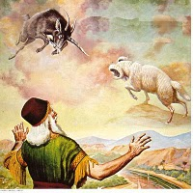
The Biblical Physical Signs
Dan. 10:8, 16-18 “Therefore I was left alone, and saw this great vision, and there remained no strength in me: for my comeliness was turned in me into corruption, and I retained no strength. And, behold, one like the similitude of the sons of men touched my lips: then I opened my mouth, and spake . . . straightway there remained no strength in me, neither is there breath left in me. Then there came again and touched me one like the appearance of a man, and he strengthened me,”
Num. 24:4 “He hath said, which heard the words of God, which saw the vision of the Almighty, falling into a trance, but having his eyes open”
* No strength * speaks but has no breath * strengthened
* Eyes remain open entire time

Slide 6
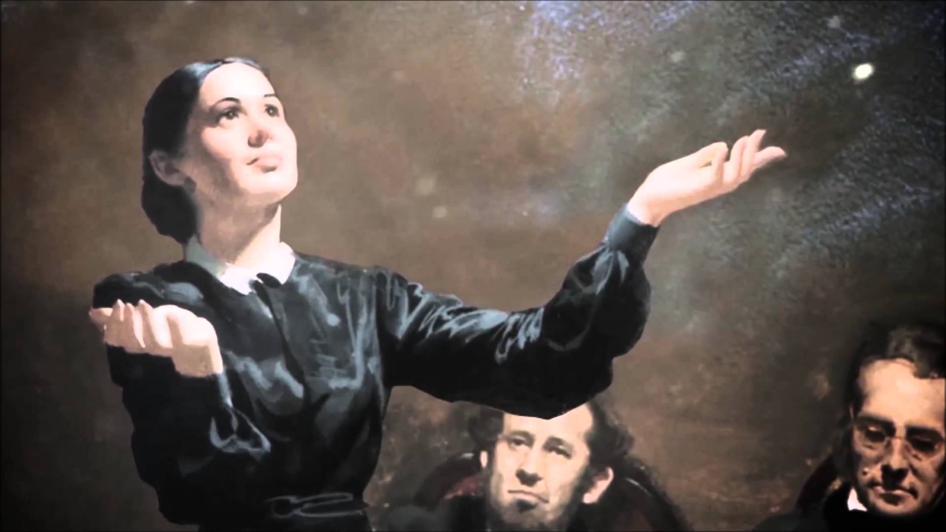
The Physical Tests Fulfilled:
“In vision her eyes were open. There was no breath, but there were graceful movements of the shoulders, arms and hands expressive of what she saw. It was impossible for anyone else to move her hands or arms. . . When the vision ended . . . She was then limp and strengthless.”—Martha Amadon, Notebook Leaflets

Slide 7
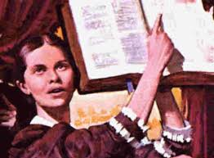
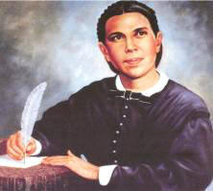
“June 28, 1857, I saw Sister Ellen G. White in vision for the first time. I was an unbeliever in the visions; but one circumstance among others that I might mention convinced me that her visions were of God. To satisfy my mind as to whether she breathed or not, I first put my hand on her chest sufficiently long to know that there was no more heavings of the lungs than there would have been had she been a corpse. I then took my hand and placed it over her mouth, pinching her nostrils between my thumb and forefinger, so that it was impossible for her to exhale or inhale air, even if she had desired to do so. I held her thus with my hand about ten minutes, long enough for her to suffocate under ordinary circumstances; she was not in the least affected by this ordeal. Since witnessing this wonderful phenomenon, I have not once been inclined to doubt the divine origin of her visions.”—Statement by D.T. Bourdeau, Battle Creek, Michigan, given Feb. 4, 1891

Slide 8
A Skeptic/Doctor’s Account
Michigan, May 20, 1853, at a meeting held in Tyrone, Livingston County. “Sister White was in vision about twenty minutes or half an hour. As she went into vision everyone present seemed to feel the power and presence of God, and some of us did indeed feel the Spirit of God resting upon us mightily. We were engaged in prayer and social meeting Sabbath morning at about nine o’clock. Brother White, my father, and Sister White had prayed, and I was praying at the time. There had been no excitement, no demonstrations. We did plead earnestly with God, however, that He would bless the meeting with His presence, and that He would bless the work in Michigan. As Sister White gave that triumphant shout of “Glory! g-l-o-r-y! g-l-o-r-y!” which you have heard her give so often as she goes into vision, Brother White arose and informed the audience that his wife was in vision. After stating the manner of her visions, and that she did not breathe while in vision, he invited any one who wished to do so to come forward and examine her. Dr. Drummond, a physician, who was also a First-day Adventist preacher, who (before he saw her in vision) had declared her visions to be of mesmeric origin, and that he could give her a vision, stepped forward, and after a thorough examination, turned very pale, and remarked, “She doesn’t breathe!” I am quite certain that she did not breathe at that time while in vision, nor in any of several others which she has had when I was present. The coming out of the vision was as marked as her going into it. The first indication we had that the vision was ended, was in her again beginning to breathe. She drew her first breath, deep, long, and full, in a manner showing that her lungs had been entirely empty of air. After drawing the first breath, several minutes passed before she drew the second, which filled the lungs precisely as did the first; then a pause of two minutes, and a third inhalation, after which the breathing became natural.”—Merritt. G. Kellogg, MD, Battle Creek, Mich., Dec. 28, 1890; Great Second Advent Movement, p. 206 (quoted in Messenger to the Remnant, pp. 22-23)

Slide 9
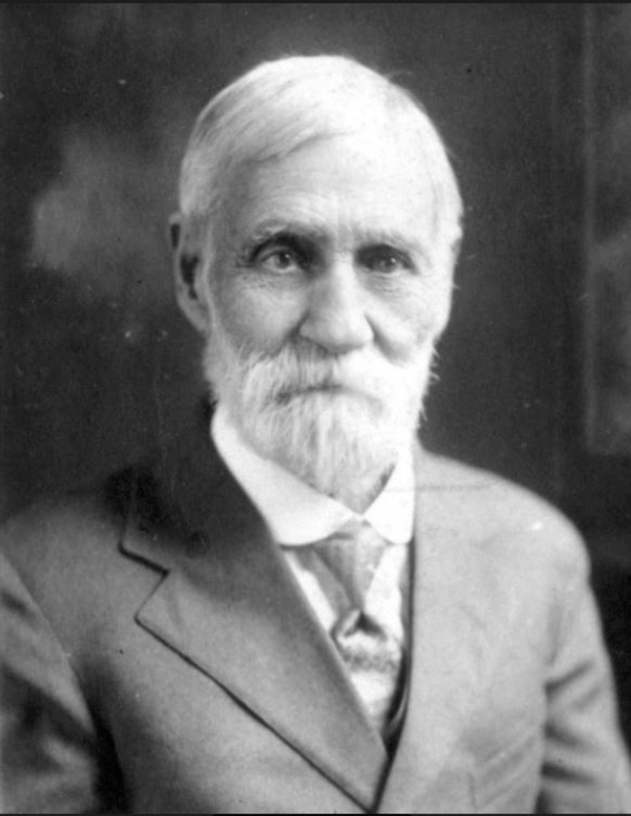
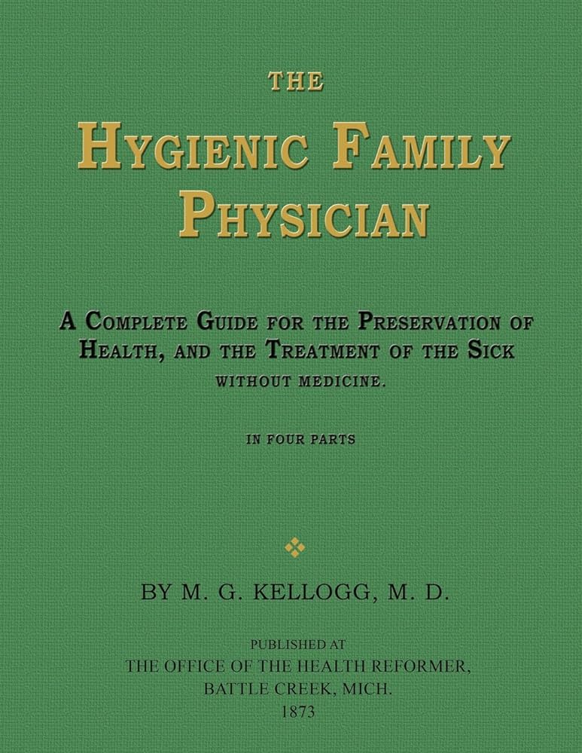

Slide 10
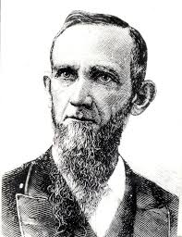
What About the Critics???
BEFORE:
“One thing I have remarked, and that is, that the most bitter opponents of the visions of Sister White admit that she is a Christian. How they can make this admission is more than I know. They try to fix it up by saying that she is deceived. They are not able to put their finger upon a single stain in all her life, nor an immoral sentence in all her writings. They have to admit that much of her writings are excellent, and whoever would live out all she says would be a good Christian, sure of Heaven. This is passing strange if she is a tool of the devil, inspired by Satan, or if her writings are immoral or the vagaries of her own mind.”—R&H, April 26, 1877.
Dudley M. Canright (1840-1919)

Slide 11
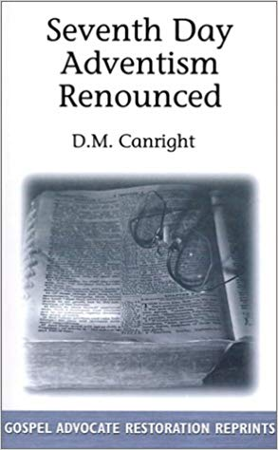
AFTER:
“That she is not inspired is plainly shown by many facts. She has never wrought a single miracle. The old prophets and the apostles wrought miracles freely, to prove that God had sent them. In all these seventy years, in all her forty volumes, not a single prediction has she ever made that has come to pass. This is astonishing, considering that she dwells almost wholly in predictions. It seems as though she ought to have blundered into many things which could afterward be construed into a fulfilled prophecy. But not one can be found. This shows how wild and utterly wrong her theories have been.”—Dudley Canright, Seventh-day Adventism Renounced, p. 138

Slide 12
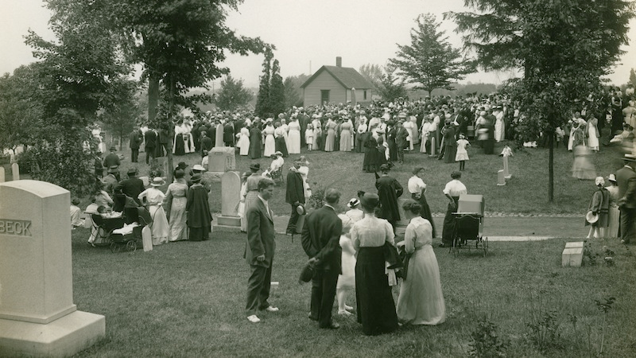
“My brother [Dudley M. Canright] rested his hand upon the side of the casket, and with tears rolling down his cheeks, he said brokenly ‘There is a noble Christian woman gone.’”—WA Spicer, The Spirit of Prophecy in the Advent Movement, p. 127

Slide 13
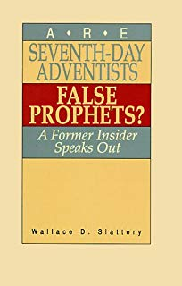
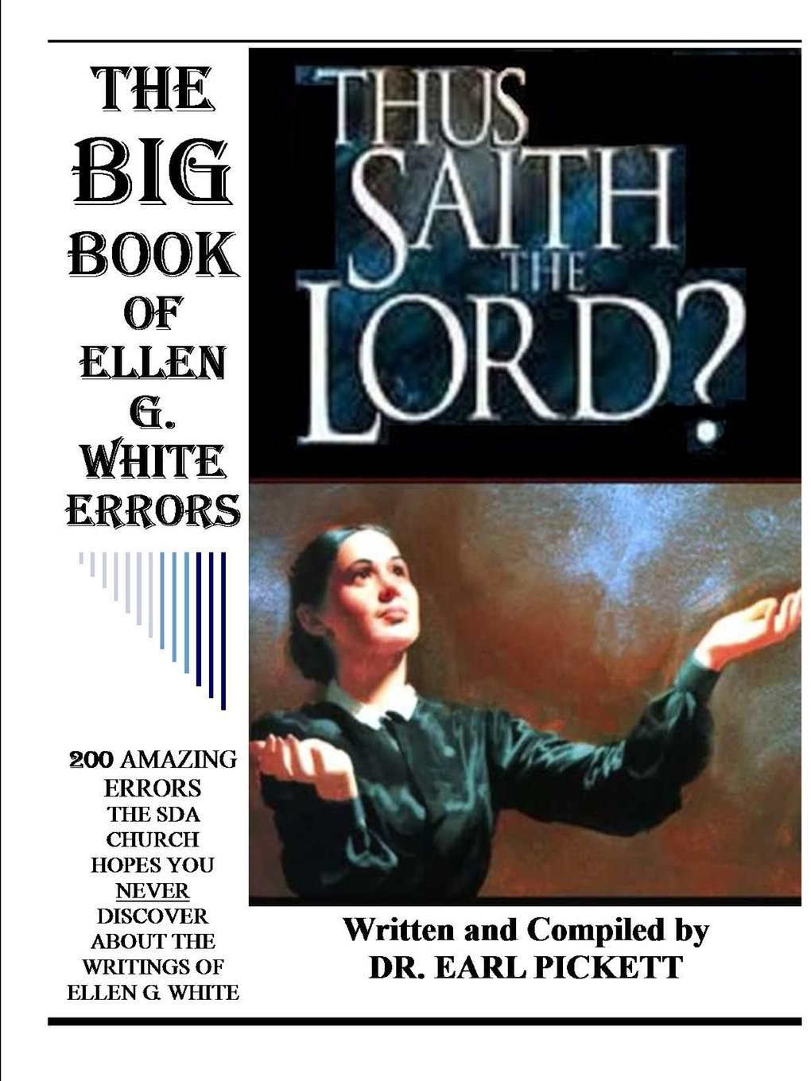
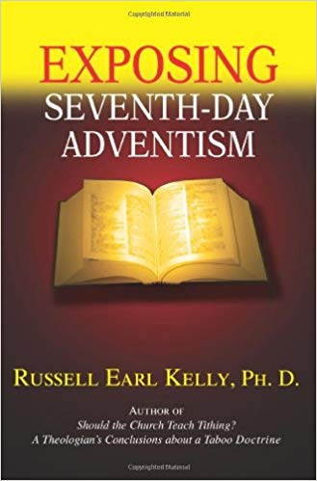
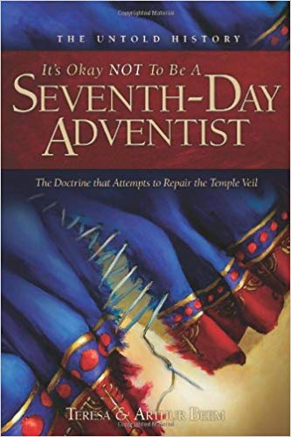
For The Others…
John 15:18-20 “If the world hate you, ye know that it hated me before it hated you. If ye were of the world, the world would love his own: but because ye are not of the world, but I have chosen you out of the world, therefore the world hateth you. Remember the word that I said unto you, The servant is not greater than his lord. If they have persecuted me, they will also persecute you; if they have kept my saying, they will keep yours also.”
How were the other prophets treated? Jesus? What about women’s suffrage?

Slide 14
Will We Listen to God’s Last Day Council?
“How many have read carefully Patriarchs and Prophets, The Great Controversy, and The Desire of Ages? I wish all to understand that my confidence in the light that God has given stands firm, because I know that the Holy Spirit's power magnified the truth, and made it honorable, saying: “This is the way, walk ye in it.” In my books, the truth is stated, barricaded by a “Thus saith the Lord.” The Holy Spirit traced these truths upon my heart and mind as indelibly as the law was traced by the finger of God, upon the tables of stone, which are now in the ark, to be brought forth in that great day when sentence will be pronounced against every evil, seducing science produced by the father of lies.”—Letter 90, 1906

