Slide 1
“For Such a Time”
Amazing Grace, pt. 13

Slide 2
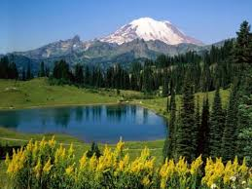
The Silence of Childhood
“His quiet and simple life, and even the silence of the Scriptures concerning His early years, teach an important lesson. The more quiet and simple the life of the child,--the more free from artificial excitement, and the more in harmony with nature,--the more favorable is it to physical and mental vigor and to spiritual strength.” DA, pg. 74

Slide 3
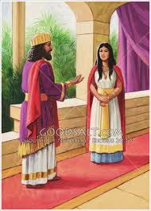
Her Early Life
“Now in Shushan the palace there was a certain Jew, whose name was Mordecai, the son of Jair, the son of Shimei, the son of Kish, a Benjamite; Who had been carried away from Jerusalem with the captivity which had been carried away with Jeconiah king of Judah, whom Nebuchadnezzar the king of Babylon had carried away. And he brought up Hadassah, that is, Esther, his uncle's daughter: for she had neither father nor mother, and the maid was fair and beautiful; whom Mordecai, when her father and mother were dead, took for his own daughter.” Esther 1:5-7

Slide 4
The Story Speeds Up!
1. The wealthy king of Media-Persia, Ahasuerus, or Xerxes, deposed his wife, Vashti, because she disobeyed him.
2. The king went looking for a new bride throughout his kingdom.
3. Esther was chosen as his new queen.

Slide 5
The Problem Arises
“After these things did king Ahasuerus promote Haman the son of Hammedatha the Agagite, and advanced him, and set his seat above all the princes that were with him. And all the king's servants, that were in the king's gate, bowed, and reverenced Haman: for the king had so commanded concerning him. But Mordecai bowed not, nor did him reverence. Then the king's servants, which were in the king's gate, said unto Mordecai, Why transgressest thou the king's commandment? Now it came to pass, when they spake daily unto him, and he hearkened not unto them, that they told Haman, to see whether Mordecai's matters would stand: for he had told them that he was a Jew. And when Haman saw that Mordecai bowed not, nor did him reverence, then was Haman full of wrath. And he thought scorn to lay hands on Mordecai alone; for they had shewed him the people of Mordecai: wherefore Haman sought to destroy all the Jews that were throughout the whole kingdom of Ahasuerus, even the people of Mordecai.” Esther 3:1-6

Slide 6
In Our Time Too!
“The decree that will finally go forth against the remnant people of God will be very similar to that issued by Ahasuerus against the Jews. Today the enemies of the true church see in the little company keeping the Sabbath commandment, a Mordecai at the gate. The reverence of God's people for His law is a constant rebuke to those who have cast off the fear of the Lord and are trampling on His Sabbath. Satan will arouse indignation against the minority who refuse to accept popular customs and traditions. Men of position and reputation will join with the lawless and the vile to take counsel against the people of God. Wealth, genius, education, will combine to cover them with contempt. Persecuting rulers, ministers, and church members will conspire against them. With voice and pen, by boasts, threats, and ridicule, they will seek to overthrow their faith. By false representations and angry appeals, men will stir up the passions of the people. Not having a "Thus saith the Scriptures" to bring against the advocates of the Bible Sabbath, they will resort to oppressive enactments to supply the lack. To secure popularity and patronage, legislators will yield to the demand for Sunday laws. But those who fear God, cannot accept an institution that violates a precept of the Decalogue. On this battlefield will be fought the last great conflict in the controversy between truth and error. And we are not left in doubt as to the issue. Today, as in the days of Esther and Mordecai, the Lord will vindicate His truth and His people.” PK, pgs. 605, 606

Slide 7
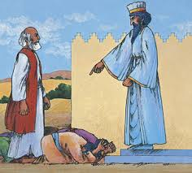
When we Refuse…
Haman felt snubbed. A person full of themselves will seek revenge against the one they feel has done them wrong. When we dare to cross someone’s ‘authority’, they can not handle it and will do anything to destroy us!
“And when he was come into the temple, the chief priests and the elders of the people came unto him as he was teaching, and said, By what authority doest thou these things? and who gave thee this authority?” Matt. 21:23

Slide 8
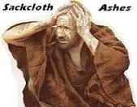
Mordecai’s Response
“When Mordecai perceived all that was done, Mordecai rent his clothes, and put on sackcloth with ashes, and went out into the midst of the city, and cried with a loud and a bitter cry; And came even before the king's gate: for none might enter into the king's gate clothed with sackcloth. And in every province, whithersoever the king's commandment and his decree came, there was great mourning among the Jews, and fasting, and weeping, and wailing; and many lay in sackcloth and ashes. So Esther's maids and her chamberlains came and told it her. Then was the queen exceedingly grieved; and she sent raiment to clothe Mordecai, and to take away his sackcloth from him: but he received it not.” Esther 4:1-4

Slide 9
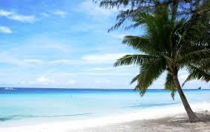
Tension/Dialogue with Esther-Mordecai
Mordecai pleaded with Esther to speak to the king; Esther knew it could mean her death. Mordecai challenged her with some of the most sublime words that have ever come from human lips!

Slide 10
For Such a Time!
“Then Mordecai commanded to answer Esther, Think not with thyself that thou shalt escape in the king's house, more than all the Jews. For if thou altogether holdest thy peace at this time, then shall there enlargement and deliverance arise to the Jews from another place; but thou and thy father's house shall be destroyed: and who knoweth whether thou art come to the kingdom for such a time as this?” Esther 4:13,14

Slide 11
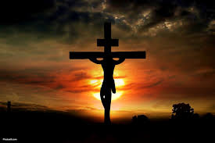
The Lord Calls!
There is a cross to bear as an SDA Christian. We must not kid ourselves into believing that we can deny Christ and yet be saved! The Lord calls us to sacrifice and submission to His authority just as He called Esther. How shall we respond?

Slide 12
She Chose; The Lord Empowered!
“Then Esther bade them return Mordecai this answer, Go, gather together all the Jews that are present in Shushan, and fast ye for me, and neither eat nor drink three days, night or day: I also and my maidens will fast likewise; and so will I go in unto the king, which is not according to the law: and if I perish, I perish. So Mordecai went his way, and did according to all that Esther had commanded him.” Esther 4:15-17

Slide 13
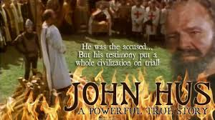
What can God’s Amazing Grace not do? It enabled Esther to risk her life; it enabled John Huss to brave the fires of the stake!
It empowered Jesus to be separated from His Father! God’s Amazing Grace is there for us too!

Slide 14
Our Choice
“Whatever may be our inherited or cultivated tendencies to wrong, we can overcome through the power that He is ready to impart. The tempted one needs to understand the true force of the will. This is the governing power in the nature of man—the power of decision, of choice. Everything depends on the right action of the will. Desires for goodness and purity are right, so far as they go; but if we stop here, they avail nothing. Many will go down to ruin while hoping and desiring to overcome their evil propensities. They do not yield the will to God. They do not choose to serve Him. God has given us the power of choice; it is ours to exercise. We cannot change our hearts, we cannot control our thoughts, our impulses, our affections. We cannot make ourselves pure, fit for God’s service. But we can choose to serve God, we can give Him our will; then He will work in us to will and to do according to His good pleasure. Thus our whole nature will be brought under the control of Christ. Through the right exercise of the will, an entire change may be made in the life…

Slide 15
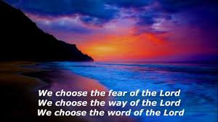
We Decide
…By yielding up the will to Christ, we ally ourselves with divine power. We receive strength from above to hold us steadfast. A pure and noble life, a life of victory over appetite and lust, is possible to everyone who will unite his weak, wavering human will to the omnipotent, unwavering will of God.” MH, pg. 176

Slide 16
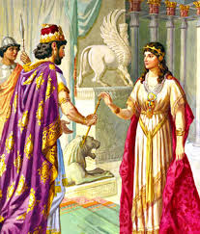
“Now it came to pass on the third day, that Esther put on her royal apparel, and stood in the inner court of the king's house, over against the king's house: and the king sat upon his royal throne in the royal house, over against the gate of the house.
And it was so, when the king saw Esther the queen standing in the court, that she obtained favour in his sight: and the king held out to Esther the golden sceptre that was in his hand. So Esther drew near, and touched the top of the sceptre.” Esther 5:1,2

Slide 17
God’s Amazing Grace!
1. Interceded for Esther. (Esther 5:1, 2)
2. Exalted Mordecai to a high position. (Esther 6:11,12)
3. Destruction Came to Haman. (Esther 7:9-11)
4. God’s People Delivered (Esther 9:1,2)

Slide 18
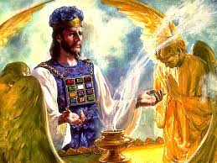
The Same Today
God’s Amazing Grace today intercedes on our behalf, exalts us to a position of children of God, will ultimately destroy those who reject Him, and will deliver His people!

