Slide 1
Daniel 5 ‘Babylon Falls’
Belshazzar's Feast and Folly

Slide 2
One Big Problem
1. It wasn’t because he used the sacred vessels from God’s temple for drunkenness.
2. It wasn’t because he was a profane and immoral wretch.
3. It wasn’t because Cyrus encamped just outside his walls.
4. None of these caused the downfall of the golden kingdom of Babylon.
5. It was because Belshazzar forgot……………………….!

Slide 3
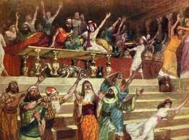
Bad Boy Belshazzar!
“Belshazzar the king made a great feast to a thousand of his lords, and drank wine before the thousand. Belshazzar, whiles he tasted the wine, commanded to bring the golden and silver vessels which his father Nebuchadnezzar had taken out of the temple which was in Jerusalem; that the king, and his princes, his wives, and his concubines, might drink therein.” Daniel 5:1,2

Slide 4
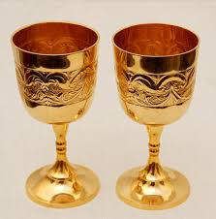
Tampering with God’s Temple
“Then they brought the golden vessels that were taken out of the temple of the house of God which was at Jerusalem; and the king, and his princes, his wives, and his concubines, drank in them. They drank wine, and praised the gods of gold, and of silver, of brass, of iron, of wood, and of stone.” Daniel 5:3,4

Slide 5
Do Not Touch the Temple of the Lord!
Belshazzar played with the sacred cups and was destroyed!
Uzzah touched the ark of the covenant and was cut down on the spot!
Babylon the Great arrogantly twists the purpose of the temple cups and is toast!
Babylon the Great will again play her tune on God’s law AND SHE WILL BE NO MORE!

Slide 6
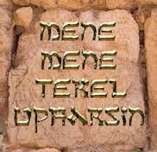
The Writing on the Wall!
“In the same hour came forth fingers of a man's hand, and wrote over against the candlestick upon the plaister of the wall of the king's palace: and the king saw the part of the hand that wrote.”
Daniel 5:5
“It is a fearful thing to fall into the hands of the living God.” Hebrews 10:31

Slide 7
Unseen Watcher
“ Soon the uninvited Guest made His presence felt. When the revelry was at its height a bloodless hand came forth and traced upon the walls of the palace characters that gleamed like fire--words which, though unknown to the vast throng, were a portent of doom to the now conscience-stricken king and his guests. Hushed was the boisterous mirth, while men and women, seized with nameless terror, watched the hand slowly tracing the mysterious characters. Before them passed, as in panoramic view, the deeds of their evil lives; they seemed to be arraigned before the judgment bar of the eternal God, whose power they had just defied. Where but a few moments before had been hilarity and blasphemous witticism, were pallid faces and cries of fear. When God makes men fear, they cannot hide the intensity of their terror. Belshazzar was the most terrified of them all. He it was who above all others had been responsible for the rebellion against God which that night had reached its height in the Babylonian realm.” PK, pgs. 526

Slide 8
Belshazzar Lost it!
“Then the king's countenance was changed, and his thoughts troubled him, so that the joints of his loins were loosed, and his knees smote one against another.” Daniel 5:5,6
He lost control of his bodily functions! He was urinating on himself! He was terrorized!!
“Wherefore we receiving a kingdom which cannot be moved, let us have grace, whereby we may serve God acceptably with reverence and godly fear:” Hebrews 12:28

Slide 9
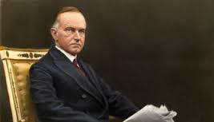
He was Against it!
Coolidge: It has been written that President Calvin Coolidge came home from church one Sunday and his wife asked, “What did the preacher preach about?” The President replied in his usual concise manner, “Sin.” Then Mrs. Coolidge asked, “What did he say about sin?” The President replied, “He was against it.”

Slide 10
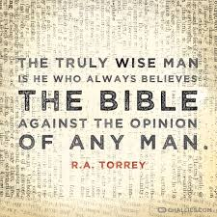
Babylon Enamored by Worldly Wise men!
“Then came in all the king's wise men: but they could not read the writing, nor make known to the king the interpretation thereof. Then was king Belshazzar greatly troubled, and his countenance was changed in him, and his lords were astonied.” Daniel 5:8,9

Slide 11
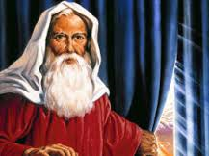
Time for the Old Man!
“Then was Daniel brought in before the king. And the king spake and said unto Daniel, Art thou that Daniel, which art of the children of the captivity of Judah, whom the king my father brought out of Jewry? I have even heard of thee, that the spirit of the gods is in thee, and that light and understanding and excellent wisdom is found in thee. And now the wise men, the astrologers, have been brought in before me, that they should read this writing, and make known unto me the interpretation thereof: but they could not shew the interpretation of the thing:” Daniel 5:13-15

Slide 12
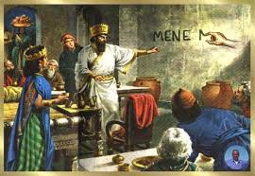
Daniel Cut it Straight!
“Before that terror-stricken throng, Daniel, unmoved by the promises of the king, stood in the quiet dignity of a servant of the Most High, not to speak words of flattery, but to interpret a message of doom. "Let thy gifts be to thyself," he said, "and give thy rewards to another; yet I will read the writing unto the king, and make known to him the interpretation.” PK, pg. 529

Slide 13
You Forgot!
“O thou king, the most high God gave Nebuchadnezzar thy father a kingdom, and majesty, and glory, and honour: And for the majesty that he gave him, all people, nations, and languages, trembled and feared before him: whom he would he slew; and whom he would he kept alive; and whom he would he set up; and whom he would he put down. But when his heart was lifted up, and his mind hardened in pride, he was deposed from his kingly throne, and they took his glory from him: And he was driven from the sons of men; and his heart was made like the beasts, and his dwelling was with the wild asses: they fed him with grass like oxen, and his body was wet with the dew of heaven; till he knew that the most high God ruled in the kingdom of men, and that he appointeth over it whomsoever he will. And thou his son, O Belshazzar, hast not humbled thine heart, though thou knewest all this; But hast lifted up thyself against the Lord of heaven; and they have brought the vessels of his house before thee, and thou, and thy lords, thy wives, and thy concubines, have drunk wine in them; and thou hast praised the gods of silver, and gold, of brass, iron, wood, and stone, which see not, nor hear, nor know: and the God in whose hand thy breath is, and whose are all thy ways, hast thou not glorified:” Daniel 5:18-23

Slide 14

Don’t Forget!
“We have nothing to fear for the future, except as we shall forget the way the Lord has led us, and His teaching in our past history." Life Sketches, p. 196.

Slide 15
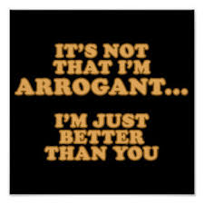
Arrogance Replaces Trust!
“Because thou sayest, I am rich, and increased with goods, and have need of nothing; and knowest not that thou art wretched, and miserable, and poor, and blind, and naked: I counsel thee to buy of me gold tried in the fire, that thou mayest be rich; and white raiment, that thou mayest be clothed, and that the shame of thy nakedness do not appear; and anoint thine eyes with eyesalve, that thou mayest see.” Revelation 3: 17,18

Slide 16
Dependence Where?
“Every nation that has come upon the stage of action has been permitted to occupy its place on the earth, that the fact might be determined whether it would fulfill the purposes of the Watcher and the Holy One. Prophecy has traced the rise and progress of the world's great empires--Babylon, Medo-Persia, Greece, and Rome. With each of these, as with the nations of less power, history has repeated itself. Each has had its period of test; each has failed, its glory faded, its power departed.
While nations have rejected God's principles, and in this rejection have wrought their own ruin, yet a divine, overruling purpose has manifestly been at work throughout the ages. It was this that the prophet Ezekiel saw in the wonderful representation given him during his exile in the land of the Chaldeans, when before his astonished gaze were portrayed the symbols that revealed an overruling Power that has to do with the affairs of earthly rulers.” PK, pg. 535

Slide 17
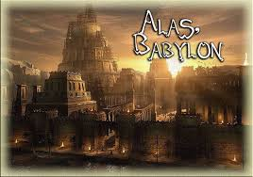
You Are Gone!
“And this is the writing that was written, MENE, MENE, TEKEL, UPHARSIN. This is the interpretation of the thing: MENE; God hath numbered thy kingdom, and finished it. TEKEL; Thou art weighed in the balances, and art found wanting. PERES; Thy kingdom is divided, and given to the Medes and Persians.” Daniel 5:25-28

Slide 18
History of Nations and Individuals
“Babylon, shattered and broken at last, passed away because in prosperity its rulers had regarded themselves as independent of God, and had ascribed the glory of their kingdom to human achievement. The Medo-Persian realm was visited by the wrath of Heaven because in it God's law had been trampled underfoot. The fear of the Lord had found no place in the hearts of the vast majority of the people. Wickedness, blasphemy, and corruption prevailed. The kingdoms that followed were even more base and corrupt; and these sank lower and still lower in the scale of moral worth. The power exercised by every ruler on the earth is Heaven-imparted; and upon his use of the power thus bestowed, his success depends. To each the word of the divine Watcher is, "I girded thee, though thou hast not known Me." Isaiah 45:5. And to each the words spoken to Nebuchadnezzar of old are the lesson of life: "Break off thy sins by righteousness, and thine iniquities by showing mercy to the poor: if it may be a lengthening of thy tranquillity." Daniel 4:27. To understand these things,--to understand that "righteousness exalteth a nation;" that "the throne is established by righteousness," and "upholden by mercy;" to recognize the outworking of these principles in the manifestation of His power who "removeth kings, and setteth up kings,"-- this is to understand the philosophy of history. Proverbs 14:34; 16:12; 20:28; Daniel 2:21. In the word of God only is this clearly set forth. Here it is shown that the strength of nations, as of individuals, is not found in the opportunities or facilities that appear to make them invincible; it is not found in their boasted greatness. It is measured by the fidelity with which they fulfill God's purpose.” PK, pgs. 501,502

Slide 19
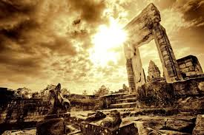
Truth Triumphs!
God and His Faithful Children- 5
Babylon and Man-made kingdoms-0

