Slide 1
For Men Only, pt. 4
Israel’s Kings/Dads

Slide 2
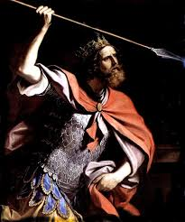
Saul and David
Israel’s first two kings, Saul and David, were exemplary in many ways. They both showed great bravery in combat, were very fair to those less fortunate, and defended those in the minority. These traits resulted from their dependence on God.

Slide 3
Protecting the minority
“And when he numbered them in Bezek, the children of Israel were three hundred thousand, and the men of Judah thirty thousand. And they said unto the messengers that came, Thus shall ye say unto the men of Jabesh Gilead, To morrow, by that time the sun be hot, ye shall have help. And the messengers came and shewed it to the men of Jabesh; and they were glad. Therefore the men of Jabesh said, To morrow we will come out unto you, and ye shall do with us all that seemeth good unto you. And it was so on the morrow, that Saul put the people in three companies; and they came into the midst of the host in the morning watch, and slew the Ammonites until the heat of the day: and it came to pass, that they which remained were scattered, so that two of them were not left together. And the people said unto Samuel, Who is he that said, Shall Saul reign over us? bring the men, that we may put them to death. And Saul said, There shall not a man be put to death this day: for to day the LORD hath wrought salvation in Israel.” 1 Sam. 10:8-13

Slide 4
In the Home
How critical this is at home. Any child that is made to feel like they are out in the cold, must receive special encouragement. They must be given added, positive attention that will spur them to greatness!

Slide 5
Avoid Irrational Oaths
“And Saul asked counsel of God, Shall I go down after the Philistines? wilt thou deliver them into the hand of Israel? But he answered him not that day. And Saul said, Draw ye near hither, all the chief of the people: and know and see wherein this sin hath been this day. For, as the LORD liveth, which saveth Israel, though it be in Jonathan my son, he shall surely die. But there was not a man among all the people that answered him. Then said he unto all Israel, Be ye on one side, and I and Jonathan my son will be on the other side. And the people said unto Saul, Do what seemeth good unto thee. Therefore Saul said unto the LORD God of Israel, Give a perfect lot. And Saul and Jonathan were taken: but the people escaped. And Saul said, Cast lots between me and Jonathan my son. And Jonathan was taken. Then Saul said to Jonathan, Tell me what thou hast done. And Jonathan told him, and said, I did but taste a little honey with the end of the rod that was in mine hand, and, lo, I must die. And Saul answered, God do so and more also: for thou shalt surely die, Jonathan. And the people said unto Saul, Shall Jonathan die, who hath wrought this great salvation in Israel? God forbid: as the LORD liveth, there shall not one hair of his head fall to the ground; for he hath wrought with God this day. So the people rescued Jonathan, that he died not.” 1 Samuel 14:37-45

Slide 6
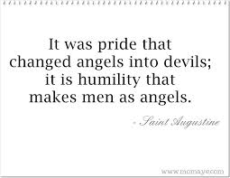
Be Ready to be Humble
Saul made such a ridiculous standard that led Israel to sin. By telling the soldiers not to eat, he opened the door for them to savagely devour the blood and the animals after the victory. He was so ready to defend himself, he would have slain his own boy!

Slide 7
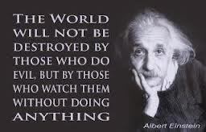
Protect your family
It was the soldiers that protected Jonathan from his dad! How often we see the gross extreme of protecting someone when they are dead wrong! As a husband and father, we must protect our families when they are right and suffer with them when they wrong!

Slide 8
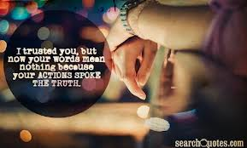
Keep Your Word/Consistently
“And Saul said to David, Behold my elder daughter Merab, her will I give thee to wife: only be thou valiant for me, and fight the LORD'S battles. For Saul said, Let not mine hand be upon him, but let the hand of the Philistines be upon him. And David said unto Saul, Who am I? and what is my life, or my father's family in Israel, that I should be son in law to the king? But it came to pass at the time when Merab Saul's daughter should have been given to David, that she was given unto Adriel the Meholathite to wife.” 1 Sam. 18:17-19

Slide 9
Death to His Son!
“And the king sat upon his seat, as at other times, even upon a seat by the wall: and Jonathan arose, and Abner sat by Saul's side, and David's place was empty. Nevertheless Saul spake not any thing that day: for he thought, Something hath befallen him, he is not clean; surely he is not clean. And it came to pass on the morrow, which was the second day of the month, that David's place was empty: and Saul said unto Jonathan his son, Wherefore cometh not the son of Jesse to meat, neither yesterday, nor to day? And Jonathan answered Saul, David earnestly asked leave of me to go to Bethlehem: And he said, Let me go, I pray thee; for our family hath a sacrifice in the city; and my brother, he hath commanded me to be there: and now, if I have found favour in thine eyes, let me get away, I pray thee, and see my brethren. Therefore he cometh not unto the king's table. Then Saul's anger was kindled against Jonathan, and he said unto him, Thou son of the perverse rebellious woman, do not I know that thou hast chosen the son of Jesse to thine own confusion, and unto the confusion of thy mother's nakedness? For as long as the son of Jesse liveth upon the ground, thou shalt not be established, nor thy kingdom. Wherefore now send and fetch him unto me, for he shall surely die. And Jonathan answered Saul his father, and said unto him, Wherefore shall he be slain? what hath he done? And Saul cast a javelin at him to smite him: whereby Jonathan knew that it was determined of his father to slay David. So Jonathan arose from the table in fierce anger, and did eat no meat the second day of the month: for he was grieved for David, because his father had done him shame.” 1 Samuel 20:25-34

Slide 10
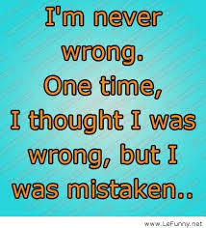
Saul, Arrogant, anger, Ugly
Jonathan’s desire to save David almost resulted in his own death. His dad was determined to destroy anything standing in his way. Saul’s wickedness as a king, dad, and person are well known. His greatest mistake was his unwillingness to admit his wrongs and turn from them!

Slide 11
David Wasn’t Perfect Either
“ Then came David to Nob to Ahimelech the priest: and Ahimelech was afraid at the meeting of David, and said unto him, Why art thou alone, and no man with thee? And David said unto Ahimelech the priest, The king hath commanded me a business, and hath said unto me, Let no man know any thing of the business where about I send thee, and what I have commanded thee: and I have appointed my servants to such and such a place. Now therefore what is under thine hand? give me five loaves of bread in mine hand, or what there is present. And the priest answered David, and said, There is no common bread under mine hand, but there is hallowed bread; if the young men have kept themselves at least from women. And David answered the priest, and said unto him, Of a truth women have been kept from us about these three days, since I came out, and the vessels of the young men are holy, and the bread is in a manner common, yea, though it were sanctified this day in the vessel. So the priest gave him hallowed bread: for there was no bread there but the shew bread, that was taken from before the LORD, to put hot bread in the day when it was taken away…

Slide 12
Cont.
…Now a certain man of the servants of Saul was there that day, detained before the LORD; and his name was Doeg, an Edomite, the chiefest of the herdmen that belonged to Saul. And David said unto Ahimelech, And is there not here under thine hand spear or sword? for I have neither brought my sword nor my weapons with me, because the king's business required haste. And the priest said, The sword of Goliath the Philistine, whom thou slewest in the valley of Elah, behold, it is here wrapped in a cloth behind the ephod: if thou wilt take that, take it: for there is no other save that here. And David said, There is none like that; give it me. And David arose, and fled that day for fear of Saul, and went to Achish the king of Gath. And the servants of Achish said unto him, Is not this David the king of the land? did they not sing one to another of him in dances, saying, Saul hath slain his thousands, and David his ten thousands? And David laid up these words in his heart, and was sore afraid of Achish the king of Gath. And he changed his behavior before them, and feigned himself mad in their hands, and scrabbled on the doors of the gate, and let his spittle fall down upon his beard.” 1 Samuel 21:1-13

Slide 13
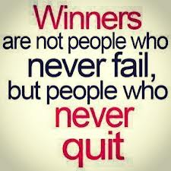
David Failed, but…
“Here he manifested a want of faith in God, and his sin resulted in causing the death of the high priest. Had the facts been plainly stated, Ahimelech would have known what course to pursue to preserve his life. God requires that truthfulness shall mark His people, even in the greatest peril…The first error of David was his distrust of God at Nob, and his second mistake was his deception before Achish. David had displayed noble traits of character, and his moral worth had won
him favor with the people; but as trial came upon him, his faith was shaken, and human weakness appeared. He saw in every man a spy and a betrayer. In a great emergency David had looked up to God with a steady eye of faith, and had vanquished the Philistine giant. He believed in God, he went in His name. But as he had been hunted and persecuted, perplexity and distress had nearly hidden his heavenly Father from his sight. Yet this experience was serving to teach David wisdom; for it led him to realize his weakness and the necessity of constant dependence upon God.” PP, pgs. 656,657

Slide 14
Repay Evil with Good
“And he came to the sheepcotes by the way, where was a cave; and Saul went in to cover his feet: and David and his men remained in the sides of the cave. And the men of David said unto him, Behold the day of which the LORD said unto thee, Behold, I will deliver thine enemy into thine hand, that thou mayest do to him as it shall seem good unto thee. Then David arose, and cut off the skirt of Saul's robe privily. And it came to pass afterward, that David's heart smote him, because he had cut off Saul's skirt. And he said unto his men, The LORD forbid that I should do this thing unto my master, the LORD'S anointed, to stretch forth mine hand against him, seeing he is the anointed of the LORD. So David stayed his servants with these words, and suffered them not to rise against Saul. But Saul rose up out of the cave, and went on his way. David also arose afterward, and went out of the cave, and cried after Saul, saying, My lord the king. And when Saul looked behind him, David stooped with his face to the earth, and bowed himself. And David said to Saul, Wherefore hearest thou men's words, saying, Behold, David seeketh thy hurt? Behold, this day thine eyes have seen how that the LORD had delivered thee to day into mine hand in the cave: and some bade me kill thee: but mine eye spared thee; and I said, I will not put forth mine hand against my lord; for he is the LORD'S anointed.” 1 Sam. 24:3-10

Slide 15
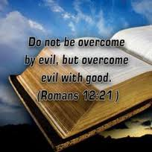
Let Good Win!
David had every right, humanly speaking, to let Saul have it. He could have so easily returned evil for all of Saul’s evil. However, he didn’t do this. How big is this in the home; when wife or children anger us, how easy to be overcome by their unkindness and repay them accordingly. This is NEVER the answer!

Slide 16
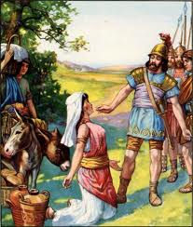
Saved from Murder!
“Now David had said, Surely in vain have I kept all that this fellow hath in the wilderness, so that nothing was missed of all that pertained unto him: and he hath requited me evil for good. So and more also do God unto the enemies of David, if I leave of all that pertain to him by the morning light any that pisseth against the wall.
And when Abigail saw David, she hasted, and lighted off the ass, and fell before David on her face, and bowed herself to the ground,” ! Sam. 25:1-3

Slide 17
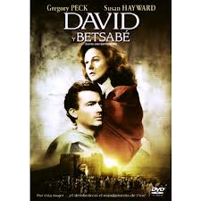
Not from Horrible Immorality!
“And unto David were sons born in Hebron: and his firstborn was Amnon, of Ahinoam the Jezreelitess; And his second, Chileab, of Abigail the wife of Nabal the Carmelite; and the third, Absalom the son of Maacah the daughter of Talmai king of Geshur; And the fourth, Adonijah the son of Haggith; and the fifth, Shephatiah the son of Abital; And the sixth, Ithream, by Eglah David's wife. These were born to David in Hebron.” 2 Samuel 3:2-5

Slide 18
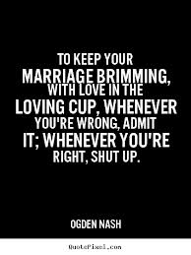
The One Big Difference
David did as many evil things as Saul. Deception, lies, immorality, all characterized the man after God’s own heart. The one and only difference was David’s willingness to admit wrong; confession and repentance were wrought in his character. Saul refused to admit his faults! Which one will we emulate?

