Slide 1
Ezekiel, pt. 16
Tyre/Papal Rome Fall

Slide 2
Brief Review
We noticed in Ezekiel, pt. 15 that Ezekiel prophesied judgments on a host of nations. Those nations were Ammon, Moab, Edom, Philistia, and Tyre. With the first four countries, anywhere from 4-7 verses are used to discuss their punishments. However, when it comes to Tyre, 3 full chapters are used to discuss her sins, her judgments, and her annihilation. This will be the subject of our study this morning.

Slide 3
Nebuchadnezzar Topples Tyre
For thus saith the Lord GOD; Behold, I will bring upon Tyrus Nebuchadnezzar king of Babylon, a king of kings, from the north, with horses, and with chariots, and with horsemen, and companies, and much people. He shall slay with the sword thy daughters in the field: and he shall make a fort against thee, and cast a mount against thee, and lift up the buckler against thee. And he shall set engines of war against thy walls, and with his axes he shall break down thy towers.” Ezekiel 26:7-9

Slide 4
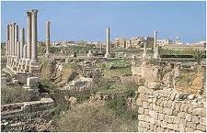
Tyre Goes Down- 573 BC
Secular history records that Nebuchadnezzar laid siege to the great mainland city of Tyre about a year after Ezekiel's prophecy. The Encyclopedia Britannica says: "After a 13-year siege (585-573 BC) by Nebuchadnezzar II, Tyre made terms and acknowledged Babylonian suzerainty." ⁸ When Nebuchadnezzar broke through the city gates, he found it nearly empty. Most of the people had moved by ship to an island about a half mile off the coast and fortified a city there. The mainland city was destroyed in 573 BC (Ezekiel's first prediction), but the city of Tyre on the island remained a powerful city for several hundred years.

Slide 5
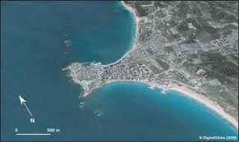
Aerial View of Tyre
In ancient times, called antiquity, the island land mass of Tyre was not connected to the mainland. It was actually separated by 100 yards of water. But as the following Scripture declares, someone would take the remains of mainland Tyre and lay them in the water and connect the two. The man who did it was Alexander of Greece!

Slide 6
Laid in the Water
“ And they shall make a spoil of thy riches, and make a prey of thy merchandise: and they shall break down thy walls, and destroy thy pleasant houses: and they shall lay thy stones and thy timber and thy dust in the midst of the water. And I will cause the noise of thy songs to cease; and the sound of thy harps shall be no more heard. And I will make thee like the top of a rock: thou shalt be a place to spread nets upon; thou shalt be built no more: for I the LORD have spoken it, saith the Lord GOD.” Ezekiel 26:12-14

Slide 7
Never Regained its Power!
So many rulers wanted to pillage and then destroy Tyre, but none had been successful. Nebuchadnezzar got mainland Tyre in 573 after a 12 year siege!! Many Tyrians escaped to the island! None could conquer it! However, Alexander figured on a new plan. Taking the remains of old Tyre, he had his engineers lay them in the water, building a causeway to the island. This way, he was able to have his ground troops go across the causeway, use a battering ram against the city walls and have his navy attack by water, and the island of Tyre was subdued by Alexander in 332 BC. Prophecy Complete!

Slide 8
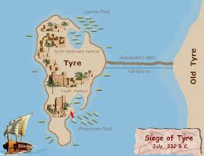
Not The Last
Mighty, powerful, mainland Tyre fell to the forces of Nebuchadnezzar in 573 BC. The island of Tyre fell to Alexander in 332 BC. This powerful nation, universally known for its might and opulence fell, never to rise again. John the Revelator saw another powerhouse and he used similar language to describe its demise!!!

Slide 9
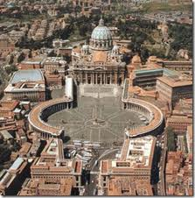
Papacy Falls Soon!!
Revelation 17 depicts the resurrection of the papacy at the end of time . She controls the:
1. political leaders (verse 2)
2. the churches (verse 5)
3. the wealthy (Rev. 18:15)
4. uses war and terror to accomplish their ends. (Rev. 18:24)
John uses the words of Ezekiel to declare their fall just like TYRE!!

Slide 10
Notice
“And I will cause the noise of thy songs to cease; and the sound of thy harps shall be no more heard.” Ezekiel 26:13
“And the voice of harpers, and musicians, and of pipers, and trumpeters, shall be heard no more at all in thee…” Rev. 18:22
“And they shall take up a lamentation for thee, and say to thee, How art thou destroyed, that wast inhabited of seafaring men, the renowned city, which wast strong in the sea, she and her inhabitants, which cause their terror to be on all that haunt it!” Ezek. 26:17
“And the kings of the earth…shall bewail her, and lament for her… when they shall see the torment of her burning Standing far off for the fear of her torment.” Rev. 18:9,10

Slide 11
Notice-ARROGANCE
“And say unto Tyrus, O thou that art situate at the entry of the sea, which art a merchant of the people for many isles, Thus saith the Lord GOD; O Tyrus, thou hast said, I am of perfect beauty.” Ezekiel 27:3
“How much she hath glorified herself, and lived deliciously, so much torment and sorrow give her: for she saith in her heart, I sit a queen, and am no widow, and shall see no sorrow.” Rev. 18:7

Slide 12
Impregnable and Unconquerable
Phoenician Tyre was queen of the seas, an island city of unprecedented splendor. She grew wealthy from her far-reaching colonies and her industries of purple-dyed textiles. But she also attracted the attention of jealous conquerors. Phoenician expansion began about 815 B.C. when traders from Tyre founded Carthage in North Africa. Eventually its colonies spread around the Mediterranean and Atlantic, bringing to the city a flourishing maritime trade. But prosperity and power make their own enemies.

Slide 13
Who is like Tyre/Rome?
”And all that handle the oar, the mariners, and all the pilots of the sea, shall come down from their ships, they shall stand upon the land; And shall cause their voice to be heard against thee, and shall cry bitterly, and shall cast up dust upon their heads, they shall wallow themselves in the ashes: And they shall make themselves utterly bald for thee, and gird them with sackcloth, and they shall weep for thee with bitterness of heart and bitter wailing. And in their wailing they shall take up a lamentation for thee, and lament over thee, saying, What city is like Tyrus, like the destroyed in the midst of the sea?” Ezekiel 27:29-32
“ And every shipmaster, and all the company in ships, and sailors, and as many as trade by sea, stood afar off, And cried when they saw the smoke of her burning, saying, What city is like unto this great city!” Rev. 18:17,18

Slide 14
Not Be Found Again!
“I will make thee a terror, and thou shalt be no more: though thou be sought for, yet shalt thou never be found again, saith the Lord GOD.” Ezekiel 26:21
“And a mighty angel took up a stone like a great millstone, and cast it into the sea, saying, Thus with violence shall that great city Babylon be thrown down, and shall be found no more at all.” Rev. 18:21

Slide 15
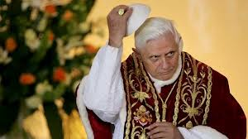
Fall of Benedict
On Friday, February 1, 2013, on the basis of evidence supplied by our affiliated Common Law Court of Justice (itccs.org), our Office concluded an agreement with representatives of a European nation and its courts to secure an arrest warrant against Joseph Ratzinger, aka Pope Benedict, for crimes against humanity and ordering a criminal conspiracy.

Slide 16
Brussels Central Office, The International Tribunal into Crimes of Church and State
In closing, our Tribunal acknowledges that Pope Benedict's complicity in criminal activities of the Vatican Bank (IOR) was compelling his eventual dismissal by the highest officials of the Vatican. But according to our sources, Secretary of State Tarcisio Bertone forced Joseph Ratzinger's resignation immediately, and in direct response to the diplomatic note concerning the arrest warrant that was issued to him by the said nation's government on February 4, 2013. We call upon all citizens and governments to assist our efforts to legally and directly disestablish the Vatican, Inc. and arrest its chief officers and clergy who are complicit in crimes against humanity and the ongoing criminal conspiracy to aid and protect child torture and trafficking.

Slide 17
Tyre/Rome/Lucifer
Ezekiel 28 parallels the king of Tyre with Lucifer. “Son of man, take up a lamentation upon the king of Tyrus, and say unto him, Thus saith the Lord GOD; Thou sealest up the sum, full of wisdom, and perfect in beauty. Thou hast been in Eden the garden of God;…” “Thou art the anointed cherub that covereth; and I have set thee so: thou wast upon the holy mountain of God; thou hast walked up and down in the midst of the stones of fire. Thou wast perfect in thy ways from the day that thou wast created, till iniquity was found in thee.”
These passages discuss Lucifer and his fall from heaven.

Slide 18
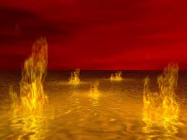
Tyre/ Papal Rome/Lucifer Fall
“Thine heart was lifted up because of thy beauty, thou hast corrupted thy wisdom by reason of thy brightness: I will cast thee to the ground, I will lay thee before kings, that they may behold thee. Thou hast defiled thy sanctuaries by the multitude of thine iniquities, by the iniquity of thy traffick; therefore will I bring forth a fire from the midst of thee, it shall devour thee, and I will bring thee to ashes upon the earth in the sight of all them that behold thee.” Ezek. 28:17,18

