Slide 1
Prophecy Update- 12/30/23

Slide 2
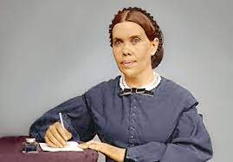
Right on Time!!
Everything foretold by this lowly, thrifty, woman is coming to pass. From the unification of the Catholic, Apostate Protestant, and apostate Adventist churches in order to set up the temporary reign of the papal anti-Christ, to the economy instability on a world scale, and even the pinpointing of Ellen White as to the use of climate upheaval to bring in a Sunday Law. This uneducated woman, untrained by the schools of her day, has been educated in the school of Christ and has blessed the nations with knowledge of current and future events!! Praise God!!

Slide 3
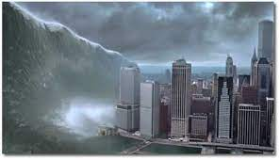
One Bright Promise Awaits
The tsunami like power of the Holy Spirit waits word to flood the earth!!
“I saw the latter rain is coming suddenly, as the midnight cry and with ten times the power.” Ellen White letter, Spalding-Megan Collection, pages 3,4
“In the parable of Matthew 25 the time of waiting and slumber is followed by the coming of the bridegroom. This was in accordance with the arguments just presented, both from prophecy and from the types. They carried strong conviction of their truthfulness; and the "midnight cry" was heralded by thousands of believers.
Like a tidal wave the movement swept over the land. From city to city, from village to village, and into remote country places it went, until the waiting people of God were fully aroused.” GC, pg. 400

Slide 4
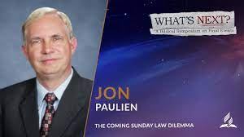
Naysayers be Silent!!
How dare Jon Paulien of Loma Linda theological department say that if Ellen White were alive, she would change what was written in the Great Controversy. And, by the way, there is no Sunday Law dilemma!! And this man continues to receive a paycheck from the denomination!! Something stinks in Dodge!!

Slide 5
ADRA
COP28, the annual global UN Climate Conference taking place November 30 – December 12, has brought together heads of state and government officials, UN agencies, corporations, civil society, and religious organizations to negotiate and coordinate global climate action. Hosted by the United Arab Emirates, this year’s conference took place amidst a growing urgency and commitment to take immediate action. At COP28, Adventist Development and Relief Agency (ADRA) has called on global leaders to take more ambitious action, especially in helping “marginalized groups” that have been “hard hit by climate change.” According to ADRA, there have been numerous impacts of climate change, including “economic, environmental, human conflict, migration, to name a few.” In addition, ADRA is calling for “emissions reductions” and “political discussions” in order to come up with “climate protection measures.” In case that wasn’t enough, ADRA is also advocating for the adoption of “One Health,” a comprehensive strategy for combating climate change that takes into account the well-being of humans, animals, and the earth. Furthermore, ADRA is “pushing for a funding mechanism that reflects the importance of these interactions.” from Advent Messenger

Slide 6

“For us (ADRA), the World Climate Conference is a place of cooperation and exchange. Both between the various aid organizations and with the governments of the world. The aim of our work at the World Climate Conference is to advance the preservation of creation. As humanitarian aid actors, we experience first-hand how climate change threatens health and livelihoods and exacerbates poverty and injustice. We are working with all our might to combat this in our projects.” [1] https://www.apd.info/news/2023/11/28/weltklimakonferenz-cop-28-adra-ruft-zu-ganzheitlichen-klimaschutzmassnahmen-auf

Slide 7
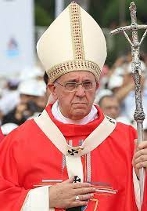
Adventist Disaster Relief Agency
From Laudato Si in 2015, Francis made it very clear that the climate change agenda had at its core Sunday keeping!
Great Controversy, pgs. 589,590 are very clear that climate catastrophes will be used to bring in a Sunday law!
What is ADRA doing promoting an agenda that will lead to Sunday? How is it possible that Adventist monies go to support this agenda? How is it that so few say anything about this travesty?

Slide 8
She said it!!
“As the storm approaches, a large class who have professed faith in the third angel's message, but have not been sanctified through obedience to the truth, abandon their position and join the ranks of the opposition. By uniting with the world and partaking of its spirit, they have come to view matters in nearly the same light; and when the test is brought, they are prepared to choose the easy, popular side. Men of talent and pleasing address, who once rejoiced in the truth, employ their powers to deceive and mislead souls. They become the most bitter enemies of their former brethren. When Sabbath keepers are brought before the courts to answer for their faith, these apostates are the most efficient agents of Satan to misrepresent and accuse them, and by false reports and insinuations to stir up the rulers against them.” GC, pg. 608

Slide 9
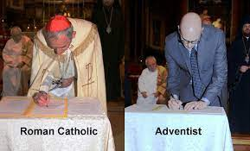
Wow!!
1. A part of the organized church.
2. funded by the organized church.
3. under the satanic delusion that as long as you are in the church, anything goes!!
4. ADRA and the bulk of Adventism have joined up with Rome and apostate Protestantism to promote the Sunday agenda of Rome!
5. By supporting this insanity, Adventists are supporting the setting up of the image of the beast!! Is this serious?? Should someone say something? Walter? Doug? 3ABN?

Slide 10
Laudato Si’ is the “Loud Call” for the Earth.
• “Archbishop Ettore Balestrero, the Permanent Observer of the Holy See to the United Nations in Geneva, moderated the meeting and delivered the opening speech. He began by recognizing the Universal Declaration of Human Rights as the ‘cornerstone of the life and work of the United Nations,’ that acknowledges the ‘intrinsic dignity of the human person and formally protecting and promoting the human rights that derive from it’.” Furthermore, Archbishop Balestrero described Laudato Si’as a ‘loud call’ to respond to the ‘attacks on our common home that have consequences for human lives’…The Permanent Observer of the Holy See reiterated Pope Francis’s warning regarding the international community’s response to the climate crisis, which ‘has not been adequate, while the world we live in is collapsing and may be close to the breaking point’.” advent messenger https://www.vaticannews.va/en/vatican-city/news/2023-12/holy-see-un-geneva-balestrero-smerilli-laudate-deum-human-rights.html

Slide 11
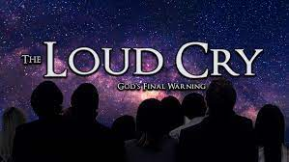
“And after these things I saw another angel come down from heaven, having great power; and the earth was lightened with his glory. And he cried mightily with a strong voice, saying, Babylon the great is fallen, is fallen, and is become the habitation of devils, and the hold of every foul spirit, and a cage of every unclean and hateful bird. For all nations have drunk of the wine of the wrath of her fornication, and the kings of the earth have committed fornication with her, and the merchants of the earth are waxed rich through the abundance of her delicacies. And I heard another voice from heaven, saying, Come out of her, my people, that ye be not partakers of her sins, and that ye receive not of her plagues. For her sins have reached unto heaven, and God hath remembered her iniquities.” Revelation 18:1-5

Slide 12

Two Loud Cries
The antichrist has his loud cry about climate change and how everyone must obey his voice/agenda!!
The Lord God of heaven also has His loud cry coming very soon in mighty power!!
Which loud cry will we hear and follow? The great bulk of Adventism is listening to Francis’ loud cry and will be left out of God’s loud cry of Rev. 18! Amazing, a part of the church organization and does not discern God’s voice!! Tragic, and oh so very sad! Is this something to preach about, Doug? Walter?

Slide 13
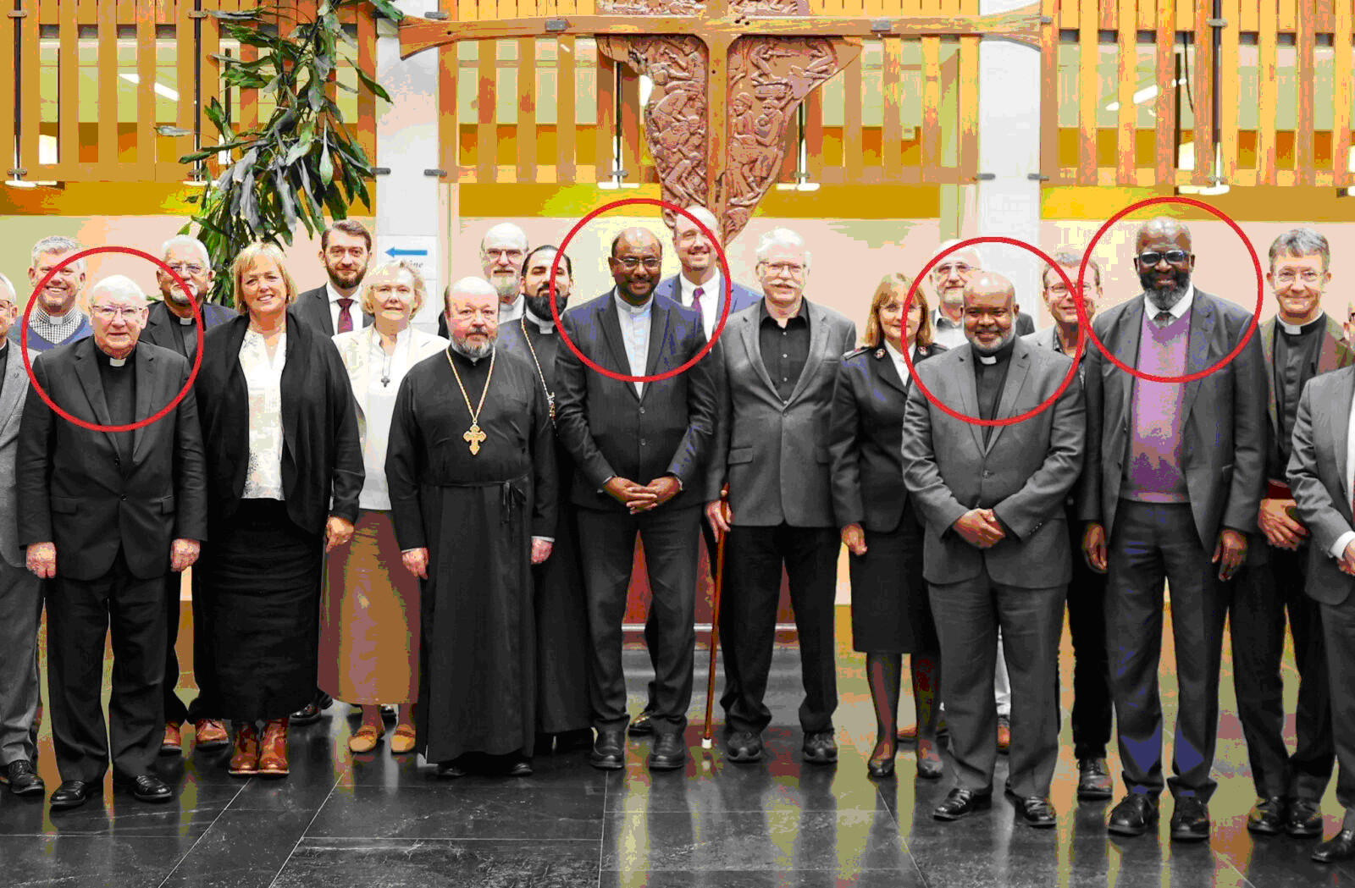
Support this, Walter!
The major ecumenical players in the world. Red circles from left to right: Roman Catholic Bishop Brian Farrell, the Vatican’s Secretary of the Dicastery for Promoting Christian Unity; Dr. Jerry Pillay, the General Secretary of the World Council of Churches; Dr. Casely Essamuah, the Secretary of the Global Christian Forum; and Ganoune Diop, Secretary of the Conference of Secretaries of Christian World Communions and Director of Public Affairs and Religious Liberty for the Worldwide Seventh-day Adventist Church.

Slide 14
Diop Declares
“Rev. Dr Ganoune Diop, secretary of the Conference of Secretaries of Christian World Communions, said: ‘This unique yearly gathering is a space where distinguished leaders of Christian world communions engage in bilateral and multilateral dialogues, each communion sharing on their own terms about their ecclesiastical life, and work as witnesses to the sovereignty of the triune God and His ultimate purpose to gather the whole world, oikumene, under the lordship of Christ. The core of the meetings consists in reports, and conversations on each report. This group does not sign resolutions, engage in common strategic planning or plan of actions. The focus is on relations, on being, rather than doing things together. Mingling with one another helps dispel prejudices and helps us focus on our respective participation in what God is doing in the world’.”
https://www.oikoumene.org/news/wcc-hosts-conference-of-secretaries-of-christian-world-communions
Advent Messenger

Slide 15

Serious and Scary Time
1. Support the one world religion where the papacy reigns?
2. Support Diop in his mad dash to bring Adventism to embrace the Sunday?
3. serious enough, Doug, to warn SDA’s?
4. serious enough, Walter, to encourage Adventists to put their money toward the proclamation of the 3 Angel’s messages and not toward the setting up of the image of the beast?

Slide 16
