Slide 1
What is the Difference Between Mormons, Jehovah’s Witnesses, and Seventh-day Adventists? pt 11

Slide 2
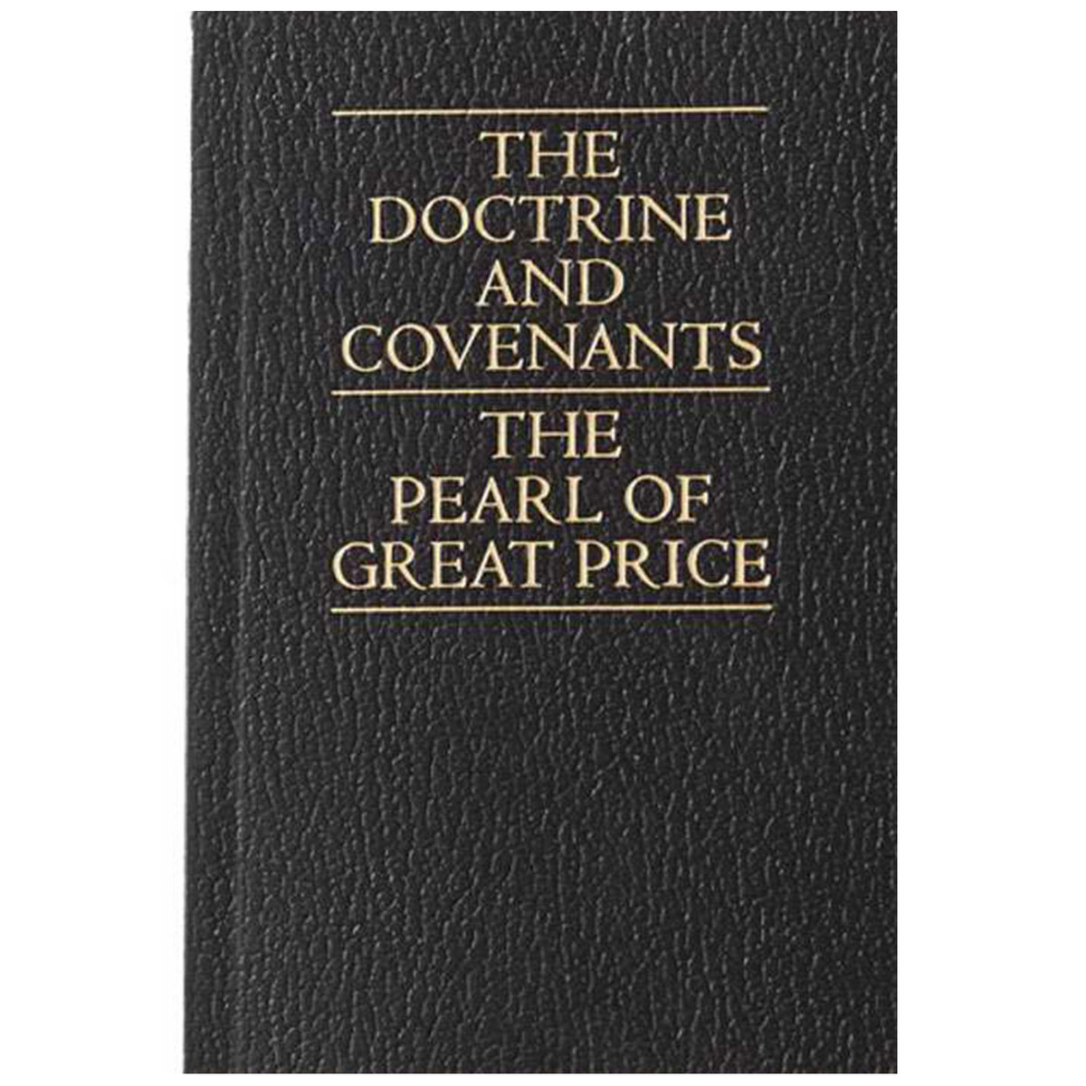
What We Will Look At Today…
The history of the evolution of the Mormon scripture “Doctrines and Covenants”
The additions, omissions, and revisions to DNC
Controversial/Contradictory Statements in D&C

Slide 3
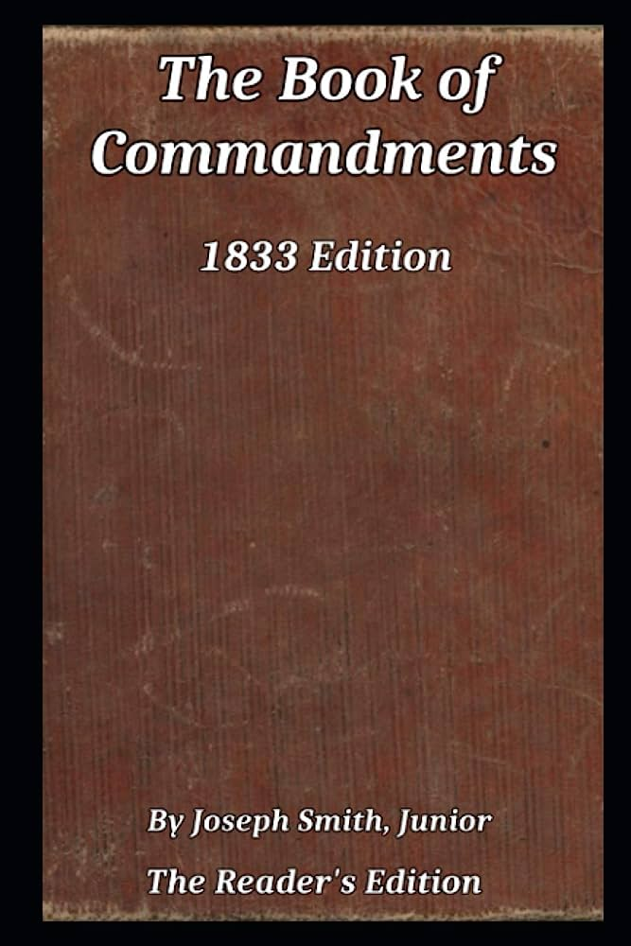
Importance of Doctrines and Covenants
“In the LDS Church, The Doctrine and Covenants of The Church of Jesus Christ of Latter-day Saints stands alongside the Bible, the Book of Mormon, and the Pearl of Great Price as scripture. Together the LDS Church's scriptures are referred to as the "standard works". The LDS Church's version of the Doctrine and Covenants is described by the church as ‘containing revelations given to Joseph Smith, the Prophet, with some additions by his successors in the Presidency of the Church.’”—Wikipedia, Doctrines and Covenants

Slide 4
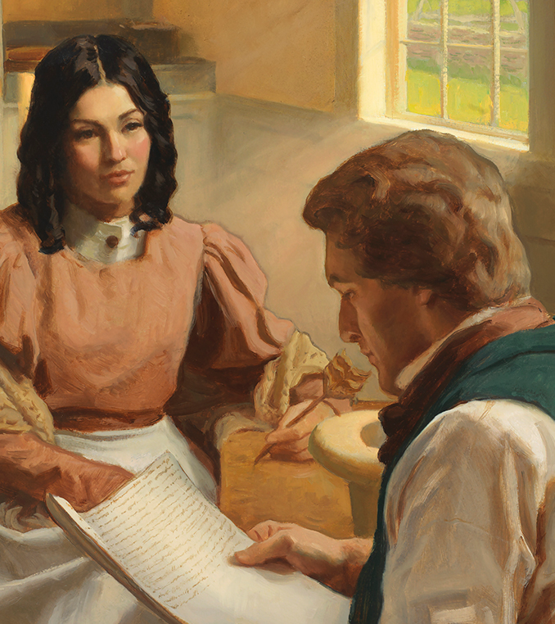
The Background
The original version of this book was called the Book of Commandments, which was published in 1833, however several revisions were made and the writing changed, deleting some words or sections, adding others and changing entirely the meaning in other areas. Wikipedia says this: “The Doctrine and Covenants was first published in 1835 as a later version of the Book of Commandments, which had been partially printed in 1833. This earlier book contained 65 early revelations to church leaders, notably Joseph Smith and Oliver Cowdery. Before many copies of the book could be printed, the printing press and most of the printed copies were destroyed by a mob in Missouri.” Ibid.

Slide 5
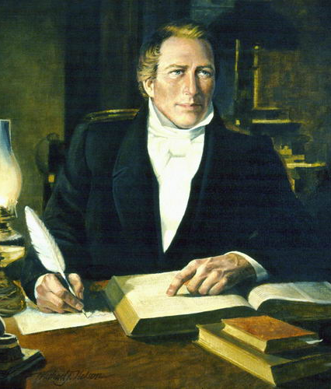
History Continued… What Does it Contain?
“On September 24, 1834, a committee was appointed by the general assembly of the church to organize a new volume containing the most significant revelations. This committee of Presiding Elders, consisting of Smith, Cowdery, Sidney Rigdon, and Frederick G. Williams, began to review and revise numerous revelations for inclusion in the new work. The committee eventually organized the book into two parts: a "Doctrine" part and a "Covenants" part. . . . The "Doctrine" part of the book consisted of a theological course now called the "Lectures on Faith". The lectures were a series of doctrinal courses used in the School of the Prophets which had recently been completed in Kirtland, Ohio.” Ibid.

Slide 6
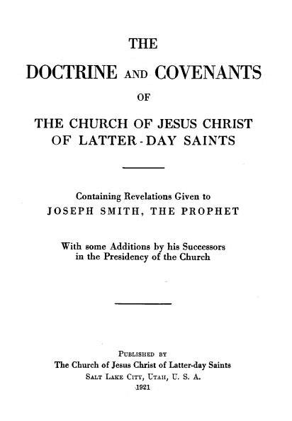
What Were the Covenants?
“The ‘Covenants’ part of the book, labeled ‘Covenants and Commandments of the Lord, to his servants of the church of the Latter Day Saints’, contained a total of 103 revelations. These 103 revelations were said to ‘contain items or principles for the regulation of the church, as taken from the revelations which have been given since its organization, as well as from former ones.’ Each of the 103 revelations was assigned a ‘section number’; however, section 66 was mistakenly used twice. Thus, the sections of the original work were numbered only to 102” Ibid.

Slide 7
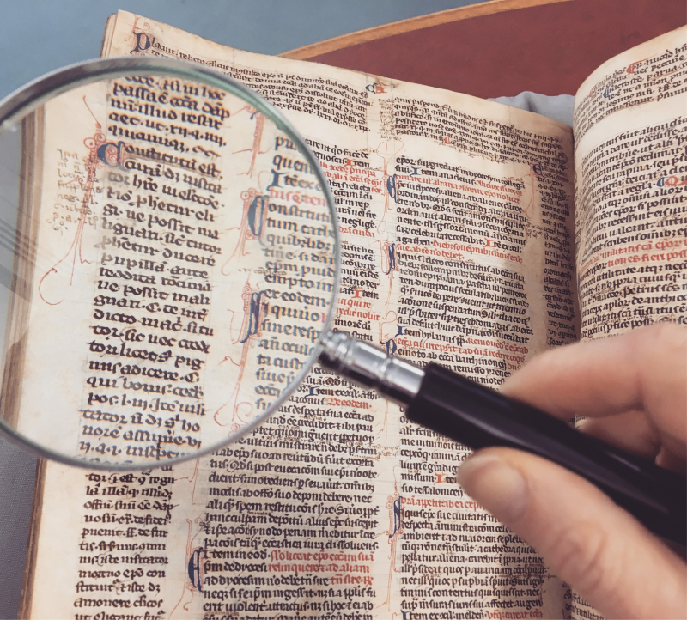
Updated Editions
1831: Book of Commandments and Revelations
1833: Book of Commandments
1835: Doctrines and Covenants
1844: added 8 sections
1876: reordered chronologically and added 26 sections, removed section 101 about the importance of monogamy, and added 131 & 132 which lays down the doctrine of plural marriage
1921: “doctrines” part removed entirely, de-canonized from Mormon scripture and is now known as “Lectures on Faith”

Slide 8
Why Were the Lectures Removed???
“commentators have theorized that the lectures represented official church doctrine in 1835, but that by 1897 [Community of Christ] or 1921, when the work was decanonized by the major Latter Day Saint denominations, the doctrine concerning the Godhead had changed, and the lectures were no longer generally consistent with accepted doctrines. For instance, in Lecture 5, paragraph 2, it defines the Father as a "personage of spirit, glory and power," whereas in section 130 of the D&C, verse 22 states that "the Father has a body of flesh and bones as tangible as man's." In addition, the Father and Son are said to possess the same mind, "which mind is the Holy Spirit" (Lecture 5, paragraph 2). The Holy Spirit is not a personage, as defined at the beginning of paragraph 2: "There are two personages who constitute the great, matchless, governing and supreme power over all things ... They are the Father and Son." This could cause confusion when compared with section 130 of the Doctrine and Covenants: "The Holy Ghost has not a body of flesh and bones, but is a personage of Spirit." Section 130 was added in the 1876 edition and hence co-existed with the Lectures on Faith.” Wikipedia, Lectures on Faith

Slide 9
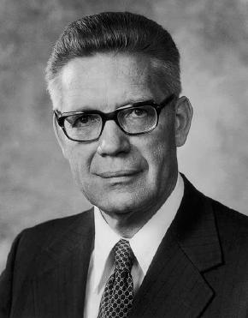
Church Leaders Quorum Member
In 1972, Bruce R. McConkie, who was a member of the LDS Church's First Council of the Seventy, said the Lectures were Inspired and Authoritative:
"In my judgment, it is the most comprehensive, inspired utterance that now exists in the English language—that exists in one place defining, interpreting, expounding, announcing, and testifying what kind of being God is. It was written by the power of the Holy Ghost, by the spirit of inspiration. It is, in effect, eternal scripture; it is true.“ (McConkie, Bruce R., 4 January 1972, "The Lord God of Joseph Smith". BYU Speeches. Provo, Utah: Brigham Young University Press. "Speeches of the Year"

Slide 10
Scripture—can you just add and subtract?
Deut. 4:2 “Ye shall not add unto the word which I command you, neither shall ye diminish ought from it, that ye may keep the commandments of the Lord your God which I command you.”
Rev. 22:18-19 “For I testify unto every man that heareth the words of the prophecy of this book, If any man shall add unto these things, God shall add unto him the plagues that are written in this book: And if any man shall take away from the words of the book of this prophecy, God shall take away his part out of the book of life, and out of the holy city, and from the things which are written in this book.”
Is. 40:8 “The grass withereth, the flower fadeth: but the word of our God shall stand for ever.”
Matt. 24:35 “Heaven and earth shall pass away, but my words shall not pass away.”

Slide 11
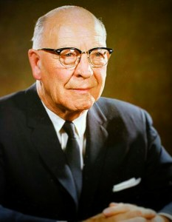
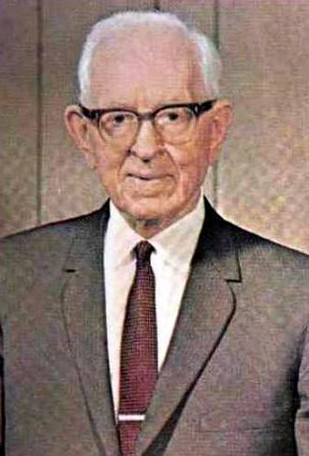
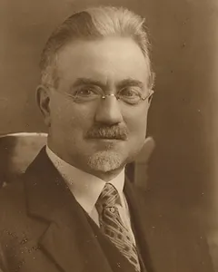
“Revelations NOT Changed…”
Apostle Legrand Richards: "As far as I know there have been no changes at all in any of the revelations. If there have been any changes it would all have been fixing grammar or something like that." (1978 Interview, https://thoughtsonthingsandstuff.com/the-legrand-richards-interview/)
Joseph Fielding Smith: "Inspiration is discovered in the fact that each part, as it was revealed, dovetailed perfectly with what had come before. There was no need for eliminating, changing, or adjusting any part to make it fit; but each new revelation on doctrine and priesthood fitted in its place perfectly to complete the whole structure, as it had been prepared by the Master Builder." (Doctrines of Salvation, Vol, 1, page 170)
Apostle John A. Widtsoe: "Within a few years after its organization, the Church had received practically all necessary supplementary laws and regulations. These also have remained unchanged. There has been no tampering with God's word.... the whole body of Church laws forms a harmonious unit, which does not anywhere contradict itself nor has it been found necessary to alter any part of it." (Joseph Smith—Seeker After Truth, pages 119 and 122)

Slide 12
Verifiably False
March 1829 Revelation to Joseph Smith about the Book of Mormon: "...and he has a gift to translate the book, and I have commanded him that he shall pretend to no other gift, for I will grant him no other gift." (Book of Commandments, 4:2)
​However, Joseph’s translating gifts did not stop. He continued to receive revelations from God throughout his career as a Mormon prophet, writing D&C, translating the Pearl of Great Price, revising the KJV Bible and directly guiding his followers, thus D&C
"And you have a gift to translate the plates; and this is the first gift that I bestowed upon you; and I have commanded that you should pretend to no other gift, until my purpose is fulfilled in this; for I will grant unto you no other gift until it is finished." (Doctrine and Covenants, Section 5, verse 4)

Slide 13
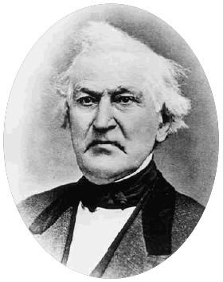
Insight From David Whitmer
"As if God had commanded Joseph to pretend to no other gift but to translate the Book of Mormon, that he would "grant him no other gift," and then afterwards God had changed his mind and concluded to grant him another gift. God does not change and work in this manner. The way the revelation has been changed, twenty two words being added to it, it would appear that God had broken His word after giving His word in plainness; commanding Brother Joseph to pretend to no other gift but to translate the Book of Mormon, and then the Lord had changed and concluded to grant Joseph the gift of a Seer to the Church.“(An Address To All Believers In Christ, Richmond, Missouri, 1887, p. 32)

Slide 14
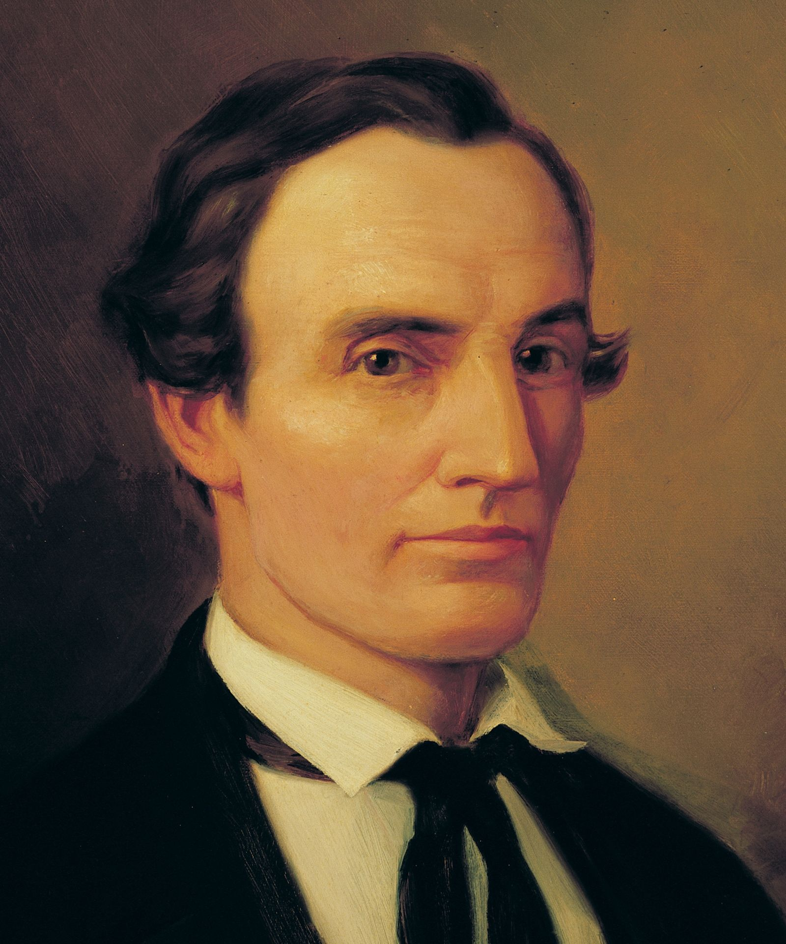
Cowdery’s Demotion
“Which commandments were given to Joseph, who was called of God and ordained an apostle of Jesus Christ, an elder of this church; And also to Oliver [Cowdery], who was called of God an apostle of Jesus Christ, an elder of this church, and ordained under his hand (Book of Commandments, 24:3-4)
By 1835, the relationship between Joseph and Oliver was straining, in 1838 Oliver was excommunicated.
“Which commandments were given to Joseph Smith, Jun., who was called of God, and ordained an apostle of Jesus Christ, to be the first elder of this church; And to Oliver Cowdery, who was also called of God, an apostle of Jesus Christ, to be the second elder of this church, and ordained under his hand” (D&C 20:2-3)

Slide 15
D&C 101 vs D&C 132
“Inasmuch as this church of Christ has been reproached with the crime of fornication, and polygamy: we declare that we believe, that one man should have one wife; and one woman, but one husband, except in the case of death, when either is at liberty to marry again." (Not Written by Joseph Smith, D&C 101:4)
Timeline:
1833: Joseph Smith has a polygamous/extramarital relationship with Fanny Alger [16 years old]. 1835: D&C 101 added as a response to political pressure from the United States and rumors of polygamy being practiced by LDS
1836: Joseph Smith claims a vision where he is to restore the priesthood keys, later to be understood to include sealing keys
1841: Polygamous marriages begin in Nauvoo, IL with Louisa Beaman
1842: Joseph publicly denounces the spiritual wifery of John Bennett
1843: Joseph resumes polygamy, marrying over a dozen women and bringing the total to over 30.
1843, July 12: Joseph gives revelation to William Clayton on polygamy (D&C 132).

Slide 16
D&C 132: “The Everlasting Covenant”?
Joseph Smith’s 1843 Revelation: “1 Verily, thus saith the Lord unto you my servant Joseph, that inasmuch as you have inquired of my hand to know and understand wherein I, the Lord, justified my servants Abraham, Isaac, and Jacob, as also Moses, David and Solomon, my servants, as touching the principle and doctrine of their having many wives and concubines—2 Behold, and lo, I am the Lord thy God, and will answer thee as touching this matter. 3 Therefore, prepare thy heart to receive and obey the instructions which I am about to give unto you; for all those who have this law revealed unto them must obey the same. 4 For behold, I reveal unto you a new and an everlasting covenant; and if ye abide not that covenant, then are ye damned; for no one can reject this covenant and be permitted to enter into my glory. 5 For all who will have a blessing at my hands shall abide the law which was appointed for that blessing, and the conditions thereof, as were instituted from before the foundation of the world. . . . 37 Abraham received concubines, and they bore him children; and it was accounted unto him for righteousness, because they were given unto him, and he abode in my law; as Isaac also and Jacob did none other things than that which they were commanded; and because they did none other things than that which they were commanded, they have entered into their exaltation, according to the promises, and sit upon thrones, and are not angels but are gods.” (D&C 132:1-5, 37)

Slide 17
Abraham Had Multiple Wives Was Righteousness?
Rom. 4:2-3 “For if Abraham were justified by works, he hath whereof to glory; but not before God. For what saith the scripture? Abraham believed God, and it was counted unto him for righteousness.”
Fate of Ishmael: Gen. 21:12 “And God said unto Abraham, Let it not be grievous in thy sight because of the lad, and because of thy bondwoman; in all that Sarah hath said unto thee, hearken unto her voice; for in Isaac shall thy seed be called.”

Slide 18
Concubines for All of Eternity?
“38 David also received many wives and concubines, and also Solomon and Moses my servants, as also many others of my servants, from the beginning of creation until this time; and in nothing did they sin save in those things which they received not of me. 39 David’s wives and concubines were given unto him of me, by the hand of Nathan, my servant, and others of the prophets who had the keys of this power; and in none of these things did he sin against me save in the case of Uriah and his wife; and, therefore he hath fallen from his exaltation, and received his portion; and he shall not inherit them out of the world, for I gave them unto another, saith the Lord. 40 I am the Lord thy God, and I gave unto thee, my servant Joseph, an appointment, and restore all things. Ask what ye will, and it shall be given unto you according to my word. . . . 46 And verily, verily, I say unto you, that whatsoever you seal on earth shall be sealed in heaven . . . 52 And let mine handmaid, Emma Smith, receive all those that have been given unto my servant Joseph, and who are virtuous and pure before me; and those who are not pure, and have said they were pure, shall be destroyed, saith the Lord God. 53 For I am the Lord thy God, and ye shall obey my voice; and I give unto my servant Joseph that he shall be made ruler over many things; for he hath been faithful over a few things, and from henceforth I will strengthen him.” (D&C 132:38-40, 46, 52-53)

Slide 19
D&C Contradicts BoM
“38 David also received many wives and concubines, and also Solomon and Moses my servants, as also many others of my servants, from the beginning of creation until this time; and in nothing did they sin save in those things which they received not of me. 39 David’s wives and concubines were given unto him of me, by the hand of Nathan, my servant, and others of the prophets who had the keys of this power; and in none of these things did he sin against me save in the case of Uriah and his wife” (D&C 132:38-39)
“23 But the word of God burdens me because of your grosser crimes. For behold, thus saith the Lord: This people begin to wax in iniquity; they understand not the scriptures, for they seek to excuse themselves in committing whoredoms, because of the things which were written concerning David, and Solomon his son. 24 Behold, David and Solomon truly had many wives and concubines, which thing was abominable before me, saith the Lord.” (BoM Jacob:2:23-24)
VS

Slide 20
Mormonism—Against Marriage and Families
“When the wife is faithful and desires to obey the divine law and the husband is rebellious, or unwilling to obey the will of the Lord, if she maintains her integrity to the best of her ability, she will be given to another husband in eternity and will receive all the blessings of the celestial kingdom.” (Joseph Fielding Smith, Doctrines and Salvation, Answers to Gospel Questions, Vol. 3, Pg. 23, 24. Pub. 195)

Slide 21
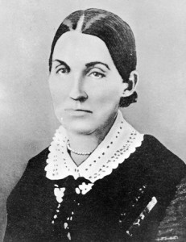
Emma, Get with the Program of Die
“54 And I command mine handmaid, Emma Smith, to abide and cleave unto my servant Joseph, and to none else. But if she will not abide this commandment she shall be destroyed, saith the Lord; for I am the Lord thy God, and will destroy her if she abide not in my law. 55 But if she will not abide this commandment, then shall my servant Joseph do all things for her, even as he hath said; and I will bless him and multiply him and give unto him an hundred-fold in this world, of fathers and mothers, brothers and sisters, houses and lands, wives and children, and crowns of eternal lives in the eternal worlds. . . 61 And again, as pertaining to the law of the priesthood—if any man espouse a virgin, and desire to espouse another, and the first give her consent, and if he espouse the second, and they are virgins, and have vowed to no other man, then is he justified; he cannot commit adultery for they are given unto him; for he cannot commit adultery with that that belongeth unto him and to no one else. 62 And if he have ten virgins given unto him by this law, he cannot commit adultery, for they belong to him, and they are given unto him; therefore is he justified. (D&C 132:54-55, 61-62)

Slide 22
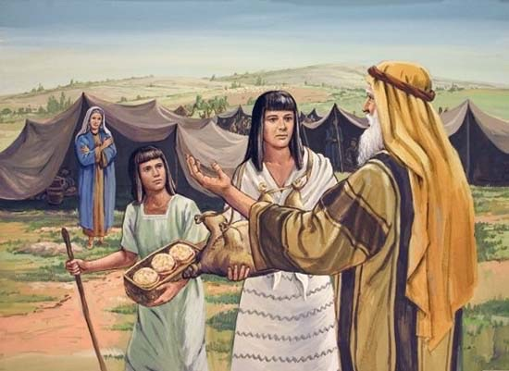
God Told Abraham to Take Hagar?
“63 But if one or either of the ten virgins, after she is espoused, shall be with another man, she has committed adultery, and shall be destroyed; for they are given unto him to multiply and replenish the earth, according to my commandment, and to fulfil the promise which was given by my Father before the foundation of the world, and for their exaltation in the eternal worlds, that they may bear the souls of men; for herein is the work of my Father continued, that he may be glorified. . . . 65 Therefore, it shall be lawful in me, if she receive not this law, for him to receive all things whatsoever I, the Lord his God, will give unto him, because she did not believe and administer unto him according to my word; and she then becomes the transgressor; and he is exempt from the law of Sarah, who administered unto Abraham according to the law when I commanded Abraham to take Hagar to wife.” (D&C 132:63, 65)

Slide 23
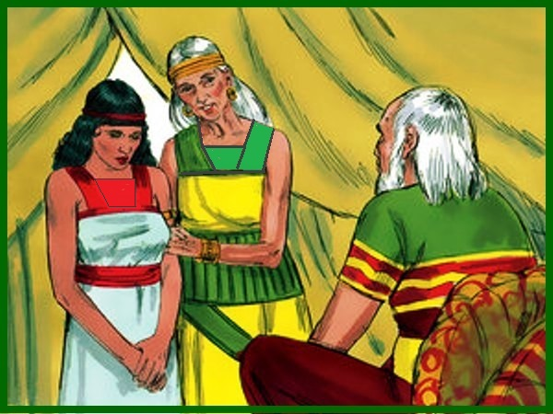
The Bible Disproves D&C 132
Gen. 16:1-4 “Now Sarai Abram's wife bare him no children: and she had an handmaid, an Egyptian, whose name was Hagar. And Sarai said unto Abram, Behold now, the Lord hath restrained me from bearing: I pray thee, go in unto my maid; it may be that I may obtain children by her. And Abram hearkened to the voice of Sarai. And Sarai Abram's wife took Hagar her maid the Egyptian, after Abram had dwelt ten years in the land of Canaan, and gave her to her husband Abram to be his wife. And he went in unto Hagar, and she conceived: and when she saw that she had conceived, her mistress was despised in her eyes”

Slide 24
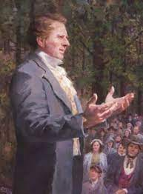
No Wonder He Said This…
“I charged the Saints not to follow the example of the adversary in accusing the brethren, and said “if you do not accuse each other God will not accuse you. If you have no accuser you will enter heaven; and if you will follow the Revelations and instructions which God gives you through me, I will take you into heaven as my back load. If you will not accuse me, I will not accuse you. If you will throw a cloak of charity over my sins, I will over yours— for charity covereth a multitude of sins. What many people call sin is not sin; I do many things to break down superstition, and I will break it down:” (History, 1838–1856, volume C-1 Addenda)

Slide 25
The Conclusion…
Evidence that Doctrines and Covenants is not of God:
“Lectures on Faith” Removed by later leadership, even though high-ranking leaders insist it is Scripture (by other LDS denominations as well)—it also contains doctrines which contradict current teachings
Updates and Revisions don’t just add, but change the meanings of former passages, always expanding Joseph Smith’s privileges and never curtailing them—even though high-ranking members say falsely that it had not been changed. Do your own research! “scripture does not change”
The D&C condemns and weakens any and all possible opposition to Joseph Smith’s power and/or desires. Oliver Cowdery’s role is weakened between 1833 vs 1835 editions. Emma is threatened with eternal death if she does not allow Joseph to cheat on her
The D&C contradicts and removes former passages– D&C 5, D&C 101 vs D&C 132
The D&C contradicts the Book of Mormon Jacob 2 vs D&C 132
The D&C is anti-family, anti-marriage, and promotes the idea that a woman’s heaven is to be an eternally pregnant concubine who shares a husband with dozens to hundred, and even thousands of other women
The D&C contradicts the Bible, Abraham Story, the Word of God does not change

Slide 26
Time-setting Again! 1975
"Choosing the Best Way of Life". The Watchtower. March 15, 1980. pp. 17–18. With the appearance of the book Life Everlasting—in Freedom of the Sons of God, ... considerable expectation was aroused regarding the year 1975. ... there were other statements published that implied that such realization of hopes by that year was more of a probability than a mere possibility. It is to be regretted that these latter statements apparently overshadowed the cautionary ones and contributed to a buildup of the expectation already initiated. ... persons having to do with the publication of the information ... contributed to the buildup of hopes centered on that date.
"What will the 1970's Bring?". Awake!. Watch Tower Society. October 8, 1968. p. 14. Does this mean that the above evidence positively points to 1975 as the complete end of this system of things? Since the Bible does not specifically state this, no man can say... If the 1970s should see intervention by Jehovah God to bring an end to a corrupt world drifting toward ultimate disintegration, that should surely not surprise us.
"How Are You Using Your Life?". Our Kingdom Ministry. May 1, 1974. p. 63. Reports are heard of brothers selling their homes and property and planning to finish out the rest of their days in this old system in the pioneer service. Certainly, this is a fine way to spend the short time remaining before the wicked world's end.

Slide 27
Decline of the Watch Tower After Death
Chicago Daily Tribune October 30, 1949 pg 18: "Pastor Russell died in 1916. In the 33 years since, the methods of this sect have deviated completely from those of Pastor Russell and his manner of teaching."

