Slide 1
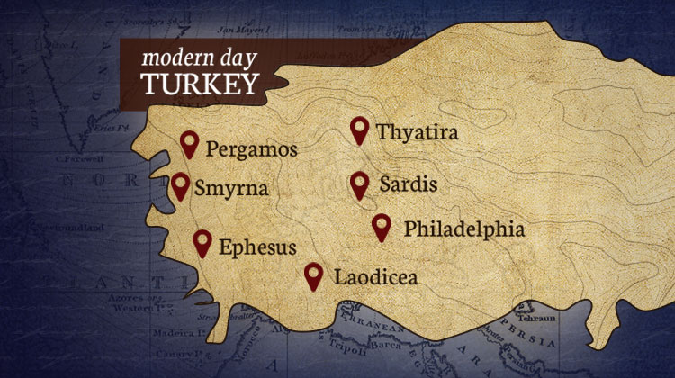
The Seven Churches pt 3: Smyrna

Slide 2
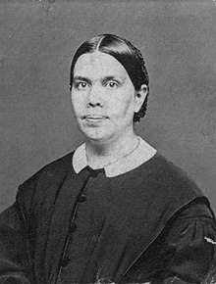
Smyrna: The Church of Persecution—Another Church of John
“The stay of Jesus in Samaria was designed to be a blessing to His disciples, who were still under the influence of Jewish bigotry. . . . After the outpouring of the Holy Spirit, they recalled the Saviour's look, His words, the respect and tenderness of His bearing toward these despised strangers. When Peter went to preach in Samaria, he brought the same spirit into his own work. When John was called to Ephesus and Smyrna, he remembered the experience at Shechem, and was filled with gratitude to the divine Teacher, who, foreseeing the difficulties they must meet, had given them help in His own example.” DA, 193, 194

Slide 3
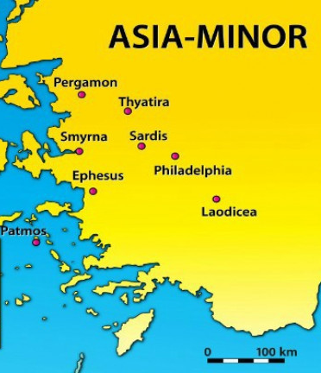
What We Will Study and How….
The Seven Churches in the Context of the Literal Seven Churches—How the messages relate to that specific Church
The Seven Churches in the Context of a time Prophecy—How the messages relate prophetically to chronological periods of Church history
The Seven Churches in the Context of Personal counsel—How the messages relate to all Christians in all periods of earth’s history

Slide 4
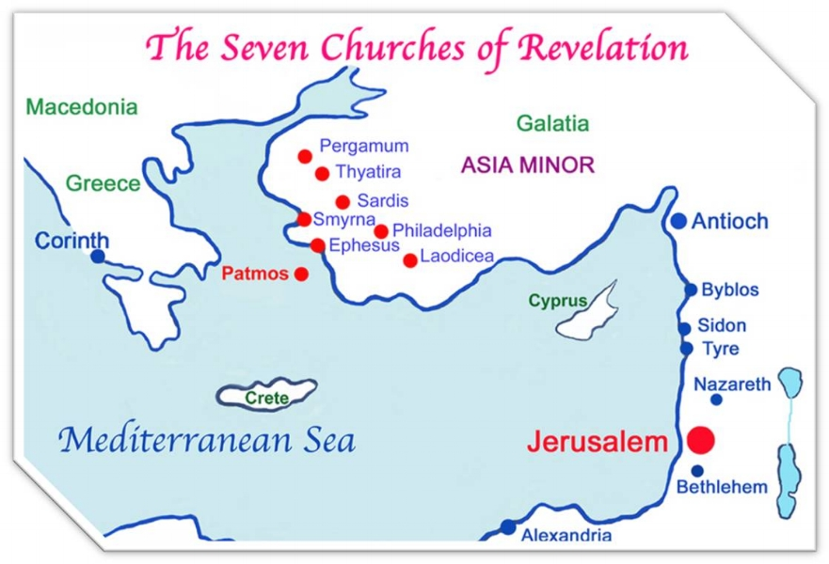
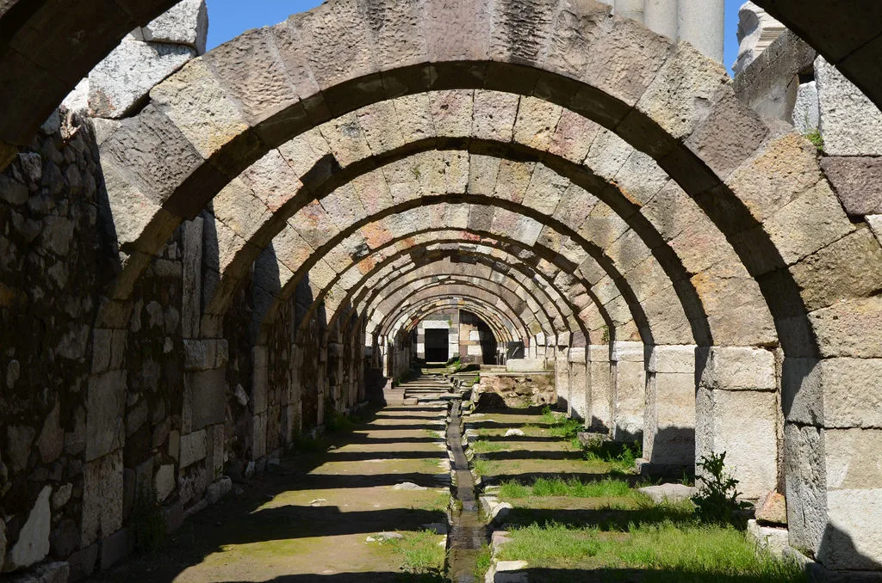
A Few Facts About Smyrna…
The Name Smyrna [today Izmir] is likely derived from their biggest export: myrrh—which they were the world leader; this incense was used in healing and burial preparations—Egypt was their biggest buyer. The scent is created by taking the gum from a Myrrh tree and crushing and bruising it which produces the fragrance—it is likely that Jesus’ burial was accompanied with myrrh from Smyrna…
Smyrna was a competing port city with Ephesus, but they also had a river [Hermus] and mountains—ships could stop in port and sail into Lydia to reach other towns.
Self-proclaimed “First in Asia” and “Crown of Asia”—their Agora [marketplace] was on a steep precipice and appeared to be and was called “The Crown of Smyrna”

Slide 5
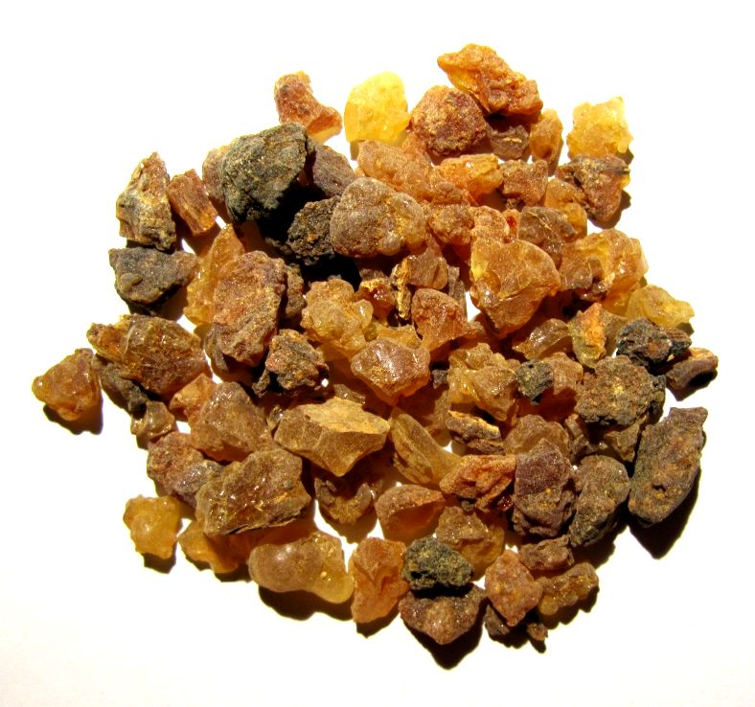
The Bible and Myrrh
Ps. 45:7-9 “Thou lovest righteousness, and hatest wickedness: therefore God, thy God, hath anointed thee with the oil of gladness above thy fellows. All thy garments smell of myrrh, and aloes, and cassia, out of the ivory palaces, whereby they have made thee glad. Kings' daughters were among thy honourable women: upon thy right hand did stand the queen in gold of Ophir.”
Song of Solomon 3:5-6 “I charge you, O ye daughters of Jerusalem, by the roes, and by the hinds of the field, that ye stir not up, nor awake my love, till he please. Who is this that cometh out of the wilderness like pillars of smoke, perfumed with myrrh and frankincense, with all powders of the merchant?”
At Christ’s Birth the Wisemen from the East gave Jesus: Gold [Faith and Character], Frankincense [Merits/Works] and Myrrh [Sacrifice/Death and Resurrection]

Slide 6
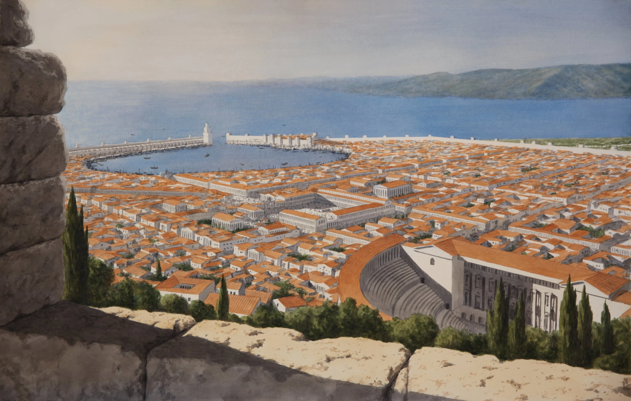
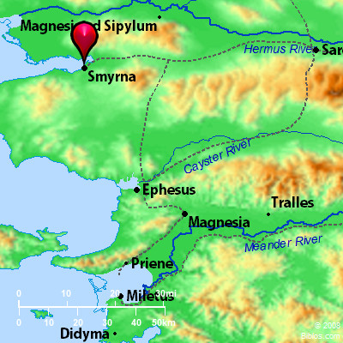
Facts Continued…
4. Ancient Smyrna was originally founded around 1100BC, became a metropolis in 600s BC, but was destroyed by the Lydian King Alyattes [609-560BC], father of Croesus [the Lydian King who fell to Persian Cyrus]—the city was so decimated that it only remained a small village… Until Alexander the Great rebuilt [resurrected] the city around the 330s-300s
5. Smyrna had a very large Jewish population for many years, especially during the Apostolic time period
6. In 197BC, Smyrna tried to break away from King Eumenes of Pergamum and join the Roman Republic; in order to gain favor they started the cult of Rome, built a temple to the goddess Roma—in 133BC King Attalus III of Pergamos, the Greek Ruler of Asia Minor, bequeathed all his territory to Rome after his death, including Smyrna
7. The Temple Roma, Temple of Tiberius, Temple of Athena (anciently) and Temple of Zeus [Olympia had main]
8. During the Mithridatic Wars, [88-85BC] Smyrna refused to the join the rebellion and remained loyal to Rome, Ephesus did not

Slide 7
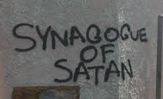
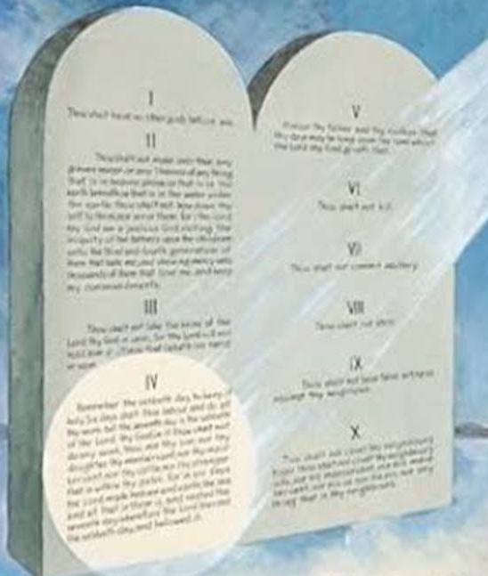
Jewish Influence & Evidence of Sabbath-Keeping!
“Asian Jewish Christianity received in turn the knowledge that henceforth the "church" would be open without hesitation to the Jewish influence mediated by Christians, coming not only from the apocalyptic traditions, but also from the synagogue with its practices concerning worship, which led to the appropriation of the Jewish passover observance. Even the observance of the sabbath by Christians appears to have found some favor in Asia...we find that in post-apostolic times, in the period of the formation of ecclesiastical structure, the Jewish Christians in these regions come into prominence. (Kraft, Bauer W.; Krodel, G., eds. (1996). Orthodoxy and Heresy in Earliest Christianity (2nd ed.). Mifflintown (PA): Sigler Press. pp. 87–89.)

Slide 8
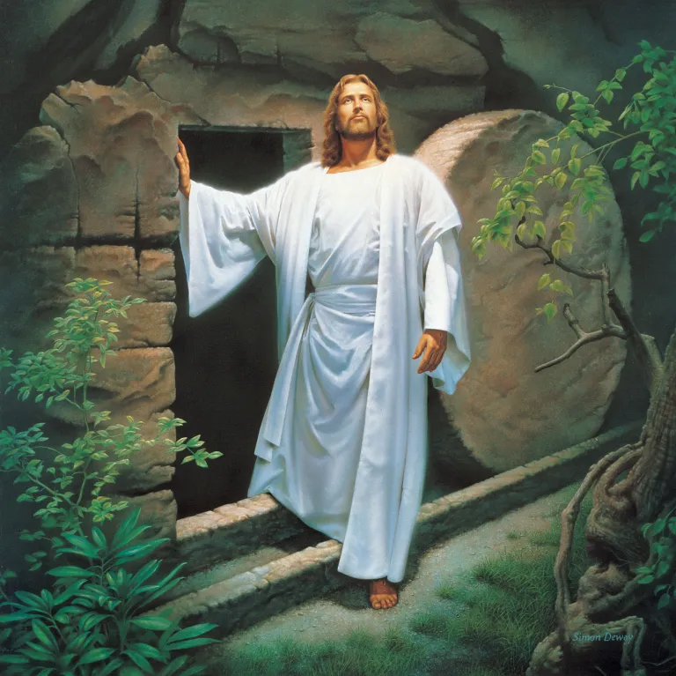
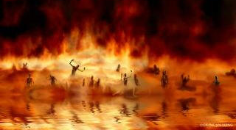
The Letter to Smyrna…
Rev. 2:8-11 “And unto the angel of the church in Smyrna write; These things saith the first and the last, which was dead, and is alive; I know thy works, and tribulation, and poverty, (but thou art rich) and I know the blasphemy of them which say they are Jews, and are not, but are the synagogue of Satan. Fear none of those things which thou shalt suffer: behold, the devil shall cast some of you into prison, that ye may be tried; and ye shall have tribulation ten days: be thou faithful unto death, and I will give thee a crown of life. He that hath an ear, let him hear what the Spirit saith unto the churches; He that overcometh shall not be hurt of the second death.”

Slide 9
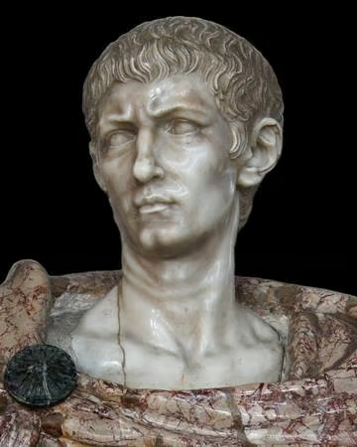
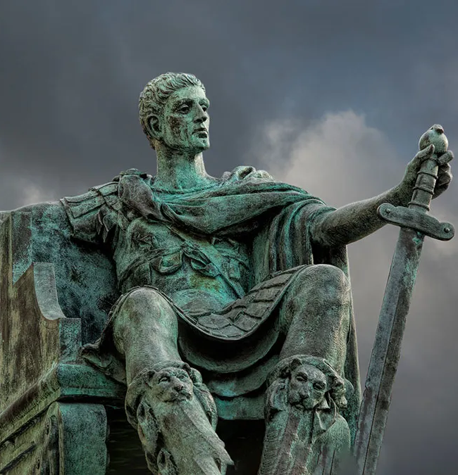
Persecution in the 2nd Church Age:
The martyrdom of Polycarp around 160AD, he was considered the “12th martyr of Smyrna”—10 can be used in a generic sense (see Ecc. 7:19; Amos 6:9; Haggai 2:16)—for literal Smyrna “10” was a generic term for a short while
Christian persecutions were off and on; many happening locally not nationally—the Christian religion was not outlawed but their practices were on many occasions
Persecutions under Marcus Aurelius (161-180AD)
Widespread Persecutions under Decian (249-251AD)
Empire-wide Persecution under Diocletian (303-313AD) (10 years!) [The Great Persecution] This was the first general persecution of Christianity, fearing that paganism would die if Christianity was allowed to continue! Edict of Serdica [311] ended the persecutions in the East, and the Edict of Milan [313] ended the persecutions in the West—by the time of the Council of Nicea, many who attended had missing arms, eyes, and limbs according to early historians

Slide 10
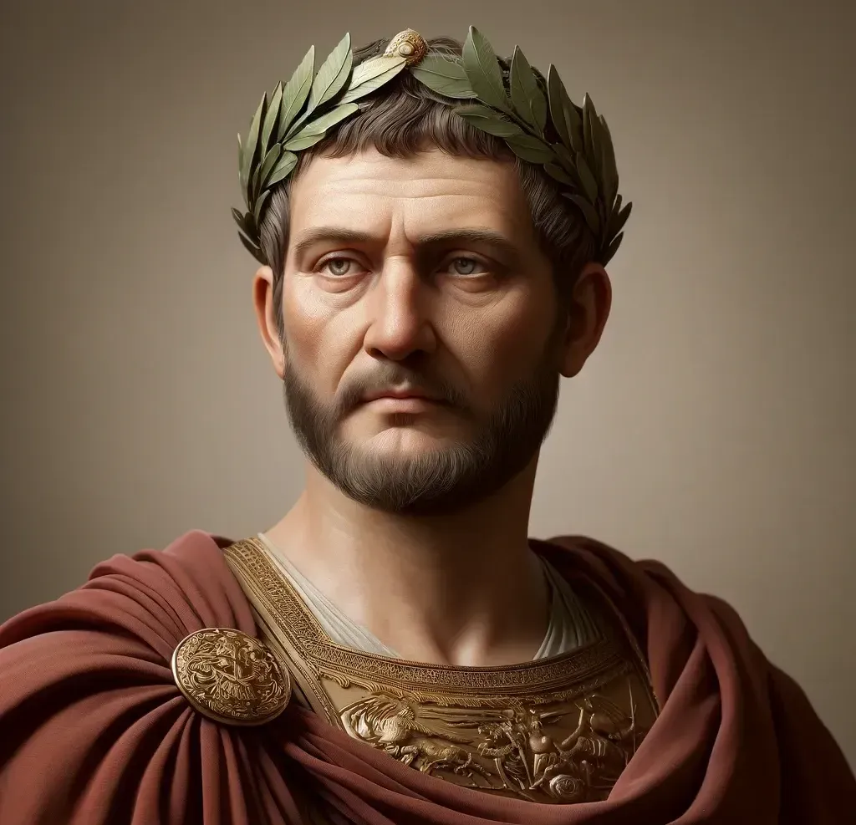
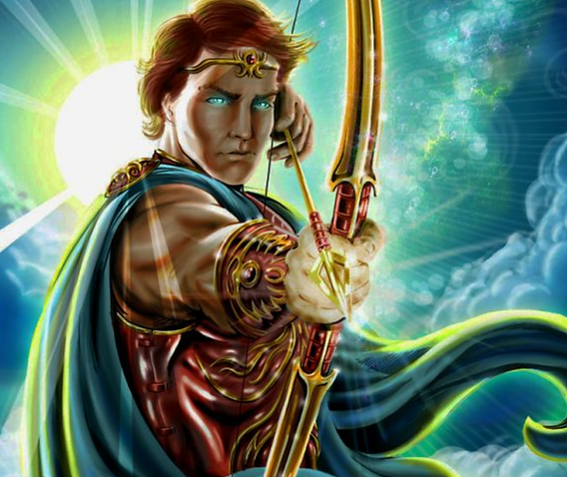
A Look At Diocletian
“Diocletian. . . was a Roman emperor (284–305 ce) who restored efficient government to the empire after the near anarchy of the 3rd century. His reorganization of the fiscal, administrative, and military machinery of the empire laid the foundation for the Byzantine Empire in the East and temporarily shored up the decaying empire in the West. The last major persecution of Christians occurred during his reign.” Encyclopaedia Britannica Online, Diocletian https://www.britannica.com/biography/Diocletian

Slide 11
Historical Backdrop of Diocletian’s Persecution!
“Diocletian's assumption of power in 284 did not mark an immediate reversal of imperial inattention to Christianity, but it did herald a gradual shift in official attitudes toward religious minorities. In the first fifteen years of his rule, Diocletian purged the army of Christians, condemned Manicheans to death, and surrounded himself with public opponents of Christianity. Diocletian's preference for activist government, combined with his self-image as a restorer of past Roman glory, foreboded the most pervasive persecution in Roman history. In the winter of 302, Galerius urged Diocletian to begin a general persecution of the Christians. Diocletian was wary and asked the oracle at Didyma [oracle of the Sun god Apollo] for guidance. The oracle's reply was read as an endorsement of Galerius's position, and a general persecution was called on February 23, 303. . . In 303, the emperors Diocletian, Maximian, Galerius, and Constantius issued a series of edicts rescinding Christians' legal rights and demanding that they comply with traditional religious practices. Later edicts targeted the clergy and demanded universal sacrifice, ordering all inhabitants to sacrifice to the gods. The persecution varied in intensity across the empire—weakest in Gaul and Britain, where only the first edict was applied, and strongest in the Eastern provinces.” (Wikipedia, Diocletianic Persecution, retrieved on 11/29/24)

Slide 12
Smyrna: A Perfect Church, Preserved by Persecution
Rev. 2:9 “I know thy works, and tribulation, and poverty, (but thou art rich)…”
“The humblest and poorest of the true disciples of Christ, who are rich in good works, are more blessed and more precious in the sight of God than the men who boast of their great riches. They are more honorable in the courts of heaven than the most exalted kings and nobles who are not rich toward God.” 2T, 682

Slide 13
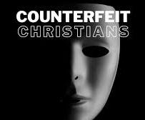
Ellen White on the Synagogue of Satan
“Christ recognized no virtue in lineage. He taught that spiritual connection supersedes all natural connection. The Jews claimed to have descended from Abraham; but by failing to do the works of Abraham, they proved that they were not his true children. Only those who prove themselves to be spiritually in harmony with Abraham by obeying the voice of God, are reckoned as of true descent. Although the beggar belonged to the class looked upon by men as inferior, Christ recognized him as one whom Abraham would take into the very closest friendship.” COL, 268

Slide 14
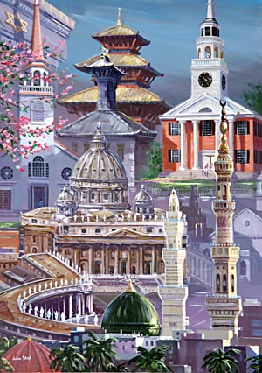
A Vision about the Synagogue of Satan!
“I saw a very large company professing the name of Christ, but God did not recognize them as His. He had no pleasure in them. Satan seemed to assume a religious character and was very willing that the people should think they were Christians. He was even anxious that they should believe in Jesus, His crucifixion, and His resurrection. Satan and his angels fully believe all this themselves, and tremble. But if this faith does not provoke to good works, and lead those who profess it to imitate the self-denying life of Christ, Satan is not disturbed; for they merely assume the Christian name, while their hearts are still carnal, and he can use them in his service even better than if they made no profession. Hiding their deformity under the name of Christian, they pass along with their unsanctified natures, and their evil passions unsubdued. This gives occasion for the unbeliever to reproach Christ with their imperfections, and causes those who do possess pure and undefiled religion to be brought into disrepute” EW, 227

Slide 15
Synagogue of Satan Reviewed…
Literal Synagogue of Satan: The Jews in the early church history who were constantly undermining the truth and working with the pagan Roman Empire to destroy Christians—they were successful in persecuting the Apostles like Paul from city to city (see Acts of the Apostles), they blamed the Fire of Rome caused by Nero on the Christians resulting in the death of Paul. They were pivotal in the martyrdom of Polycarp in Smyrna around 160AD and have a history of provoking unrest against Christians
Prophetic Synagogue of Satan: Professed Christians in during the Smyrna age who were forming under apostasy in Rome and Alexandria primarily: Marcion [85-160AD], Justin Martyr [100-165AD], Tatian [120-180AD], Clement of Alexandria [150-215AD], Origen [185-254AD], Eusebius [260-339AD], and the “Church Fathers” who began mixing Greek Philosophy with Christian doctrine and presenting it to the flocks---Heroes who stood against these insanities include: Lucian, the churches of Syria, the Celtic Churches, and Galatians:
“Lucian was really a learned man; his work on the text of the Old Testament, which he corrected from the original Hebrew, soon became famous; he was a Hebrew scholar, and his version was adopted by the greater number of the churches of Syria and Asia Minor. He occupied himself also with the New Testament. His exegesis differs widely from that of Origen. In Antioch allegorical interpretation was not in fashion” (Duchesne, Early History of the Christian Church, vol. 1, p. 362)

Slide 16
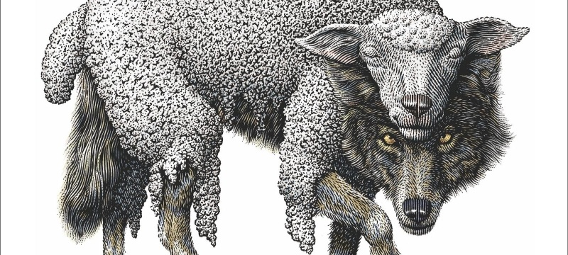
Spiritual Synagogue of Satan: False Christians in every age—especially the last!!! “As the storm approaches, a large class who have professed faith in the third angel's message, but have not been sanctified through obedience to the truth, abandon their position and join the ranks of the opposition. By uniting with the world and partaking of its spirit, they have come to view matters in nearly the same light; and when the test is brought, they are prepared to choose the easy, popular side. Men of talent and pleasing address, who once rejoiced in the truth, employ their powers to deceive and mislead souls. They become the most bitter enemies of their former brethren. When Sabbathkeepers are brought before the courts to answer for their faith, these apostates are the most efficient agents of Satan to misrepresent and accuse them, and by false reports and insinuations to stir up the rulers against them.” GC, p. 608

Slide 17
Fear None of those Things Which Thou Shalt Suffer
“I was carried forward to the time when the heathen idolaters cruelly persecuted the Christians, and killed them. Blood flowed in torrents. The noble, the learned, and the common people, were alike slain without mercy. Wealthy families were reduced to poverty because they would not yield their religion. Notwithstanding the persecution and sufferings those Christians endured, they would not lower the standard. They kept their religion pure. I saw that Satan exulted and triumphed over the sufferings of God’s people. But God looked with great approbation upon his faithful martyrs, and the Christians who lived in that fearful time were greatly beloved of him; for they were willing to suffer for his sake. Every suffering endured by them increased their reward in heaven. But although Satan rejoiced because the saints suffered, yet he was not satisfied. He wanted control of the mind as well as the body. The sufferings those Christians endured drove them closer to the Lord, and led them to love one another, and caused them to fear more than ever to offend him. Satan wished to lead them to displease God; then they would lose their strength, fortitude and firmness. Although thousands were slain, yet others were springing up to supply their place. Satan saw that he was losing his subjects, and although they suffered persecution and death, yet they were secured to Jesus Christ, to be the subjects of his kingdom, and he laid his plans to more successfully fight against the government of God, and overthrow the church. He led on those heathen idolaters to embrace part of the Christian faith. They professed to believe in the crucifixion and resurrection of Christ, without a change of heart, and proposed to unite with the followers of Jesus” Spiritual Gifts vol. 1, 103-104

Slide 18
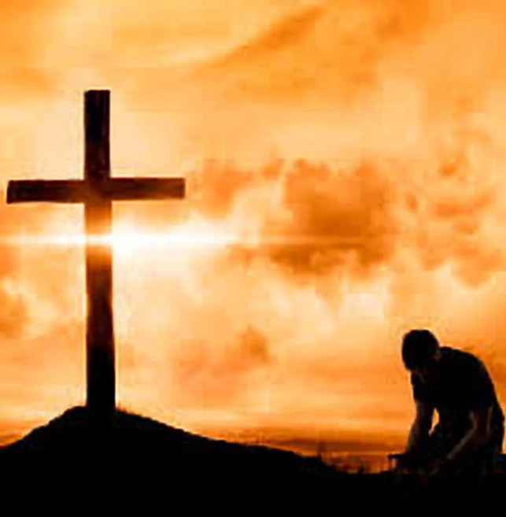
Persecution of Christians: Happens Still!
The French Inquisition (1100s-1600s)
The Spanish Inquisition (1478-1834)
St Bartholomew’s Day Massacre (1572)
Thirty Years War (1618-1648)
Irish Rebellion (1641)
Great Massacre of the Waldenses (1650 and many times earlier)
French Revolution (1789-1799) and De-Christianization
Armenian Genocide (April 24, 1915)
Massacres of Christians in Atheist Russia, China, Cambodia, Hitler during WWII
Catholic Actionist Croats kill Orthodox Serbs during WWII
Catholic Terrorism from the Irish Republican Army (IRA)
Christian persecutions by Islam, terrorists, Communism, and throughout the world…

Slide 19
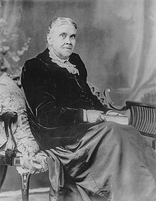
God’s Message to the Overcomer! Hang On!
“Let no man flatter himself that he is a successful man unless he preserves the integrity of his conscience, giving himself wholly to the truth and to God. We should move steadily forward, never losing heart or hope in the good work, whatever trials beset our path, whatever moral darkness may encompass us. Patience, faith, and love for duty are the lessons we must learn. Subduing self and looking to Jesus is an everyday work. The Lord will never forsake the soul that trusts in Him and seeks His aid. The crown of life is placed only upon the brow of the overcomer. There is, for everyone, earnest, solemn work for God while life lasts. As Satan’s power increases and his devices are multiplied, skill, aptness, and sharp generalship should be exercised by those in charge of the flock of God. Not only have we each a work to do for our own souls, but we have also a duty to arouse others to gain eternal life.” 5T, 70-71

