Slide 1
What is the Difference Between Mormons, Jehovah’s Witnesses, and Seventh-day Adventists? pt 29

Slide 2
Word of Caution to the Rejecters of SOP…
“If you seek to turn aside the counsel of God to suit yourselves, if you lessen the confidence of God’s people in the testimonies He has sent them, you are rebelling against God as certainly as were Korah, Dathan, and Abiram. You have their history. You know how stubborn they were in their own opinions. They decided that their judgment was better than that of Moses and that Moses was doing great injury to Israel. Those who united with them were so set in their opinions that, notwithstanding the judgments of God in a marked manner destroyed the leaders and the princes, the next morning the survivors came to Moses and said: “Ye have killed the people of the Lord.” We see what fearful deception will come upon the human mind. How hard it is to convince souls that have become imbued with a spirit which is not of God. As Christ’s ambassador, I would say to you: Be careful what positions you take. This is God’s work, and you must render to Him an account for the manner in which you treat His message.” 5T, p. 66-67
“No message on Time” (RH, Mar. 22, 1892) → 6,000 year cycle, March 2024, 2027, 2031
“The Holy Spirit is the Third Person of the Godhead” (Letter 8, 1896) → The Trinity is Catholic
“Faithful souls have constituted the church on earth” (AA, p. 11) → You must stay in the fold to be saved
“You must be perfect” (Conflict and Courage, 96) → You can never be perfect—stop trying!!!

Slide 3
Another Few Quotes
“Feast Days are no longer binding” (Ms 72, 1901) → You Have to Keep the Feast Days!!!
“The earth is a globe” (RH Aug. 15, 1899) → The earth is Flat!!!
“The Sanctuary is the foundation of our faith” (20MR, 66) → the sanctuary doctrine is outdated and unbiblical
“A Sunday Law will be the Mark of the Beast” (RH, Dec. 18, 1888) → Ellen would not write that today
“Sabbath is from sunset to sunset” (Letter 167, 1900) → NO!, you have to keep the lunar sabbaths
“Yet now when I send you a testimony of warning and reproof, many of you declare it to be merely the opinion of Sister White. You have thereby insulted the Spirit of God. You know how the Lord has manifested Himself through the spirit of prophecy.” 5T, p. 64
“While I am able to do this work, the people must have things to revive past history, that they may see that there is one straight chain of truth, without one heretical sentence, in that which I have written. This, I am instructed, is to be a living letter to all in regard to my faith.” 3SM, p. 52

Slide 4
Holy Ghost is the author of the SOP!
“The Holy Ghost is the author of the Scriptures and of the Spirit of Prophecy. These are not to be twisted and turned to mean what man may want them to mean, to carry out man’s ideas and sentiments, to carry forward man’s schemes at all hazards” 3SM, p. 30
“Doubt, and even disbelief of the testimonies of the Spirit of God, is leavening our churches everywhere. Satan would have it thus. Ministers who preach self instead of Christ would have it thus. The testimonies are unread and unappreciated. God has spoken to you. Light has been shining from His word and from the testimonies, and both have been slighted and disregarded. The result is apparent in the lack of purity and devotion and earnest faith among us” 5T, p. 217
“Jesus is not a created being” (DA, 161) → Jesus is begotten, therefore I’m Right and the prophet is confused..
“Do not try to say some parts of the Bible are inspired and some are not” (1SM, 23) → 1 John 5 was added by the Catholic Church!
“Do not cast doubt on the Testimonies, saying things have been changed” (1SM, 23) → Her writings have been changed!!

Slide 5
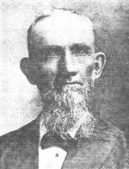
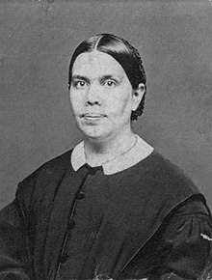
Charge: She was a Hypocrite About Health
“She forbade the eating of meat, and said, ‘Can we possibly have confidence in ministers who, at tables where flesh is served, join with others in eating it?’ (Lake Union Herald, Oct. 4, 1911), and yet secretly she herself ate meat more or less most of her life.” Dudley Canright, The Life of Ellen White, Ch. 22
It is possible, even likely, that Dudley Canright saw Ellen White eat meat. Canright came into Adventism in 1859—Ellen White did not receive her vision on health until 1863, even then the diet was to be progressive, Ellen White was a woman of principles—let’s see if those principles were ever violated…

Slide 6
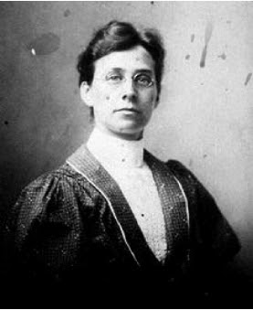
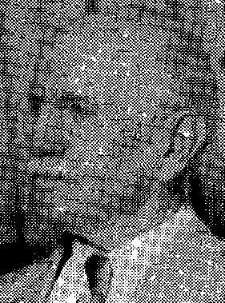
Fannie Bolton’s Charge
“At the depot Sr. White was not with her party, so Eld. Starr hunted around till he found her behind a screen in the restaurant very gratified in eating big white raw oysters with vinegar, pepper and salt” Fannie Bolton to Mrs EC Slawson, Dec. 30, 1914
“On the cars out to California, W. C. White came into the train with a great thick piece of bloody beefsteak spread out on a brown paper and he bore it through the tourist car on his two hands. Sarah McEnterfer who is now with Sr. White as her attendent, cooked it on a small oil stove and everyone ate of it except myself and Marian Davis who I found out afterwards was more the author of the books purported to be Sr. White’s than she was herself” Ibid., (see also “The Fannie Bolton Story”, p. 108)

Slide 7
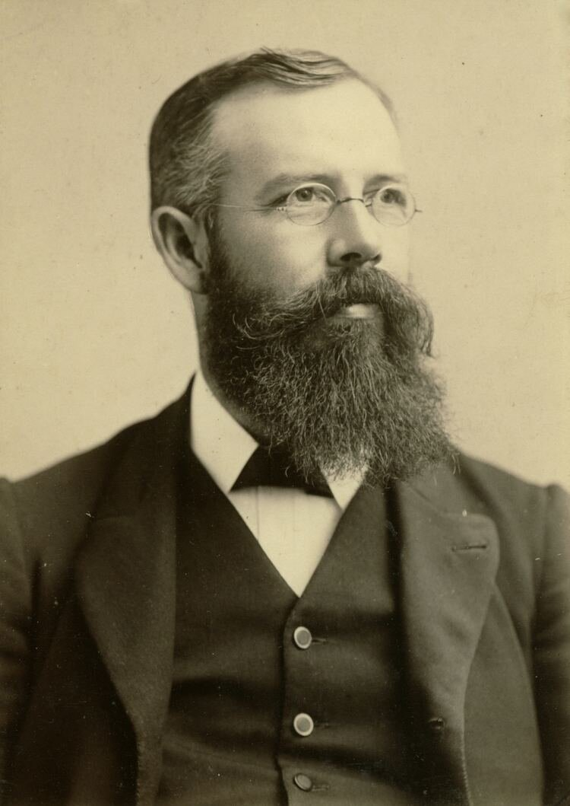
GB Starr Responds
“Regarding the letter, or statement supposed to have been made by Miss Fannie Bolton, Dec. 30, 1914, to some friend, which you enclosed, I can only say that I regard it as the most absurdly, untruthful lot of rubbish that I have ever seen or read regarding our dear Sister White. The event simply never occurred. I never saw your mother eat oysters or meat of any kind either in a restaurant or at her own table. Fannie Bolton’s statement that “Elder Starr hunted around till he found her behind a screen in the restaurant of the station where she was apparently very gratified in eating big white raw oysters with vinegar, pepper and salt,” is a lie of the first order. I never had such an experience and it is too absurd for anyone who ever knew your mother to believe. Of course you will know how true the story of the “Bloody beefstake” spread on a brown paper, and carried into the Tourist car and cooked by Miss McEnterfer, is. I do not believe that either. I think this entire letter was written by Fannie Bolton in one of her most insane moments [Fannie spent 13 mo. in a mental hospital “Kalamazoo State Hospital” from 1911-1912, and again in 1924-1925]; when the enemy of her soul and of the Testimonies of Jesus, was working her poor mind at a high pitch. I pity her and any one who will believe what she has written. When we visited Florida, in 1928, Mrs. Starr and I were told that at a camp meeting, Fannie Bolton, made a public statment that she had lied about Sr. White, and that she repented of it. We sincerely hope that she did repent and that she received entire forgiveness” GB Starr to WC White, Aug. 20, 1933

Slide 8
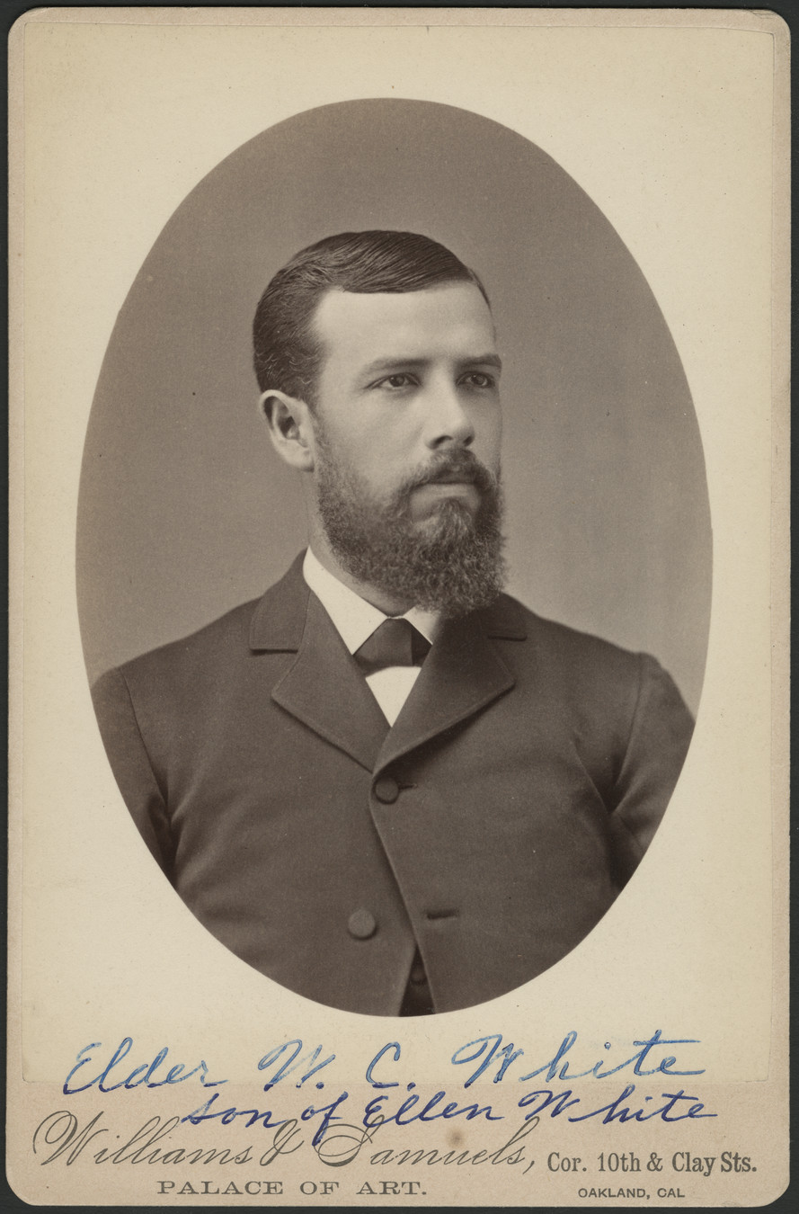
WC White Responds to Starr
“There were about 35 of us going from Battle Creek to Oakland in 1884 in two skeleton sleeping cars.... As we approached to the border line between Nevada and California it was found that our provisions were running low. Some of us were able to make good meals out of the dried things that were left in our lunch boxes, but Sister White’s appetite failed. We were in a country where fresh fruit was very expensive and so one morning at a station where our train had stopped for half an hour, I went out and purchased two or three pounds of beefsteak and this was cooked by Sister McEnterfer on an alcohol stove, and most of the members that composed Sister White’s party partook of it . . . When I bought the beefsteak, I reasoned that freshly killed ox from this cattle country, would probably be a healthy animal and that the risk of acquiring disease would be very small. This was eight or nine years before Sister White decided at the time of the Melbourne camp-meeting [1894] to be a teetotaler as regards the eating of flesh foods. You will find in Sister White’s writings several instances where she says flesh meats do not appear on our table, and this was true. During a number of years when on rare occasions a little meat was used, [it] was considered to be an emergency” WC White to GB Starr Aug. 24, 1933
Jesus and the Mustard seed vs Jewel Orchid or Bergonia seeds (Matt. 13:31-32)

Slide 9
Principles over Policy Diet Was to Be Progressive
“Let the diet reform be progressive. Let the people be taught how to prepare food without the use of milk or butter. Tell them that the time will soon come when there will be no safety in using eggs, milk, cream, or butter, because disease in animals is increasing in proportion to the increase of wickedness among men. The time is near when, because of the iniquity of the fallen race, the whole animal creation will groan under the diseases that curse our earth” Counsels on Health, p. 478
“Why do not Christians open their eyes to see the work God requires them to do? Sanctification is the progressive work of a lifetime. The Lord declares, ‘This is the will of God, even your sanctification.’ Is it your will that your desires and inclinations shall be brought into conformity to the divine will?” 4MR, p. 351

Slide 10
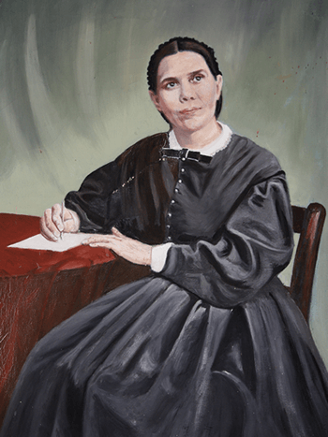
Charge: Oysters???
“Mary, if you can get a good box of herrings--fresh ones--please do so. The last ones that Willie got are bitter and old. If you can buy cans, say, half a dozen cans, of good tomatoes, please do so. We shall need them. If you can get a few cans of good oysters, get them” (Letter 16, May 31, 1882—Letter to her daughter-in-law, Mary Kelsey White)

Slide 11
Oysters Were NOT a settled Issue
One of the major issues within the health reform movement was clean vs unclean meats—what constituted unclean meats and which were ‘exceptions’ to the rule? It was a debated issue. In 1866, Canright argued against the use of pork and oysters (Health Reformer Vol. 1, Dec. 1866; Apr. 1867). In 1870, WC Gage made the argument that swine is not necessarily unclean, and one should observe the animal’s eating and habits to determine if it is unclean (Ibid. vol 4, Feb. 1870). In 1872, James White argued against the use of swine’s flesh citing Deut. 14:8 & Lev. 11. (Ibid. vol. 7, Jan. 1872). Uriah Smith argued against using the Levitical law as the reasoning for the prohibition of pork in 1883: “We believe there is better ground on which to rest [the prohibition on pork] than the ceremonial law of the former dispensation, for if we take the position that that law is still binding, we must accept it all, and then we shall have more on our hands than we can easily dispose of.” (R&H, July 3, 1883). Again in 1883, W. H. Littlejohn, in a Q&A said he was not sure whether oysters were applicable to the prohibition found in Lev. 11. (R&H Aug. 14, 1883). Even though Russel Trall, James C Jackson, & JN Loughborough had been claiming for years to stay away from oysters and other mollusks, many Adventists were not settled on this issue. WC White recalls one time when his mother was ill, she was encouraged to drink some oyster broth, which she did then refused (Arthur White, Unpublished paper, Washington, D. C., 1978).
Ellen White as a rule, as a principle did not eat meat. Sometimes emergencies made it necessary, but she followed the counsel of God and she grew over time in her understanding of health reform—which was progressive! Many health questions remained unsettled and so the Adventist grew over time. She also made mistakes in diet, things she had to overcome just like all of us. Take note of her counsel from God, not on her shortcomings as a person/Christian. Leave room for Grace!!! The only perfect person was Jesus Christ!

Slide 12
The Timeline of Dietary Progression…
1844: No Health Reform Counsel
Autumn 1848: Vision to abstain from tea, coffee, and tobacco (R&H, Nov. 8, 1870)
October 21, 1858: Counseled others to not try to force others to discontinue the use pork—God will make it clear. (1T, 206-207)
June 6, 1863: Receives counsel to abstain from pork and in general flesh foods (Manuscript 29, 1897)—this solved her fainting spells. She changed her diet at once: “I have not changed my course a particle since I adopted the health reform. I have not taken one step back since the light from heaven upon this subject first shone upon my pathway. I broke away from everything at once” (2T 371)—she still at fish in moderation.
1890: The exception--"When I could not obtain the food I needed, I have sometimes eaten a little meat; but I am becoming more and more afraid of it.” Christian Temperance and Bible Hygiene, p. 118
1894: Ellen White progresses to full abstinence: “Since the camp meeting at Brighton [January, 1894] I have absolutely banished meat from my table. It is an understanding that whether I am at home or abroad, nothing of this kind is to be used in my family, or come upon my table. I have had much representation before my mind in the night season on this subject” (Letter 76, 1895)—she’s still eating fish at this time: “Two years ago I came to the conclusion that there was danger in using the flesh of dead animals, and since then I have not used meat at all. It is never placed on my table. I use fish when I can get it. We get beautiful fish from the salt water lake near here. I use neither tea nor coffee. As I labor against these things, I cannot but practice that which I know to be best for my health, and my family are all in perfect harmony with me. You see, my dear niece, that I am telling you matters just as they are” (Letter 128, July 9, 1896).

Slide 13
Timeline Continued…
1894: Explains the Adventist position on flesh foods: “I am happy to assure you that as a denomination we are in the fullest sense total abstainers from the use of spirituous liquors, wine, beer, [fermented] cider, and also tobacco and all other narcotics . . . . All are vegetarians, many abstaining wholly from the use of flesh food, while others use it in only the most moderate degree” (Letter 99, Jan. 8, 1894).
1905: Ellen White entirely discards fish as well: “In many places fish become so contaminated by the filth on which they feed as to be a cause of disease. This is especially the case where the fish come in contact with the sewage of large cities . . . .Thus when used as food they bring disease and death on those who do not suspect the danger” (Ministry of Healing, 314-315)

Slide 14
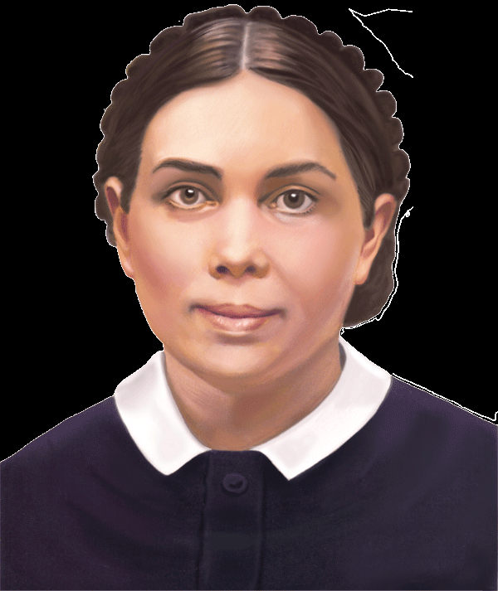
Principle over the letter of the law!
"I present these matters [health reform] before the people, dwelling upon general principles" (Manuscript 29, 1897)
I left off these things from principle. I took my stand on health reform from principle . . . I moved out from principle, not from impulse. I have advanced nothing but what I stand to today" (2T 372).
“It is reported by some that I have not followed the principles of health reform as I have advocated them with my pen; but I can say that I have been a faithful health reformer. Those who have been members of my family know that this is true” (9T 159).

Slide 15
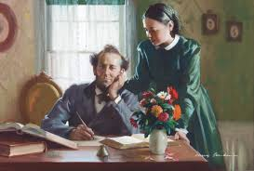
No One is a Criterion For All
“Those who understand the laws of health and who are governed by principle, will shun the extremes, both of indulgence and of restrictions. Their diet is chosen, not for the mere gratification of appetite, but for the upbuilding of the body. They seek to preserve every power in the best condition for the highest service to God and man . . . . There is a real common sense in dietetic reform. The subject should be studied broadly and deeply, and no one should criticize others because their practice is not, in all things, in harmony with his own. It is impossible to make an unvarying rule to regulate everyone's habits, and no one should think himself a criterion for all” (MH 319-320)

Slide 16
I’m Not Your Criteria for Diet Either!
“They will tell, “Sister White said this.” “Sister White ate cheese, and therefore we are all at liberty to eat cheese.” Well, who told them I ate cheese? Who told them? I never have cheese on my table. There was but one time—I was at Minneapolis—one or two times I have tasted of cheese. That is a different thing from making it a diet, entirely different thing. I have tasted of very bitter herbs on special occasions, when I would not make it a diet. But there was a special occasion in Minneapolis where that I could get nothing, and there were some little bits of cheese cut up on the table, and the brethren were there, and one of them had told me, “If you eat a little of that cheese, it will change the condition;” and I did. I took a bit of that cheese. I do not think that I touched it again the second time. Another says: “Sister White drinks tea, and you can drink tea.” Who of my brethren has ever made that statement? Who has ever heard it, to ever made it of me? I never have tea in my house, and I never set it before any one. Sister White has not had meat in her house or cooked it in any line, or any dead flesh, for years and years. And here is the health reform. “Now I have told you Sister White did not eat meat. Now I want you not to eat meat, because Sister White does not eat it.” Well, I would not give—I would not care a farthing for anything like that. If you have not got any better conviction—you won’t eat meat because Sister White does not eat any—if I am the authority, I would not give a farthing for your health reform. What I want is that every one of you should stand in your individual dignity before God, in your individual consecration to God, that the soul-temple shall be dedicated to God. “Whosoever defileth the temple of God, him will God destroy.” [Verse 17.] Now I want you to think of these things, and do not make any human being your criterion” (Manuscript 43a, 1901)

Slide 17
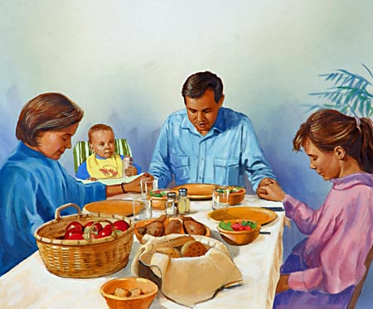
The Holy Spirit’s Counsel for Us Today
“God is trying to lead us back, step by step, to His original design—that man should subsist upon the natural products of the earth. Among those who are waiting for the coming of the Lord meat eating will eventually be done away; flesh will cease to form a part of their diet. We should ever keep this end in view and endeavor to work steadily toward it.”—Counsels on Health, 450
“Greater reforms should be seen among the people who claim to be looking for the soon appearing of Christ. Health reform is to do among our people a work which it has not yet done. There are those who ought to be awake to the danger of meat eating who are still eating the flesh of animals, thus endangering the physical, mental, and spiritual health. Many who are now only half converted on the question of meat eating will go from God’s people, to walk no more with them.”—R&H, May 27, 1902

