Slide 1
Rubicon 2022-2025

Slide 2
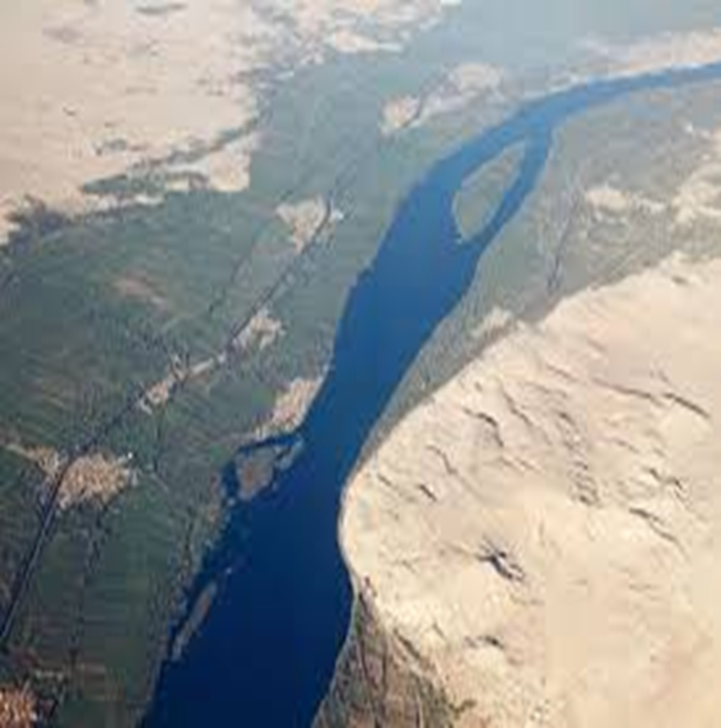
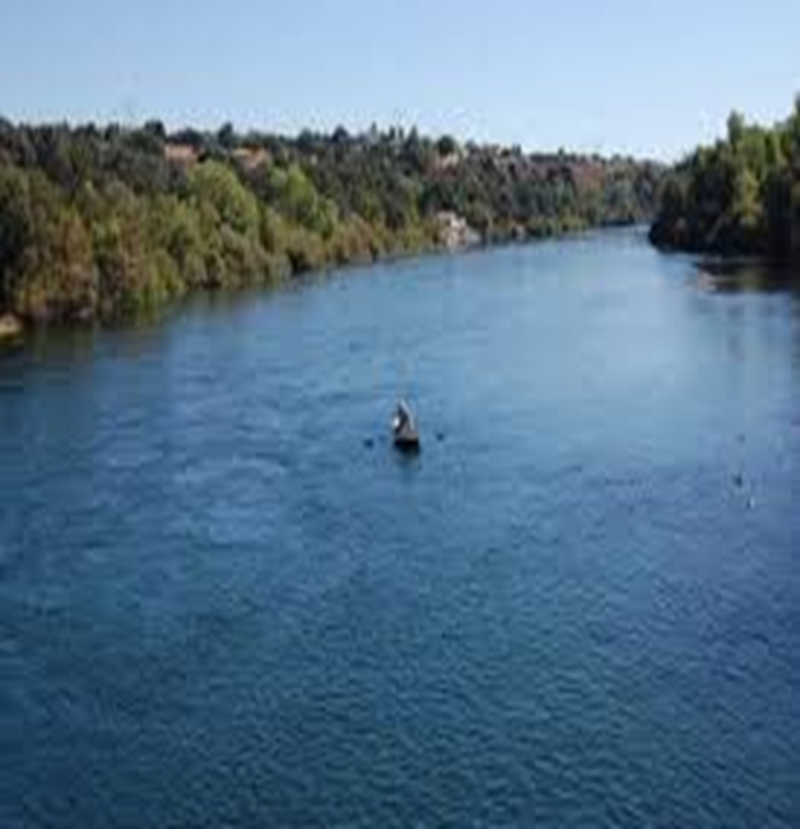
Not the Nile or…………….. the Sacramento

Slide 3
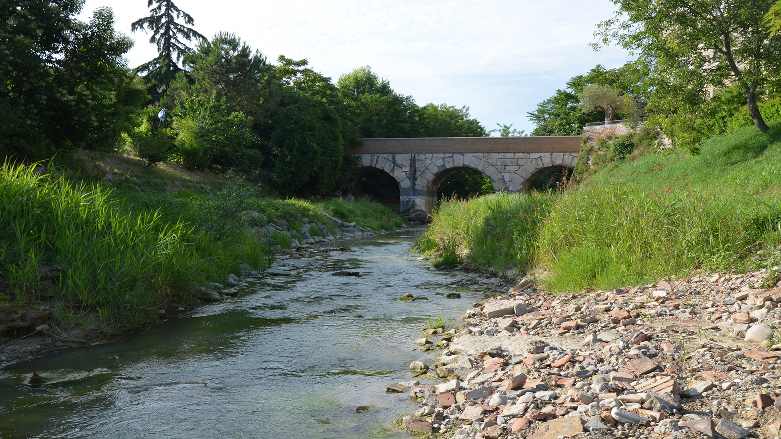
A Little Stream—the Rubicon!

Slide 4
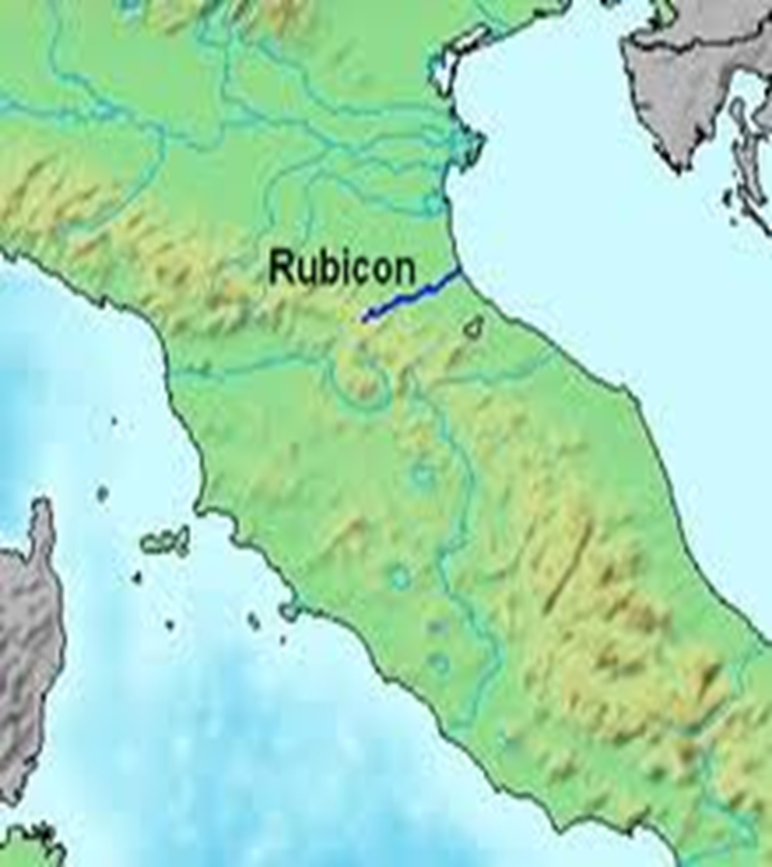
A Small Stream!
The Rubicon stream is not dramatic or mighty flowing; it is just a small stream. The Rubicon is a shallow river in northeastern Italy, just south of Ravenna. The same name was given to a river that was famously crossed by Julius Caesar in 49 BC.

Slide 5
Rubicon No Return!
During the Roman republic, the river Rubicon marked the boundary between the Roman province of Cisalpine Gaul to the north-east and Italy proper (controlled directly by Rome and its allies) to the south. Governors of Roman provinces were appointed promagistrates with imperium (roughly, "right to command") in one or more provinces. Any promagistrate who entered Italy at the head of his troops forfeited his imperium and was therefore no longer legally allowed to command troops. This was considered an act of war! Exercising imperium when forbidden by the law was a capital offence. Furthermore, obeying the commands of a general who did not legally possess imperium was a capital offence. If a general entered Italy in command of an army, both the general and his soldiers became outlaws and were automatically condemned to death. Generals were thus obliged to disband their armies before entering Italy.

Slide 6
The Die Was Cast!!
Julius Caesar paused on the banks of the Rubicon. In 49 BC, perhaps on January 10, Julius Caesar led a single legion, Legio XIII, south over the Rubicon from Cisalpine Gaul to Italy to make his way to Rome. In doing so, he (deliberately) broke the law on imperium and made armed conflict inevitable. According to Suetonius, Caesar uttered the famous phrase ālea iacta est ("the die has been cast").[2] The phrase "crossing the Rubicon" has survived to refer to any individual or group committing itself irrevocably to a risky or revolutionary course of action, similar to the modern phrase "passing the point of no return“. Caesar's subsequent victory in Caesar's Civil War ensured that he would never be punished for the infraction.

Slide 7
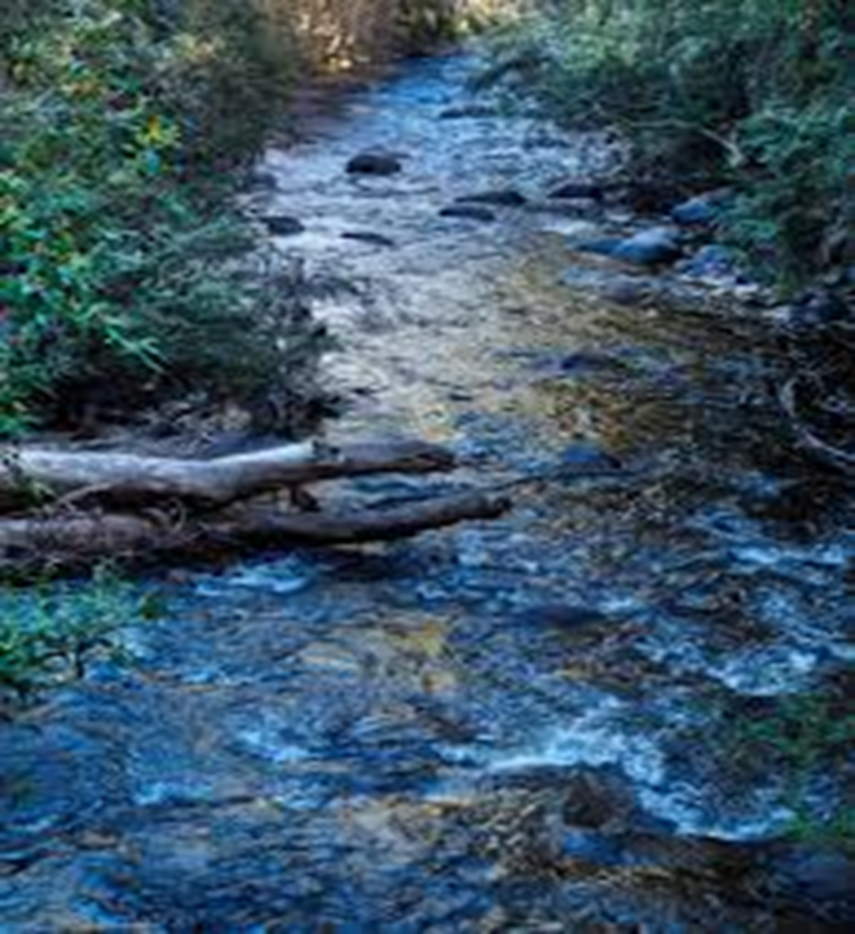
Point of No Return
The Rubicon was really a nothing little stream. But, oh, to a Roman, it was a point of no return. If Julius Caesar crossed the Rubicon, he and his men would be considered outlaws of the Roman Empire and no longer worthy of protection of Roman law. Crossing into Italy with his army, Caesar was throwing the gauntlet down and letting Pompey know that war was inevitable!

Slide 8
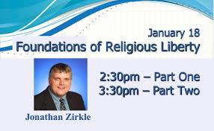
Rubicon!
The 61st General Conference Session of the Seventh-day Adventist Church was held in St. Louis, Missouri, from June 6-11, 2022. It was delayed 2 years because of CoVid 19! During these meetings, Jonathan Zirkle called for a discussion on the church’s stand during CoVid that did not protect Adventists. Many Adventists lost their jobs, their health, and confidence if church leadership. Zirkle had over 25,000 names, 2,000 delegates, and several thousand health care professionals who wanted this discussed. It was seconded!

Slide 9
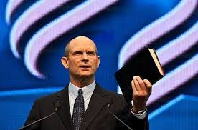
Church did not Protect the Members!
Discussion was tabled by GC president Ted Wilson! The people’s religious liberty was butchered; the church would not protect its members!! In making his position known, Wilson mentioned two men who were with him in this matter; GC treasurer Paul Douglass, and VP Erton Kohler! These three men decreed that Adventists’ liberty of conscience would not be protected now or in the future. Something else took precedent to members liberty of conscience! Rubicon!!

Slide 10

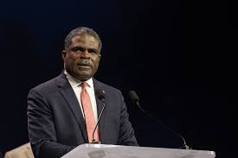
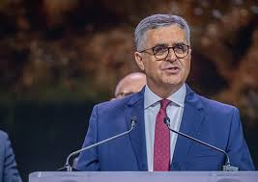

Slide 11
ADRA—UN Connection
Name Title Compensation
Josue Orellana Guevara Dir. of Health, Nutrition, & Wash $282,850
Scot Coppock Senior Director For Development $225,766
Alex Balint Senior Dir. Corporate/Social Partnership $207,049
Aykut Ozger Senior Dir., Legal Counsel For Org. $203,219
Mario Lopes de Oliveira Director For Emergency Management $202,212
Matt Siliga VP For Strategic Operations & Growth $193,770
Korey Dowling VP For People & Culture $191,953
Peter Landless Board Member $184,127
Michael Kruger Board Secretary/President $181,319
Erton C Kohler Board Member $161,868
Paul Douglas Treasurer/1st Vice Chair/Fin. Committee Chair $154,836
Gary Krause Board Member $137,016
Geoffrey Mbwana Board Chair $134,363
Ted Wilson Board Member $126,896
Audrey Andersson Second Vice Chair $121,930
Olivier Guth Through 424 Treasurer/Vp For Finance/CFO $107,004
Compensation data as of: 12/31/2024

Slide 12
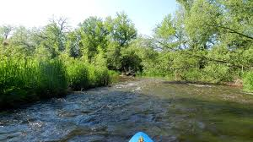
Rubicon!!
Ted Wilson, Paul Douglass, and Erton Kohler determined that their financial connection to Medicare and the United Nation’s was more important than the Adventists people’s liberty of conscience. Through the denominations connection with these groups, they personally and the denomination as a whole were raking in millions and billions of dollars. They feared that if the Adventists conscience’s were taken into account, either or both of these entities would cut off support to them and to the church; thus the people’s liberty of conscience was sacrificed and it will happen again!!

Slide 13

These 3 men agreed NOT to defend SDA’s religious liberty in time of crisis. These 3 men agreed that there was something far more important than protecting the conscientious SDA’s who couldn’t follow govt. mandates for religious-health reasons. Instead of standing with SDA’s, these 3 men decided that something else superseded hurting Adventists. For a people who have prized liberty of conscience and the stories of the faithful through the ages who would rather die than surrender their beliefs, what these 3 men did was un-Adventist, unconscionable, and a down right betrayal!!!!

Slide 14
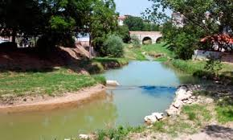
Kohler’s Election Guaranteed Repeat!!
Kohler’s election guaranteed that when liberty of conscience issues, Sunday, come, Kohler and others will protect their money flows and will sacrifice Adventists again!!
“The Lord has a controversy with his professed people in these last days. In this controversy men in responsible positions will take a course directly opposite to that pursued by Nehemiah. They will not only ignore and despise the Sabbath themselves, but they will try to keep it from others by burying it beneath the rubbish of custom and tradition. In churches and in large gatherings in the open air, ministers will urge upon the people the necessity of keeping the first day of the week. There are calamities on sea and land: and these calamities will increase, one disaster following close upon another; and the little band of conscientious Sabbath-keepers will be pointed out as the ones who are bringing the wrath of God upon the world by their disregard of Sunday.” RH, March 18,1884

Slide 15
Nehemiah Refused to Unite With the Enemies of God’s People!!!!
“And before this, Eliashib the priest, having the oversight of the chamber of the house of our God, was allied unto Tobiah: And he had prepared for him a great chamber, where aforetime they laid the meat offerings, the frankincense, and the vessels, and the tithes of the corn, the new wine, and the oil, which was commanded to be given to the Levites, and the singers, and the porters; and the offerings of the priests. But in all this time was not I at Jerusalem: for in the two and thirtieth year of Artaxerxes king of Babylon came I unto the king, and after certain days obtained I leave of the king: And I came to Jerusalem, and understood of the evil that Eliashib did for Tobiah, in preparing him a chamber in the courts of the house of God. And it grieved me sore: therefore I cast forth all the household stuff of Tobiah out of the chamber. Then I commanded, and they cleansed the chambers: and thither brought I again the vessels of the house of God, with the meat offering and the frankincense.” Nehemiah 13:4-9

