Slide 1
The Mighty Cleaver
1. 9 positive cards wanting follow up books and Bible studies.
2. Countless orders from across the world for more books.
3. 3 negative cards, calling me anything from ‘you are wacko’ to ‘you’re an idiot’ to ‘you will burn in hell for this.’
The message is either loved or hated ; the message is distinct, it has always been this way…..

Slide 2
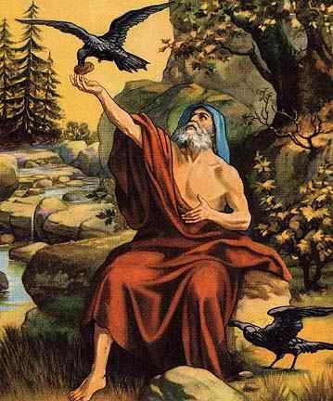
God sent a Man-Elijah #1
1. He sent him to rebuke sin in high places.
2. He sent him to warn a people asleep in sin.
3. He sent him at a time of crisis in his nation.
4. One either loved him or hated him. There was no middle ground.

Slide 3
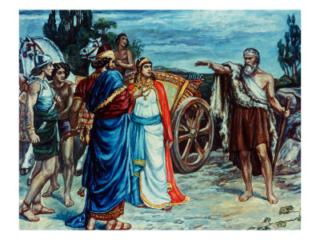
How he was Received
“So Obadiah went to meet Ahab, and told him: and Ahab went to meet Elijah. And it came to pass, when Ahab saw Elijah, that Ahab said unto him, Art thou he that troubleth Israel? And he answered, I have not troubled Israel; but thou, and thy father's house, in that ye have forsaken the commandments of the LORD, and thou hast followed Baalim.” 1 Kings 18:16-18

Slide 4
The Inside Scoop
“Though Ahab is filled with passionate hatred, yet in the presence of Elijah he seems unmanned, powerless. In his first faltering words, "Art thou he that troubleth Israel?" he unconsciously reveals the inmost feelings of his heart. Ahab knew that it was by the word of God that the heavens had become as brass, yet he sought to cast upon the prophet the blame for the heavy judgments resting on the land. It is natural for the wrongdoer to hold the messengers of God responsible for the calamities that come as the sure result of a departure from the way of righteousness. Those who place themselves in Satan's power are unable to see things as God sees them. When the mirror of truth is held up before them, they become indignant at the thought of receiving reproof. Blinded by sin, they refuse to repent; they feel that God's servants have turned against them and are worthy of severest censure. Standing in conscious innocence before Ahab, Elijah makes no attempt to excuse himself or to flatter the king. Nor does he seek to evade the king's wrath by the good news that the drought is almost over. He has no apology to offer. Indignant, and jealous for the honor of God, he casts back the imputation of Ahab, fearlessly declaring to the king that it is his sins, and the sins of his fathers, that have brought upon Israel this terrible calamity.” PK , pgs. 139,140

Slide 5
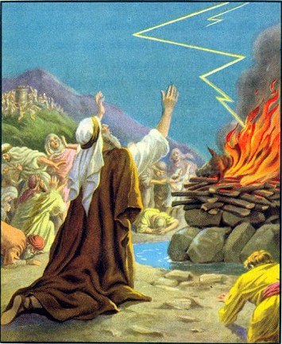
His Message was Clear………….
“So Ahab sent unto all the children of Israel, and gathered the prophets together unto mount Carmel. And Elijah came unto all the people, and said, How long halt ye between two opinions? if the LORD be God, follow him: but if Baal, then follow him. And the people answered him not a word.” 1 Kings 18:21,22

Slide 6
What are We Doing?
“Today there is need of the voice of stern rebuke; for grievous sins have separated the people from God. Infidelity is fast becoming fashionable. "We will not have this man to reign over us," is the language of thousands. Luke 19:14. The smooth sermons so often preached make no lasting impression; the trumpet does not give a certain sound. Men are not cut to the heart by the plain, sharp truths of God's word.
“There are many professed Christians who, if they should express their real feelings, would say, What need is there of speaking so plainly? They might as well ask, Why need John the Baptist have said to the Pharisees, "O generation of vipers, who hath warned you to flee from the wrath to come?" Luke 3:7. Why need he have provoked the anger of Herodias by telling Herod that it was unlawful for him to live with his brother's wife? The forerunner of Christ lost his life by his plain speaking. Why could he not have moved along without incurring the displeasure of those who were living in sin? So men who should be standing as faithful guardians of God's law have argued, till policy has taken the place of faithfulness, and sin is allowed to go unreproved. When will the voice of faithful rebuke be heard once more in the church?” PK, pgs. 140, 141

Slide 7
God Sent Another Man-Elijah #2
And his disciples asked him, saying, Why then say the scribes that Elias must first come? And Jesus answered and said unto them, Elias truly shall first come, and restore all things. But I say unto you, That Elias is come already, and they knew him not, but have done unto him whatsoever they listed. Likewise shall also the Son of man suffer of them.
Then the disciples understood that he spake unto them of John the Baptist. ‘ Matthew 17:10-13
1. He sent him to rebuke sin in high places.
2. He sent him to warn a people asleep in sin.
3. He sent him at a time of crisis in his nation.
4. One either loved him or hated him. There was no middle ground.

Slide 8
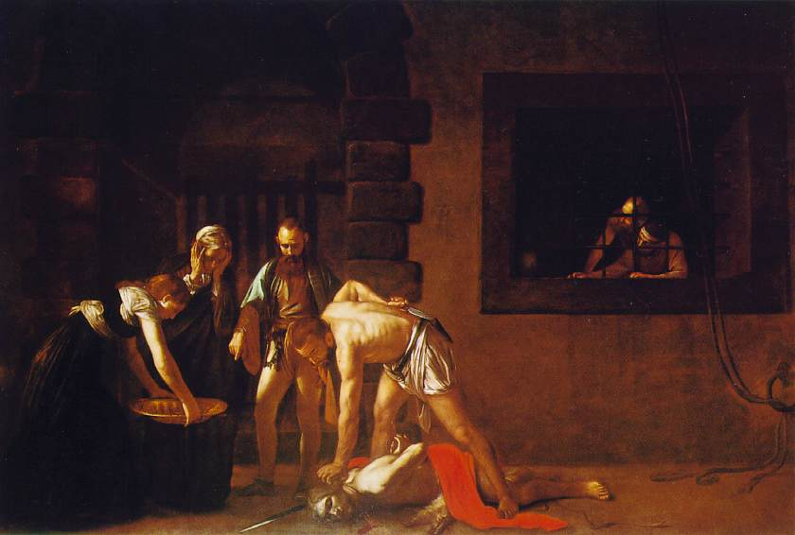
How He was Received
“For Herod himself had sent forth and laid hold upon John, and bound him in prison for Herodias' sake, his brother Philip's wife: for he had married her. For John had said unto Herod, It is not lawful for thee to have thy brother's wife. Therefore Herodias had a quarrel against him, and would have killed him; but she could not: For Herod feared John, knowing that he was a just man and an holy, and observed him; and when he heard him, he did many things, and heard him gladly. And when a convenient day was come, that Herod on his birthday made a supper to his lords, high captains, and chief estates of Galilee; And when the daughter of the said Herodias came in, and danced, and pleased Herod and them that sat with him, the king said unto the damsel, Ask of me whatsoever thou wilt, and I will give it thee. …And she went forth, and said unto her mother, What shall I ask? And she said, The head of John the Baptist. And she came in straightway with haste unto the king, and asked, saying, I will that thou give me by and by in a charger the head of John the Baptist.” Mark 6:17-25

Slide 9
The Inside Scoop
“The tall reeds that grew beside the Jordan, bending before every breeze, were fitting representatives of the rabbis who had stood as critics and judges of the Baptist's mission. They were swayed this way and that by the winds of popular opinion. They would not humble themselves to receive the heart-searching message of the Baptist, yet for fear of the people they dared not openly oppose his work. But God's messenger was of no such craven spirit. The multitudes who were gathered about Christ had been witnesses to the work of John. They had heard his fearless rebuke of sin. To the self-righteous Pharisees, the priestly Sadducees, King Herod and his court, princes and soldiers, publicans and peasants, John had spoken with equal plainness. He was no trembling reed, swayed by the winds of human praise or prejudice. In the prison he was the same in his loyalty to God and his zeal for righteousness as when he preached God's message in the wilderness. In his faithfulness to principle he was as firm as a rock.’ DA, pg. 218

Slide 10
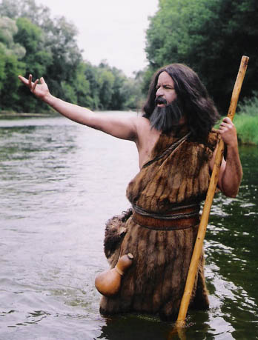
John’s message was clear
“He saw his people deceived, self-satisfied, and asleep in their sins. He longed to rouse them to a holier life. The message that God had given him to bear was designed to startle them from their lethargy, and cause them to tremble because of their great wickedness. Before the seed of the gospel could find lodgment, the soil of the heart must be broken up. Before they would seek healing from Jesus, they must be awakened to their danger from the wounds of sin. God does not send messengers to flatter the sinner. He delivers no message of peace to lull the unsanctified into fatal security. He lays heavy burdens upon the conscience of the wrongdoer, and pierces the soul with arrows of conviction. The ministering angels present to him the fearful judgments of God to deepen the sense of need, and prompt the cry, "What must I do to be saved?" Then the hand that has humbled in the dust, lifts up the penitent. The voice that has rebuked sin, and put to shame pride and ambition, inquires with tenderest sympathy, "What wilt thou that I shall do unto thee?" DA, pgs. 103,104

Slide 11
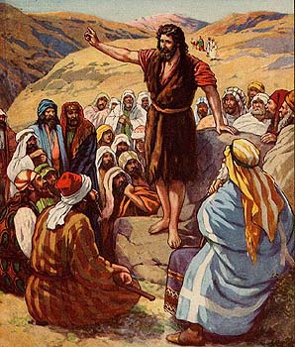
You Either Loved him or…………..
“But when he saw many of the Pharisees and Sadducees come to his baptism, he said unto them, O generation of vipers, who hath warned you to flee from the wrath to come? Bring forth therefore fruits meet for repentance: And think not to say within yourselves, We have Abraham to our father: for I say unto you, that God is able of these stones to raise up children unto Abraham. And now also the axe is laid unto the root of the trees: therefore every tree which bringeth not forth good fruit is hewn down, and cast into the fire. I indeed baptize you with water unto repentance: but he that cometh after me is mightier than I, whose shoes I am not worthy to bear: he shall baptize you with the Holy Ghost, and with fire:” Matthew 3:7-11

Slide 12
What Message are we Giving?
‘So men who should be standing as faithful guardians of God's law have argued, till policy has taken the place of faithfulness, and sin is allowed to go unreproved. When will the voice of faithful rebuke be heard once more in the church?
"Thou art the man." 2 Samuel 12:7. Words as unmistakably plain as these spoken by Nathan to David are seldom heard in the pulpits of today, seldom seen in the public press. If they were not so rare, we should see more of the power of God revealed among men. The Lord's messengers should not complain that their efforts are without fruit until they repent of their own love of approbation and their desire to please men, which leads them to suppress truth.
Those ministers who are men pleasers, who cry, Peace, peace, when God has not spoken peace, might well humble their hearts before God, asking pardon for their insincerity and their lack of moral courage. It is not from love for their neighbor that they smooth down the message entrusted to them, but because they are self-indulgent and ease-loving. True love seeks first the honor of God and the salvation of souls. Those who have this love will not evade the truth to save themselves from the unpleasant results of plain speaking. When souls are in peril, God's ministers will not
consider self, but will speak the word given them to speak, refusing to excuse or palliate evil. Would that every minister might realize the sacredness of his office and the holiness of his work, and show the courage that Elijah showed!” PK, pgs. 141,142

Slide 13
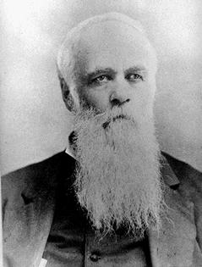

God Tried to Send Another Men!

Slide 14
There Would be an Elijah #3
“Behold, I will send you Elijah the prophet before the coming of the great and dreadful day of the LORD: And he shall turn the heart of the fathers to the children, and the heart of the children to their fathers, lest I come and smite the earth with a curse.” Malachi 4:5,6
1. Someone would come to prepare the way for Christ’s Second Coming.
2. Someone would tell people to get off the fence of compromise.
3. Someone would accept God’s call and do His bidding.
4. The 3rd Elijah is a woman!

Slide 15
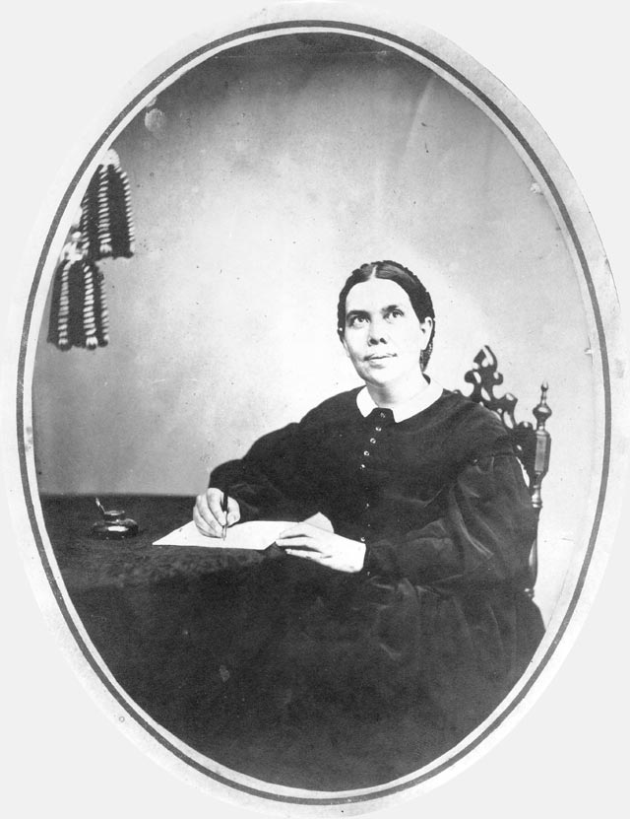
What did you say?

Slide 16
How has Elijah number 3 been Received
“This is the reason that men and women do not always see their errors and mistakes, even when these are pointed out to them. They claim to believe the testimonies that come to them, until the message comes that they must change their plans and methods, that their character-building must be altogether different, else the storm and tempest will sweep it from its foundation. Then the enemy tempts them to justify themselves.
After reading this message, you will doubtless be tempted to say, "This is not so. I am not as I am represented here. Someone has filled Sister White's mind with a mass of trash about me." But I tell you in the name of the Lord that the words of this writing are from God. If you choose thus to dispose of the matter, you show the measure of your faith in the work that the Lord has given His servant to do.
The Portions Condemning Favorite Indulgences. --There are some professed believers who accept certain portions of the testimonies as the message of God, while they reject those portions which condemn their favorite indulgences. Such persons are working contrary to their own welfare and the welfare of the
church. It is essential that we walk in the light while we have the light.
Trifling With the Messages.--Frequently I do not anticipate saying the things I do say when I am speaking before the people. God may give me words of reproof, of warning, or encouragement as He sees fit, for the benefit of souls. I shall speak these words, and they may cut across the track of my brethren, whom I sincerely love and respect in the truth.
I expect to have these words distorted, misapprehended by unbelievers, and it is no surprise to me. But to have my brethren, who are acquainted with my mission and my work, trifle with the message that God gives me to bear, grieves His Spirit.” 3SM pgs, 80,81

Slide 17
She cleared the Fence
“I know thy works, that thou art neither cold nor hot: I would thou wert cold or hot. So then because thou art lukewarm, and neither cold nor hot, I will spue thee out of my mouth. Because thou sayest, I am rich, and increased with goods, and have need of nothing; and knowest not that thou art wretched, and miserable, and poor, and blind, and naked:
I counsel thee to buy of me gold tried in the fire, that thou mayest be rich; and white raiment, that thou mayest be clothed, and that the shame of thy nakedness do not appear; and anoint thine eyes with eyesalve, that thou mayest see.
As many as I love, I rebuke and chasten: be zealous therefore, and repent. “ Revelation 3:15-19

Slide 18
She has been/is being Butchered
In all my years as a an SDA, I’ve never seen someone so maligned and attacked than Ellen White.
There are a few reasons why.
1. Many have never read her books.
2. Many have had their pet indulgences pointed out and they don’t like it.
Her writings simply point us to our great need of Christ.

Slide 19
An Example
"Although it is true that there was a period in the life of the Seventh-day Adventist Church when the denomination took a distinctly anti-Roman Catholic viewpoint...that attitude on the church's part was nothing more than a manifestation of widespread anti-popery among conservative Protestant denominations in the early part of this century and the latter part of the last, and which has now been consigned to the historical trash heap so far as the Seventh-day Adventist Church is concerned." (Neal C. Wilson, past president of the Seventh-day Adventist General Conference, Court Transcript of United States vs the Seventh-day Adventist Church, Equal Employment Opportunity Commission vs the Pacific Press Publishing Association and the General Conference, Reply Brief for Defendants, p 4, Civil Case #74-2025 CBR, presided over by Judge Charles B. Renfrew, U.S. District Court, San Francisco, California, 1974-1975.)

Slide 20
Another
William Johnson-Editor-Adventist Review-1994,1995 ‘Saints Victory in the End-time’ “To interpret the sea monster of Revelation 13 as the papacy seems somewhat out of keeping with the spirit of the times. In an age when Christianity in general faces the onslaughts of secularism and when among Christians ecumenism has become popular, the interpretation smacks of narrowness and bigotry.” Shocking………………………………………

Slide 21
One More
Associate Editor of the Review, Myron Widmer “I was surprised and delighted to learn that the Bible is the sole textbook during the pope’s visit and the World Youth Day activities. What a wonderful opportunity fro so many young people to hear the gospel message straight from God’s Word…Or might a better understanding be that God is working through this pope to open doors for Catholics to the great truths of Scripture concerning salvation by faith in Christ?”…I can only wonder if in these last days He is using some very unexpected sources to encourage many individuals (especially Catholics) in search for truth.” Review and Herald, September 9,23,and 30, 1993

Slide 22
Elijah has Children
"In the Spirit and Power of Elias"
Through the long centuries that have passed since Elijah's time, the record of his lifework has brought inspiration and courage to those who have been called to stand for the right in the midst of apostasy. And for us, "upon whom the ends of the world are come" (1 Corinthians 10:11), it has special significance. History is being repeated. The world today has its Ahabs and its Jezebels. The present age is one of idolatry, as verily as was that in which Elijah lived. No outward shrine may be visible; there may be no image for the eye to rest upon; yet thousands are following after the gods of this world--after riches, fame, pleasure, and the pleasing fables that permit man to follow the inclinations of the unregenerate heart. Multitude have a wrong conception of God and His attributes, and are as truly serving a false god as were the worshipers of Baal. Many even of those who claim to be Christians have allied themselves with influences that are unalterably opposed to God and His truth. Thus they are led to turn away from the divine and to exalt the human.” PK 177, 178

Slide 23
Cont.
“The prevailing spirit of our time is one of infidelity and apostasy--a spirit of avowed illumination because of a knowledge of truth, but in reality of the blindest presumption. Human theories are exalted and placed where God and His law should be. Satan tempts men and women to disobey, with the promise that in disobedience they will find liberty and freedom that will make them as gods. There is seen a spirit of opposition to the plain word of God, of idolatrous exaltation of human wisdom above divine revelation. Men have allowed their minds to become so darkened and confused by conformity to worldly customs and influences that they seem to have lost all power to discriminate between light and darkness, truth and error. So far have they departed from the right way that they hold the opinions of a few philosophers, so-called, to be more trustworthy than the truths of the Bible. The entreaties and promises of God's word, its threatenings against disobedience and idolatry--these seem powerless to melt their hearts. A faith such as actuated Paul, Peter, and John they regard as old-fashioned, mystical, and unworthy of the intelligence of modern thinkers.” PK 178

Slide 24
Our Message-the Cleaver
In this day, God has called His church, as He called ancient Israel, to stand as a light in the earth. By the mighty cleaver of truth,--the messages of the first, second, and third angels,--He has separated a people from the churches and from the world, to bring them into a sacred nearness to Himself. He has made them the depositories of His law, and has committed to them the great truths of prophecy for this time. Like the holy oracles committed to ancient Israel, these are a sacred trust to be communicated to the world.
Prophecy declares that the first angel would make his announcement to "every nation, and kindred, and tongue, and people." The warning of the third angel, which forms a part of the same threefold message, and is the message for this time, will be no less widespread. The banner on which is inscribed, "The commandments of God and the faith of Jesus," is to be raised aloft. The power of the first and second messages is to be intensified in the third. It is represented in the prophecy as being proclaimed with a loud voice by an angel flying in the midst of heaven, and it will command the attention of the world.
The most fearful threatening ever addressed to mortals is contained in the third angel's message. That must be a terrible sin which calls down the wrath of God unmingled with mercy. But men are not left in darkness concerning this important matter; the warning against the worship of the beast and his image is to be given to the world before the visitation of God's judgments, that all may know why the judgments are inflicted, and may have opportunity to escape.“ST, January 25, 1910

Slide 25
A Dividing Message
“In the issue of the contest, all Christendom will be divided into two great classes, -- those who keep the commandments of God and the faith of Jesus, and those who worship the beast and his image, and receive his mark. Although church and state will unite their power to compel "all, both small and great, rich and poor, free and bond," to receive "the mark of the beast," yet the true people of God will not receive it. The prophet of Patmos beholds "them that had gotten the victory over the beast, and over his image, and over his mark, and over the number of his name, stand on the sea of glass, having the harps of God," and singing the "song of Moses the servant of God, and the song of the Lamb.
The third angel's message increases in importance as we near the close of this earth's history. It is the last offer of mercy to the world, the most solemn message ever given to mortals. In heaven there is a record kept of the impieties of nations, of families, of individuals. God may bear long while the account goes on; calls to repentance and offers of pardon may be given; yet a time will come when the account will be full, when the soul's decision will have been made, when by his own choice man's destiny will have been fixed. Then the signal will be given for judgment to be executed.”ST, January 25, 1910

Slide 26
Our Work is Clear
“So long have men worshiped human opinions and human institutions that almost the whole world is following after idols. And he who has endeavored to change God's law is using every deceptive artifice to induce men and women to array themselves against God and against the sign by which the righteous are known. But the Lord will not always suffer His law to be broken and despised with impunity. There is a time coming when "the lofty looks of man shall be humbled, and the haughtiness of men shall be bowed down, and the Lord alone shall be exalted in that day." Isaiah 2:11. Skepticism may treat the claims of God's law with jest, scoffing, and denial. The spirit of worldliness may contaminate the many and control the few, the cause of God may hold its ground only by great exertion and continual sacrifice, yet in the end the truth will triumph gloriously.
In the closing work of God in the earth, the standard of His law will be again exalted. False religion may prevail…

Slide 27
Continued
…iniquity may abound, the love of many may wax cold, the cross of Calvary may be lost sight of, and darkness, like the pall of death, may spread over the world; the whole force of the popular current may be turned against the truth; plot after plot may be formed to overthrow the people of God; but in the hour of greatest peril the God of Elijah will raise up human instrumentalities to bear a message that will not be silenced. In the populous cities of the land, and in the places where men have gone to the greatest lengths in speaking against the Most High, the voice of stern rebuke will be heard. Boldly will men of God's appointment denounce the union of the church with the world. Earnestly will they call upon men and women to turn from the observance of a man-made institution to the observance of the true Sabbath. "Fear God, and give glory to Him," they will proclaim to every nation; "for the hour of His judgment is come: and worship Him that made heaven, and earth, and the sea, and the fountains of waters. . . . If any man worship the beast and his image, and receive his mark in his forehead, or in his hand, the same shall drink of the wine of the wrath of God, which is poured out without mixture into the cup of His indignation." Revelation 14:7-10.” PK, pgs. 187,188

