Slide 1
Stalin ‘Uncle Joe’

Slide 2
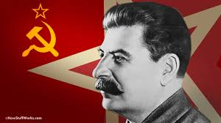
Bolshevik Bloodhound
So much speculation surrounds this bloody man of Moscow. That many people died during his rule is without question. Exactly how many remains uncertain.
His early upbringing is also widely disputed. Some say his dad was rich and others say he was poor. Some say his father was a priest; others say he was a cobbler. Due to these wide discrepancies, we will not look in detail at his early years. About the first thing every historian agrees on is his college education at Tiflis Orthodox University! It was controlled by the Jesuits!!

Slide 3
Stalin Trained by the Jesuits at Tiflis
“Msgr. Gregory Agagianian, Patriarch of the Catholic Rite of the Armenian Church [was elevated by the ex-Jesuit Pope Pius XI] to the Patriarchate in 1937, a post which he held for 25 years thereafter . . . In 1946, anti-Communist Pope Pius XII made him a Cardinal . . . Cardinal Agagianian was expected to play a major role during the developing Cold War . . . The reason was that Agagianian was the top expert on the Soviet Union, Communism, and the Orthodox Church; . . . He was of Armenian origin, but a Georgian by birth. He had known Communism at first hand, having lived three difficult years as a young priest in Tiflis, Georgia, whilst the Bolshevist Revolution was raging. He spoke fluent Russian . . . Agagianian was also considered very special by Stalin himself [as both Josef Stalin had been educated by, and Gregory Rasputin had been advised by the rector of the Order’s “Orthodox” Tiflis Theological Seminary—Jesuit Spiritual Coadjutor and Orthodox Bishop Hermogen], the Cardinal having had the dubious distinction of attending the same Jesuit seminary [though “Russian Orthodox” in name] in Georgia as Stalin had done. This was a small, but significant, fact, . . .” {37} [Emphasis added] Murder in the Vatican (pp. 25, 26) by Avro Manhattan

Slide 4
Confirmation
Another source giving testament to Tiflis being under the Jesuits comes from Joseph Stalin; a Short Biography by G. F. Alexandrov published 1947:
The Jesuitical regime that reigned in the seminary aroused in Stalin a burning sense of protest and strengthened his revolutionary sentiments. At the age of fifteen Stalin became a revolutionary. And finally from Stalin himself:
Stalin himself openly admitted the Jesuit control of the institution in his famous interview with Jewish Journalist Emil Ludwig (Cohen):
Ludwig: What impelled you to become an oppositionist? Was it, perhaps, bad treatment by your parents?
Stalin: No. My parents were uneducated, but they did not treat me badly by any means. But it was a different matter at the Orthodox theological seminary which I was then attending. In protest against the outrageous regime and the Jesuitical methods prevalent at the seminary, I was ready to become, and actually did become, a revolutionary, a believer in Marxism as a really revolutionary teaching. Ludwig: But do you not admit that the Jesuits have good points?
Stalin: Yes, they are systematic and persevering in working to achieve sordid ends. Hut their principal method is spying, prying, worming their way into people’s souls and outraging their feelings. What good can there be in that? For instance, the spying in the hostel. At nine o’clock the bell rings for morning tea, we go to the dining-room, and when we return to our rooms we find that meantime a search has been made and all our chests have been ransacked…. What good point can there be in that?
The Jesuit Generals rule through provincial government the article did not say the Jesuit General himself was in Russia, his subordinates however, were.

Slide 5
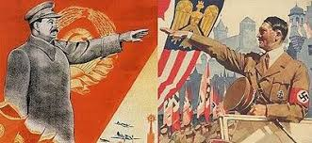
Jesuit Killer!
Stalin would take what he learned from the Jesuits at Tiflis University and become a Marxist/Communist for the rest of his life. He used his Communistic leanings to fulfill the purposes of the Jesuits all over the world!

Slide 6
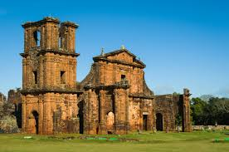
It was on the Reductions of Paraguay that the principles of Marxism/Communism were perfected. These principles, the Jesuits then incorporated into Russia, China, and much of the world. These were the principles Stalin was taught at Tiflis and that he instituted into Russia following the death of Lenin!

Slide 7
Communism is the Jesuits Political Plan
“The principles of socialism or communism—very much as now understood—governed all the Reductions. Everything necessary to the material comfort and prosperity of the Indians was in common. Each family had a portion of land set apart for cultivation. They also learned trades, and many of them, both men and women, became experts. But the earnings of the whole were deposited in common storehouses at each Reduction, and distributed by the Jesuits in such portions to each individual as necessity required. "Even meat was portioned from the public slaughter-houses in the same way." The surplus produce remaining after these distributions was sent to Europe, and sold or exchanged for wares and merchandise, solely at the discretion of the Jesuits. Everything was conducted in obedience to them, and nothing contrary to their orders was tolerated. Rigid rules of conduct and hours of labor were prescribed, and the violators of them were subject to corporal punishment. Houses of worship, colleges, and palatial residences for the Jesuit fathers, were built by the common labor and at the expense of the common treasury. Suffrage was universal; but "the sanction of the Jesuits was necessary to the validity of the election." In fact, says Nicolini, "the Jesuits substituted themselves for the State or community"[100]—a fact which fully establishes the monarchical and theocratic character of the Government.” Thompson, Footprints of the Jesuits, pgs. 176,177

Slide 8
Stalin’s Life Work!
“Ye shall know them by their fruits. Do men gather grapes of thorns, or figs of thistles? Even so every good tree bringeth forth good fruit; but a corrupt tree bringeth forth evil fruit. A good tree cannot bring forth evil fruit, neither can a corrupt tree bring forth good fruit. Every tree that bringeth not forth good fruit is hewn down, and cast into the fire. Wherefore by their fruits ye shall know them.” Matthew 7:16-20

Slide 9
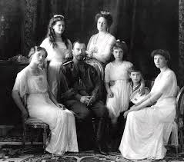
Before Stalin and the Jesuits could create a Communistic regime in Russia, the Romanov family, that had ruled Russia for centuries had to be removed. Alexander I, Alexander II, and Nicholas had all sought to bring about constitutional reforms in Russia. These the Jesuits could not tolerate. All three of these rulers had assassination attempts made on their lives. Each one was killed prematurely by the Jesuits who hated them. Stalin was one of the many Jesuit puppets that wanted the czarist system destroyed!

Slide 10
Attacks on the Romanov’s
“The Russian emperor, Alexander, was currently compelled to issue a royal decree in 1816, by which he expelled them [the Jesuits] from St. Petersburg and Moscow. This proving ineffectual, he issued another in 1820, excluding them entirely from the Russian dominions. — R.W. Thompson, The Footprints of the Jesuits, Hunt and Eaton, pp. 245, 246.
Five years later, Alexander was poisoned to death. The Czars were under Jesuit attack. Alexander II broke all diplomatic ties with Rome in 1877 and even proposed a Constitution.
“Alexander II had progressed well with his great reforms and had attached his signature to a Constitution to be adopted by Russia. The next day a bomb was thrown at his carriage, which killed and wounded a number of Cossacks, who accompanied the carriage. The Emperor in deep sympathy left the carriage to look at the dying men, when a second bomb blew him to pieces. — Arno Gaebelien, Conflict of the Ages, The Exhorters, p. 85.

Slide 11
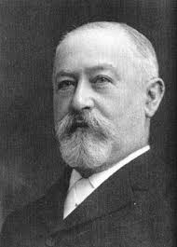
Needed Lots of Money
In order to topple the czar, the Bolshevik’s/Lenin/Stalin would need lots of money. They would need to be fed, clothed, and armed in order to overthrow the Romanov’s. Where would they get the millions needed in order to place Communism-the Jesuits model of government-on the throne of vast Russia? They turned to Jesuit agents in America!!

Slide 12
Money, Money, Money!!
“William Franklin Sands, a director of the Federal Reserve Bank of New York, had just contributed $1,000,000 to the Bolsheviks. — Anthony Sutton, Wall Street and the Bolshevik Revolution, Veritas Publishing, pp. 133, 134.
“Jacob Schiff was the principle Jesuit in America who was assigned the task of taking over the American banking system and establishing the Federal Reserve. Jacob Schiff came to America in the late 1800s with orders from the Rothschilds to get control of the American banking system. By the turn of the century, 1900, Schiff had mastery of the entire banking fraternity on Wall Street. — Myron Fagan, The Illuminati and the Council on Foreign Relations, Taped Lecture.
“Since Schiff had control of the Federal Reserve Bank, he now had a source of money to finance the Communist Revolution in Russia. In the February 3, 1949, issue of the New York Journal American, Schiff’s grandson, John, was quoted by columnist Cholly Knickerbocker as saying that his grandfather [Jacob Schiff] had given about twenty million dollars for the triumph of Communism in Russia. — G. Edward Griffin, The Creature from Jekyll Island, American Opinion Publishing, p. 265.

Slide 13
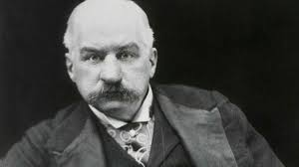
American’s Financing Communism????
Jacob Schiff brought Rothschild/Jesuit money to America after the Civil War. This money was used to gain control over JP Morgan, the Rockefeller’s, Carnegie, Pullman, Stanford, DuPont, and others. Thus, these men sold their soul to Schiff and the Jesuits consortium. Thereafter, while claiming to be American, these wealthy men bent their every nerve at taking over the world for Rome and the Jesuits! They lived in America, but did what was best for Rome. Thus, American’s financed the Communistic Bolshevik’s!!!!

Slide 14
Overthrow Orthodox Church
The czar was the protector of the Orthodox Church. This had been the case for over 1,000 years. With the overthrow of the czar would inevitably bring about the overthrow of the Orthodox Church. The papacy wanted this badly. Thus, with the end of the Romanov Family would come the downfall of the Russian Orthodox Church!! Cracked two birds with one stone!!

Slide 15
Destroy Orthodox Church!
“The overthrow of the Czarist system therefore, brought with it the inevitable overthrow of the established Orthodox Church. To the Vatican, which had waged war against the Orthodox Church since the eleventh century, the downfall of her millenarian rival was too good to be true. — Avro Manhattan, The Vatican Billions, Chick Publications, pp. 120, 121
“ The instruments of this new alliance between the Soviets and the Vatican were to be the Jesuits, described as the hereditary enemies of the Orthodox Church. Reportedly, there were large numbers of representatives of the Jesuit Order in Moscow during the Revolution. — James Zatko, Descent into Darkness, University of Notre Dame Press, p. 111.
“Among the 1,766,188 victims up to the beginning of 1922, figures obtained from the Soviet documents, nearly five thousand were priests, teachers, nuns, etc. of the Orthodox Church.... Nearly 100,000 Lutherans banished..... Whole villages were wiped out.... Thousands of churches of the different branches have been demolished and the work of destruction goes on...... — Arno Gaebelien, Conflict of the Ages, The Exhorters, pp. 103-106.

Slide 16
Is Anyone Listening??
Stalin kicked it into high gear in 1939 when he began the outlawing of the Russian Orthodox Church, seizing thousands of schools and churches to be put in the hands of the Catholic Church. The history books report that Christianity was banned in Russia under the Communists, but this was not the case with the Jesuits. They remained in Russian territory.
A greatly suppressed fact is that the head of Stalin’s death camps in Siberia was none other than Cardinal Gregory Agagianian, his classmate at Tiflis. Together these sinister Roman Catholic classmates would kill tens of million of people in their death camps, far exceeding the casualties of Hitler in Germany. Sadly, this information has barely seen the light of day.

Slide 17
How Could Roosevelt do What He did?
FDR provided Stalin with weaponry, trucks, money, and everything else during and after the war. Why did he do that? Very simple: Stalin worked for the Jesuits and FDR was part of the Council on Foreign Relations. This is a front for the Jesuits. They worked for the same people and it was easy for them to do as they were told! “The unlikely cooperation between the capitalist and the communist, the product of human warmth and trust, created the flawed but essential United Nations. As Churchill sulked, Roosevelt and Stalin grinned and charmed and arm-twisted their way to victory and the world beyond the war. We all live in their legacy.” Their cooperation is not unlikely at all!

Slide 18
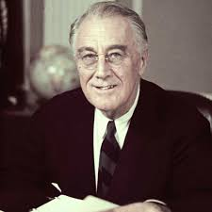
Roosevelt’s Salutation!
Washington worked hard at fostering a public sense of solidarity with Russia. Similarly in the U.S.S.R the censors and propagandists toned down somewhat their traditional anti-imperialist and anti-capitalist rhetoric to justify their alliance with American and British forces. American movies such as Mission to Moscow were sympathetic to Russia in general and Stalin in particular, depicting a very likable “Uncle Joe” and celebrating the Soviet Union as America’s ally against Germany. The two men bond by making fun of an annoyed Churchill, and Stalin even teases FDR by acting offended to learn he’s called “Uncle Joe” behind the scenes.

Slide 19
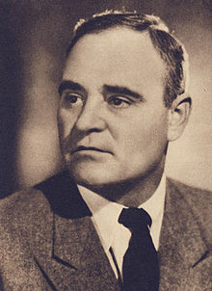
Romania was softened up by the brutal, police state of Gheorghiu-Dej. He was involved in communist movements' activities from the early 1930s. Upon the outbreak of World War II in Europe, he was imprisoned by Ion Antonescu's regime in the Târgu Jiu detention camp, and escaped only in August 1944. After the forces of King Michael ousted Antonescu and had him arrested for war crimes, Gheorghiu-Dej together with prime-minister Petru Groza pressured the King into abdicating in December 1947, marking the onset of out-and-out Communist rule in Romania. Under his rule, Romania was considered one of the Soviet Union's most loyal satellite states, though Gheorghiu-Dej was partially unnerved by the rapid De-Stalinization policy initiated by Nikita Khrushchev at the end of the 1950s. Gheorghiu-Dej stepped up measures that greatly increased trade relations between Romania and the Western countries. However, at the same time his government was accused of human rights violations within the country.

Slide 20
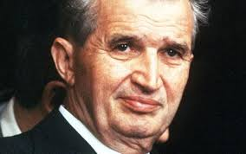
“During the relative liberalization of the 1960s, sporadic talks between the Holy See and the Romanian state were carried out over the status of Greek-Catholic possessions, but without any significant result. Romania became a Jesuit Province by 1974 (numbering, at that time, eight priests and five brothers). The situation normalized soon after the Romanian Revolution of 1989. Links with the Holy See were resumed in May 1990 (Romania was the fourth formerly Eastern Bloc country and first minority Catholic country to allow this, after the majority-Catholic Poland, Hungary and Czechoslovakia). All six dioceses were recognized by the Romanian state during 1990, and the one in Alba Iulia became an archdiocese in 1991. Religious institutes were once again permitted to function,[2] and Jesuit activities were freely resumed following the 1990 visit of Provincial superior Peter Hans Kolvenbach.” Wikipedia

