Slide 1
Elijah, pt. 6
“Preparation For Rain”

Slide 2
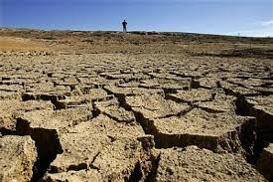
Backdrop
Apostasy paid a heavy price. Many died and crops were non-existent. Hope was well-nigh gone among God’s professed people. God sent a man. He called the people to repentance. He prayed and fire fell from heaven. Yet, there still was no rain!

Slide 3
The People Respond!
“And when all the people saw it, they fell on their faces: and they said, The LORD, he is the God; the LORD, he is the God.” 1 Kings 18:39

Slide 4
Taking a Stand
“The Lord abhors indifference and disloyalty in a time of crisis in His work. The whole universe is watching with inexpressible interest the closing scenes of the great controversy between good and evil. The people of God are nearing the borders of the eternal world; what can be of more importance to them than that they be loyal to the God of heaven? All through the ages, God has had moral heroes, and He has them now--those who, like Joseph and Elijah and Daniel, are not ashamed to acknowledge themselves His peculiar people. His special blessing accompanies the labors of men of action, men who will not be swerved from the straight line of duty, but who with divine energy will inquire, "Who is on the Lord's side?" (Exodus 32:26), men who will not stop merely with the inquiry, but who will demand that those who choose to identify themselves with the people of God shall step forward and reveal unmistakably their allegiance to the King of kings and Lord of lords. Such men make their wills and plans subordinate to the law of God… Fidelity to God is their motto.” PK, pg.148

Slide 5
Penitent
“The people on the mount prostrate themselves in awe before the unseen God. They dare not continue to look upon the Heaven-sent fire. They fear that they themselves will be consumed; and, convicted of their duty to acknowledge the God of Elijah as the God of their fathers, to whom they owe allegiance, they cry out together as with one voice, "The Lord, He is the God; the Lord, He is the God." With startling distinctness the cry resounds over the mountain and echoes in the plain below. At last Israel is aroused, undeceived, penitent. At last the people see how greatly they have dishonored God. The character of Baal worship, in contrast with the reasonable service required by the true God, stands fully revealed. The people recognize God's justice and mercy in withholding the dew and the rain until they have been brought to confess His name. They are ready now to admit that the God of Elijah is above every idol.” PK, pg. 153

Slide 6
Turning from Sin!
“The prayer of David after his fall, illustrates the nature of true sorrow for sin. His repentance was sincere and deep. There was no effort to palliate his guilt; no desire to escape the judgment threatened, inspired his prayer. David saw the enormity of his transgression; he saw the defilement of his soul; he loathed his sin. It was not for pardon only that he prayed, but for purity of heart. He longed for the joy of holiness--to be restored to harmony and communion with God.” SC, pgs. 24,25

Slide 7
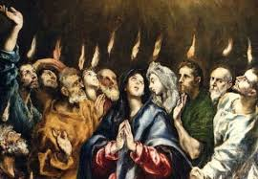
Early Rain at Pentecost
“As the disciples waited for the fulfillment of the promise, they humbled their hearts in true repentance and confessed their unbelief. As they called to remembrance the words that Christ had spoken to them before His death they understood more fully their meaning. Truths which had passed from their memory were again brought to their minds, and these they repeated to one another. They reproached themselves for their misapprehension of the Saviour. Like a procession, scene after scene of His wonderful life passed before them. As they meditated upon His pure, holy life they felt that no toil would be too hard, no sacrifice too great, if only they could bear witness in their lives to the loveliness of Christ's character.” AA, pg. 36

Slide 8
How About Us?
Ancient Adventism, on Mt. Carmel, would never have seen rain until their was genuine repentance and an acknowledgment of the true and living God.
Adventism in the 1st century saw the early rain because of their confession and repentance.
Today, we will never see rain until we repent of our sins, confess our inability to obey the Lord, and in humility rely upon His power to overcome. Only then will the rain fall!

Slide 9
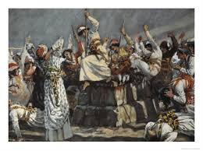
Phase Number #2
“And Elijah said unto them, Take the prophets of Baal; let not one of them escape. And they took them: and Elijah brought them down to the brook Kishon, and slew them there.” 1 Kings 18:40

Slide 10
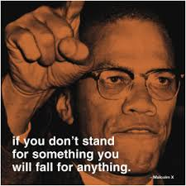
Taking a Stand!
The Baal prophets were unrepentant and unwilling to acknowledge the power of God. They would ever continue to spread a cancer over God’s professed people. They must go and so Elijah had them slain!

Slide 11
Cut Down
“The priests of Baal witness with consternation the wonderful revelation of Jehovah's power. Yet even in their discomfiture and in the presence of divine glory, they refuse to repent of their evil-doing. They would still remain the prophets of Baal. Thus they showed themselves ripe for destruction. That repentant Israel may be protected from the allurements of those who have taught them to worship Baal, Elijah is directed by the Lord to destroy these false teachers. The anger of the people has already been aroused against the leaders in transgression; and when Elijah gives the command, "Take the prophets of Baal; let not one of them escape," they are ready to obey. They seize the priests, and take them to the brook Kishon, and there, before the close of the day that marked the beginning of decided reform, the ministers of Baal are slain. Not one is permitted to live.” PK, pgs. 153, 154

Slide 12
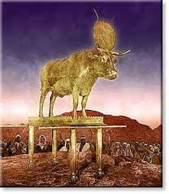
At the Golden Calf!
“Then Moses stood in the gate of the camp, and said, Who is on the LORD'S side? let him come unto me. And all the sons of Levi gathered themselves together unto him. And he said unto them, Thus saith the LORD God of Israel, Put every man his sword by his side, and go in and out from gate to gate throughout the camp, and slay every man his brother, and every man his companion, and every man his neighbour. And the children of Levi did according to the word of Moses: and there fell of the people that day about three thousand men.” Ex. 32:26-28

Slide 13
No Sanction for Evil
“The Israelites had been guilty of treason, and that against a King who had loaded them with benefits and whose authority they had voluntarily pledged themselves to obey. That the divine government might be maintained justice must be visited upon the traitors. Yet even here God's mercy was displayed. While He maintained His law, He granted freedom of choice and opportunity for repentance to all. Only those were cut off who persisted in rebellion. It was necessary that this sin should be punished, as a testimony to surrounding nations of God's displeasure against idolatry. By executing justice upon the guilty, Moses, as God's instrument, must leave on record a solemn and public protest against their crime. As the Israelites should hereafter condemn the idolatry of the neighboring tribes, their enemies would throw back upon them the charge that the people who claimed Jehovah as their God had made a calf and worshiped it in Horeb. Then though compelled to acknowledge the disgraceful truth, Israel could point to the terrible fate of the transgressors, as evidence that their sin had not been sanctioned or excused.” PP, pgs. 324,325

Slide 14
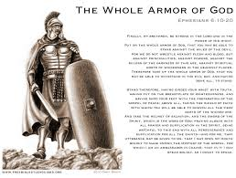
Phinehas
“And when Phinehas, the son of Eleazar, the son of Aaron the priest, saw it, he rose up from among the congregation, and took a javelin in his hand; And he went after the man of Israel into the tent, and thrust both of them through, the man of Israel, and the woman through her belly. So the plague was stayed from the children of Israel.” Num. 25:7,8

Slide 15
What About Today?
Elijah, Moses, and Phinehas, just to name a few, were used as God’s instruments to punish and slay apostasy.
What about those today who are seeking to destroy Adventism? 1. women’s ordination
2. spiritual formation.
3. obedience to the state
4. follow the church and not Christ.
They must be removed or the rain will NEVER fall on Apostate Adventism!!!

Slide 16
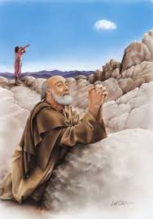
Phase #3
“So Ahab went up to eat and to drink. And Elijah went up to the top of Carmel; and he cast himself down upon the earth, and put his face between his knees”. 1 Kings 18:42

Slide 17
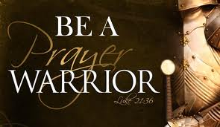
“Elias was a man subject to like passions as we are, and he prayed earnestly that it might not rain: and it rained not on the earth by the space of three years and six months.” James 5:17

Slide 18
The Menial and the Lowly
“In this gracious act of God's messenger shown to a wicked king is a lesson for all who claim to be servants of God, but who are exalted in their own estimation. There are those who feel above performing duties that to them appear menial. They hesitate to perform even needful service, fearing that they will be found doing the work of a servant. These have much to learn from the example of Elijah. By his word the treasures of heaven had been for three years withheld from the earth; he had been signally honored of God as, in answer to his prayer on Carmel, fire had flashed from heaven and consumed the sacrifice; his hand had executed the judgment of God in slaying the idolatrous prophets; his petition for rain had been granted. And yet, after the signal triumphs with which God had been pleased to honor his public ministry, he was willing to perform the service of a menial.” PK, gs. 158,159

