Slide 1
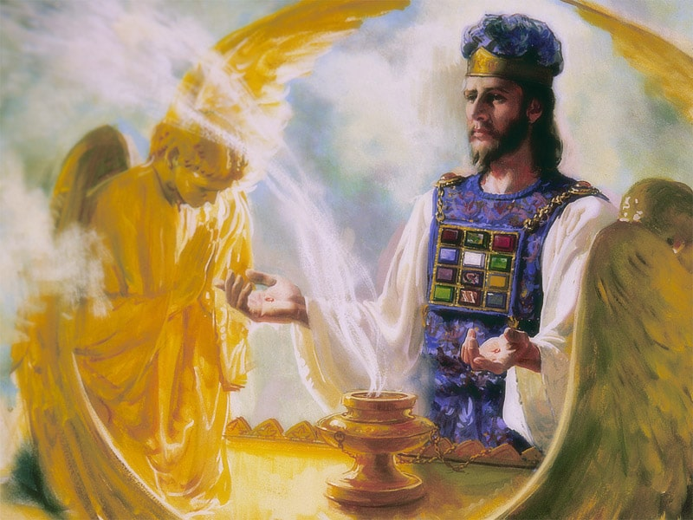
The Sanctuary pt 55: The Day of Atonement 2

Slide 2
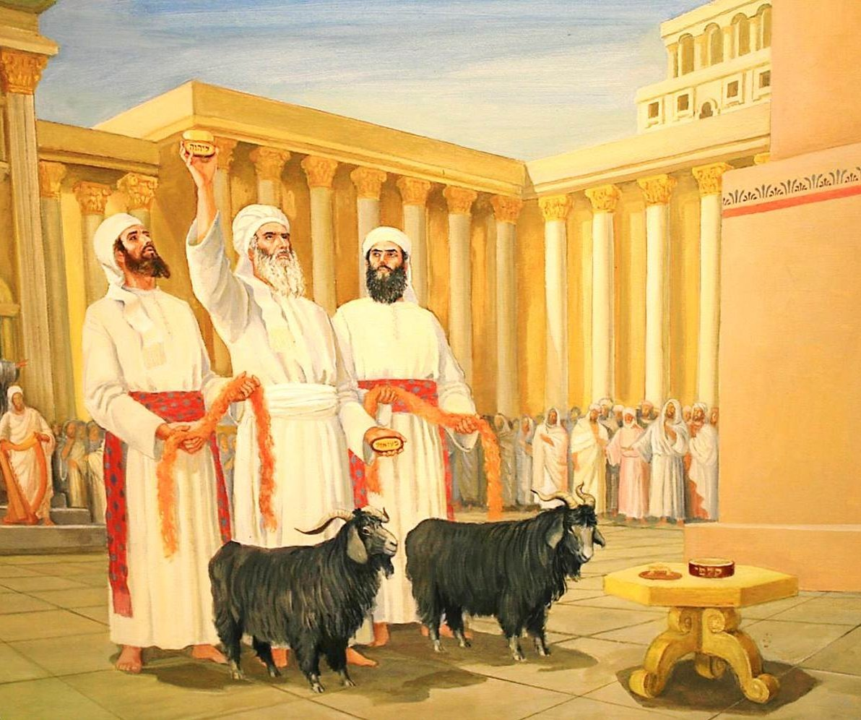

Slide 3
Who/What Are Represented by the Goats?
“In the great day of final award, the dead are to be "judged out of those things which were written in the books, according to their works." Revelation 20:12. Then by virtue of the atoning blood of Christ, the sins of all the truly penitent will be blotted from the books of heaven. Thus the sanctuary will be freed, or cleansed, from the record of sin. In the type, this great work of atonement, or blotting out of sins, was represented by the services of the Day of Atonement—the cleansing of the earthly sanctuary, which was accomplished by the removal, by virtue of the blood of the sin offering, of the sins by which it had been polluted. As in the final atonement the sins of the truly penitent are to be blotted from the records of heaven, no more to be remembered or come into mind, so in the type they were borne away into the wilderness, forever separated from the congregation. Since Satan is the originator of sin, the direct instigator of all the sins that caused the death of the Son of God, justice demands that Satan shall suffer the final punishment. Christ's work for the redemption of men and the purification of the universe from sin will be closed by the removal of sin from the heavenly sanctuary and the placing of these sins upon Satan, who will bear the final penalty. So in the typical service, the yearly round of ministration closed with the purification of the sanctuary, and the confessing of the sins on the head of the scapegoat.” PP, p. 357-358

Slide 4
Biblical Proof of this????
Rev. 20:1-3 “And I saw an angel come down from heaven, having the key of the bottomless pit and a great chain in his hand. And he laid hold on the dragon, that old serpent, which is the Devil, and Satan, and bound him a thousand years, And cast him into the bottomless pit, and shut him up, and set a seal upon him, that he should deceive the nations no more, till the thousand years should be fulfilled: and after that he must be loosed a little season.”

Slide 5
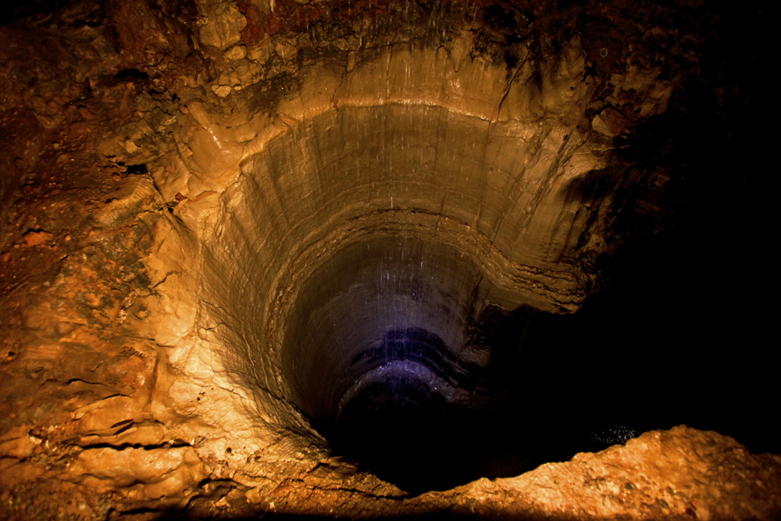
What is the “bottomless pit”?
Bottomless Pit: 12 Strong’s Concordance: abussos (ab’-us-sos)- bottomless pit, deep, bottomless, 1) bottomless 2) unbounded 3) the abyss 3a) the pit 3b) the immeasurable depth 3c) of Orcus, a very deep gulf or chasm in the lowest parts of the earth used as the common receptacle of the dead and especially as the abode of demons

Slide 6
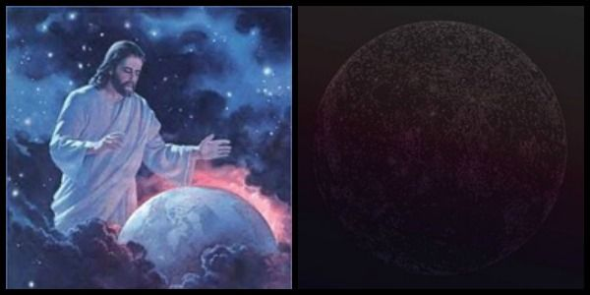
“Bottomless Pit” can be “earth”?
Gen. 1:1-2 “In the beginning God created the heaven and the earth. And the earth was without form, and void; and darkness was upon the face of the deep. And the Spirit of God moved upon the face of the waters.”
Deep: 8415 Strong’s Concordance: thowm (teh’-home’) thom (teh’-home’)-deep, depth, deep places, 1) deep, depths, deep places, abyss, the deep sea 1a) deep (of subterranean waters) 1b) deep, sea, abysses (of sea) 1c) primeval ocean, deep 1d) deep, depth (of river) 1e) abyss, Sheol

Slide 7
The “Wilderness/Bottomless Pit” Satan is Confined to
“At the coming of Christ the wicked are blotted from the face of the whole earth—consumed with the spirit of His mouth and destroyed by the brightness of His glory. Christ takes His people to the City of God, and the earth is emptied of its inhabitants. "Behold, the Lord maketh the earth empty, and maketh it waste, and turneth it upside down, and scattereth abroad the inhabitants thereof." "The land shall be utterly emptied, and utterly spoiled: for the Lord hath spoken this word." "Because they have transgressed the laws, changed the ordinance, broken the everlasting covenant. Therefore hath the curse devoured the earth, and they that dwell therein are desolate: therefore the inhabitants of the earth are burned." Isaiah 24:1, 3, 5, 6. The whole earth appears like a desolate wilderness. The ruins of cities and villages destroyed by the earthquake, uprooted trees, ragged rocks thrown out by the sea or torn out of the earth itself, are scattered over its surface, while vast caverns mark the spot where the mountains have been rent from their foundations.” GC, p. 657

Slide 8
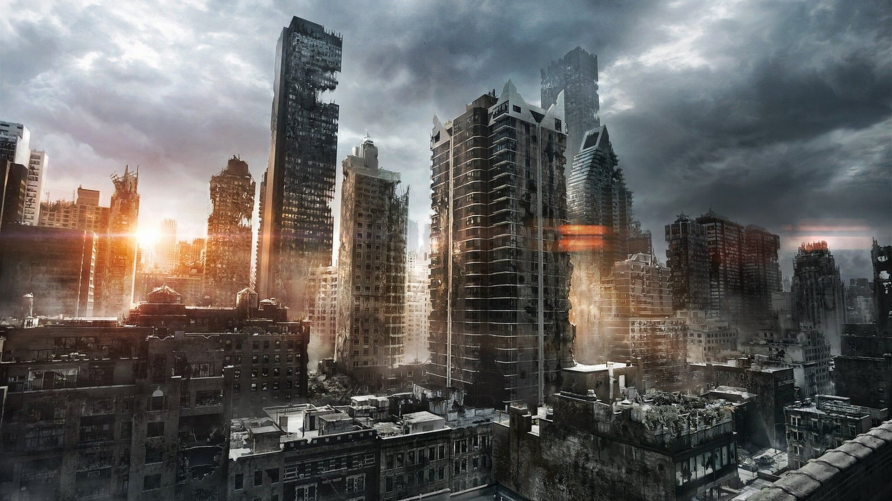

Slide 9
“Now the event takes place foreshadowed in the last solemn service of the Day of Atonement. When the ministration in the holy of holies had been completed, and the sins of Israel had been removed from the sanctuary by virtue of the blood of the sin offering, then the scapegoat was presented alive before the Lord; and in the presence of the congregation the high priest confessed over him "all the iniquities of the children of Israel, and all their transgressions in all their sins, putting them upon the head of the goat." Leviticus 16:21. In like manner, when the work of atonement in the heavenly sanctuary has been completed, then in the presence of God and heavenly angels and the hosts of the redeemed the sins of God's people will be placed upon Satan; he will be declared guilty of all the evil which he has caused them to commit. And as the scapegoat was sent away into a land not inhabited, so Satan will be banished to the desolate earth, an uninhabited and dreary wilderness.” GC, p. 658

Slide 10
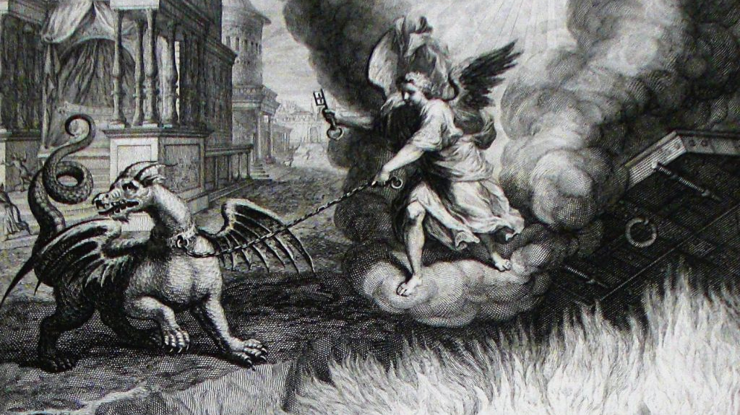

Slide 11
“The revelator foretells the banishment of Satan and the condition of chaos and desolation to which the earth is to be reduced, and he declares that this condition will exist for a thousand years. After presenting the scenes of the Lord's second coming and the destruction of the wicked, the prophecy continues . . . [Revelation 20:1-3 quoted]. That the expression "bottomless pit" represents the earth in a state of confusion and darkness is evident from other scriptures. Concerning the condition of the earth "in the beginning," the Bible record says that it "was without form, and void; and darkness was upon the face of the deep." Genesis 1:2. Prophecy teaches that it will be brought back, partially at least, to this condition. Looking forward to the great day of God, the prophet Jeremiah declares: "I beheld the earth, and, lo, it was without form, and void; and the heavens, and they had no light. I beheld the mountains, and, lo, they trembled, and all the hills moved lightly. I beheld, and, lo, there was no man, and all the birds of the heavens were fled. I beheld, and, lo, the fruitful place was a wilderness, and all the cities thereof were broken down." Jeremiah 4:23-26.”—GC, p. 658-659

Slide 12
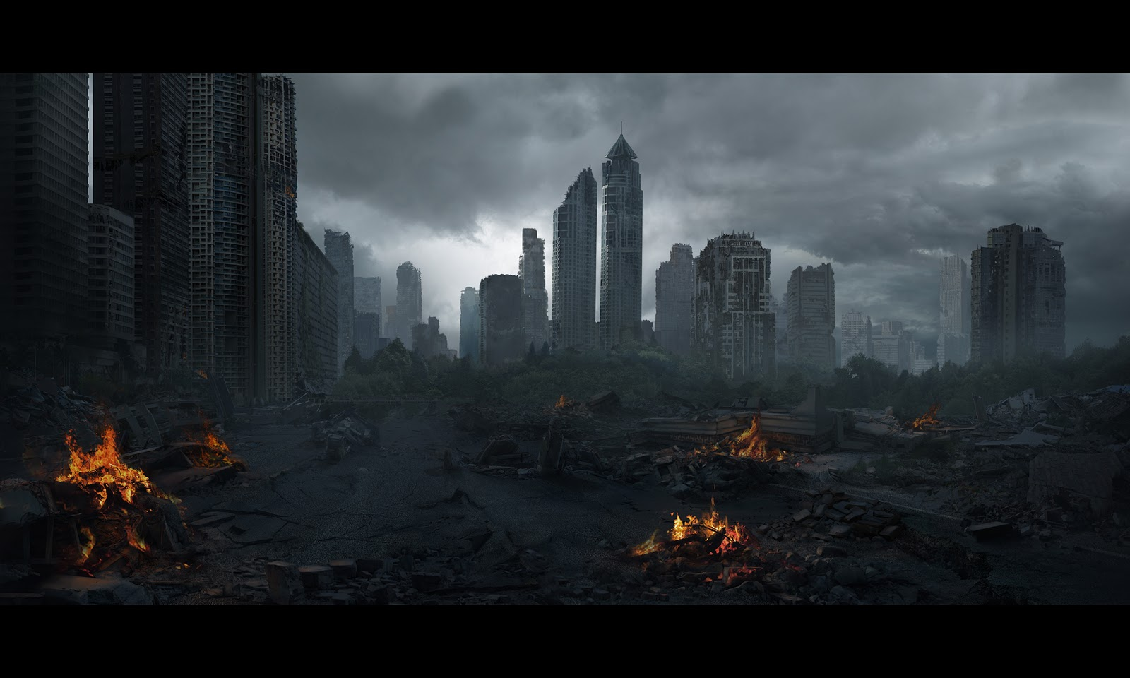

Slide 13
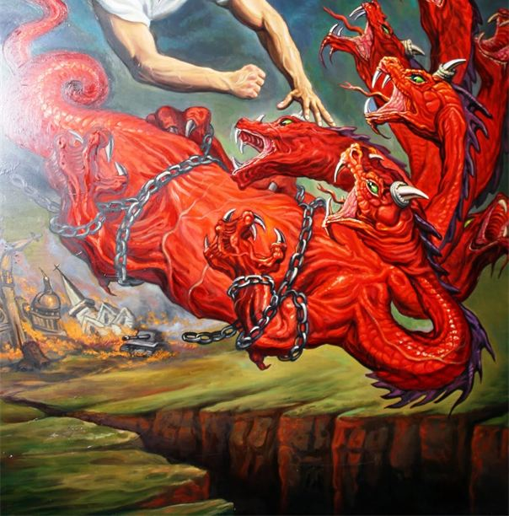
Great Controversy Reveals in Detail!
“Here is to be the home of Satan with his evil angels for a thousand years. Limited to the earth, he will not have access to other worlds to tempt and annoy those who have never fallen. It is in this sense that he is bound: there are none remaining, upon whom he can exercise his power. He is wholly cut off from the work of deception and ruin which for so many centuries has been his sole delight.” GC, p. 659

Slide 14
Satan Not Permitted to Die
“The prophet Isaiah, looking forward to the time of Satan's overthrow, exclaims: "How art thou fallen from heaven, O Lucifer, son of the morning! how art thou cut down to the ground, which didst weaken the nations! . . . Thou hast said in thine heart, I will ascend into heaven, I will exalt my throne above the stars of God: . . . I will be like the Most High. Yet thou shalt be brought down to hell, to the sides of the pit. They that see thee shall narrowly look upon thee, and consider thee, saying, Is this the man that made the earth to tremble, that did shake kingdoms; that made the world as a wilderness, and destroyed the cities thereof; that opened not the house of his prisoners?" Isaiah 14:12-17. For six thousand years, Satan's work of rebellion has "made the earth to tremble." He had "made the world as a wilderness, and destroyed the cities thereof." And he "opened not the house of his prisoners." For six thousand years his prison house has received God's people, and he would have held them captive forever; but Christ had broken his bonds and set the prisoners free” GC, p. 659

Slide 15
Satan to Wander 1000 Years
“Even the wicked are now placed beyond the power of Satan, and alone with his evil angels he remains to realize the effect of the curse which sin has brought. "The kings of the nations, even all of them, lie in glory, everyone in his own house [the grave]. But thou art cast out of thy grave like an abominable branch. . . . Thou shalt not be joined with them in burial, because thou hast destroyed thy land, and slain thy people." Isaiah 14:18-20. For a thousand years, Satan will wander to and fro in the desolate earth to behold the results of his rebellion against the law of God. During this time his sufferings are intense. Since his fall his life of unceasing activity has banished reflection; but he is now deprived of his power and left to contemplate the part which he has acted since first he rebelled against the government of heaven, and to look forward with trembling and terror to the dreadful future when he must suffer for all the evil that he has done and be punished for the sins that he has caused to be committed.” GC. P. 660

Slide 16
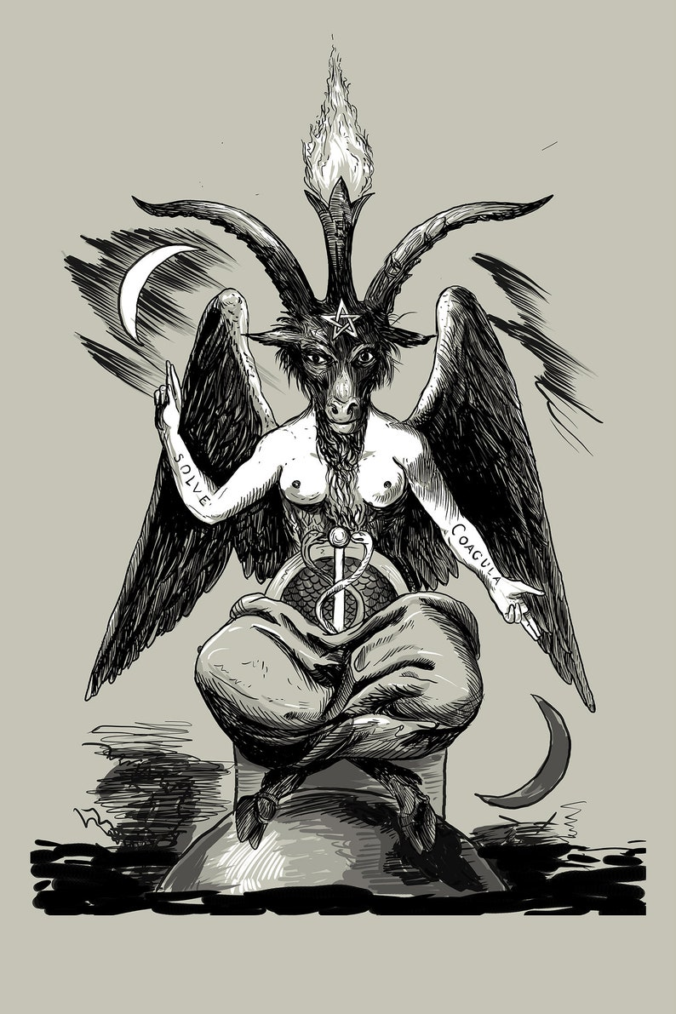
Satan Knows He is the “other” goat

Slide 17
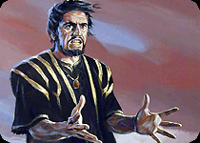
A Final Word
“Thus in the ministration of the tabernacle, and of the temple that afterward took its place, the people were taught each day the great truths relative to Christ's death and ministration, and once each year their minds were carried forward to the closing events of the great controversy between Christ and Satan, the final purification of the universe from sin and sinners.” PP, p. 358

Slide 18
Finishing Up Leviticus
Lev. 16:29-34 “And this shall be a statute for ever unto you: that in the seventh month, on the tenth day of the month, ye shall afflict your souls, and do no work at all, whether it be one of your own country, or a stranger that sojourneth among you: For on that day shall the priest make an atonement for you, to cleanse you, that ye may be clean from all your sins before the Lord. It shall be a sabbath of rest unto you, and ye shall afflict your souls, by a statute for ever. And the priest, whom he shall anoint, and whom he shall consecrate to minister in the priest's office in his father's stead, shall make the atonement, and shall put on the linen clothes, even the holy garments: And he shall make an atonement for the holy sanctuary, and he shall make an atonement for the tabernacle of the congregation, and for the altar, and he shall make an atonement for the priests, and for all the people of the congregation. And this shall be an everlasting statute unto you, to make an atonement for the children of Israel for all their sins once a year. And he did as the Lord commanded Moses.”

Slide 19
Sin to Be Put Away in the Day of Atonement
“Those who are living upon the earth when the intercession of Christ shall cease in the sanctuary above are to stand in the sight of a holy God without a mediator. Their robes must be spotless, their characters must be purified from sin by the blood of sprinkling. Through the grace of God and their own diligent efforts, they must be conquerors in the battle with evil. While the investigative judgment is going forward in heaven, while the sins of penitent believers are being removed from the sanctuary, there is to be a special work of purification, of putting away sin, among God's people on earth.” R&H, January 17, 1907

Slide 20
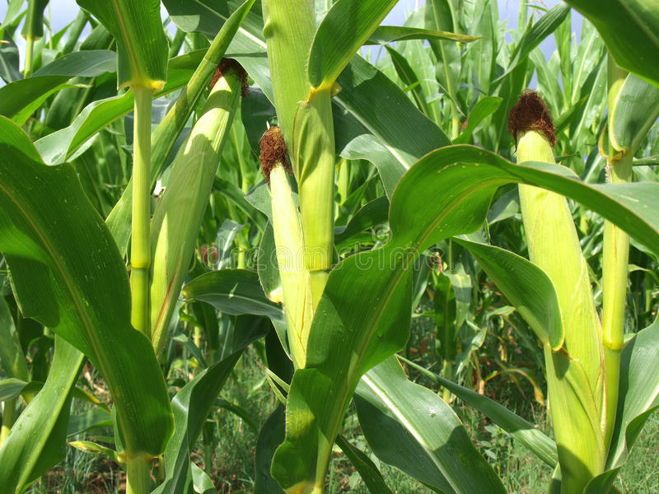
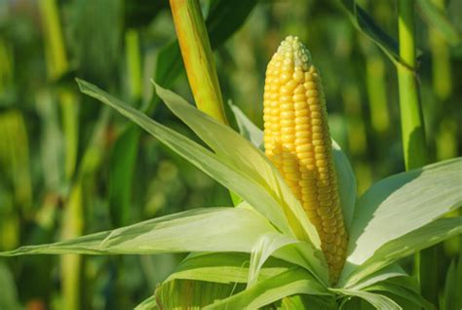
No Sophistry Here!
"The fruit of the Spirit is love, joy, peace, longsuffering, gentleness, goodness, faith, meekness, temperance." Gal. 5:22, 23. This fruit can never perish, but will produce after its kind a harvest unto eternal life. "When the fruit is brought forth, immediately he putteth in the sickle, because the harvest is come." Christ is waiting with longing desire for the manifestation of Himself in His church. When the character of Christ shall be perfectly reproduced in His people, then He will come to claim them as His own. It is the privilege of every Christian not only to look for but to hasten the coming of our Lord Jesus Christ, (2 Peter 3:12, margin). Were all who profess His name bearing fruit to His glory, how quickly the whole world would be sown with the seed of the gospel. Quickly the last great harvest would be ripened, and Christ would come to gather the precious grain.” COL, p. 68-69
VS

Slide 21
Very Clear Teaching
“Says the prophet: "Who may abide the day of His coming? and who shall stand when He appeareth? for He is like a refiner's fire, and like fullers' soap: and He shall sit as a refiner and purifier of silver: and He shall purify the sons of Levi, and purge them as gold and silver, that they may offer unto the Lord an offering in righteousness." Malachi 3:2, 3. Those who are living upon the earth when the intercession of Christ shall cease in the sanctuary above are to stand in the sight of a holy God without a mediator. Their robes must be spotless, their characters must be purified from sin by the blood of sprinkling. Through the grace of God and their own diligent effort they must be conquerors in the battle with evil. While the investigative judgment is going forward in heaven, while the sins of penitent believers are being removed from the sanctuary, there is to be a special work of purification, of putting away of sin, among God's people upon earth. This work is more clearly presented in the messages of Revelation 14. When this work shall have been accomplished, the followers of Christ will be ready for His appearing. "Then shall the offering of Judah and Jerusalem be pleasant unto the Lord, as in the days of old, and as in former years." Malachi 3:4. Then the church which our Lord at His coming is to receive to Himself will be a "glorious church, not having spot, or wrinkle, or any such thing." Ephesians 5:27. Then she will look "forth as the morning, fair as the moon, clear as the sun, and terrible as an army with banners." Song of Solomon 6:10.” GC, p. 425

Slide 22
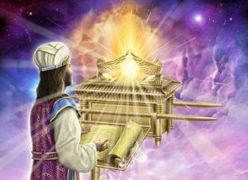
The Hour of His Judgment
Dan. 8:14 “And he said unto me, Unto two thousand and three hundred days; then shall the sanctuary be cleansed.”---ended in 1844
Lev. 16:15-16 “Then shall he kill the goat of the sin offering, that is for the people, and bring his blood within the vail, and do with that blood as he did with the blood of the bullock, and sprinkle it upon the mercy seat, and before the mercy seat: And he shall make an atonement for the holy place, because of the uncleanness of the children of Israel, and because of their transgressions in all their sins: and so shall he do for the tabernacle of the congregation, that remaineth among them in the midst of their uncleanness.”

Slide 23
