Slide 1
Hebrews, Chapter 3
Greater Than Moses

Slide 2
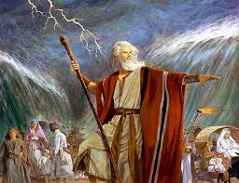
Moses- Highly Revered by the Jews
Following the discussion in the previous chapters, Paul now turns to one of the greatest of the Hebrew prophets, Moses, and will now show that Christ was greater than him.

Slide 3
Moses was Faithful
“Wherefore, holy brethren, partakers of the heavenly calling, consider the Apostle and High Priest of our profession, Christ Jesus; Who was faithful to him that appointed him, as also Moses was faithful in all his house. For this man was counted worthy of more glory than Moses, inasmuch as he who hath builded the house hath more honour than the house. For every house is builded by some man; but he that built all things is God. And Moses verily was faithful in all his house, as a servant, for a testimony of those things which were to be spoken after; But Christ as a son over his own house; whose house are we, if we hold fast the confidence and the rejoicing of the hope firm unto the end.” Hebrews 3:1-6

Slide 4
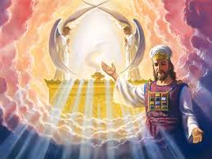
Our Great High Priest
Christ has been mentioned now for the 2nd time in Hebrews to be our great High Priest. The first time was in Hebrews 2:17 “Wherefore in all things it behooved him to be made like unto his brethren, that he might be a merciful and faithful high priest in things pertaining to God, to make reconciliation for the sins of the people.” This concept Paul will continue to expand throughout Hebrews!

Slide 5
Christ Greater by Creation, Redemption
Thru the power of Christ, Moses was empowered to do some great things. The Red Sea, deliverance from Egypt, the law of God and the sanctuary, etc. But Christ, He was the One responsible for the great things that Moses did. Therefore, the Creator, the Author of the works is greater than the creature, or the mouthpiece!

Slide 6
Christ-Greater Than Moses
“Because of the unbelief manifested toward Christ, the originator and foundation of the whole Jewish economy, a heavier retribution will come upon men than befell unbelieving Israel in the wilderness. Moses was the prophet by whom God communicated to the church in the wilderness; but great as was Moses, a greater than he is the Son of God, who builded the house. The presence of Jesus Christ, enshrouded in the pillar of cloud by day and the pillar of fire by night, followed this people in their wilderness wandering. The Angel of the covenant came in the name of God, as the invisible leader of Israel. The Son of God over His own house is higher than Moses, higher than the highest angel. He bears the name of Jehovah upon His miter, while on His breastplate is written the name of Israel. Christ took humanity that humanity might touch humanity. In the form of man He humbled Himself, and became a servant, but as the Son of God He was higher than the angels. By His life in humanity man may become a partaker of the divine nature. As the Majesty of heaven, He was exalted above the angels, and in His work of redemption He carries with Him all who have received Him and believed on His name (Letter 97, 1898).

Slide 7
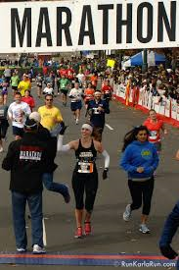
Hold on to the end
“….if we hold fast the confidence and the rejoicing of the hope firm unto the end.” verse 6
“...if we hold the beginning of our confidence stedfast unto the end;” verse 14
“But he that shall endure unto the end, the same shall be saved.” Matthew 24:13

Slide 8
Today, Listen to the voice of the Lord!
“Wherefore (as the Holy Ghost saith, To day if ye will hear his voice, Harden not your hearts, as in the provocation, in the day of temptation in the wilderness: When your fathers tempted me, proved me, and saw my works forty years. Wherefore I was grieved with that generation, and said, They do always err in their heart; and they have not known my ways.” Hebrews 3:7-10

Slide 9
Today, Today, Today
while it is called To day; lest any of you be hardened through the deceitfulness of sin.” “To day if ye will hear his voice, harden not your hearts, as in the provocation.” Heb. 3:13, 15
Paul repeatedly hits this in Hebrews 3 and Hebrews 4.
“To day, after so long a time; as it is said, To day if ye will hear his voice, harden not your hearts.” Heb. 4:7
With each day, our heart either becomes softer toward the Lord, or harder. We must heed the Lord’s voice TODAY!

Slide 10
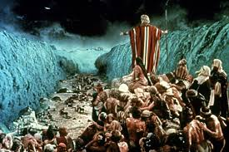
Every Effort was Futile
The one thing God can not do. The Infinite One cannot save us if we choose to cling to our sins. Even the Lord could not save ancient Adventists and can He save us from ourselves?

Slide 11
No Rest for the Unbelievers
“So I sware in my wrath, They shall not enter into my rest.) Take heed, brethren, lest there be in any of you an evil heart of unbelief, in departing from the living God. But exhort one another daily, while it is called To day; lest any of you be hardened through the deceitfulness of sin. For we are made partakers of Christ, if we hold the beginning of our confidence steadfast unto the end; While it is said, To day if ye will hear his voice, harden not your hearts, as in the provocation.” Hebrews 3:11-15

Slide 12
Cherishing Faith
“There is no encouragement given for unbelief. The Lord manifests His grace and His power over and over again, and this should teach us that it is always profitable under all circumstances to cherish faith, to talk faith, to act faith. We are not to have our hearts and hands weakened by allowing the suggestions of suspicious minds to plant in our hearts the seeds of doubt and distrust [Hebrews 3:12 quoted] (Letter 97, 1898).
“The Lord works in cooperation with the will and action of the human agent. It is the privilege and duty of every man to take God at His word, to believe in Jesus as his personal Saviour, and to respond eagerly, immediately, to the gracious propositions which He makes. He is to study to believe and obey the divine instruction in the Scriptures. He is to base his faith not on feeling but upon the evidence and the Word of God (Manuscript 3, 1895).

Slide 13
Did Not Enter the Lord’s Rest!
The Israelites, who refused to believe in the Lord’s promises, failed to enter His rest. There is a clear connection between faith and God’s rest. There is a clear connection between faith and the Sabbath rest. The Sabbath, because it lacks a moral quality, is the ultimate test of faith. The Sabbath is kept as a sign of faith in the believer! This highlighted again and again in Hebrews 3 and 4.

Slide 14
Rest and Faith
“So I sware in my wrath, They shall not enter into my rest.)” Heb. 3:11
“And to whom sware he that they should not enter into his rest, but to them that believed not?” Heb. 3:18
“Let us therefore fear, lest, a promise being left us of entering into his rest, any of you should seem to come short of it.” Heb. 4:1
“For we which have believed do enter into rest, as he said, As I have sworn in my wrath, if they shall enter into my rest: although the works were finished from the foundation of the world.” Heb. 4:3

Slide 15
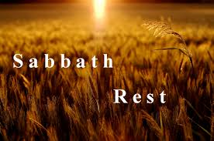
Keep All the Rest!
“The sign of obedience is the observance of the Sabbath of the fourth commandment. If men keep the fourth commandment, they will keep all the rest (Letter 31, 1898). “

Slide 16
Out of Egypt physically, but not Spiritually
“For some, when they had heard, did provoke: howbeit not all that came out of Egypt by Moses. But with whom was he grieved forty years? was it not with them that had sinned, whose carcasses fell in the wilderness? And to whom sware he that they should not enter into his rest, but to them that believed not? So we see that they could not enter in because of unbelief.” Heb. 3:16-19

Slide 17
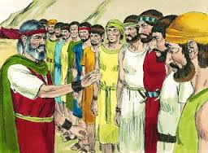
Failure
“And they told him, and said, We came unto the land whither thou sentest us, and surely it floweth with milk and honey; and this is the fruit of it. Nevertheless the people be strong that dwell in the land, and the cities are walled, and very great: and moreover we saw the children of Anak there. The Amalekites dwell in the land of the south: and the Hittites, and the Jebusites, and the Amorites, dwell in the mountains: and the Canaanites dwell by the sea, and by the coast of Jordan.” Num. 13:27-29

Slide 18
Unbelief!
“But after describing the beauty and fertility of the land, all but two of the spies enlarged upon the difficulties and dangers that lay before the Israelites should they undertake the conquest of Canaan. They enumerated the powerful nations located in various parts of the country, and said that the cities were walled and very great, and the people who dwelt therein were strong, and it would be impossible to conquer them. They also stated that they had seen giants, the sons of Anak, there, and it was useless to think of possessing the land.
Now the scene changed. Hope and courage gave place to cowardly despair, as the spies uttered the sentiments of their unbelieving hearts, which were filled with discouragement prompted by Satan. Their unbelief cast a gloomy shadow over the congregation, and the mighty power of God, so often manifested in behalf of the chosen nation, was forgotten.” PP, pg. 388

