Slide 1
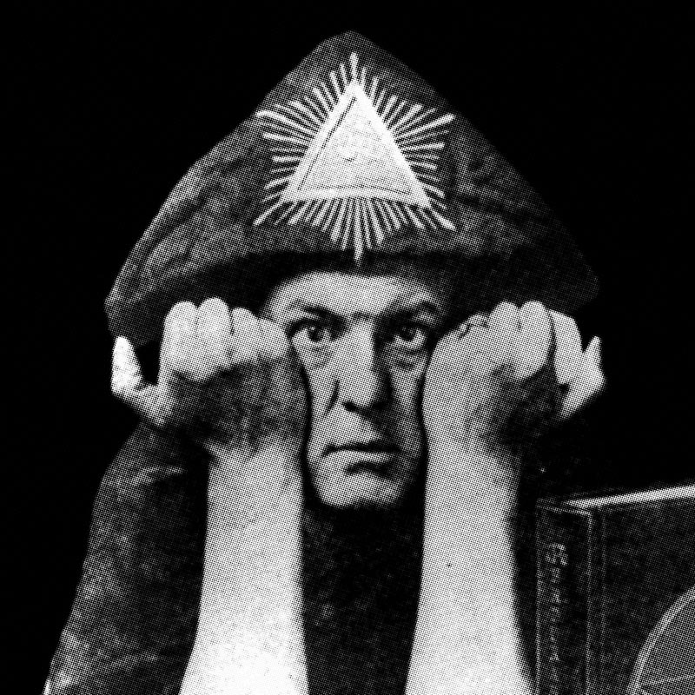
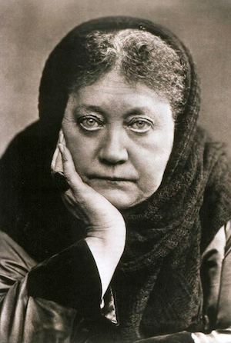
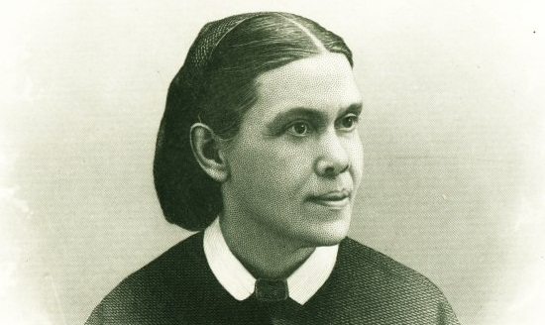
PROVING THE PROPHET

Slide 2
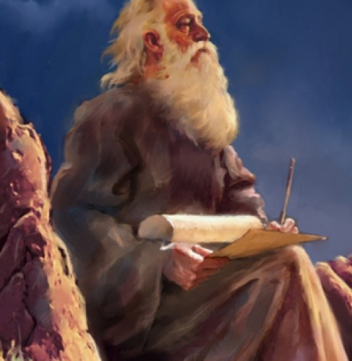
The Bible Says this about Prophets…
2 Chron. 20:20 “Jehoshaphat stood and said, Hear me, O Judah, and ye inhabitants of Jerusalem; Believe in the Lord your God, so shall ye be established; believe his prophets, so shall ye prosper.”
Heb. 1:1-2 “God, who at sundry times and in divers manners spake in time past unto the fathers by the prophets, Hath in these last days spoken unto us by his Son, whom he hath appointed heir of all things, by whom also he made the worlds”

Slide 3
Cessation of the Gifts?
Acts 2:17 “And it shall come to pass in the last days, saith God, I will pour out of my Spirit upon all flesh: and your sons and your daughters shall prophesy, and your young men shall see visions, and your old men shall dream dreams”
1 Cor, 12:1, 8-10 “Now concerning spiritual gifts, brethren, I would not have you ignorant. . . For to one is given by the Spirit the word of wisdom; to another the word of knowledge by the same Spirit; To another faith by the same Spirit; to another the gifts of healing by the same Spirit; To another the working of miracles; to another prophecy; to another discerning of spirits; to another divers kinds of tongues; to another the interpretation of tongues”
Eph. 4:11 “And he gave some, apostles; and some, prophets; and some, evangelists; and some, pastors and teachers; [1] For the perfecting of the saints, [2] for the work of the ministry, [3] for the edifying of the body of Christ”

Slide 4
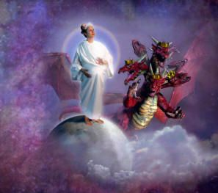
Will the Last Day Church Have the Gift of Prophecy??
Rev. 12:17 “And the dragon was wroth with the woman, and went to make war with the remnant of her seed, which keep the commandments of God, and have the testimony of Jesus Christ.”
Rev. 19:10 “ And I fell at his feet to worship him. And he said unto me, See thou do it not: I am thy fellowservant, and of thy brethren that have the testimony of Jesus: worship God: for the testimony of Jesus is the spirit of prophecy.”

Slide 5
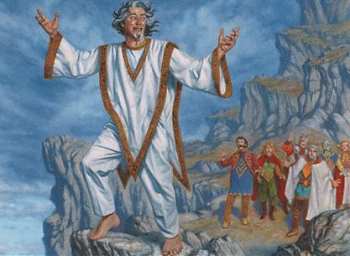
What are we to do if someone claims to be a Prophet?
Assume they are False and Ignore them
Assume they are True and believe everything they say
Give them all your money
Test them by Scripture

Slide 6
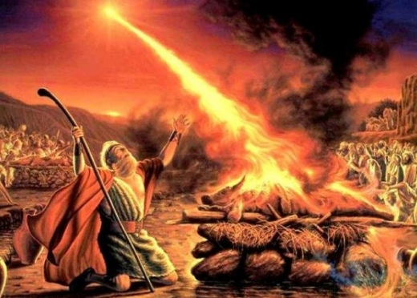
We are to Test the Prophets, to see if they are of God
1 John 4 “Beloved, believe not every spirit, but try the spirits whether they are of God: because many false prophets are gone out into the world.”
Matt. 24:4, 11 “And Jesus answered and said unto them, Take heed that no man deceive you. . . And many false prophets shall rise, and shall deceive many.”

Slide 7
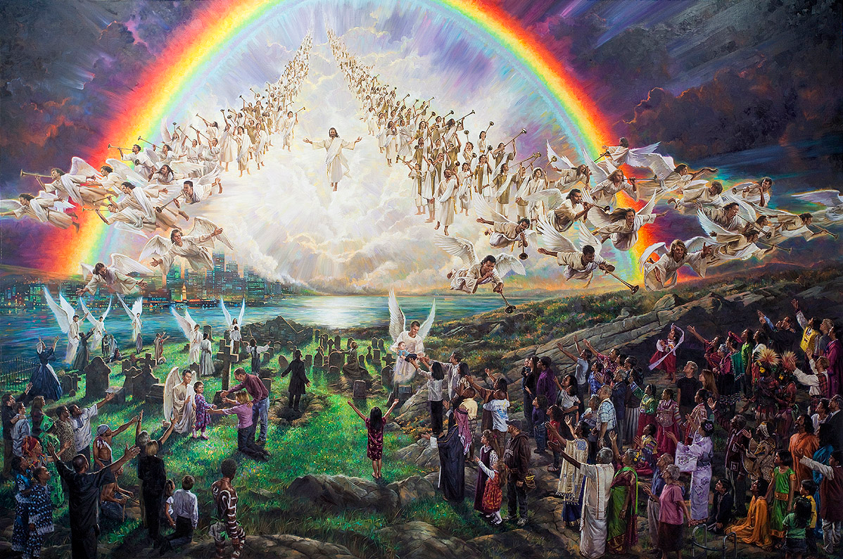
Why God Gives True Prophets…
Prov. 29:18 “Where there is no vision, the people perish: but he that keepeth the law, happy is he.”
Amos 3:7 “Surely the Lord God will do nothing, but he revealeth his secret unto his servants the prophets.”

Slide 8
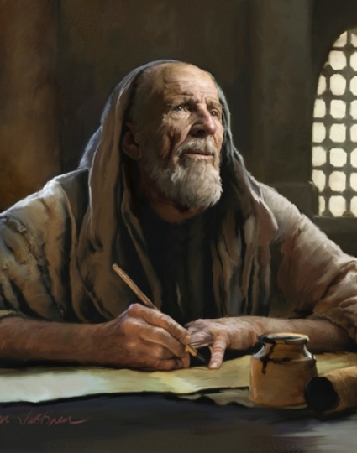
Questions for Prophets:
Does a prophet have to be a man?
A: No, Deborah the Judge, Miriam the sister of Moses, Huldah of The Jerusalem college (2 Kings 22:14), Anna the prophetess that blessed Jesus (Luke 2), Elizabeth prophesied of Jesus-calling Him Lord (Luke 1:41-43), Philip’s daughters (Acts 21:9)
2. Does a Prophet have to contribute to the Bible canon?
No. 1 Chron. 29:29 “Now the acts of David the king, first and last, behold, they are written in the book of Samuel the seer, and in the book of Nathan the prophet, and in the book of Gad the seer”

Slide 9
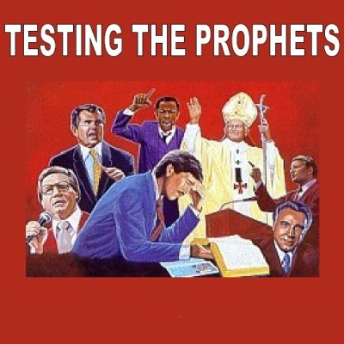
Tests of a Prophet
From 1 Corinthians 12
Perfecting of Saints—Will point out sin
Work of Ministry—Evangelism Focus
Edify Church—Strengthen/Protect Church
Teach and Comfort
1 Cor. 14:3 “But he that prophesieth speaketh unto men to edification, and exhortation, and comfort.”
5. “by their fruits, ye shall know them” (Matt. 7:20)

Slide 10
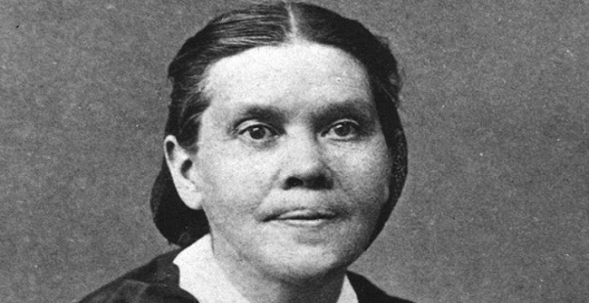

Slide 11
New York Independent, August 23, 1915: “These teachings are based on the strictest doctrine of inspiration of Scripture. Seventh-day Adventism could not have gotten out in any other way. And the gift of prophecy was to be expected as promised to the remnant church who held fast to the truth. This faith gave great purity and life and incessant zeal. No body of Christians excels them in moral character and religious earnestness. . . Here is a notable record, and she deserves great honor. . . She showed no spiritual pride and she sought no ‘filthy lucre.’ She lived the life and did the work of a worthy prophetess, the most admirable of the American succession.”

Slide 12
“Mrs. White was a remarkable woman in many ways. She was deeply religious, and none who knew her intimately had any doubt, as to her sincerity." Editorial, Detroit "News-Tribune," July 25,1915.
Thomas M. Elliott, editor of the "Atlanta Constitution," wrote a key editorial in his paper on October 9, 1950: “Among the many hundreds of books I have studied on the subject of religion that inspire heart warmth and enriched faith, none have been of greater help than Ellen G. White's two books 'Patriarchs and Prophets' and 'Prophets and Kings.' Those books were written, not for literary fame or financial reward, but to help heart-hungry humanity learn of God. They make God's dealings with man clear to the most simple-minded reader without bias or sectarianism, I commend these books to all seekers after a clearer knowledge of the righteousness of God.”

Slide 13
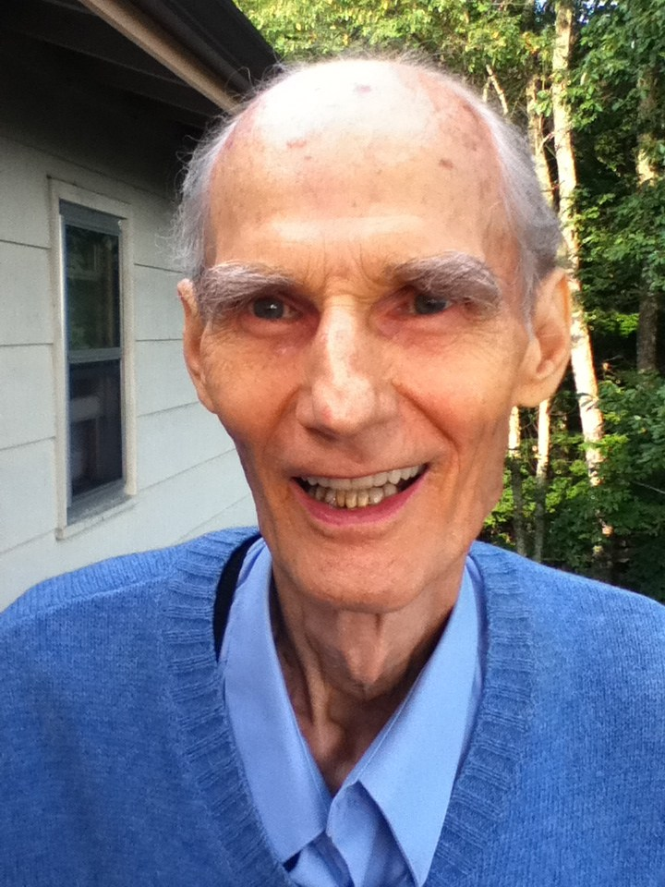
How About an opinion of someone within the Church?
“The above two books, "Patriarchs and Prophets" and "Prophets and Kings" provide a detailed description of the Old Testament story. They have encouraged many folk. The present writer recalls the story of an older man, who when asked the name of his favorite book by Ellen White, said, "I value them all, but—" and then his voice faltered, "it is 'Patriarchs and Prophets' that I appreciate the most—for that is the book that brought me back to God.“—Prophet of the End, Vance Farrell, p. 84

Slide 14
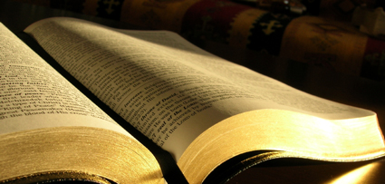
Tests Continued…
6. They will NOT contradict the Bible or the Law of God
Is. 8:20 “To the law and to the testimony: if they speak not according to this word, it is because there is no light in them.”
“The people of God are directed to the Scriptures as their safeguard against the influence of false teachers and the delusive power of spirits of darkness. . . The last great delusion is soon to open before us. Antichrist is to perform his marvelous works in our sight. So closely will the counterfeit resemble the true that it will be impossible to distinguish between them except by the Holy Scriptures. By their testimony every statement and every miracle must be tested.”—Great Controversy, 593

Slide 15
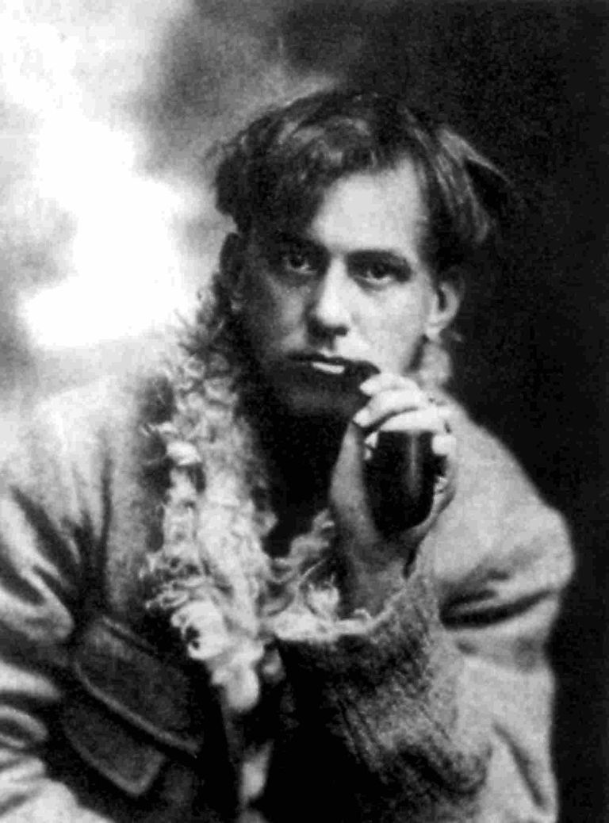
“Do what thou wilt shall be the whole of the law”—The Law of Thelema, Aliester Crowley

Slide 16
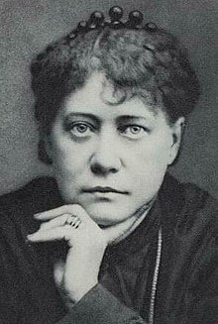
“Thus addressing the bright luminary in perpetual abscondito beyond the eternal fogs of the great city . . . we might entreat him at the same time to pour a little light into the no less befogged heads of those who insist on boycotting Lucifer under the extraordinary notion that he and Satan are one.”—Helena Petrovna Blavatsky, Collected Writings vol. X (Wheaton, IL: Theosophical Publishing House, 1988), 280.

Slide 17
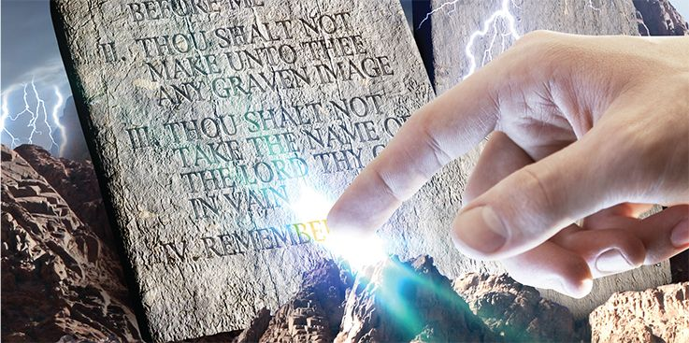
“Then present to them the prophecies; show them the purity and binding claims of the law of God, Not one jot or tittle of this law is to lose its force, but hold its binding claims upon every soul to the end of time.”—Manuscript Releases vol. 15, p. 351

Slide 18
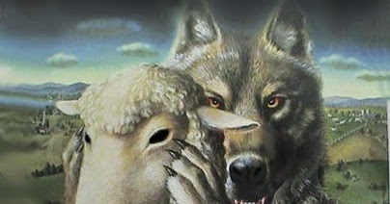
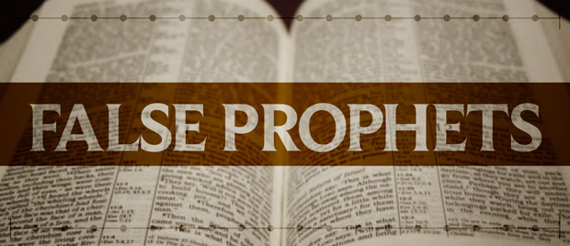
A Prophet’s Predictions Must Come True
Deut 18:15, 21-22 “The Lord thy God will raise up unto thee a Prophet from the midst of thee, of thy brethren, like unto me; unto him ye shall hearken. . . And if thou say in thine heart, How shall we know the word which the Lord hath not spoken? When a prophet speaketh in the name of the Lord, if the thing follow not, nor come to pass, that is the thing which the Lord hath not spoken, but the prophet hath spoken it presumptuously: thou shalt not be afraid of him.”
7. Prophet must prophesy truth 8. Prophets spring up from within the Church

Slide 19
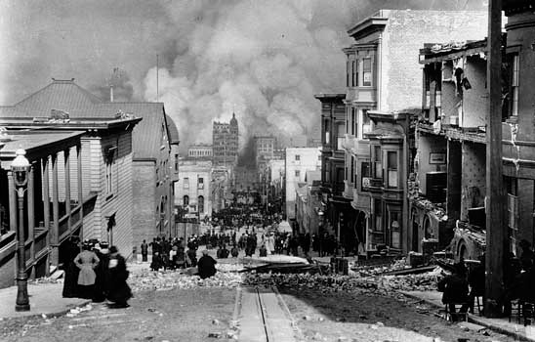
The San Francisco Earthquake
Sept. 1, 1902: Well-equipped tent meetings should be held in the large cities, such as San Francisco; for not long hence these cities will suffer under the judgments of God. San Francisco and Oakland are becoming as Sodom and Gomorrah, and the Lord will visit them in wrath. (Manuscript 1902, p. 114)
The San Francisco Earthquake of April 18, 1906 was followed by a fire lasting four days and destroying 497 city blocks covering five square miles. 28,188 buildings were demolished, causing approximately a billion dollars in damage and costing 500 lives.

Slide 20
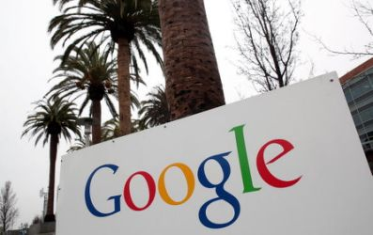
“In the world gigantic monopolies will be formed. Men will bind themselves together in unions that will wrap them in the folds of the enemy. A few men will combine to grasp all the means to be obtained in certain lines of business. Trades unions will be formed, and those who refuse to join these unions will be marked men”—Letter 26, 1903

Slide 21
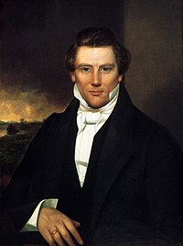
“Yea, the word of the Lord concerning his church, established in the last days for the restoration of his people, as he has spoken by the mouth of his prophets, and for the gathering of his saints to stand upon Mount Zion, which shall be the city of New Jerusalem. Which city shall be built, beginning at the temple lot, which is appointed by the finger of the Lord, in the western boundaries of the State of Missouri, and dedicated by the hand of Joseph Smith, Jun., and others with whom the Lord was well pleased. . . . Therefore, as I said concerning the sons of Moses for the sons of Moses and also the sons of Aaron shall offer an acceptable offering and sacrifice in the house of the Lord, which house shall be built unto the Lord in this generation, upon the consecrated spot as I have appointed."(Doctrines and Covenants 84:2-3, 31)

