Slide 1
Jesus Life, pt.22 ‘Sabbath Truth’

Slide 2
For the Whole World
“The Sabbath was not for Israel merely, but for the world. It had been made known to man in Eden, and, like the other precepts of the Decalogue, it is of imperishable obligation. Of that law of which the fourth commandment forms a part, Christ declares, “Till heaven and earth pass, one jot or one tittle shall in nowise pass from the law.” So long as the heavens and the earth endure, the Sabbath will continue as a sign of the Creator's power. And when Eden shall bloom on earth again, God's holy rest day will be honored by all beneath the sun. “From one Sabbath to another” the inhabitants of the glorified new earth shall go up “to worship before Me, saith the Lord.” Matthew 5:18; Isaiah 66:23. No other institution which was committed to the Jews tended so fully to distinguish them from surrounding nations as did the Sabbath. God designed that its observance should designate them as His worshipers. It was to be a token of their separation from idolatry, and their connection with the true God. But in order to keep the Sabbath holy, men must themselves be holy. Through faith they must become partakers of the righteousness of Christ. When the command was given to Israel, “Remember the Sabbath day, to keep it holy,” the Lord said also to them, “Ye shall be holy men unto Me.” Exodus 20:8; 22:31. Only thus could the Sabbath distinguish Israel as the worshipers of God.” DA, pg. 283

Slide 3
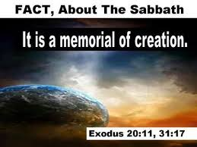
Sabbath at Creation
“Thus the heavens and the earth were finished, and all the host of them. And on the seventh day God ended his work which he had made; and he rested on the seventh day from all his work which he had made. And God blessed the seventh day, and sanctified it: because that in it he had rested from all his work which God created and made.” Genesis 2:1-3

Slide 4
Why Adventism Failed Anciently
“As the Jews departed from God, and failed to make the righteousness of Christ their own by faith, the Sabbath lost its significance to them. Satan was seeking to exalt himself and to draw men away from Christ, and he worked to pervert the Sabbath, because it is the sign of the power of Christ. The Jewish leaders accomplished the will of Satan by surrounding God's rest day with burdensome requirements. In the days of Christ the Sabbath had become so perverted that its observance reflected the character of selfish and arbitrary men rather than the character of the loving heavenly Father. The rabbis virtually represented God as giving laws which it was impossible for men to obey. They led the people to look upon God as a tyrant, and to think that the observance of the Sabbath, as He required it, made men hard-hearted and cruel.” DA, pg. 283

Slide 5
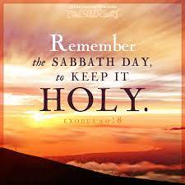
The Sabbath Sign
“But in order to keep the Sabbath holy, men must themselves be holy. Through faith they must become partakers of the righteousness of Christ. When the command was given to Israel, “Remember the Sabbath day, to keep it holy,” the Lord said also to them, “Ye shall be holy men unto Me.” Exodus 20:8; 22:31. Only thus could the Sabbath distinguish Israel as the worshipers of God.” DA, pg. 283

Slide 6
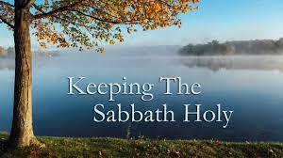
The SOP continually declares that the Sabbath/Saturday is about holiness. This is also clearly the truth of the Bible. The Sabbath is about resting in the power of Christ to save us from our sins. The Sabbath is ALL about righteousness coming by faith in Jesus Christ alone!!

Slide 7
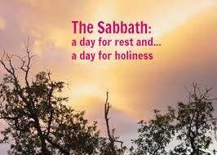
Proclaiming the Sabbath More Fully
Is this what the SOP was talking about when she declared, “At the commencement of the time of trouble, we were filled with the Holy Ghost as we went forth and proclaimed the Sabbath more fully. The commencement of that time of trouble, here mentioned, does not refer to the time when the plagues shall begin to be poured out, but to a short period just before they are poured out, while Christ is in the sanctuary. At that time, while the work of salvation is closing, trouble will be coming on the earth, and the nations will be angry, yet held in check so as not to prevent the work of the third angel. At that time the “latter rain,” or refreshing from the presence of the Lord, will come, to give power to the loud voice of the third angel, and prepare the saints to stand in the period when the seven last plagues shall be poured out.” LDE, pg. 143

Slide 8
Christ Cleared Rubbish from the Sabbath
“It was the work of Christ to clear away these misconceptions. Although the rabbis followed Him with merciless hostility, He did not even appear to conform to their requirements, but went straight forward, keeping the Sabbath according to the law of God. DA, pg. 283
“The Jews had so perverted the law that they made it a yoke of bondage. Their meaningless requirements had become a byword among other nations. Especially was the Sabbath hedged in by all manner of senseless restrictions. It was not to them a delight, the holy of the Lord, and honorable. The scribes and Pharisees had made its observance an intolerable burden. A Jew was not allowed to kindle a fire nor even to light a candle on the Sabbath. As a consequence the people were dependent upon the Gentiles for many services which their rules forbade them to do for themselves. They did not reflect that if these acts were sinful, those who employed others to perform them were as guilty as if they had done the work themselves. They thought that salvation was restricted to the Jews, and that the condition of all others, being already hopeless, could be made no worse. But God has given no commandments which cannot be obeyed by all. His laws sanction no unreasonable or selfish restrictions.

Slide 9
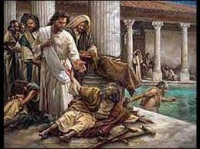
Sabbath-Healing and Restoration
“Jesus was again at Jerusalem. Walking alone, in apparent meditation and prayer, He came to the pool. He saw the wretched sufferers watching for that which they supposed to be their only chance of cure. He longed to exercise His healing power, and make every sufferer whole. But it was the Sabbath day. Multitudes were going to the temple for worship, and He knew that such an act of healing would so excite the prejudice of the Jews as to cut short His work.” DA, pg. 201

Slide 10
Help an animal, not a Human
“When questioned, “Is it lawful to heal on the Sabbath days?” Jesus answered, “What man shall there be among you, that shall have one sheep, and if it fall into a pit on the Sabbath day, will he not lay hold on it, and lift it out? How much then is a man better than a sheep? Wherefore it is lawful to do well on the Sabbath days.” Matthew 12:10-12. The spies dared not answer Christ in the presence of the multitude, for fear of involving themselves in difficulty. They knew that He had spoken the truth. Rather than violate their traditions, they would leave a man to suffer, while they would relieve a brute because of the loss to the owner if it were neglected. Thus greater care was shown for a dumb animal than for man, who is made in the image of God. This illustrates the working of all false religions. They originate in man's desire to exalt himself above God, but they result in degrading man below the brute. Every religion that wars against the sovereignty of God defrauds man of the glory which was his at the creation, and which is to be restored to him in Christ. Every false religion teaches its adherents to be careless of human needs, sufferings, and rights. The gospel places a high value upon humanity as the purchase of the blood of Christ, and it teaches a tender regard for the wants and woes of man. The Lord says, “I will make a man more precious than fine gold; even a man than the golden wedge of Ophir.” Isaiah 13:12.” DA, pg. 286

Slide 11
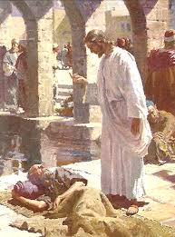
Would Christ Help and Break the Sabbath?
“But the Saviour saw one case of supreme wretchedness. It was that of a man who had been a helpless cripple for thirty-eight years. His disease was in a great degree the result of his own sin, and was looked upon as a judgment from God. Alone and friendless, feeling that he was shut out from God's mercy, the sufferer had passed long years of misery. At the time when it was expected that the waters would be troubled, those who pitied his helplessness would bear him to the porches. But at the favored moment he had no one to help him in. He had seen the rippling of the water, but had never been able to get farther than the edge of the pool.” DA, pg. 202

Slide 12
Would YOU Like to Walk?
“The sick man was lying on his mat, and occasionally lifting his head to gaze at the pool, when a tender, compassionate face bent over him, and the words, “Wilt thou be made whole?” arrested his attention. Hope came to his heart. He felt that in some way he was to have help. But the glow of encouragement soon faded. He remembered how often he had tried to reach the pool, and now he had little prospect of living till it should again be troubled. He turned away wearily, saying, “Sir, I have no man, when the water is troubled, to put me into the pool: but while I am coming, another steppeth down before me.” Jesus does not ask this sufferer to exercise faith in Him. He simply says, “Rise, take up thy bed, and walk.” But the man's faith takes hold upon that word. Every nerve and muscle thrills with new life, and healthful action comes to his crippled limbs. Without question he sets his will to obey the command of Christ, and all his muscles respond to his will. Springing to his feet, he finds himself an active man. Jesus had given him no assurance of divine help. The man might have stopped to doubt, and lost his one chance of healing. But he believed Christ's word, and in acting upon it he received strength.” DA, pg. 202,203

Slide 13
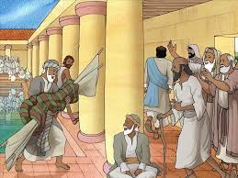
“Through the same faith we may receive spiritual healing. By sin we have been severed from the life of God. Our souls are palsied. Of ourselves we are no more capable of living a holy life than was the impotent man capable of walking. There are many who realize their helplessness, and who long for that spiritual life which will bring them into harmony with God; they are vainly striving to obtain it. In despair they cry, “O wretched man that I am! who shall deliver me from this body of death?” Romans 7:24, margin. Let these desponding, struggling ones look up. The Saviour is bending over the purchase of His blood, saying with inexpressible tenderness and pity, “Wilt thou be made whole?” He bids you arise in health and peace. Do not wait to feel that you are made whole. Believe His word, and it will be fulfilled. Put your will on the side of Christ.” DA, pg. 203

Slide 14
Sabbath and Restoration
“The restored paralytic stooped to take up his bed, which was only a rug and a blanket, and as he straightened himself again with a sense of delight, he looked around for his Deliverer; but Jesus was lost in the crowd. The man feared that he would not know Him if he should see Him again. As he hurried on his way with firm, free step, praising God and rejoicing in his new-found strength, he met several of the Pharisees, and immediately told them of his cure. He was surprised at the coldness with which they listened to his story.
With lowering brows they interrupted him, asking why he was carrying his bed on the Sabbath day. They sternly reminded him that it was not lawful to bear burdens on the Lord's day. In his joy the man had forgotten that it was the Sabbath; yet he felt no condemnation for obeying the command of One who had such power from God. He answered boldly, “He that made me whole, the same said unto me, Take up thy bed, and walk.” They asked who it was that had done this, but he could not tell. These rulers knew well that only One had shown Himself able to perform this miracle; but they wished for direct proof that it was Jesus, that they might condemn Him as a Sabbath-breaker. In their judgment He had not only broken the law in healing the sick man on the Sabbath, but had committed sacrilege in bidding him bear away his bed.” DA, pg. 203

Slide 15
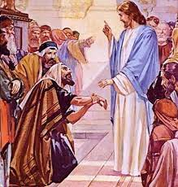
“Nature must continue her unvarying course. God could not for a moment stay His hand, or man would faint and die. And man also has a work to perform on this day. The necessities of life must be attended to, the sick must be cared for, the wants of the needy must be supplied. He will not be held guiltless who neglects to relieve suffering on the Sabbath. God's holy rest day was made for man, and acts of mercy are in perfect harmony with its intent. God does not desire His creatures to suffer an hour's pain that may be relieved upon the Sabbath or any other day.
The demands upon God are even greater upon the Sabbath than upon other days. His people then leave their usual employment, and spend the time in meditation and worship. They ask more favors of Him on the Sabbath than upon other days. They demand His special attention. They crave His choicest blessings. God does not wait for the Sabbath to pass before He grants these requests.” DA, pg. 207

