Slide 1
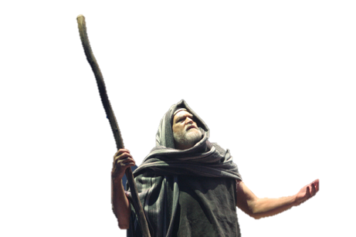
Aaron’s Rod

Slide 2
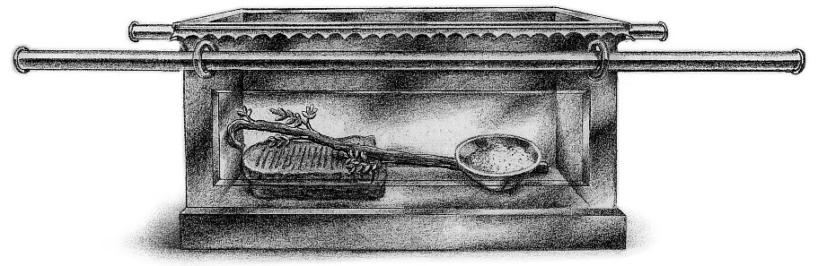
Key Text
Heb 9:4 “Which had the golden censer, and the ark of the covenant overlaid round about with gold, wherein was the golden pot that had manna, and Aaron's rod that budded, and the tables of the covenant”

Slide 3
Who’s Rod???
Ex. 4:1-4, 17, 20 “And Moses answered and said, But, behold, they will not believe me, nor hearken unto my voice: for they will say, The LORD hath not appeared unto thee. And the LORD said unto him, What is that in thine hand? And he said, A rod. And he said Cast it on the ground. And he cast it on the ground, and it became a serpent; and Moses fled before it. And the LORD said unto Moses, Put forth thine hand, and take it by the tail. And he put forth his hand, and caught it, and it became a rod in his hand. . . And thou shalt take this rod in thine hand, wherewith thou shalt do signs. . . And Moses took his wife and his sons, and set them upon an ass, and he returned to the land of Egypt: and Moses took the rod of God in his hand.”
Ex. 17:9 “And Moses said unto Joshua, Choose us out men, and go out, fight with Amalek: to morrow I will stand on the top of the hill with the rod of God in mine hand.”

Slide 4
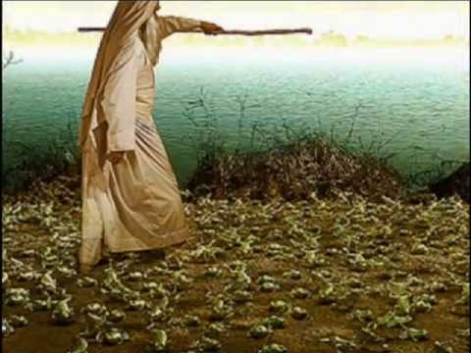
Rod of God to Aaron
Ex. 7:9, 19 “When Pharaoh shall speak unto you, saying, Shew a miracle for you: then thou shalt say unto Aaron, Take thy rod, and cast it before Pharaoh, and it shall become a serpent. . . And the LORD spake unto Moses, say unto Aaron, Take thy rod, and stretch out thine hand upon the waters of Egypt, upon their streams, upon their rivers, and upon their ponds, and upon all their pools of water, that they may become blood; and that there may be blood throughout all the land of Egypt, both in vessels of wood, and in vessels of stone.

Slide 5
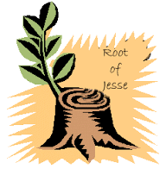
The Symbols
1. The Messiah- Is. 11:1 “And there shall come forth a rod out of the stem of Jesse, and a Branch shall grow out of his roots”
Micah 6:9 “The LORD'S voice crieth unto the city, and the man of wisdom shall see thy name: hear ye the rod, and who hath appointed it.”

Slide 6
Revisiting the Promise
2 Sam. 7:12-17 “And when thy days be fulfilled, and thou shalt sleep with thy fathers, I will set up thy seed after thee, which shall proceed out of thy bowels, and I will establish his kingdom. He shall build an house for my name, and I will stablish the throne of his kingdom for ever. I will be his father, and he shall be my son. If he commit iniquity, I will chasten him with the rod of men, and with the stripes of the children of men: But my mercy shall not depart away from him, as I took it from Saul, whom I put away before thee. And thine house and thy kingdom shall be established for ever before thee: thy throne shall be established for ever. According to all these words, and according to all this vision, so did Nathan speak unto David.”
Rom. 1:3 “Concerning his Son Jesus Christ our Lord, which was made of the seed of David according to the flesh”

Slide 7
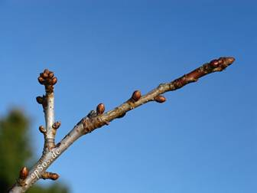
The Branch
Jer. 33:15 “In those days, and at that time, will I cause the Branch of righteousness to grow up unto David; and he shall execute judgment and righteousness in the land.”
Zech. 6:12 “And speak unto him, saying, Thus speaketh the LORD of hosts, saying, Behold the man whose name is The BRANCH; and he shall grow up out of his place, and he shall build the temple of the LORD”

Slide 8

Other Symbols
2. God’s inheritance- Ps. 74:2 “Remember thy congregation, which thou hast purchased of old; the rod of thine inheritance, which thou hast redeemed; this mount Zion, wherein thou hast dwelt.”
Matt. 7:21 “Not every one that saith unto me, Lord, Lord, shall enter into the kingdom of heaven; but he that doeth the will of my Father which is in heaven”

Slide 9
Doing the Father’s Will
Luke 18:18-20 “And a certain ruler asked him, saying, Good Master, what shall I do to inherit eternal life? And Jesus said unto him, Why callest thou me good? none is good, save one, that is, God. Thou knowest the commandments, Do not commit adultery, Do not kill, Do not steal, Do not bear false witness, Honour thy father and thy mother.
Luke 9:23 “And he said to them all, If any man will come after me, let him deny himself, and take up his cross daily, and follow me.
1 Pet. 2:21 “For even hereunto were ye called: because Christ also suffered for us, leaving us an example, that ye should follow his steps:

Slide 10
Father’s Will Continued…
Lev. 19:2 “Speak unto all the congregation of the children of Israel, and say unto them, Ye shall be holy: for I the LORD your God am holy.”
Matt 5:48 “Be ye therefore perfect, even as your Father which is in heaven is perfect.”
1 Thess. 4:3-8 “For this is the will of God, even your sanctification, that ye should abstain from fornication: That every one of you should know how to possess his vessel in sanctification and honour; Not in the lust of concupiscence, even as the Gentiles which know not God: That no man go beyond and defraud his brother in any matter: because that the Lord is the avenger of all such, as we also have forewarned you and testified. For God hath not called us unto uncleanness, but unto holiness. He therefore that despiseth, despiseth not man, but God, who hath also given unto us his holy Spirit.

Slide 11
Father’s Will Continued. . .
Matt. 28:16-20 “Then the eleven disciples went away into Galilee, into a mountain where Jesus had appointed them. And when they saw him, they worshipped him: but some doubted. And Jesus came and spake unto them, saying, All power is given unto me in heaven and in earth. Go ye therefore, and teach all nations, baptizing them in the name of the Father, and of the Son, and of the Holy Ghost: Teaching them to observe all things whatsoever I have commanded you: and, lo, I am with you always, even unto the end of the world. Amen.
1 Tim. 2:3-4 “For this is good and acceptable in the sight of God our Saviour; Who will have all men to be saved, and to come unto the knowledge of the truth.”

Slide 12
The Two Sticks
Ez. 37:16-25 “Moreover, thou son of man, take thee one stick, and write upon it, For Judah, and for the children of Israel his companions: then take another stick, and write upon it, For Joseph, the stick of Ephraim and for all the house of Israel his companions: And join them one to another into one stick; and they shall become one in thine hand. And when the children of thy people shall speak unto thee, saying, Wilt thou not shew us what thou meanest by these? Say unto them, Thus saith the Lord God; Behold, I will take the stick of Joseph, which is in the hand of Ephraim, and the tribes of Israel his fellows, and will put them with him, even with the stick of Judah, and make them one stick, and they shall be one in mine hand. And the sticks whereon thou writest shall be in thine hand before their eyes. And say unto them, Thus saith the Lord God; Behold, I will take the children of Israel from among the heathen, whither they be gone, and will gather them on every side, and bring them into their own land: And I will make them one nation in the land upon the mountains of Israel; and one king shall be king to them all: and they shall be no more two nations, neither shall they be divided into two kingdoms any more at all. Neither shall they defile themselves any more with their idols, nor with their detestable things, nor with any of their transgressions: but I will save them out of all their dwellingplaces, wherein they have sinned, and will cleanse them: so shall they be my people, and I will be their God. And David my servant shall be king over them; and they all shall have one shepherd: they shall also walk in my judgments, and observe my statutes, and do them. And they shall dwell in the land that I have given unto Jacob my servant, wherein your fathers have dwelt; and they shall dwell therein, even they, and their children, and their children's children for ever: and my servant David shall be their prince for ever.”

Slide 13
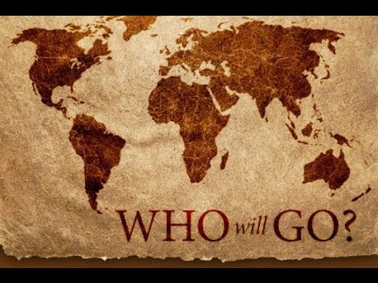
More Symbols of the Rod
3. Power of spreading the Gospel- Ps. 110:1-4 “The Lord said unto my Lord, Sit thou at my right hand, until I make thine enemies thy footstool. The Lord shall send the rod of thy strength out of Zion: rule thou in the midst of thine enemies. Thy people shall be willing in the day of thy power, in the beauties of holiness from the womb of the morning: thou hast the dew of thy youth. The Lord hath sworn, and will not repent, Thou art a priest for ever after the order of Melchizedek.”

Slide 14
Father’s Will for this Time
We are now living in the closing scenes of this world’s history. Let men tremble with the sense of the responsibility of knowing the truth. The ends of the world are come. Proper consideration of these things will lead all to make an entire consecration of all that they have and are to their God. . . . The weighty obligation of warning a world of its coming doom is upon us. From every direction, far and near, calls are coming to us for help. The church, devotedly consecrated to the work, is to carry the message to the world: Come to the gospel feast; the supper is prepared, come. . . . Crowns, immortal crowns, are to be won. The kingdom of heaven is to be gained. A world, perishing in sin, is to be enlightened. The lost pearl is to be found. The lost sheep is to be brought back in safety to the fold. Who will join in the search? Who will bear the light to those who are wandering in the darkness of error? . . . We should now feel the responsibility of laboring with intense earnestness to impart to others the truths that God has given for this time. We cannot be too much in earnest. . . . Now is the time for the last warning to be given. There is a special power in the presentation of the truth at the present time; but how long will it continue?—Only a little while. If there was ever a crisis, it is now. All are now deciding their eternal destiny. Men need to be aroused to realize the solemnity of the time, the nearness of the day when human probation shall be ended. Decided efforts should be made to bring the message for this time prominently before the people. The third angel is to go forth with great power. Evangelistic work, opening the Scriptures to others, warning men and women of what is coming upon the world, is to occupy more and still more of the time of God’s servants. (Ellen White, Evangelism, p. 16,17).

Slide 15
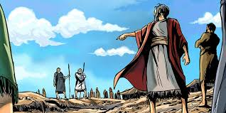
The Rebellion and the Rod
Numbers 16:1-3 “Now Korah, the son of Izhar, the son of Kohath, the son of Levi, and Dathan and Abiram, the sons of Eliab, and On, the son of Peleth, sons of Reuben, took men: And they rose up before Moses, with certain of the children of Israel, two hundred and fifty princes of the assembly, famous in the congregation, men of renown: And they gathered themselves together against Moses and against Aaron, and said unto them, Ye take too much upon you, seeing all the congregation are holy, every one of them, and the Lord is among them: wherefore then lift ye up yourselves above the congregation of the Lord?”

Slide 16
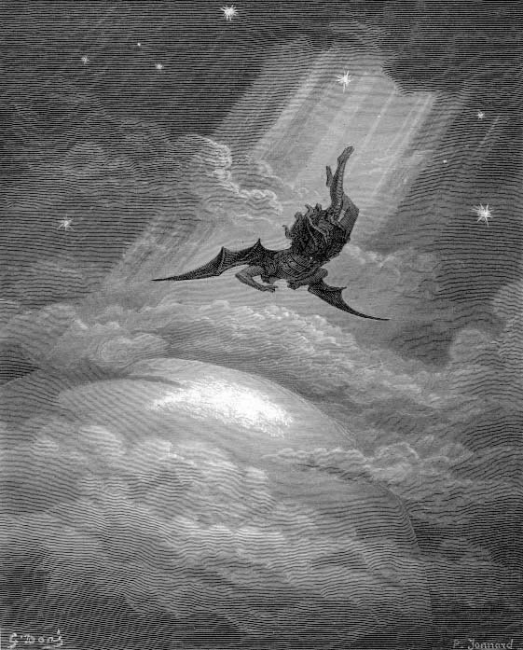
Where Have We seen this before?
Those men of Israel were determined to resist all evidence that would prove them to be wrong, and they went on and on in their course of disaffection until many were drawn away to unite with them. Who were these? Not the weak, not the ignorant, not the unenlightened. In that rebellion there were two hundred and fifty princes famous in the congregation, men of renown (EW, Letter 2a, 1892)

Slide 17
Same Mindset!!
The judgments visited upon the Israelites served for a time to restrain their murmuring and insubordination, but the spirit of rebellion was still in the heart and eventually brought forth the bitterest fruits. The former rebellions had been mere popular tumults, arising from the sudden impulse of the excited multitude; but now a deep-laid conspiracy was formed, the result of a determined purpose to overthrow the authority of the leaders appointed by God Himself. (PP, 394)
Korah had cherished his envy and rebellion until he was self-deceived, and he really thought that the congregation was a very righteous people, and that Moses was a tyrannical ruler, continually dwelling upon the necessity of the congregation’s being holy, when there was no need of it for they were holy (EW, Spiritual Gifts Vol. 4, p. 31).

Slide 18
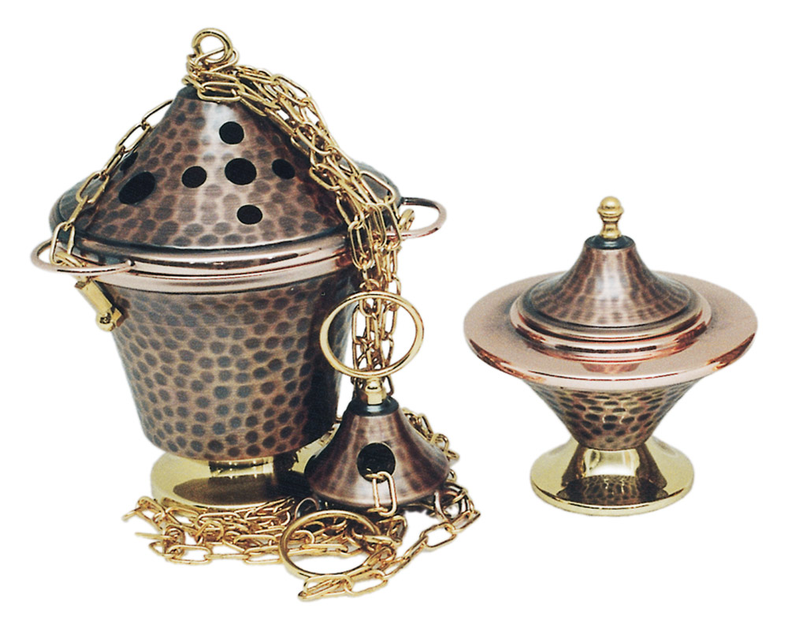
The Censers
Num. 16:5-7 “And he spake unto Korah and unto all his company, saying, Even to morrow the Lord will shew who are his, and who is holy; and will cause him to come near unto him: even him whom he hath chosen will he cause to come near unto him. This do; Take you censers, Korah, and all his company; And put fire therein, and put incense in them before the Lord to morrow: and it shall be that the man whom the Lord doth choose, he shall be holy: ye take too much upon you, ye sons of Levi.

Slide 19
Discontent and Unsatisfied
Num. 16:8-14 “And Moses said unto Korah, Hear, I pray you, ye sons of Levi: Seemeth it but a small thing unto you, that the God of Israel hath separated you from the congregation of Israel, to bring you near to himself to do the service of the tabernacle of the Lord, and to stand before the congregation to minister unto them? And he hath brought thee near to him, and all thy brethren the sons of Levi with thee: and seek ye the priesthood also? For which cause both thou and all thy company are gathered together against the Lord: and what is Aaron, that ye murmur against him? And Moses sent to call Dathan and Abiram, the sons of Eliab: which said, We will not come up: Is it a small thing that thou hast brought us up out of a land that floweth with milk and honey, to kill us in the wilderness, except thou make thyself altogether a prince over us? Moreover thou hast not brought us into a land that floweth with milk and honey, or given us inheritance of fields and vineyards: wilt thou put out the eyes of these men? we will not come up.

Slide 20
Moses and Aaron Pray for the People. . .
Num. 16:16-25 “And Moses said unto Korah, Be thou and all thy company before the Lord, thou, and they, and Aaron, to morrow: And take every man his censer, and put incense in them, and bring ye before the Lord every man his censer, two hundred and fifty censers; thou also, and Aaron, each of you his censer. And they took every man his censer, and put fire in them, and laid incense thereon, and stood in the door of the tabernacle of the congregation with Moses and Aaron. And Korah gathered all the congregation against them unto the door of the tabernacle of the congregation: and the glory of the Lord appeared unto all the congregation. And the Lord spake unto Moses and unto Aaron, saying, Separate yourselves from among this congregation, that I may consume them in a moment. And they fell upon their faces, and said, O God, the God of the spirits of all flesh, shall one man sin, and wilt thou be wroth with all the congregation? And the Lord spake unto Moses, saying, Speak unto the congregation, saying, Get you up from about the tabernacle of Korah, Dathan, and Abiram.

Slide 21
The Decision is Made
Num. 16:26-33 “And he spake unto the congregation, saying, Depart, I pray you, from the tents of these wicked men, and touch nothing of their's, lest ye be consumed in all their sins. So they gat up from the tabernacle of Korah, Dathan, and Abiram, on every side: and Dathan and Abiram came out, and stood in the door of their tents, and their wives, and their sons, and their little children. And Moses said, Hereby ye shall know that the Lord hath sent me to do all these works; for I have not done them of mine own mind. If these men die the common death of all men, or if they be visited after the visitation of all men; then the Lord hath not sent me. But if the Lord make a new thing, and the earth open her mouth, and swallow them up, with all that appertain unto them, and they go down quick into the pit; then ye shall understand that these men have provoked the Lord. And it came to pass, as he had made an end of speaking all these words, that the ground clave asunder that was under them: And the earth opened her mouth, and swallowed them up, and their houses, and all the men that appertained unto Korah, and all their goods. They, and all that appertained to them, went down alive into the pit, and the earth closed upon them: and they perished from among the congregation.

Slide 22
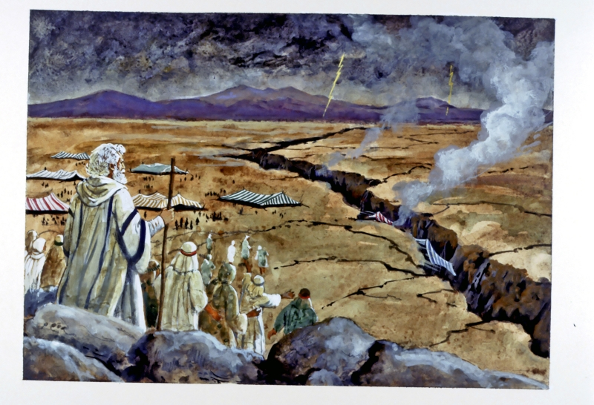
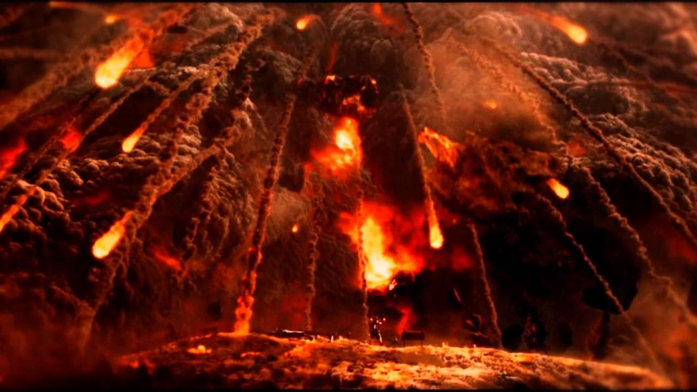
Fire From Heaven
Num. 16:35 “And there came out a fire from the LORD, and consumed the two hundred and fifty men that offered incense.
Killed like Sodomites! Good Lesson for US! Stay away from the rebels of God.

Slide 23
Why Did it Happen?
The facts relative to Korah and his company, who rebelled against Moses and Aaron, and against Jehovah, are recorded for a warning to God's people, especially those who live upon the earth near the close of time. Satan has led persons to imitate the example of Korah, Dathan and Abiram, in raising insurrection among the people of God. Those who permit themselves to rise in opposition to the plain testimony, become self-deceived, and have really thought that those upon whom God laid the burden of his work were exalted above the people of God, and that their counsels and reproofs were uncalled for. They have risen in opposition to the plain testimony which God would have them bear in rebuking the wrongs among God's people. The testimonies borne against hurtful indulgences, as tea, coffee, snuff and tobacco, have irritated a certain class, because it would destroy their idols. Many for a while were undecided whether to make an entire sacrifice of all these hurtful things, or reject the plain testimonies borne, and yield to the clamors of appetite. They occupied an unsettled position. There was a conflict between their convictions of truth and their self-indulgences. Their state of indecision made them weak, and with many, appetite prevailed. Their sense of sacred things was perverted by the use of these slow poisons; and they at length fully decided, let the consequence be what it might, they would not deny self. (Spirit of Prophecy, vol. 1. p. 306)

Slide 24
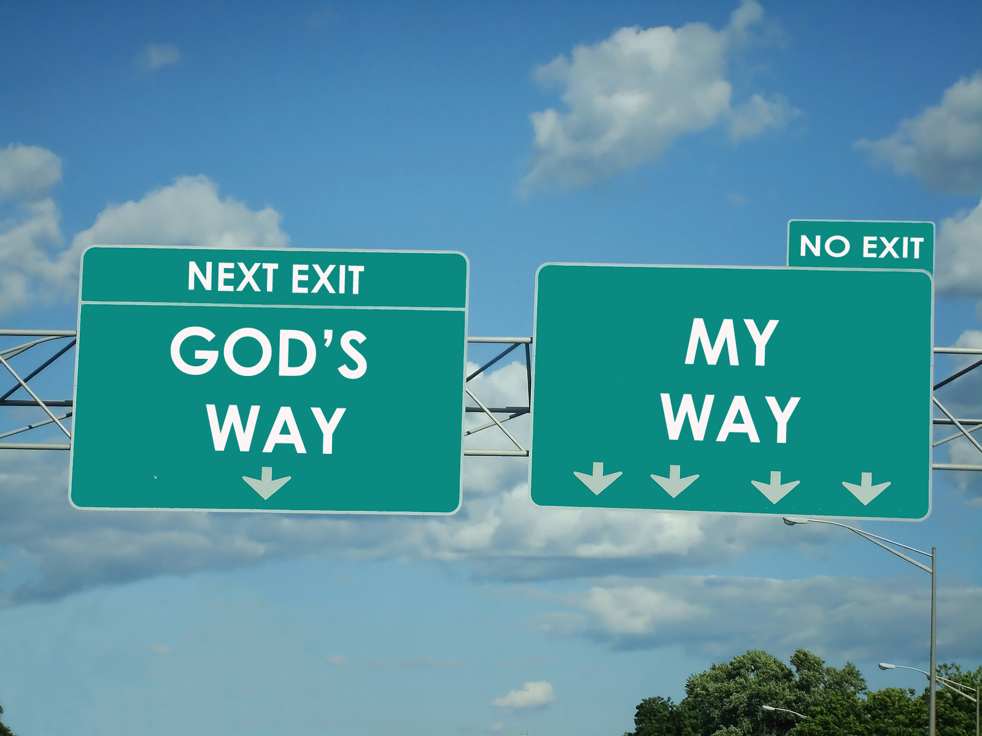
A New Sign for Israel
Num. 16:38-40 “The censers of these sinners against their own souls, let them make them broad plates for a covering of the altar: for they offered them before the Lord, therefore they are hallowed: and they shall be a sign unto the children of Israe. And Eleazar the priest took the brasen censers, wherewith they that were burnt had offered; and they were made broad plates for a covering of the altar: To be a memorial unto the children of Israel, that no stranger, which is not of the seed of Aaron, come near to offer incense before the Lord; that he be not as Korah, and as his company: as the Lord said to him by the hand of Moses.

Slide 25
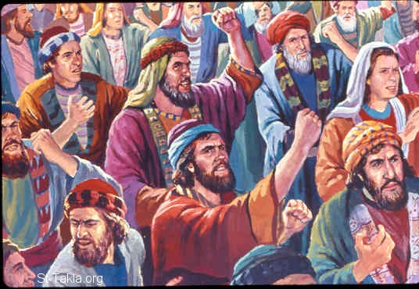
Lesson Learned Right?
Num. 16:41-50 “But on the morrow all the congregation of the children of Israel murmured against Moses and against Aaron, saying, Ye have killed the people of the Lord. And it came to pass, when the congregation was gathered against Moses and against Aaron, that they looked toward the tabernacle of the congregation: and, behold, the cloud covered it, and the glory of the Lord appeared. And Moses and Aaron came before the tabernacle of the congregation. And the Lord spake unto Moses, saying, Get you up from among this congregation, that I may consume them as in a moment. And they fell upon their faces. And Moses said unto Aaron, Take a censer, and put fire therein from off the altar, and put on incense, and go quickly unto the congregation, and make an atonement for them: for there is wrath gone out from the Lord; the plague is begun. And Aaron took as Moses commanded, and ran into the midst of the congregation; and, behold, the plague was begun among the people: and he put on incense, and made an atonement for the people. And he stood between the dead and the living; and the plague was stayed. Now they that died in the plague were fourteen thousand and seven hundred, beside them that died about the matter of Korah. And Aaron returned unto Moses unto the door of the tabernacle of the congregation: and the plague was stayed.”

Slide 26
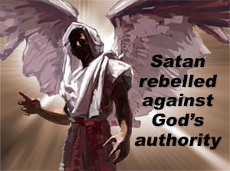
Mrs. White Elaborates
These men of Israel complained, and influenced the people to stand with them in rebellion, and even after God stretched forth Hus hand and swallowed up the wrong-doers, and the people fled to their tents in horror, their rebellion was not cured. The depth of their disaffection was med manifest even under the judgment of the Lord. The morning after the destruction of Korah, Dathan, and Abiram and their confederates, the people came to Moses and Aaron, saying, “Ye have killed the people of the Lord.” For this false charge on the servants of God, thousands more were killed, for there was in them sin, exultation and presumptuous wickedness. (Letter 12a, 1893)

Slide 27
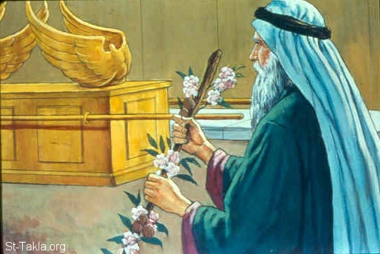
God’s Mercy Grants Another Sign
Num 17:2-5 “Speak unto the children of Israel, and take of every one of them a rod according to the house of their fathers, of all their princes according to the house of their fathers twelve rods: write thou every man's name upon his rod. And thou shalt write Aaron's name upon the rod of Levi: for one rod shall be for the head of the house of their fathers. And thou shalt lay them up in the tabernacle of the congregation before the testimony, where I will meet with you. And it shall come to pass, that the man's rod, whom I shall choose, shall blossom: and I will make to cease from me the murmurings of the children of Israel, whereby they murmur against you.

Slide 28
The Resurrection of the Rod
Num. 17:8-10, 12 “And it came to pass, that on the morrow Moses went into the tabernacle of witness; and, behold, the rod of Aaron for the house of Levi was budded, and brought forth buds, and bloomed blossoms, and yielded almonds. And Moses brought out all the rods from before the Lord unto all the children of Israel: and they looked, and took every man his rod. And the Lord said unto Moses, Bring Aaron's rod again before the testimony, to be kept for a token against the rebels; and thou shalt quite take away their murmurings from me, that they die not. . . And the children of Israel spake unto Moses, saying, Behold, we die, we perish, we all perish.”

Slide 29
The Rod Preserved to Preserve Others
All the remarkable changes in the rod occurred in one night, to convince them that God had positively distinguished between Aaron and the rest of Israel. After this miracle of divine power, the authority of the priesthood was no longer called in question. This wonderful rod was preserved to be frequently shown to the people to remind them of the past, to prevent them from murmuring, and again calling in question to whom the priesthood rightfully belonged. After the children of Israel were fully convinced of their wrong, in unjustly accusing Moses and Aaron, as they had done, they saw their past rebellion in its true light, and they were terrified. They spake unto Moses, saying, “Behold we die, we perish; we all perish.” They are at length compelled to believe the unwelcome truth, that their fate is to die in the wilderness. After they believed that it was indeed the Lord who had said they should not enter the promised land, but should die, they then acknowledged that Moses and Aaron were right, and that they had sinned against the Lord, in rebelling against their authority. They also confessed that Korah, and those who perished with him, were sinners against the Lord and that they had justly suffered His wrath. (Spiritual Gifts Vol. 4, p. 35, 36)

Slide 30
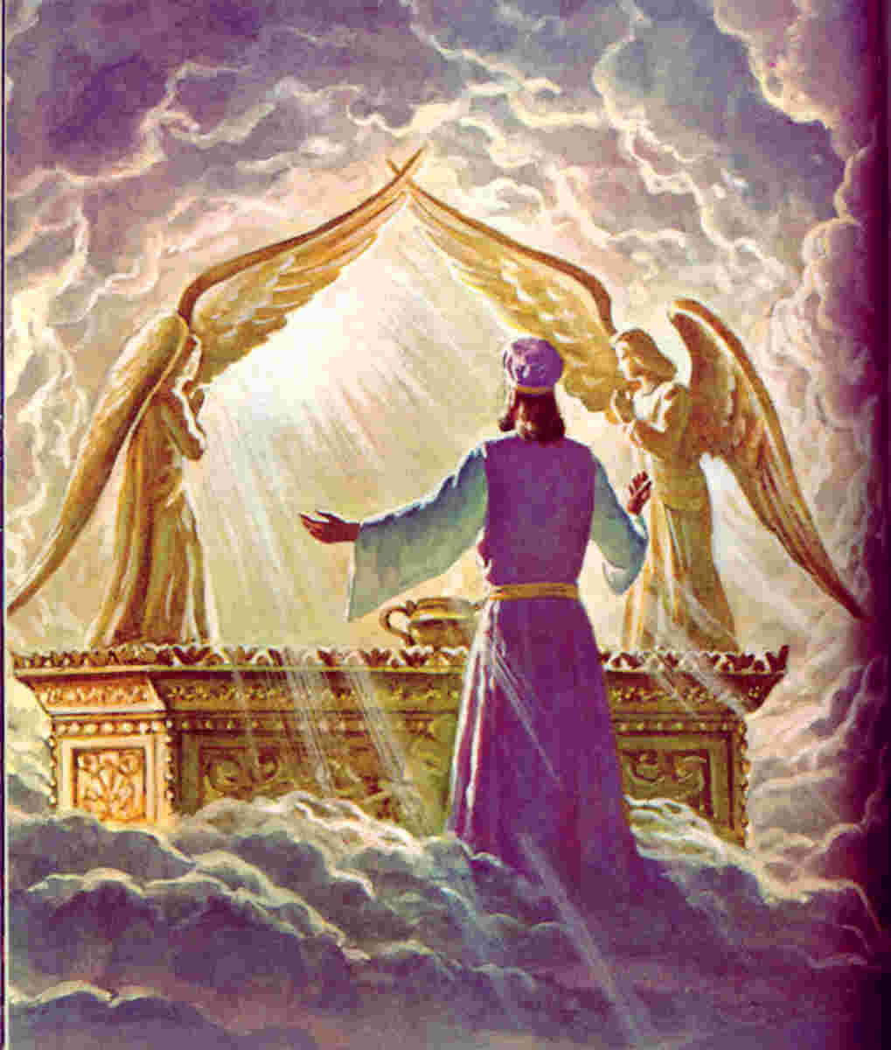
More Symbols Taken From this Story
4. God’s Chosen-As the Bible and Mrs. White clearly point out, the demise of Korah, censers, plagues, and Aaron’s rod budding were all lessons to make it undoubtedly clear that God had made His decision in regards to the leadership, who was the typologically “anointed” ones, and the privilege of the priesthood. None of these positions were negotiable, nor would attempts to usurp authority be tolerated.

Slide 31
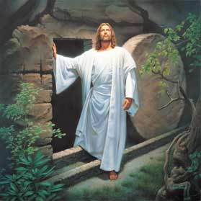
5. Resurrection-A rod is a branch or trunk which is no longer alive and dwelling in the ground collecting nourishment. It is a dead and deteriorating item. However, Aaron’s rod budded and blossomed, showing the resurrection of this dead branch through the power of God. Just like Jesus, who was the BRANCH and died for our sins, He rose again and budded and blossomed in newness of life given to Him by His Father. For this reason, Aaron’s rod is a clear symbol for the resurrection and future work of Christ (at that point). It is a promise that if we are the branches to Christ’s VINE, then we will share in His destiny.

Slide 32
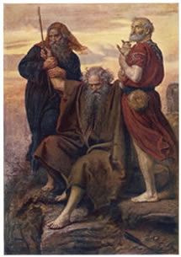
6. Power-The Rod had become a symbol for God’s power by the many uses of it, including the plagues, the Amalekite battle, the priesthood selection, and induction into the ark of the Covenant. Mrs. White states: “God would make that rod the symbol of His power… In place of a shepherd’s crook a rod of power had been given him” (PP, 251, 396).

Slide 33
Verses Read in a new light. . .
Jer. 1:11-12 “Moreover the word of the LORD came unto me, saying, Jeremiah, what seest thou? And I said, I see a rod of an almond tree. Then said the LORD unto me, Thou hast well seen: for I will hasten my word to perform it.“
Psalm 23:4 “Yea, though I walk through the valley of the shadow of death, I will fear no evil: for thou art with me; thy rod and thy staff they comfort me.”
Job 21:9 “Their houses are safe from fear, neither is the rod of God upon them.“

Slide 34
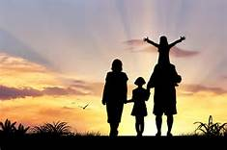
Rev. 11:1 “And there was given me a reed like unto a rod: and the angel stood, saying, Rise, and measure the temple of God, and the altar, and them that worship therein.”
Proverbs 13:24 “He that spareth his rod hateth his son: but he that loveth him chasteneth him betimes.”

Slide 35
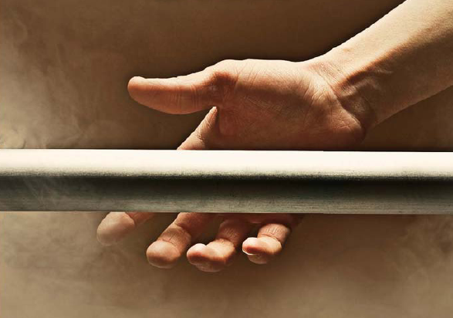
Rod of Iron
To the Overcomer-Rev. 2:27 “And he shall rule them with a rod of iron; as the vessels of a potter shall they be broken to shivers: even as I received of my Father.”
Jesus to Rule-Rev. 19:15 “And out of his mouth goeth a sharp sword, that with it he should smite the nations: and he shall rule them with a rod of iron: and he treadeth the winepress of the fierceness and wrath of Almighty God.

Slide 36
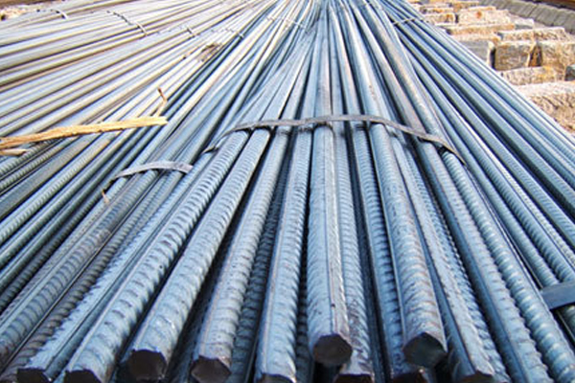
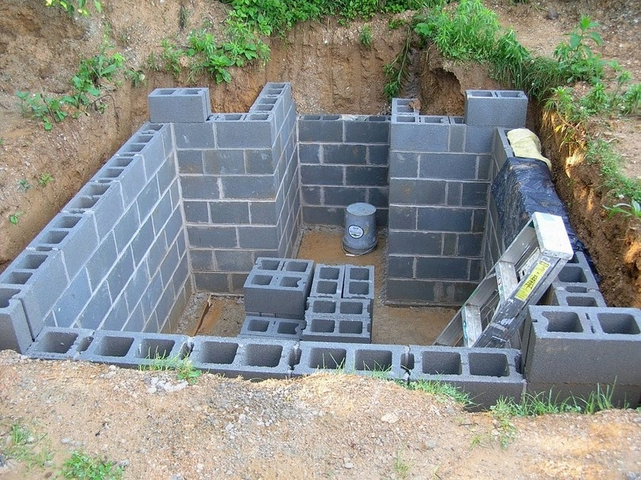
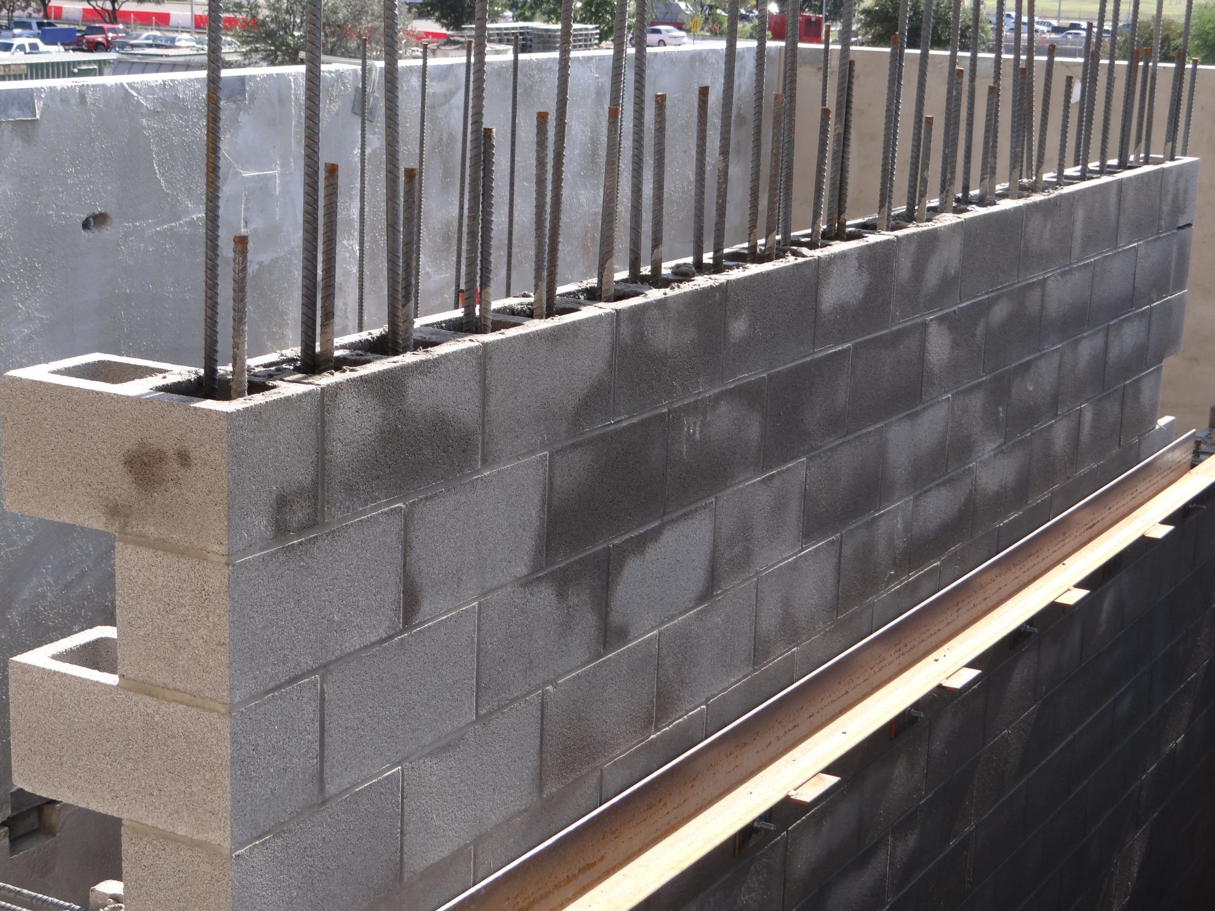
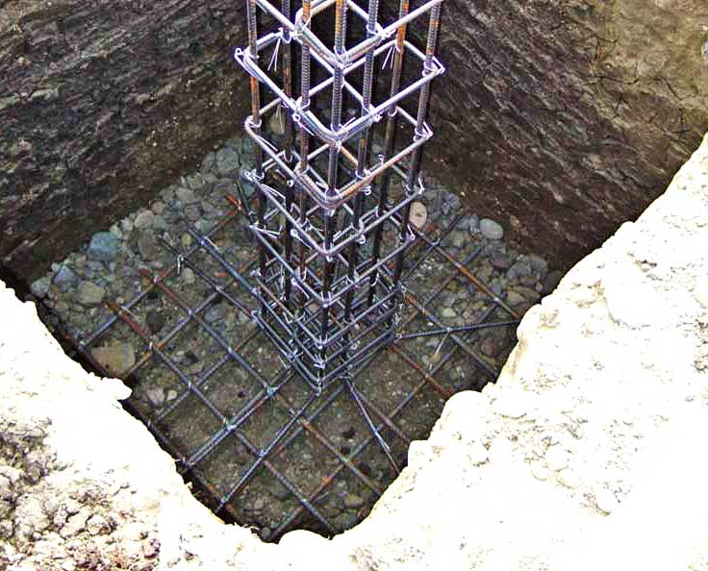
What are your Building Materials?

Slide 37
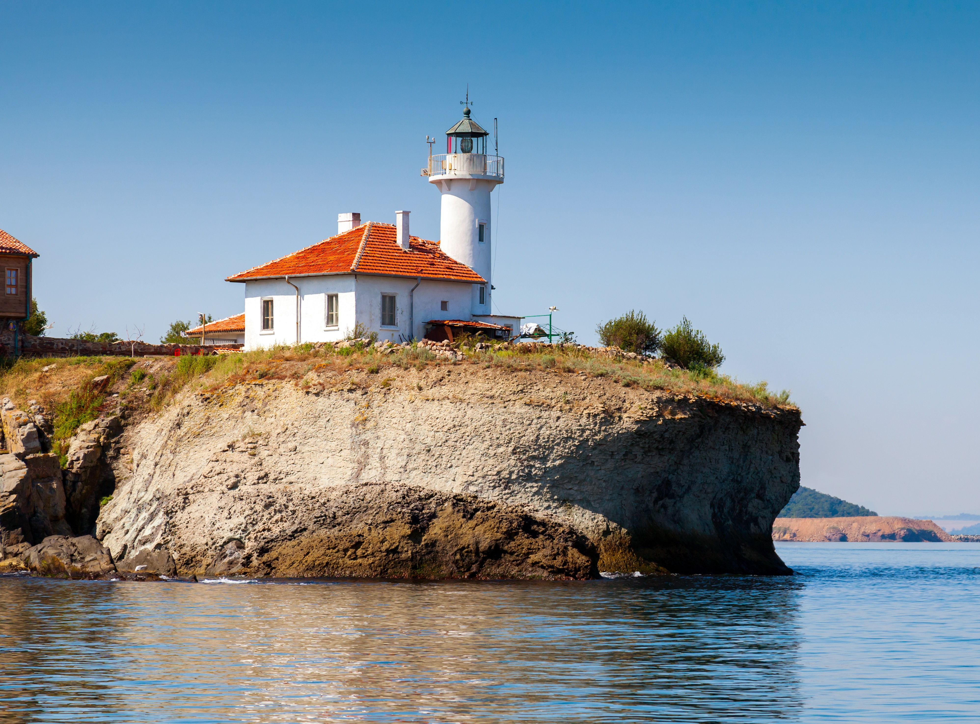
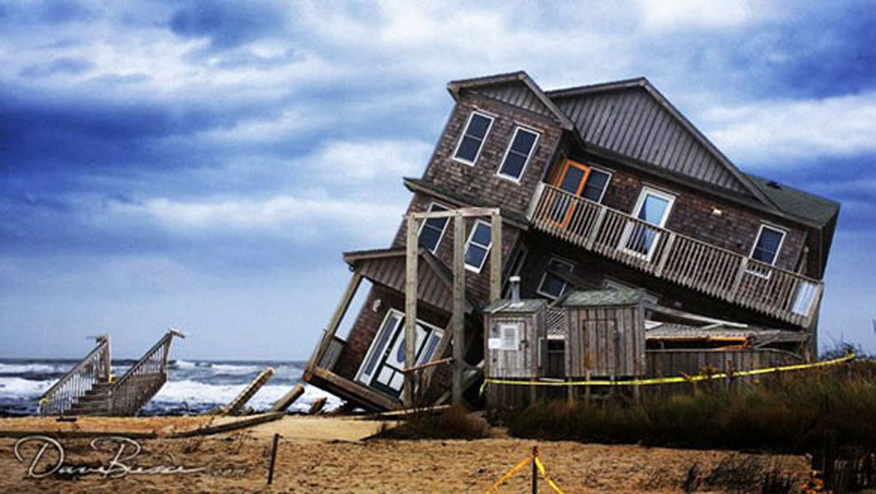
How’s Your Foundation?

Slide 38
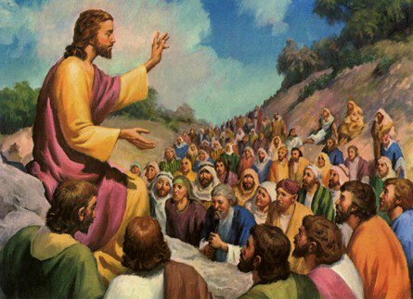
Hear the Rod!
Mic. 6:9 “The Lord's voice crieth unto the city, and the man of wisdom shall see thy name: hear ye the rod, and who hath appointed it.”
Mark 9:7 “And there was a cloud that overshadowed them: and a voice came out of the cloud, saying, This is my beloved Son: hear him.”

Slide 39
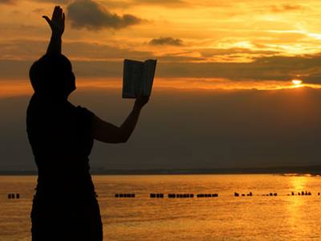
A Thoughtful Hour
It would be well for us to spend a thoughtful hour each day in contemplation of the life of Christ. We should take it point by point and let the imagination grasp each scene, especially the closing ones. (DA, p. 83)
Communion with God will ennoble the character and the life. Men will take knowledge of us, as of the first disciples, that we have been with Jesus. This will impart to the worker a power that nothing else can give. Of this power he must not allow himself to be deprived. We must live a twofold life--a life of thought and action, of silent prayer and earnest work. (The Ministry of Healing, p. 512)

