Slide 1
Behind the Door pt 30
The Catholic History of Mexico Continued

Slide 2
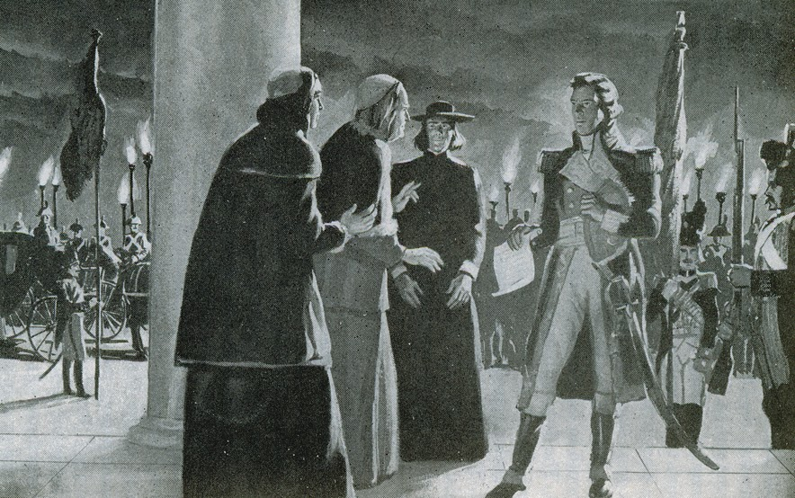
Revelation 17 & 18: 1798—End of Earth’s History
“With whom the kings of the earth have committed fornication, and the inhabitants of the earth have been made drunk with the wine of her fornication.” Rev. 17:2

Slide 3
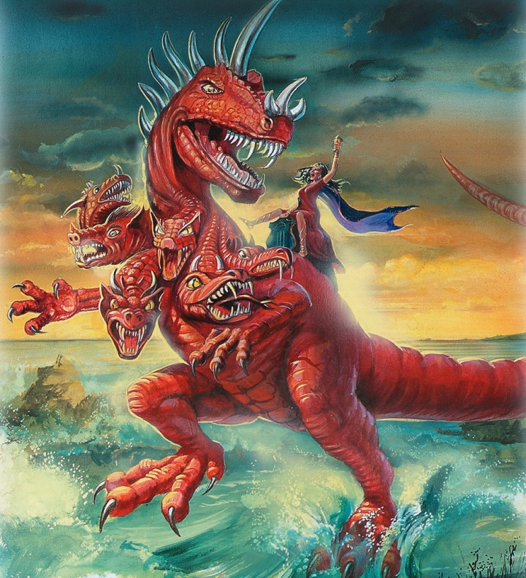
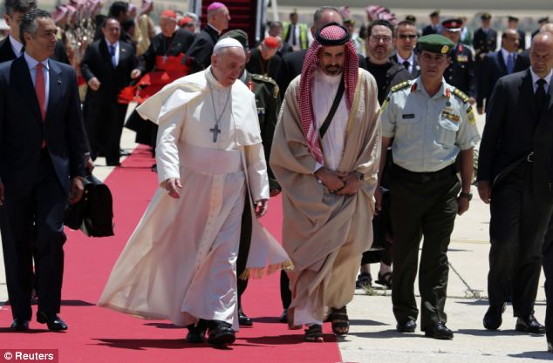
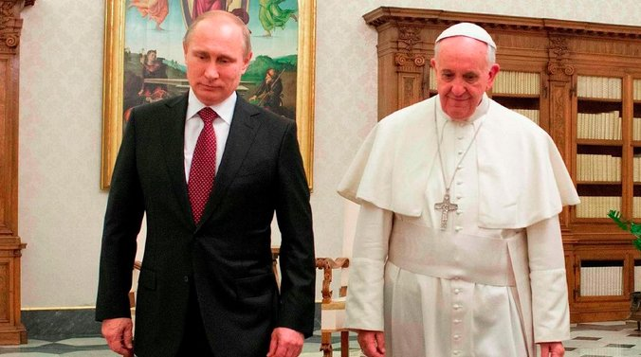
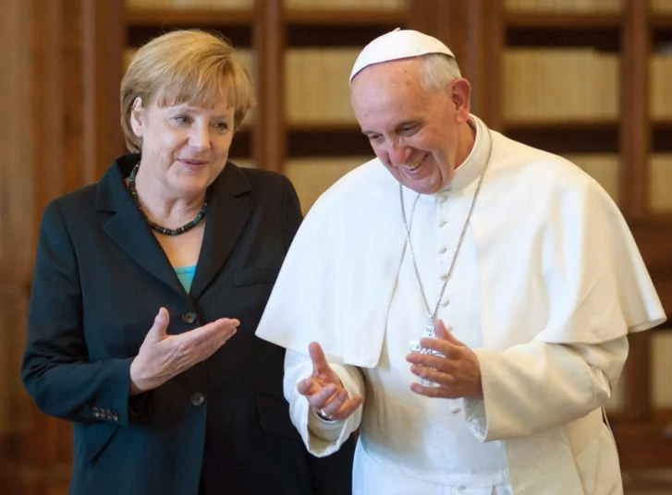
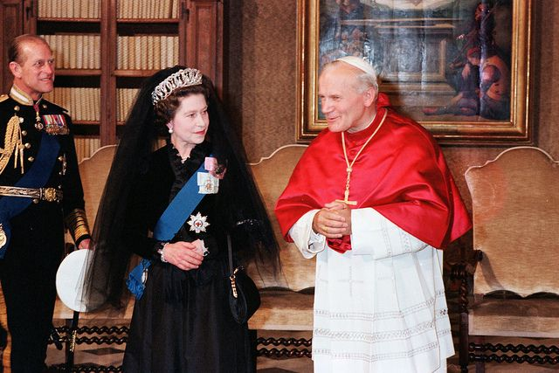
Not Some, Not Most, But All the Kings (Leaders) of the Earth are in subjection to the Roman Catholic Church in the Close of Time…
“With whom the kings of the earth have committed fornication, and the inhabitants of the earth have been made drunk with the wine of her fornication.” Rev. 17:2

Slide 4
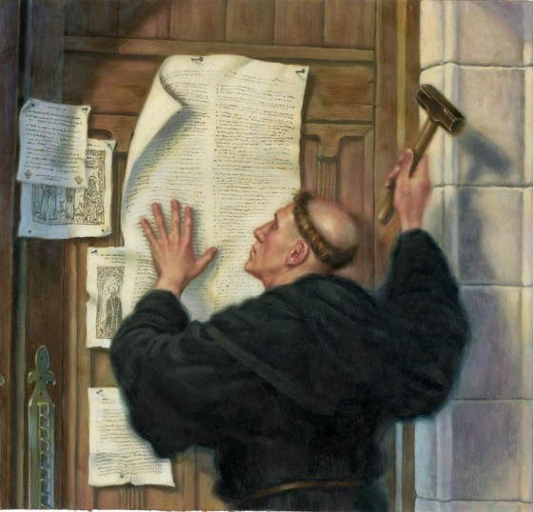
The Protestant Reformation Led To:
-The Bible Translated in Modern Language
-hymns and spiritual songs sung by laity
-spiritual awakening and individual independence
-limited government over divine right of kings
-inalienable rights and freedoms protected by God
-constitutional governments
-the United States of America-the Declaration of Independence and Constitution
-strong middle class
-capitalism
-Democratic-Republicanism, checks and balances, separation of Church and State, separation of powers
-innovation, invention, and the industrial revolution

Slide 5
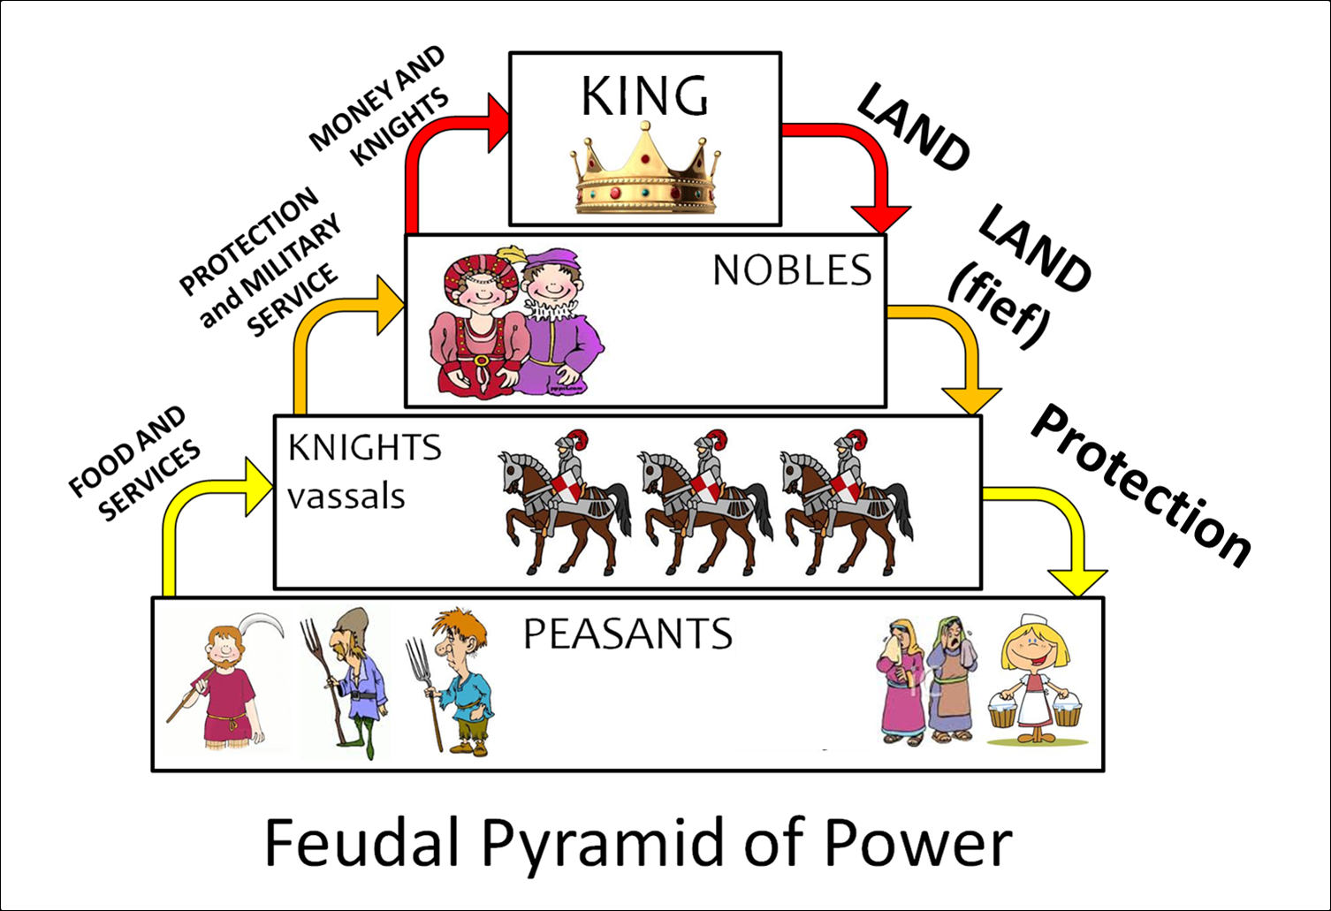
The Feudal System of the Dark Ages was the Pope/Jesuits Ideal System of Government, Religion, and Economy. This is what Rome wants to reinstate throughout the entire world, while Protestantism gave us a government of the people, freedom of religion, and capitalism

Slide 6
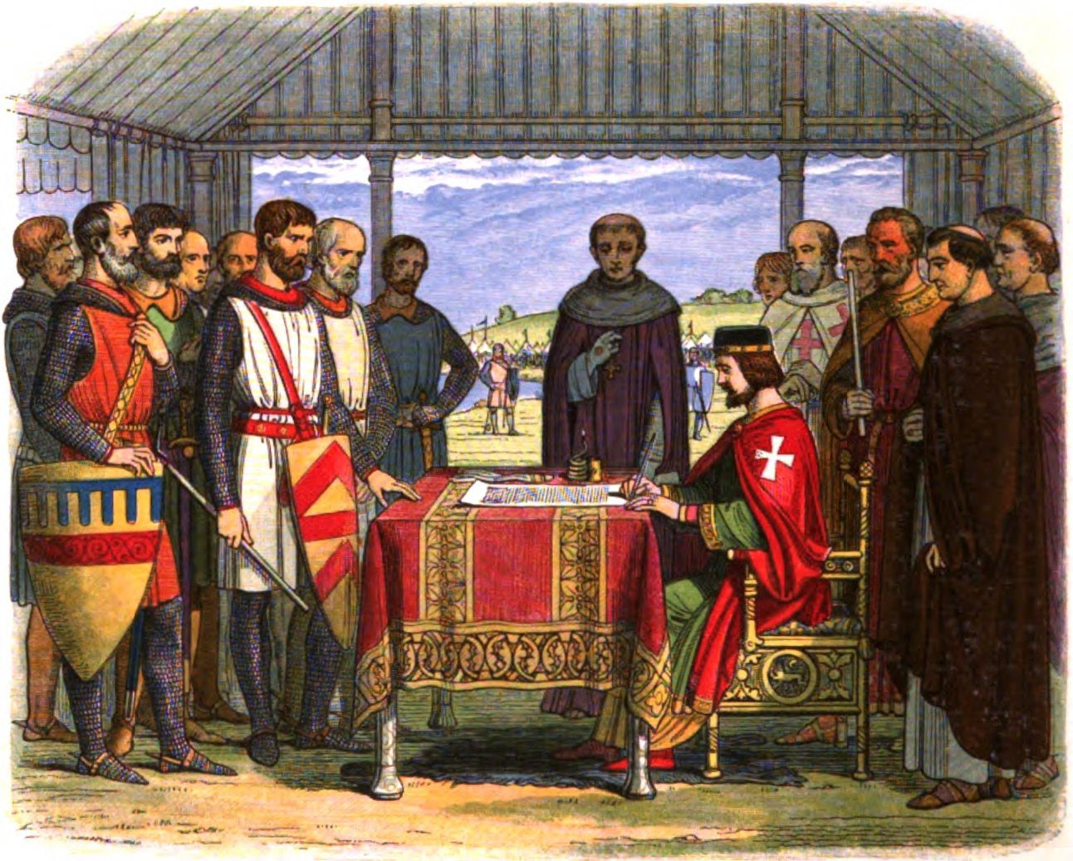
The First Steps Towards Constitutional Governments and Rule of Law: The Magna Carta

Slide 7
The Protestant Reformation
Economy:
-Capitalism-Protestant Work Ethic
-Innovation
-Middle Class
-More Wealth for lower classes
-Unhindered Entrepreneurship
-Less Taxes
-Own Property
-Individualism
-Wealth/Class Mobility
Religion:
-Liberty of Conscience
-Freedom of Religion
-Separation of Church and State
-Bible in own language
-Personal relationship with God (not only through church)
Politics:
-Limited Government
-Power with People (not King)
-Separation of Church and State
-Inalienable Rights: speech, privacy, due process, bear arms, press, speedy trial, etc.
-separation of powers, rule of law, checks and balances, Republic
-Constitutionalism
-Liberty and the Pursuit of Happiness

Slide 8
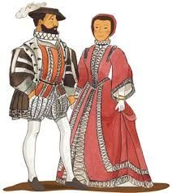
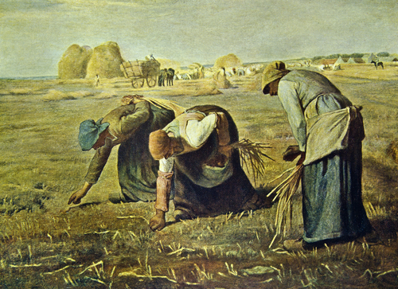
The Catholic Church System: NO MIDDLE CLASS
Rich
Poor
Or…
And once entrenched in a class, you were likely stuck there

Slide 9
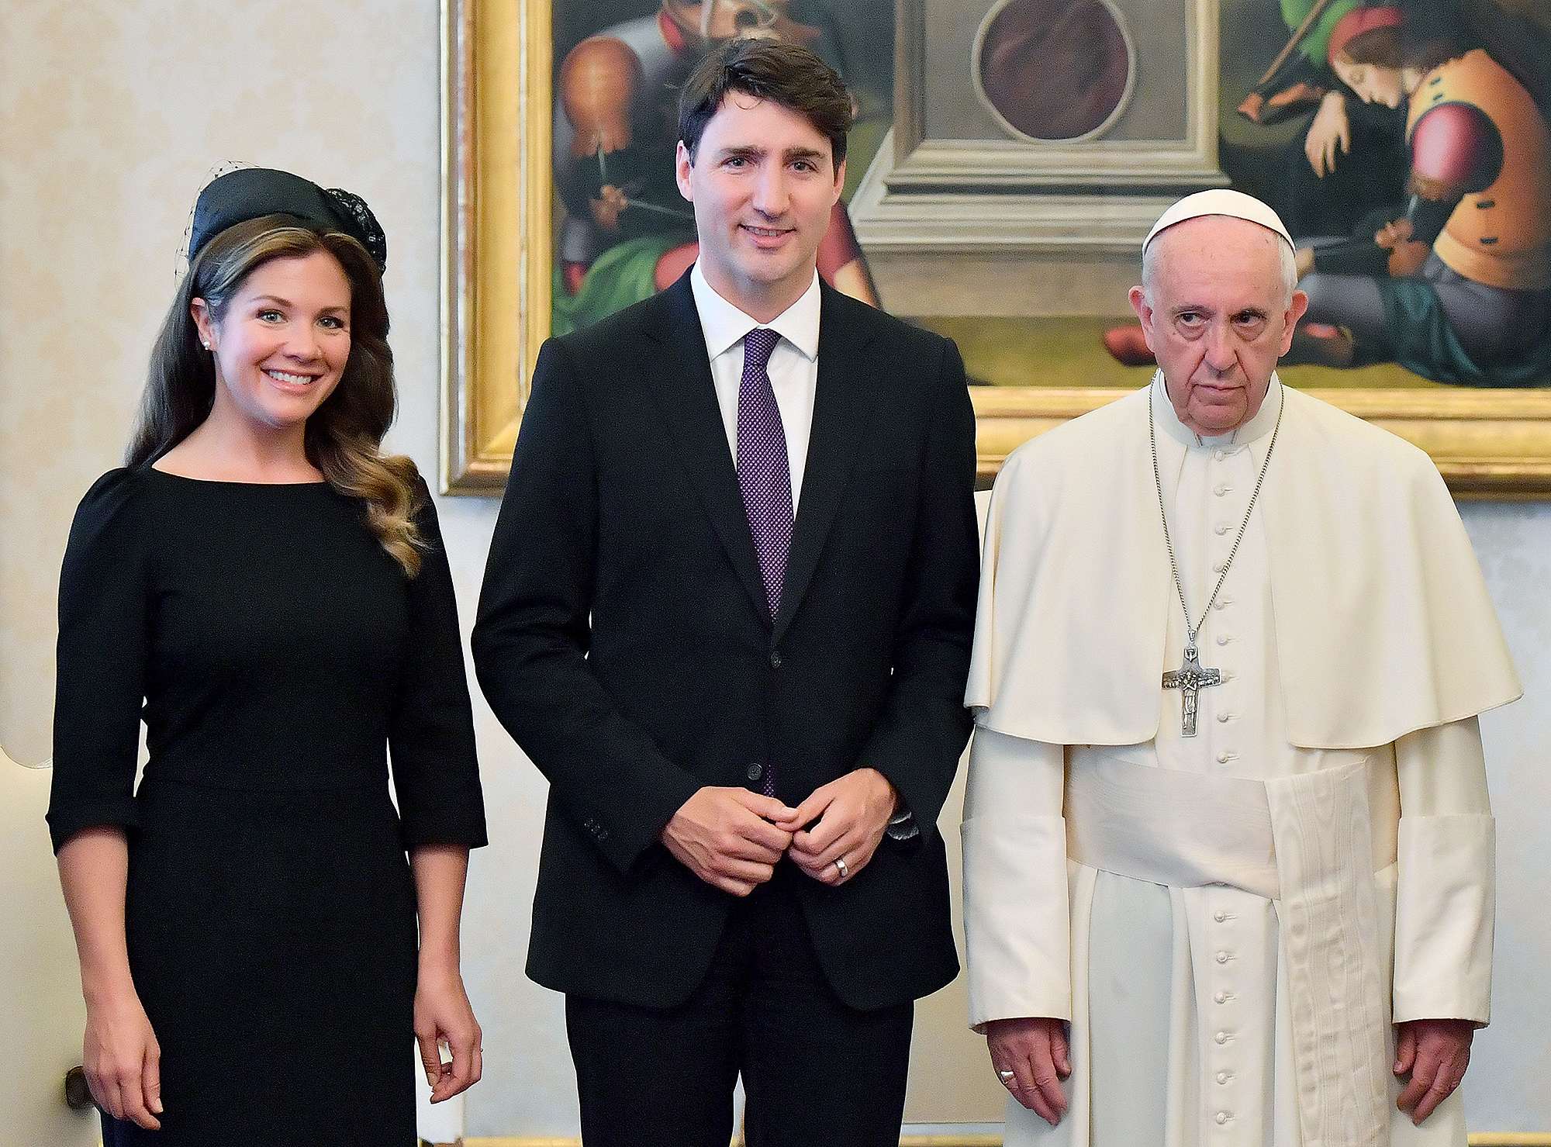
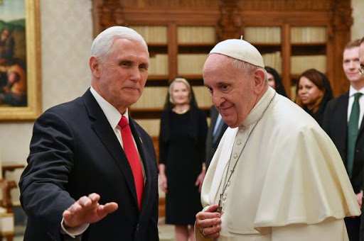
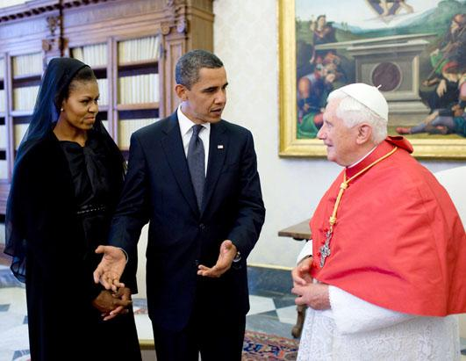
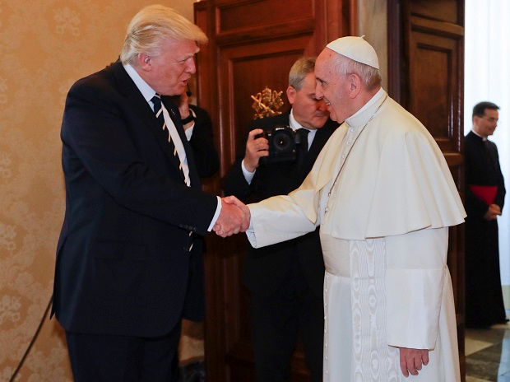
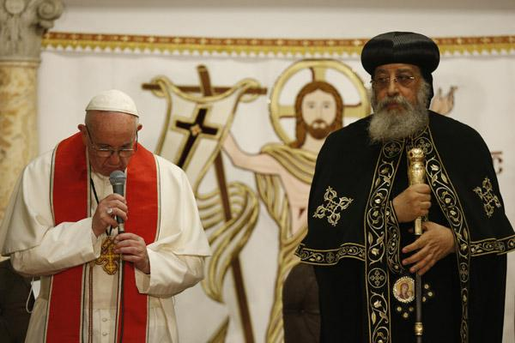
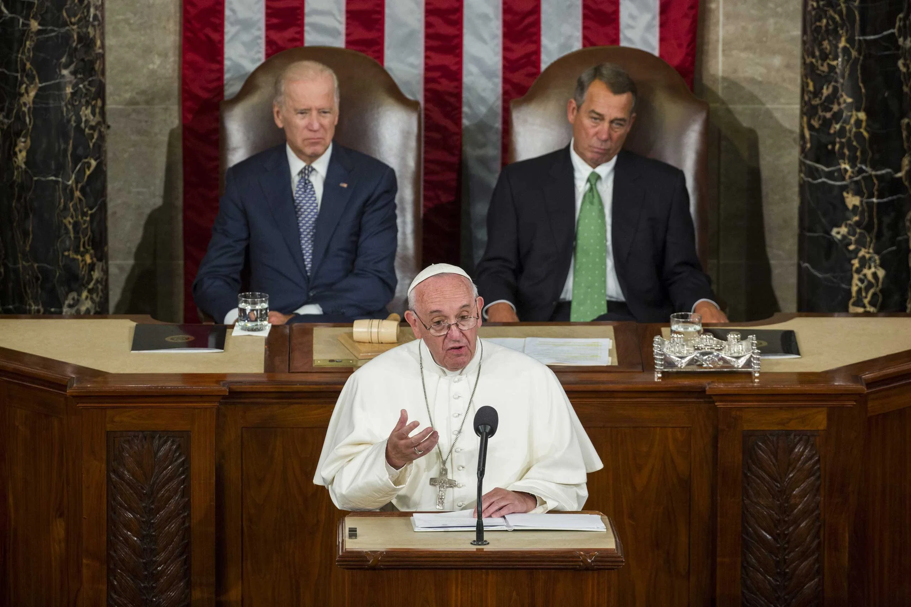
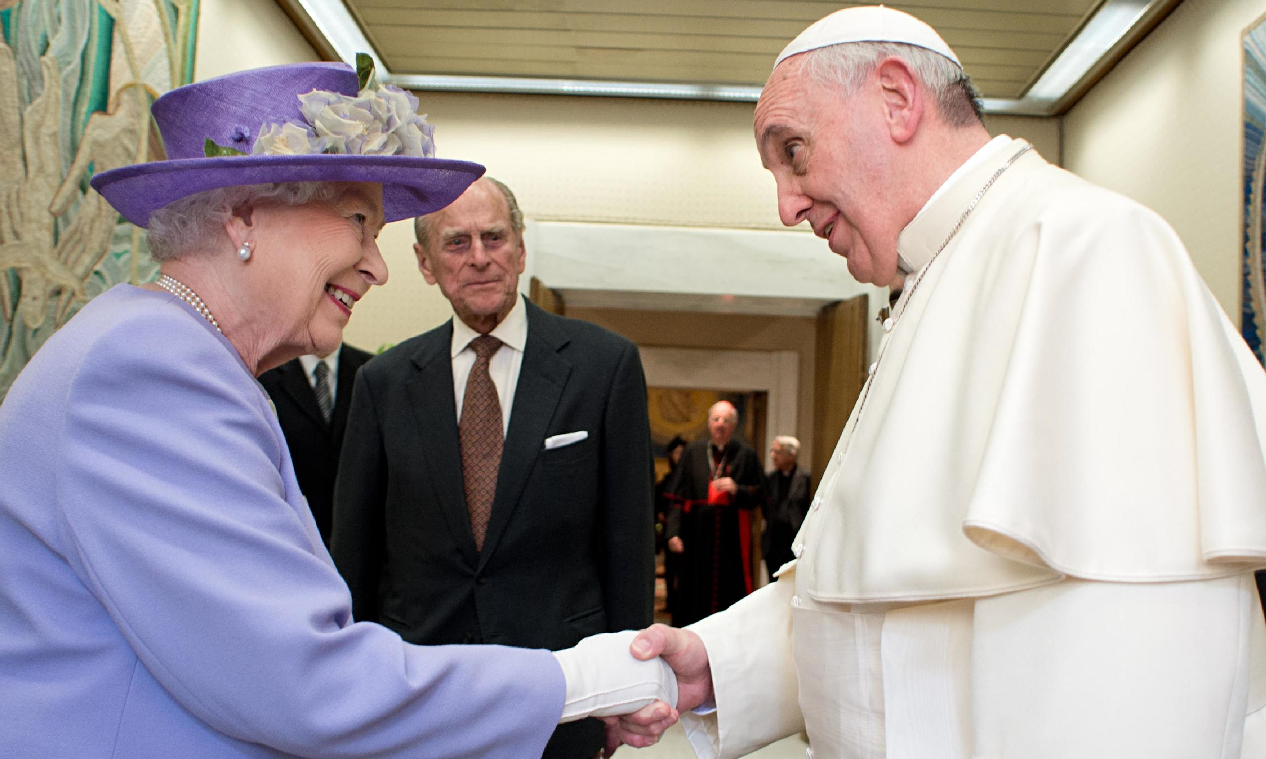
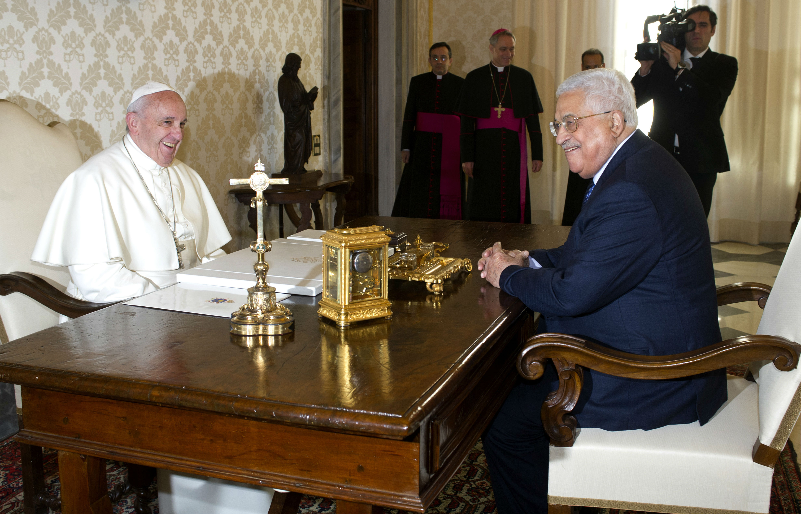
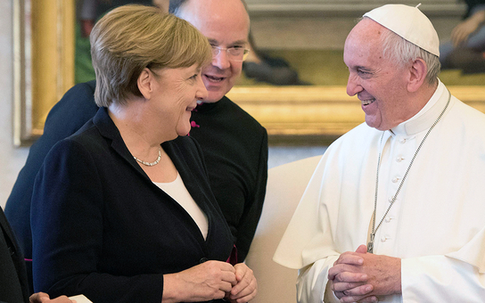
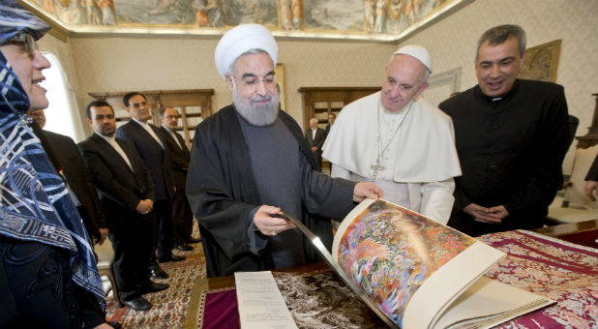
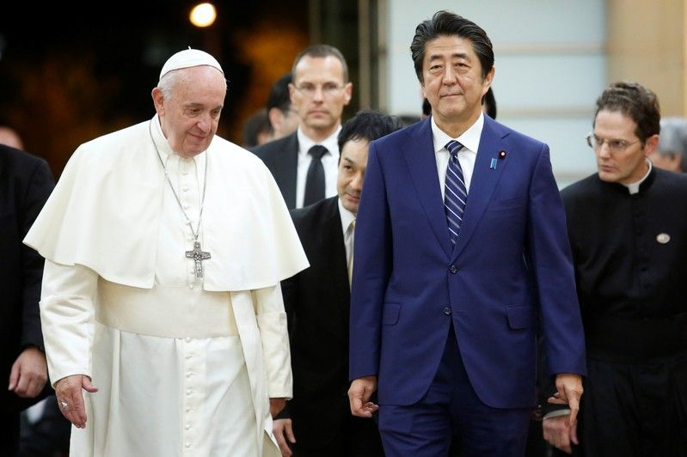
All Means All…
“And he causeth all, both small and great, rich and poor, free and bond, to receive a mark in their right hand, or in their foreheads: And that no man might buy or sell, save he that had the mark, or the name of the beast, or the number of his name.”—Rev. 13:16-17

Slide 10
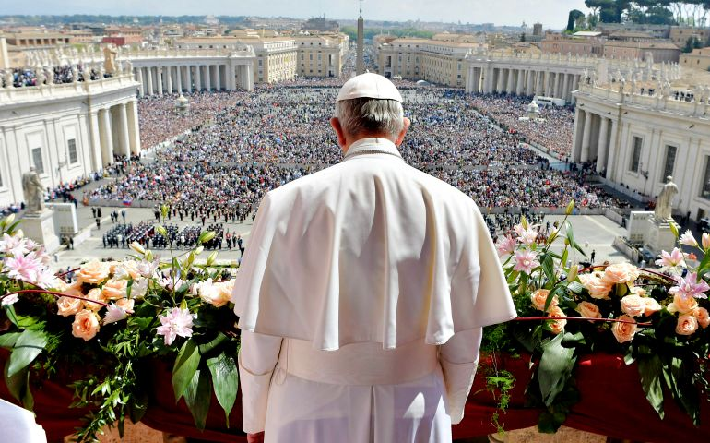
Though sad to say, the Bible tells us clearly that the Papacy will achieve her goals; it will overthrow Protestant principles in every country and force every national leader, every merchant, and every church to be in subjection to her will…

Slide 11
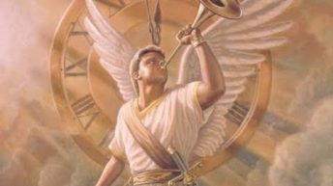
The 4th Angel and the Loud Cry are Coming…
“And after these things I saw another angel come down from heaven, having great power; and the earth was lightened with his glory.”—Rev. 18:1

Slide 12
Regardless of the Nation, if you study their history, you will see the great struggle between Protestant principles and Catholic principles warring against each other. And if you take note, when Roman principles win in nations, those nations suffer greatly…

Slide 13
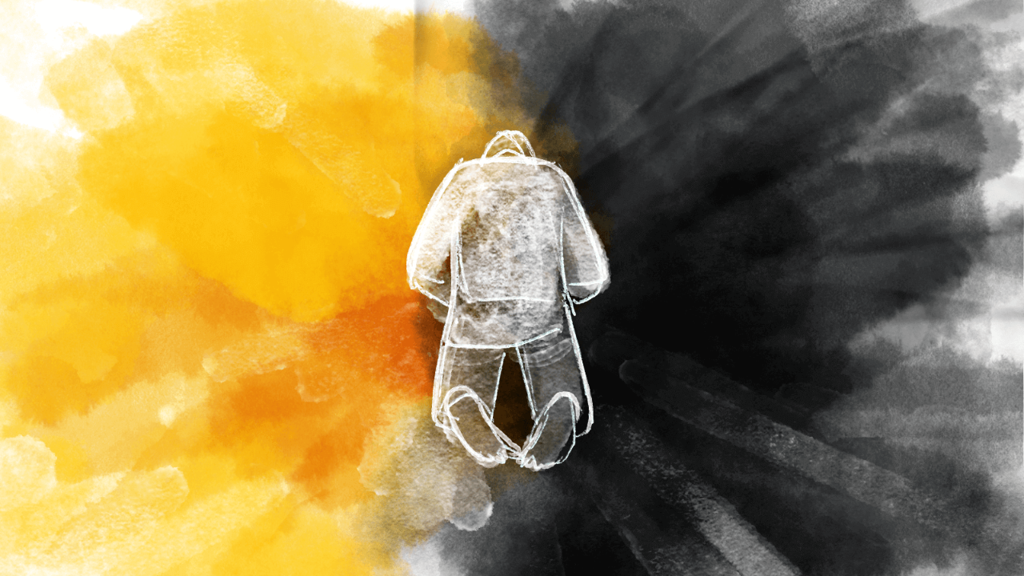
In Every Country, in every individual, there is a war raging between the Devil and God; between Catholic principles and Protestant principles…

Slide 14
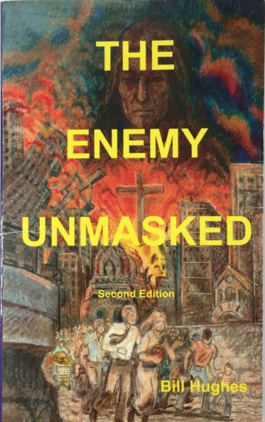
Books By Bill Hughes about the Papacy/Jesuit Order and their undermining of nations

Slide 15
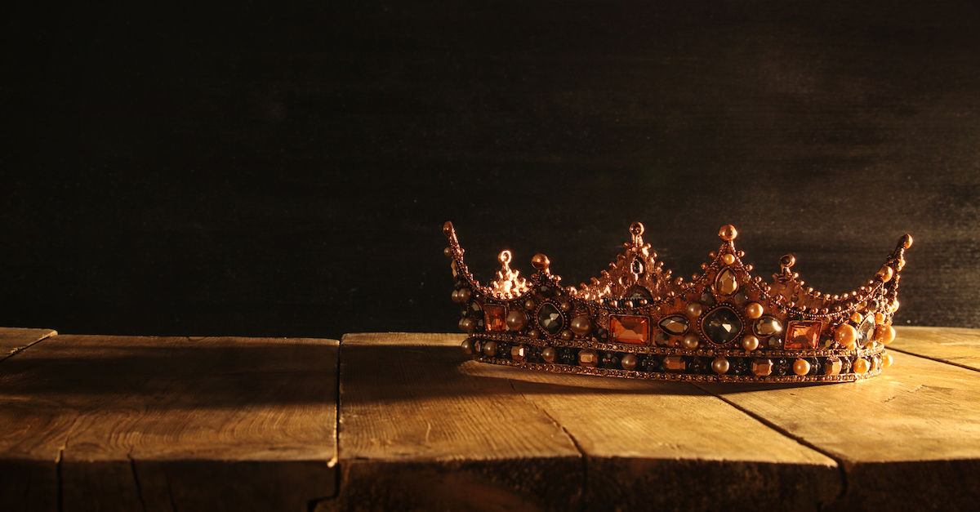
Before His Throne

Slide 17
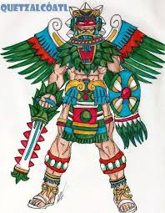
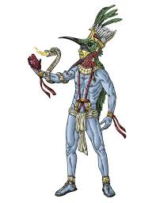
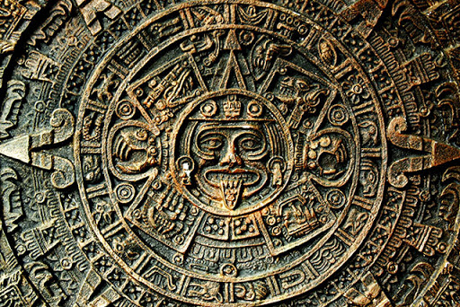
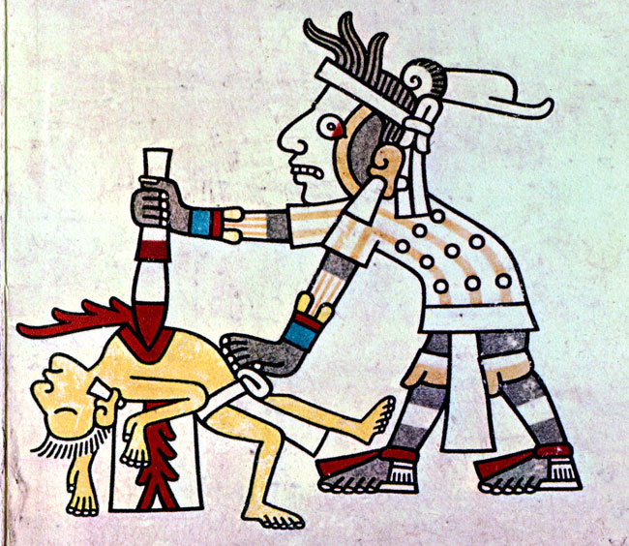
They were sun worshipers. They believed that the Sun needed human hearts to have enough strength to rise again the next day, so they engaged in the abominable act of human sacrifice….
Quetzalcoatl
Huitzilopochtli-sun god

Slide 18
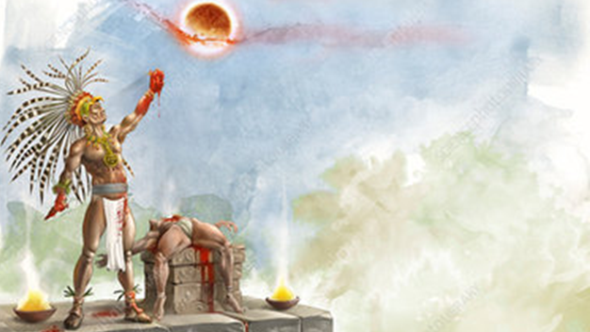
They actually believed that something they did had an effect on the strength of their sun god. There is no limit to the madness, insanity, and horror of false religion….

Slide 19
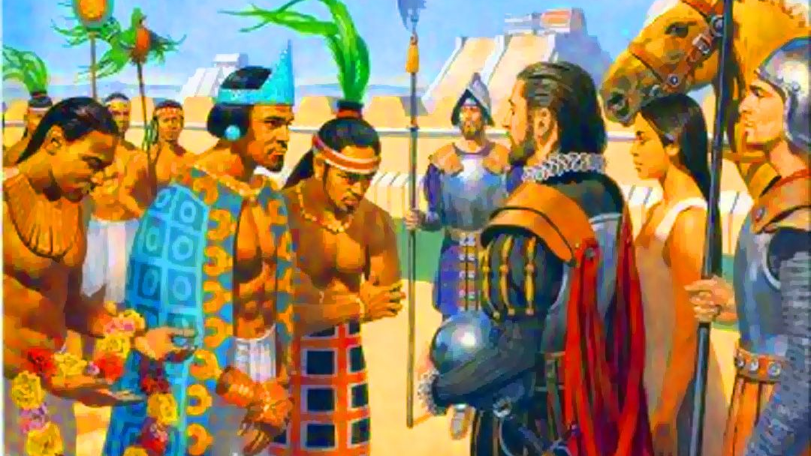
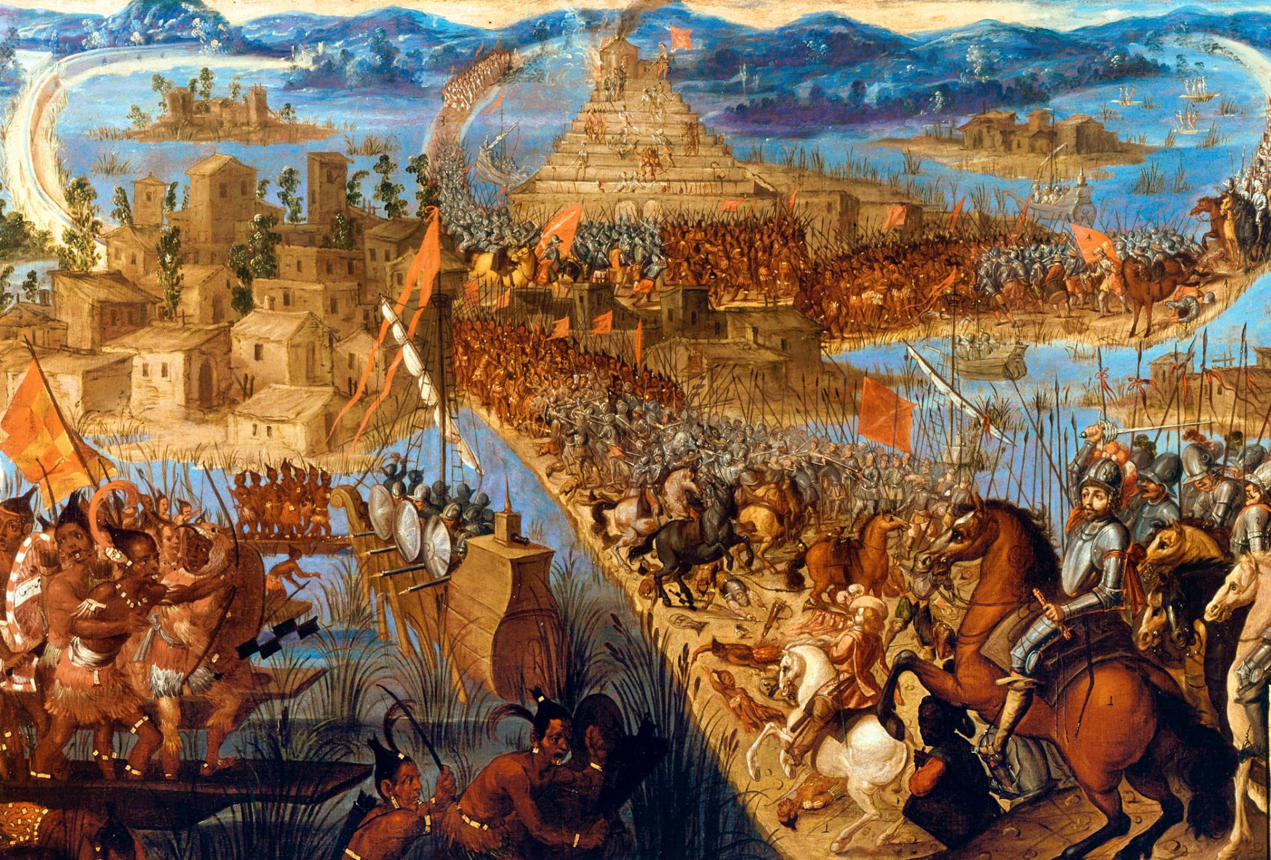
The Catholic Hostile Takeover!
1519
1521
1521-1810: Church Corruption on a Major Scale Unchecked!

Slide 20
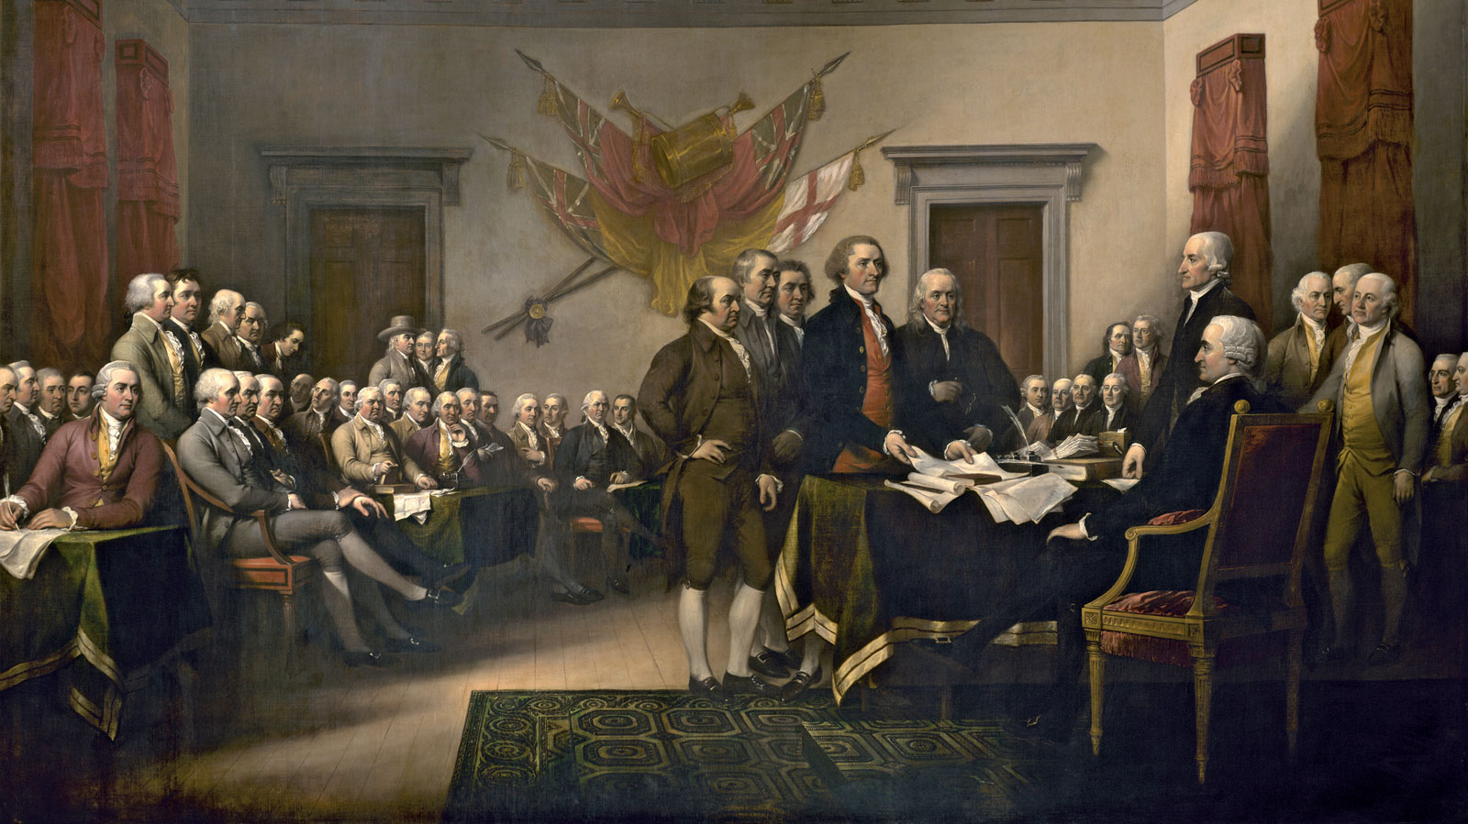
The Protestant Principles Laid Out in the Declaration of Independence and Constitution of the United States Blew A Trumpet Out to the World that Men are Equal and Ought to be in Control of Their Own Destinies…

Slide 21
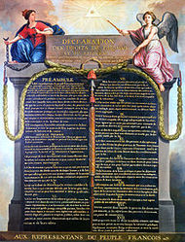
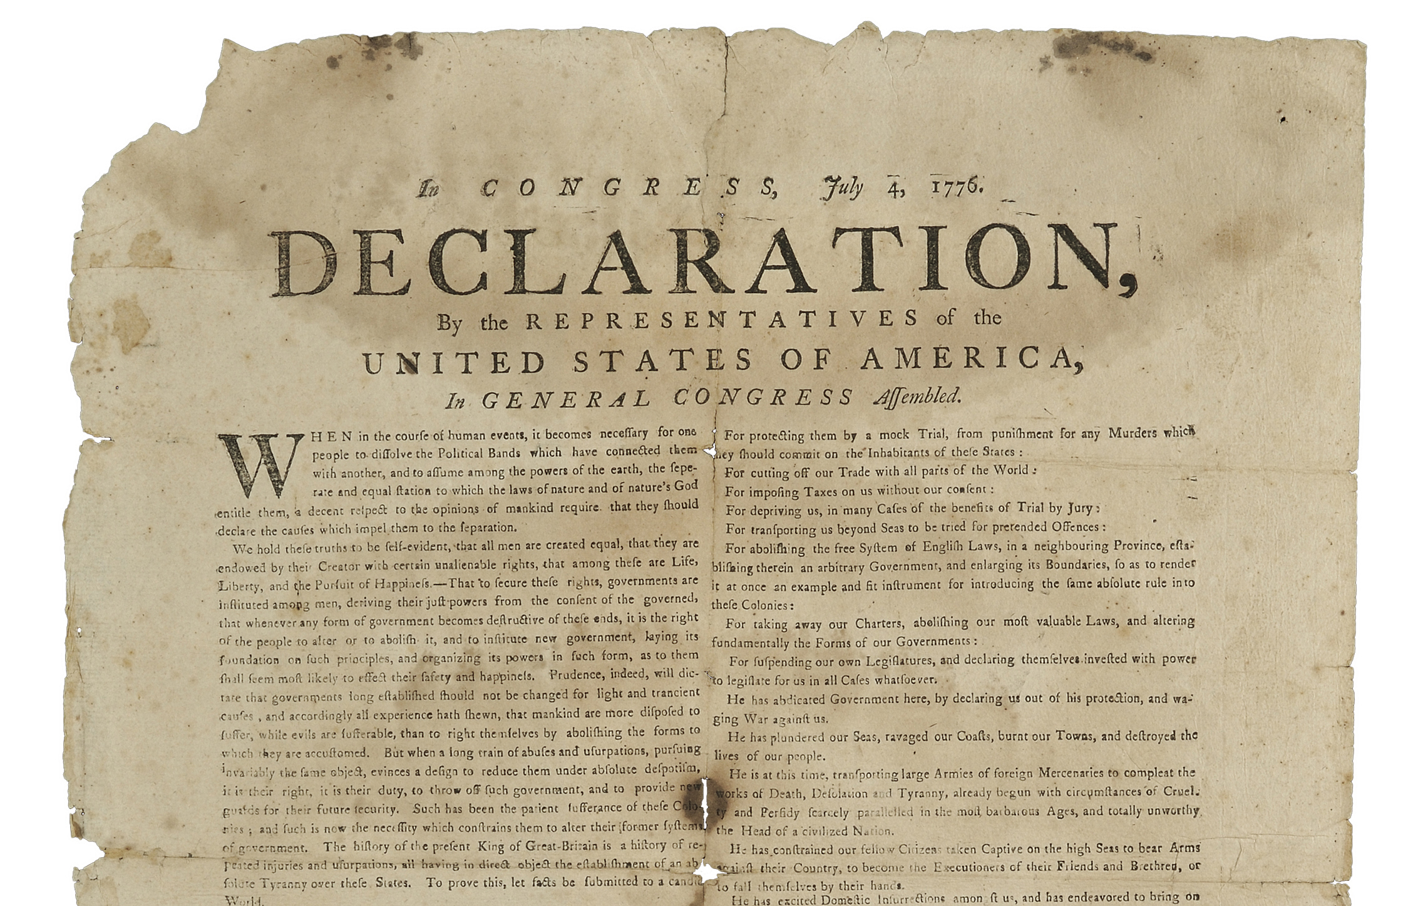
The American Revolution: A Revolution with God
The French Revolution: A (Jesuit) Revolution without God

Slide 22
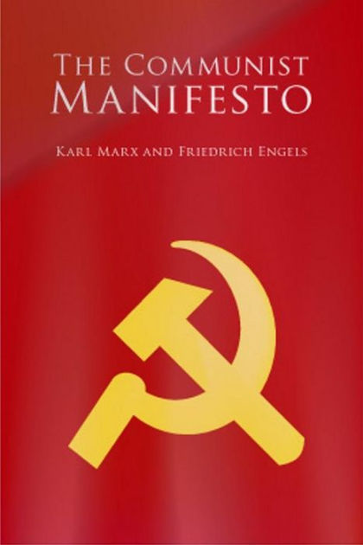
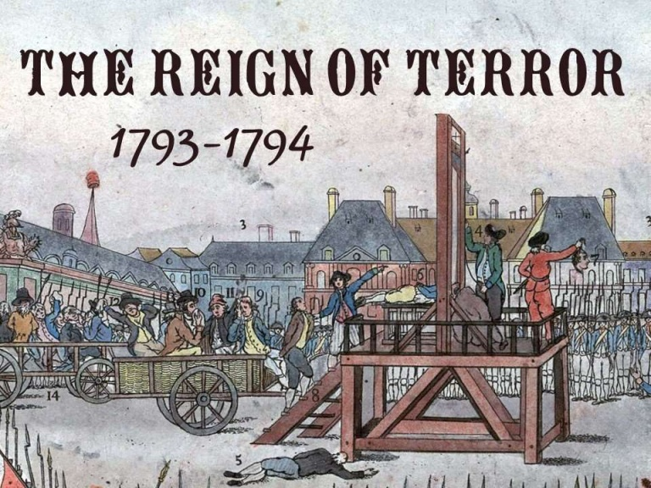
The French Revolution Principles
Economy:
-Communism/socialism
-No Innovation at all
-failing economy
-Right is might
-Debauchery
Religion:
-Atheism
-Abolishment of Religious Institutions
-Bibles Confiscated and Burned
-Goddess of Reason
Politics:
-Pure Democracy (Mob Rule)
-Murdering the wealthy
-Reign of Terror
-Human Rights (not from God)
-Communism, Socialism, Social Justice
-Fraternity and Equality
-Jesuit State
Led to..

Slide 23
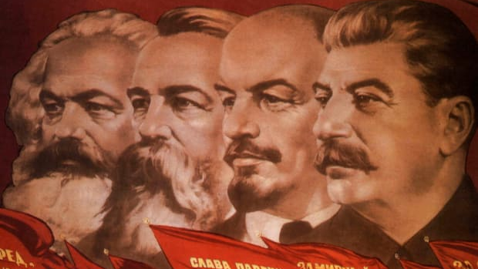
Communism is responsible for 160+ million deaths directly in the 20th Century

Slide 24
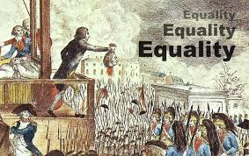
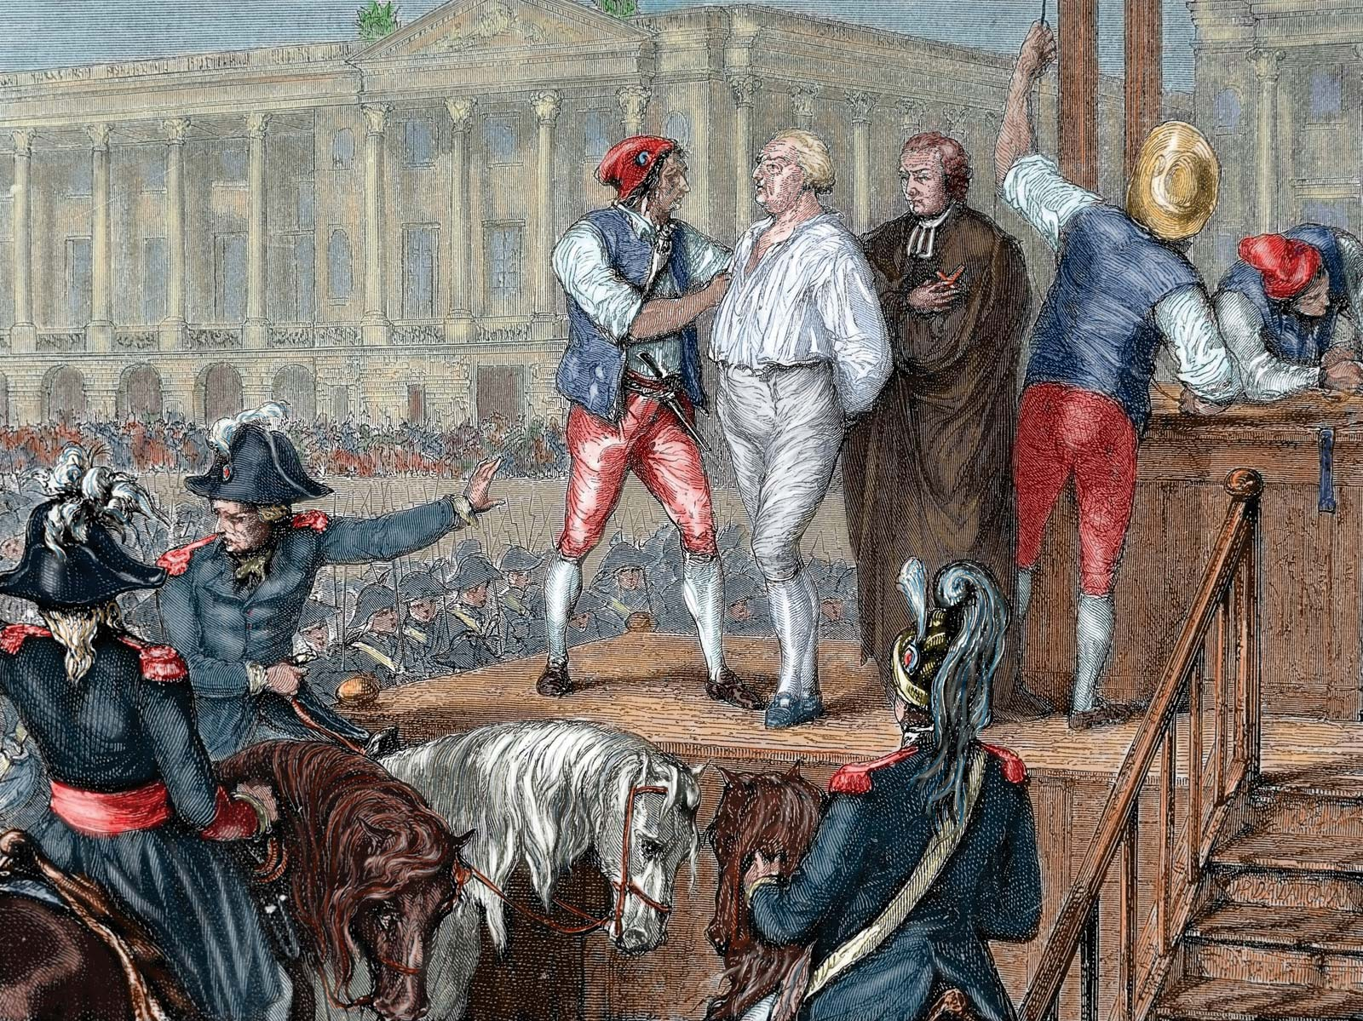
Unlike the Protestant Principle “equal protection under the law”, the French Revolution principle of “equality” levels the playing field completely. So if you begin to succeed, your fruits will be taken from you and given to others so that everyone is equal. You have no rights to your house if others don’t have houses, you have no rights to any property if others are lacking, no rights to the money you’ve earned, or the labors you’ve tilled. No, everyone has a right to your stuff—that’s how “equality” works under Socialism, Communism, and Democracy

Slide 25
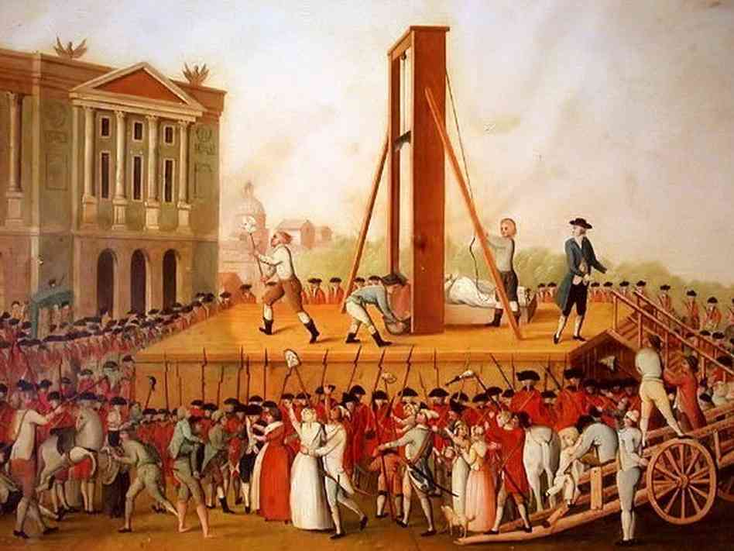
Democracy, Liberty, Equality, and Fraternity—all sound very romantic! But in practice, they’ve led to the some of the most horrific crimes!
The Democracy in France led the majority to rule that ‘it would be best for all’ if the guillotine was implemented against her own citizens

Slide 26
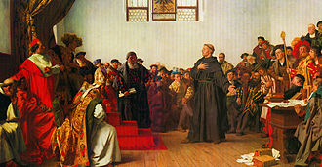
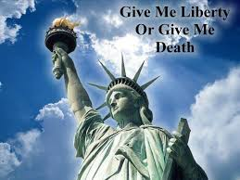
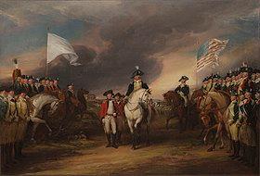
Amendments 1-12: Based on Constitutional Principles of: Liberty, Republicanism, and Protestantism

Slide 27
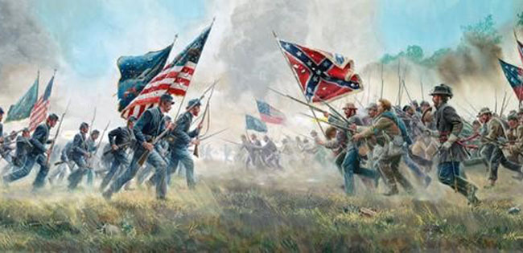
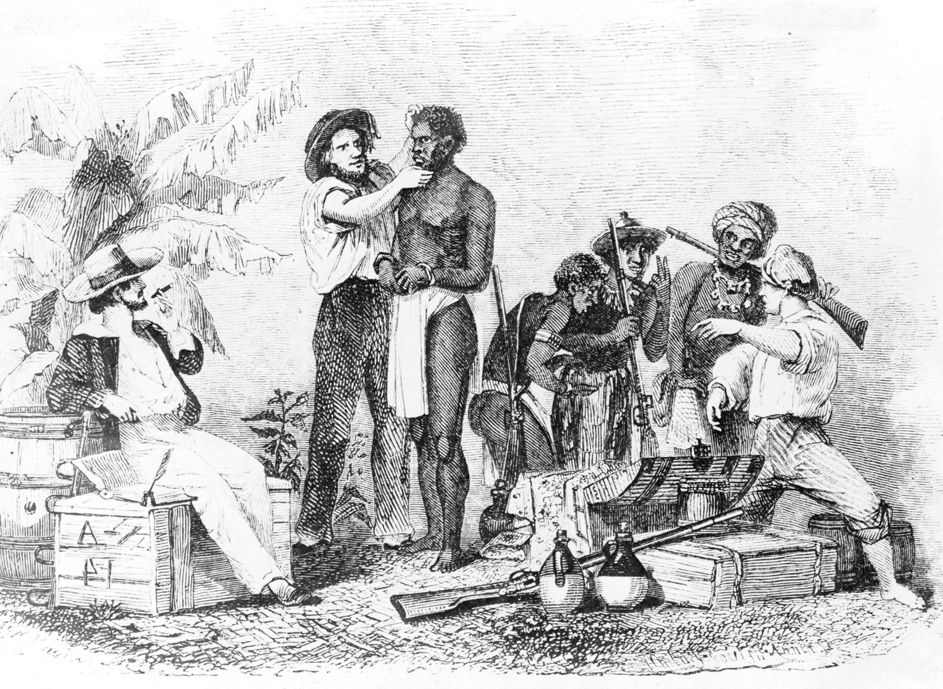
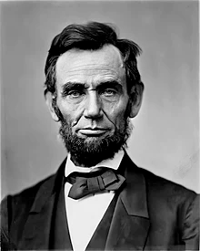
The Second Constitution: The 14th Amendment….
Slavery was a shameful and wicked practice which almost tore America apart. The Civil War, according to Abraham Lincoln as quoted in Charles Chiniquy’s 50 Years in the Church of Rome, was a Jesuit War designed to destroy America. However, the Devil used the French Revolution concept of ‘equality’ to undermine the foundations of American institutions… It is not the idea of equality itself, as much as it is applied and how it is defined which has wreaked havoc against the Constitution and humanity as a whole. Remember, this concept led to the guillotine and the Reign of Terror in France… It’s romantic language, but with sinister implications used by dark forces…
“Unfortunately, I feel more and more every day that it is not against the Americans of the South, alone, I am fighting, it is more against the pope of Rome, his perfidious Jesuits and their blind and bloodthirsty slaves.”—50 Years in the Church of Rome, p. 294

Slide 28
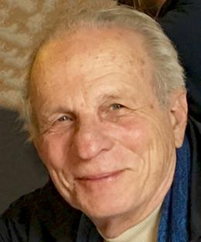
“Our Civil War called forth a new constitutional order. At the heart of this postbellum legal order the Reconstruction Amendments—the Thirteenth, Fourteenth, and Fifteenth Amendments, ratified in the years 1865 to 1870. The principles of this new legal regime are so radically different from our original Constitution, drafted in 1787, that they deserved to recognized as a second American constitution. The new constitution established, in fact, a second American Republic. The first Constitution was based the principles of peoplehood as a voluntary association, individual freedom, and republican elitism. The guiding premises of the second constitution”—Goerge P. Fletcher, Our Secret Constitution, p. 2
Professor Fletcher is a Constitutional scholar, and professor of jurisprudence at Columbia University as of 2020.

Slide 29
Where did the principles of democracy, equality, and fraternity end up in France?
Answer: The burning of Bibles, almost total collapse of France’s society, economy and government, the murder of innocent people in the Reign of Terror, an attempt to change the 7-day week to a 10-day week, extreme levels of debauchery, the idolizing of reason and rejection of God, and the rise of the tyrant Napoleon amidst the turmoil and instability of France
NO WONDER AMERICA’S FOUNDERS HATED DEMOCRACY!
“were, in contrast, organic nationhood, equality of all persons, and popular democracy. These are principles radically opposed to each other.”—Goerge P. Fletcher, Our Secret Constitution, p. 2
“I do not say that democracy has been more pernicious on the whole, and in the long run, than monarchy or aristocracy. Democracy has never been and never can be so durable as aristocracy or monarchy; but while it lasts, it is more bloody than either. … Remember, democracy never lasts long. It soon wastes, exhausts, and murders itself. There never was a democracy yet that did not commit suicide.”—John Adams, The Letters of John and Abigail Adams

Slide 30
The Second Constitution of the Second American Republic rested upon organic nationhood, equality of all persons, and popular democracy. Hardly anyone in America realizes that Marxism sees itself as resting upon the most advanced form of democracy and equality
These principles are at war with the Founders of the United States, the Declaration of Independence, the Republic of America, and instead embrace the principles which would later be called Communism!
“democracies have ever been spectacles of turbulence and contention; have ever been found incompatible with personal security, or the rights of property; and have, in general, been as short in their lives as they have been violent in their deaths.”--James Madison quoted in The Federalist on the New Constitution (Philadelphia: Benjamin Warner, 1818), p. 53, #10, by Alexander Hamilton, John Jay, James Madison

Slide 31
Miguel Hidalgo-Rome’s Revolutionist
“Hidalgo had been trained at the Jesuit college Valladolid, and had later instructed seminarians. He was widely read, in religion, Spanish, and foreign literature—in fact, he had a great fondness for French writings and ideas.”—T.R. Fehrenbach, Fire and Blood, p. 316
Miguel Hidalgo (1753-1811): Spanish-Catholic Priest, Leader in the Mexican War of Independence

Slide 32
Jesuit-trained Miguel Hidalgo fostered and spread the same Jesuitical and murderous principles that plagued France… But God stepped in for the people of Mexico

Slide 33
Benito Juarez-God’s Tool Against Rome
“If we’re looking for a true ‘Lincoln,’ one who resembled the Emancipator in spirit as well as in his political role, it is instructive to look at the life and career of Benito Juárez. . . . Lincoln was tall and angular; Juárez short and stocky. Lincoln was of old American stock; Juárez a full-blooded Indian. . . . Both were born poor, both cared more for political power than riches, and both believed law was the best preparation for a political career”—Jim Tuck, Mexico’s Lincoln: The ecstasy and agony of Benito Juarez, https://www.mexconnect.com/articles/274-mexico-s-lincoln-the-ecstasy-and-agony-of-benito-juarez/
Benito Juarez (1806-1872): 26th President of Mexico (1858-1872)

Slide 34
“Though they never met personally, they formed a lifetime mutual admiration society and helped each other whenever they could.”—Jim Tuck, Mexico’s Lincoln: The ecstasy and agony of Benito Juarez, https://www.mexconnect.com/articles/274-mexico-s-lincoln-the-ecstasy-and-agony-of-benito-juarez/
“Most controversial was the law pushed through by Alvarez’s minister of justice, Benito Juarez, who took direct aim at ecclesiastical and military privilege when he denied all special courts jurisdiction in civil matters. . . . The Jesuits were suppressed,”—Victor Alba, The Horizon Concise History of Mexico, p. 97

Slide 35
Benito Juarez Broke the Catholic Stranglehold Over Mexico
“and then in June, 1856, the drastic Ley Lerdo (a law named for its chief drafter, Miguel Lerdo de Tejada) was passed. The Lerdo law ordered that the Church divest itself of all lands not specifically devoted to religious functions (that is, lands upon which no churches or ecclesiastical buildings stood) and that these lands be sold to existing tenants.”—Victor Alba, The Horizon Concise History of Mexico, p. 97
Benito Juarez:
Forced Rome to be subject (and not above) the civil laws of Mexico
Rightfully took back the Mexican property gained by the Church and gave it back to the Mexican people
Banished the Jesuit Order

Slide 36
Benito Juarez:
Forced Rome to be subject (and not above) the civil laws of Mexico
Rightfully took back the Mexican property gained by the Church and gave it back to the Mexican people
Banished the Jesuit Order

Slide 37
The old Jesuit policy of do what we say or else, and payback was alive and well. The Jesuits controlled the countries of England (see JA Wylie’s The Jesuits), France (see Ellen White’s Great Controversy) and the Austrian Empire (see Congress of Vienna) all bore down great pressure upon Benito Juarez and Mexico to pay off the large debts owed to them. Eventually, this political pressure turned into The Second Franco-Mexican War (1861-1867)

Slide 38
The Jesuits were willing to do anything to reverse the political successes of Benito Juarez, the Mexican People and their newly established Republic. The invasion began 1861, but Mexico was diplomatically supported by the United States.

Slide 39
The Roman Catholic Maximilian I of Austria was set up after France took Mexico City in 1863. There they suppressed the Republic of Mexico in favor of the Second Mexican Empire with Maximilian I installed as leader. However, this scenario did not last. The Roman Catholic Church had hoped not only to regain Mexico, but also to destroy the Union forces currently engaged in the Civil War.
Republic Vs Empire
Maximilian I of Austria (1832-1867)

Slide 40
The Second Mexican Empire failed, Maximilian I of Austria was executed, and Benito Juarez was returned to power along with the Republic of Mexico. From thereon, Juarez labored to entrench Constitutional government in Mexico, but was assassinated by poisoning in 1872 (mainstream reports his death as a heart attack).…
Benito Juarez was also commemorated in the United States in 1866, when he became the only non-US citizen to be awarded membership as a companion of the 3rd class of the Pennsylvania Commandery of the Military Order of the Loyal Legion of the United States (MOLLUS).

Slide 41
Unlike Benito Juarez, Porfirio Diaz was a friend of the Church. He allowed the wealthy businessmen of America to control Mexico’s resources. Instead of putting the people, freedom, and Mexico first, Diaz did not protect Mexico from foreign interests. Moreover, he allowed the Catholic Church to regain prominence. They got back their lost property, they started collecting tithes again, they lifted the ban against the Jesuit Order, established the education system, and Diaz did not directly enforce the Lerdo and Juarez laws against the Church…
Porfirio Diaz (1830-1915): 29th President of Mexico (1877-1880; 1884-1911)

Slide 42
The Mexican Revolution (1910-1920)
Both Leaders of the Constitutionalist Forces in the Mexican Revolution and fought against Porfirio Diaz
Pancho Villa (1878-1923): Leader in the Mexican Revolution
Emiliano Zapata (1879-1919): Leader in the Mexican Revolution

Slide 43
The Mexican Constitution of 1917
Article 27: Banned the Catholic Church from owning, acquiring or administering real property
Article 3: Banned the Catholic Church from directing schools of primary education
Article 5: Outlawed Monastic Orders (like the Jesuits and other monks) and restricted the clergy

Slide 44
The Revolution was Against the Catholic Church
Led To…
The Cristero War (1926-1929)
-Freedom of Speech was granted to all Mexicans, but denied to religious leaders and clerics
-Priests could not criticize national laws or government authorities

Slide 45
The War Between Protestant Principles and Catholic Principles…
The Cristero War eventually ended in ceasefire, most of the anti-clerical measures remained in place until 1979 when John Paul II visited Mexico, and again in 1992 when the Mexican Government amended the Constitution to grant full privileges to the Catholic Church once again.

Slide 46
By 1992, the Mexican Government reinstated the Catholic Church, allowing them to once again own lands, vote, have full diplomatic relations, and they were permitted to once again setup Catholic educational institutions…

Slide 47
True Corruption in Government is From Rome…

Slide 48
Just as we see today in Venezuela, the United States, Honduras, Columbia, and abroad, the corrupt politicians, rigged elections, and overall despondency of the countries of the earth are natural results of their infiltration, bribing, and seditious intrigue by the Jesuit Order/Catholic Church
Vincente Fox (born 1942): 55th President of Mexico (2000-2006)

Slide 49
Nancy Pelosi
Felipe Calderón of Mexico (2006-2012)
George Bush
Right or Left, Liberal or Conservative, Venezuelan Socialism or American Capitalism, the Mexican Government and ALL Governments pay homage to Rome, proving Scripture to be True when it says that the kings of the earth are drunk with the wine of Babylon
Nicolo Maduro of Venezuela
Hugo Chavez of Venezuela
Enrique Peña Nieto of Mexico (2012-2018)

Slide 50
Because direct conflicts failed (like the Cristero War), Rome resorted to infiltration, bribery, and started corrupting Mexico from the inside out. This has happened throughout the world in every country: our history has changed, our “free” press has been corrupted, censorship is on the rise and freedoms are beginning to fail… How long will it be until Rome reaches ultimate ascendency?

Slide 51
“With whom the kings of the earth have committed fornication, and the inhabitants of the earth have been made drunk with the wine of her fornication.”—Revelation 17:2

Slide 52
Jesus is Coming Soon!!!! Get Ready! Get Ready! Get Ready!

