Slide 1
Guy Fawkes Day
WHO?

Slide 2
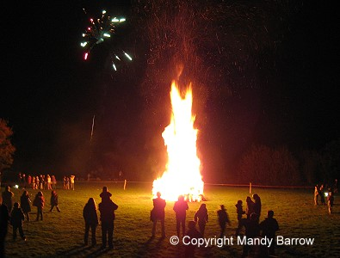
Gunpowder, Treason, and Plot
"Remember, remember, the fifth of November, Gunpowder, treason and plot. We see no reason why Gunpowder treason Should ever be forgot!"

Slide 3
A rhyme for Guy!
Remember, remember the fifth of November Gunpowder, treason and plot. I see no reason, why gunpowder treason Should ever be forgot.
Guy Fawkes, guy, t'was his intent To blow up king and parliament. Three score barrels were laid below To prove old England's overthrow. By God's mercy he was catch'd With a darkened lantern and burning match. So, holler boys, holler boys, Let the bells ring. Holler boys, holler boys, God save the king. And what shall we do with him? Burn him!

Slide 4
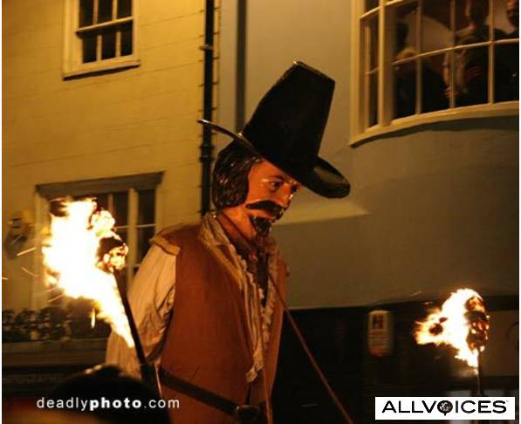
November 5
Every year on November 5th, a celebration erupts in England and it is known as Guy Fawkes Day/Bonfire Night. Effigies of this famous man are burned all over England. Who in the world is Guy Fawkes? Why is he burned in effigy? Why is he burned November 5?

Slide 5
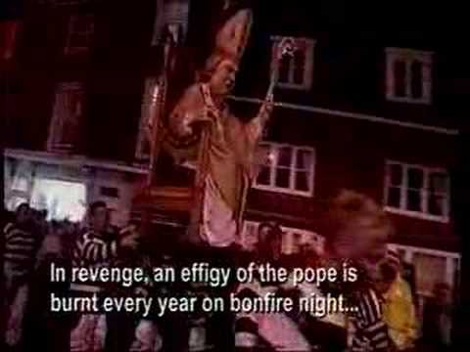
A Different Story
This picture tells a different story. This photo says that the pope is burned every year on Bonfire Night. In the story connected to the picture, it refers to Bonfire Night as November 5. There appears to be a discrepancy. Who is burned? The pope or Guy Fawkes? Why are they burned? Why is it done on November 5th?

Slide 6
Pope was Responsible for the Plot
“Within a few decades Gunpowder Treason Day, as it was known, became the predominant English state commemoration, but as it carried strong religious overtones it also became a focus for anti-Catholic sentiment. Puritans delivered sermons regarding the perceived dangers of popery, while during increasingly raucous celebrations common folk burnt effigies of popular hate-figures, such as the pope. Towards the end of the 18th century reports appear of children begging for money with effigies of Guy Fawkes and 5 November gradually became known as Guy Fawkes Day. Towns such as Lewes and Guildford were in the 19th century scenes of increasingly violent class-based confrontations, fostering traditions those towns celebrate still, albeit peaceably. In the 1850s changing attitudes eventually resulted in the toning down of much of the day's anti-Catholic rhetoric, and in 1859 the original 1606 legislation was repealed.”

Slide 7
Here Goes…………
﻿”Guy Fawkes was the most famous of a group of men involved in the Gunpowder Plot in 1604 and 1605. The Gunpowder Plot was a conspiracy to bring forth an English Catholic uprising by destroying the English Parliament and killing King James I. The reason for the conspiracy was in retaliation against increasingly restrictive laws against Catholicism by King James I, a Protestant.” http://factoidz.com/november-5-guy-fawkes-day-and-bonfire-night-england-and-canada-primarily/

Slide 8
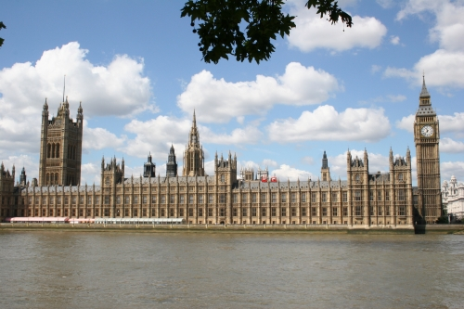
Catholic Uprising
The Gunpowder Plot came to its culmination November 5th, 1605. The intent of the Gunpowder Plot was the wholesale attempt to assassinate King James I and all of Parliament as they begin delineating in session. If you don’t like the laws, you blow up those making them!

Slide 9
James I, Successor of Elizabeth
The reign of Queen Elizabeth was full of intrigue and suspicion. Not less than 10 attempts were made to assassinate her by Jesuit/Catholic assassins. When these all failed, Rome commissioned her beloved son, Philip II of Spain to build the Spanish Armada. The Armada was to invade England, remove Elizabeth, and place a Catholic on the throne. This attempt failed and the papacy was fit to be tied. With the natural passing of Elizabeth in 1603, Rome hoped for better days with her successor, James I.

Slide 10
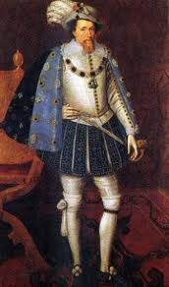
King James I
While most accounts indicate that James I was far more agreeable to and trying to be less stringent on Rome and her Jesuits, clearly Rome was not pleased with James I progress. Thus, the Gunpowder Plot was hatched. This was aimed at all of Parliament in one awful, devilish moment of annihilation! This event is identical to the Lincoln plot of 1865!!

Slide 11
Catholic Assault on James
“James was disposed to be tolerant of the Catholic cause; certainly he favoured and end to hostilities with Catholic Spain. Unfortunately for the Catholics, however, two half-baked radical plots turned the king against them. The Main Plot planned to depose James and set his cousin Arabella Stuart on the throne. The Bye Plot was even more far-fetched; the conspirators hoped to kidnap James and force him to repeal anti-Catholic legislation. The ultimate result of these plots was that James banished all Catholic priests from the kingdom.” http://www.britainexpress.com/History/stuart/gunpowder.htm

Slide 12
Conspiracy to Destroy America in One Night!
The papacy/Jesuits hoped that the Civil War would come out in favor of the South. When it didn’t, a plot was hatched by the Jesuits/ Pope Pius IX to destroy the power structure of America. The Civil War was over; now the papacy planned to kill Abraham Lincoln, Vice-President Andrew Johnson, Secretary of State William Seward, and leading Northern general Ulysses S. Grant all the same night. Only Lincoln died; Seward was brutally stabbed, Grant left town on an emergency, and Johnson’s assassin got drunk. The plan of the Jesuits was to destroy the government hierarchy in one blow, crippling the battered nation.

Slide 13
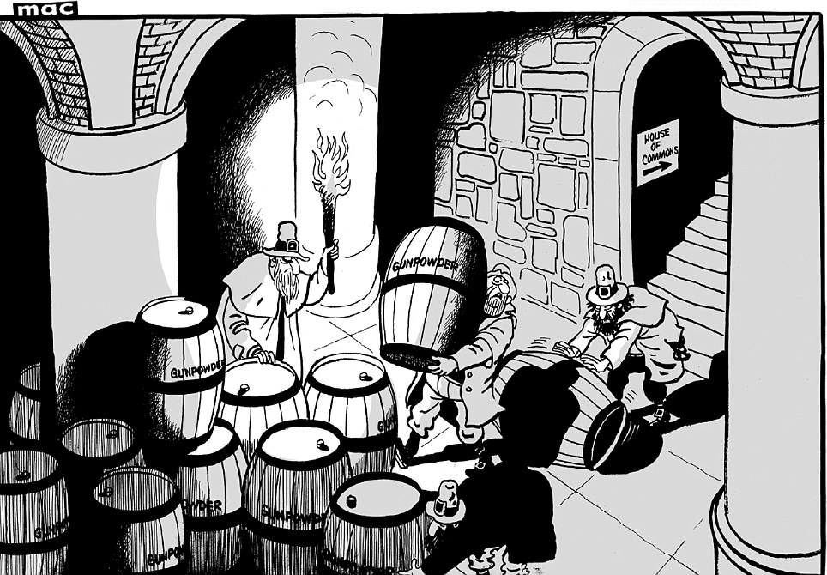
The Plot
Again, just as in the case of Lincoln and the others; in the Gunpowder Plot, there were multiple Catholic conspirators involved.
“ Early in 1604, Robert Catesby began to recruit other Catholics to his cause, including Thomas Winter, John Wright, Thomas Percy, and Guy Fawkes. Described latterly as a charismatic and influential man, as well as a religious zealot, over the following months he helped bring a further eight conspirators into the plot, whose naissance was planned for 5 November 1605. A letter sent anonymously to William Parker, 4th Baron Mont eagle, alerted the authorities, and on the eve of the planned explosion, during a search of Parliament, Fawkes was found guarding the barrels of gunpowder. News of his arrest caused the other plotters to flee London, warning Catesby along their way.” Wikipedia Ency.

Slide 14
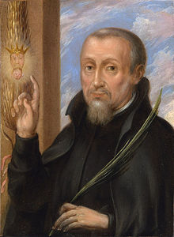
The Chief Chicken who Hatched it!
Booth, Herold, Atzerodt, Payne, and the Surratt's were the visible conspirators in the Lincoln/American plot of 1865; behind these were the Jesuit priests of Rome, plotting, hatching, and planning the events to occur. So too, in England, the frontlines were Catesby, Winter, Fawkes, and others; behind them, the priests of Rome. The one on the ground in England was diabolical, devilish, disgusting Henry Garnett.

Slide 15
Garnett Called a Martyr by Rome!
“As the Gunpowder Plot marked a new era of cruelty in the Protestant persecution of Catholics, so Protestant efforts to excuse their fault by blaming Garnet were at one time untiring, and even to the present day his case is discussed in an unfriendly spirit by non-Catholic writers (e.g. Jardine and Gardiner). On the other hand, the great Catholic theologians, who opposed King James in the matter of the Oath of Allegiance have spoken in Garnet's defense (especially Bellarmine "Apologia", XIII, xiii, 186, and Francisco Suárez, "Defensio Fidei Catholicæ". VI, ix, s. 6) — a matter of good omen, considering the theological intricacies that beset his case. It is a matter of regret that we have as yet nothing like an authoritative pronouncement from Rome on the subject of Garnet's martyrdom.” Catholic Ency.

Slide 16
Pathetic
Here is a despicable soul that plotted to kill the king and all of Parliament. He dies for his crimes and the papacy calls him a ‘Martyr’. How utterly sick and revolting! The man was a vicious criminal, a mass murderer, and an evil menace to society and he is called a martyr! He was persecuted for his faith! Unbelievable!!

Slide 17
The Plan
“At first the men hired lodgings near the Parliament buildings and attempted to tunnel into the cellars of Parliament. The tunnel scheme was quickly abandoned, however, either because of water from the Thames seeping into the tunnel, or because the going proved too difficult. Instead, Thomas Percy used his influence to gain access to cellars beneath Parliament, and into these cellars they secretly brought 36 barrels of gunpowder, which they carefully hid.
The opening of Parliament was put off, but Catesby used the time to draw more men into the circle of conspirators, including Jesuit leaders, while Fawkes made trips to the Low Countries for fresh powder to replace that which was beginning to spoil.” http://www.britainexpress.com/History/stuart/gunpowder.htm

Slide 18
The Plot Found Out!
“On October 26, 1605, the whole conspiracy began to unravel. A mysterious letter was sent to Lord Monteagle, a former Catholic supporter, warning him not to attend the opening of Parliament set for November 5. Monteagle, however, at once passed the letter on to Robert Cecil, the king's chief secretary. The conspirators found out about the letter; indeed they blamed one another for writing it. But still, they did not cancel their plans, convinced that the government knew nothing. On the night of November 4, Guy Fawkes was found in the cellars with the gunpowder.” http://www.britainexpress.com/History/stuart/gunpowder.htm

Slide 19
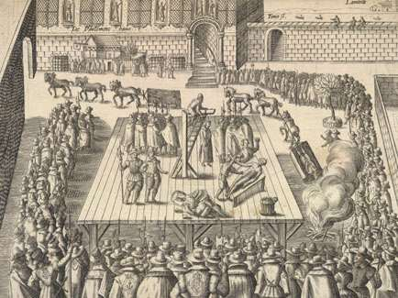
The Slain
“On January 30 four of the conspirators were put to death in St. Paul's churchyard. The following day the remaining four were executed at the Old Palace Yard, Westminster. All eight men were hung, drawn, and quartered, that being the standard punishment for those convicted of treason. Catesby and his fellows who had died at Holbeche House were exhumed and their heads placed on pikes for public display.” http://www.britainexpress.com/History/stuart/gunpowder.htm

Slide 20
Still Do it Today!
“Please to remember The Fifth of November, Gunpowder treason and plot; I see no reason Why gunpowder treason Should ever be forgot.
Guy, guy, guy! Stick him up on high; Hang him on a lamp post And leave him there to die.
Ladies and gentlemen you’ll never grow fat, If you don’t put a penny in the old Guy’s hat.”

