Slide 1
“The Donkey: Issachar”

Slide 2
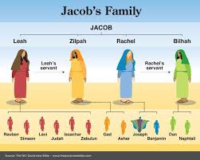
“And God hearkened unto Leah, and she conceived, and bare Jacob the fifth son. And Leah said, God hath given me my hire, because I have given my maiden to my husband: and she called his name Issachar.” Genesis 30:17, 18
8 boys have been born to Jacob; 4 to Leah, and 2 to each of the maid wives, Zilpah and Bilhah. Leah’s fifth and Jacob’s 9th was kind of a surprise, his name was Issachar!

Slide 3
Normal Happenings in a Family
The four older sons of Jacob made a huge splash into difficulty whereas the rest went along with them for a time, but eventually became their own men. While all the sons went along with the selling of Joseph, we read nothing else of them until Jacob’s dying benediction on them. Sometimes, when children see their older siblings doing wrong and suffering horrible consequences for their wicked actions, the younger ones learn the lessons and do not have to go through the sorrows of their older siblings. It appears to be the case with Jacob’s family. Rueben, Simeon, Levi, and Judah suffered terribly for their wrongs, but nothing is said about any really horrible things from the rest. They appear to have learned their lessons!

Slide 4
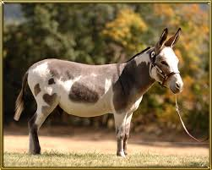
Jacob’s Benediction on Issachar
“Issachar is a strong ass couching down between two burdens: And he saw that rest was good, and the land that it was pleasant; and bowed his shoulder to bear, and became a servant unto tribute.” Genesis 49:14,15

Slide 5
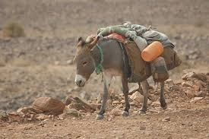
Like some of the other brothers, Jacob opted to use a very well-known animal to describe one of his sons, Issachar. Immediately, the use of this creature painted very clear pictures as to the likes of this young man and his future.
Issachar is a donkey!!

Slide 6
Dependable Workers!
‘The donkey has been used as a working animal for at least 5000 years. There are more than 40 million donkeys in the world, mostly in underdeveloped countries, where they are used principally as draught or pack animals….Donkeys have a notorious reputation for stubbornness, but this has been attributed to a much stronger sense of self-preservation than exhibited by horses. Likely based on a stronger prey instinct and a weaker connection with man, it is considerably more difficult to force or frighten a donkey into doing something it perceives to be dangerous for whatever reason. Once a person has earned their confidence they can be willing and companionable partners and very dependable in work. Although formal studies of their behaviour and cognition are rather limited, donkeys appear to be quite intelligent, cautious, friendly, playful, and eager to learn.’ Wikipedia

Slide 7
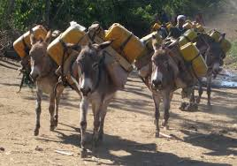
Beast of Burden
The wealth of the Egyptians was due to the precious metals carried from Africa by donkeys.
Donkeys were used to carry silk along the 'Silk Road' from the Pacific Ocean to the Mediterranean in return for trade goods.
In Greece donkeys were used for working on the narrow paths between vines and their work in vineyards spread as far as Spain. The donkey was associated with the Syrian God of Wine, Dionysius.
The Roman Army moved donkeys into Northern Europe using them in agriculture, vineyards and as pack animals.
Donkeys came to England with the Roman invasion of Britain in 43CE.

Slide 8
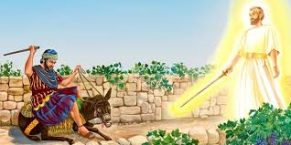
Issachar is a sturdy, hard-working donkey, who is seen resting from his labors. When he sees how good his inheritance is and how productive the land may become, he becomes determined to continue his hard-working efforts. Issachar was all of the above as a few Bible stories will indicate!

Slide 9
Carrying the Burden
“Then sang Deborah and Barak the son of Abinoam on that day, saying, Praise ye the LORD for the avenging of Israel, when the people willingly offered themselves. Hear, O ye kings; give ear, O ye princes; I, even I, will sing unto the LORD; I will sing praise to the LORD God of Israel…. Out of Ephraim was there a root of them against Amalek; after thee, Benjamin, among thy people; out of Machir came down governors, and out of Zebulun they that handle the pen of the writer. And the princes of Issachar were with Deborah; even Issachar, and also Barak: he was sent on foot into the valley. For the divisions of Reuben there were great thoughts of heart.” Judges 5:1-3, 14,15

Slide 10
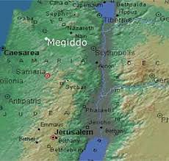
Laying it All on the Line!
In the famous battle with the heather hoards that had run roughshod over God’s people for 20 years, Deborah and Barak turned to some of the lesser known tribes to do great things in this hour of crisis. Naphtali and Zebulon were there and so was Issachar. Issachar was ready to sacrifice for the sake of God’s cause knowing that there would be a reward in the end.
“Looking unto Jesus the author and finisher of our faith; who for the joy that was set before him endured the cross, despising the shame, and is set down at the right hand of the throne of God.” Heb. 12:2

Slide 11
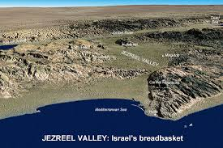
The hill of Megiddo, located west of the Jordan River in north central Palestine, some ten miles south of Nazareth and fifteen miles inland from the Mediterranean seacoast, was an extended plain on which many of Israel’s battles had been fought. There Deborah and Barak defeated the Canaanites (Judges 4:1;5:1). There Gideon triumphed over the Midianites (Judges 7:1). There Saul was slain in the battle of the Philistines (1Sam. 31:8).

Slide 12
Fighting on the Lord’s side!
“The vast army marched solemnly around the devoted walls. All was silent, save the measured tread of many feet, and the occasional sound of the trumpet, breaking the stillness of the early morning. The massive walls of solid stone seemed to defy the siege of men. The watchers on the walls looked on with rising fear, as, the first circuit ended, there followed a second, then a third, a fourth, a fifth, a sixth. What could be the object of these mysterious movements? What mighty event was impending? They had not long to wait. As the seventh circuit was completed, the long procession paused. The trumpets, which for an interval had been silent, now broke forth in a blast that shook the very earth. The walls of solid stone, with their massive towers and battlements, tottered and heaved from their foundations, and with a crash fell in ruin to the earth. The inhabitants of Jericho were paralyzed with terror, and the hosts of Israel marched in and took possession of the city.
The Israelites had not gained the victory by their own power; the conquest had been wholly the Lord's; and as the first fruits of the land, the city, with all that it contained, was to be devoted as a sacrifice to God. It was to be impressed upon Israel that in the conquest of Canaan they were not to fight for themselves, but simply as instruments to execute the will of God; not to seek for riches or self-exaltation, but the glory of Jehovah their King.” PP, pg. 491

Slide 13
Knew What Needed to Be Done!
“For at that time day by day there came to David to help him, until it was a great host, like the host of God. And these are the numbers of the bands that were ready armed to the war, and came to David to Hebron, to turn the kingdom of Saul to him, according to the word of the LORD….
And of the children of Issachar, which were men that had understanding of the times, to know what Israel ought to do; the heads of them were two hundred; and all their brethren were at their commandment.” 1 Chronicles 12:22,23, 32

Slide 14
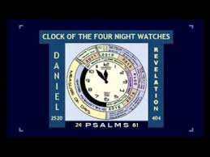
Understood the Times
The men of Issachar had a grasp of the Lord’s hand in current events in the light of prophecy. They knew that the hourglass of prophetic fulfillment had arrived and David was the right man for the job. Saul had collapsed and the men of Issachar knew that David was entitled to the throne! They not only knew the time, but acted upon it as well.

Slide 15
Do We Know the Time?
“As the storm approaches, a large class who have professed faith in the third angel's message, but have not been sanctified through obedience to the truth, abandon their position and join the ranks of the opposition. By uniting with the world and partaking of its spirit, they have come to view matters in nearly the same light; and when the test is brought, they are prepared to choose the easy, popular side. Men of talent and pleasing address, who once rejoiced in the truth, employ their powers to deceive and mislead souls. They become the most bitter enemies of their former brethren. When Sabbath keepers are brought before the courts to answer for their faith, these apostates are the most efficient agents of Satan to misrepresent and accuse them, and by false reports and insinuations to stir up the rulers against them. In this time of persecution the faith of the Lord's servants will be tried. They have faithfully given the warning, looking to God and to His word alone. God's Spirit, moving upon their hearts, has constrained them to speak. Stimulated with holy zeal, and with the divine impulse strong upon them, they entered upon the performance of their duties without coldly calculating the consequences of speaking to the people the word which the Lord had given them.” GC, pgs. 608,609

Slide 16
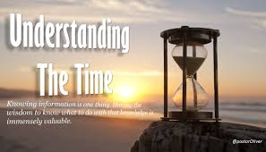
Is This Not Happening?
1. Down playing the work of Sanctification??
2. Are not the professed people of God not uniting with the world and the movement for a one world religion?
3. Are they not ready to embrace a Sunday law?
4. Are not leaders rejecting the great truths that make us who we are?
5. Do we not see the times?

Slide 17
Right Before Our Eyes!
“The enemy of souls has sought to bring in the supposition that a great reformation was to take place among Seventh-day Adventists, and that this reformation would consist in giving up the doctrines which stand as the pillars of our faith, and engaging in a process of reorganization. Were this reformation to take place, what would result? The principles of truth that God in His wisdom has given to the remnant church, would be discarded. Our religion would be changed. The fundamental principles that have sustained the work for the last fifty years would be accounted as error. A new organization would be established. Books of a new order would be written. A system of intellectual philosophy would be introduced. The founders of this system would go into the cities, and do a wonderful work. The Sabbath of course, would be lightly regarded, as also the God who created it. Nothing would be allowed to stand in the way of the new movement. The leaders would teach that virtue is better than vice, but God being removed, they would place their dependence on human power, which, without God, is worthless. Their foundation would be built on the sand, and storm and tempest would sweep away the structure.” 1 Selected Messages, pgs. 204,205

Slide 19
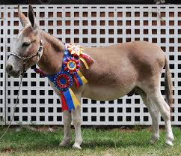
The Donkey Wins
“Of the tribe of Simeon were sealed twelve thousand. Of the tribe of Levi were sealed twelve thousand. Of the tribe of Issachar were sealed twelve thousand.” Rev. 7:7
While being lowly, hard working, lacking flamboyance, Issachar will be found among the elect at the end of time. He was willing to put everything on the line for the Lord’s work and he understood the signs of the times, willing to give all for the glory of God! May we do the same!

