Slide 1
Footsteps of an Approaching God
Fiery Moment

Slide 2
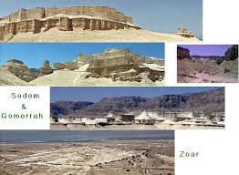
what is This?

Slide 3
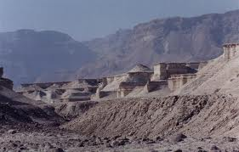
What is This?

Slide 4
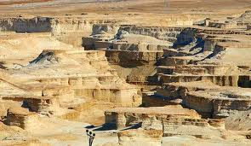
How About This?

Slide 5
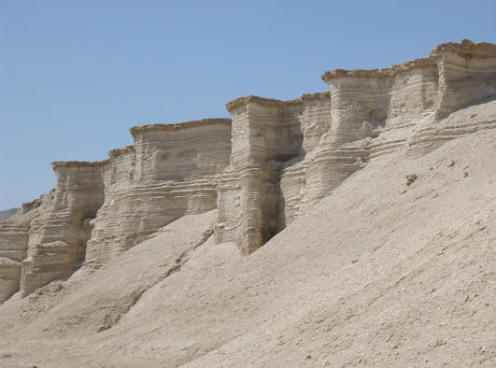

Slide 6
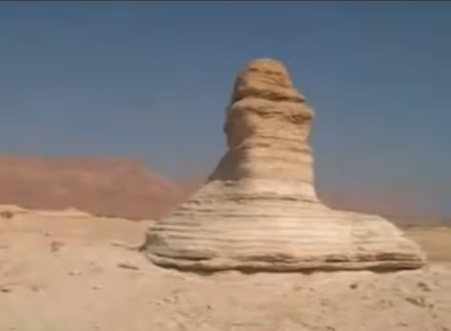

Slide 7
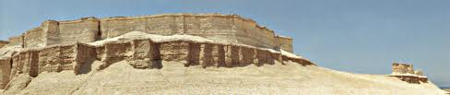

Slide 8
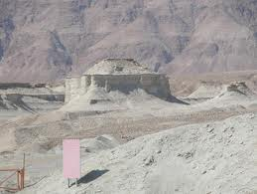
This?

Slide 9
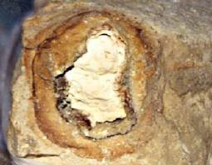
What They all have in Common?
All of those places just seen have sulfur balls imbedded in them! These sulfur balls are mostly golf ball sized, and some have burn marks all around them! Webster's Dictionary says that "brimstone" = sulfur. All of those structures are in the Jordan plain where Lot lived!!!

Slide 10
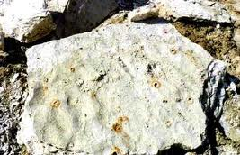
What Are Those Holes?

Slide 11
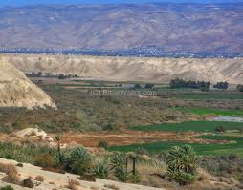
The Jordan Plain
The land in the vicinity of the Jordan River was once so beautiful that the Bible says, “Is not the whole land before thee? separate thyself, I pray thee, from me: if thou wilt take the left hand, then I will go to the right; or if thou depart to the right hand, then I will go to the left. And Lot lifted up his eyes, and beheld all the plain of Jordan, that it was well watered every where, before the LORD destroyed Sodom and Gomorrah, even as the garden of the LORD, like the land of Egypt, as thou comest unto Zoar.” Genesis 13:10

Slide 12

Eden Beauty
It was no wonder that the nephew of Abraham wanted to live in this most beautiful place. The bible just told us it was so beautiful, it reminded one of the Garden of Eden!

Slide 13
Riches Underground
“And there went out the king of Sodom, and the king of Gomorrah, and the king of Admah, and the king of Zeboiim, and the king of Bela (the same is Zoar;) and they joined battle with them in the vale of Siddim; With Chedorlaomer the king of Elam, and with Tidal king of nations, and Amraphel king of Shinar, and Arioch king of Ellasar; four kings with five. And the vale of Siddim was full of slime pits; and the kings of Sodom and Gomorrah fled, and fell there; and they that remained fled to the mountain.” Genesis 14:8-10

Slide 14
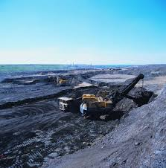
Black Gold of Siddim
So coveted were these bitumen deposits for a wide range of purposes, there was an ancient battle in that very area for the coveted fluid oozing out of the ground! It was used widely as a preservative in covering bricks and was used as a sealant throughout the Mediterranean world. Whoever controlled it was very, very, wealthy!

Slide 15
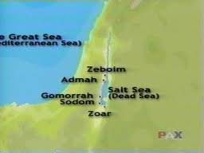
Five Cities of the Plain
The Bible referred to five cities defending their bitumen/petroleum rich-land. They were Sodom, Gomorrah, Admah, Zeboiim, and Zoar. These cities all had a vested interest in the substance and fought to protect their wealth! Eventually, their life of ease led to their destruction!

Slide 16
Confirmation
“And that the whole land thereof is brimstone, and salt, and burning, that it is not sown, nor beareth, nor any grass groweth therein, like the overthrow of Sodom, and Gomorrah, Admah, and Zeboiim, which the LORD overthrew in his anger, and in his wrath:” Deut. 29:23
“Even as Sodom and Gomorrah, and the cities about them in like manner, giving themselves over to fornication, and going after strange flesh, are set forth for an example, suffering the vengeance of eternal fire.” Jude 7

Slide 17
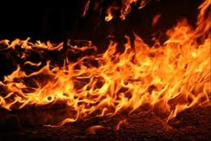
Eternal Fire
Are those cities still burning or did they burn until there was nothing left to burn? How long does eternal burning burn?
“But Hannah went not up; for she said unto her husband, I will not go up until the child be weaned, and then I will bring him, that he may appear before the LORD, and there abide for ever.” 1 Sam. 1:22 Is Samuel still a priest in Israel?

Slide 18

Still Serving?
“Then his master shall bring him unto the judges; he shall also bring him to the door, or unto the door post; and his master shall bore his ear through with an aul; and he shall serve him for ever.” Ex. 21:6

Slide 19
Josephus, famous Jewish Historian
“Now this country is then so sadly burnt up, that nobody cares to come at it . . . It was of old a most happy land, both for the fruits it bore and the riches of its cities, although it be now all burnt up. It is related how for the impiety of its inhabitants, it was burned by lightning; in consequence of which there are still the remainders of the divine fire; and the traces of the five cities are still to be seen.” (Josephus in his “Wars Of The Jews”, Book IV, Chapter VIII)

Slide 20
Five Cities?
Sodom and Gomorrah, Admah and Zeboiim were burned by the fire of Heaven. Josephus said five cities. The Bible offers an explanation for Zoar being destroyed too. “And Lot went up out of Zoar, and dwelt in the mountain, and his two daughters with him; for he feared to dwell in Zoar: and he dwelt in a cave, he and his two daughters. And the firstborn said unto the younger, Our father is old, and there is not a man in the earth to come in unto us after the manner of all the earth:” Gen. 19:31

Slide 21
Pride and Idleness
“Behold, this was the iniquity of thy sister Sodom, pride, fullness of bread, and abundance of idleness was in her and in her daughters, neither did she strengthen the hand of the poor and needy. And they were haughty, and committed abomination before me: therefore I took them away as I saw good.” Ezekiel 16:49,50

Slide 22
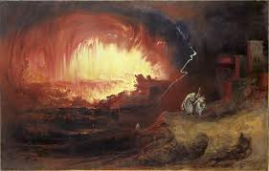
Sexual Perversion a Result!
The five cities were overthrown because of idleness and pride. Homosexuality was the fruit of pride and idleness. Heaven does not accept sexual perversion in any form nor justify it!

Slide 23


Slide 24
Silent Witness Still!
2 Peter 2:5-7 “And spared not the old world, but saved Noah the eighth person, a preacher of righteousness, bringing in the flood upon the world of the ungodly; And turning the cities of Sodom and Gomorrah into ashes condemned them with an overthrow, making them an ensample unto those that after should live ungodly; And delivered just Lot, vexed with the filthy conversation of the wicked:” 2 Peter 2:5-7

Slide 25
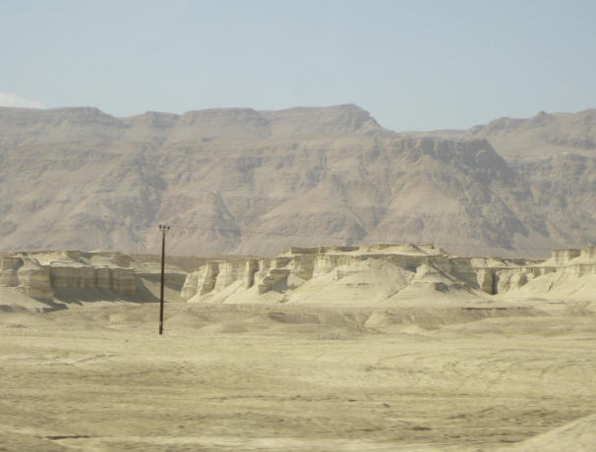
Example and Warning
“And the angels which kept not their first estate, but left their own habitation, he hath reserved in everlasting chains under darkness unto the judgment of the great day. Even as Sodom and Gomorrah, and the cities about them in like manner, giving themselves over to fornication, and going after strange flesh, are set forth for an example, suffering the vengeance of eternal fire.” Jude 6,7

Slide 26
Footsteps of an Approaching God
A visible warning still exists along the western side of the Jordan river. One time, God drew very near to earth and five cities of the plain knew Heaven’s judgments on wickedness. The Bible says that one day soon, Heaven will draw very near to earth and judgment will fall again. Are we preparing for that day? Do we hear the footsteps of an approaching God?

Slide 27
