Slide 1
Totally Known, Totally Loved
The Woman at the Well

Slide 2
A Must!
“It would be well for us to spend a thoughtful hour each day in contemplation of the life of Christ. We should take it point by point, and let the imagination grasp each scene, especially the closing ones. As we thus dwell upon His great sacrifice for us, our confidence in Him will be more constant, our love will be quickened, and we shall be more deeply imbued with His spirit. If we would be saved at last, we must learn the lesson of penitence and humiliation at the foot of the cross.” DA, pg. 83

Slide 3
Not an Easy Trip
Christ had to have left Jerusalem feeling unhappy. The Adventists weren’t happy with Him cleansing the temple. In fact, they wanted to kill Him. “Then answered the Jews and said unto him, What sign shewest thou unto us, seeing that thou doest these things? Jesus answered and said unto them, Destroy this temple, and in three days I will raise it up. Then said the Jews, Forty and six years was this temple in building, and wilt thou rear it up in three days? But he spake of the temple of his body.” Jn. 2:18-21
The interview with Nicodemus had gone well. Not, at first, but a few years hence and he would come around. Heading north, Christ and the disciples paused at Jacob’s well in Samaria. Here is where the story begins…………

Slide 4
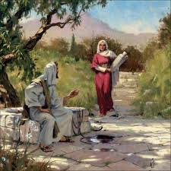
The Samaritan Woman
“ Now Jacob's well was there. Jesus therefore, being wearied with his journey, sat thus on the well: and it was about the sixth hour. There cometh a woman of Samaria to draw water: Jesus saith unto her, Give me to drink. (For his disciples were gone away unto the city to buy meat.) Then saith the woman of Samaria unto him, How is it that thou, being a Jew, askest drink of me, which am a woman of Samaria? for the Jews have no dealings with the Samaritans.” Jn. 4:6-9

Slide 5
No Such Thing as Caste/Prejudice
“The people of this district were of the old Canaanite race. They were idolaters, and were despised and hated by the Jews. To this class belonged the woman who now came to Jesus. She was a heathen, and was therefore excluded from the advantages which the Jews daily enjoyed…The partition wall which Jewish pride had erected, shut even the disciples from sympathy with the heathen world. But these barriers were to be broken down.
Christ did not immediately reply to the woman's request. He received this representative of a despised race as the Jews would have done. In this He designed that His disciples should be impressed with the cold and heartless manner in which the Jews would treat such a case, as evinced by His reception of the woman, and the compassionate manner in which He would have them deal with such distress, as manifested by His subsequent granting of her petition.” DA, pgs. 399, 400

Slide 6
No Walls
”That at that time ye were without Christ, being aliens from the commonwealth of Israel, and strangers from the covenants of promise, having no hope, and without God in the world: But now in Christ Jesus ye who sometimes were far off are made nigh by the blood of Christ. For he is our peace, who hath made both one, and hath broken down the middle wall of partition between us; Having abolished in his flesh the enmity, even the law of commandments contained in ordinances; for to make in himself of twain one new man, [so] making peace; And that he might reconcile both unto God in one body by the cross, having slain the enmity thereby: And came and preached peace to you which were afar off, and to them that were nigh.” Ephesians 2:12-17

Slide 7
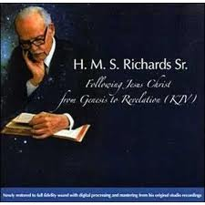
No White or Black People in Heaven!!!!!!!!!!!!!!!!!!!!!!!!!!!!!!!!!!!!

Slide 8
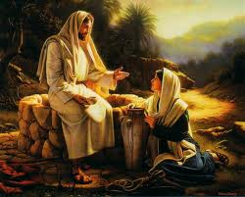
The Gift
“ Jesus answered and said unto her, If thou knewest the gift of God, and who it is that saith to thee, Give me to drink; thou wouldest have asked of him, and he would have given thee living water. The woman saith unto him, Sir, thou hast nothing to draw with, and the well is deep: from whence then hast thou that living water? Art thou greater than our father Jacob, which gave us the well, and drank thereof himself, and his children, and his cattle?
Jesus answered and said unto her, Whosoever drinketh of this water shall thirst again: But whosoever drinketh of the water that I shall give him shall never thirst; but the water that I shall give him shall be in him a well of water springing up into everlasting life.” Jn. 4:10-14

Slide 9
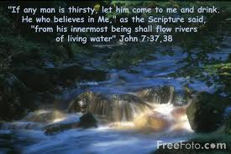

Slide 10
“He who seeks to quench his thirst at the fountains of this world will drink only to thirst again. Everywhere men are unsatisfied. They long for something to supply the need of the soul. Only One can meet that want. The need of the world, "The Desire of all nations," is Christ. The divine grace which He alone can impart, is as living water, purifying, refreshing, and invigorating the soul.
Jesus did not convey the idea that merely one draft of the water of life would suffice the receiver. He who tastes of the love of Christ will continually long for more; but he seeks for nothing else. The riches, honors, and pleasures of the world do not attract him. The constant cry of his heart is, More of Thee. And He who reveals to the soul its necessity is waiting to satisfy its hunger and thirst. Every human resource and dependence will fail. The cisterns will be emptied, the pools become dry; but our Redeemer is an inexhaustible fountain. We may drink, and drink again, and ever find a fresh supply. He in whom Christ dwells has within himself the fountain of blessing,--"a well of water springing up into everlasting life." From this source he may draw strength and grace sufficient for all his needs.” DA, pg. 187

Slide 11
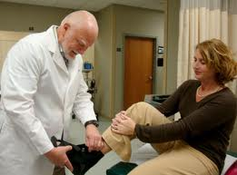
The Need
”The woman saith unto him, Sir, give me this water, that I thirst not, neither come hither to draw. Jesus saith unto her, Go, call thy husband, and come hither. The woman answered and said, I have no husband. Jesus said unto her, Thou hast well said, I have no husband: For thou hast had five husbands; and he whom thou now hast is not thy husband: in that saidst thou truly.” Jn. 4:14-18

Slide 12
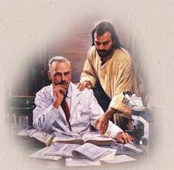
No need, no doctor
“And when the scribes and Pharisees saw him eat with publicans and sinners, they said unto his disciples, How is it that he eateth and drinketh with publicans and sinners? When Jesus heard [it], he saith unto them, They that are whole have no need of the physician, but they that are sick: I came not to call the righteous, but sinners to repentance.” Mk. 2:16,17

Slide 13
Fully Known, Fully Loved
“Jesus now abruptly turned the conversation. Before this soul could receive the gift He longed to bestow, she must be brought to recognize her sin and her Saviour. He "saith unto her, Go, call thy husband, and come hither." She answered, "I have no husband." Thus she hoped to prevent all questioning in that direction. But the Saviour continued, "Thou hast well said, I have no husband: for thou hast had five husbands; and he whom thou now hast is not thy husband: in that saidst thou truly. The listener trembled. A mysterious hand was turning the pages of her life history, bringing to view that which she had hoped to keep forever hidden. Who was He that could read the secrets of her life? There came to her thoughts of eternity, of the future Judgment, when all that is now hidden shall be revealed. In its light, conscience was awakened. She could deny nothing; but she tried to evade all mention of a subject so unwelcome.” DA, pgs. 187, 188

Slide 14
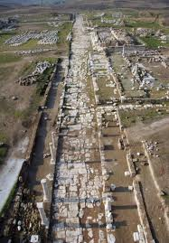
Our Problem
“These things saith the Amen, the faithful and true witness, the beginning of the creation of God; I know thy works, that thou art neither cold nor hot: I would thou wert cold or hot. So then because thou art lukewarm, and neither cold nor hot, I will spue thee out of my mouth. Because thou sayest, I am rich, and increased with goods, and have need of nothing; and knowest not that thou art wretched, and miserable, and poor, and blind, and naked: I counsel thee to buy of me gold tried in the fire, that thou mayest be rich; and white raiment, that thou mayest be clothed, and [that] the shame of thy nakedness do not appear; and anoint thine eyes with eyesalve, that thou mayest see. As many as I love, I rebuke and chasten: be zealous therefore, and repent.” Rev. 3:15-19

Slide 15
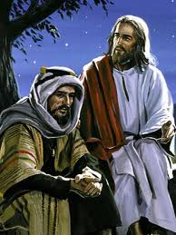
Skirting the Issue
“ Our fathers worshipped in this mountain; and ye say, that in Jerusalem is the place where men ought to worship. Jesus saith unto her, Woman, believe me, the hour cometh, when ye shall neither in this mountain, nor yet at Jerusalem, worship the Father. Ye worship ye know not what: we know what we worship: for salvation is of the Jews. But the hour cometh, and now is, when the true worshippers shall worship the Father in spirit and in truth: for the Father seeketh such to worship him. God [is] a Spirit: and they that worship him must worship [him] in spirit and in truth.” Jn. 4:20-24

Slide 16
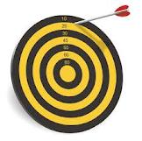
Nicodemus
“ The same came to Jesus by night, and said unto him, Rabbi, we know that thou art a teacher come from God: for no man can do these miracles that thou doest, except God be with him. Jesus answered and said unto him, Verily, verily, I say unto thee, Except a man be born again, he cannot see the kingdom of God. Nicodemus saith unto him, How can a man be born when he is old? can he enter the second time into his mother's womb, and be born?” Jn. 3:2-4

Slide 17
“Nicodemus had come to the Lord thinking to enter into a discussion with Him, but Jesus laid bare the foundation principles of truth. He said to Nicodemus, It is not theoretical knowledge you need so much as spiritual regeneration. You need not to have your curiosity satisfied, but to have a new heart. You must receive a new life from above before you can appreciate heavenly things. Until this change takes place, making all things new, it will result in no saving good for you to discuss with Me My authority or My mission.” DA, pg. 171

Slide 18
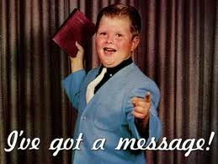
Instant Evangelist
”The woman then left her water pot, and went her way into the city, and saith to the men, Come, see a man, which told me all things that ever I did: is not this the Christ? Then they went out of the city, and came unto him.” Jn. 4:28-30

