Slide 1
Romans, pt. 22
By the Mercy of God

Slide 2
Review of Romans 11:22-36
1. Paul concludes his discussion of Israel’s failure and the grafting in of the Gentiles.
2. In spite of Israel's/Adventism’s failure, God has had a perfect plan.
3. The perversity/rebellion of Israel/Adventism has brought about their demise.
4. God did everything possible to save them/us!

Slide 3
Romans 12:1,2
These passages are pregnant with meaning. This is the beginning of the end of Paul’s letter to the Romans. To this juncture, Paul’s focus has been ‘getting certain points across’; now, his focus becomes practical or exhortative. Paul had points he wanted to make; now, he wants to exhort, challenge, and encourage the people to live lives under God’s control and direction.
“I beseech you therefore, brethren, by the mercies of God, that ye present your bodies a living sacrifice, holy, acceptable unto God, [which is] your reasonable service. And be not conformed to this world: but be ye transformed by the renewing of your mind, that ye may prove what [is] that good, and acceptable, and perfect, will of God.”

Slide 4

How can this be?
Paul comforts us, encourages us to present ourselves totally to God and allow Him full reign in our lives. He, alone, knows what is best and He alone can enable us to do right. Apart from Him, our efforts to do right are foolishness and futile.
“To take the cross of Christ means to depend solely on Him for everything, and this is the abasement of all human pride. Men love to fancy themselves independent. But let the cross be preached, let it be made known that in man dwells no good thing and that all must be received as a gift, and straightway someone is offended." Waggoner on Romans.

Slide 5

Impossible for man; Possible with God!
It is impossible for humanity to present anything that is HOLY! We can only offer that which is filthy, degraded, and messy! Paul understood this and that was why he started off his point by saying. ‘by the mercies of God’. Through God’s matchless mercy, and by our utter dependence upon that mercy, man can be enabled to present a holy offering to God and for His use in this world!

Slide 6
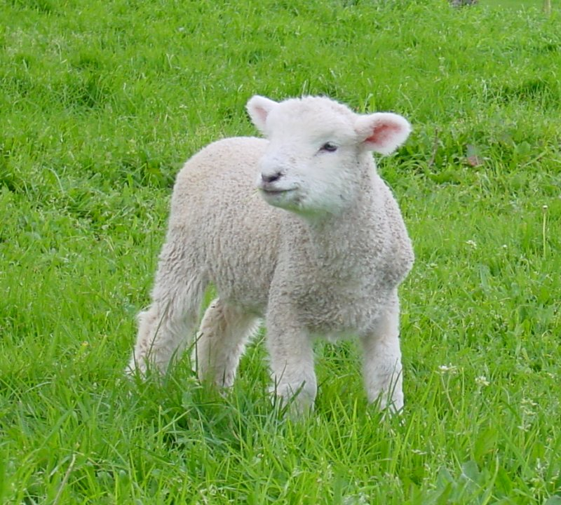
A Living Sacrifice
” Every morning and evening a lamb of a year old was burned upon the altar, with its appropriate meat offering, thus symbolizing the daily consecration of the nation to Jehovah, and their constant dependence upon the atoning blood of Christ. God expressly directed that every offering presented for the service of the sanctuary should be "without blemish.". . . Only an offering "without blemish" could be a symbol of His perfect purity who was to offer Himself as "a lamb without blemish and without spot." 1 Peter 1:19. The apostle Paul points to these sacrifices as an illustration of what the followers of Christ are to become. He says, "I beseech you therefore, brethren, by the mercies of God, that ye present your bodies a living sacrifice, holy, acceptable unto God, which is your reasonable service." . . . (Faith I Live By, 196)

Slide 7
Think Highly of What?
“For I say, through the grace given unto me, to every man that is among you, not to think [of himself] more highly than he ought to think; but to think soberly, according as God hath dealt to every man the measure of faith.” Romans 12:3
“But we are all as an unclean [thing], and all our righteousnesses [are] as filthy rags; and we all do fade as a leaf; and our iniquities, like the wind, have taken us away.” Isaiah 64:6
“Can the Ethiopian change his skin, or the leopard his spots? [then] may ye also do good, that are accustomed to do evil.” Jer. 13:23

Slide 8
Christ Alone!
“Those who accept Christ, and in their first confidence say, I am saved, are in danger of trusting to themselves. They lose sight of their own weakness and their constant need of divine strength. They are unprepared for Satan's devices, and under temptation many, like Peter, fall into the very depths of sin. We are admonished, "Let him that thinketh he standeth, take heed lest he fall." 1 Cor. 10:12. Our only safety is in constant distrust of self, and dependence on Christ.” COL, pg. 155

Slide 9
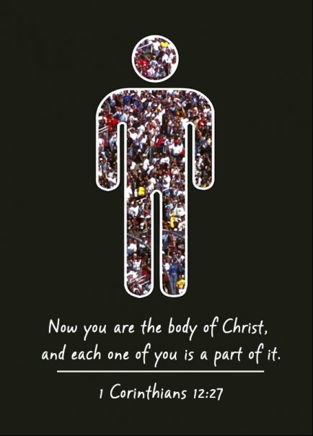
One Body
“For as we have many members in one body, and all members have not the same office: So we, [being] many, are one body in Christ, and every one members one of another. Having then gifts differing according to the grace that is given to us, whether prophecy, [let us prophesy] according to the proportion of faith; Or ministry, [let us wait] on [our] ministering: or he that teacheth, on teaching; Or he that exhorteth, on exhortation: he that giveth, [let him do it] with simplicity; he that ruleth, with diligence; he that sheweth mercy, with cheerfulness.” Romans 12:4-8

Slide 10
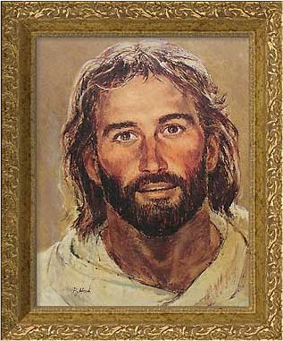
The Head of the Body
We all have different gifts that God has graciously given to each of us. What is key is using those gifts for His glory. The head of the body is not the leadership of the organization, or a pope, or a pastor, but Christ Jesus!

Slide 11
Preferring Others
Dissimulation means to be sincere; not hypocritical. Paul admonishes us to love others without the hope of getting something in return. Showing compassion for others, putting them first as Christ did.
“[Let] love be without dissimulation. Abhor that which is evil; cleave to that which is good.
[Be] kindly affectioned one to another with brotherly love; in honour preferring one another;” Romans 12:9,10

Slide 12

True Love
“Let] nothing [be done] through strife or vainglory; but in lowliness of mind let each esteem other better than themselves. Look not every man on his own things, but every man also on the things of others. Let this mind be in you, which was also in Christ Jesus: Who, being in the form of God, thought it not robbery to be equal with God: But made himself of no reputation, and took upon him the form of a servant, and was made in the likeness of men: And being found in fashion as a man, he humbled himself, and became obedient unto death, even the death of the cross. Wherefore God also hath highly exalted him, and given him a name which is above every name:” Philippians 2:4-9

Slide 13
Christ’s Victory Our Victory
Paul also tells us to abhor evil. This warning is seen throughout the Bible. “Dearly beloved, I beseech [you] as strangers and pilgrims, abstain from fleshly lusts, which war against the soul;” 1 Peter 2:11“There was a man in the land of Uz, whose name [was] Job; and that man was perfect and upright, and one that feared God, and eschewed evil.” Job 1:1
“Christ's victory was as complete as had been the failure of Adam.
So we may resist temptation, and force Satan to depart from us. Jesus gained the victory through submission and faith in God, and by
the apostle He says to us, "Submit yourselves therefore to God. Resist the devil, and he will flee from you. Draw nigh to God, and He will draw nigh to you." James 4:7, 8. We cannot save ourselves from the tempter's power; he has conquered humanity, and when we try to stand in our own strength, we shall become a prey to his devices; but "the name of the Lord is a strong tower: the righteous runneth into it, and is safe." Prov. 18:10. Satan trembles and flees before the weakest soul who finds refuge in that mighty name.” DA, pg. 130,131

Slide 14
Business Practices
“Not slothful in business; fervent in spirit; serving the Lord;
Rejoicing in hope; patient in tribulation; continuing instant in prayer;” Romans 12:11,12 The Bible is so clear as to how to have a successful business. It is found in honesty, diligence, thrift, and………………………….
“There is no branch of legitimate business for which the Bible does not afford an essential preparation. Its principles of diligence, honesty, thrift, temperance, and purity are the secret of true success. These principles, as set forth in the book of Proverbs, constitute a treasury of practical wisdom. Where can the merchant, the artisan, the director of men in any department of business, find better maxims for himself or for his employees than are found in these words of the wise man:
"Seest thou a man diligent in his business? he shall stand before kings; he shall not stand before mean men." Proverbs 22:29.
"In all labor there is profit: but the talk of the lips tendeth only to penury." Proverbs 14:23.
"The soul of the sluggard desireth, and hath nothing." "The drunkard and the glutton shall come to poverty: and drowsiness shall clothe a man with rags." Proverbs 13:4; 23:21.” Education, pg. 135

Slide 15
Balance in Giving
“But I say unto you, Love your enemies, bless them that curse you, do good to them that hate you, and pray for them which despitefully use you, and persecute you; That ye may be the children of your Father which is in heaven: for he maketh his sun to rise on the evil and on the good, and sendeth rain on the just and on the unjust. For if ye love them which love you, what reward have ye? do not even the publicans the same?”
Matthew 5:44-46
Romans 12:13,14 “Distributing to the necessity of saints; given to hospitality. Bless them which persecute you: bless, and curse not.”
To help the worthy poor is a Biblical admonition; to assist those who feel that they are owed a livelihood from us should not be assisted!

Slide 16
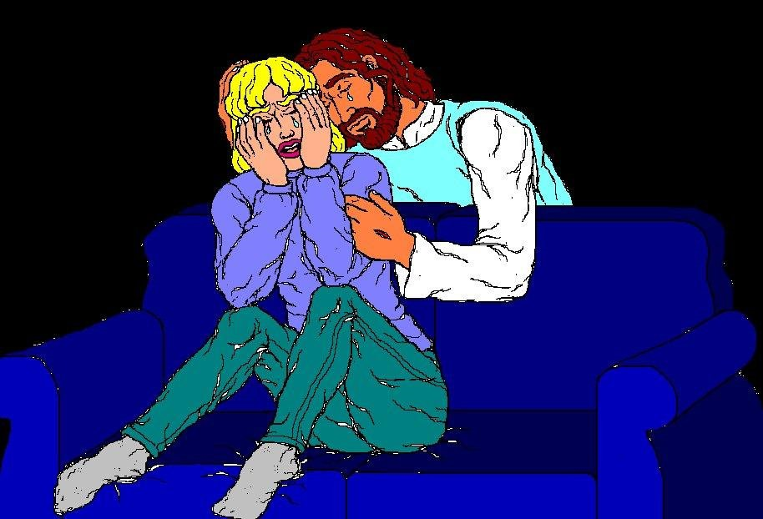
Weep with those that Weep
Romans 12:15-17 “Rejoice with them that do rejoice, and weep with them that weep. [Be] of the same mind one toward another. Mind not high things, but condescend to men of low estate. Be not wise in your own conceits. Recompense to no man evil for evil. Provide things honest in the sight of all men.”

Slide 17
Rejoice when Someone else is Happy
“To rejoice with them that rejoice and to weep with them that weep, is not an easy thing for the natural man. Only the grace of God can work such sympathy in men. It is not so difficult to weep with those who are afflicted, but it is often very difficult to rejoice with those who rejoice. For instance, suppose another has received something which we very much desired, and is rejoicing over his gain; it requires much grace to rejoice with him.” Waggoner, Book on Romans, pg. 181

Slide 18

Live Peaceably
Romans 12:18,19 “If it be possible, as much as lieth in you, live peaceably with all men.
Dearly beloved, avenge not yourselves, but [rather] give place unto wrath: for it is written, Vengeance [is] mine; I will repay, saith the Lord.”

Slide 19
Live Peaceably with all Men?
“We are to live peaceably with all men if it be possible. But what is the limit of possibility? Some will say that they tried to keep peace until “forbearance ceased to be a virtue,” and then they paid the troublesome one in his own coin. Many think that this verse exhorts them to hold out as long as they can, and not to take part in any disturbance until they have had great provocation. But this verse says, “as much as lies in you, live peaceably with all men.” That is, there is to be no trouble so far as we are concerned. We can not always keep other people from warring, but we can be at peace ourselves. “Thou wilt keep him in perfect peace, whose mind is stayed on thee; because he trusts in thee.” Isaiah 26:3. “Being justified by faith, we have peace with God through our Lord Jesus Christ.” Romans 5:1. “Let the peace of God rule in your hearts.” Colossians 3:15. “And the peace of God, which passes all understanding, shall keep your hearts and minds through Christ Jesus.” Philippians 4:7. He who has this abiding peace of God, will never have any trouble with men.” Waggoner, Book on Romans, pg. 181

Slide 20
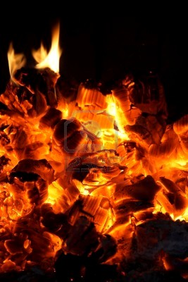
Coals of Fire
“Therefore if thine enemy hunger, feed him; if he thirst, give him drink: for in so doing thou shalt heap coals of fire on his head. Be not overcome of evil, but overcome evil with good.” Romans 12: 20,21 “And when they were come to the place, which is called Calvary, there they crucified him, and the malefactors, one on the right hand, and the other on the left. Then said Jesus, Father, forgive them; for they know not what they do. And they parted his raiment, and cast lots.” Luke 23: 33,34

Slide 21
Next Time: Romans 13
The Christian and the Civil Government! What is our duty and responsibility as SDA Christians?

