Slide 1
Romans pt. 21
Romans 11:22-36

Slide 2
Review of Romans 11:1-21
1. Israel ceased to be the people of God because of their stubbornness and hardheartedness.
2. God never arbitrarily casts away anyone.
3. The Jews failed to share the truth with the Gentiles. God never intended for the Gentiles to be shut away from Gospel privileges.
4. The Jews took care of that! “The message of salvation is communicated to men through human agencies. But the Jews had sought to make a monopoly of the truth which is eternal life. They had hoarded the living manna, and it had turned to corruption. The religion which they tried to shut up to themselves became an offense. They robbed God of His glory, and defrauded the world by a counterfeit of the gospel. They had refused to surrender themselves to God for the salvation of the world, and they became agents of Satan for its destruction.
The people whom God had called to be the pillar and ground of the truth had become representatives of Satan. They were doing the work that he desired them to do, taking a course to misrepresent the character of God, and cause the world to look upon Him as a tyrant.” DA, pg. 36

Slide 3
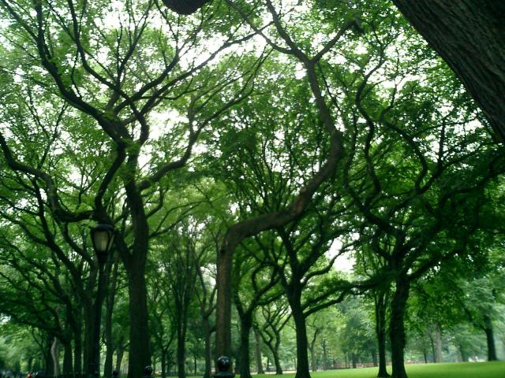
God’s Severity?
“Behold therefore the goodness and severity of God: on them which fell, severity; but toward thee, goodness, if thou continue in [his] goodness: otherwise thou also shalt be cut off. And they also, if they abide not still in unbelief, shall be graffed in: for God is able to graff them in again.” Romans 11:22,23

Slide 4
Intense Love
“His tears were not for Himself, though He well knew whither His feet were tending. Before Him lay Gethsemane, the scene of His approaching agony. The sheepgate also was in sight, through which for centuries the victims for sacrifice had been led, and which was to open for Him when He should be "brought as a lamb to the slaughter." Isaiah 53:7. Not far distant was Calvary, the place of crucifixion. Upon the path which Christ was soon to tread must fall the horror of great darkness as He should make His soul an offering for sin. Yet it was not the contemplation of these scenes that cast the shadow upon Him in this hour of gladness. No foreboding of His own superhuman anguish clouded that unselfish spirit. He wept for the doomed thousands of Jerusalem--because of the blindness and impenitence of those whom He came to bless and to save.
The history of more than a thousand years of God's special favor and guardian care, manifested to the chosen people, was open to the eye of Jesus. There was Mount Moriah, where the son of promise, an unresisting victim, had been bound to the altar--emblem of the offering of the Son of God. There the covenant of blessing, the glorious Messianic promise, had been confirmed to the father of the faithful. Genesis 22:9, 16-18. There the flames of the sacrifice ascending to heaven from the threshing floor of Ornan had turned
aside the sword of the destroying angel (1 Chronicles 21)--fitting symbol of the Saviour's sacrifice and mediation for guilty men. Jerusalem had been honored of God above all the earth. The Lord had "chosen Zion," He had "desired it for His habitation." Psalm 132:13. There, for ages, holy prophets had uttered their messages of warning. There priests had waved their censers, and the cloud of incense, with the prayers of the worshipers, had ascended before God. There daily the blood of slain lambs had been offered, pointing forward to the Lamb of God

Slide 5
continued
. There Jehovah had revealed His presence in the cloud of glory above the mercy seat. There rested the base of that mystic ladder connecting earth with heaven (Genesis 28:12; John 1:51)--that ladder upon which angels of God descended and ascended, and which opened to the world the way into the holiest of all. Had Israel as a nation preserved her allegiance to Heaven, Jerusalem would have stood forever, the elect of God. Jeremiah 17:21-25. But the history of that favored people was a record of backsliding and rebellion. They had resisted Heaven's grace, abused their privileges, and slighted their opportunities.
Although Israel had "mocked the messengers of God, and despised His words, and misused His prophets" (2 Chronicles 36:16), He had still manifested Himself to them, as "the Lord God, merciful and gracious, long-suffering, and abundant in goodness and truth" (Exodus 34:6); notwithstanding repeated rejections, His mercy had continued its pleadings. With more than a father's pitying love for the son of his care, God had "sent to them by His messengers, rising up betimes, and sending; because He had compassion on His people, and on His dwelling place." 2 Chronicles 36:15. When remonstrance, entreaty, and rebuke had failed, He sent to them the best gift of heaven; nay, He poured out all heaven in that one Gift.
The Son of God Himself was sent to plead with the impenitent city. It was Christ that had brought Israel as a goodly vine out of Egypt. Psalm 80:8. His own hand had cast out the heathen before it. He had planted it "in a very fruitful hill." His guardian care had hedged it about. His servants had been sent to nurture it. "What could have been done more to My vineyard," He exclaims, "that I have not done in it?" Isaiah 5:1-4. Though when He looked that it should bring forth grapes, it brought forth wild grapes, yet with a still yearning hope of fruitfulness He came in person to His vineyard, if haply it might be saved from destruction. He digged about His vine; He pruned and cherished it. He was unwearied in His efforts to save this vine of His own planting.

Slide 6
God’s Longsuffering
“He will turn again; He will have compassion upon us. He will subdue our iniquities and Thou wilt cast all their sins into the depths of the sea.” Micah 7:19
So often, people say that probation closed on the Jews at Christ’s death. Even after that, there was still opportunity for repentance. For 3 and a half years after the death of Christ, God still pled with Israel. We are so quick to pronounce judgment on people; let God take care of it!

Slide 7

The Gathering in of the Gentiles
“And they also, if they abide not still in unbelief, shall be grafted in: for God is able to graff them in again. For if thou wert cut out of the olive tree which is wild by nature, and wert graffed contrary to nature into a good olive tree: how much more shall these, which be the natural [branches], be graffed into their own olive tree?” Romans 11:23,24

Slide 8

Reach Out to Them
Wherefore remember, that ye [being] in time past Gentiles in the flesh, who are called Uncircumcision by that which is called the Circumcision in the flesh made by hands; That at that time ye were without Christ, being aliens from the commonwealth of Israel, and strangers from the covenants of promise, having no hope, and without God in the world: But now in Christ Jesus ye who sometimes were far off are made nigh by the blood of Christ. For he is our peace, who hath made both one, and hath broken down the middle wall of partition [between us];” Ephesians 2:11-14

Slide 9
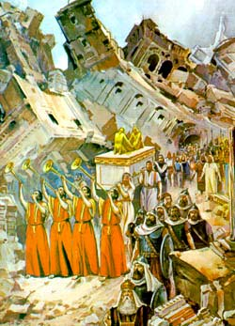
Moments of Greatness
While Adventism/Judaism failed, they had moments of brilliant faith. Remember, “By faith, the walls of Jericho fell down.” Hebrews 11:30 Adventism failed to maintain their connection to the vine. “Abide in Me, and I in you. As the branch cannot bear fruit of itself, except it abide in the vine, no more can you,……..” Jn. 15:4 Because of this, they were cut off!

Slide 10
For Everyone
“For I would not, brethren, that ye should be ignorant of this mystery, lest ye should be wise in your own conceits; that blindness in part is happened to Israel, until the fullness of the Gentiles be come in. And so all Israel shall be saved: as it is written, There shall come out of Sion the Deliverer, and shall turn away ungodliness from Jacob:” Romans 11:25,26
From the very beginning, God purposed that all men would have access to the great truths of redemption. “And this gospel of the kingdom shall be preached in all the world for a witness unto all nations; and then shall the end come.” Matthew 24:14

Slide 11
Deliverance
Opportunity for deliverance comes only through faith in Jesus Christ. “The only defense against evil is the indwelling of Christ in the heart through faith in His righteousness.” DA, pg. 324
That Israel wasn’t delivered from sin is only because of their own perversity and rebellion. While we suffer the sure results of sin, we have no one to blame but ourselves. Even within our suffering, it is God’s distinct purpose to bring us to Christ that we would find peace and power with God.

Slide 12
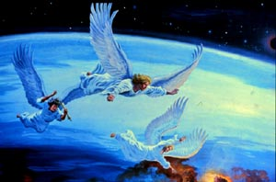
Unbelief Shut the Door
“And I saw another angel fly in the midst of heaven, having the everlasting gospel to preach unto them that dwell on the earth, and to every nation, and kindred, and tongue, and people, Saying with a loud voice,” Rev.14:6 “And the scripture, foreseeing that God would justify the heathen through faith, preached before the gospel unto Abraham, [saying], In thee shall all nations be blessed. So then they which be of faith are blessed with faithful Abraham.” Galatians 3:8,9

Slide 13
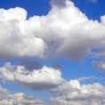
As Thick as the Clouds!
“For this [is] my covenant unto them, when I shall take away their sins.” Romans 11:27
This was ever the promise of God; He alone can remove sin from the life. “I, [even] I, [am] he that blotteth out thy transgressions for mine own sake, and will not remember thy sins.” Isaiah 43:25

Slide 14
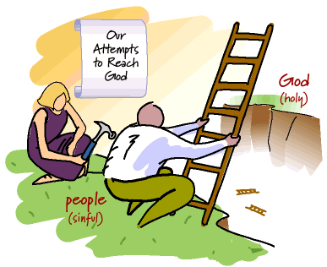
Gift of God
“As concerning the gospel, [they are] enemies for your sakes: but as touching the election, [they are] beloved for the fathers' sakes. For the gifts and calling of God [are] without repentance.” Romans 11:28,29

Slide 15
gifts
The gifts of God are just that: GIFTS! We don’t earn them, work for them, or gain them. We must simply receive them as we receive a gift at our birthday. “For by grace are ye saved through faith, and that not of yourselves, it is the gift of God; not of works, lest any man should boast.” Eph. 2:8,9
Titus 3:5,6 “Not by works of righteousness which we have done, but according to His mercy He saved us; by the washing of regeneration and the renewing of the Holy Ghost, which He shed on us abundantly through Jesus Christ…..

Slide 16

No Difference
“For as ye in times past have not believed God, yet have now obtained mercy through their unbelief: Even so have these also now not believed, that through your mercy they also may obtain mercy. For God hath concluded them all in unbelief, that he might have mercy upon all.” Romans 11:30-32

Slide 17
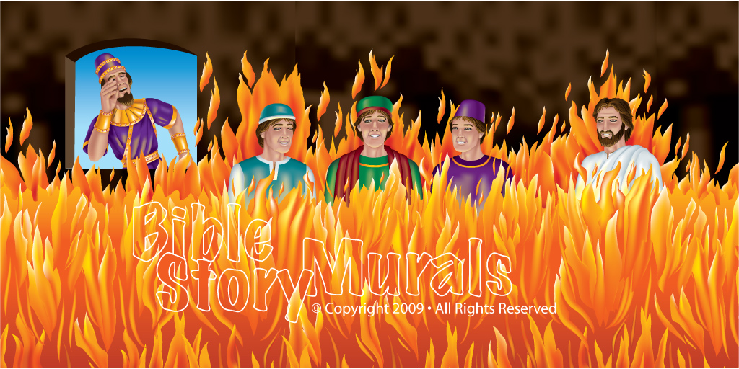
God has His Ways!
Never was it God’s plan/purpose for there to be a distinction between Jew and Gentile. Because the Jews failed to spread the light, the Gentiles, to a degree, were shut out from the blessings given to Israel. God used different means. Truth would be made known!

Slide 18
God’s Wisdom
“O the depth of the riches both of the wisdom and knowledge of God! how unsearchable [are] his judgments, and his ways past finding out! For who hath known the mind of the Lord? or who hath been his counselor? Or who hath first given to him, and it shall be recompensed unto him again?
For of him, and through him, and to him, [are] all things: to whom [be] glory for ever. Amen.” Romans 11:33-36
“He has made everything beautiful in His time….” Eccl. 3:11
God has a plan and the wickedness of men and demons will not stop it. Nor will those who know better. The plans of God will go forward and truth will triumphant at last. Let us stay with the truth-it is going through!

Slide 19
Everything Beautiful in His Time
But like the stars in the vast circuit of their appointed path, God's purposes know no haste and no delay. Through the symbols of the great darkness and the smoking furnace, God had revealed to Abraham the bondage of Israel in Egypt, and had declared that the time of their sojourning should be four hundred years. "Afterward," He said, "shall they come out with great substance." Gen. 15:14. Against that word, all the power of Pharaoh's proud empire battled in vain. On "the self-same day" appointed in the divine promise, "it came to pass, that all the hosts of the Lord went out from the land of Egypt." Ex. 12:41. So in heaven's council the hour for the coming of Christ had been determined. When the great clock of time pointed to that hour, Jesus was born in Bethlehem.
"When the fullness of the time was come, God sent forth His Son." Providence had directed the movements of nations, and the tide of human impulse and influence, until the world was ripe for the coming of the Deliverer. The nations were united under one government. One language was widely spoken, and was everywhere recognized as the language of literature. From all lands the Jews of the dispersion gathered to Jerusalem to the annual feasts. As these returned to the places of their sojourn, they could spread throughout the world the tidings of the Messiah's coming.” DA, pg. 32

