Slide 1
Rubicon

Slide 2
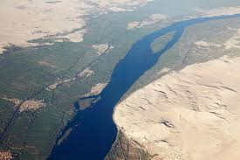
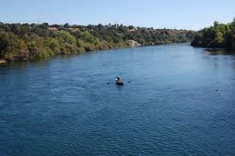
Not the Nile…………………. or the Sacramento

Slide 3
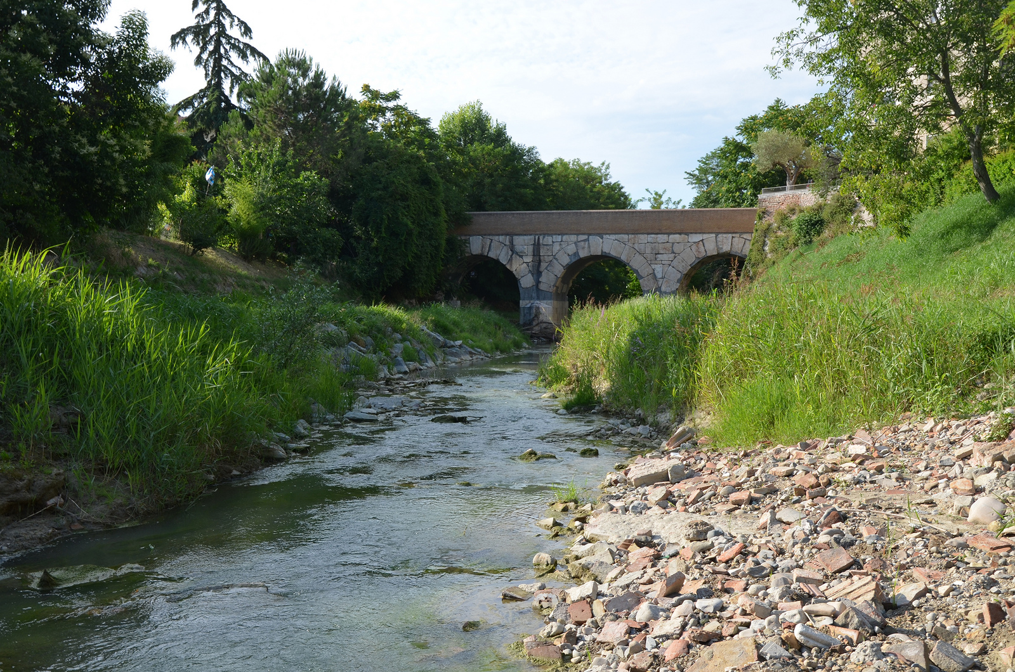

Slide 4
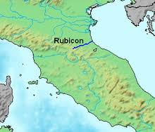
The Rubicon stream is not dramatic or mighty flowing; it is just a small stream. The Rubicon is a shallow river in northeastern Italy, just south of Ravenna. The same name was given to a river that was famously crossed by Julius Caesar in 49 BC.

Slide 5
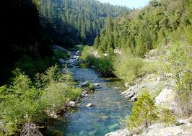
During the Roman republic, the river Rubicon marked the boundary between the Roman province of Cisalpine Gaul to the north-east and Italy proper (controlled directly by Rome and its allies) to the south. On the north-western side, the border was marked by the river Arno, a much wider and more important waterway, which flows westward from the Apennine Mountains (its source is not far from Rubicon's source) into the Tyrrhenian Sea. Governors of Roman provinces were appointed promagistrates with imperium (roughly, "right to command") in one or more provinces. The governor then served as the general of the Roman army within the territory they ruled. Roman law specified that only the elected magistrates (consuls and praetors) could hold imperium within Italy. Any promagistrate who entered Italy at the head of his troops forfeited his imperium and was therefore no longer legally allowed to command troops.
Exercising imperium when forbidden by the law was a capital offence. Furthermore, obeying the commands of a general who did not legally possess imperium was a capital offence. If a general entered Italy in command of an army, both the general and his soldiers became outlaws and were automatically condemned to death. Generals were thus obliged to disband their armies before entering Italy.

Slide 6
The Die Was Cast
Julius Caesar paused on the banks of the Rubicon. In 49 BC, perhaps on January 10, Julius Caesar led a single legion, Legio XIII, south over the Rubicon from Cisalpine Gaul to Italy to make his way to Rome. In doing so, he (deliberately) broke the law on imperium and made armed conflict inevitable. According to Suetonius, Caesar uttered the famous phrase ālea iacta est ("the die has been cast").[2] The phrase "crossing the Rubicon" has survived to refer to any individual or group committing itself irrevocably to a risky or revolutionary course of action, similar to the modern phrase "passing the point of no return". Caesar's decision for swift action forced Pompey, the lawful consul, and a large part of the Roman Senate to flee Rome in fear. Caesar's subsequent victory in Caesar's Civil War ensured that he would never be punished for the infraction.

Slide 7
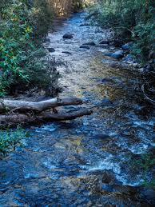
The Rubicon was really a nothing little stream. But, oh, to a Roman, it was a point of no return. If Julius Caesar crossed the Rubicon, he and his men would be considered outlaws of the Roman Empire and no longer worthy of protection of Roman law. Crossing into Italy with his army, Caesar was throwing the gauntlet down and letting Pompey know that war was inevitable!

Slide 8
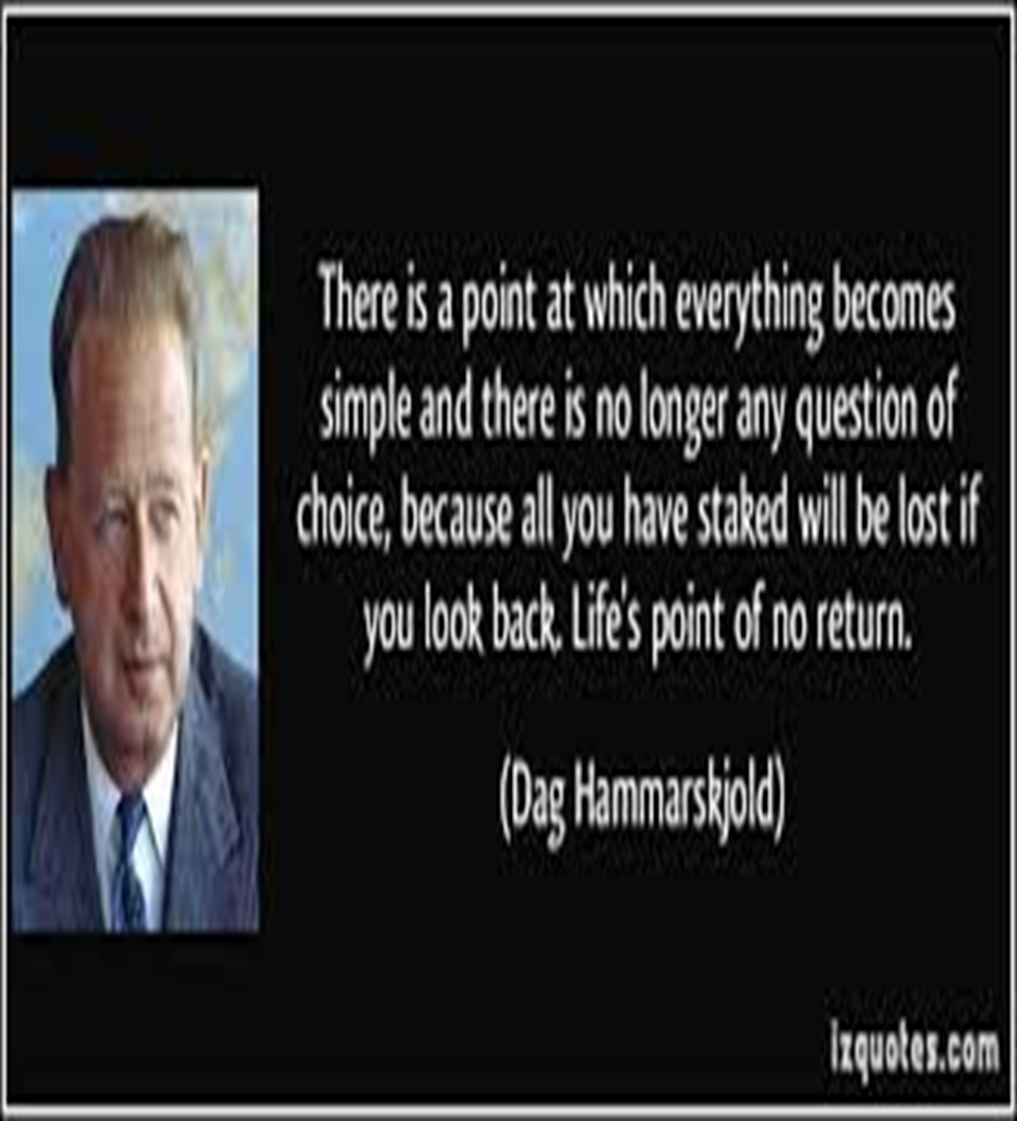
There will come a point in this earth’s history; the exact time of which we do not know, when we will meet the Rubicon. It will indeed, be a point of no return. At that point, our characters will be sealed for eternity, we will be judged in the courts of heaven as either with God or against Him! We will either receive the seal of God, which is the 7th day Sabbath or we will receive the mark of the beast, which is Sunday! At that point, we will be given the Latter Rain of the Holy Spirit or will become the most vicious opposers of God and His people!

Slide 9
The Judgment of the Living has not Begun Yet!
“The Lord has shown me clearly that the image of the beast will be formed before probation closes; for it is to be the great test for the people of God, by which their eternal destiny will be decided.... [Revelation 13:11-17 quoted.] ...This is the test that the people of God must have before they are sealed. All who proved their loyalty to God by observing His law, and refusing to accept a spurious sabbath, will rank under the banner of the Lord God Jehovah, and will receive the seal of the living God. Those who yield the truth of heavenly origin and accept the Sunday sabbath, will receive the mark of the beast (Letter 11, 1890).

Slide 10
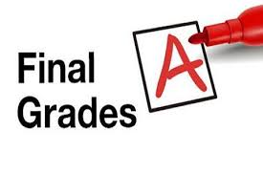
Judgment of the Living Begins at the Sunday Law!
“The Lord has shown me clearly that the image of the beast will be formed before probation closes; for it is to be the great test for the people of God, by which their eternal destiny will be decided.” Letter 11,1890 The final test that determines ones destiny will be at the National Sunday Law. Then, people will be sealed!

Slide 11
Prepare, prepare, NOW!
“The grand judgment is taking place, and has been going on for some time. Now the Lord says, Measure the temple and the worshipers thereof. Remember when you are walking the streets about your business, God is measuring you; when you are attending your household duties, when you engage in conversation, God is measuring you. Remember that your words and actions are being daguerreotyped [photographed] in the books of heaven, as the face is reproduced by the artist on the polished plate.... Here is the work going on, measuring the temple and its worshipers to see who will stand in the last day. Those who stand fast shall have an abundant entrance into the kingdom of our Lord and Savior Jesus Christ. When we are doing our work remember there is One that is watching the spirit in which we are doing it. Shall we not bring the Savior into our everyday lives, into our secular work and domestic duties? Then in the name of God we want to leave behind everything that is not necessary, all gossiping or unprofitable visiting, and present ourselves as servants of the living
God.” (Manuscript 4, 1888)

Slide 12
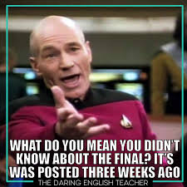
The Teacher Gives the Final Grade
Any teacher realizes that no final grades are given until the final test has been recorded in the grade book. Once the final test has been taken, tallied, and recorded, then the teacher gives out the final grade. Thus, in the Heavenly Classroom, once the Sunday Law is urged upon us, if we pass this final test, then our name will be registered as ‘victor’ in the courts above. We will be sealed for eternity while still living. We will be given the Latter Rain, and will give the Loud Cry!

Slide 13
The Sealing/Judgment Work!
“This is the test that the people of God must have before they are sealed. All who proved their loyalty to God by observing His law, and refusing to accept a spurious sabbath, will rank under the banner of the Lord God Jehovah, and will receive the seal of the living God. Those who yield the truth of heavenly origin and accept the Sunday sabbath, will receive the mark of the beast (Letter 11, 1890).”

Slide 14
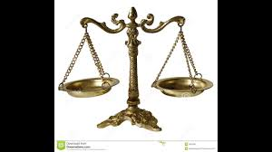
“With unerring accuracy the Infinite One still keeps an account with all nations. While His mercy is tendered with calls to repentance, this account will remain open; but when the figures reach a certain amount which God has fixed, the ministry of His wrath commences. The account is closed. Divine patience ceases. There is no more pleading of mercy in their behalf. The prophet, looking down the ages, had this time presented before his vision. The nations of this age have been the recipients of unprecedented mercies. The choicest of heaven's blessings have been given them, but increased pride, covetousness, idolatry, contempt of God, and base ingratitude are written against them. They are fast closing up their account with God.” {5T 208, 209

Slide 15
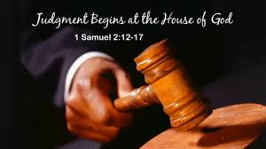
Judgment Comes First to SDAdventists
“And the LORD said unto him, Go through the midst of the city, through the midst of Jerusalem, and set a mark upon the foreheads of the men that sigh and that cry for all the abominations that be done in the midst thereof. And to the others he said in mine hearing, Go ye after him through the city, and smite: let not your eye spare, neither have ye pity: Slay utterly old and young, both maids, and little children, and women: but come not near any man upon whom is the mark; and begin at my sanctuary. Then they began at the ancient men which were before the house.” Ezekiel 9:4-6

Slide 16
The Church is Judged First!
“Here we see that the church--the Lord's sanctuary--was the first to feel the stroke of the wrath of God. The ancient men, those to whom God had given great light and who had stood as guardians of the spiritual interests of the people, had betrayed their trust. They had taken the position that we need not look for miracles and the marked manifestation of God's power as in former days. Times have changed. These words strengthen their unbelief, and they say: The Lord will not do good, neither will He do evil. He is too merciful to visit His people in judgment. Thus "Peace and safety" is the cry from men who will never again lift up their voice like a trumpet to show God's people their transgressions and the house of Jacob their sins. These dumb dogs that would not bark are the ones who feel the just vengeance of an offended God. Men, maidens, and little children all perish together. {5T 211.2}

Slide 17
Solemn Time!
“The abominations for which the faithful ones were sighing and crying were all that could be discerned by finite eyes, but by far the worst sins, those which provoked the jealousy of the pure and holy God, were unrevealed. The great Searcher of hearts knoweth every sin committed in secret by the workers of iniquity. These persons come to feel secure in their deceptions and, because of His long-suffering, say that the Lord seeth not, and then act as though He had forsaken the earth. But He will detect their hypocrisy and will open before others those sins which they were so careful to hide. No superiority of rank, dignity, or worldly wisdom, no position in sacred office, will preserve men from sacrificing principle when left to their own deceitful hearts. Those who have been regarded as worthy and righteous prove to be ring-leaders in apostasy and examples in indifference and in the abuse of God's mercies. Their wicked course He will tolerate no longer, and in His wrath He deals with them without mercy.” 5T 212

Slide 18
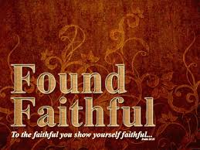
Faithful SDA’s
Those SDA’s who are sighing and crying over the apostasy amongst us; those SDA’s who are settling into the truth intellectually so that false doctrine does not move them; those SADA’s who are experiencing the power of Christ in their lives will receive the seal of God, be filled with the Latter Rain, and will be judged in the courts of heaven as faithful and true! These SDA’s will give the Loud Cry of Revelation 18:1,2 “And after these things I saw another angel come down from heaven, having great power; and the earth was lightened with his glory. And he cried mightily with a strong voice, saying, Babylon the great is fallen, is fallen, and is become the habitation of devils, and the hold of every foul spirit, and a cage of every unclean and hateful bird.”

Slide 19
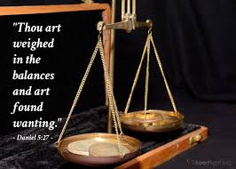
Unfaithful SDA’s
Unfaithful SDA’s will be those who embrace Sunday worship. They do not know what they believe and are carried about with every wind of doctrine. They refuse the power of Christ in their lives and are found wanting. They become the most violent opposers of faithful SDA’s; they have the faithful arrested; they even will come to faithful Adventists homes and have all their goods confiscated! They are judged unfaithful in the heavenly courts and will perish in the lake of fire!

Slide 20
“As the storm approaches, a large class who have professed faith in the third angel's message, but have not been sanctified through obedience to the truth, abandon their position and join the ranks of the opposition. By uniting with the world and partaking of its spirit, they have come to view matters in nearly the same light; and when the test is brought, they are prepared to choose the easy, popular side. Men of talent and pleasing address, who once rejoiced in the truth, employ their powers to deceive and mislead souls. They become the most bitter enemies of their former brethren. When Sabbath keepers are brought before the courts to answer for their faith, these apostates are the most efficient agents of Satan to misrepresent and accuse them, and by false reports and insinuations to stir up the rulers against them. “ GC, pg. 608

