Slide 1
Ezekiel, chapters 1-16 in Review
A Look Back

Slide 2
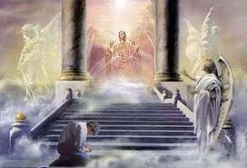
Similarities with SDA’s
Before beginning his ministry, Ezekiel was given a vision of the Heavenly Sanctuary in chapter 1. Before SDA’s were called to give the 3 Angel’s messages to the world, they were given a vision of the Heavenly Sanctuary. (Dan. 7:9-14;Dan. 8:14; Rev. 14:7)

Slide 3
Sweet/Bitter Experience
Ezekiel was told his mission would be sweet and bitter. (Ezekiel 3:3,14) He was called to preach to a rebellious people.
SDA’s were given a similar call and experience. “And I took the little book out of the angel's hand, and ate it up; and it was in my mouth sweet as honey: and as soon as I had eaten it, my belly was bitter.” Rev. 10:10

Slide 4
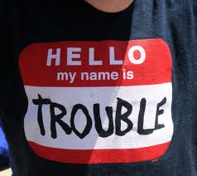
Messages of Warning!
Ezekiel , chapters 4-7, reveal the warnings and judgments to befall ancient Adventism. Rev. 14:7-10 detail the messages of judgment that we are to give to the world.
‘the hour of His judgment is come.’
‘Babylon is fallen.’
‘If any man worship the beast.’

Slide 5
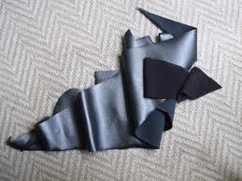
A Remnant always Emerges
Ezekiel 6:8 “Yet will I leave a remnant, that ye may have some that shall escape the sword among the nations, when ye shall be scattered through the countries.”
Rev. 12:17 “And the dragon was wroth with the woman, and went to make war with the remnant of her seed, which keep the commandments of God, and have the testimony of Jesus Christ.”

Slide 6
Causes for judgments
Ezekiel 8 pinpoints the reasons that judgments fall.
1. “So I went in and saw; and behold every form of creeping things, and abominable beasts, and all the idols of the house of Israel, portrayed upon the wall round about.” (v.10)
2. “Then he brought me to the door of the gate of the LORD'S house which was toward the north; and, behold, there sat women weeping for Tammuz.” (V. 14) sexual immorality!
3. “And he brought me into the inner court of the LORD'S house, and, behold, at the door of the temple of the LORD, between the porch and the altar, were about five and twenty men, with their backs toward the temple of the LORD, and their faces toward the east; and they worshipped the sun toward the east.” (v. 16 ) Sunday keeping

Slide 7
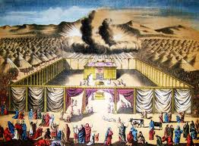
The Glory Begins to Move
“And the glory of the God of Israel was gone up from the cherub, whereupon he was, to the threshold of the house. And he called to the man clothed with linen, which had the writer's inkhorn by his side;” Ezekiel 9:3
God’s strange act of departing from those He loves breaks His heart, but He has no choice!

Slide 8
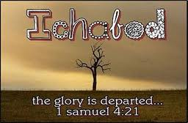
Ichabod!!!
“Then the glory of the LORD departed from off the threshold of the house, and stood over the cherubim's.” Ezek. 10:18
“And the glory of the LORD went up from the midst of the city, and stood upon the mountain which is on the east side of the city.” Ezekiel 11:23

Slide 9
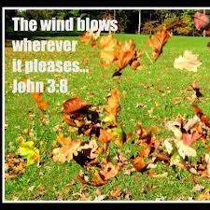
Holy Spirit Withdrawing
“God's long-suffering has ended. The world has rejected His mercy, despised His love, and trampled upon His law. The wicked have passed the boundary of their probation; the Spirit of God, persistently resisted, has been at last withdrawn. Unsheltered by divine grace, they have no protection from the wicked one. Satan will then plunge the inhabitants of the earth into one great, final trouble. . . . The people of God will then be plunged into those scenes of affliction and distress described by the prophet as the time of Jacob's trouble.” FLB 339

Slide 10
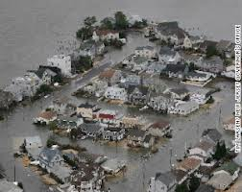
Sandy Speaks!!!

Slide 11
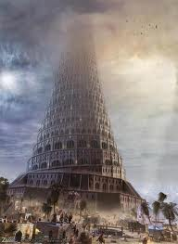
Adventism’s Folly
“Which say, It is not near; let us build houses: this city is the caldron, and we be the flesh.” Ezekiel 11:3
Ancient Adventism thought they were safe/protected simply because they were in the eternal city. Salvation came by church affiliation and being part of the denomination!!
“Neither is there salvation in any other: for there is none other name under heaven given among men, whereby we must be saved.” Acts 4:12

Slide 12
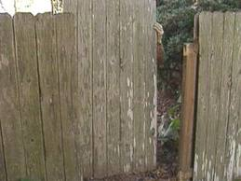
The False Prophet’s Folly
“O Israel, thy prophets are like the foxes in the deserts. Ye have not gone up into the gaps, neither made up the hedge for the house of Israel to stand in the battle in the day of the LORD.” Ezekiel 13:4,5

Slide 13
The Hedge
“In the parable the householder represented God, the vineyard the Jewish nation, and the hedge the divine law which was their protection. The tower was a symbol of the temple. The lord of the vineyard had done everything needful for its prosperity.” DA, pg.596
“They will not only ignore and despise the Sabbath themselves, but they will try to keep it from others by burying it beneath the rubbish of custom and tradition. In churches and in large gatherings in the open air, ministers will urge upon the people the necessity of keeping the first day of the week. “ RH, 3-18-1884

Slide 14
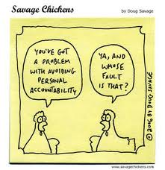
Accountability
Though Noah, Daniel, and Job, were in it, as I live, saith the Lord GOD, they shall deliver neither son nor daughter; they shall but deliver their own souls by their righteousness.” Ezekiel 14:20

Slide 15
Personal Accountability
“This is the class that in time of peril are found crying, Peace and safety. They lull their hearts into security, and dream not of danger. When startled from their lethargy, they discern their destitution, and entreat others to supply their lack; but in spiritual things no man can make up another’s deficiency. The grace of God has been freely offered to every soul. The message of the gospel has been heralded, “Let him that is athirst come. And whosoever will, let him take the water of life freely.” Revelation 22:17. But character is not transferable. No man can believe for another. No man can receive the Spirit for another. No man can impart to another the character which is the fruit of the Spirit’s working. “Though Noah, Daniel, and Job were in it [the land], as I live, saith the Lord God, they shall deliver neither son nor daughter; they shall but deliver their own souls by their righteousness.” Ezekiel 14:20. COL 411

Slide 16
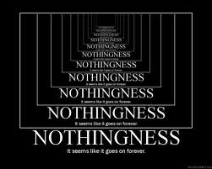
Did We Forget Something?
“Son of man, cause Jerusalem to know her abominations, And say, Thus saith the Lord GOD unto Jerusalem; Thy birth and thy nativity is of the land of Canaan; thy father was an Amorite, and thy mother an Hittite.” Ezekiel 16:2,3

Slide 17
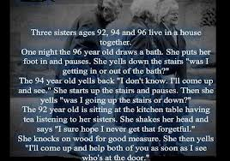

Slide 18
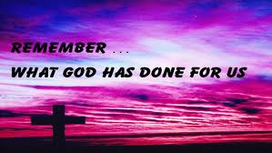
Remember
“In reviewing our past history, having traveled over every step of advance to our present standing, I can say, Praise God! As I see what God has wrought, I am filled with astonishment, and with confidence in Christ as leader. We have nothing to fear for the future, except as we shall forget the way the Lord has led us, and His teaching in our past history.” CET 204

