Slide 1
Currents of Time
What is Happening Today?

Slide 2
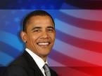
Obama and Friends
Yes, President Barack Obama is absolutely right—change is coming! Especially when we consider that many of his appointees are Jesuit-trained. For example, Obama's Chief Speechwriter, Jon Favreau, was Jesuit-trained; Obama's Senior Military and Foreign Policy Advisor, Major General J. Scott Gration, was Jesuit-trained; Obama's Deputy Communications Director, Dan Pfeiffer, was

Slide 3
Same Old Thing
Jesuit-trained; Obama’s Chicago mentor is Gregory Galluzzo, a “former” Jesuit priest and National Director and co-founder of the Gamaliel Foundation—a community organizing network representing more than a million multi-faith, church-going people who work on campaigns for social justice guided by an extreme, anti-American ideology; and former congressman Leon Panetta, who graduated from Santa Clara University—a comprehensive Jesuit, Catholic university, as head of the Central Intelligence Agency (CIA). Fasten your seatbelts!” D. Vierra’s, The Final Inquisition, pg. 27

Slide 4
Change
Barry Goldwater, With No Apologies , “When a new President comes on board, there is a great turnover in personnel, but no change in policy. Example: During the Nixon[a Republican] years Henry Kissinger, CFR member and Nelson Rockefeller’s protégé, was in charge of foreign policy. When Jimmy Carter [a Democrat] was elected, Kissinger was replaced by Zbigniew Brzezinski, CFR member and David Rockefeller’s protégé.” pg. 279

Slide 5
The ‘No Difference’ Principle
Revelation 17:1,2,17 “…I will shew unto thee the judgments of the great whore that sitteth upon many waters. With whom the kings of the earth have committed fornication…And the woman, which thou sawest, is that great city, which reigneth over the kings of the earth .” The President elect, like the man he ran against, and the man who is leaving the White House, are all kings/leaders in the earth. They are all controlled by Babylon the Great. They do Rome’s bidding. There is no difference between them……………………………………………..

Slide 6
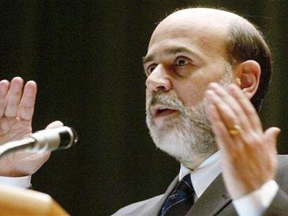
Controlling and Contracting the money
Andrew Jackson “Is there no danger to our liberty and independence in a bank that in its nature has so little to bind it to our country? Is there not cause to tremble for the purity of our elections in peace and for the independence of our country in war? Controlling our currency, receiving our public monies, and holding thousands of our citizens in dependence, it would be more formidable and dangerous than a naval and military power of the enemy.” — Herman E. Kross, Documentary History of Banking and Currency in the United States, Chelsea House, pp. 26, 27.

Slide 7
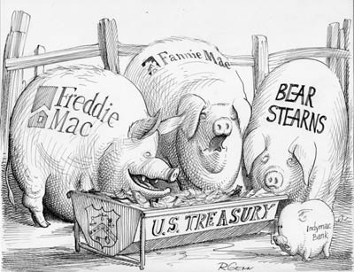
Gobbling up the Goods
The blunt reality is that the Rothschild banking dynasty in Europe was the dominant force, both financially and politically, in the formation of the Bank of the United States. — G. Edward Griffin, The Creature from Jekyll Island, American Opinion Publishing, p. 331.
Over the years since N.M. [Rothschild], the Manchester textile manufacturer, had bought cotton from the Southern states, The Rothschilds had developed heavy American commitments. Nathan… had made loans to various states of the Union, had been, for a time, the official European banker for the U.S. government and was a pledged supporter of the Bank of the United States. — Derek Wilson, Rothschild: The Wealth and Power of a Dynasty, Charles Scribner’s Sons, p. 178

Slide 8
Jesuits Calling the Shots
“Aware that the Rothschilds are an important Jewish family, I looked them up in Encyclopedia Judaica and discovered that they bear the title ‘Guardians of the Vatican Treasury’…. The appointment of Rothschild gave the black papacy absolute financial privacy and secrecy. Who would ever search a family of orthodox Jews for the key to the wealth of the Roman Catholic Church? — F. Tupper Saussy, Rulers of Evil, Harper Collins, page 160, 161

Slide 9
Rome, Crisis, and Control
Revelation 18:11-15 “And the merchants of the earth shall weep and mourn over her; for no man buyeth their merchandise any more:
The merchandise of gold, and silver, and precious stones, and of pearls, and fine linen, and purple, and silk, and scarlet, and all thyine wood, and all manner vessels of ivory, and all manner vessels of most precious wood, and of brass, and iron, and marble,
And cinnamon, and odours, and ointments, and frankincense, and wine, and oil, and fine flour, and wheat, and beasts, and sheep, and horses, and chariots, and slaves, and souls of men.
And the fruits that thy soul lusted after are departed from thee, and all things which were dainty and goodly are departed from thee, and thou shalt find them no more at all.
The merchants of these things, which were made rich by her, shall stand afar off for the fear of her torment, weeping and wailing...”

Slide 10
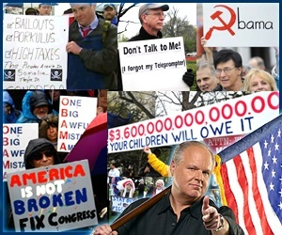
A Response to Powerbrokers and Washington
Chattanooga: Wednesday’s Tax Day Tea Party at Ross’s Landing drew about 1,000 area citizens who came to protest runaway federal spending. “We’ve gotten to the point where Congress just passes spending to make people feel good, but there is little accountability to ensure that spending gets real results. Continued spending of this magnitude will force huge tax hikes for everybody, not just the so-called rich, and limit economic opportunity for our children and grandchildren.”

Slide 11
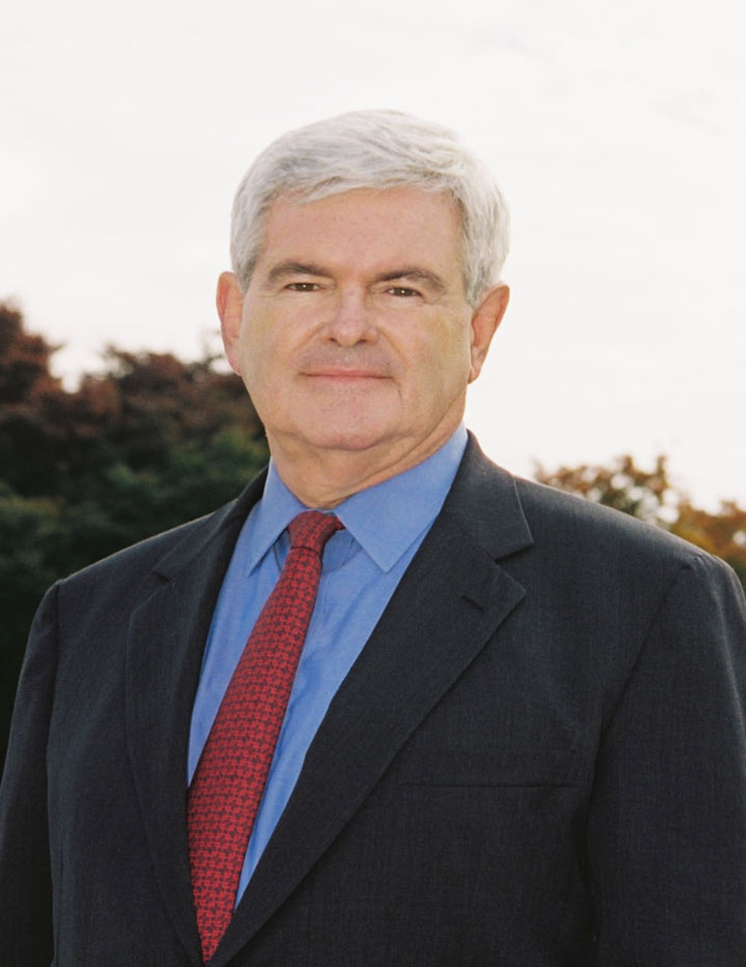
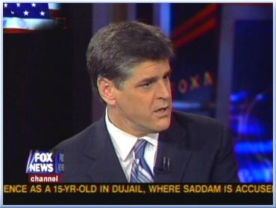
Tea Party Big Boys

Slide 12
Gingrich is a…………………………Catholic
“Indeed, on Sunday, March 29, Gingrich converted to Catholicism, the faith of his third wife, Calista Bisek. Though the ceremony was announced without fanfare, leading Catholic conservatives like Deal Hudson are brimming with excitement. Hudson was the most important Catholic political adviser to President Bush and Karl Rove, founder of the seminal Catholic journal, Crisis magazine, and self-described “theocon.” He contends that Gingrich’s conversion represents more than a concession to his wife; it signals a dramatic break from the past, both personally and politically.”
Alternet.org

Slide 13
Hannity is…………………………………Too
March 9, 2007
Pro-life priest criticizes Sean Hannity; Catholic journalist in legal trouble. Father Tom Euteneuer, president of one of my favorite pro-life organizations, Human Life International, isn't too happy with conservative commentator Sean Hannity…………………..
Sean Hannity said that he was himself Catholic and that he attends a church which on Sundays is standing room only. He attributes this in part to God, but mostly to his pastor, who, says Hannity, is rigorous in his defense of Christian doctrines, forswearing temptations to truckle to modernism.

Slide 14
Playing Both Sides Against Each Other
Obama, Bernanke, and Washington are controlled the Jesuits. The Tea Party people, Gingrich and Hannity, and the concerned masses, are controlled and led by Catholic-led men. This is the Hegelian dialectic. Create a thesis/antithesis in order to achieve your synthesis or solution.
Thesis-financial crisis
Antithesis-Tea Party uprising
Synthesis-???????????????
With so many out of work, with no work in sight, mounting bills to pay, and people losing their homes, a revolution is very possible in America.
The streets of America’s big cities could run red very soon. In the aftermath, what would Rome bring forth as the answer?

Slide 15
Another Piece of the Puzzle
Obama admits: Attack on US soil likely
Wed, 01 Apr 2009 14:58:59 GMT
President Barack Obama admits that al-Qaeda network is planning fresh raids on the United States from the militants' safe havens in Pakistan.
Obama said Wednesday the US would chase and defeat the terrorist organization wherever it is present in the world. Pakistan and Afghanistan would not be allowed to become a safe haven for al-Qaeda and its allied groups, the US president said while addressing a joint press conference with British Prime Minister Gordon Brown in London. Obama's remarks followed a threat by Tehrik-e-Taliban Pakistan (TTP) leader Baitullah Mehsud, who said his group was planning a terrorist attack on the US to 'amaze' the world. "Soon we will launch an attack in Washington that will amaze everyone in the world," Baitullah Mehsud said Tuesday, giving no further details. US intelligence officials are increasingly concerned that Mehsud could eclipse even Osama bin Laden as a threat to America.

Slide 16
Continued
Obama further urged Pakistan to demonstrate its commitment to rooting out al-Qaeda and Taliban along its troubled border with Afghanistan. The US president had earlier unveiled a new strategy for Afghanistan and Pakistan, saying the top goal was to destroy al-Qaeda. "Al Qaeda and its allies are cancer that risks killing Pakistan From within," said Obama on Friday. The warnings come after multiple intelligence estimates warned that al-Qaeda is actively planning attacks on the US homeland from its safe-haven in the violence-hit Pakistan. Al-Qaeda's top leaders are believed to be hiding in tribal areas along the Pakistan-Afghanistan border, where their Taliban allies have strongholds. The insurgents have regrouped in the tribal areas after a US-led invasion in late 2001 toppled the Taliban in Afghanistan and sent militants to border areas with Pakistan. American officials say the mountains along the Pakistan-Afghanistan border threaten the US and its western allies' security in the western countries. On September 11, 2001 a series of attacks were launched on New York and the pentagon by suspected al-Qaeda insurgents, killing 2,973 people.”

Slide 17
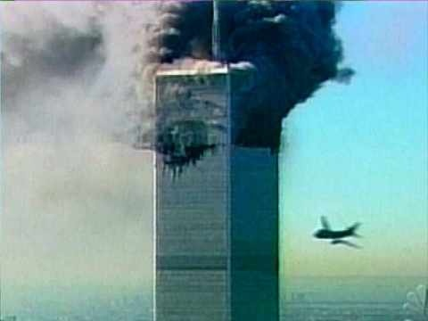
This Could Happen Again?

Slide 18
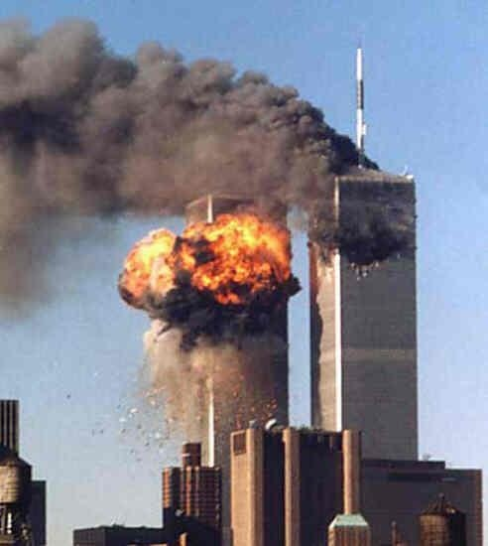
What Would Be the Fallout/Synthesis?
The solution to September 11, 2001 was the Patriot Act which gutted freedom in America, giving the government the authority to read people’s e-mail, listen to their Cell phone calls, and find out what books a person is getting from the library.

Slide 19
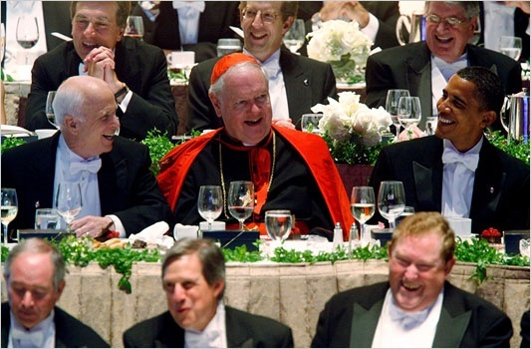
Could this be used by the Jesuit General?
Vice President Joe Biden, a devout Roman Catholic, warned America "Mark my words," Biden told donors at a Seattle fund-raiser Sunday night.
"It will not be six months before the world tests Barack Obama like they did John Kennedy. The world is looking. We're about to elect a brilliant 47-year-old senator president of the United States of America.
"Watch. We're going to have an international crisis, a generated crisis, to test the mettle of this guy.
"And he's going to need help . . . to stand with him. Because it's not going to be apparent initially; it's not going to be apparent that we're right." Biden could know this because his master is………….

Slide 20
Edward Egan-Cardinal/Archbishop
“Cardinal Egan’s American Intelligence Network includes the Central Intelligence Agency, the National Security Agency, the Secret Service, Military Intelligence, the Federal Bureau of Investigation, and the Mafia Commission. Years ago these agencies and criminals all worked together in carrying out the Kennedy Assassination and Cover-up under the control of their former master, Francis Cardinal Spellman…For Washington, D.C. is secretly ruled by Edward Cardinal Egan from St. Patrick’s Cathedral in New York. As the country’s “Military Vicar” and most powerful American Archbishop, Egan is aided by Georgetown University and Fordham University Jesuits.” Eric Phelps, Vatican Assassins

Slide 21
Every Means to Her End
“But Romanism as a system is no more in harmony with the gospel of Christ now than at any former period in her history. The Protestant churches are in great darkness, or they would discern the signs of the times. The Roman Church is far-reaching in her plans and modes of operation. She is employing every device to extend her influence and increase her power in preparation for a fierce and determined conflict to regain control of the world, to re-establish persecution, and to undo all that Protestantism has done. Catholicism is gaining ground upon every side. See the increasing number of her churches and chapels in Protestant countries. Look at the popularity of her colleges and seminaries in America, so widely patronized by Protestants. Look at the growth of ritualism in England and the frequent defections to the ranks of the Catholics. These things should awaken the anxiety of all who prize the pure principles of the gospel. Protestants have tampered with and patronized popery; they have made compromises and concessions which papists themselves are surprised to see and fail to understand. Men are closing their eyes to the real character of Romanism and the dangers to be apprehended from her supremacy. The people need to be aroused to resist the advances of this most dangerous foe to civil and religious liberty.” GC, pg. 565,566

Slide 22
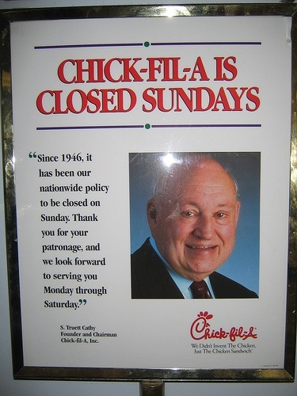
The Hidden Goal
1. The corruption/free spending in Washington.
2. The rise of the ‘righteous right’ in the tea party movement.
3. The reality of another, more violent terror attack.
4. One or both will be used to bring about………..

Slide 23
Sunday Will be the ‘only’ answer
In a time of crisis, Sunday will be the answer.
In a time of moral demise, Sunday will get us back to God.
To reject Sunday will be a sign of rebellion.
To reject Sunday will be the worst of crimes.
To reject Sunday will be evil personified.
How critical that we share the truth now in a time of relative peace so that people can make sound decisions now!

Slide 24
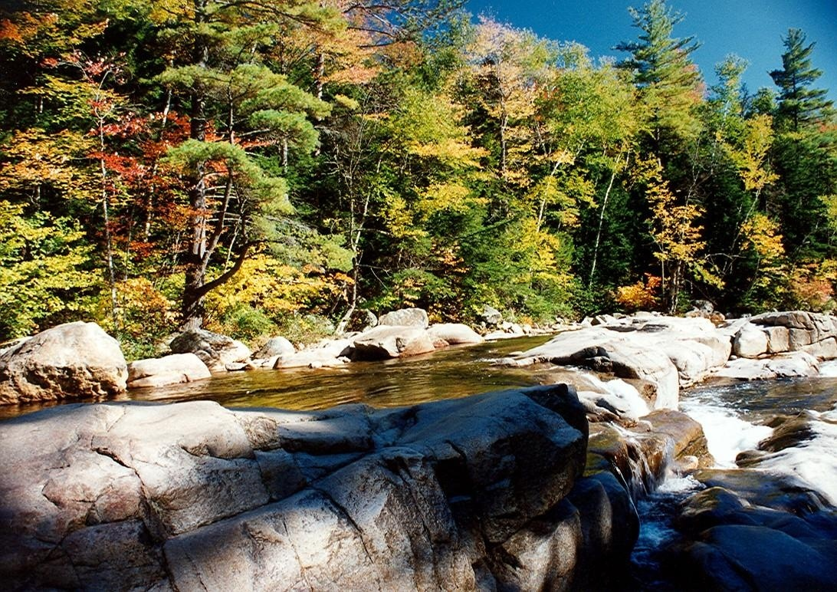
Repair the Breach!
“And they that shall be of thee shall build the old waste places: thou shalt raise up the foundations of many generations; and thou shalt be called, The repairer of the breach, The restorer of paths to dwell in. If thou turn away thy foot from the sabbath, from doing thy pleasure on my holy day; and call the sabbath a delight, the holy of the LORD, honourable; and shalt honour him, not doing thine own ways, nor finding thine own pleasure, nor speaking thine own words: Then shalt thou delight thyself in the LORD; and I will cause thee to ride upon the high places of the earth, and feed thee with the heritage of Jacob thy father: for the mouth of the LORD hath spoken it.” Isaiah 58:12-14

