Slide 1
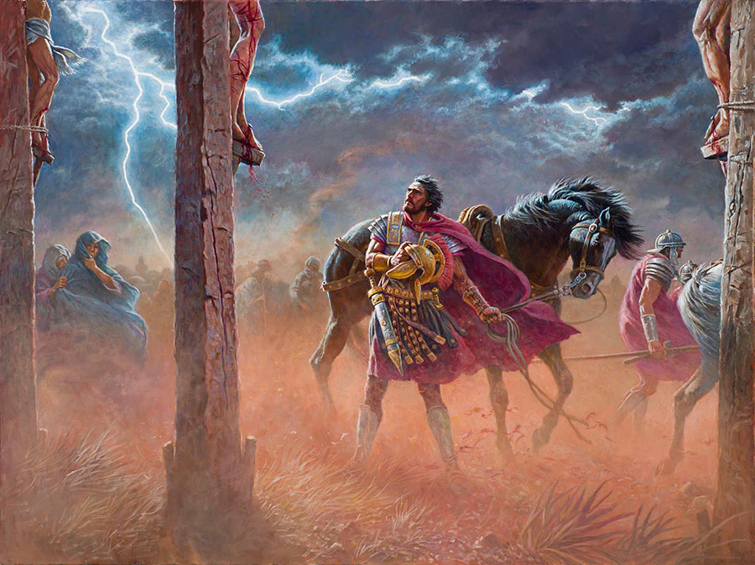
The Son of God: Begotten or Eternal?

Slide 2
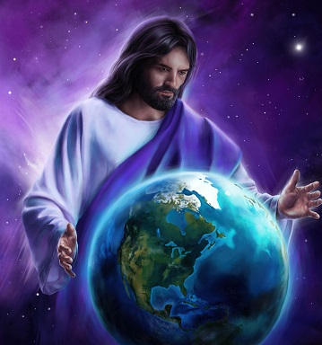
The Issue…
Since the very beginning of the Christian Church, the idea has persisted over the Deity of Christ. There are some that say Jesus is NOT God, but a god; a created being—such as the false doctrine of the Jehovah’s Witnesses. Others say Jesus is definitely God, but He is “begotten”—meaning He is the Father’s first creation, which in turn created everything else; this more closely aligns with Arianism of early Church history. Then there is the Catholic idea of Jesus—He’s God, not created, but more like a piece of the one true Godhead—”of the same substance” making up a God-pie which is separated into 3 Parts/Persons: The Father, The Son, & The Holy Ghost. Today in SDA and other Christian denominations, this side-issue is still prevalent, even urging that “the pioneers” believed Jesus was created/begotten and also that the Holy Spirit is not a Person, separate and distinct… But what does the Bible & SOP say? Does it matter? We must understand God in the way He has chosen to reveal Himself to us in His Word…

Slide 3
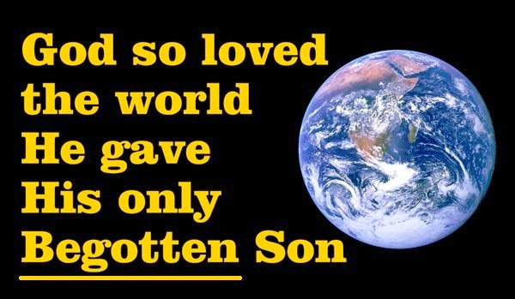
Pioneer Thoughts…
“He is the author of our faith inasmuch as it originated with him. The doctrines, precepts, and promises of Scripture are but the radiations of the Sun of righteousness. There may have been a period when Jehovah dwelt alone in the solitude of eternity; but it is difficult to antedate the existence of Christ. We know, however, that in the nature of things, there must have been a period when his Sonship began. This is by no means inconsistent with the idea of his authorship of our faith; for he is the “brightness of His glory, and the express image of His person.” Heb. 1:3 ; John 1:14.”—(The Sermon – THE AUTHOR AND FINISHER OF OUR FAITH. BY ELD. A. MCLBARD, Review and Herald – January 11, 1881 p.229)

Slide 4
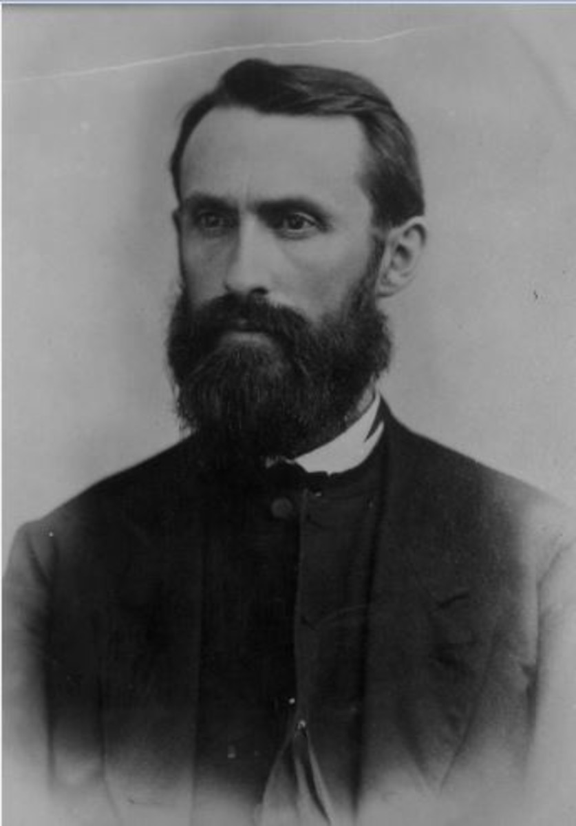
Another Take…
“You are mistaken in supposing that S. D. Adventists teach that Christ was ever created. They believe, on the contrary, that he was “begotten” of the Father, and that he can properly be called God and worshiped as such. They believe, also, that the worlds, and everything which is, was created by Christ in conjunction with the Father. They believe, however, that somewhere in the eternal ages of the past there was a point at which Christ came into existence. They think that it is necessary that God should have antedated Christ in his being, in order that Christ could have been begotten of him, and sustain to him the relation of son. They hold to the distinct personality of the Father and Son, rejecting as absurd that feature of Trinitarianism which insists that God, and Christ, and the Holy Spirit are three persons, and yet but one person. S. D. Adventists hold that God and Christ are one in the sense that Christ prayed that his disciples might be one; i. e., one in spirit, purpose, and labor.”—(Commentary-Scripture Questions, W. H. Littlejohn, 96.—CHRIST NOT A CREATED BEING., Review & Herald, April 17, 1883, pg. 250)

Slide 5
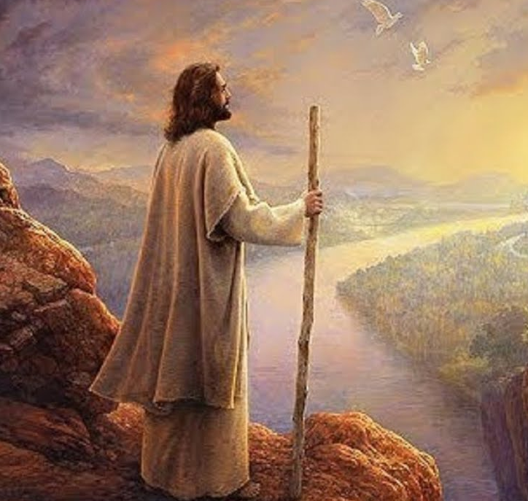
Begotten?
John 3:16 “For God so loved the world, that he gave his only begotten Son, that whosoever believeth in him should not perish, but have everlasting life.”
Strong’s Concordance 3439: Monogenes (mon-og-en-ace’)- only begotten, only, only child, 1) single of its kind, only 1a) used of only sons or daughters (viewed in relation to their parents) 1b) used of Christ, denotes the only begotten son of God

Slide 6
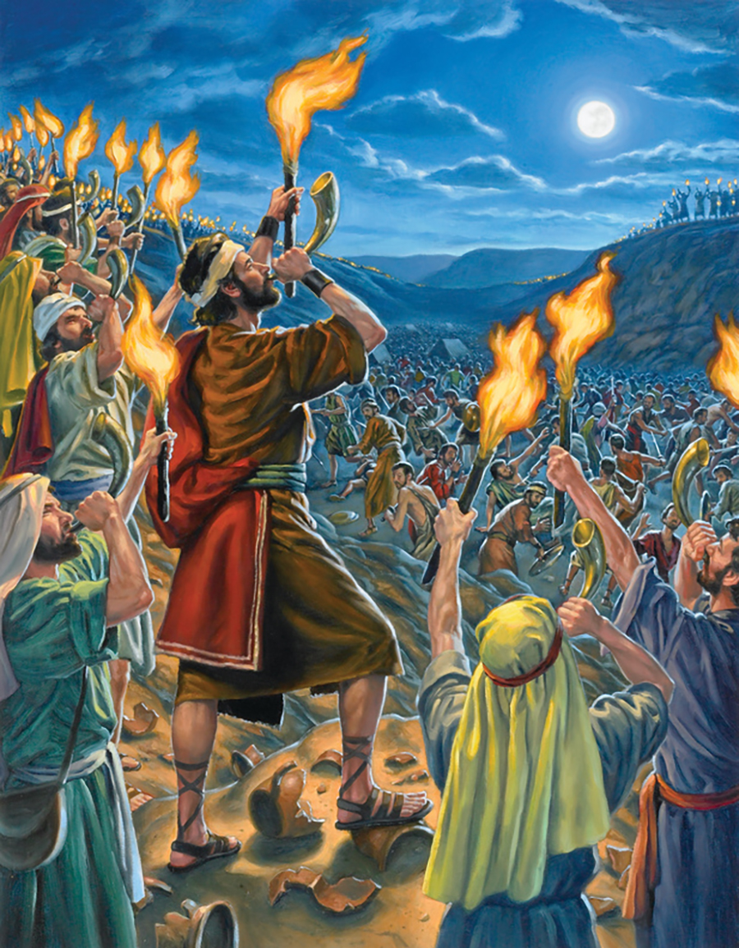
Other “Begotten” Bible Examples…
Gen. 5:4 “And the days of Adam after he had begotten Seth were eight hundred years: and he begat sons and daughters”
Deut. 23:8 “The children that are begotten of them shall enter into the congregation of the Lord in their third generation.”
Judges 8:30 “And Gideon had threescore and ten sons of his body begotten: for he had many wives.”

Slide 7
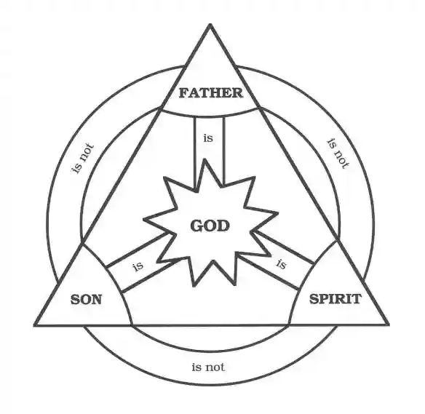
The Schools of Thought…
Arian/Jehovah’s Witnesses—Jesus is a created being, elevated above the rest of creation
Catholic/Christian Mainstream Evangelical—Jesus is a piece (1/3) of the 1 God—He’s God, He’s Eternal, but He’s part of the 3 sections of God
Some SDA Pioneers—There was a point when Jesus was not, but He sprang forth from Jehovah, but both were before any creation existed… Jesus is begotten of God, but He is also God

Slide 8
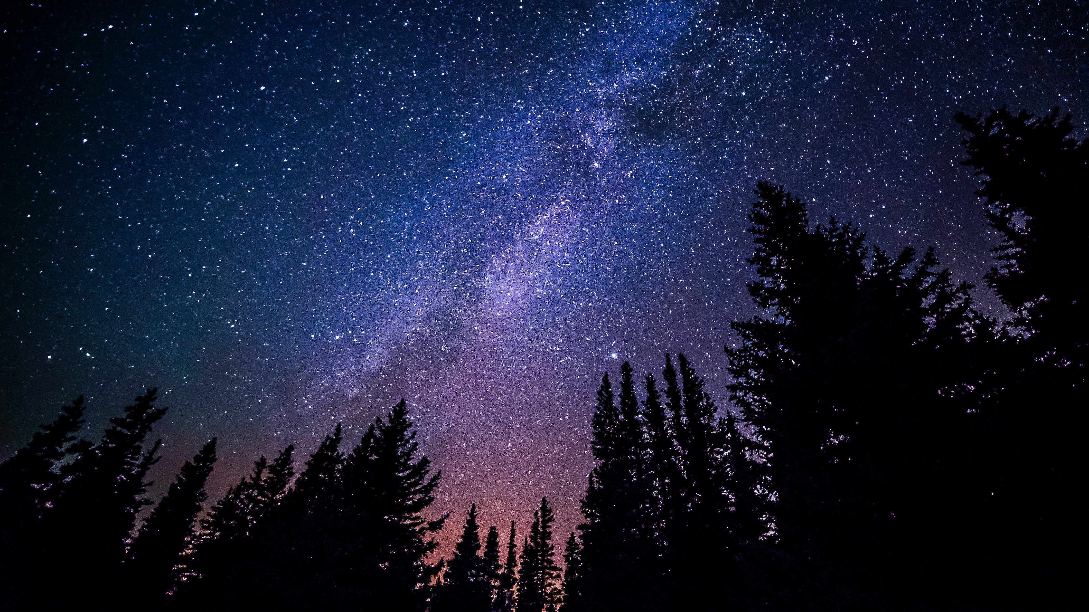
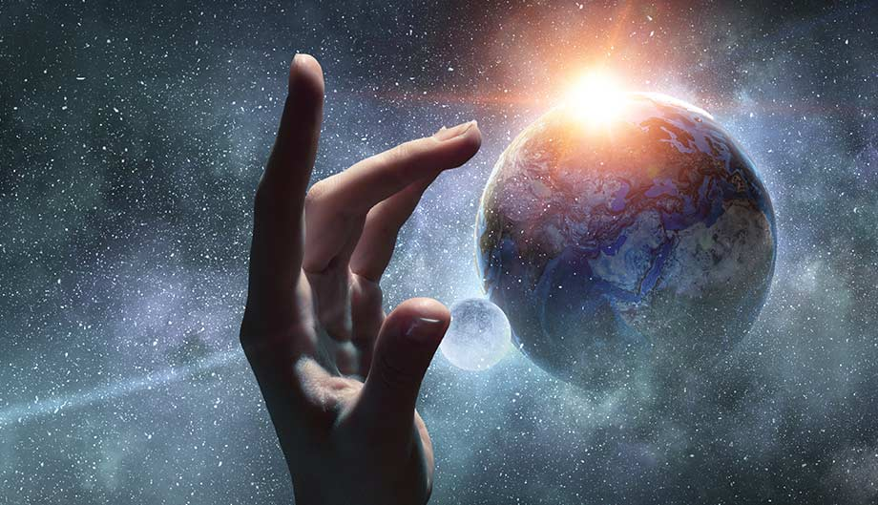
Is Jesus Created…?
John 1:1-3, 13-14 “In the beginning was the Word, and the Word was with God, and the Word was God. The same was in the beginning with God. All things were made by him; and without him was not any thing made that was made. . . . Which were born, not of blood, nor of the will of the flesh, nor of the will of man, but of God. And the Word was made flesh, and dwelt among us, (and we beheld his glory, the glory as of the only begotten of the Father,) full of grace and truth.”

Slide 9
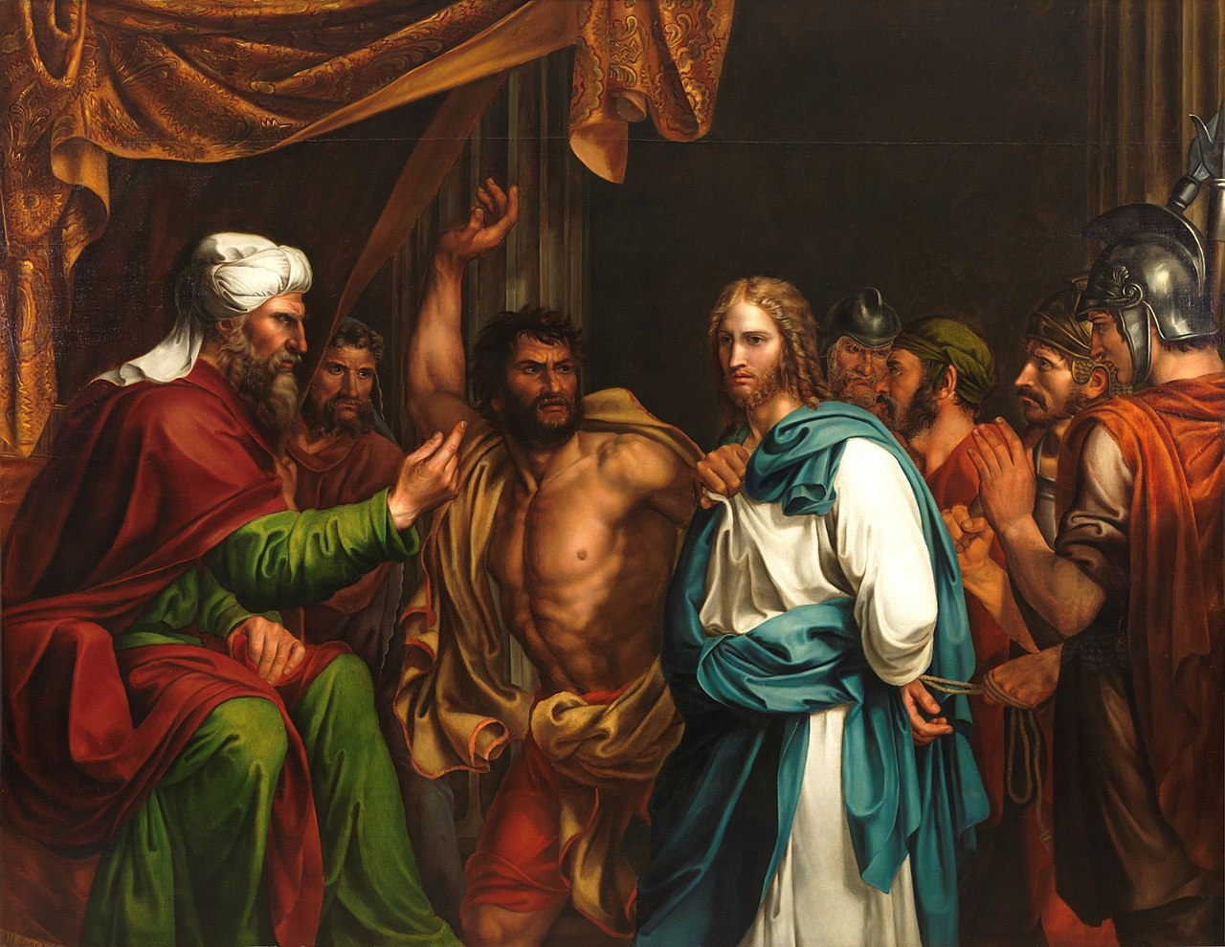
By Him and For Him…
Col. 1:16-17 “For by him were all things created, that are in heaven, and that are in earth, visible and invisible, whether they be thrones, or dominions, or principalities, or powers: all things were created by him, and for him: And he is before all things, and by him all things consist.”
John 8:58 “Jesus said unto them, Verily, verily, I say unto you, Before Abraham was, I am.”
Mark 14: “But he held his peace, and answered nothing. Again the high priest asked him, and said unto him, Art thou the Christ, the Son of the Blessed? And Jesus said, I am: and ye shall see the Son of man sitting on the right hand of power, and coming in the clouds of heaven.”

Slide 10
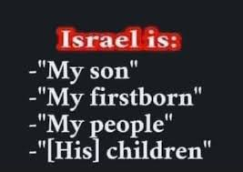
What Does Begotten Mean Biblically?
Ps. 2:7 “Yet have I set my king upon my holy hill of Zion. I will declare the decree: the Lord hath said unto me, Thou art my Son; this day have I begotten thee.”
Ex. 4:22-23 “And thou shalt say unto Pharaoh, Thus saith the LORD, Israel is my son, even my firstborn: And I say unto thee, Let my son go, that he may serve me: and if thou refuse to let him go, behold, I will slay thy son, even thy firstborn.”
Jer. 31:9 “They shall come with weeping, and with supplications will I lead them: I will cause them to walk by the rivers of waters in a straight way, wherein they shall not stumble: for I am a father to Israel, and Ephraim is my firstborn.”

Slide 11
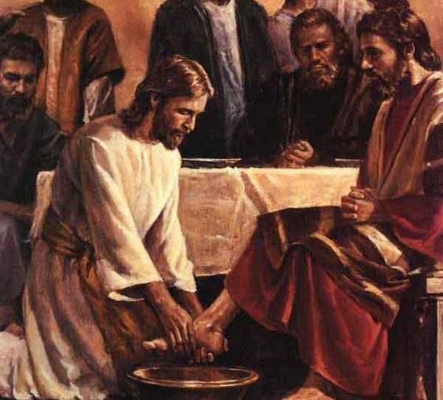
Jesus is Equal With the Father
Phil. 2:6-9 “Who, being in the form of God, thought it not robbery to be equal with God: But made himself of no reputation, and took upon him the form of a servant, and was made in the likeness of men: And being found in fashion as a man, he humbled himself, and became obedient unto death, even the death of the cross. Wherefore God also hath highly exalted him, and given him a name which is above every name”

Slide 12
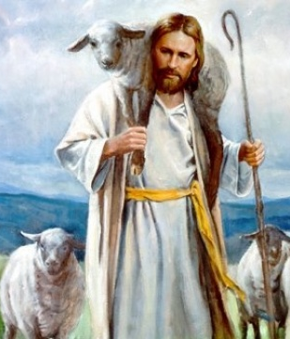
Jesus Has Life in Himself!
John 5:25-27 “Verily, verily, I say unto you, The hour is coming, and now is, when the dead shall hear the voice of the Son of God: and they that hear shall live. For as the Father hath life in himself; so hath he given to the Son to have life in himself; And hath given him authority to execute judgment also, because he is the Son of man.”
John 10:17-18 “Therefore doth my Father love me, because I lay down my life, that I might take it again. No man taketh it from me, but I lay it down of myself. I have power to lay it down, and I have power to take it again. This commandment have I received of my Father.”

Slide 13
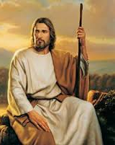
What We Know…
“Christ, the Word, the only begotten of God, was one with the eternal Father—one in nature, in character, in purpose—the only being that could enter into all the counsels and purposes of God. “His name shall be called Wonderful, Counselor, The mighty God, The everlasting Father, The Prince of Peace.” Isaiah 9:6. His “goings forth have been from of old, from everlasting.” Micah 5:2. And the Son of God declares concerning Himself: “The Lord possessed Me in the beginning of His way, before His works of old. I was set up from everlasting.... When He appointed the foundations of the earth: then I was by Him, as one brought up with Him: and I was daily His delight, rejoicing always before Him.” Proverbs 8:22-30.”—PP, p. 34

Slide 14
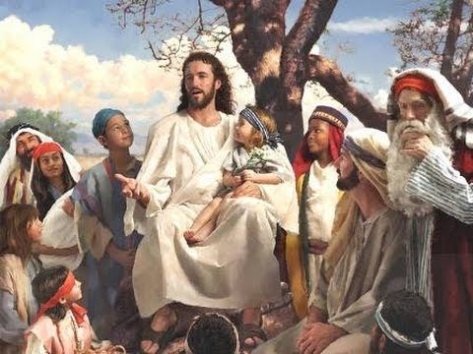
Jesus Was the ONLY One!
“In all the universe there was but one who could, in behalf of man, satisfy its claims. Since the divine law is as sacred as God Himself, only one equal with God could make atonement for its transgression. None but Christ could redeem fallen man from the curse of the law and bring him again into harmony with Heaven. Christ would take upon Himself the guilt and shame of sin—sin so offensive to a holy God that it must separate the Father and His Son. Christ would reach to the depths of misery to rescue the ruined race” PP, p. 63

Slide 15
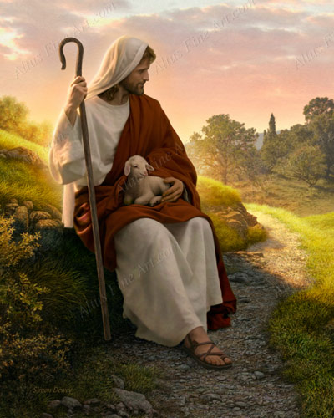
Spiritually Only Begotten: Jesus Had a RBF Mind
“These words are not addressed to any human being, except to the Son of the Infinite God. Never, in any way, leave the slightest impression upon human minds that a taint of, or inclination to corruption rested upon Christ, or that He in any way yielded to corruption. He was tempted in all points like as man is tempted, yet He is called that holy thing. It is a mystery that is left unexplained to mortals that Christ could be tempted in all points like as we are, and yet be without sin. The incarnation of Christ has ever been, and will ever remain a mystery. That which is revealed, is for us and for our children, but let every human being be warned from the ground of making Christ altogether human, such an one as ourselves: for it cannot be. The exact time when humanity blended with divinity, it is not necessary for us to know. We are to keep our feet on the rock, Christ Jesus, as God revealed in humanity.” 13MR, No. 100-1080, p. 19

Slide 16

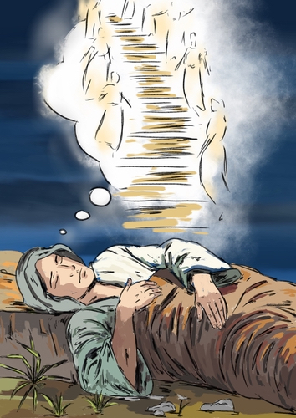
Jesus the Truly Begotten of God!
The reality is, Jesus Christ, in His humanity is the ONLY truly Begotten Son of God and Man to ever exist. He’s the only One from the Human family that was tempted in everyway, yet never sinned; He did not use His divine power to accomplish victory over sin—He relied on the Father and the Holy Spirit to overcome, for provision, for His miracles, and was obedient to death. Even Bible titans like Abraham, Joseph, Moses, Daniel, John the Baptist do not even come close to what Jesus accomplished or who He truly was in relation to God—He stands… Without a peer! He reconciled God and Humanity, grasping the Divine Throne with one arm and the dregs of Earth with His Human arm. He is God’s gift to humanity; He is “The Son of God”!

Slide 17
THE SON OF MAN
“By His life and His death, Christ has achieved even more than recovery from the ruin wrought through sin. It was Satan’s purpose to bring about an eternal separation between God and man; but in Christ we become more closely united to God than if we had never fallen. In taking our nature, the Saviour has bound Himself to humanity by a tie that is never to be broken. Through the eternal ages He is linked with us. “God so loved the world, that He gave His only-begotten Son.” John 3:16. He gave Him not only to bear our sins, and to die as our sacrifice; He gave Him to the fallen race. To assure us of His immutable counsel of peace, God gave His only-begotten Son to become one of the human family, forever to retain His human nature. This is the pledge that God will fulfill His word. “Unto us a child is born, unto us a son is given: and the “God With Us” government shall be upon His shoulder.” God has adopted human nature in the person of His Son, and has carried the same into the highest heaven. It is the “Son of man” who shares the throne of the universe. It is the “Son of man” whose name shall be called, “Wonderful, Counselor, The mighty God, The everlasting Father, The Prince of Peace.” Isaiah 9:6. The I AM is the Daysman between God and humanity, laying His hand upon both. He who is “holy, harmless, undefiled, separate from sinners,” is not ashamed to call us brethren. Hebrews 7:26; 2:11. In Christ the family of earth and the family of heaven are bound together. Christ glorified is our brother. Heaven is enshrined in humanity, and humanity is enfolded in the bosom of Infinite Love” DA, p. 25-26

