Slide 1
Circumcision
Abraham’s Impotence

Slide 2
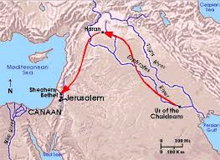
Promises to Abraham
“Now the LORD had said unto Abram, Get thee out of thy country, and from thy kindred, and from thy father's house, unto a land that I will shew thee: And I will make of thee a great nation, and I will bless thee, and make thy name great; and thou shalt be a blessing: And I will bless them that bless thee, and curse him that curseth thee: and in thee shall all families of the earth be blessed.” Genesis 12:1-3

Slide 3
Promises
Abraham was promised several things.
1. A land
2. prosperity
3. offspring
4. the Messiah would come through his seed.

Slide 4
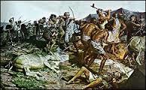
The Battle
Genesis 14 discusses the captivity of Lot and Sodom. Abraham, thru the Lord’s intervention, delivered them from the kings of Canaan. However, Abraham was deeply stressed by this. These kings would one day seek revenge and he still had no heir. Then, comes the discussion in Genesis 15!

Slide 5
The Confirmation
“After these things the word of the LORD came unto Abram in a vision, saying, Fear not, Abram: I am thy shield, and thy exceeding great reward. And Abram said, Lord GOD, what wilt thou give me, seeing I go childless, and the steward of my house is this Eliezer of Damascus? And Abram said, Behold, to me thou hast given no seed: and, lo, one born in my house is mine heir. And, behold, the word of the LORD came unto him, saying, This shall not be thine heir; but he that shall come forth out of thine own bowels shall be thine heir. And he brought him forth abroad, and said, Look now toward heaven, and tell the stars, if thou be able to number them: and he said unto him, So shall thy seed be. And he believed in the LORD; and he counted it to him for righteousness.” Genesis 15:1-6

Slide 6
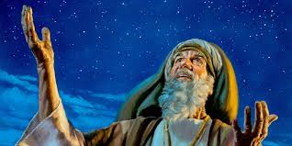
Righteousness by Faith
Abraham understood that:
1. a child was coming thru him.
2. he accepted the Lord’s promise by faith to have a son.
3. he already knew in his own experience that the only way he could resist sin was thru faith in the power of God.
4. Abraham’s faith in the power of God to have a son was accounted to him as righteousness.
5. When we accept the Word of God to do for us what we can not do, the Lord accounts that to us as righteousness too!

Slide 7
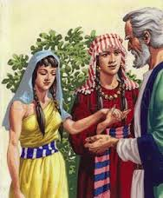
Abraham Loses faith in God
“Now Sarai Abram's wife bare him no children: and she had an handmaid, an Egyptian, whose name was Hagar. And Sarai said unto Abram, Behold now, the LORD hath restrained me from bearing: I pray thee, go in unto my maid; it may be that I may obtain children by her. And Abram hearkened to the voice of Sarai. And Sarai Abram's wife took Hagar her maid the Egyptian, after Abram had dwelt ten years in the land of Canaan, and gave her to her husband Abram to be his wife. And he went in unto Hagar, and she conceived: and when she saw that she had conceived, her mistress was despised in her eyes.” Genesis 16:1-4

Slide 8
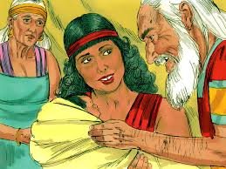
Abraham now 86 Years Old!
“And Hagar bare Abram a son: and Abram called his son's name, which Hagar bare, Ishmael. And Abram was fourscore and six years old, when Hagar bare Ishmael to Abram.” Genesis 16:15,16

Slide 9
Abraham’s Failure
“Abraham had accepted without question the promise of a son, but he did not wait for God to fulfill His word in His own time and way. A delay was permitted, to test his faith in the power of God; but he failed to endure the trial. Thinking it impossible that a child should be given her in her old age, Sarah suggested, as a plan by which the divine purpose might be fulfilled, that one of her handmaidens should be taken by Abraham as a secondary wife. Polygamy had become so widespread that it had ceased to be regarded as a sin, but it was no less a violation of the law of God, and was fatal to the sacredness and peace of the family relation. Abraham's marriage with Hagar resulted in evil, not only to his own household, but to future generations.
Flattered with the honor of her new position as Abraham's wife, and hoping to be the mother of the great nation to descend from him, Hagar became proud and boastful, and treated her mistress with contempt. Mutual jealousies disturbed the peace of the once happy home. Forced to listen to the complaints of both, Abraham vainly endeavored to restore harmony. Though it was at Sarah's earnest entreaty that he had married Hagar, she now reproached him as the one at fault. She desired to banish her rival; but Abraham refused to permit this; for Hagar was to be the mother of this child, as he fondly hoped, the son of promise.” PP, pg. 145

Slide 10
Circumcision
Abraham clearly understood righteousness comes by faith in Christ alone! (Genesis 15:6)
Abraham had trusted to his own scheming to fulfill God’s promise of a son. (Genesis 16)
13 years after Ishmael’s birth, with Abraham now 99 and Sarah 89, past the time of child birth capabilities, the Lord comes again!
Abraham is humbled in the dust. He has no hope of ever having a child with Sarah.
Abraham is fully expecting that Ishmael will be the promised heir.
The sign of circumcision is given. How representative this is of Abraham’s experience. At this point, only a miracle of the Lord could give them a son. At this point, the Lord reminds him that only the Lord can enable him and humanity to obey the law of God and that thru faith alone!

Slide 11
The Power of God Alone!
“The birth of a son to Zacharias, like the birth of the child of Abraham, and that of Mary, was to teach a great spiritual truth, a truth that we are slow to learn and ready to forget. In ourselves we are incapable of doing any good thing; but that which we cannot do will be wrought by the power of God in every submissive and believing soul. It was through faith that the child of promise was given. It is through faith that spiritual life is begotten, and we are enabled to do the works of righteousness.” DA, pg. 98

Slide 12
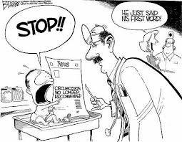
Circumcision always a Sign
“And the LORD thy God will circumcise thine heart, and the heart of thy seed, to love the LORD thy God with all thine heart, and with all thy soul, that thou mayest live.” Deut. 30:6
“Behold, the days come, saith the LORD, that I will punish all them which are circumcised with the uncircumcised; Egypt, and Judah, and Edom, and the children of Ammon, and Moab, and all that are in the utmost corners, that dwell in the wilderness: for all these nations are uncircumcised, and all the house of Israel are uncircumcised in the heart.” Jer. 9:25, 26

Slide 13
Jews Perverted Sabbath, Circumcision, Sanctuary, etc.
“As the Jews departed from God, and failed to make the righteousness of Christ their own by faith, the Sabbath lost its significance to them. Satan was seeking to exalt himself and to draw men away from Christ, and he worked to pervert the Sabbath, because it is the sign of the power of Christ. The Jewish leaders accomplished the will of Satan by surrounding God's rest day with burdensome requirements. In the days of Christ the Sabbath had become so perverted that its observance reflected the character of selfish and arbitrary men rather than the character of the loving heavenly Father. The rabbis virtually represented God as giving laws which it was impossible for men to obey. They led the people to look upon God as a tyrant, and to think that the observance of the Sabbath, as He required it, made men hard-hearted and cruel.” DA, pgs. 283, 284
The Jews perverted everything. They looked upon the Sabbath, circumcision, etc. as their means to salvation! They looked to the outward sign, but failed to grasp these things pointed to righteousness by faith and without that, these signs lost all meaning for them!

Slide 14
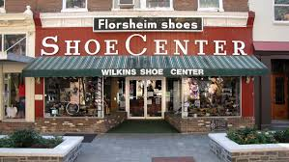
Sign Without the Substance is Worthless
This shoe store would be the laughingstock of the neighborhood if people entered the shoe store and found that there were no shoes! The outward sign becomes meaningless without the inner substance. Also, circumcision, without Christ in the heart by faith, ceases to be of value and is thus worthless!
“Is any man called being circumcised? let him not become uncircumcised. Is any called in uncircumcision? let him not be circumcised. Circumcision is nothing, and uncircumcision is nothing, but the keeping of the commandments of God.” 1 Corinthians 7:18, 19

Slide 15
Circumcision is on the Inside!
“For circumcision verily profiteth, if thou keep the law: but if thou be a breaker of the law, thy circumcision is made uncircumcision. Therefore if the uncircumcision keep the righteousness of the law, shall not his uncircumcision be counted for circumcision? And shall not uncircumcision which is by nature, if it fulfil the law, judge thee, who by the letter and circumcision dost transgress the law? For he is not a Jew, which is one outwardly; neither is that circumcision, which is outward in the flesh: But he is a Jew, which is one inwardly; and circumcision is that of the heart, in the spirit, and not in the letter; whose praise is not of men, but of God.” Romans 2:25-29

Slide 16
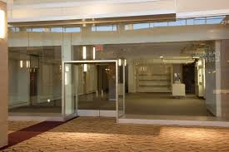
In The Spirit
“For we are the circumcision, which worship God in the spirit, and rejoice in Christ Jesus, and have no confidence in the flesh. Though I might also have confidence in the flesh. If any other man thinketh that he hath whereof he might trust in the flesh, I more: Circumcised the eighth day, of the stock of Israel, of the tribe of Benjamin, an Hebrew of the Hebrews; as touching the law, a Pharisee; Concerning zeal, persecuting the church; touching the righteousness which is in the law, blameless.” Philippians 3:3-6

Slide 17
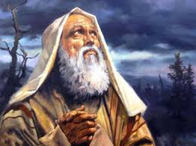
“Cometh this blessedness then upon the circumcision only, or upon the uncircumcision also? for we say that faith was reckoned to Abraham for righteousness. How was it then reckoned? when he was in circumcision, or in uncircumcision? Not in circumcision, but in uncircumcision. And he received the sign of circumcision, a seal of the righteousness of the faith which he had yet being uncircumcised: that he might be the father of all them that believe, though they be not circumcised; that righteousness might be imputed unto them also: And the father of circumcision to them who are not of the circumcision only, but who also walk in the steps of that faith of our father Abraham, which he had being yet uncircumcised.” Romans 4:9-12

Slide 18
“There were those in Paul’s day who were constantly dwelling upon circumcision, and they could bring plenty of proof from the Bible to show its obligation on the Jews; but this teaching was of no consequence at this time; for Christ had died upon Calvary’s cross, and circumcision in the flesh could not be of any further value. The typical service and the ceremonies connected with it were abolished at the cross. The great antitypical Lamb of God had become an offering for guilty man, and the shadow ceased in the substance. Paul was seeking to bring the minds of men to the great truth for the time; but these who claimed to be followers of Jesus were wholly absorbed in teaching the tradition of the Jews, and the obligation of circumcision.” (The Review and Herald, May 29, 1888).

