Slide 1
Windows from the Past to the Future, pt. 1

Slide 2
Confront the Reformation
“The first triumphs of the Reformation past, Rome summoned new forces, hoping to accomplish its destruction. At this time the order of the Jesuits was created, the most cruel, unscrupulous, and powerful of all the champions of popery. Cut off from earthly ties and human interests, dead to the claims of natural affection, reason and conscience wholly silenced, they knew no rule, no tie, but that of their order, and no duty but to extend its power. (See Appendix.) The gospel of Christ had enabled its adherents to meet danger and endure suffering, undismayed by cold, hunger, toil, and poverty, to uphold the banner of truth in face of the rack, the dungeon, and the stake. To combat these forces, Jesuitism inspired its followers with a fanaticism that enabled them to endure like dangers, and to oppose to the power of truth all the weapons of deception. There was no crime too great for them to commit, no deception too base for them to practice, no disguise too difficult for them to assume. Vowed to perpetual poverty and humility, it was their studied aim to secure wealth and power, to be devoted to the overthrow of Protestantism, and the re-establishment of the papal supremacy….

Slide 3
Their Oath
“I do further promise and declare, that I will have no opinion or will of my own, or any mental reservation whatever, even as a corpse or cadaver, but will unhesitatingly obey each and every command that I may receive from my superiors in the Militia of the Pope… I furthermore promise and declare that I will, when opportunity presents, make and wage relentless war, secretly or openly, against all heretics, Protestants and Liberals, as I am directed to do, to extirpate and exterminate them from the face of the whole earth; and that I will spare neither age, sex or condition; and that I will hang, burn, waste, boil, flay, strangle and bury alive these infamous heretics, rip up the stomachs and the wombs of their women and crush their infants heads against the walls, in order to annihilate forever their execrable race…

Slide 4
Deadly!!!!!!!!!!!
…That when the same cannot be done openly, I will secretly use the poisoned cup, the strangulating cord, the steel of the poniard or the leaden bullet, regardless of the honor, rank, dignity, or authority of the person or persons, whatever may be their condition in life, either public or private, as I at any time may be directed so to do by any agent of the Pope or Superior of the Brotherhood of the Holy Faith, of the Society of Jesus.” — Edwin A. Sherman, The Engineer Corps of Hell; or Rome’s Sapper’s and Miners, Private Subscription, 1883, pp. 118-124.

Slide 5
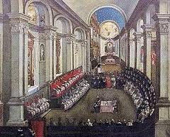
Trent-1545-1563
The Jesuits first duty, after coming into power in 1540, was to lay out the groundwork for the Catholic Church for the next hundreds of years. It was determined in this council that tradition was on par with Scripture. Really, tradition would supersede the Bibles authority.

Slide 6
St. Bartholomew’s Massacre
1572/ “But blackest in the black catalogue of crime, most horrible among the fiendish deeds of all the dreadful centuries, was the St. Bartholomew Massacre. The world still recalls with shuddering horror the scenes of that most cowardly and cruel onslaught. The king of France, urged on by Romish priests and prelates, lent his sanction to the dreadful work. A bell, tolling at dead of night, was a signal for the slaughter. Protestants by thousands, sleeping quietly in their homes, trusting to the plighted honor of their king, were dragged forth without a warning and murdered in cold blood. As Christ was the invisible leader of His people from Egyptian bondage, so was Satan the unseen leader of his subjects in this horrible work of multiplying martyrs. For seven days the massacre was continued in Paris, the first three with inconceivable fury. And it was not confined to the city itself, but by special order of the king was extended to all the provinces and towns where Protestants were found. Neither age nor sex was respected. Neither the innocent babe nor the man of gray hairs was spared. Noble and peasant, old and young, mother and child, were cut down together. Throughout France the butchery continued for two months. Seventy thousand of the very flower of the nation perished. When the news of the massacre reached Rome, the exultation among the clergy knew no bounds.” GC, pgs. 272,273

Slide 7
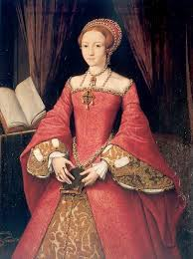
Protestant Queen Elizabeth
Queen Elizabeth wisely rejected the assumed ‘Divine Right’ of the papacy to rule over and control the throne of England. Because of this there were at least five attempts to assassinate her. These attempts all failed because she had a superb secret service group, and her life was saved.
When the papacy realized that all their efforts to assassinate Elizabeth had failed, they turned to one of their Catholic sons, Phillip the Second of Spain. In 1580 the papacy arranged for Spain to invade England.

Slide 8
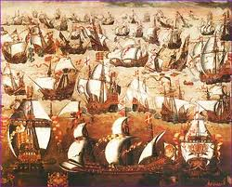
Spanish Armada-1588

Slide 9
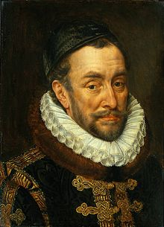
William of Orange
1584/ The Prince went on to break the Pope’s Temporal Power over the Netherlands. He protected the Anabaptists and Mennonites who refused to take up the Sword of Just Defense against the armies of Philip II, and gave refuge to the persecuted Jews of Europe. But he was murdered by an assassin sent by the Jesuits, Balthazar Gerard, in obedience to the bloody Jesuit Oath.

Slide 10
Henry III of France 1589
“Neither Henry III nor Henry IV, nor the Elector of Saxony [Frederick III], nor the Queen Elizabeth, are true kings. That [Jacques] Clement has done a heroic action in killing Henry III . . . it is a meritorious action
with God to kill a heretic king.” Jean Guignard, 1589
French Jesuit
In 1576, Henry signed the Edict of Beaulieu, which granted many concessions to the Huguenots…On 1 August 1589, Henry III lodged with his army at Saint-Cloud, Hauts-de-Seine, and was preparing to attack Paris, when a young fanatical Dominican friar, Jacques Clément, carrying false papers, was granted access to deliver important documents to the king. The monk gave the king a bundle of papers and stated that he had a secret message to deliver.

Slide 11
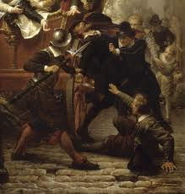
Henry IV –Edict of Nantes
One of the most popular French kings, both during and after his reign, Henry showed great care for the welfare of his subjects. As a pragmatic politician (in the parlance of the time, a politique), he displayed an unusual religious tolerance for the time. Notably, he promulgated the Edict of Nantes in 1598, which guaranteed religious liberties to Protestants, thereby effectively ending the Wars of Religion. He was assassinated by François Ravaillac, a fanatical Catholic.^{[1]}

Slide 12
Gunpowder-1605
England posed a problem for the Jesuit General. The king was a Protestant (“a confirmed heretic” in the words of Spain’s King Philip III), the House of Commons was full of Protestants and the people no longer gave heed to the Pope’s decrees. Therefore the Jesuits determined to annihilate the king, with his whole family, together with the entire heads of Protestantism in England in one blow.” How? By blowing up the King and the assembled Parliament with thirty-six barrels of gunpowder. The plot nearly succeeded but a letter alerted the king to the plan. When the sheriff entered the large cellar beneath the Parliament he discovered the conspirator, Guy Fawkes, a soldier in the service of King Philip III of Spain, with piece of tinder, three matches, a dagger and a pistol . . booted and spurred, like a man who was prepared to take a journey on horseback.” Indeed he was. Violently resisting arrest, Fawkes was tried and executed having been the fanatical tool of England’s Jesuit Provincial, Henry Garnett. Convicted of high
treason having obeyed the Jesuit Oath Garnett was also publicly executed in 1606. Garnett is looked upon by Rome as an ‘English Martyr!’

Slide 13
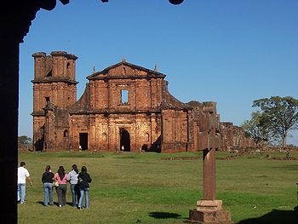
1600-1750 Reductions in Paraguay
These are the remains of the Reductions created in Paraguay by the Jesuit Order. It was on these reductions that the principles of Communism were perfected. From here, the League of Just Men put them into a book, and Karl Marx’ name was put to it in 1850!

Slide 14
The Roots of Communism
“The unsuspecting Indians were easily seduced by acts of kindness, and the result was that, in the course of a brief period, they succeeded in establishing a number of what were called Reductions – or, more properly speaking, villages – with multitudes of Indians assembled about them; the whole aggregating, in the end, several hundred thousand. These constituted the Jesuit State, and were all, by the mere ceremony of baptism, brought under Jesuit dominion… The Commune, called by the Jesuits a “republic,” gave the appearance that it was self-governing. It was a republic in form but a monarchy in power controlled by the Jesuit General in Rome…At each Reduction the natives were allowed to select a secular magistry, with limited and unimportant powers over such temporal affairs as could be intrusted to them without impairing the theocratic feature of the Government. It was in everything pertaining to the management of public affairs an absolute monarchy, with all its powers centered in the general at Rome, whose authority was accepted as equal to that of God, and to whose command obedience was exacted from all.” R.W. Thompson, Footprints of the Jesuits, pg. 174,175

Slide 15
“The Guarani Reductions, 1600 - 1750 #47 These secret and evil socialist-communist Reductions, known today as “Communes” or “Kibbutzim,” produced untold wealth for the Order using hundreds of thousands of slaves, “collecting from each according to his ability and giving to each according to his need.” This wealth in turn was used to finance the many occult stratagems of the Order. The lessons learned on these Platonic Republics provided the groundwork for Marx’s The Communist Manifesto by which every nation on earth would be reduced to a Guarani Reduction, thereby destroying the Protestant Middle Classes of Northern Europe and Western Civilization. In restoring the communal Feudalism of the Dark Ages known as “the World’s Midnight,” the Order would submit the world to the rule of Rome’s bold Papal Caesar.” Jesuits: A Multibiography, Jean Lacouture, (Collegeville, Minnesota: The Liturgical Press, 1995) pp. 342, 343.

Slide 16
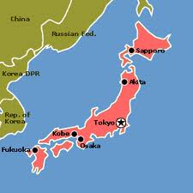
Japanese Debacle!
In attempting to capture Japan with Francis Xavier arriving in 1549, the Jesuits converted many of the Japanese lords called “daimyo.” The Jesuits then incited them to destroy hundreds of Buddhist temples and slaughter the priests…With the Order first expelled in 1587 and again in 1597 by Daimyo Hideyoshi (for which he paid with his life in 1598), in 1614 Iyeyasu issued an edict in the name of his son, Hidetada, finally expelling the Company and outlawing both Protestant and Catholic “Christianity.” In 1622 many Jesuits were justly put to death (“martyred”) for high treason, and in 1624 the Roman Catholic Spanish were banished by one of Iyemitsu’s edicts. And why? “The Christians [Jesuits], so the decree alleged, were striving ‘to spread abroad a pernicious code, to exterminate the true religion [Buddhism], to overthrow the government, and to make themselves masters of the whole empire.’

Slide 17
Never Again?
In 1637 it resisted the shogun’s edicts by force through raising an army and inciting a rebellion. This army of thirty thousand Roman Catholic Japanese declared a religious war and openly revolted against the Emperor. It seized an abandoned castle on the coast of Shimabara and waited for the Spanish fleet. The fleet would have reinforced the Jesuits and their army. But the shogun’s forces, along with the Protestant Dutch fleet, foiled the aim of the Order by destroying the fortress along with the rebels. Chapter 8149 (Dear truth-seeker, as we shall later see, this is exactly what the Jesuits did to our Federal Republic established by our great George Washington. They founded a new “Holy Roman” American Empire on the ruins of our nation devastated by the War Between the States (1861-1865).

Slide 18
The Jesuits then used their new American Empire to subdue all nations to the Temporal Power of their “infallible” Pope. In so doing the Jesuit General used his International Intelligence Community – the Holy Office of the Inquisition – and thereby conducted his warfare against freedom of conscience, freedom of speech and human progress pursuant to the evil Council of Trent.) The result of this upheaval was that in 1639 shogun Iyemitsu, having previously expelled the Jesuits and the Spanish, now banished the Roman Catholic Portuguese and all foreigners from Japan forever. The Expulsion Edict reads: “For the future, let none, so long as the sun illuminates the world, presume to sail to Japan, not even in the quality of ambassadors, and this declaration is never to be revoked, on pain of death.”

Slide 19
You See?
“See, sir, from this chamber I govern not only to Paris, but to China, not only to China, but to all the world, without any one to know how I do it.” Michaelangelo Tamburini 14th Jesuit General, 1706-1730

