Slide 1
Carmel
The Missing Piece

Slide 2
The Command
“Now therefore send, and gather to me all Israel unto mount Carmel, and the prophets of Baal four hundred and fifty, and the prophets of the groves four hundred, which eat at Jezebel's table. So Ahab sent unto all the children of Israel, and gathered the prophets together unto mount Carmel.” 1 Kings 18:19,20

Slide 3
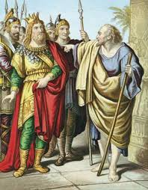
Political Brass
Ahab and his soldiers obeyed the command to meet Elijah on Mt. Carmel. All his leaders were there too. Governors, politicians, they were all there. Someone, though, was missing………………

Slide 4
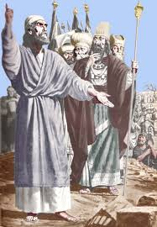
Religious Apostates Arrive
The Baal prophets came and so did the prophets/priests of the grove; they were all there. Someone, though, had failed to come. Someone was missing………………….

Slide 5
The People Were There
The ignorant, the deceived, the curious, the expectant, were all there on Mt. Carmel. In the midst of the huge throng, someone was missing……………..

Slide 6
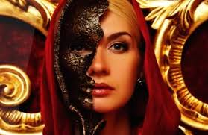
Jezebel Wasn’t There!

Slide 7
Controlled Everything
Jezebel had her hand in everything on Mt. Carmel, but wasn’t there.
She controlled the political process.
She controlled the religious brass.
She controlled the commoners as well. They were told that Jezebel was vivacious, voluptuous, and virtuous. She was made out to be wonderful, but she was seeking the destruction of all society.

Slide 8
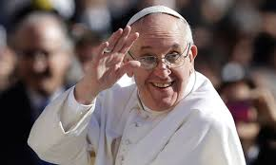
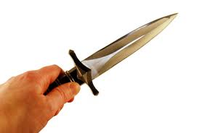
The Man With the Dagger!

Slide 9
Carmel’s Missing Piece
We hear today about the Trump’s, Putin’s, Kim Jung Un’s, McConnell’s. We hear nothing about the papacy controlling them behind the scenes. ‘Carmel’s Missing Piece.’
We hear today of Joyce Meyer’s, Rick Warren, Joel Osteen, TD Jakes. We hear nothing about the papacy controlling them behind the scenes. ‘Carmel’s Missing Piece.’
“With whom the kings of the earth have committed fornication, and the inhabitants of the earth have been made drunk with the wine of her fornication…. And upon her forehead was a name written, MYSTERY, BABYLON THE GREAT, THE MOTHER OF HARLOTS AND ABOMINATIONS OF THE EARTH.” Rev. 17:2,5

Slide 10
Jezebel of the Dark Ages
“Notwithstanding I have a few things against thee, because thou sufferest that woman Jezebel, which calleth herself a prophetess, to teach and to seduce my servants to commit fornication, and to eat things sacrificed unto idols.” Rev. 2:20

Slide 11
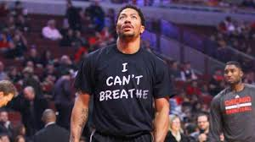
Vatican’s Role Today in Key Political/Religious Issues

Slide 12
Ferguson, Illinois and New York City
A concerted attempt is being made to split America in half over the issue of race. Rioting, bloodshed, arrests, looting,………….. Where will it end?...... Has it been used before and who was behind it then?

Slide 13
Rome Instigated Slavery
“Rome saw at once that the very existence of the United States was a formidable menace to her own life. From the very beginning she perfidiously sowed the germs of division and hatred between the two great sections of this country and succeeded in dividing South from North on the burning question of slavery. That division was her golden opportunity to crush one by the other, and reign over the bloody ruins of both, a favored, long-standing policy. — Charles Chiniquy, Fifty Years in the Church of Rome, Chick Publications, p. 291, emphasis supplied.

Slide 14
Civil War Destroyed Constitution
“The Civil War called forth a new constitutional order. At the heart of this post bellum legal order lay the Reconstruction Amendments-the Thirteenth, Fourteenth, and Fifteenth Amendments, ratified in the years 1865 to 1870. The principles of this new legal regime are so radically different from our original Constitution, drafted in 1787, that they deserve to be recognized as a second American constitution. The new constitution established, in fact a second American Republic. The first Constitution was based on the principles of peoplehood as a voluntary association, individual freedom, and republican elitism. The guiding premises of the second constitution were, in contrast, organic nationhood, equality of all persons, and popular democracy. These are Principles radically opposed to each other. – George P. Fletcher, Our Secret Constitution, Oxford University Press, p. 2.

Slide 15
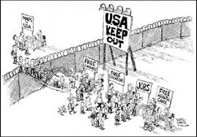
Immigration
The illegal immigrants that are flooding this nation from Central America and particularly Mexico are not only coming in illegally, but they are 98 percent of one particular religious background. They are all Roman Catholics. What is the point behind the bringing into this country of so many Roman Catholics?

Slide 16
Catholic Vote=Catholic Politicians
We are also determined to take possession of the United States; but we must proceed with the utmost secrecy.
Silently and patiently, we must mass our Roman Catholics in the great cities of the United States, remembering that the vote of a poor journeyman, though he be covered with rags, has as much weight in the scale of powers as the millionaire Astor, and that if we have two votes against his one, he will become as powerless as an oyster. Let us then multiply our votes; let us call our poor but faithful Irish Catholics from every corner of the world, and gather them into the very hearts of the cities of Washington, New York, Boston, Chicago, Buffalo, Albany, Troy, Cincinnati.
Under the shadows of those great cities, the Americans consider themselves a giant unconquerable race. They look upon the poor Irish Catholics with supreme contempt, as only fit to dig their canals, sweep their streets and work in their kitchens. Let no one awake those sleeping lions, today. Let us pray God that they continue to sleep a few years longer, waking only to find their votes outnumbered as we will turn them forever, out of every position of honor, power and profit!…

Slide 17
What will those so-called giants think when not a single senator or member of Congress will be chosen, unless he has submitted to our holy father the pope!
We will not only elect the president, but fill and command the armies, man the navies, and hold the keys of the public treasury!…
Then, yes! then, we will rule the United States and lay them at the feet of the Vicar of Jesus Christ, that he may put an end to their godless system of education and impious laws of liberty of conscience, which are an insult to God and man! — Charles Chiniquy, Fifty Years in the Church of Rome, Chick Publications, pp. 281,282.

Slide 18
Danger Behind and Before!!
Samuel Morse, in 1835, wrote to America the grave dangers that would result from allowing so many Roman Catholics into America. Today, we are bearing the results of not listening to that man of great wisdom and foresight!

Slide 19
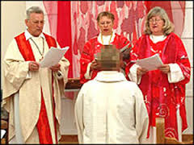
Women’s Ordination
The priest or a male member of the community represented Baal. The priestess or a female members of the community represented Asherah. In this way, God's incredible gift of sexuality was perverted to the most obscene public prostitution. No wonder God's anger burned against his people and their leaders.” Internet

Slide 20
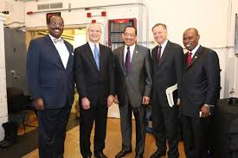
In the name of unity and preserving the church, these men will bring in women’s ordination into the denomination. It originated in Baal worship and since Adventism has united with Jezebel today, she is pushing for Baal worship in Adventism!

Slide 21
“In the closing work of God in the earth, the standard of His law will be again exalted. False religion may prevail, iniquity may abound, the love of many may wax cold, the cross of Calvary may be lost sight of, and darkness, like the pall of death, may spread over the world; the whole force of the popular current may be turned against the truth; plot after plot may be formed to overthrow the people of God; but in the hour of greatest peril the God of Elijah will raise up human instrumentalities to bear a message that will not be silenced. In the populous cities of the land, and in the places where men have gone to the greatest lengths in speaking against the Most High, the voice of stern rebuke will be heard. Boldly will men of God's appointment denounce the union of the church with the world. Earnestly will they call upon men and women to turn from the observance of a man-made institution to the observance of the true Sabbath.” PK, pg. 186, 187

