Slide 1
Jesus’ Life, pt. 3 The Faithful Few!

Slide 2
To Jerusalem and the Dedication
“And when eight days were accomplished for the circumcising of the child, his name was called JESUS, which was so named of the angel before he was conceived in the womb. And when the days of her purification according to the law of Moses were accomplished, they brought him to Jerusalem, to present him to the Lord; (As it is written in the law of the Lord, Every male that openeth the womb shall be called holy to the Lord;) And to offer a sacrifice according to that which is said in the law of the Lord, A pair of turtledoves, or two young pigeons.” Luke 2:21-24

Slide 3
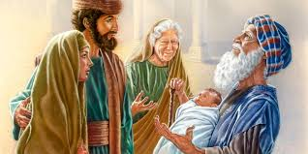
Dedication of Christ!
“About forty days after the birth of Christ, Joseph and Mary took Him to Jerusalem, to present Him to the Lord, and to offer sacrifice. This was according to the Jewish law, and as man's substitute Christ must conform to the law in every particular. He had already been subjected to the rite of circumcision, as a pledge of His obedience to the law. As an offering for the mother, the law required a lamb of the first year for a burnt offering, and a young pigeon or a turtledove for a sin offering. But the law provided that if the parents were too poor to bring a lamb, a pair of turtledoves or two young pigeons, one for a burnt offering, the other for a sin offering, might be accepted.” DA, pg. 50

Slide 4
Dedication of the Firstborn
“The offerings presented to the Lord were to be without blemish. These offerings represented Christ, and from this it is evident that Jesus Himself was free from physical deformity. He was the “lamb without blemish and without spot.” 1 Peter 1:19. His physical structure was not marred by any defect; His body was strong and healthy. And throughout His lifetime He lived in conformity to nature's laws. Physically as well as spiritually, He was an example of what God designed all humanity to be through obedience to His laws.
The dedication of the first-born had its origin in the earliest times. God had promised to give the First-born of heaven to save the sinner. This gift was to be acknowledged in every household by the consecration of the first-born son. He was to be devoted to the priesthood, as a representative of Christ among men.
In the deliverance of Israel from Egypt, the dedication of the first-born was again commanded.” DA, pg. 50,51

Slide 5
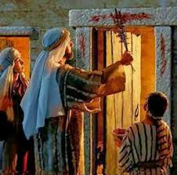
“After sending this judgment upon Egypt, the Lord said to Moses, “Sanctify unto Me all the first-born, ... both of man and of beast: it is Mine;” “for on the day that I smote all the first-born in the land of Egypt I hallowed unto Me all the first-born in Israel, both man and beast: Mine shall they be: I am the Lord.” Exodus 13:2; Numbers 3:13. After the tabernacle service was established, the Lord chose the tribe of Levi in the place of the first-born of all Israel to minister in the sanctuary. But the first-born were still to be regarded as the Lord's, and were to be bought back by a ransom. Thus the law for the presentation of the first-born was made particularly significant. While it was a memorial of the Lord's wonderful deliverance of the children of Israel, it prefigured a greater deliverance, to be wrought out by the only-begotten Son of God. As the blood sprinkled on the doorposts had saved the first-born of Israel, so the blood of Christ has power to save the world.” DA, pg. 51

Slide 6
Normal Day at the Office!
“What meaning then was attached to Christ's presentation! But the priest did not see through the veil; he did not read the mystery beyond. The presentation of infants was a common scene. Day after day the priest received the redemption money as the babes were presented to the Lord. Day after day he went through the routine of his work, giving little heed to the parents or children, unless he saw some indication of the wealth or high rank of the parents. Joseph and Mary were poor; and when they came with their child, the priests saw only a man and woman dressed as Galileans, and in the humblest garments. There was nothing in their appearance to attract attention, and they presented only the offering made by the poorer classes. The priest went through the ceremony of his official work. He took the child in his arms, and held it up before the altar. After handing it back to its mother, he inscribed the name “Jesus” on the roll of the first-born. Little did he think, as the babe lay in his arms, that it was the Majesty of heaven, the King of glory. The priest did not think that this babe was the One of whom Moses had written, “A Prophet shall the Lord your God raise up unto you of your brethren, like unto me; Him shall ye hear in all things whatsoever He shall say unto you.” Acts 3:22. He did not think that this babe was He whose glory Moses had asked to see. But One greater than Moses lay in the priest's arms; and when he enrolled the child's name, he was enrolling the name of One who was the foundation of the whole Jewish economy. That name was to be its death warrant; for the system of sacrifices and offerings was waxing old; the type had almost reached its antitype, the shadow its substance.” DA, pg. 52

Slide 7
“The Shekinah had departed from the sanctuary, but in the Child of Bethlehem was veiled the glory before which angels bow. This unconscious babe was the promised seed, to whom the first altar at the gate of Eden pointed. This was Shiloh, the peace giver. It was He who declared Himself to Moses as the I AM. It was He who in the pillar of cloud and of fire had been the guide of Israel. This was He whom seers had long foretold. He was the Desire of all nations, the Root and the Offspring of David, and the Bright and Morning Star. The name of that helpless little babe, inscribed in the roll of Israel, declaring Him our brother, was the hope of fallen humanity. The child for whom the redemption money had been paid was He who was to pay the ransom for the sins of the whole world. He was the true “high priest over the house of God,” the head of “an unchangeable priesthood,” the intercessor at “the right hand of the Majesty on high.” DA, pg. 52

Slide 8
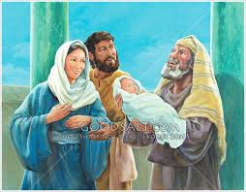
Faithful Simeon
“And, behold, there was a man in Jerusalem, whose name was Simeon; and the same man was just and devout, waiting for the consolation of Israel: and the Holy Ghost was upon him. And it was revealed unto him by the Holy Ghost, that he should not see death, before he had seen the Lord's Christ. And he came by the Spirit into the temple: and when the parents brought in the child Jesus, to do for him after the custom of the law, Then took he him up in his arms,” Luke 2:25-28

Slide 9
Conference Man under the Spirit’s Lead!
“But though he neither saw nor felt anything unusual, God's act in giving His Son to the world was acknowledged. This occasion did not pass without some recognition of Christ. “There was a man in Jerusalem, whose name was Simeon; and the same man was just and devout, waiting for the Consolation of Israel: and the Holy Ghost was upon him. And it was revealed unto him by the Holy Ghost, that he should not see death, before he had seen the Lord's Christ.”
As Simeon enters the temple, he sees a family presenting their first-born son before the priest. Their appearance bespeaks poverty; but Simeon understands the warnings of the Spirit, and he is deeply impressed that the infant being presented to the Lord is the Consolation of Israel, the One he has longed to see. To the astonished priest, Simeon appears like a man enraptured. The child has been returned to Mary, and he takes it in his arms and presents it to God, while a joy that he has never before felt enters his soul. As he lifts the infant Savior toward heaven, he says, “Lord, now lettest Thou Thy servant depart in peace, according to Thy word: for mine eyes have seen Thy salvation, which Thou hast prepared before the face of all people; a light to lighten the Gentiles, and the glory of Thy people Israel.” DA, pg. 55

Slide 10
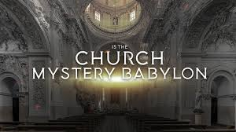
Simeon was a conference man. He was a church member in good and regular standing. The Desire of Ages says he was being led by the Holy Ghost. We need to be very careful not to think everyone in the denomination is in apostasy. Simeon tells us that simply is not true!! For those who want to call the church Babylon and close probation on her, would you have closed it on Simeon as well?

Slide 11
Quite Clear!
“My brother, I learn that you are taking the position that the Seventh-day Adventist Church is Babylon, and that all that would be saved must come out of her. You are not the only man the devil has deceived in this matter. For the last forty years, one man after another has arisen, claiming that the Lord has sent him with the same message; but let me tell you, as I have told them, that this message you are proclaiming is one of the satanic delusions designed to create confusion among the churches.
“My brother, you are certainly off the track. The second angel's message was to go to Babylon [the churches] proclaiming her downfall, and calling the people to come out of her. This same message is to be proclaimed the second time. ‘And after these things I saw another angel come down from heaven, having great power; and the earth was lightened with his glory…

Slide 12
Be Careful!
“…And he cried mightily with a strong voice, saying, Babylon the great is fallen, is fallen, and is become the habitation of devils, and the hold of every foul spirit, and a cage of every unclean and hateful bird. For all nations have drunk of the wine of the wrath of her fornication, and the kings of the earth have committed fornication with her, and the merchants of the earth are waxed rich through the abundance of her delicacies. And I heard another voice from heaven, saying, Come out of her, My people, that ye be not partakers of her sins, and that ye receive not of her plagues. For her sins have reached unto heaven, and God hath remembered her iniquities.’
“My brother, if you are teaching that the Seventh-day Adventist Church is Babylon, you are wrong, God has not given you any such message to bear. Satan will use every mind to which he can attain access, inspiring men to originate false theories or go off on some wrong tangent, that he may create a false excitement, and thus divert souls from the true issue for this time. I presume that some may be deceived by your message, because they are full of curiosity and desire for some new thing. “ TM, pgs. 58,59

Slide 13
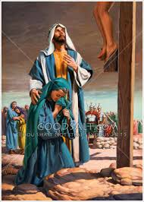
A Sword is Coming!
“Lord, now lettest thou thy servant depart in peace, according to thy word: For mine eyes have seen thy salvation, Which thou hast prepared before the face of all people; A light to lighten the Gentiles, and the glory of thy people Israel. And Joseph and his mother marveled at those things which were spoken of him. And Simeon blessed them, and said unto Mary his mother, Behold, this child is set for the fall and rising again of many in Israel; and for a sign which shall be spoken against; (Yea, a sword shall pierce through thy own soul also,) that the thoughts of many hearts may be revealed.” Luke 2:29-35

Slide 14
Didn’t Understand!
“Yet Mary did not understand Christ's mission. Simeon had prophesied of Him as a light to lighten the Gentiles, as well as a glory to Israel. Thus the angels had announced the Savior's birth as tidings of joy to all peoples. God was seeking to correct the narrow, Jewish conception of the Messiah's work. He desired men to behold Him, not merely as the deliverer of Israel, but as the Redeemer of the world. But many years must pass before even the mother of Jesus would understand His mission.
Mary looked forward to the Messiah's reign on David's throne, but she saw not the baptism of suffering by which it must be won. Through Simeon it is revealed that the Messiah is to have no unobstructed passage through the world. In the words to Mary, “A sword shall pierce through thy own soul also,” God in His tender mercy gives to the mother of Jesus an intimation of the anguish that already for His sake she had begun to bear.” DA, pg. 56

Slide 15
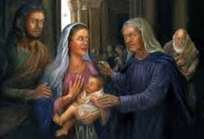
“And there was one Anna, a prophetess, the daughter of Phanuel, of the tribe of Aser: she was of a great age, and had lived with an husband seven years from her virginity; And she was a widow of about fourscore and four years, which departed not from the temple, but served God with fastings and prayers night and day. And she coming in that instant gave thanks likewise unto the Lord, and spake of him to all them that looked for redemption in Jerusalem.” Luke 2:36-38

Slide 16
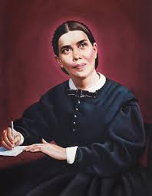
Deborah, Anna, Huldah, Philip’s four daughters: Would it Happen Again?
“Anna also, a prophetess, came in and confirmed Simeon's testimony concerning Christ. As Simeon spoke, her face lighted up with the glory of God, and she poured out her heartfelt thanks that she had been permitted to behold Christ the Lord. These humble worshipers had not studied the prophecies in vain. But those who held positions as rulers and priests in Israel, though they too had before them the precious utterances of prophecy, were not walking in the way of the Lord, and their eyes were not open to behold the Light of life.” DA, pg. 55

Slide 17
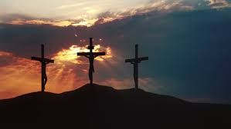
“At the cross of Calvary, love and selfishness stood face to face. Here was their crowning manifestation. Christ had lived only to comfort and bless, and in putting Him to death, Satan manifested the malignity of his hatred against God. He made it evident that the real purpose of his rebellion was to dethrone God, and to destroy Him through whom the love of God was shown. By the life and the death of Christ, the thoughts of men also are brought to view. From the manger to the cross, the life of Jesus was a call to self-surrender, and to fellowship in suffering. It unveiled the purposes of men. Jesus came with the truth of heaven, and all who were listening to the voice of the Holy Spirit were drawn to Him. The worshipers of self belonged to Satan's kingdom. In their attitude toward Christ, all would show on which side they stood. And thus everyone passes judgment on himself.” DA, pg. 57

