Slide 1

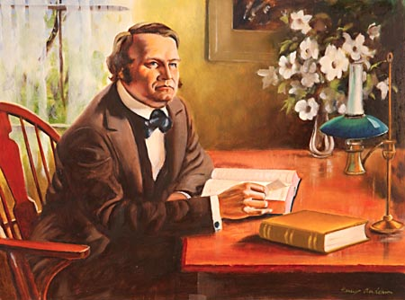
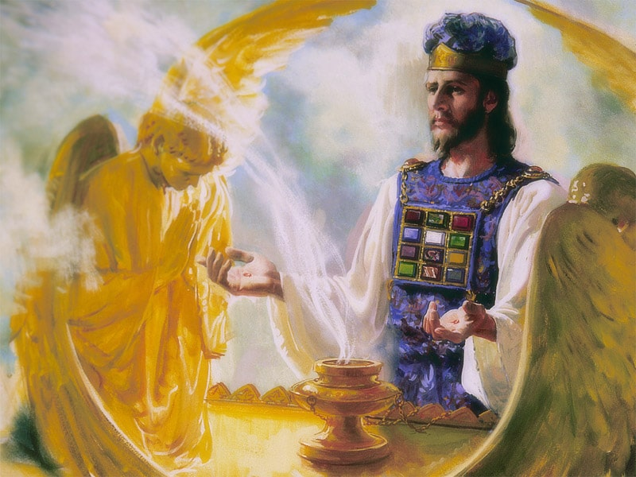
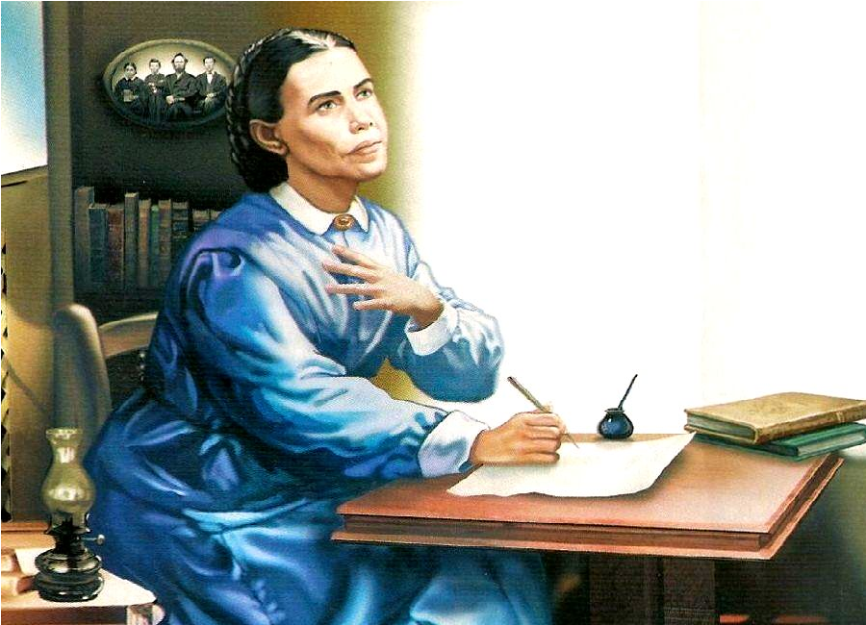
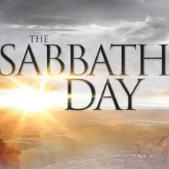
The 2300 Days

Slide 2
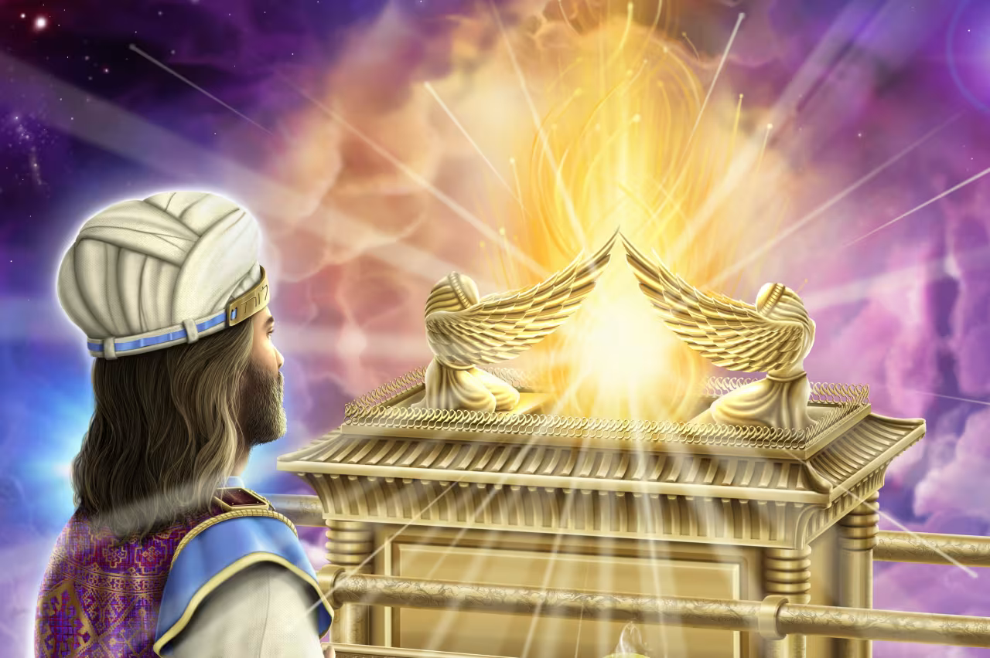
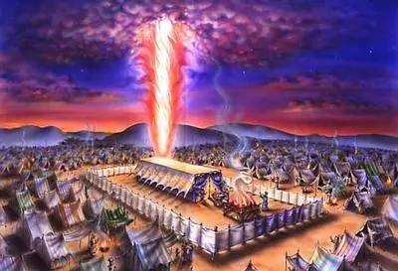
Recap…
So far we have found that the Millerite Movement of 1844 was ordained of God to:
Complete the work of the Reformation in “restoring” the Sanctuary
Fulfills to the day the prophetic time periods of Daniel 8, from 457BC-1844
Fulfills the event to take place, which was the cleansing of the Sanctuary (Day of Atonement)
Fulfills the time period of the “blessed” in Daniel 12, from 508AD-1843
Fulfills the prophetic events of the Midnight Cry from the Parable of the Ten Virgins
Is the only movement to share in the identical experience of the Disciples Great Disappointment
Fulfills the prophetic experience from Revelation 10
But Let’s take a deeper look at the prophecies of Revelation and the Millerite experience

Slide 3
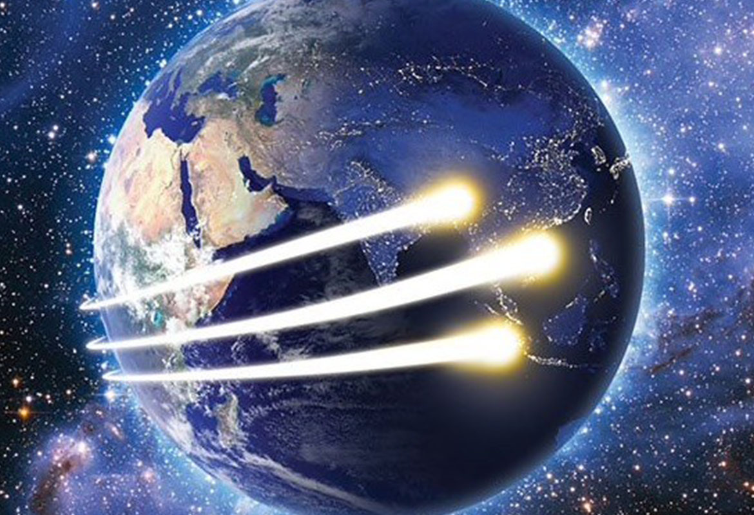
What Are the Three Angel’s Messages?
FIRST: Rev. 14:6-7 “And I saw another angel fly in the midst of heaven, having the everlasting gospel to preach unto them that dwell on the earth, and to every nation, and kindred, and tongue, and people, Saying with a loud voice, Fear God, and give glory to him; for the hour of his judgment is come: and worship him that made heaven, and earth, and the sea, and the fountains of waters.”

Slide 4
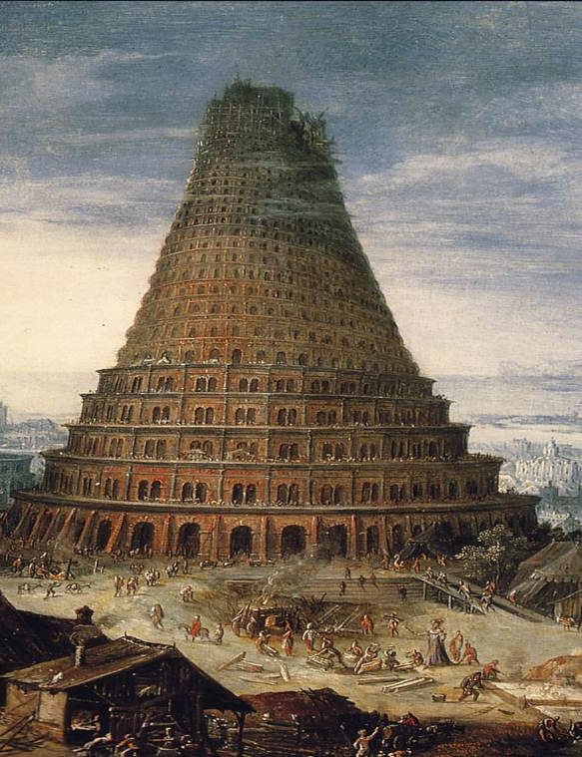
The Second Angel’s Message…
Rev. 14:8 “And there followed another angel, saying, Babylon is fallen, is fallen, that great city, because she made all nations drink of the wine of the wrath of her fornication.”

Slide 5
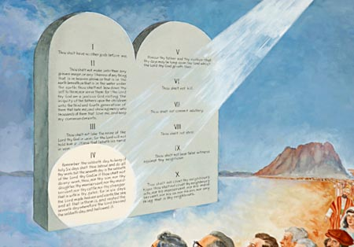
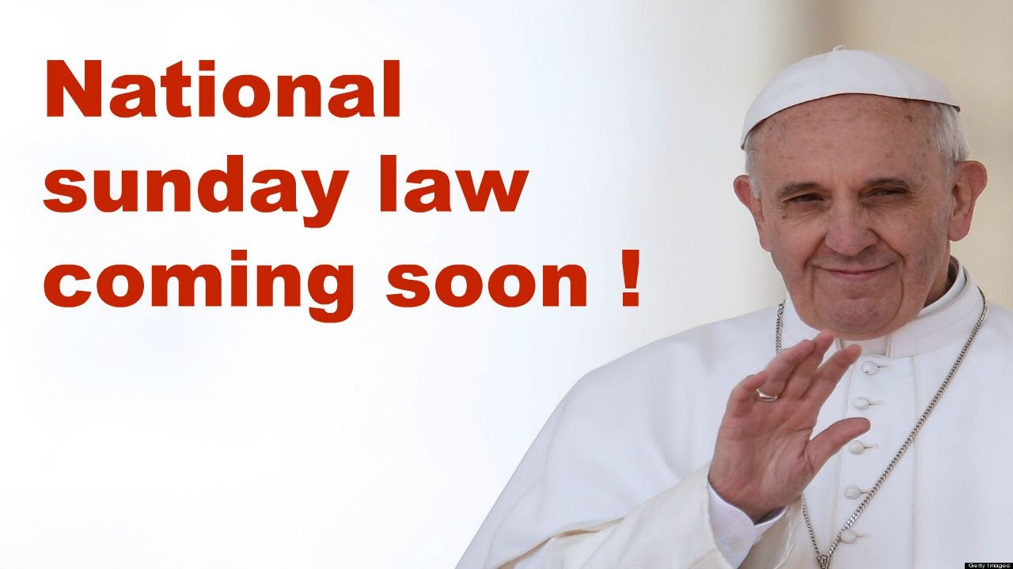
The Third Angel’s Message!!!
Rev. 14:9-12 “And the third angel followed them, saying with a loud voice, If any man worship the beast and his image, and receive his mark in his forehead, or in his hand, The same shall drink of the wine of the wrath of God, which is poured out without mixture into the cup of his indignation; and he shall be tormented with fire and brimstone in the presence of the holy angels, and in the presence of the Lamb: And the smoke of their torment ascendeth up for ever and ever: and they have no rest day nor night, who worship the beast and his image, and whosoever receiveth the mark of his name. Here is the patience of the saints: here are they that keep the commandments of God, and the faith of Jesus.”

Slide 6
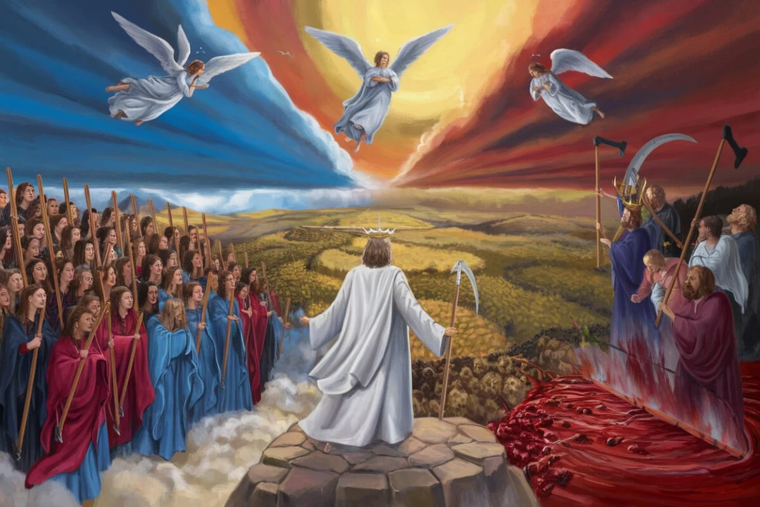
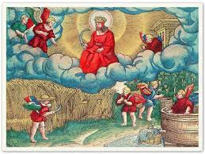
What Happens After These Messages?
Rev. 14:13-20 “And I heard a voice from heaven saying unto me, Write, Blessed are the dead which die in the Lord from henceforth: Yea, saith the Spirit, that they may rest from their labours; and their works do follow them. And I looked, and behold a white cloud, and upon the cloud one sat like unto the Son of man, having on his head a golden crown, and in his hand a sharp sickle. And another angel came out of the temple, crying with a loud voice to him that sat on the cloud, Thrust in thy sickle, and reap: for the time is come for thee to reap; for the harvest of the earth is ripe. And he that sat on the cloud thrust in his sickle on the earth; and the earth was reaped. And another angel came out of the temple which is in heaven, he also having a sharp sickle. And another angel came out from the altar, which had power over fire; and cried with a loud cry to him that had the sharp sickle, saying, Thrust in thy sharp sickle, and gather the clusters of the vine of the earth; for her grapes are fully ripe. And the angel thrust in his sickle into the earth, and gathered the vine of the earth, and cast it into the great winepress of the wrath of God. And the winepress was trodden without the city, and blood came out of the winepress, even unto the horse bridles, by the space of a thousand and six hundred furlongs.”

Slide 7
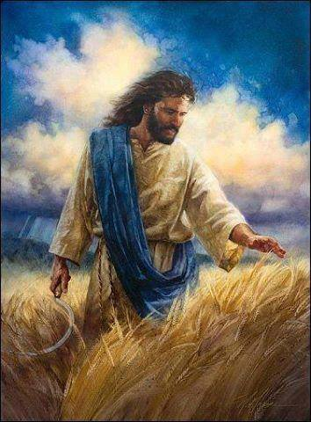
What is the Harvest?
Matt. 13:36-43 “Then Jesus sent the multitude away, and went into the house: and his disciples came unto him, saying, Declare unto us the parable of the tares of the field. He answered and said unto them, He that soweth the good seed is the Son of man; The field is the world; the good seed are the children of the kingdom; but the tares are the children of the wicked one; The enemy that sowed them is the devil; the harvest is the end of the world; and the reapers are the angels. As therefore the tares are gathered and burned in the fire; so shall it be in the end of this world. The Son of man shall send forth his angels, and they shall gather out of his kingdom all things that offend, and them which do iniquity; And shall cast them into a furnace of fire: there shall be wailing and gnashing of teeth. Then shall the righteous shine forth as the sun in the kingdom of their Father. Who hath ears to hear, let him hear.

Slide 8
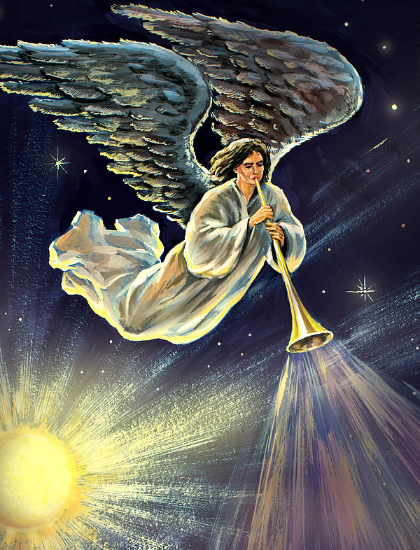
Revelation 18
Rev. 18:1-4 “And after these things I saw another angel come down from heaven, having great power; and the earth was lightened with his glory. And he cried mightily with a strong voice, saying, Babylon the great is fallen, is fallen, and is become the habitation of devils, and the hold of every foul spirit, and a cage of every unclean and hateful bird. For all nations have drunk of the wine of the wrath of her fornication, and the kings of the earth have committed fornication with her, and the merchants of the earth are waxed rich through the abundance of her delicacies. And I heard another voice from heaven, saying, Come out of her, my people, that ye be not partakers of her sins, and that ye receive not of her plagues.”

Slide 9
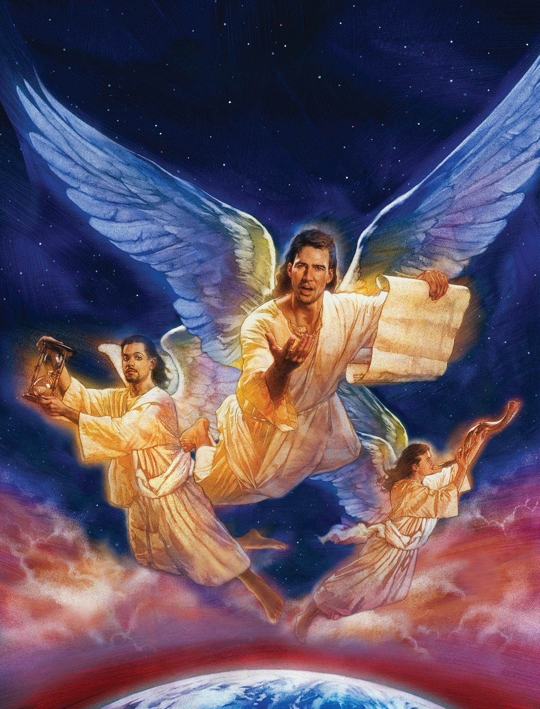
Revelation 18’s Fourth Angel:
This Messenger is superior to the other three in power, voice, authority—when He shows up everything stops to listen
The Fourth Angel’s message will be worldwide (“the earth is lightened with his glory”)
Cried mightily, the message has a powerful effect in the world—a Loud Cry
The Fourth Angel gives the same message as the three angel’s—(1st Angel’s Message is connected closely via comparing Rev. 10 with 18, 2nd Angel’s Message is connected to 18 via the repeated “Babylon . . . Is fallen”, and 3rd Angel’s Message is repeated via comparing the warning not to receive the Mark of the Beast lest you receive the wrath of God in Rev. 14 with “Come out of her . . . That ye receive not of her plagues”)

Slide 10
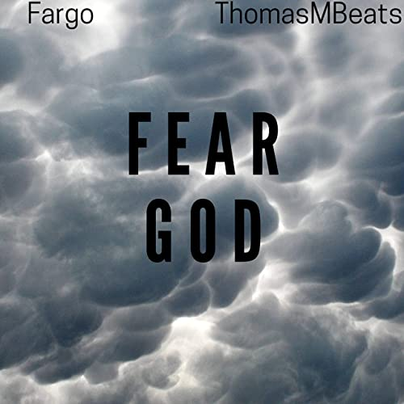
Fear God!
Strong’s Concordance: phobeo (fob-eh’-o)- fear, be afraid, be afraid of, reverence, 1) to put to flight by terrifying (to scare away), 1a) to put to flight, to flee, 1b) to fear, be afraid, 1) to be struck with fear, to be seized with alarm of those started by strange occurrences, of those struck with amazement, 2) to fear, to be afraid of one, 3) to fear (i.e. hesitate) to do something (for fear of harm), 1c) to reverence, venerate, to treat with deference or reverential obedience

Slide 11
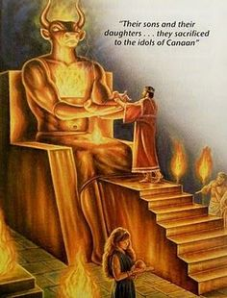
OT: We are Not to Fear False Gods
2 Kings 17:35 “With whom the LORD had made a covenant, and charged them, saying, Ye shall not fear other gods, nor bow yourselves to them, nor serve them, nor sacrifice to them”
Deut. 7:17-18,21 “If thou shalt say in thine heart, These nations are more than I; how can I dispossess them? Thou shalt not be afraid of them: but shalt well remember what the Lord thy God did unto Pharaoh, and unto all Egypt. Thou shalt not be affrighted at them: for the Lord thy God is among you, a mighty God and terrible.”

Slide 12
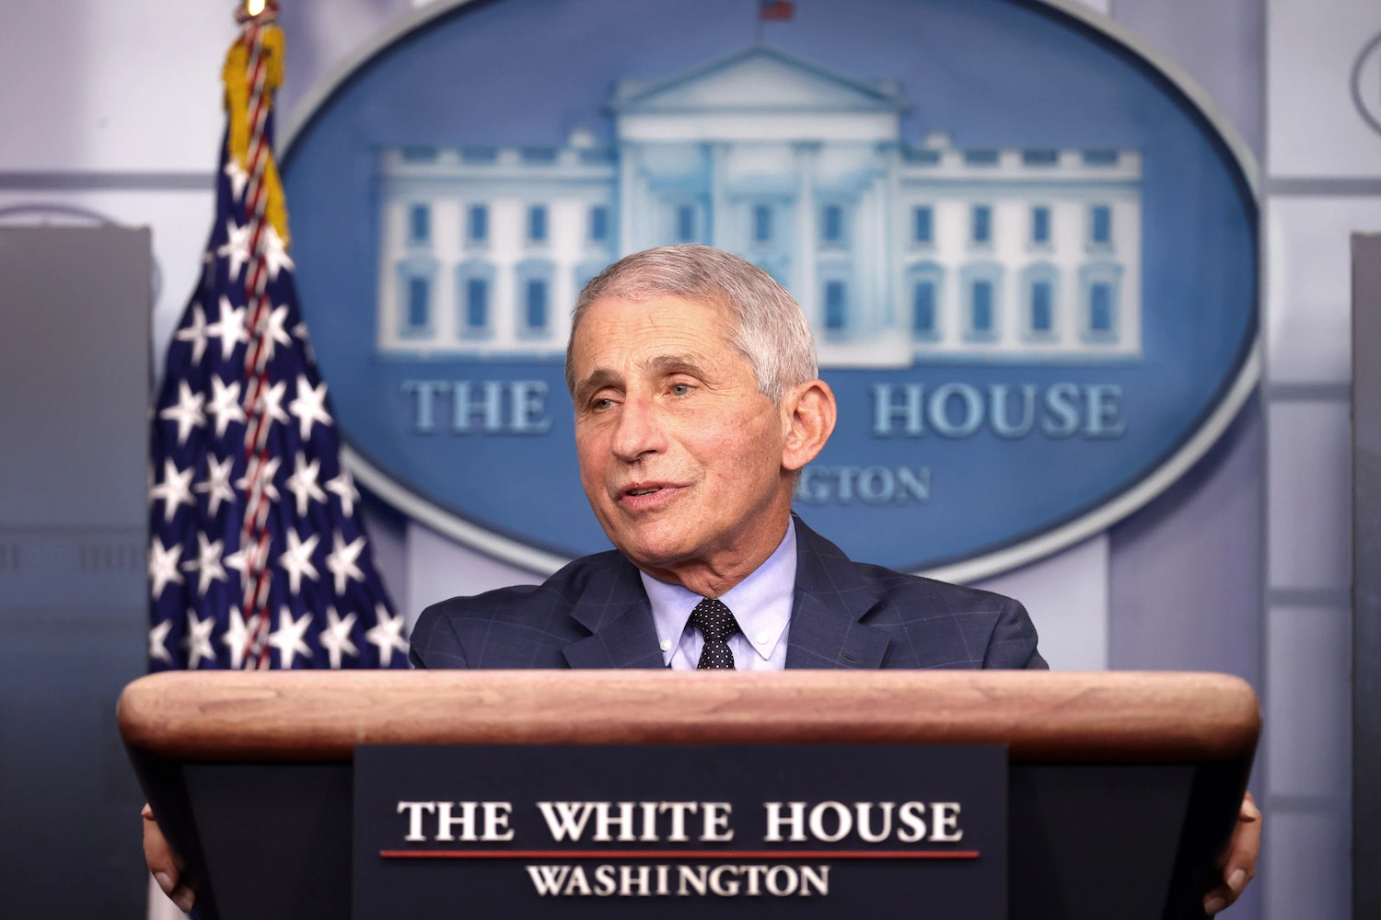

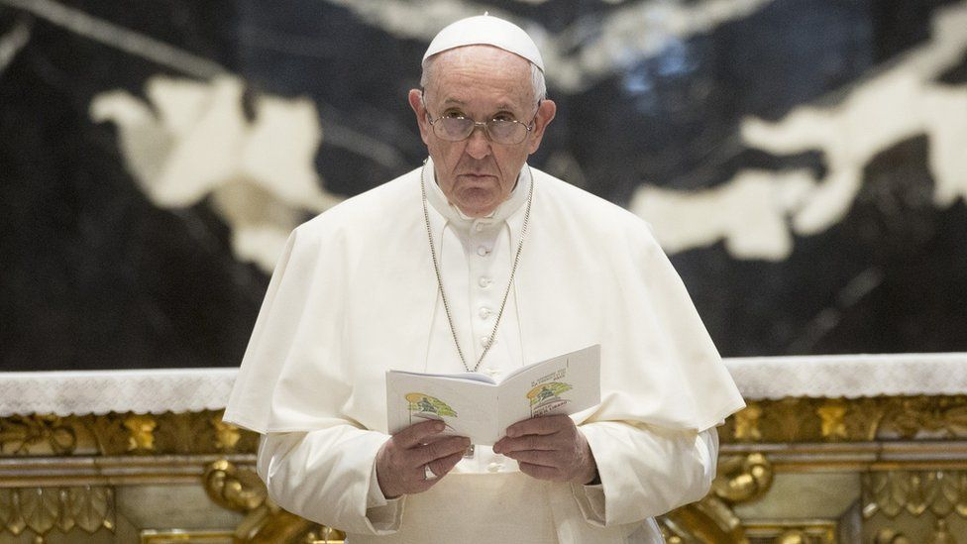
Cursed are those who trust in man
Jer. 17:5-7 “Thus saith the Lord; Cursed be the man that trusteth in man, and maketh flesh his arm, and whose heart departeth from the Lord. For he shall be like the heath in the desert, and shall not see when good cometh; but shall inhabit the parched places in the wilderness, in a salt land and not inhabited. Blessed is the man that trusteth in the Lord, and whose hope the Lord is.”
Ps. 146:3-5 “Put not your trust in princes, nor in the son of man, in whom there is no help. His breath goeth forth, he returneth to his earth; in that very day his thoughts perish. Happy is he that hath the God of Jacob for his help, whose hope is in the Lord his God:

Slide 13
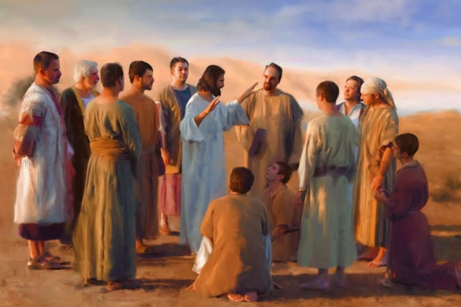
NT Fearing God
Matt. 10:28-31 “And fear not them which kill the body, but are not able to kill the soul: but rather fear him which is able to destroy both soul and body in hell. Are not two sparrows sold for a farthing? and one of them shall not fall on the ground without your Father. But the very hairs of your head are all numbered. Fear ye not therefore, ye are of more value than many sparrows.”

Slide 14
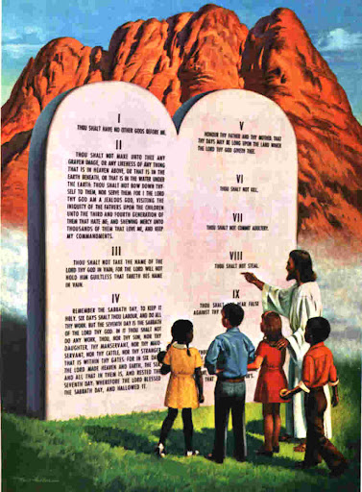
Fear God=Keep the Commandments
Deut. 5:29 “O that there were such an heart in them, that they would fear me, and keep all my commandments always, that it might be well with them, and with their children for ever!”
Prov. 8:13 “The fear of the Lord is to hate evil: pride, and arrogancy, and the evil way, and the froward mouth, do I hate.”
Job 28:28 “And unto man he said, Behold, the fear of the Lord, that is wisdom; and to depart from evil is understanding.”

Slide 15


Give Glory to Him!
1 Cor. 10:31 “Whether therefore ye eat, or drink, or whatsoever ye do, do all to the glory of God.”
John 15:1-2,5-8 “I am the true vine, and my Father is the husbandman. Every branch in me that beareth not fruit he taketh away: and every branch that beareth fruit, he purgeth it, that it may bring forth more fruit. . . . I am the vine, ye are the branches: He that abideth in me, and I in him, the same bringeth forth much fruit: for without me ye can do nothing. If a man abide not in me, he is cast forth as a branch, and is withered; and men gather them, and cast them into the fire, and they are burned. If ye abide in me, and my words abide in you, ye shall ask what ye will, and it shall be done unto you. Herein is my Father glorified, that ye bear much fruit; so shall ye be my disciples.”

Slide 16
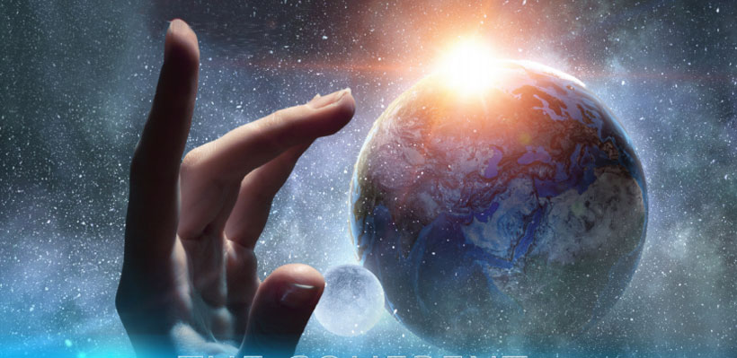
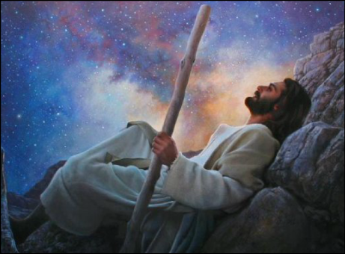
Worship the Creator
Rev. 14:7 “and worship him that made heaven, and earth, and the sea, and the fountains of waters”
Gen. 2:1-3 “Thus the heavens and the earth were finished, and all the host of them. And on the seventh day God ended his work which he had made; and he rested on the seventh day from all his work which he had made. And God blessed the seventh day, and sanctified it: because that in it he had rested from all his work which God created and made.”

Slide 17
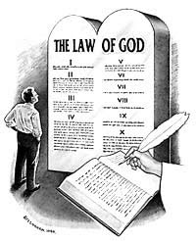
The Lost Commandment Restored!
Ex. 20:8-11 “Remember the sabbath day, to keep it holy. Six days shalt thou labour, and do all thy work: But the seventh day is the sabbath of the Lord thy God: in it thou shalt not do any work, thou, nor thy son, nor thy daughter, thy manservant, nor thy maidservant, nor thy cattle, nor thy stranger that is within thy gates: For in six days the Lord made heaven and earth, the sea, and all that in them is, and rested the seventh day: wherefore the Lord blessed the sabbath day, and hallowed it.”

Slide 18
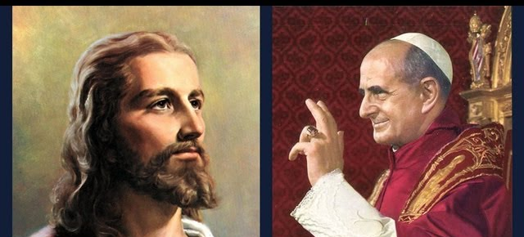
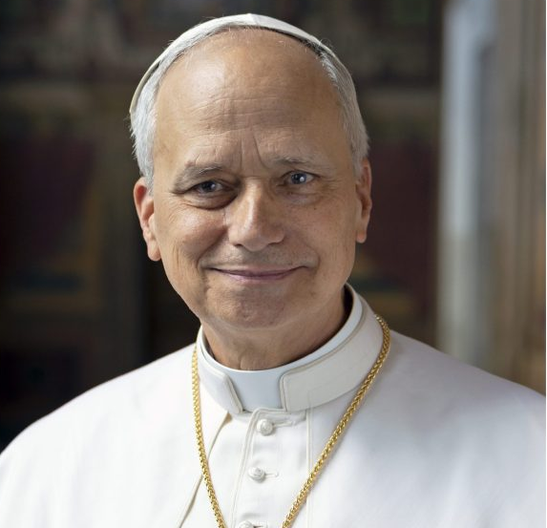
What Will We Choose?

Slide 19
Explain the time of the end and the Reformation, restoring the Sanctuary
Elijah and the restoration of the altar
Explain the Millerite movement and the 2300 days as the only ones who understood the significance of this passage
Walk through the events and the errors, highlight the importance of the sanctuary throughout
Loughborough’s account, etc.
3 Angel’s Messages—the worldwide message, the Second Great Awakening, Great Disappointment of the disciples

