Slide 1

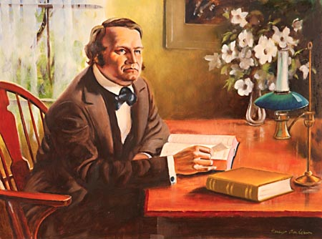
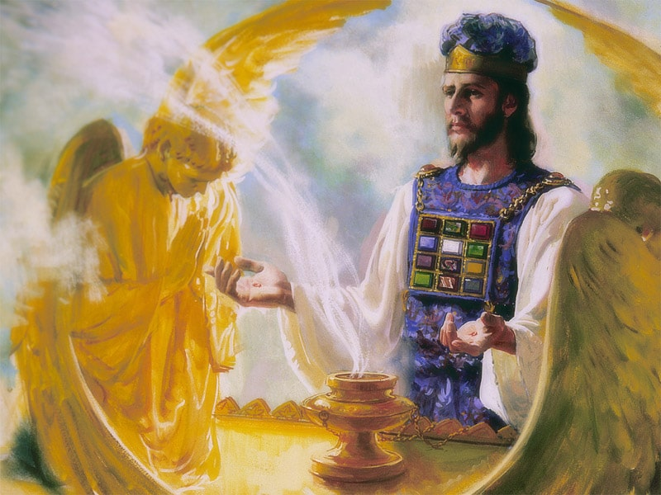
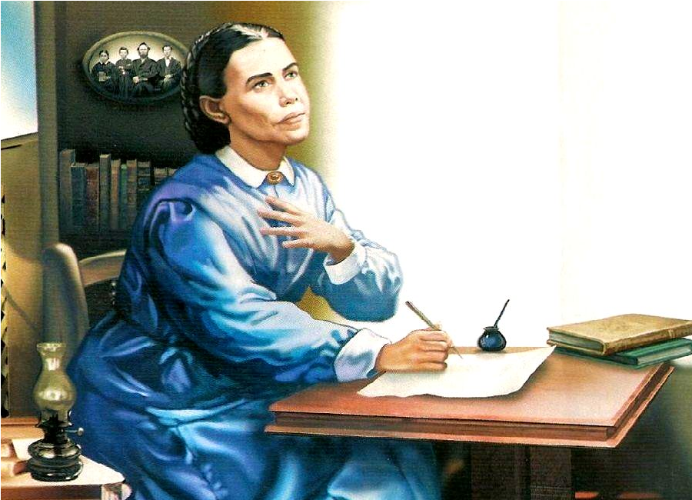
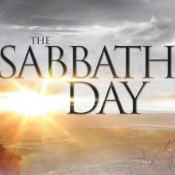
The 2300 Days

Slide 2
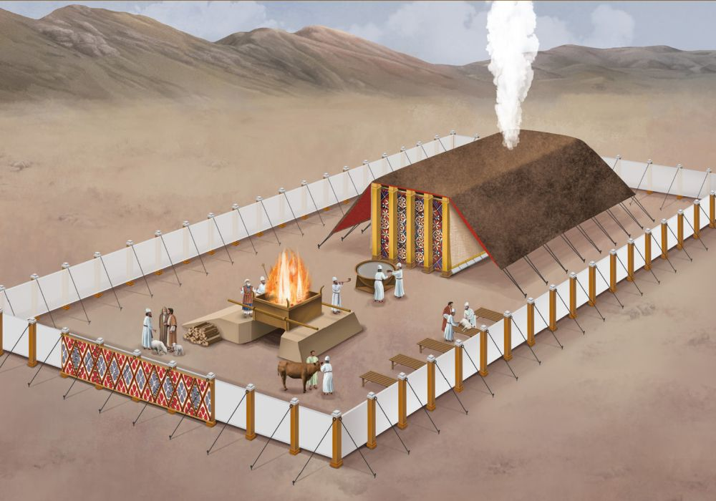
Recap
Now that we have looked at the beginning of the 70 week prophecy both in its objectives and fulfillment in the life and mission of Jesus Christ, let’s return to the 2300 day/year prophecy to try to understand what it is saying will happen the close of the 2300 days, then we can look at the end of the prophecy to see if something significant happened…

Slide 3
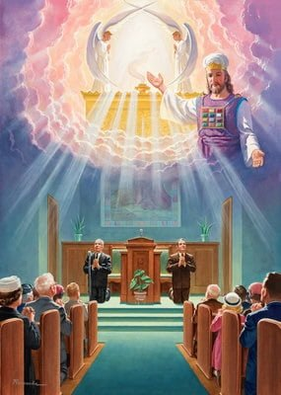
The Foundation of our Faith
“The correct understanding of the ministration in the heavenly sanctuary is the foundation of our faith”—Ellen White, Evangelism, p. 221
Ps. 77:13 “Thy way, O God, is in the sanctuary: who is so great a God as our God?”

Slide 4
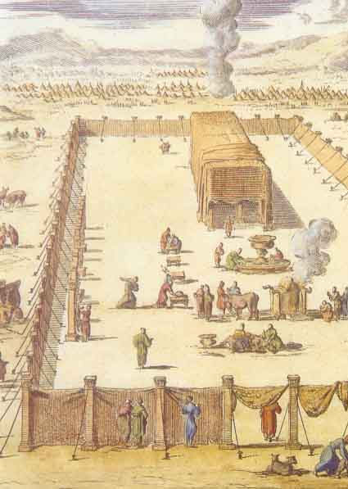
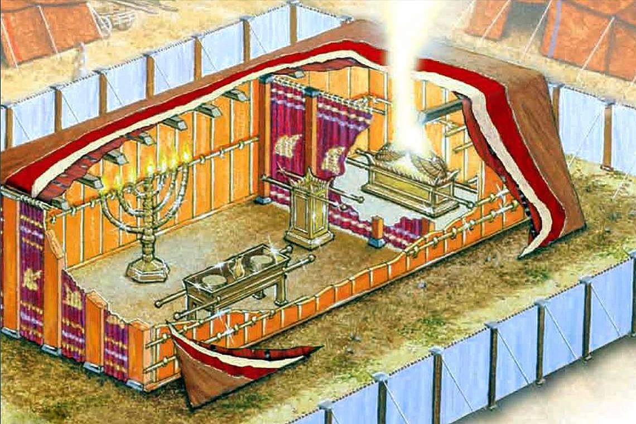
Daniel 8 Revisited…
Dan. 8:11-14 “Yea, he magnified himself even to the prince of the host, and by him the daily sacrifice was taken away, and the place of the sanctuary was cast down. And an host was given him against the daily sacrifice by reason of transgression, and it cast down the truth to the ground; and it practised, and prospered. Then I heard one saint speaking, and another saint said unto that certain saint which spake, How long shall be the vision concerning the daily sacrifice, and the transgression of desolation, to give both the sanctuary and the host to be trodden under foot? And he said unto me, Unto two thousand and three hundred days; then shall the sanctuary be cleansed.”

Slide 5
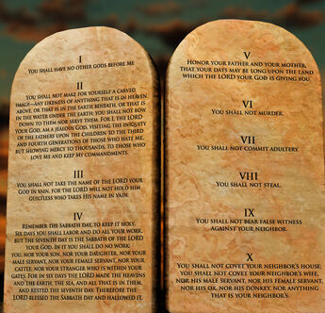
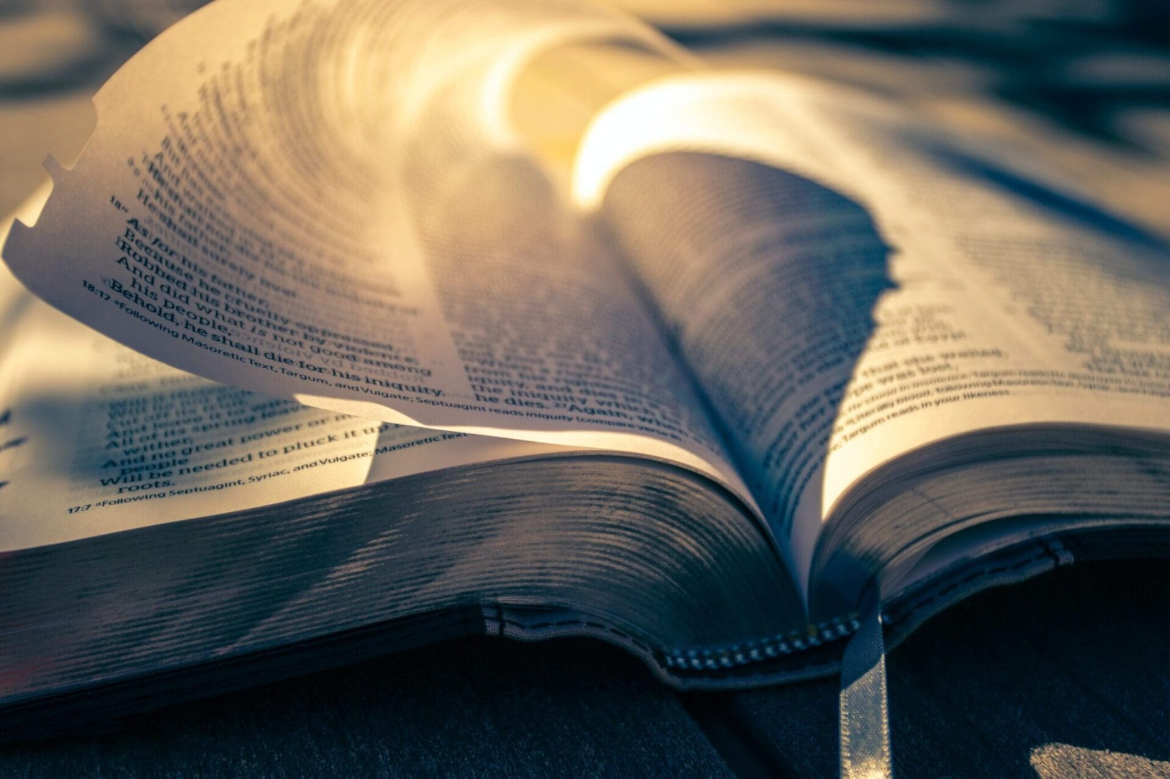
What is “Truth”?
John 17:17 “Sanctify them through thy truth: thy word is truth.”
Ps. 119:142 “Thy righteousness is an everlasting righteousness, and thy law is the truth.”

Slide 6
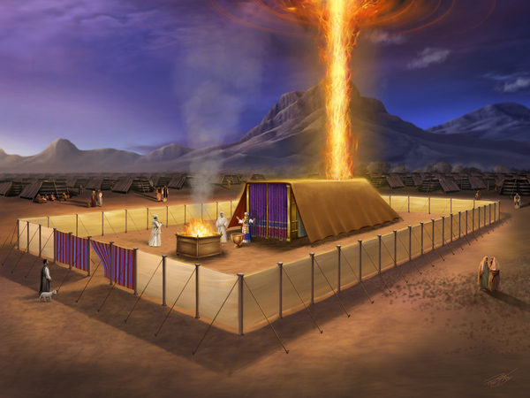
“After Their Pattern”
Ex. 25:8-9, 40 “And let them make me a sanctuary; that I may dwell among them. According to all that I shew thee, after the pattern of the tabernacle, and the pattern of all the instruments thereof, even so shall ye make it. . . . And look that thou make them after their pattern, which was shewed thee in the mount.”
Ex. 26:30 “And thou shalt rear up the tabernacle according to the fashion thereof which was shewed thee in the mount.”

Slide 7
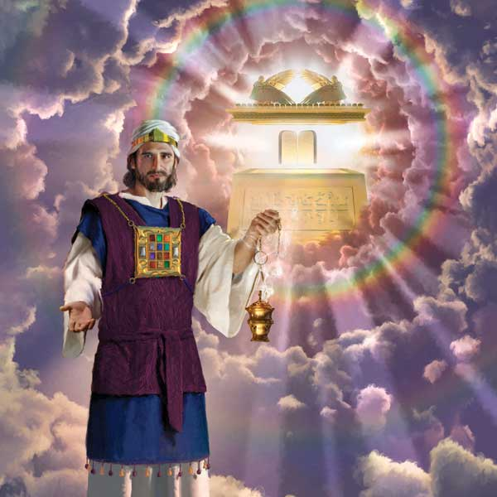
Hebrews Explains…
Heb. 8:1-5 “Now of the things which we have spoken this is the sum: We have such an high priest, who is set on the right hand of the throne of the Majesty in the heavens; A minister of the sanctuary, and of the true tabernacle, which the Lord pitched, and not man. For every high priest is ordained to offer gifts and sacrifices: wherefore it is of necessity that this man have somewhat also to offer. For if he were on earth, he should not be a priest, seeing that there are priests that offer gifts according to the law: Who serve unto the example and shadow of heavenly things, as Moses was admonished of God when he was about to make the tabernacle: for, See, saith he, that thou make all things according to the pattern shewed to thee in the mount.”

Slide 8
What’s the New Covenant?
Heb. 8:6-13 “But now hath he obtained a more excellent ministry, by how much also he is the mediator of a better covenant, which was established upon better promises. For if that first covenant had been faultless, then should no place have been sought for the second. For finding fault with them, he saith, Behold, the days come, saith the Lord, when I will make a new covenant with the house of Israel and with the house of Judah: Not according to the covenant that I made with their fathers in the day when I took them by the hand to lead them out of the land of Egypt; because they continued not in my covenant, and I regarded them not, saith the Lord. For this is the covenant that I will make with the house of Israel after those days, saith the Lord; I will put my laws into their mind, and write them in their hearts: and I will be to them a God, and they shall be to me a people: And they shall not teach every man his neighbour, and every man his brother, saying, Know the Lord: for all shall know me, from the least to the greatest. For I will be merciful to their unrighteousness, and their sins and their iniquities will I remember no more. In that he saith, A new covenant, he hath made the first old. Now that which decayeth and waxeth old is ready to vanish away.”

Slide 9
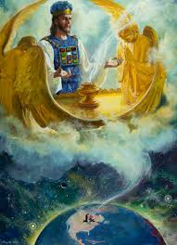
The Earthly vs the Heavenly Sanctuary
Heb. 9:1-9 “Then verily the first covenant had also ordinances of divine service, and a worldly sanctuary. For there was a tabernacle made; the first, wherein was the candlestick, and the table, and the shewbread; which is called the sanctuary. And after the second veil, the tabernacle which is called the Holiest of all [Most Holy Place]; Which had the golden censer, and the ark of the covenant overlaid round about with gold, wherein was the golden pot that had manna, and Aaron's rod that budded, and the tables of the covenant; And over it the cherubims of glory shadowing the mercyseat; of which we cannot now speak particularly. Now when these things were thus ordained, the priests went always into the first tabernacle, accomplishing the service of God. But into the second went the high priest alone once every year, not without blood, which he offered for himself, and for the errors of the people: The Holy Ghost this signifying, that the way into the holiest of all was not yet made manifest, while as the first tabernacle was yet standing: Which was a figure for the time then present, in which were offered both gifts and sacrifices, that could not make him that did the service perfect, as pertaining to the conscience”

Slide 10
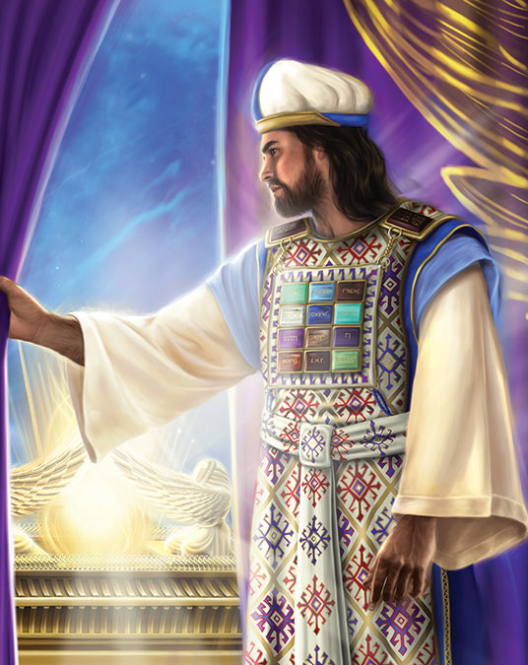
Not of This Building…
Heb. 9:10-15 “Which stood only in meats and drinks, and divers washings, and carnal ordinances, imposed on them until the time of reformation. But Christ being come an high priest of good things to come, by a greater and more perfect tabernacle, not made with hands, that is to say, not of this building; Neither by the blood of goats and calves, but by his own blood he entered in once into the holy place****, having obtained eternal redemption for us. For if the blood of bulls and of goats, and the ashes of an heifer sprinkling the unclean, sanctifieth to the purifying of the flesh: How much more shall the blood of Christ, who through the eternal Spirit offered himself without spot to God, purge your conscience from dead works to serve the living God? And for this cause he is the mediator of the new testament, that by means of death, for the redemption of the transgressions that were under the first testament, they which are called might receive the promise of eternal inheritance.”
(Heb. 9:12 interprets “most holy place” in NKJV, NLT, BereanSV, Holman ChristianSB, Contemporary English Version, God’s Word, Good News, ISV, NET, Majority StandardB)

Slide 11
Figures of the True
Heb. 9:16-28 “For where a testament is, there must also of necessity be the death of the testator. For a testament is of force after men are dead: otherwise it is of no strength at all while the testator liveth. Whereupon neither the first testament was dedicated without blood. For when Moses had spoken every precept to all the people according to the law, he took the blood of calves and of goats, with water, and scarlet wool, and hyssop, and sprinkled both the book, and all the people, Saying, This is the blood of the testament which God hath enjoined unto you. Moreover he sprinkled with blood both the tabernacle, and all the vessels of the ministry. And almost all things are by the law purged with blood; and without shedding of blood is no remission. It was therefore necessary that the patterns of things in the heavens should be purified with these; but the heavenly things themselves with better sacrifices than these. For Christ is not entered into the holy places made with hands, which are the figures of the true; but into heaven itself, now to appear in the presence of God for us: Nor yet that he should offer himself often, as the high priest entereth into the holy place every year with blood of others; For then must he often have suffered since the foundation of the world: but now once in the end of the world hath he appeared to put away sin by the sacrifice of himself. And as it is appointed unto men once to die, but after this the judgment: So Christ was once offered to bear the sins of many; and unto them that look for him shall he appear the second time without sin unto salvation.”

Slide 12
Separation Between the Law of God and Moses
-Ex. 31:18 “And he gave unto Moses, when he had made an end of communing with him upon mount Sinai, two tables of testimony, tables of stone, written with the finger of God.”
-Deut. 10:1-2 “At that time the Lord said unto me, Hew thee two tables of stone like unto the first, and come up unto me into the mount, and make thee an ark of wood. And I will write on the tables the words that were in the first tables which thou brakest, and thou shalt put them in the ark.”
-Deut. 31:24-26 “And it came to pass, when Moses had made an end of writing the words of this law in a book, until they were finished, That Moses commanded the Levites, which bare the ark of the covenant of the Lord, saying, Take this book of the law, and put it in the side of the ark of the covenant of the Lord your God, that it may be there for a witness against thee.”

Slide 13
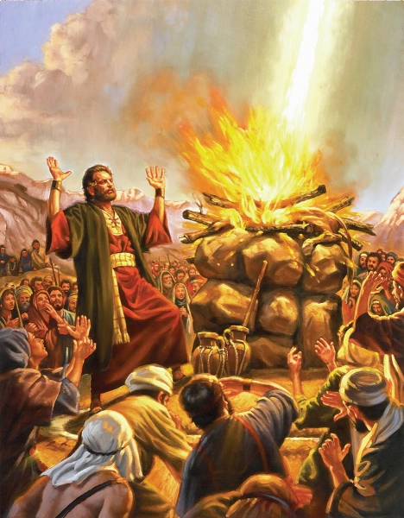
Elijah and the Restoration
Mal. 4:5 “Behold, I will send you Elijah the prophet before the coming of the great and dreadful day of the Lord”

Slide 14
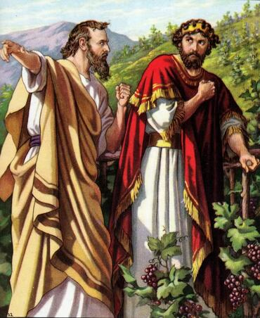
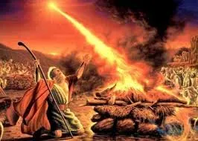
Elijah’s Works and Message
1 Kings 18:17-21 “And it came to pass, when Ahab saw Elijah, that Ahab said unto him, Art thou he that troubleth Israel? And he answered, [1] I have not troubled Israel; but thou, and thy father's house, in that ye have forsaken the commandments of the Lord, and thou hast followed Baalim. Now therefore send, and gather to me all Israel unto mount Carmel, and the prophets of Baal four hundred and fifty, and the prophets of the groves four hundred, which eat at Jezebel's table. So Ahab sent unto all the children of Israel, and gathered the prophets together unto mount Carmel. And Elijah came unto all the people, and said, [2] How long halt ye between two opinions? if the Lord be God, follow him: but if Baal, then follow him. And the people answered him not a word.”

Slide 15
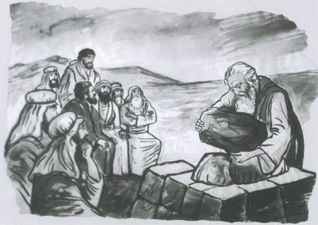
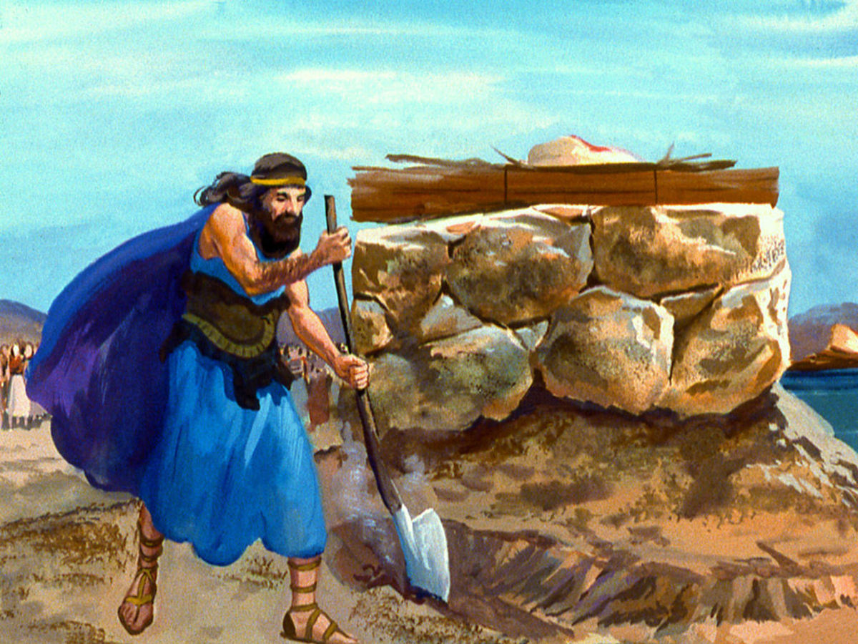
Elijah Restores the Sanctuary???
1 Kings 18:29-32 “And it came to pass, when midday was past, and they prophesied until the time of the offering of the evening sacrifice, that there was neither voice, nor any to answer, nor any that regarded. And Elijah said unto all the people, Come near unto me. And all the people came near unto him. [3] And he repaired the altar of the Lord that was broken down. And Elijah took twelve stones, according to the number of the tribes of the sons of Jacob, unto whom the word of the Lord came, saying, Israel shall be thy name: And with the stones he built an altar in the name of the Lord: and he made a trench about the altar, as great as would contain two measures of seed.”

Slide 16
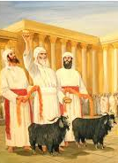
When Was the Sanctuary “Cleansed”?
Lev. 16:15-18 “Then shall he kill the goat of the sin offering, that is for the people, and bring his blood within the vail, and do with that blood as he did with the blood of the bullock, and sprinkle it upon the mercy seat, and before the mercy seat: And he shall make an atonement for the holy place, because of the uncleanness of the children of Israel, and because of their transgressions in all their sins: and so shall he do for the tabernacle of the congregation, that remaineth among them in the midst of their uncleanness. And there shall be no man in the tabernacle of the congregation when he goeth in to make an atonement in the holy place, until he come out, and have made an atonement for himself, and for his household, and for all the congregation of Israel. And he shall go out unto the altar that is before the Lord, and make an atonement for it; and shall take of the blood of the bullock, and of the blood of the goat, and put it upon the horns of the altar round about.”

Slide 17
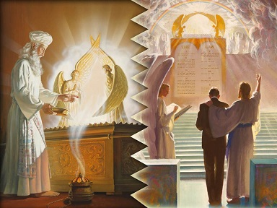
“And Cleanse it”
Lev. 16:19-21 “And he shall sprinkle of the blood upon it with his finger seven times, and cleanse it, and hallow it from the uncleanness of the children of Israel. And when he hath made an end of reconciling the holy place, and the tabernacle of the congregation, and the altar, he shall bring the live goat: And Aaron shall lay both his hands upon the head of the live goat, and confess over him all the iniquities of the children of Israel, and all their transgressions in all their sins, putting them upon the head of the goat, and shall send him away by the hand of a fit man into the wilderness:”

Slide 18
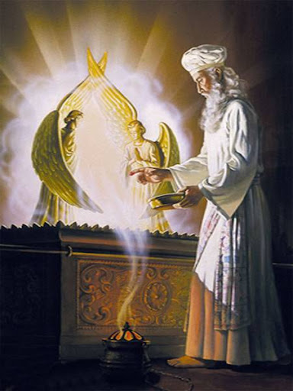
A “Judgment” Was Made???
Lev. 23: 27-29 “Also on the tenth day of this seventh month there shall be a day of atonement: it shall be an holy convocation unto you; and ye shall afflict your souls, and offer an offering made by fire unto the Lord. And ye shall do no work in that same day: for it is a day of atonement, to make an atonement for you before the Lord your God. For whatsoever soul it be that shall not be afflicted in that same day, he shall be cut off from among his people.”
Ex. 25:22 “And there I will meet with thee, and I will commune with thee from above the mercy seat, from between the two cherubims which are upon the ark of the testimony, of all things which I will give thee in commandment unto the children of Israel.

Slide 19
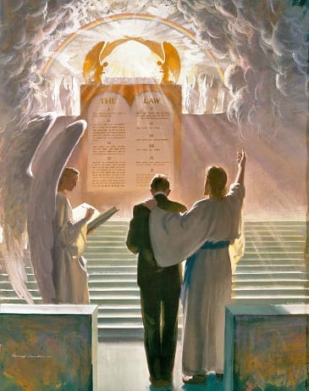
There’s An Investigation and a Judgment Coming…
Ps. 73:8-17 “They are corrupt, and speak wickedly concerning oppression: they speak loftily. They set their mouth against the heavens, and their tongue walketh through the earth. Therefore his people return hither: and waters of a full cup are wrung out to them. And they say, How doth God know? and is there knowledge in the most High? Behold, these are the ungodly, who prosper in the world; they increase in riches. Verily I have cleansed my heart in vain, and washed my hands in innocency. For all the day long have I been plagued, and chastened every morning. If I say, I will speak thus; behold, I should offend against the generation of thy children. When I thought to know this, it was too painful for me; Until I went into the sanctuary of God; then understood I their end.”

Slide 20
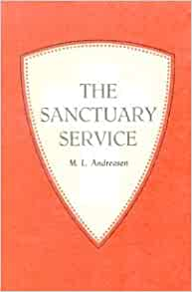
The Jewish Encyclopedia Explains… The Investigative Judgment???
“God, seated on His throne to judge the world, at the same time Judge, Pleader, Expert, and Witness, openeth the Book of Records; it is read, every man’s signature being found therein. The great trumpet is sounded; a still, small voice is heard; the angels shudder, saying, this is the day of judgment: for His very ministers are not pure before God. As a shepherd mustereth his flock, causing them to pass under his rod, so doth God cause every living soul to pass before Him to fix the limit of every creature’s life and to foreordain its destiny. On New Year’s Day the decree is written; on the Day of Atonement it is sealed who shall live and who are to die, etc. But penitence, prayer, and charity may avert the evil decree.”—Jewish Encyclopedia, “Atonement, Day of”, vol.2, p. 286

Slide 21
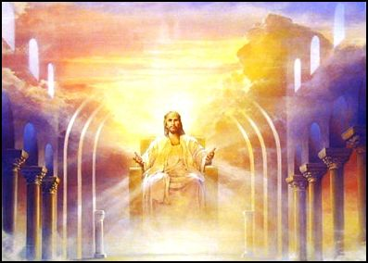
Before the Judgment Seat of Christ
2 Cor. 5:10 “For we must all appear before the judgment seat of Christ; that every one may receive the things done in his body, according to that he hath done, whether it be good or bad.”

Slide 22
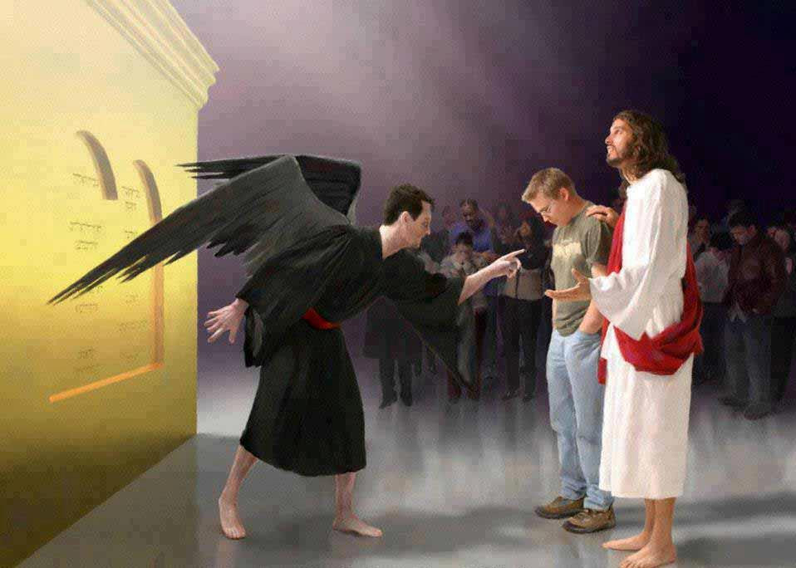
What the Tribunal Looks Like…
Zech. 3:1-4 “And he shewed me Joshua the high priest standing before the angel of the Lord, and Satan standing at his right hand to resist him. And the Lord said unto Satan, The Lord rebuke thee, O Satan; even the Lord that hath chosen Jerusalem rebuke thee: is not this a brand plucked out of the fire? Now Joshua was clothed with filthy garments, and stood before the angel. And he answered and spake unto those that stood before him, saying, Take away the filthy garments from him. And unto him he said, Behold, I have caused thine iniquity to pass from thee, and I will clothe thee with change of raiment.”

Slide 23
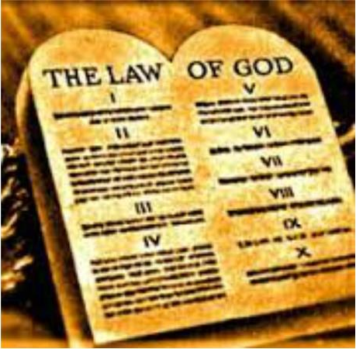
Mrs. White Sheds Some Light on Judgment Scene
“Every man's work passes in review before God and is registered for faithfulness or unfaithfulness. Opposite each name in the books of heaven is entered with terrible exactness every wrong word, every selfish act, every unfulfilled duty, and every secret sin, with every artful dissembling. Heaven-sent warnings or reproofs neglected, wasted moments, unimproved opportunities, the influence exerted for good or for evil, with its far-reaching results, all are chronicled by the recording angel. The law of God is the standard by which the characters and the lives of men will be tested in the judgment.” GC, 482

Slide 24
Explain the time of the end and the Reformation, restoring the Sanctuary
Elijah and the restoration of the altar
Explain the Millerite movement and the 2300 days as the only ones who understood the significance of this passage
Walk through the events and the errors, highlight the importance of the sanctuary throughout
Loughborough’s account, etc.

Slide 25
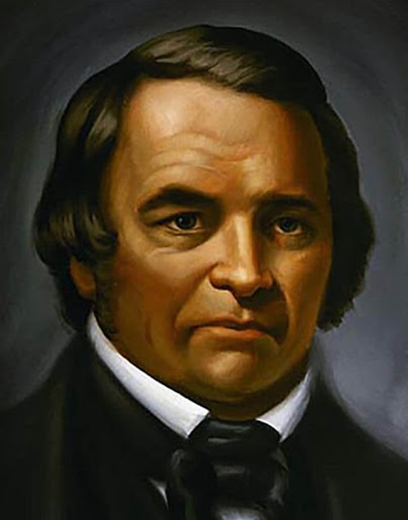
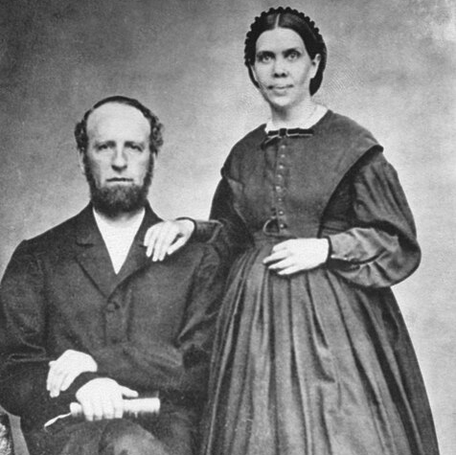
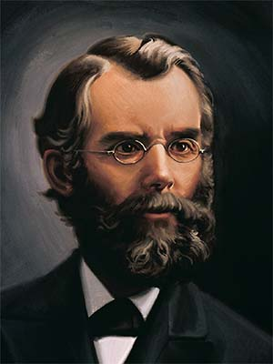
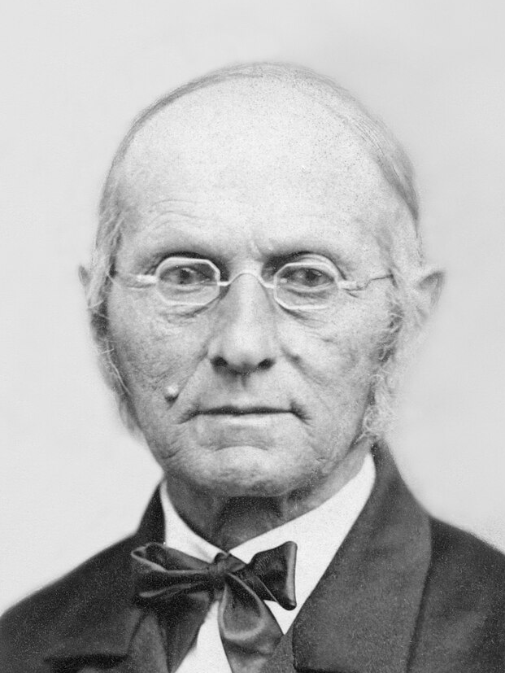
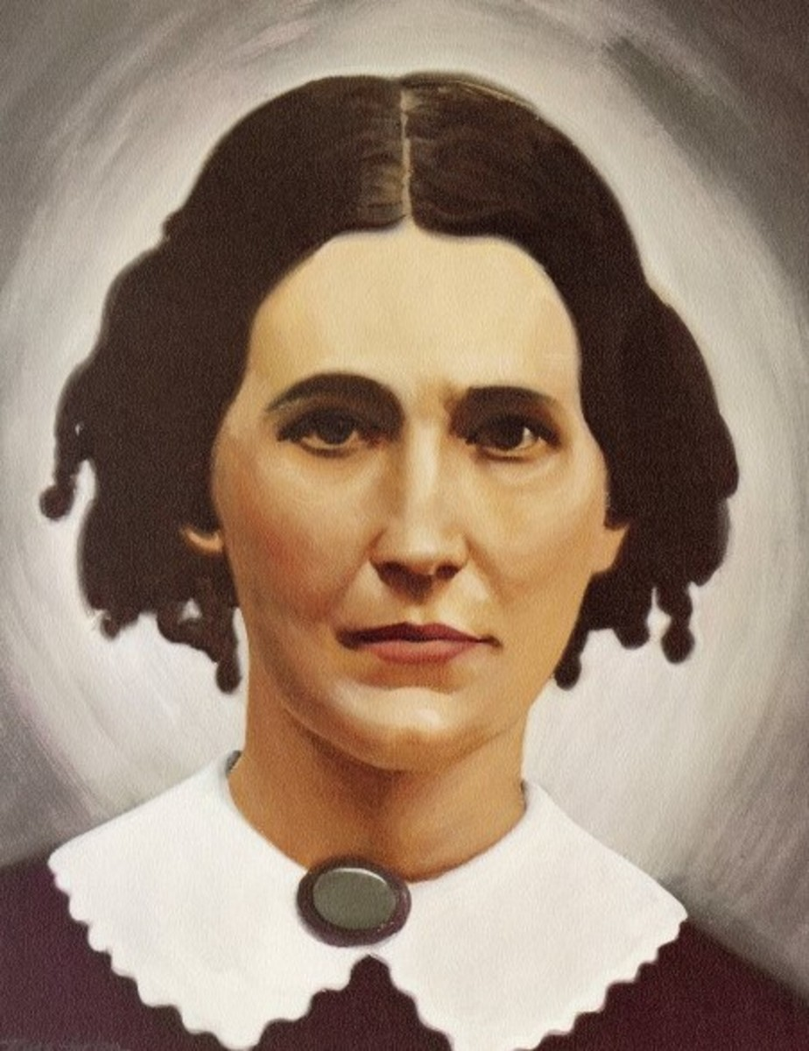
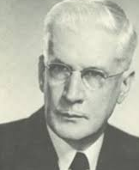
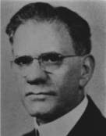
The Fruits Testify…
William Miller’s Millerite Movement bore massive fruits. Picking up where the Reformation stalled, the Millerites began studying the Bible like never before and rediscovered important Bible truths like: The State of the Dead, Prophecies of Daniel and Revelation, The Sabbath, The Investigative Judgment, The Sanctuary, Atonement, Health Principles, Binding Claims of the Law of God, Righteousness by Faith, Importance of Evangelism, Prayer, and Reading, Devotion Time, The Literal Second Coming of Christ, the Remnant, Present Truth, and more. The gift of the Spirit of Prophecy was given to Ellen White to guide this rediscovery. James and Ellen White [top right] devoted their lives to the proclamation of the 3rd Angel’s Message; Joseph Bates and Rachel Oaks [middle right] worked to reestablish the 7th Day Sabbath; John N. Andrews [middle left] was the 1st missionary to Europe and wrote the book The History of the Sabbath; Francis Nichol [bottom left] was an editor, sanitarium official, and apologetics author who wrote many works defending Adventism; Benjamin Wilkinson [bottom right] was a university professor and authored Truth Triumphant. Other names worthy of not include: JN Loughborough, Spalding & Magan, Stephen Haskell, Hyram Edson, Sylvester Bliss, ML Andreason, and many more…

Slide 26
William Miller (1782-1849): William Miller was an American Patriot and served in various offices of local government. In 1810, he moved to Poultney, Vermont where he shook off his Baptist upbringing in favor of Deism. He stated “I became acquainted with the principal men in that village [Poultney, Vermont], who were professedly Deists; but they were good citizens, and of a moral and serious deportment. They put into my hands the works of Voltaire, [David] Hume, Thomas Paine, Ethan Allen, and other deistical writers.” (Miller, William (1845). Wm. Miller's Apology and Defence. Boston, p. 24). However everything changed when he served as a captain in the War of 1812, where at the victory of the Battle of Plattsburgh (Sept. 6-11, 1814) it was evident that God had intervened on behalf of the heavily outmanned and outgunned American forces—Miller survived the battle without so much as a scratch. Recounting the affair, he said: “It seemed to me that the Supreme Being must have watched over the interests of this country in an especial manner, and delivered us from the hands of our enemies... So surprising a result, against such odds, did seem to me like the work of a mightier power than man” (Bliss, Sylvester (1853). Memoirs of William Miller, p. 32, 53). Miller was discharged from the military in 1815, and began attending the Baptist Church again in Low Hampton, NY. At this time he retained deistic views of God, until one Sunday he was volunteered to read the pastor’s sermon to the congregation during one the pastor’s absences. It was about the duty of parents to children. William Miller was so touched by the sermon that he choked up while reading; in his own words: “Suddenly the character of a Savior was vividly impressed upon my mind. It seemed that there might be a Being so good and compassionate as to Himself atone for our transgressions, and thereby save us from suffering the penalty of sin. I immediately felt how lovely such a Being must be; and imagined that I could cast myself into the arms of, and trust in the mercy of, such a One.” (Miller, William (1845). Wm. Miller's Apology and Defence, p. 5). Miller was converted and renounced Deism. When challenged by his former Deist friends on “contradictions” in the Bible, Miller undertook to reconcile these apparent “contradictions”—trusting that the Bible would render sufficient answers to these questions.

Slide 27
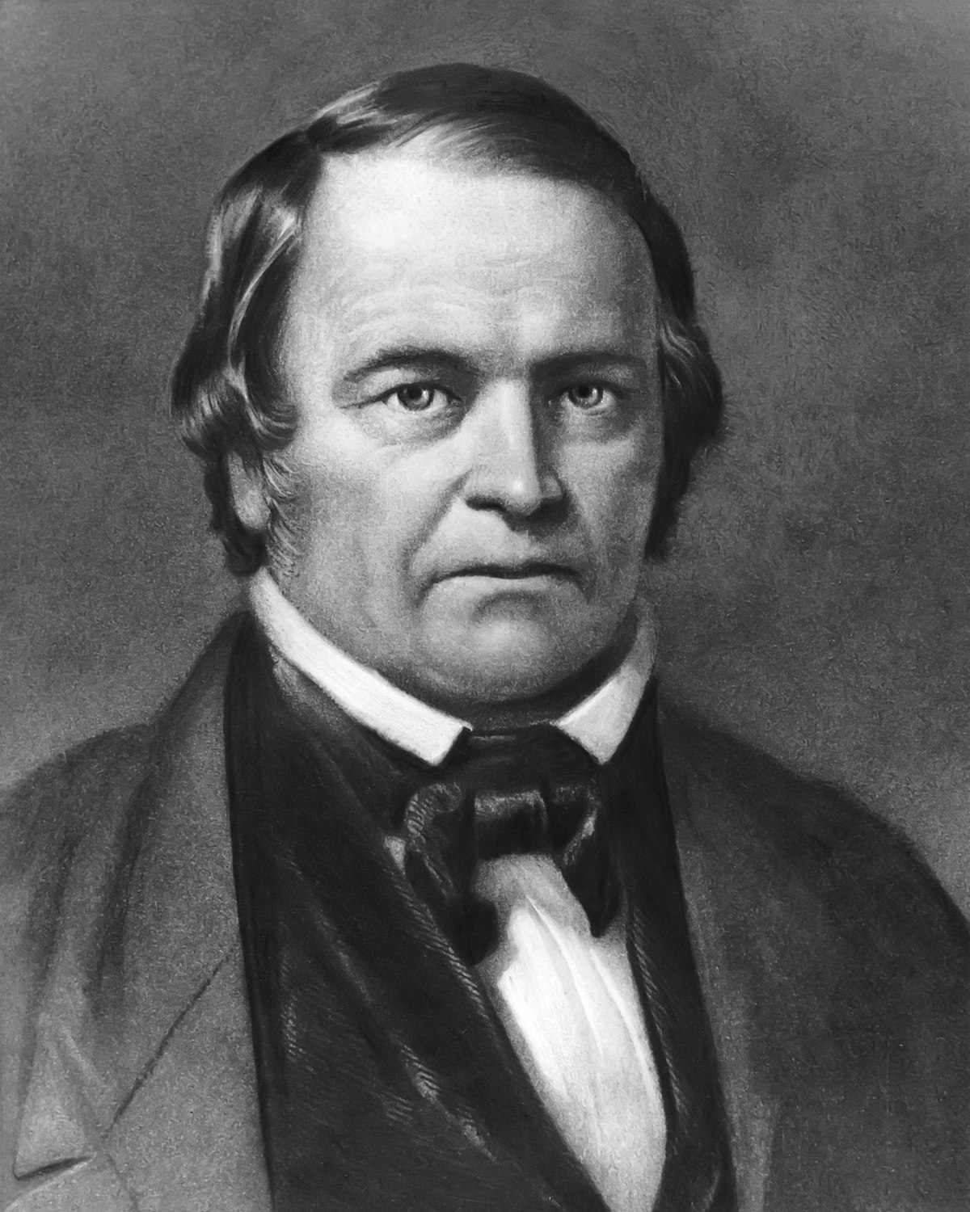
Trusting in the Bible as the Word of God, capable of giving satisfying answers to all perceived “errors” and “contradictions” William Miller began studying the Bible intensely in 1816; beginning with Genesis 1:1. By 1818 he was studying the Book of Daniel. He calculated the 2300 days mentioned in Daniel 8:14 using the Day-Year Principle to end in 1843/1844— identifying the decree to restore and build Jerusalem from Persian King Artaxerxes I in 457BC as the starting point for the prophecy (from Daniel 9:24-27). He interpreted the passage: “then shall the Sanctuary be cleansed” (Dan. 8:14) as meaning that Jesus Christ would Return to “cleanse” the earth by fire at the close of the 2300 day/year period. In 1818, he stated: “I was thus brought... to the solemn conclusion, that in about twenty-five years from that time 1818 [ending in 1843] all the affairs of our present state would be wound up” (Miller, William (1845). Wm. Miller's Apology and Defence, p. 11-12). He continued studying his views to be sure of his interpretation. Finally in 1831 he gave his first formal lecture in the town of Dresden, NY. In 1832, Miller submitted a series of articles to the Vermont Telegraph outlining his understanding of the prophecies he had been studying. The response was overwhelming: “I began to be flooded with letters of inquiry respecting my views; and visitors flocked to converse with me on the subject” (Miller, William (1845). Wm. Miller's Apology and Defence, p. 24). Unable to meet the numerous requests, Miller published: Evidence from Scripture and History of the Second Coming of Christ, about the Year 1844: Exhibited in a Course of Lectures in 1834 so that all could read about what he had discovered in the prophecies of Daniel and Revelation. In 1840, the movement grew when Joshua V. Himes allied with Miller, publishing Signs of the Times and organizing lectures for William Miller. When pressed by the people to apply a specific date for the Second Coming, Miller caved, and in 1843 predicted: “My principles in brief, are, that Jesus Christ will come again to this earth, cleanse, purify, and take possession of the same, with all the saints, sometime between March 21, 1843, and March 21, 1844” (Dick, Everett N. (1994). William Miller and the Advent Crisis, p. 96–97).

Slide 28
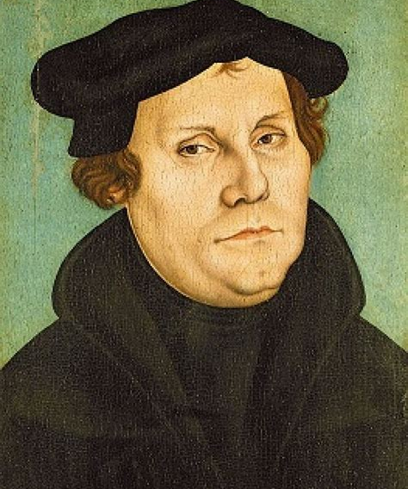
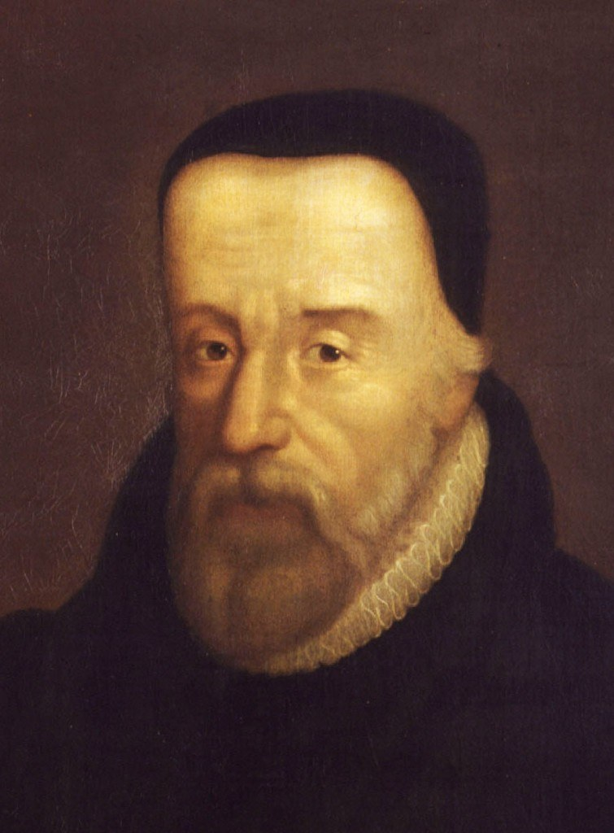
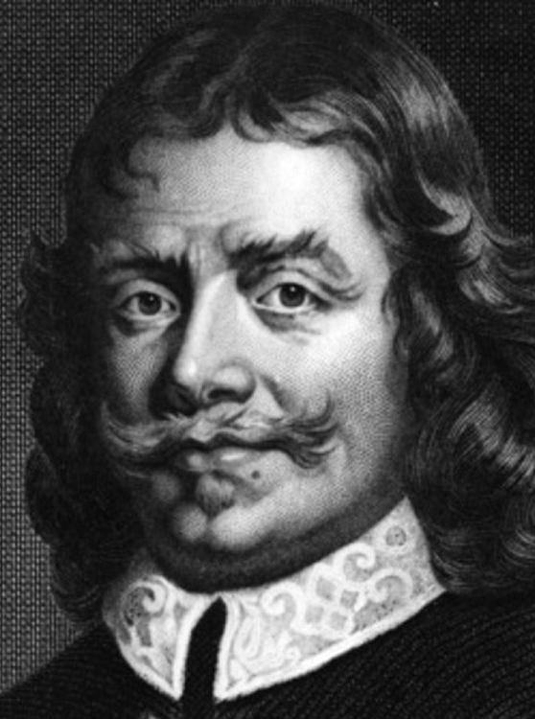
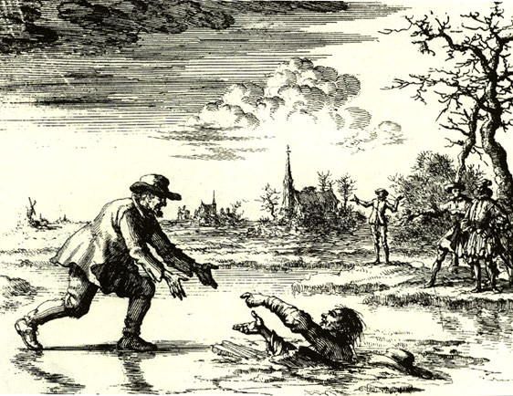
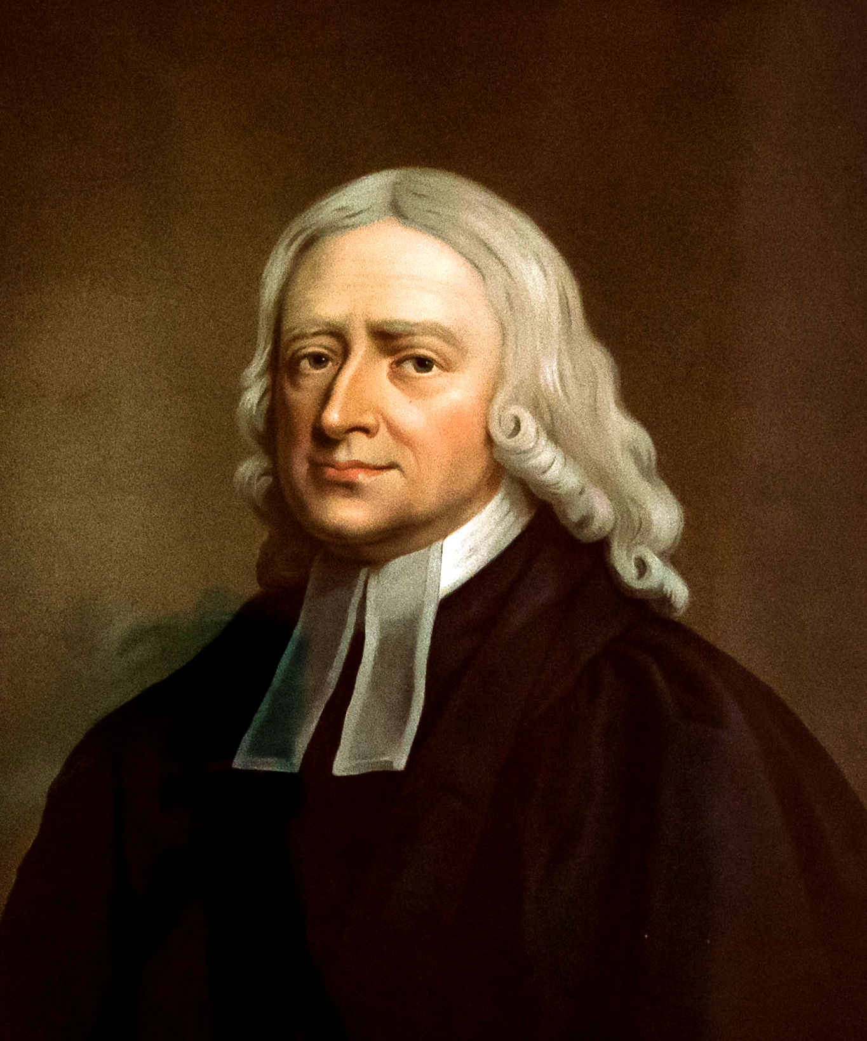
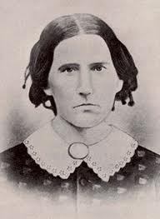

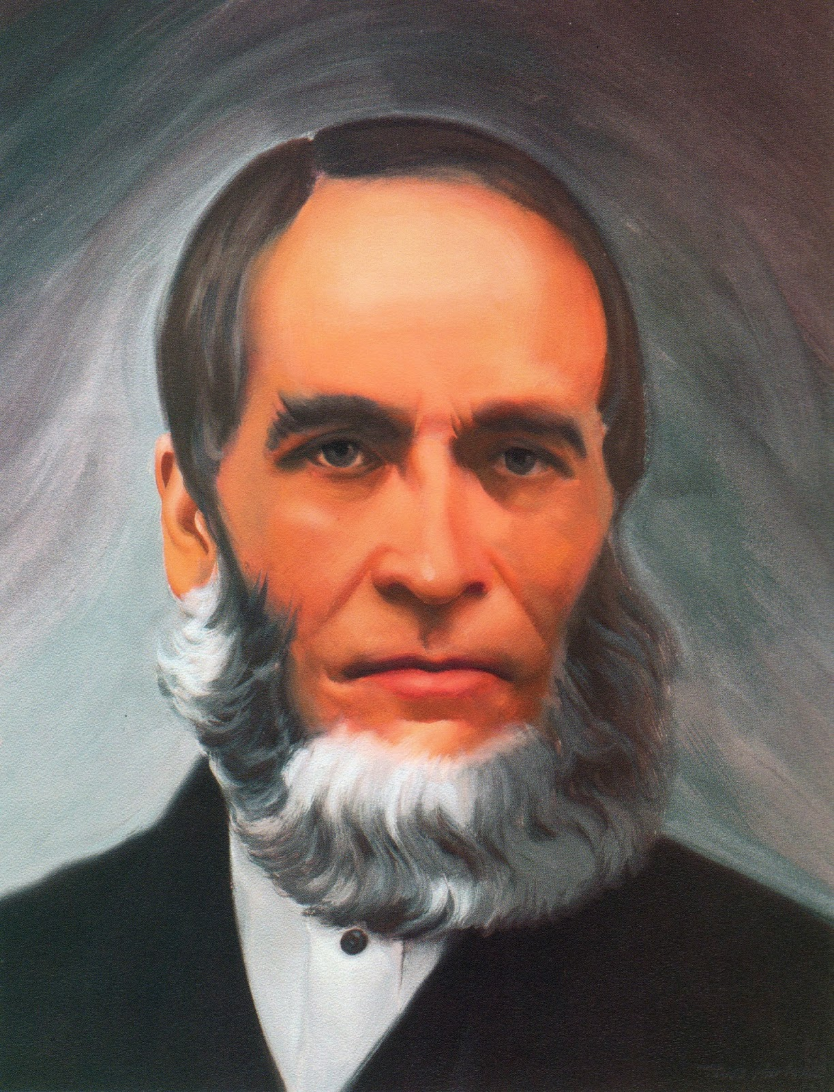
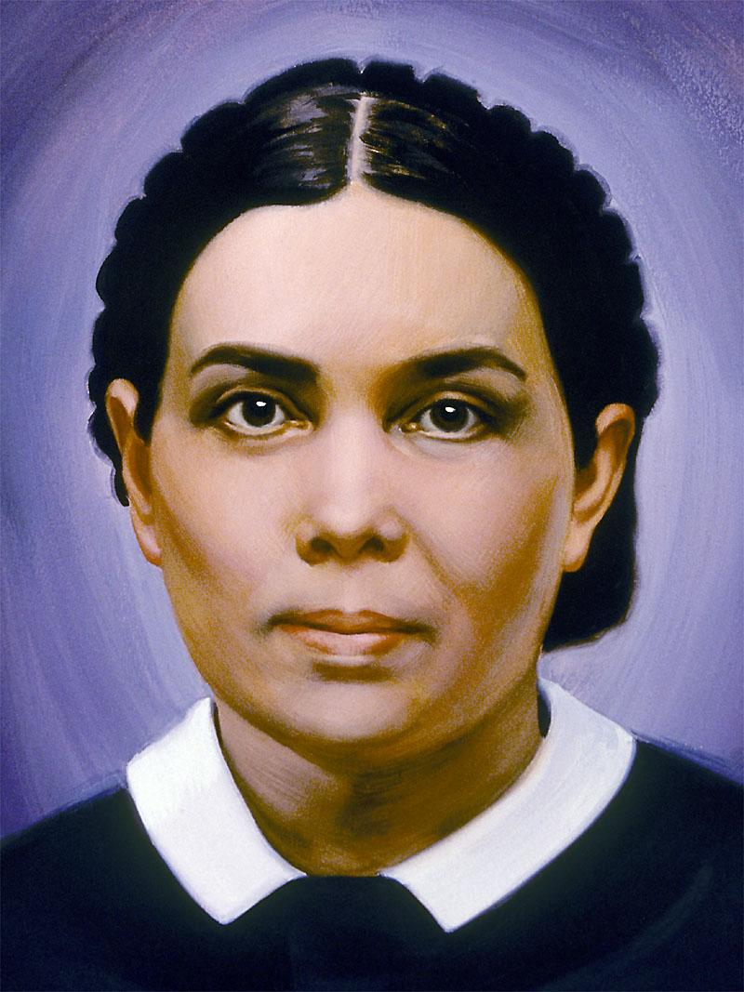

The Reformation Began Recovering the Sanctuary
The Reformation Rediscovered lost truths of the Sanctuary—effectively beginning the process of restoring the spiritual Sanctuary, culminating in the full restoration by Christ in 1844:
Justification by Faith – Altar of Burnt Offering Restored
Baptism and Communion – Laver and Drink Offering Restored
Sola Scriptura – Daily Bread/Shewbread Restored
Evangelism – Candlestick Restored
Prayer in the Spirit – Altar of Incense Restored
Righteousness by Faith – Merits of Christ/incense and oil restored
1844
7. Sabbath – Law of God Restored
8. Health Message – Manna Restored
9. Justification By Faith – Aaron’s Rod/Mercy Seat Restored
10. 3 Angel’s Messages – Judgment Hour/Day of Atonement Message Restored
11. State of the Dead – Investigative Judgment Understanding Restored

