Slide 1
What is the Difference Between Mormons, Jehovah’s Witnesses, and Seventh-day Adventists? pt 24

Slide 2
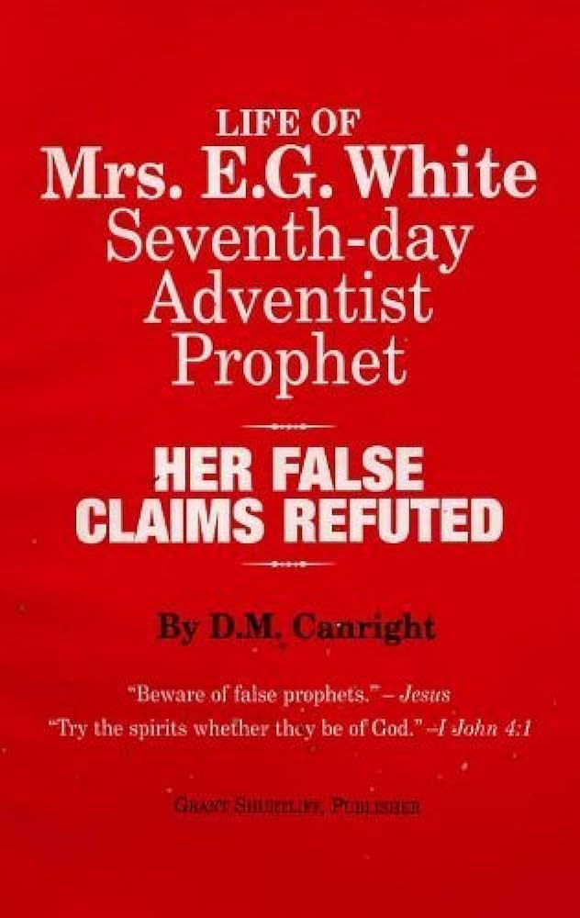
His Final Legacy….
“Canright died on May 12, 1919. Two months later, his final book, The Life of Mrs. E.G. White, was published. In it he criticised White heavily and maintained, among other charges:
that the early doctrines held in 1844 and up to 1851 failed utterly[—SHUT DOOR]
that in some cases her prophecies were wrong, and then suppressed afterwards[—FAILED PROPHECIES]
that she rebuked and controlled peoples' conduct, purportedly by spiritual knowledge, but factually by informings that often attacked an innocent party[—ELLEN WHITE CHARACTER ASSASSINATION]
that she plagiarized many of her purportedly God-inspired texts from other authors, and had to revise one of her books at an expense of $3,000[—PLAGIARISM]” DM Canright, Wikipedia

Slide 3
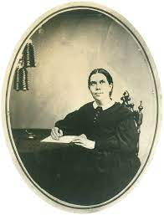
The Open and Shut Door
The “Shut Door” Theory was a very prominent belief among SDAs and FDAs in the years following the Great Disappointment in 1844. Many SDAs, including Ellen White (Harmon) believed this false doctrine. From 1844 to about 1851 articles in Present Truth, Day Star, and sermons by prominent Adventists, even William Miller taught this doctrine. What was it? It was the idea that the door of mercy was shut for the world after 1844 and that no new believers could be saved. Eventually, Ellen White received direct counsel concerning this doctrine—it was a false doctrine, but only in part. Let’s look at the critique, then the history, and see if there is not a reasonable answer to this mystery…

Slide 4
Canright’s Arguments ONLY: No Plagiarism Here!
“Seventh-day Adventists at first adopted the sanctuary theory to prove that the door of mercy was shut in 1844, a theory which Mrs. White and all of them held at that time. Here is my proof on this point: Ann Arbor, Mich., Dec. 1 1887. Elder D.M. Canright: "I kept the seventh day nearly a year, about 1848. In 1846 I explained the idea of the sanctuary in an article in an extra double number of the Day Star, Cincinnati, O. The object of that article was to support the theory that the door of mercy was shut, a theory which I and nearly all Adventists who had adopted William Miller's views, held from 1844 to 1848. Yes, I KNOW that Ellen G. Harmon - now Mrs. White - held the shut door theory at that time." Truly yours, O.R.L. Crosier. Now listen to Mrs. White: Topsham, Me., April 21, 1847. "...The Lord showed me in vision more than one year ago, that Brother Crosier had the true light on the cleansing of the sanctuary, etc., and that it was his will that Bro. C. should write out the view which he gave us in the Day Star (extra), Feb 7, 1846. I fell fully authorized by the Lord to recommend that extra to every saint...." E.G. White, "A Word to the Little Flock," pages 11,12.” Dudley Canright, Seventh-day Adventism Renounced, Ch. 7: The Sanctuary

Slide 5
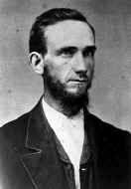
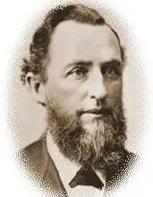
James White and Uriah Smith Too!?!?
“Here you have the origin and object of that sanctuary theory. Before me lies "The Present Truth," Vol. I, No. 6, December, 1849, by James White. "The Shut Door Explained," is the leading article, in which it is argued from the type Lev. 16:17, that when the high priest entered the Most Holy there could be no more pardon for sin. "On this day of atonement he is a high priest for THOSE ONLY whose names are inscribed on the bread-plate of judgment," page 44. No more salvation for sinners, is what their sanctuary theory was then used to prove. The whole volume is full of this idea. 6. Their argument from the type on this point was right; in the type no sin could be confessed and conveyed into the sanctuary after the high priest entered the Most Holy. Lev. 4:1-7; 16:17,23,24. So if this was a type of the entrance of Christ into the Most Holy in heaven in 1844, then truly the door of mercy did close there, and all sinners since are lost.” Ibid., Ch. 7: The Sanctuary

Slide 6
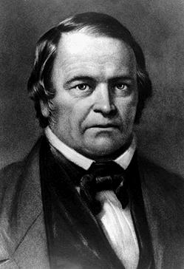
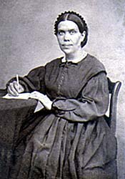
Her Own Words…
“For a time after the disappointment in 1844, I did hold in common with the advent body that the door of mercy was then forever closed to the world. This position was taken before my first vision was given me. It was the light given me of God that corrected our error and enabled us to see the true position. I am still a believer in the shut-door theory, but not in the sense in which we at first employed the term or in which it is employed by my opponents” (Manuscript 4, 1883)

Slide 7
Her First Vision…
“While I was praying at the family altar, the Holy Ghost fell upon me, and I seemed to be rising higher and higher, far above the dark world. I turned to look for the Advent people in the world, but could not find them, when a voice said to me, “Look again, and look a little higher.” At this I raised my eyes, and saw a straight and narrow path, cast up high above the world. On this path the Advent people were traveling to the city, which was at the farther end of the path. They had a bright light set up behind them at the beginning of the path, which an angel told me was the midnight cry. This light shone all along the path and gave light for their feet so that they might not stumble. If they kept their eyes fixed on Jesus, who was just before them, leading them to the city, they were safe. But soon some grew weary, and said the city was a great way off, and they expected to have entered it before. Then Jesus would encourage them by raising His glorious right arm, and from His arm came a light which waved over the Advent band, and they shouted, “Alleluia!” Others rashly denied the light behind them and said that it was not God that had led them out so far. The light behind them went out, leaving their feet in perfect darkness, and they stumbled and lost sight of the mark and of Jesus, and fell off the path down into the dark and wicked world below.” EW, p. 14-15 (32-33)

Slide 8
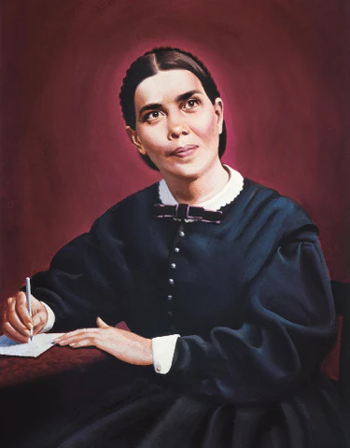
The Nail in the Coffin!!!
Camden, N. Y., June 29, 1851: “Then I saw that Jesus prayed for his enemies, but that should not cause us to pray for the wicked world, whom God had rejected. When he prayed for his enemies, there was hope for them, and they could be benefited and saved by his prayers, and also after he was a mediator in the outer apartment for the whole world; but now his spirit and sympathy were withdrawn from the world; and our sympathy must be with Jesus, and must be withdrawn from the ungodly.... I saw that the wicked could not be benefited by our prayers now.”

Slide 9
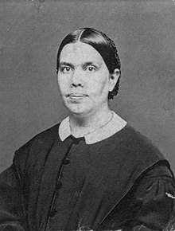
The Conclusion….
Ellen White believed a false doctrine as a 17 year old girl immediately following 1844
William Miller, James White and other Prominent Adventists believed and taught this doctrine for years following 1844, connecting the shut-door with the Sanctuary DoA—no more offering for sin
Ellen White received in vision that ORL Crosier’s Day-Star Extra had the correct view of the Sanctuary and recommended it to every saint---in Crosier’s own words, he wanted to prove that the door of mercy was shut
Ellen White admitted she believed this doctrine but claimed that her first vision corrected the shut-door theory. It appears to have confirmed the false doctrine
A Writing Alleged to have been from Ellen White from June 29, 1851 Camden appears to confirm in vision with authority from God, that the world was lost
Is it over for Ellen White??? Or there more to the story???

Slide 10
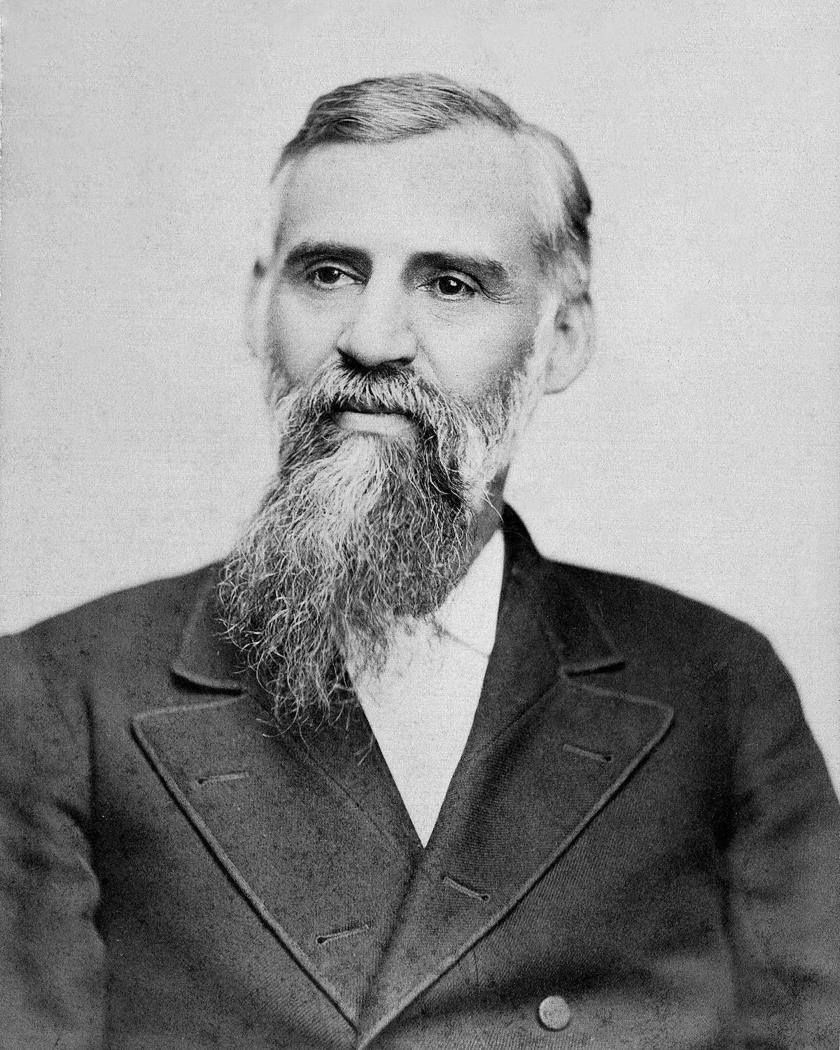
G.I. Butler’s Challenge
“We are sure from personal knowledge that we have nothing to fear from the most scrutinizing investigation of early Advent history. The more closely it is investigated, the better it will be for the cause; it is only a partial knowledge of the facts that we need to fear. When we understand all about the facts connected with the "shut door doctrine," as it is called, we shall find nothing of which we need to be ashamed.” R&H, Feb. 10, 1885

Slide 11
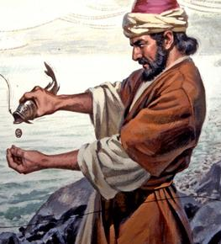
Can a Prophet Be Wrong or Side-Tracked/Misunderstand Something???
Answer: YES! 1 Pet. 1:10-12 “Of which salvation the prophets have enquired and searched diligently, who prophesied of the grace that should come unto you: Searching what, or what manner of time the Spirit of Christ which was in them did signify, when it testified beforehand the sufferings of Christ, and the glory that should follow. Unto whom it was revealed, that not unto themselves, but unto us they did minister the things, which are now reported unto you by them that have preached the gospel unto you with the Holy Ghost sent down from heaven; which things the angels desire to look into.”

Slide 12
Other Examples…
Prophet Nathan gave permission to David to build the Temple of God, then received vision that David was NOT to do it! (1 Chron. 17:1-4)
Peter believed the Gentiles were “unclean”, but God gave him vision which corrected the view (Acts 10:10-48)—Paul later had correct Peter again on this very issue (Gal. 2:11-14)
Daniel misunderstood his vision about the evening-mornings, and even fainted when the angel Gabriel confirmed the time-period of 2300 day/years (Daniel 8:14, 26-27)—But after studying Jeremiah, Daniel understood that Jerusalem was to be rebuilt after 70 years, and that the prophecy pertains to something else (Dan. 9:3)
Jonah first refused to give his vision to Ninevah, then was upset after he gave it and it led to repentance which averted the warning message God had for Ninevah (Jonah)
The prophet from Judah who rebuked Jeroboam was killed by a lion for listening to the lies of the old prophet Bethel (1 Kings 13)
Balaam was a disobedient prophet-for-hire who gave Balak the advice on how to destroy Israel (Num. 22-24; Num. 31, Rev. 2:14)
Prophets are human, they CAN make mistakes in their beliefs—but which of these prophets visions was a false prophecy? Not One!

Slide 13
Where does the Shut-Door Doctrine Come From—the Sanctuary or Somewhere Else???
“17. Then they said the door was shut, Matt. 25:10; now they say that this was wrong; it is open yet. Thus: "There can be no other place for the shut door but at the autumn of 1844." Elder White, in Present Truth, May 1850. "The door is still open, and other guests may come." U. Smith, in Parable of the Ten Virgins, page 17, February, 1889. These are the people who always KNOW they are just right!” Canright, Seventh-day Adventism Renounced, Ch. IV

Slide 14
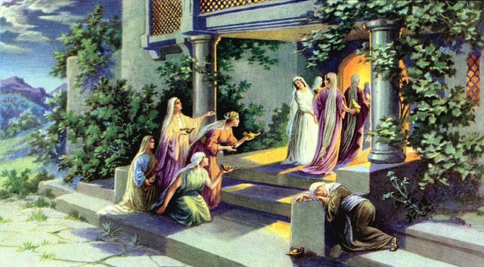
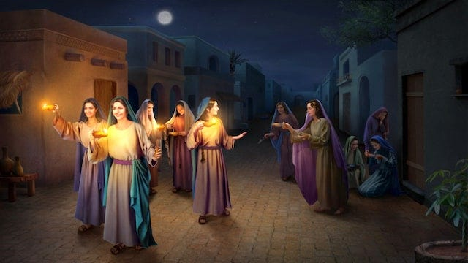
10 Virgins NOT the Sanctuary!
Matt. 10:6-13 “And at midnight there was a cry made, Behold, the bridegroom cometh; go ye out to meet him. Then all those virgins arose, and trimmed their lamps. And the foolish said unto the wise, Give us of your oil; for our lamps are gone out. But the wise answered, saying, Not so; lest there be not enough for us and you: but go ye rather to them that sell, and buy for yourselves. And while they went to buy, the bridegroom came; and they that were ready went in with him to the marriage: and the door was shut. Afterward came also the other virgins, saying, Lord, Lord, open to us. But he answered and said, Verily I say unto you, I know you not. Watch therefore, for ye know neither the day nor the hour wherein the Son of man cometh.”

Slide 15
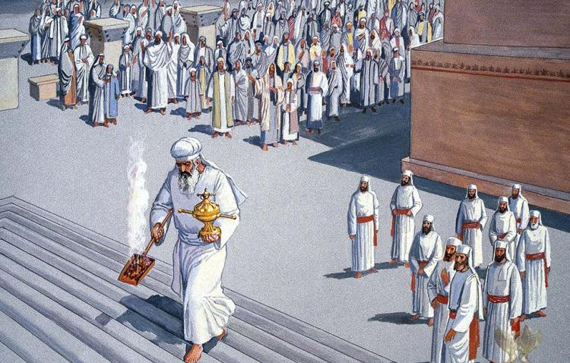
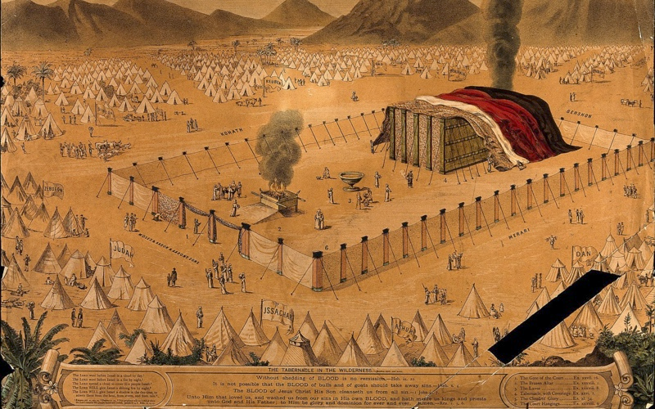
No More Sacrifice for sins after DoA Begins?
Lev. 23:27-32 “Also on the tenth day of this seventh month there shall be a day of atonement: it shall be an holy convocation unto you; and ye shall afflict your souls, and offer an offering made by fire unto the Lord. And ye shall do no work in that same day: for it is a day of atonement, to make an atonement for you before the Lord your God. For whatsoever soul it be that shall not be afflicted in that same day, he shall be cut off from among his people. And whatsoever soul it be that doeth any work in that same day, the same soul will I destroy from among his people. Ye shall do no manner of work: it shall be a statute for ever throughout your generations in all your dwellings. It shall be unto you a sabbath of rest, and ye shall afflict your souls: in the ninth day of the month at even, from even unto even, shall ye celebrate your sabbath.”

Slide 16
“Afflict Your Souls” Meant…
Afflict: 6031 anah (an-naw’): afflict, humble, force, exercised, sin, troubled, weakened, 1) to be occupied, be busied with 2) to afflict, oppress, humble, be afflicted, be bowed down 1) to be put down, become low 2) to be depressed, be downcast
Soul: 5315 nephesh (neh’-fesh): soul, self, life, creature, person, appetite, mind, living being, desire, emotion, passion 1a) that which breathes, the breathing substance or being, soul, the inner being of man 1b) living being 1c) living being (with life in the blood) 1d) the man himself, self, person or individual 1e) the seat of the appetites 1f) seat of emotions and passions 1g) activity of the mind
“To humble/afflict/bowdown yourself/mind/heart/appetite/passion to the will of God.”

Slide 17
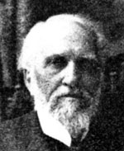
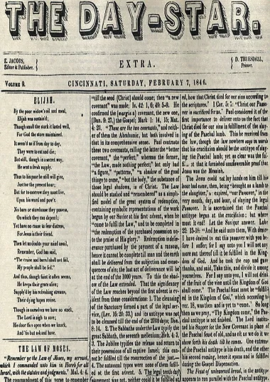
Dudley’s Dud: ORL Crosier’s Day-Star Endorsement
ORL Crosier’s Day-Star speaks nothing about the shut door. Critics of Ellen White are careful not quote ORL Crosier’s article, because the shut-door doctrine is not discussed in the Day-Star Extra. What is discussed in the Day-Star Extra of Feb. 7, 1846 is: The earthly and heavenly Sanctuary, the daily & yearly offerings, the High Priesthood of Christ, the types and Antitypes, the scapegoat, the cleansing of the sanctuary, the Day of Atonement—all of which are correct. I challenge any Adventist who has an issue with ORL Crosier claiming that the Day-Star Extra established the “shut-door” doctrine to go and read it yourself. Moreover, ORL Crosier fell away from Seventh-day Adventism and later renounced his belief in the Sanctuary doctrine altogether—by 1887 Crosier is not in the congregation anymore, by 1899 Crosier’s account is published in “The Sabbath Advocate, March 7, 1899” for Church of God Seventh Day

Slide 18
The Conclusion….
Ellen White believed a false doctrine as a 17 year old girl immediately following 1844—prophets can be privately wrong!
William Miller, James White and other Prominent Adventists believed and taught this doctrine for years following 1844, connecting the shut-door with the Sanctuary DoA—no more offering for sin—DoA does NOT teach door of mercy to be shut!
Ellen White received in vision that ORL Crosier’s Day-Star Extra had the correct view of the Sanctuary and recommended it to every saint---in Crosier’s own words, he wanted to prove that the door of mercy was shut—Crosier’s Day-Star Extra doesn’t talk about the “shut-door” doctrine + Crosier fell away
Ellen White admitted she believed this doctrine but claimed that her first vision corrected the shut-door theory. It appears to have confirmed the false doctrine
A Writing Alleged to have been from Ellen White from June 29, 1851 Camden appears to confirm in vision with authority from God, that the world was lost

Slide 19
Vision in Camden in 1851
The critics of Ellen White love to publish this manuscript as proof that Ellen White NOT only believed the shut-door doctrine herself, but that “the LORD” gave her vision concerning the concept that the door of mercy was shut for the world. The problems with this “vision” are as follows:
1. The argument comes from a vehement opponent of Ellen White, an ex-Adventist R.R. Chapin 1850-1853, then joined the off-shoot “Messenger Party” led by HS Case & CP Russell who were determined to prove Ellen White to be a false prophet—that’s the source! It’s not a manuscript or letter or book by EGW, it’s a recollection of her vision in Camden, NY in 1851, Jun. 29—solid stuff!
2. No copy of this “vision” in Ellen White’s handwriting has ever been produced
3. Ellen White was not in Camden on June 29, 1851: “Our Post Office address from the 18th to the 23d of June will be Camden N. Y. From the 25th to the 30th of June, West Milton, Saratoga Co. N. Y. After that our address will be Paris, Me.”—R&H, June 9, 1851, p. 104
4. The only reference to a situation in Camden (but it’s in the winter) comes from Loughborough in 1849-1850. He receives a second-hand account from a Mr. Preston about a hypocritical women who Mrs. White had a vision where she informed them not to pray for her (Is this the kernel of truth this lie is built on???) (see. Loughborough, Great Second Advent Movement, p. 233)

Slide 20
Ellen White Shut-Door Full Context…
“For a time after the disappointment in 1844, I did hold in common with the advent body that the door of mercy was then forever closed to the world. This position was taken before my first vision was given me. It was the light given me of God that corrected our error and enabled us to see the true position. I am still a believer in the shut-door theory, but not in the sense in which we at first employed the term or in which it is employed by my opponents. There was a shut door in Noah’s day. There was at that time a withdrawal of the Spirit of God from the sinful race that perished in the waters of the flood. God Himself gave the shut door message to Noah: “My Spirit shall not always strive with man, for that he also is flesh: yet his days shall be an hundred and twenty years.” [Genesis 6:3.] There was a shut door in the days of Abraham. Mercy ceased to plead with the inhabitants of Sodom, and all but Lot, with his wife and two daughters, were consumed by the fire sent down from heaven. There was a shut door in Christ’s day. The Son of God declared to the unbelieving Jews of that generation, “Your house is left unto you desolate.” [Matthew 23:38.] Looking down the stream of time to the last days, the same infinite power proclaimed through John: “These things saith he that is holy, he that is true, he that hath the key of David, he that openeth and no man shutteth; and shutteth, and no man openeth.” [Revelation 3:7.] I was shown in vision, and I still believe, that there was a shut door in 1844. All who saw the light of the first and second angel’s messages and rejected that light were left in darkness. And those who accepted it and received the Holy Spirit which attended the proclamation of the message from heaven and who afterward renounced their faith and pronounced their experience a delusion, thereby rejected the Spirit of God, and it no longer pleaded with them.” (Manuscript 4, 1883)

Slide 21
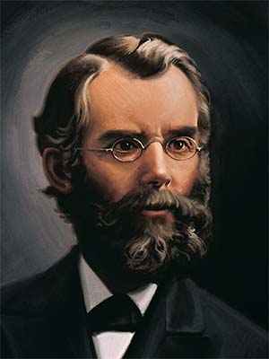
JN Andrews Agrees!
“J. N. Andrews, who resided in Paris, Maine, in 1844 and 1845, and who was fully conversant with the course of the people there, as well as with that of Joseph Turner, who taught that there was no more mercy for sinners, says of Miss-Harmon's position on the subject at that time, ‘Instead of the visions' leading them to adopt this view, it corrected those upon it who still held to it.’ [Letter of JN Andrews, Sept. 1874]” Loughborough, The Great Second Advent Movement, p. 222

Slide 22
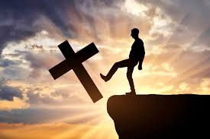
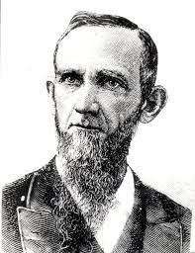
The Unpardonable Sin
Heb. 6:4-6 “For it is impossible for those who were once enlightened, and have tasted of the heavenly gift, and were made partakers of the Holy Ghost, And have tasted the good word of God, and the powers of the world to come, If they shall fall away, to renew them again unto repentance; seeing they crucify to themselves the Son of God afresh, and put him to an open shame.”
Mark 3:24-29 “And if a kingdom be divided against itself, that kingdom cannot stand. And if a house be divided against itself, that house cannot stand. And if Satan rise up against himself, and be divided, he cannot stand, but hath an end. No man can enter into a strong man's house, and spoil his goods, except he will first bind the strong man; and then he will spoil his house. Verily I say unto you, All sins shall be forgiven unto the sons of men, and blasphemies wherewith soever they shall blaspheme: But he that shall blaspheme against the Holy Ghost hath never forgiveness, but is in danger of eternal damnation.”

Slide 23
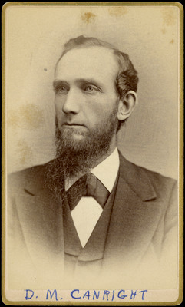
The Conclusion….
Ellen White believed a false doctrine as a 17 year old girl immediately following 1844—prophets can be privately wrong!
William Miller, James White and other Prominent Adventists believed and taught this doctrine for years following 1844, connecting the shut-door with the Sanctuary DoA—no more offering for sin—DoA does NOT teach door of mercy to be shut!
Ellen White received in vision that ORL Crosier’s Day-Star Extra had the correct view of the Sanctuary and recommended it to every saint---in Crosier’s own words, he wanted to prove that the door of mercy was shut—Crosier’s Day-Star Extra doesn’t talk about the “shut-door” doctrine + Crosier fell away
Ellen White admitted she believed this doctrine but claimed that her first vision corrected the shut-door theory. It appears to have confirmed the false doctrine—Only those who denied the light were lost
A Writing Alleged to have been from Ellen White from June 29, 1851 Camden appears to confirm in vision with authority from God, that the world was lost—This “vision” is not only not confirmed, but almost certainly false

Slide 24
What is the True “Open and Shut Door”?
“I saw that the present test on the Sabbath could not come until the mediation of Jesus in the holy place was finished and He had passed within the second veil; therefore Christians who fell asleep before the door was opened into the most holy, when the midnight cry was finished, at the seventh month, 1844, and who had not kept the true Sabbath, now rest in hope; for they had not the light and the test on the Sabbath which we now have since that door was opened. I saw that Satan was tempting some of God’s people on this point. Because so many good Christians have fallen asleep in the triumphs of faith and have not kept the true Sabbath, they were doubting about its being a test for us now. The enemies of the present truth have been trying to open the door of the holy place, that Jesus has shut, and to close the door of the most holy place, which He opened in 1844, where the ark is, containing the two tables of stone on which are written the ten commandments by the finger of Jehovah.” EW, p. 42-43 (57-58)

Slide 25
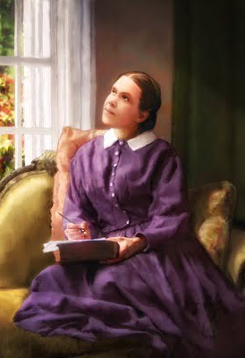
Word of Caution…
“Light and darkness, truth and error, are before us. We are free to choose. God will never remove all excuse for unbelief. Those who look for hooks to hang their doubts upon, will find them close at hand. It is far easier to suggest doubts than to inspire faith. Because the natural heart is at enmity with God, a greater effort is required to believe than to doubt the word of the Most High. And Satan himself opposes everything that would strengthen faith. There is one course which all must pursue who honestly desire to be freed from doubts. They are cherishing some indulgence forbidden by the word of God, or neglecting some duty enjoined therein. Let those who complain that they walk in darkness, give heed to the light which already shines upon them, and they will receive greater light. Let them do every duty which has been made plain to their understanding, and they will be enabled to understand and perform those of which they are now in doubt. “If any man will do His will, he shall know of the doctrine.” ST, June 8, 1882

