Slide 1
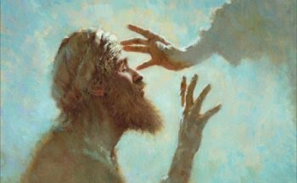

Slide 2
Behind the Door pt 15:
The Vatican Creation of Islam

Slide 3
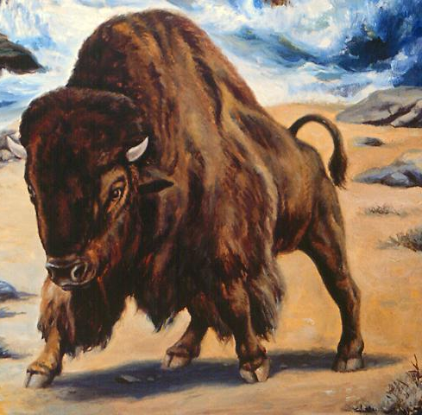
Rev. 13: 12-14 And he exerciseth all the power of the first beast before him, and causeth the earth and them which dwell therein to worship the first beast, whose deadly wound was healed. And he doeth great wonders, so that he maketh fire come down from heaven on the earth in the sight of men, And deceiveth them that dwell on the earth by the means of those miracles which he had power to do in the sight of the beast; saying to them that dwell on the earth, that they should make an image to the beast, which had the wound by a sword, and did live.

Slide 4
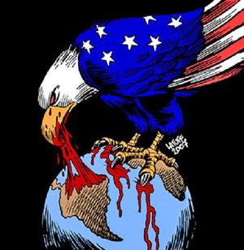

Slide 6
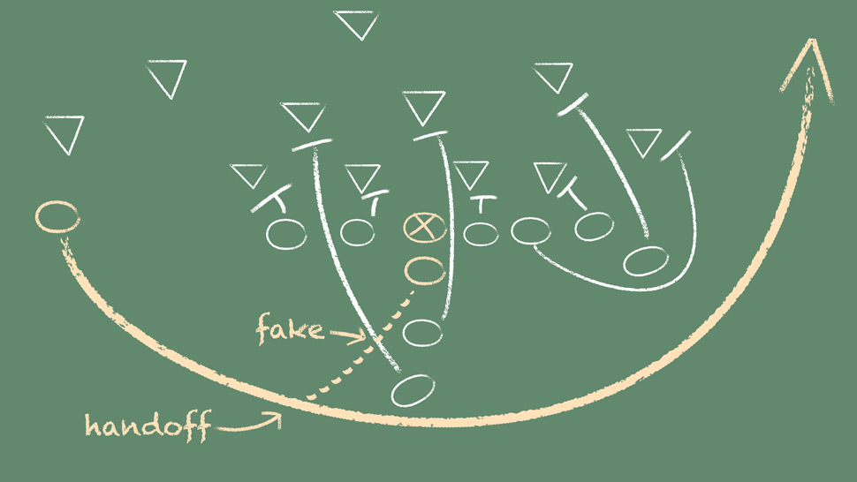

Slide 7
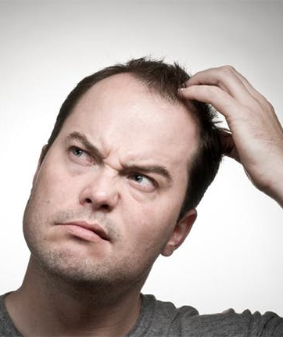
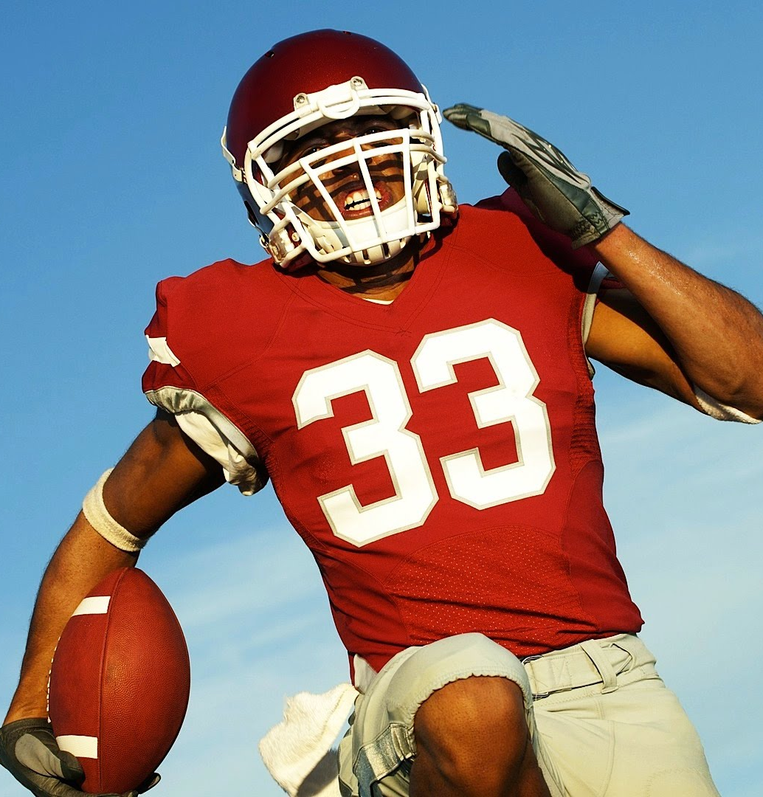

Slide 8
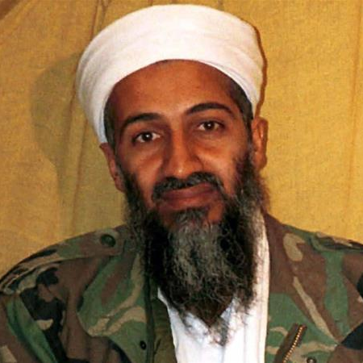
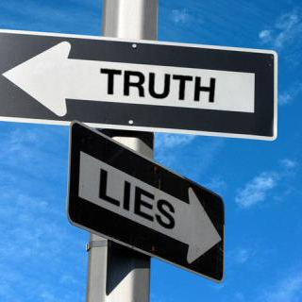
Look over here! This is the enemy!
Osama Bin Laden

Slide 9
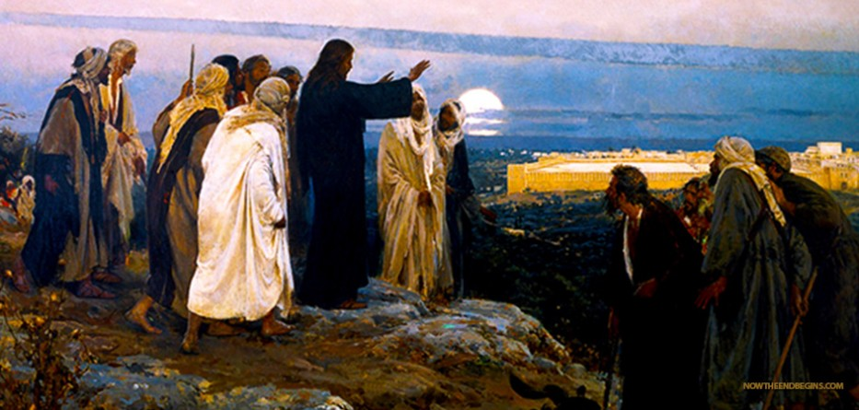
Mathew 24 :4-5, 11, 24 “And Jesus answered and said unto them, Take heed that no man deceive you. For many shall come in my name, saying, I am Christ; and shall deceive many. . . And many false prophets shall rise, and shall deceive many. . . For there shall arise false Christs, and false prophets, and shall shew great signs and wonders; insomuch that, if it were possible, they shall deceive the very elect.”

Slide 10
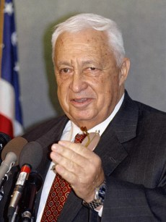
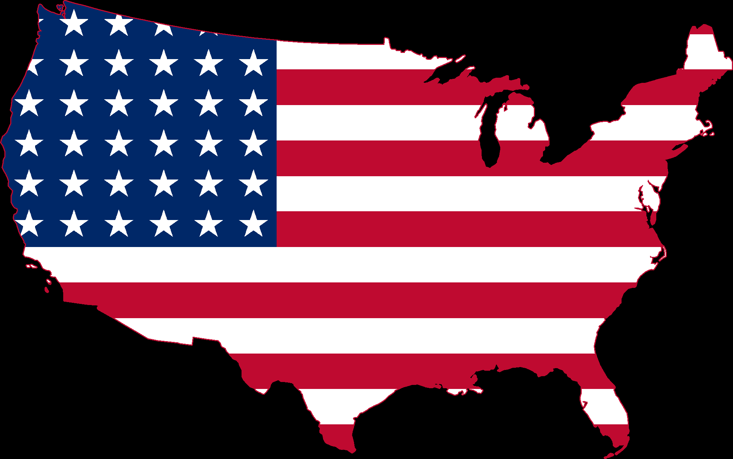
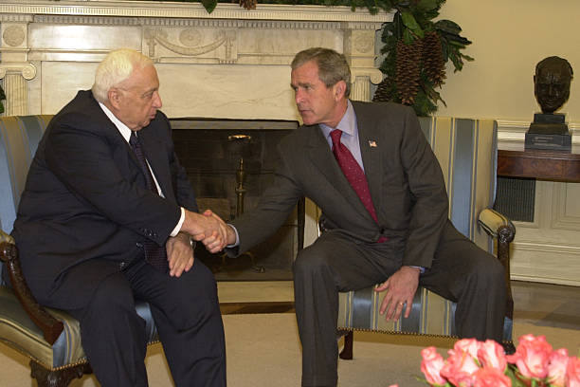
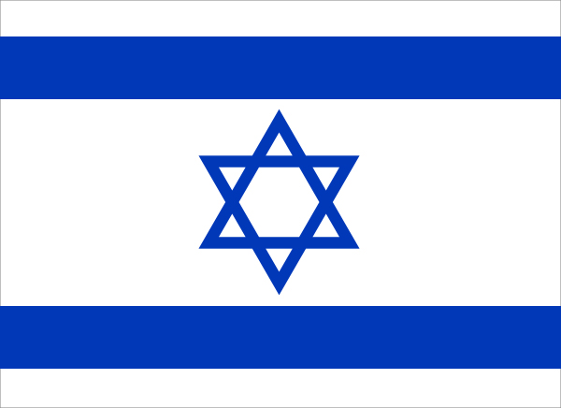
Ariel Sharon
George Bush

Slide 11
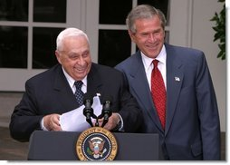
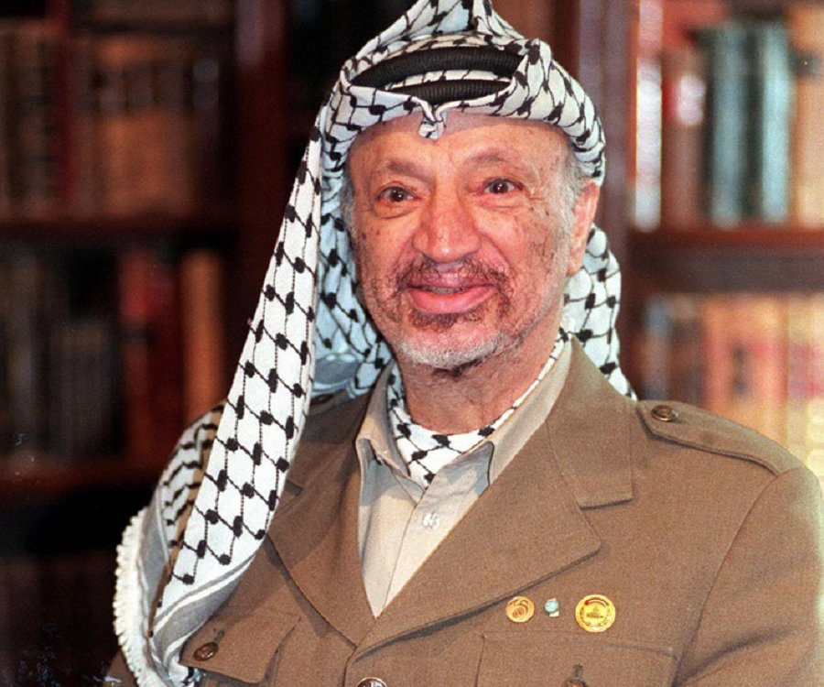
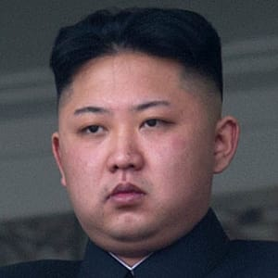
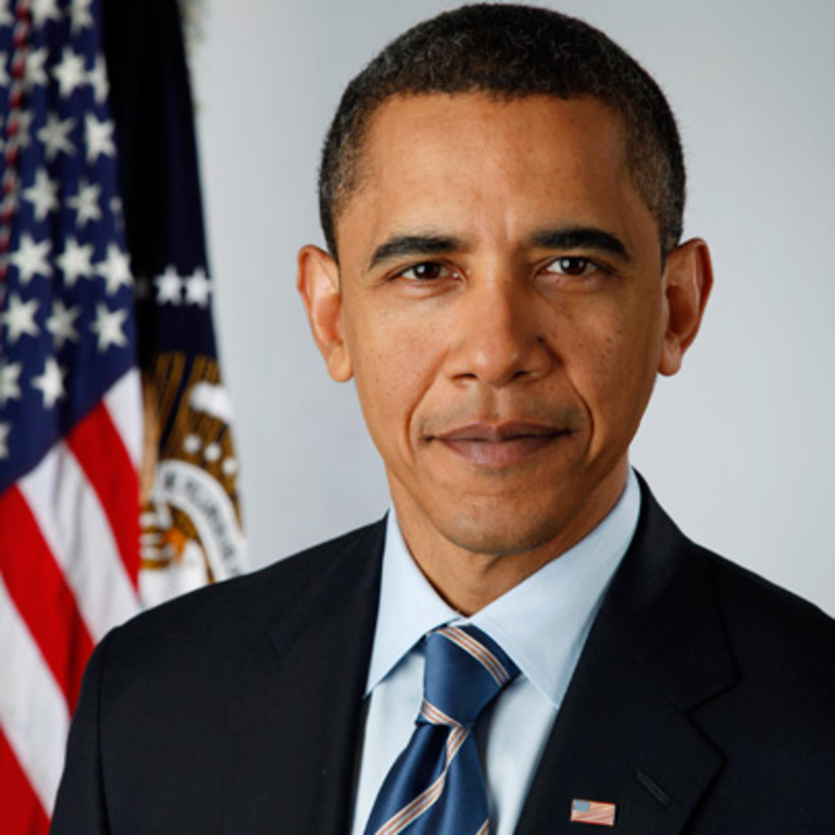
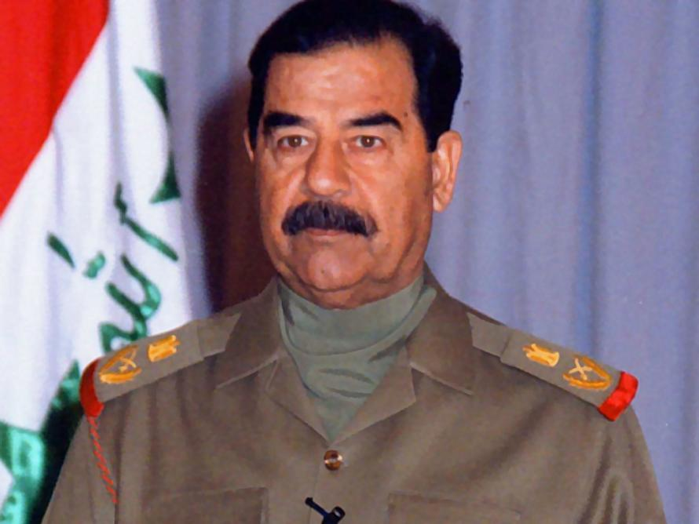
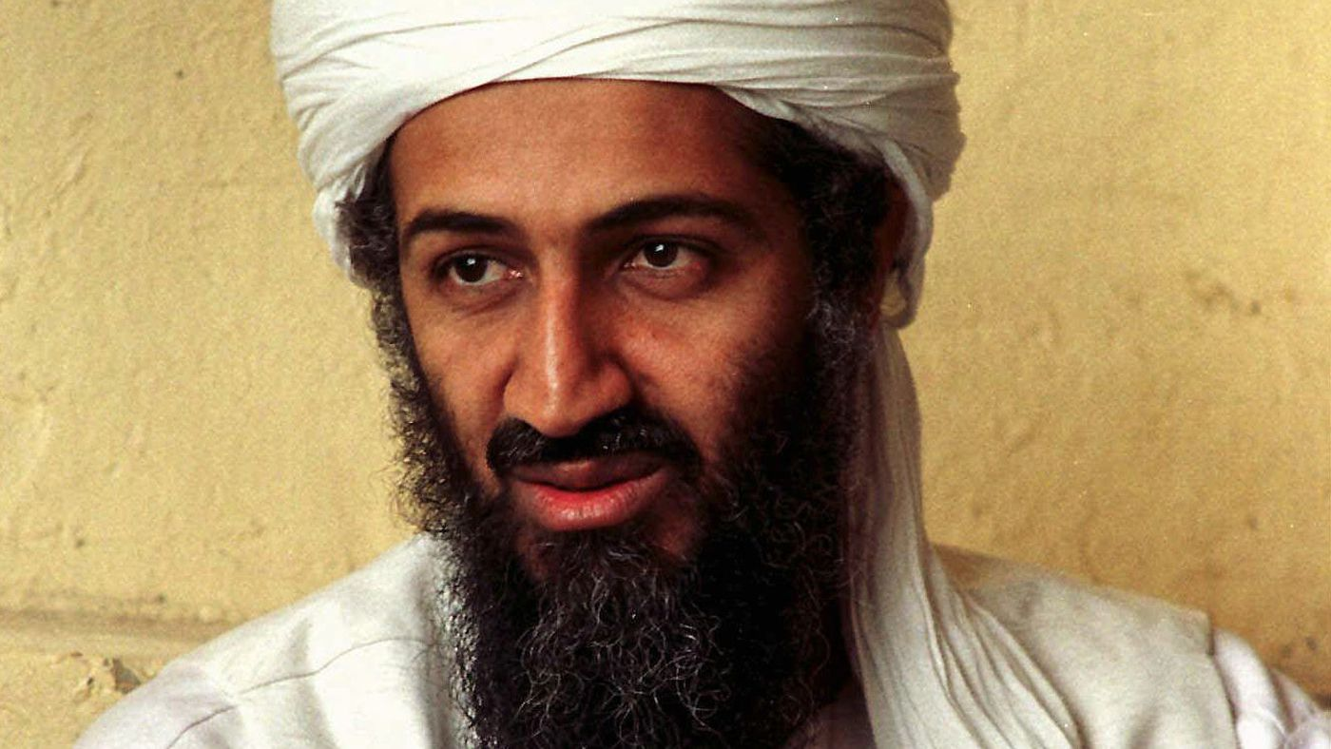
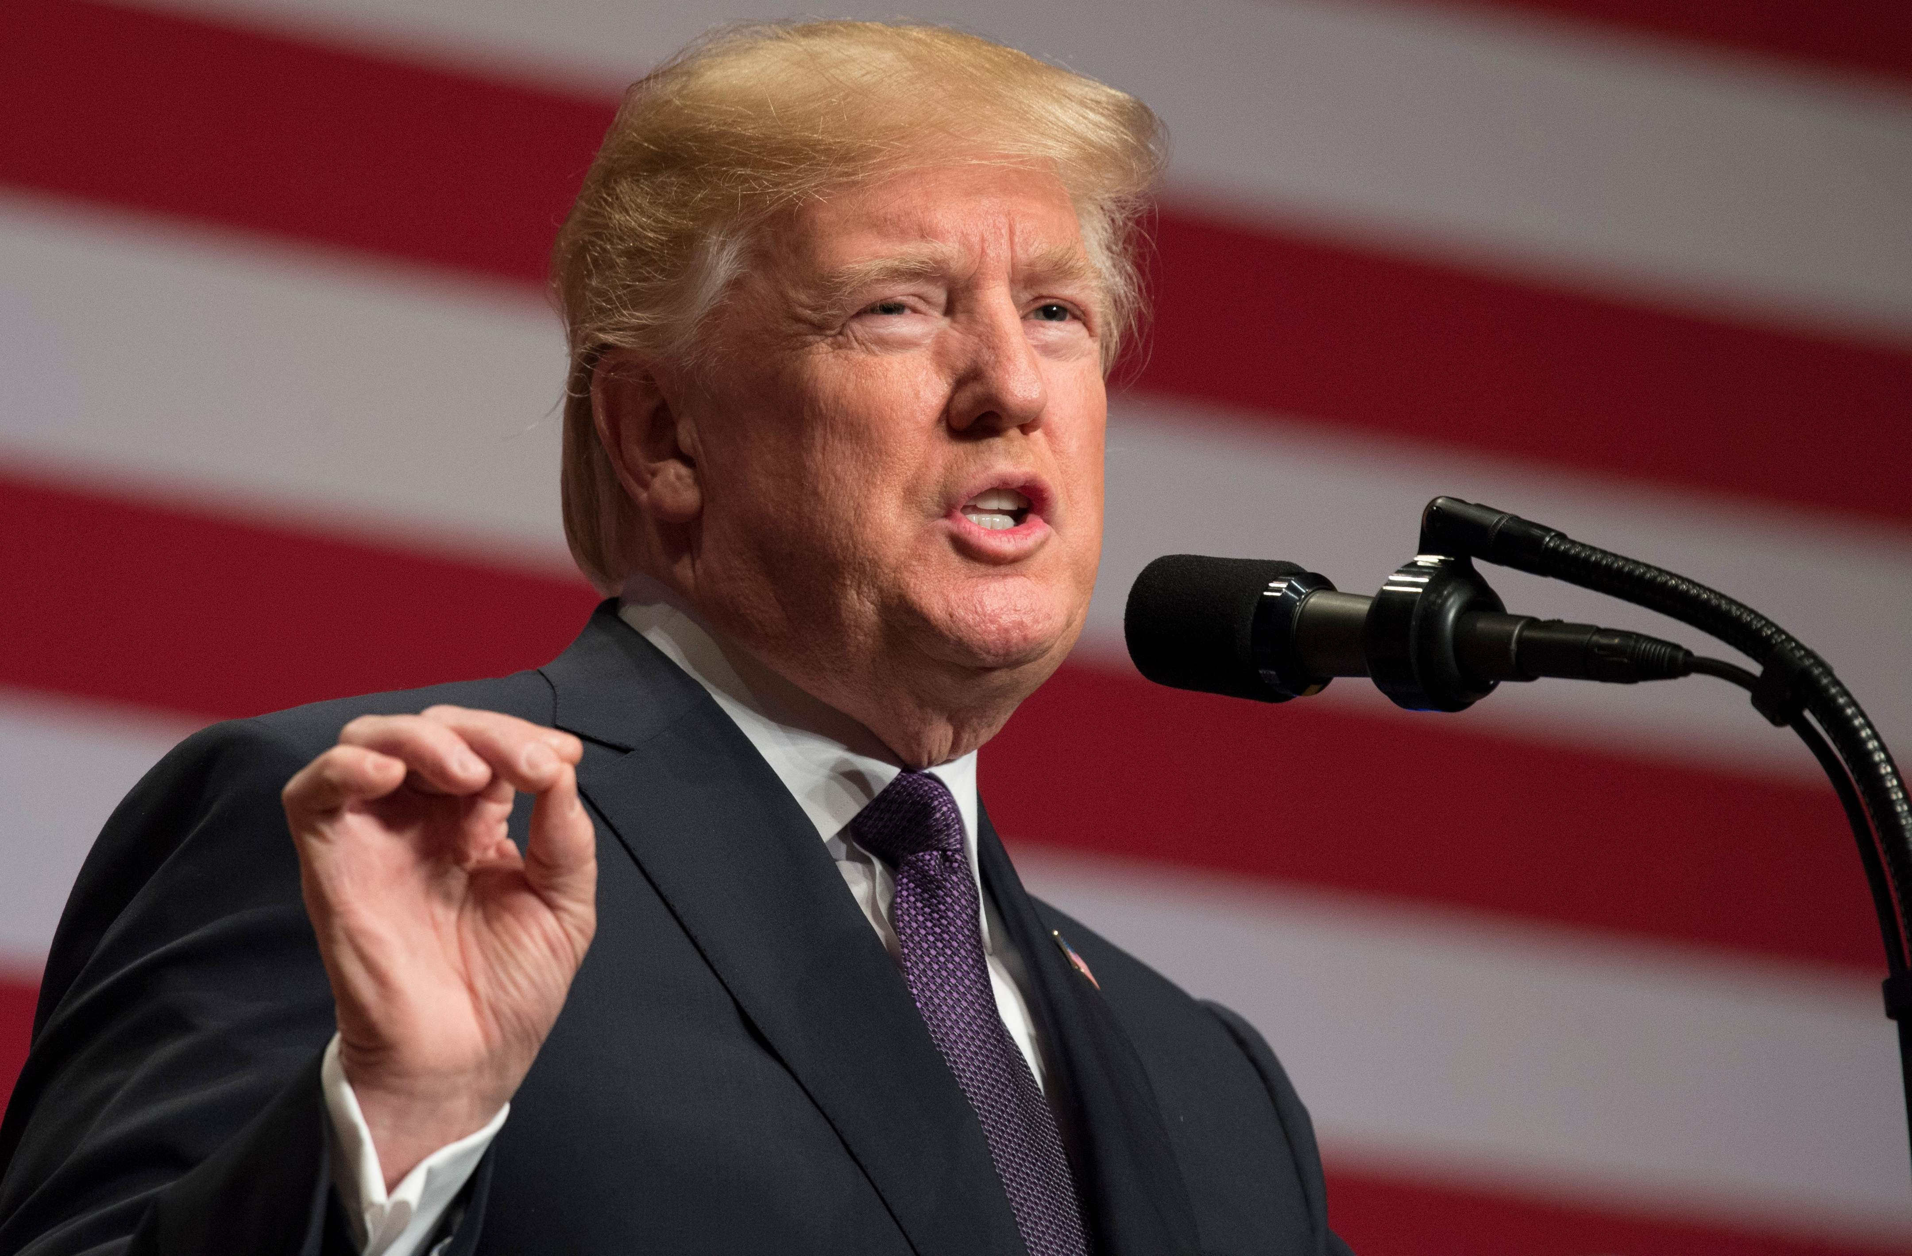
Behold the Players Change but game continues!
The “Good” Guys: Ariel Sharon and George Bush
The “Bad” Guy: Yasser Arafat
Folks they are ALL Bad Guys, they would not be leaders long if they are not bending the knee to Rome!

Slide 13
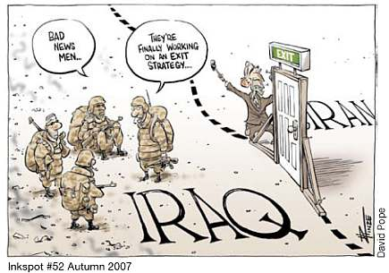

Slide 14
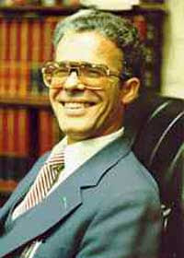
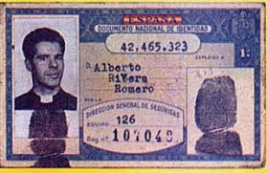
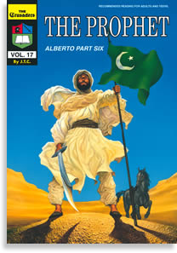
“A Jesuit Cardinal named Augustine Bea showed us how desperately the Roman Catholics wanted Jerusalem at the end of the third century. Because of its religious history and strategic location, the Holy City was considered a priceless treasure. A scheme had to be developed to make Jerusalem a Roman Catholic city. The great untapped source of manpower that could do this job was the children of Ishmael.—The Prophet, Jack Chick, p. 5
Alberto Rivera: Ex-Jesuit Priest and Activist (1935-1997)

Slide 15
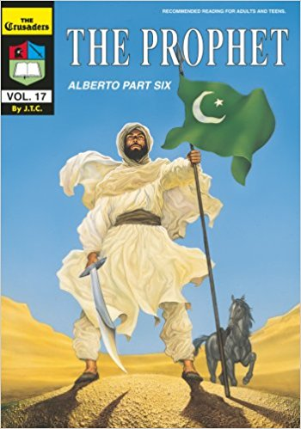
The great untapped source of manpower that could do this job was the children of Ishmael. The poor Arabs fell victim to one of the most clever plans ever devised by the powers of darkness—The Prophet, Jack Chick, p. 5
“The Vatican desperately wanted Jerusalem because of its religious significance, but it was blocked by the Jews. Another problem was the true Christians in North Africa preaching the gospel. Roman Catholicism was growing in power and would not tolerate any opposition.”—The Prophet, Jack Chick, p. 18

Slide 16
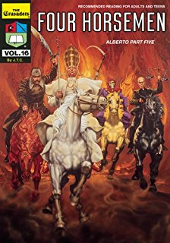
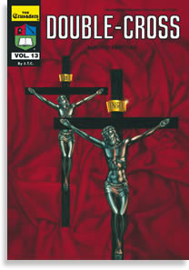
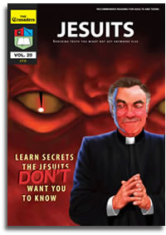
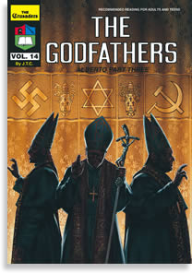
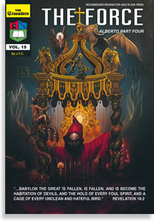
The Alberto Rivera Series by Jack Chick
“Somehow the Vatican had to create a weapon to eliminate both the Jews and the true Christian believers who refused to accept Roman Catholicism. Looking to North Africa, they saw the multitudes of Arabs as a source of manpower to do their dirty work.”—The Prophet, Jack Chick, p. 18

Slide 17
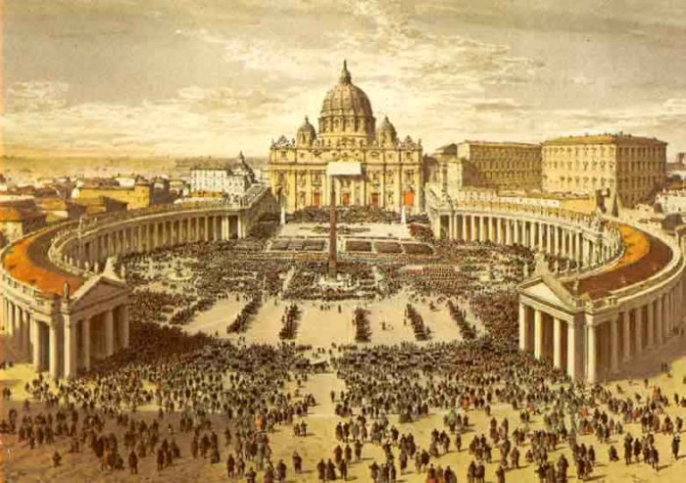
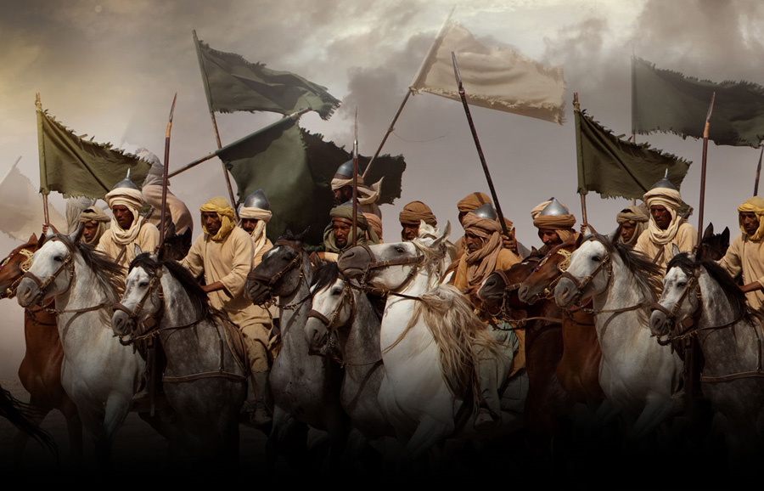
The Pope of Rome created, financed, and built the Islamic war machine!
“In their “holy” book, the Koran, Jesus is regarded as only a prophet. If the Pope was His representative on earth, then he also must be a prophet of God…. which caused the followers of Muhammad to fear and respect the pope as another “holy man.” The pope moved quickly, and issued bulls granting the Arab generals permission to invade and conquer the nations of North Africa.—The Prophet, Jack Chick, p. 21

Slide 18
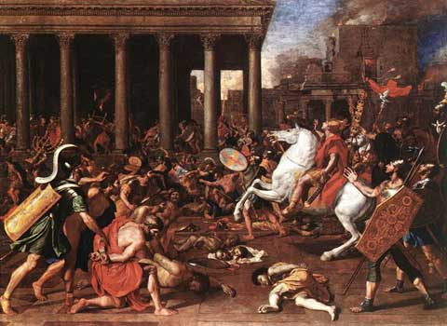
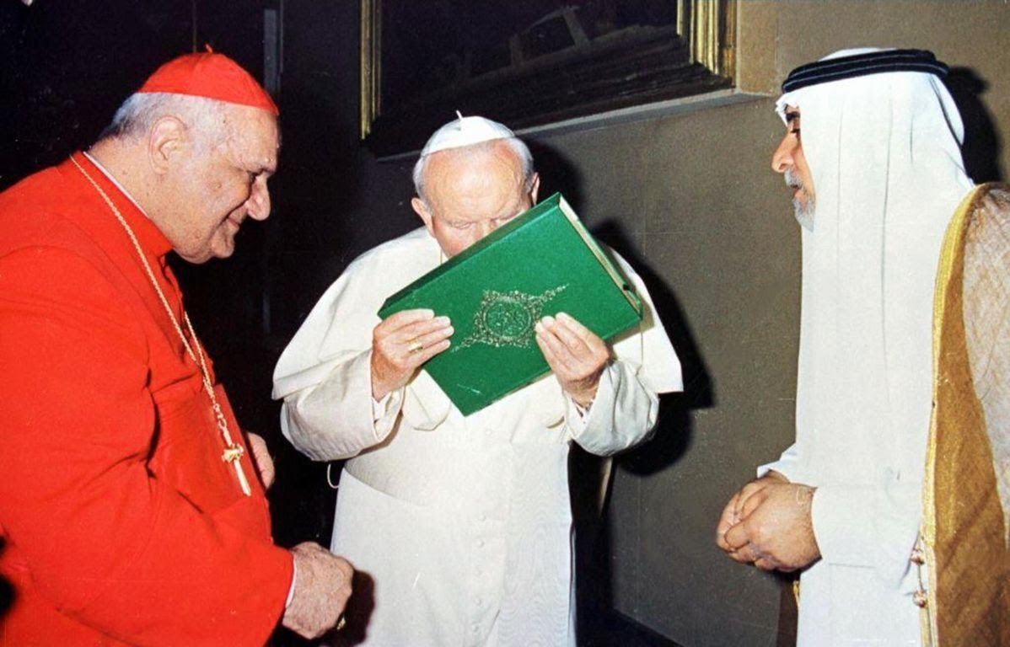
“The pope moved quickly, and issued bulls granting the Arab generals permission to invade and conquer the nations of North Africa. The Vatican helped to finance the building of these massive armies in exchange for three special favors:
Eliminate the Jews and Christians (true believers, which they called infidels).
Protect the Augustinian monks and Roman Catholics.
Conquer Jerusalem for “His Holiness” in the Vatican
—The Prophet, Jack Chick, p. 21

Slide 19
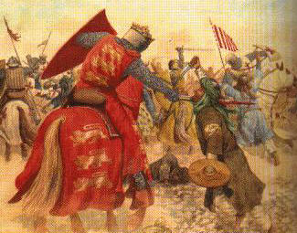
“As time passed, the power of Islam became tremendous… Jews and true Christians were slaughtered, and Jerusalem fell into their hands. (Interesting Note: Roman Catholics were never attacked, nor were their shrines, during this time.) It was time for the pay-off… The pope asked for Jerusalem. But by now, the Arab generals felt the exhilaration of victory everywhere they went. They felt nothing could stand in their way. The pope’s carefully laid plans began to backfire, and then crumbled before his eyes”—The Prophet, Jack Chick, p. 22

Slide 20
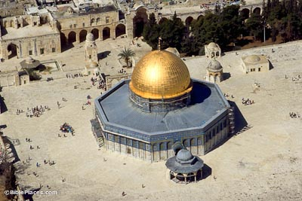

Slide 21
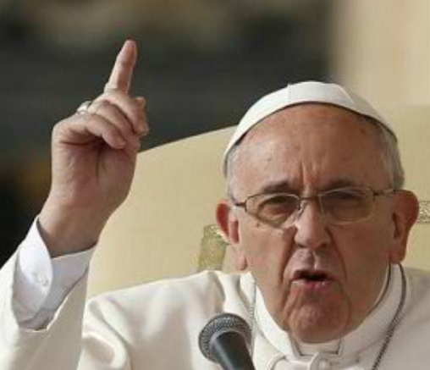
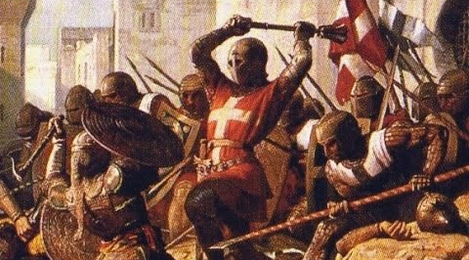
The Pope gets what he wants or else!...... This!

Slide 22
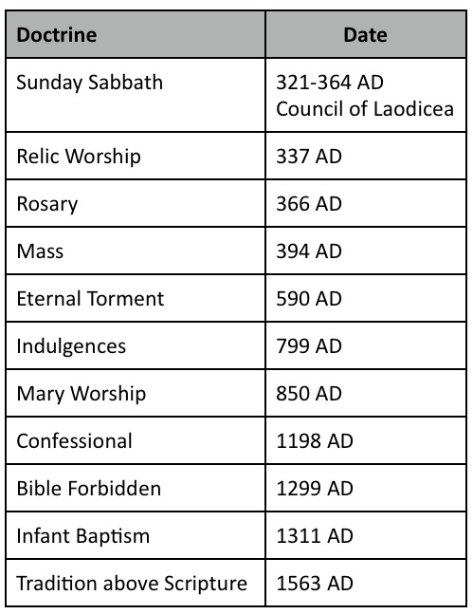

Slide 24
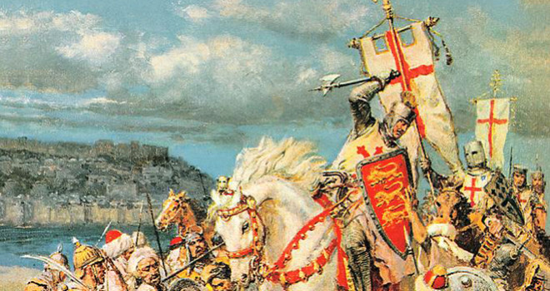
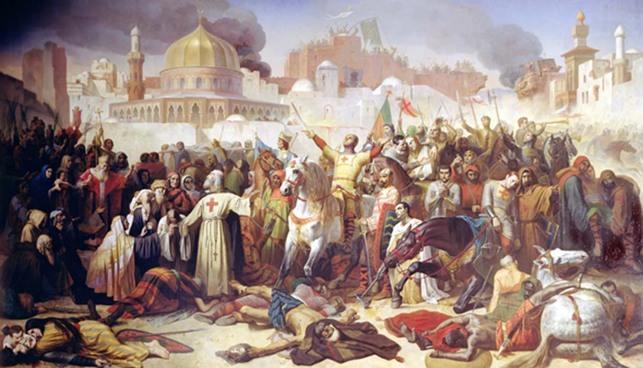
However, did not hang on to it long, by 1187 Saladin recovers Jerusalem, yet spares the Christians. Even Muslims proved to be more compassionate for human life than the Pope of Rome

Slide 25
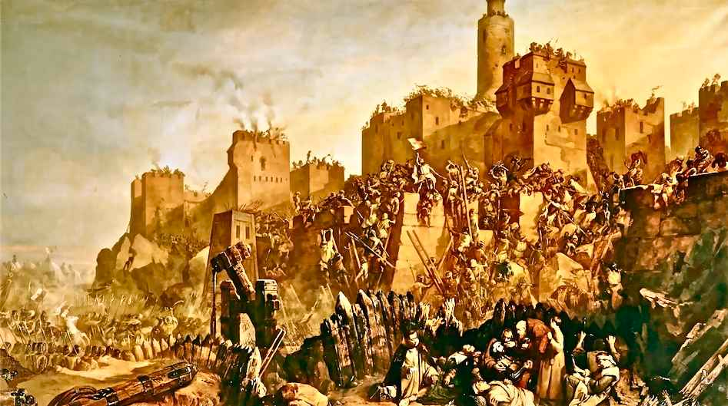

Slide 26
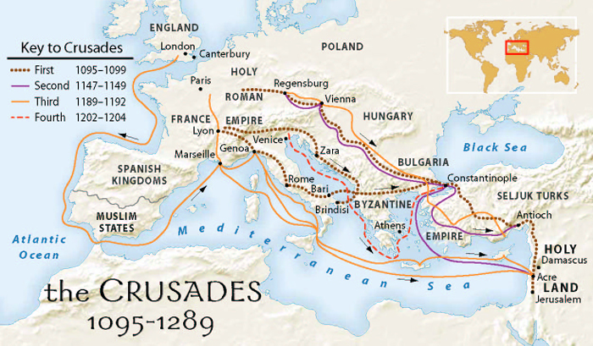

Slide 27
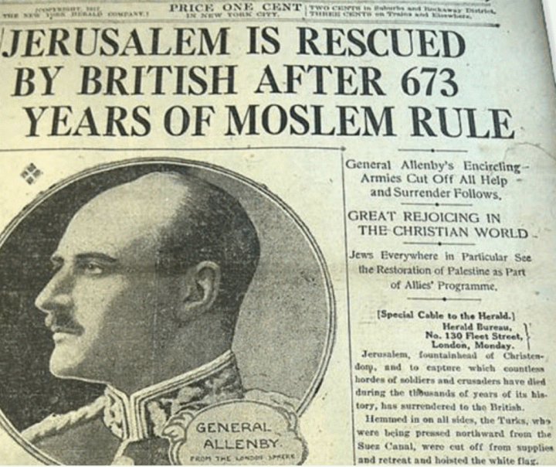
Today the wars of the Crusaders are complete—General Allenby

Slide 28
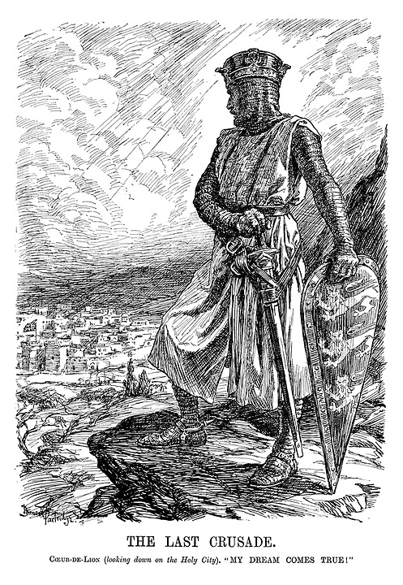
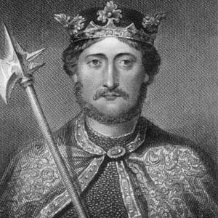
Richard the “Lionhearted” was the King of England which reigned from 1189-1199, known for his fierce ruthlessness and tenacity in battle

Slide 29
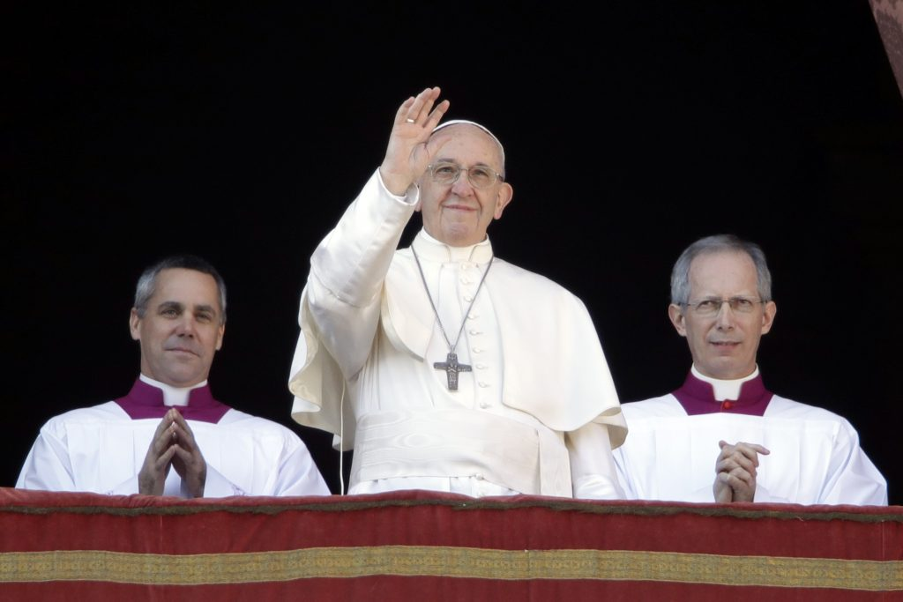
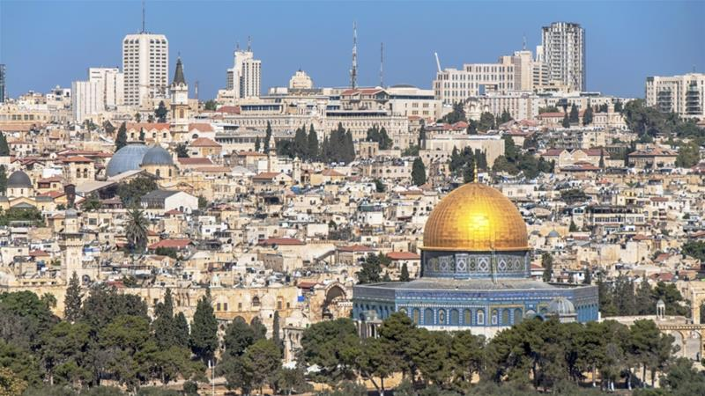
The Day is Coming When the Pope of Rome will be Jerusalem’s “Man of Peace”
2 Thessalonians 2:2-4 “That ye be not soon shaken in mind, or be troubled, neither by spirit, nor by word, nor by letter as from us, as that the day of Christ is at hand. Let no man deceive you by any means: for that day shall not come, except there come a falling away first, and that man of sin be revealed, the son of perdition; Who opposeth and exalteth himself above all that is called God, or that is worshipped; so that he as God sitteth in the temple of God, shewing himself that he is God.

Slide 30
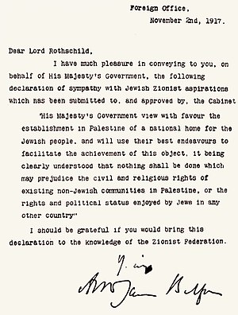

Slide 31
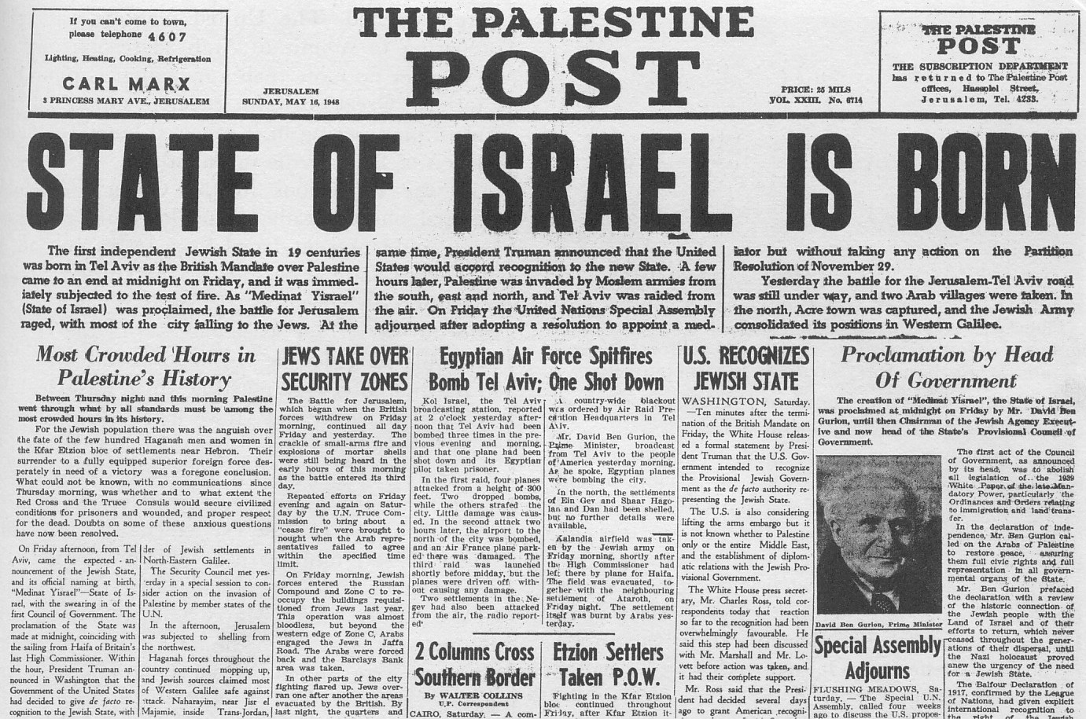

Slide 32
“Somehow the Vatican had to create a weapon to eliminate both the Jews and the true Christian believers who refused to accept Roman Catholicism. Looking to North Africa, they saw the multitudes of Arabs as a source of manpower to tdo their dirty work.”—The Prophet, Jack Chick, p. 18
Muhammad ibn Abdullah (570-632)

Slide 33
Former Jesuit, Alberto Rivera was a priest in Spain, before leaving Catholicism to embrace Christ. Books about him include: “Is Alberto for Real?-Sidney Hunter, Alberto Rivera series by Jack Chick, and interviewed by Seventh-day Adventist Jim Arabito

