Slide 1
Behind the Door pt 20:
The Bible Translations

Slide 2
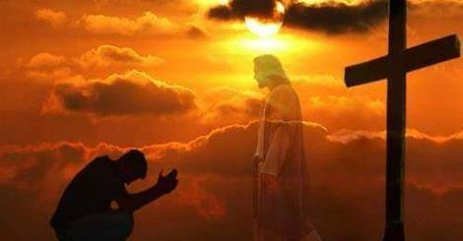

Slide 4
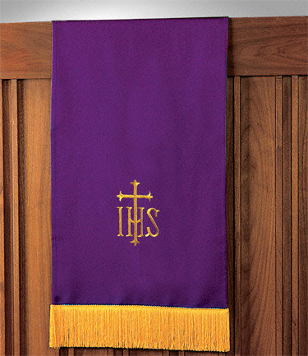
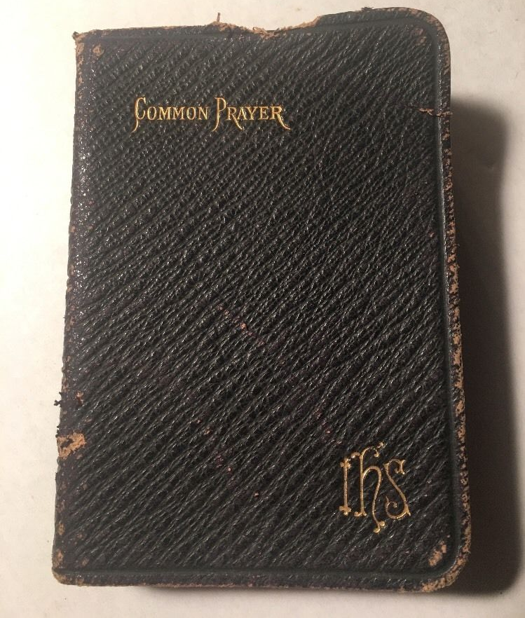
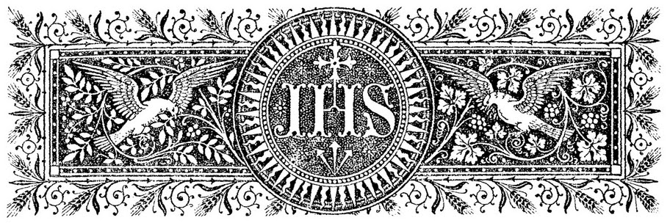
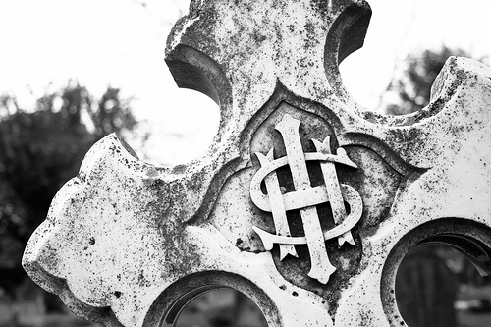
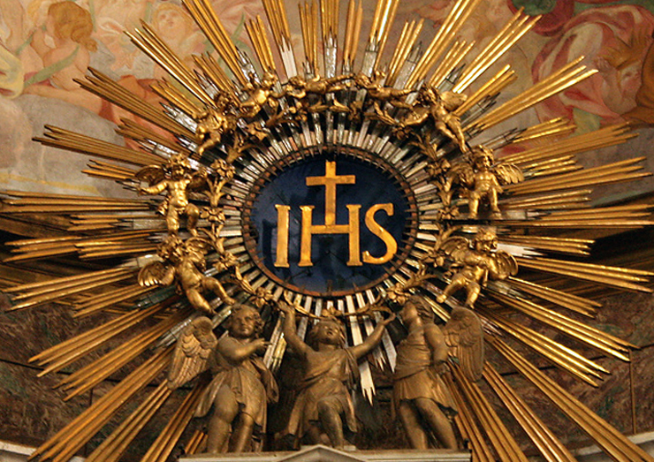

Slide 5
It is likely you will find these Pulpit Scarfs/Lecterns in Catholic Churches, but you may be surprised to find them in Protestant, Evangelical, Mormon, Jehovah’s Witnesses, EVEN Seventh-day Adventist and EVEN many independent churches also! If you see this symbol it is a huge red flag! (For more information as to the infiltration of the churches, see “Alberto, Double Cross, The Godfathers” in the Alberto Series by Jack T. Chick, Chick Publications)

Slide 6
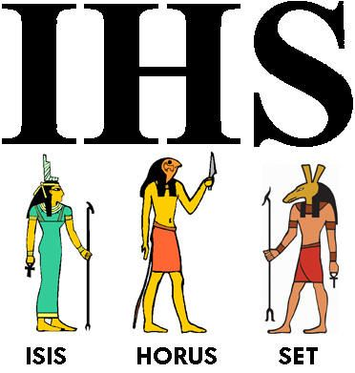
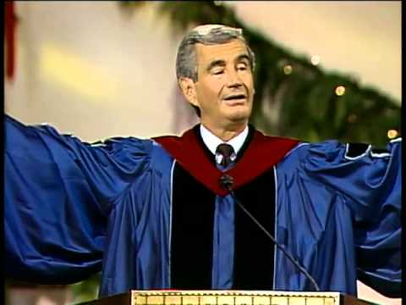
Dr. D. James Kennedy
Dr. D. James Kennedy was a Presbyterian Minister in South Florida. Again, it may surprise you just how often, and where this symbol pops up. This symbol is a sign of submission to the Catholic Jesuit Order, and an acknowledgment of her supreme authority. Be very weary of this symbol if you see it. Ignorance is a possibility, but it is at the very least, a bad indicator of the spiritual temperature of the church you see it in. It does not mean “In His Service”—to the insiders it means “Isis, Horus, Set”—the pagan gods of Egypt (Hislop, 1959, The Two Babylons, 2nd ed., p. 136)

Slide 7
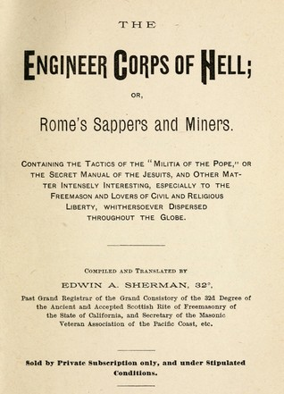

Slide 8
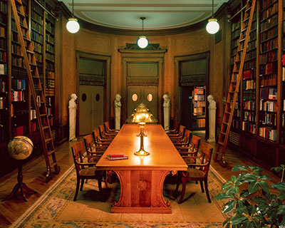
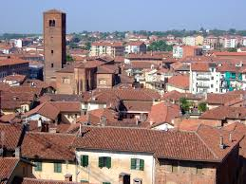
1825’s Secret Council of Chieri, Italy
“the Bible [The Authorized King James Version of 1611] that serpent which with head erect and eyes flashing threatens us with its venom while it trails along the ground, shall be changed into a rod as soon as we are able to seize it.”—Vatican Assassins, Eric Jon Phelps, p. 283 (see also The Jesuits in History, Hector Macpherson, Appendix 1)

Slide 9
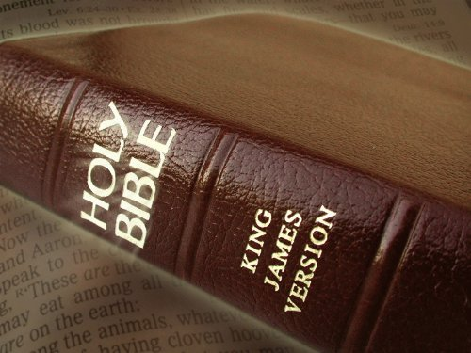
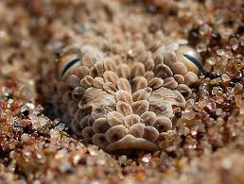
God’s Word is a Serpent???
?
“for three centuries past this cruel asp has left us no repose. You well know with what folds it entwines us and with what fangs it gnaws us.”—Ibid.

Slide 10
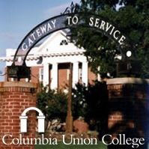
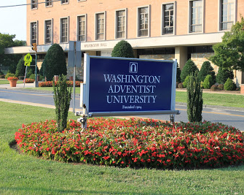
BG Wilkinson was the Dean of Theology at Columbia Union College, later called Washington Adventist University. He is also author of the church historical book “Truth Triumphant”

Slide 11
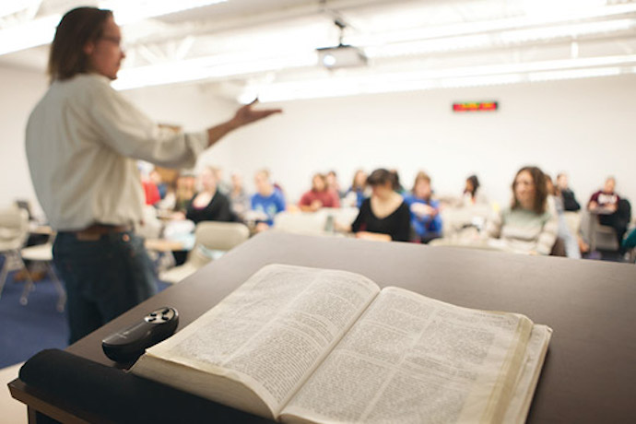
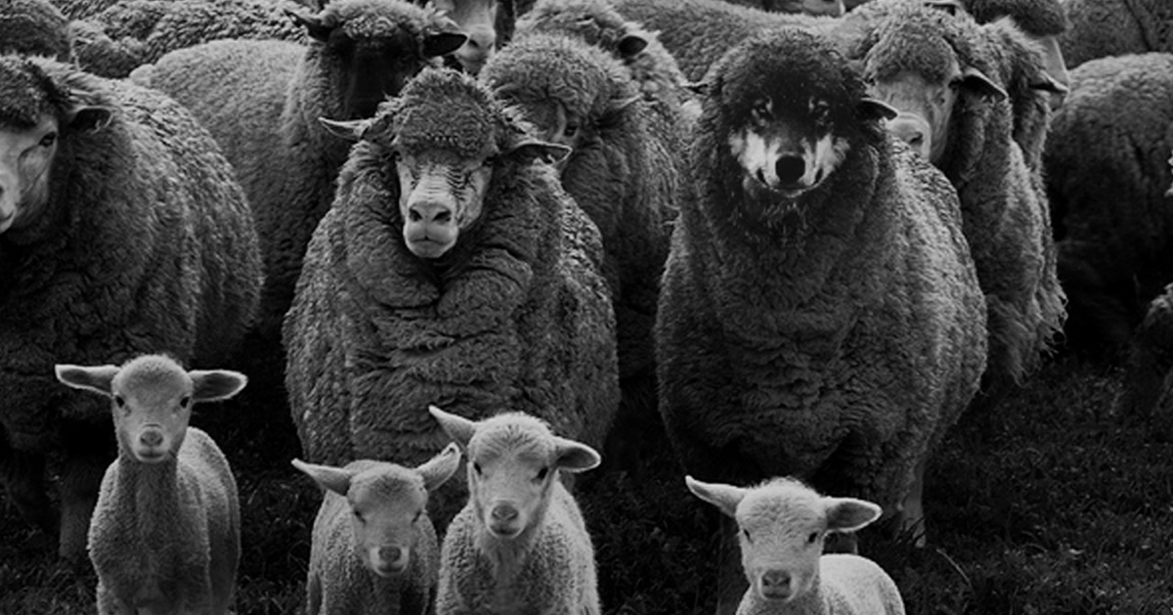
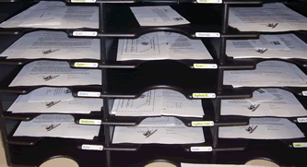
Matt. 7:15 “Beware of false prophets, which come to you in sheep's clothing, but inwardly they are ravening wolves.”

Slide 12
(It’s Still Going On Today!)

Slide 13
Look at the Seventh-day Adventist Church Today; Do we Really Believe the Infiltration attempts have ceased? Judge the Fruits and You Decide!
Quoted From: Arthur S. Maxwell, Editor, Signs of the Times, "The Outstretched Hand," A Sermon Report, given at the Loma Linda University Seventh-day Adventist Church, Loma Linda, California

Slide 14
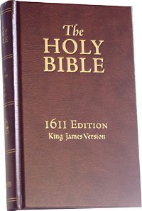
“Wherever the so-called Counter-Reformation, started by the Jesuits, gained hold of the people, the vernacular was suppressed and the Bible kept from the laity. So eager were the Jesuits to destroy the authority of the Bible — the paper pope of the Protestants, as they contemptuously called it — that they even . . .”

Slide 15
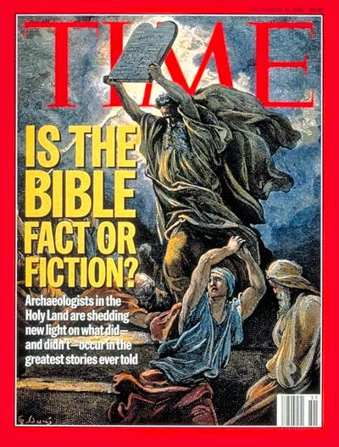
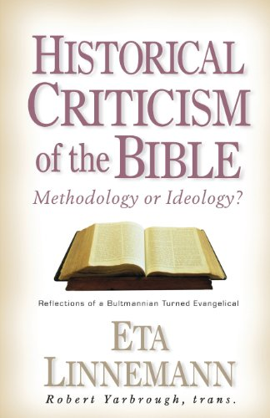
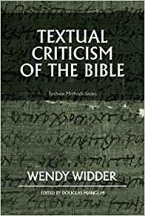
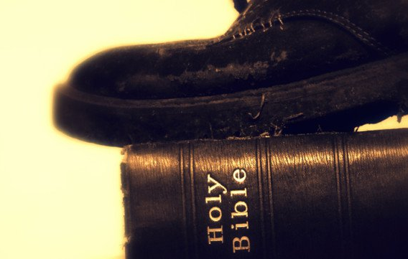
“that they even did not refrain from criticizing its genuineness and historic value. . .”—Our Authorized Bible Vindicated, BG Wilkinson, p. 60 (see also Von Dobschutz, The Influence of the Bible, p. 136)

Slide 16
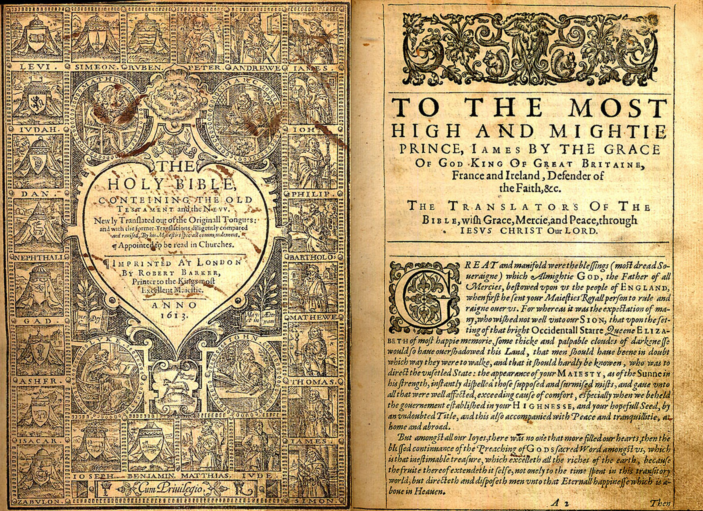

Slide 17
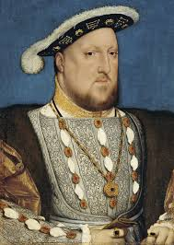
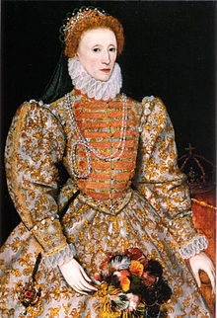
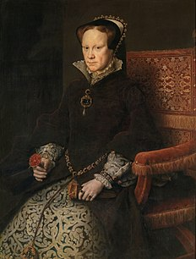
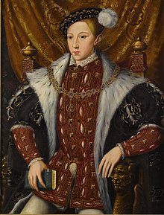
The 50 Year Battle of the Faiths in England
Henry VIII (reign 1509-1547): Professed Protestant.
Mary I (reign 1553-1558): Catholic (known by Protestants as “Bloody Mary”). She restored Papal Dominance in the regions of England, killed and imprisoned Protestants and their leaders, restored celibacy of priests—penalizing those with spouses.
Elizabeth I (reign 1558-1603): Protestant during the most prosperous era of England. Spanish Armada (Catholic) defeated by Sir Frances Drake, making England the world sea power.
Henry VIII (reign 1547-1553): Protestant. Died age 15, suspected poisoning
(Parker, Geoffrey (2000), The Grand Strategy of Philip II, p. 193-194)
(Jordan, W. K. (1970), Edward VI: The Threshold of Power, p. 520)
(Tittler, Robert (1991). The Reign of Mary I, p. 23-24)

Slide 19
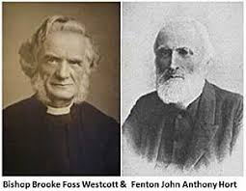
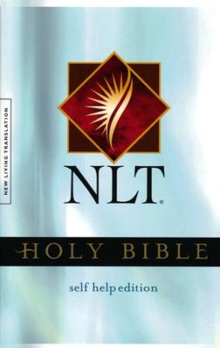
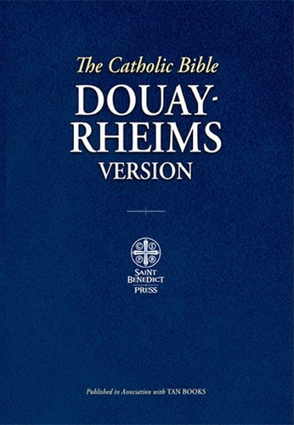
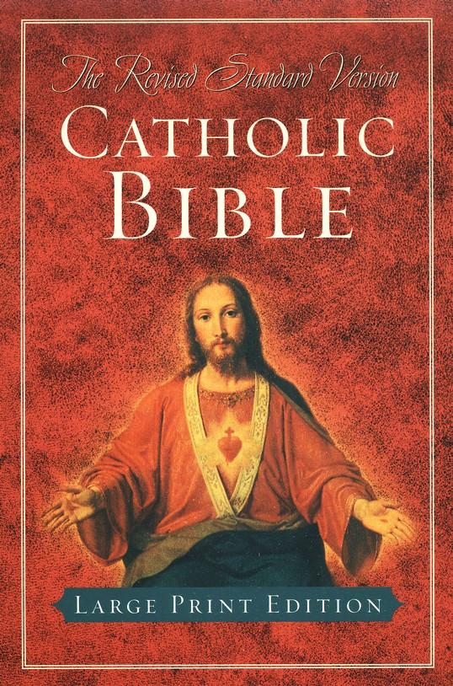
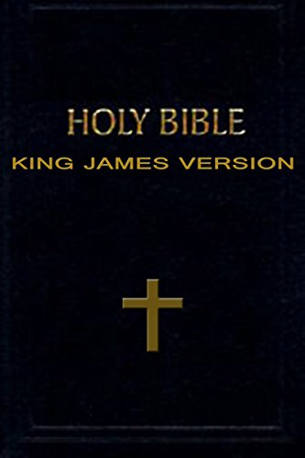
WHY SO MANY VERSIONS???
The Fathers of The Modern Translations…
Westcott and Hort created a Greek New Testament in the 1880s based out of the Codex Sinaiticus (which mirrored the Catholic Manuscripts almost entirely). This Greek New Testament became the “source text” for almost every modern Bible translation. It is taught in “Protestant” (evangelical) seminaries and Bible colleges. The NIV, ESV, ASV and NASB are the new common “Protestant Bibles”
-Westcott and Hort founded several occult societies, including: The Hermes Club, and The Ghostly Guild
Westcott and Hort: 1. Did not believe in a literal heaven, 2. Did not believe in the atonement, 3. Did not believe in the literal Second Coming of Christ, 4. Did not believe in angels, 5. Did not believe in a literal devil, 6. Did believe in evolution and contacting the dead via seances
(See “Heresies of Westcott and Hort”, D. A. Wait et al.; “Causes of Corruption of the New Testament Text”, Dean Burgon; “Look What’s Missing?”, David W. Daniels)

Slide 20
Is Your Bible the Word of God???
Or is it Someone Else’s “word”?

Slide 21
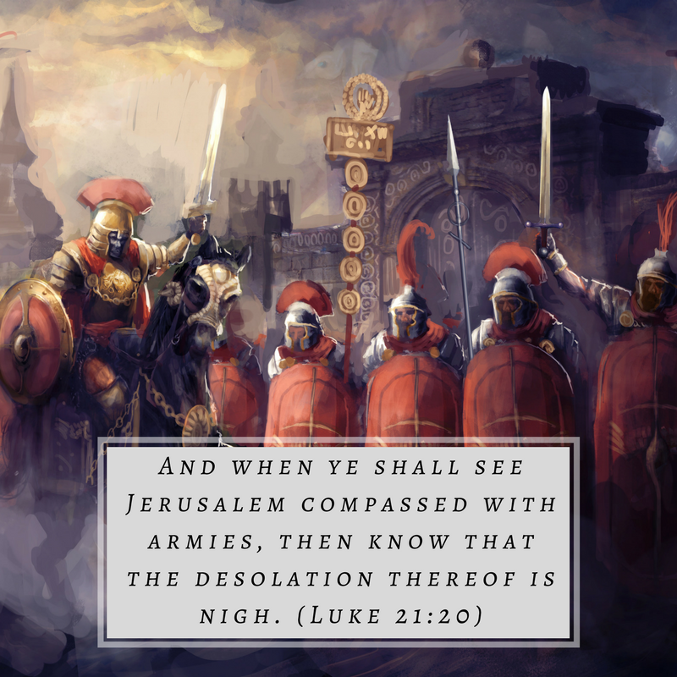
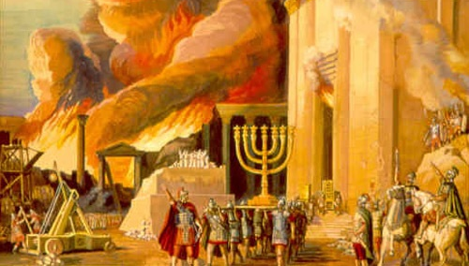
Matthew 24:15-18 “When ye therefore shall see the abomination of desolation, spoken of by Daniel the prophet, stand in the holy place, (whoso readeth, let him understand:) Then let them which be in Judaea flee into the mountains: Let him which is on the housetop not come down to take any thing out of his house: Neither let him which is in the field return back to take his clothes.”

Slide 22
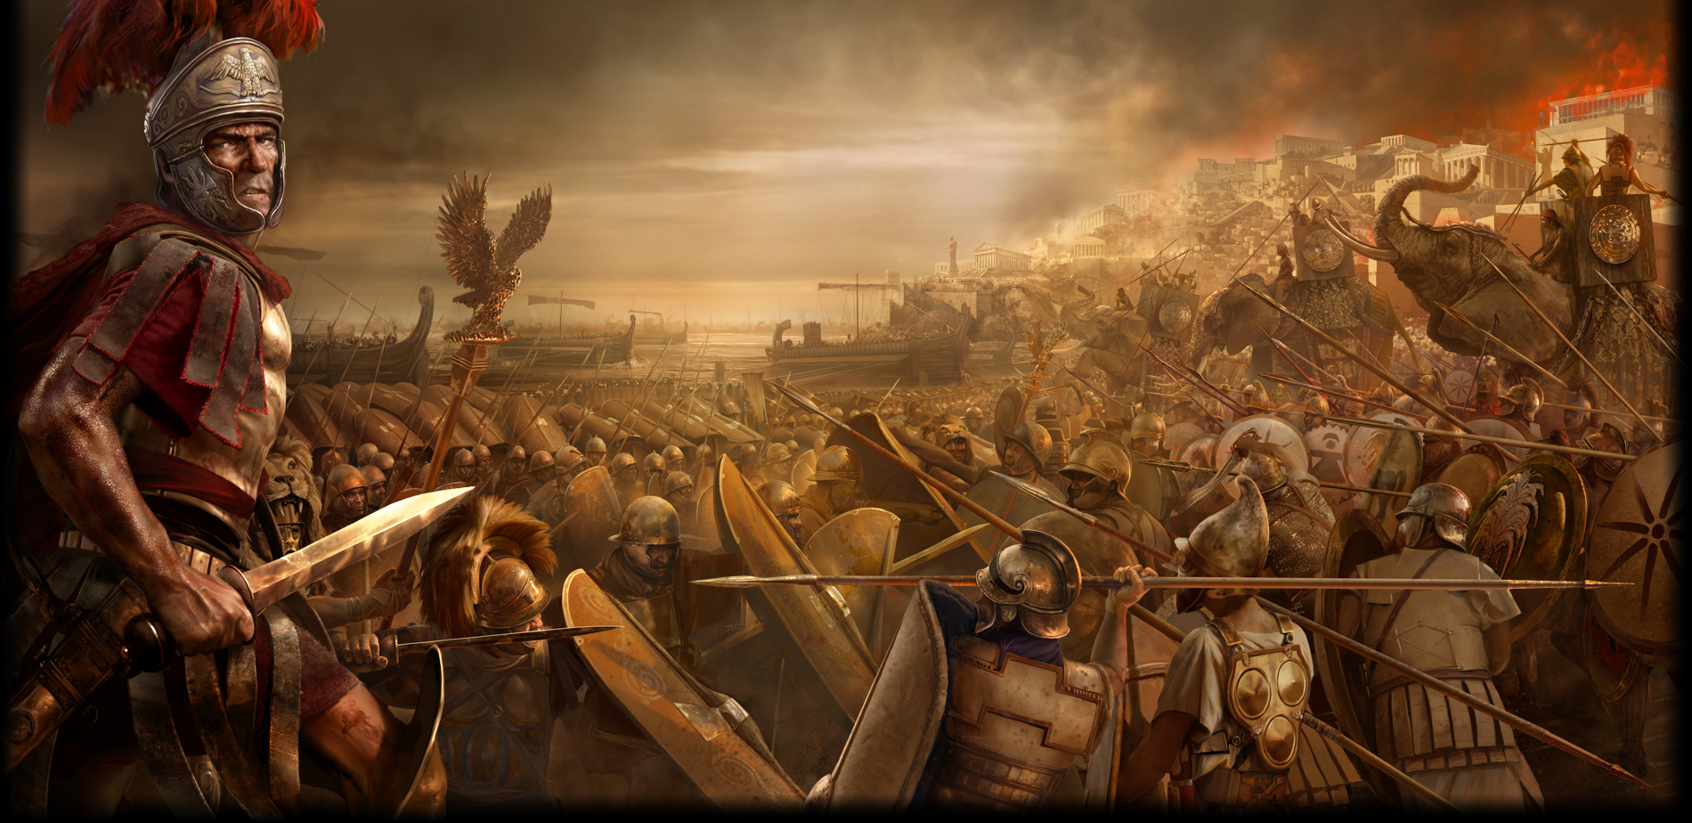
When Pagan Roman Armies pierced their sun-disc spear into the ground (symbolic of Sun-worship—the major competing false religion of Satan of all time in all cultures), which was holy land, the abomination of desolation prophecy was fulfilled. This happened in 66 AD. Then, suddenly, almost without cause, the Roman Legions picked up and left, not returning until 70 AD, when the Temple was destroyed. (Read the Great Controversy by Ellen White for more information...)

Slide 23
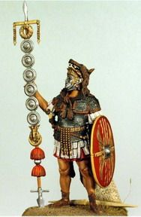
“And the Saviour warned His followers: "When ye therefore shall see the abomination of desolation, spoken of by Daniel the prophet, stand in the holy place, (whoso readeth, let him understand:) then let them which be in Judea flee into the mountains." Matthew 24:15, 16; Luke 21:20, 21. When the idolatrous standards of the Romans should be set up in the holy ground, which extended some furlongs outside the city walls, then the followers of Christ…”

Slide 24
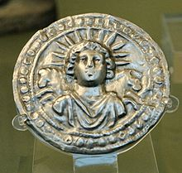
“ . . . then the followers of Christ were to find safety in flight”—Great Controversy, Ellen White, p. 26
Sol Invictus-The Roman Sun god
Day of Worship? Sunday!

Slide 25
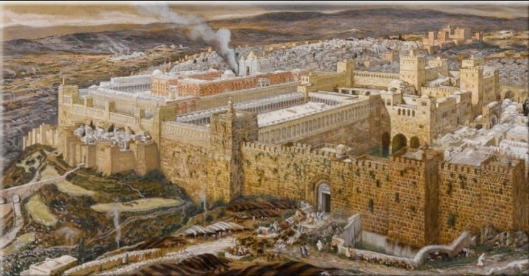
When the Roman armies fled Jerusalem in 66 AD, the Jews pursued and attacked them, giving the perfect opportunity for the Christians to escape, as they were persecuted by the Romans and Jews. When Jerusalem was destroyed in 70 AD, not a single Christian was there! God saved His people again! His word is trustworthy!

Slide 26
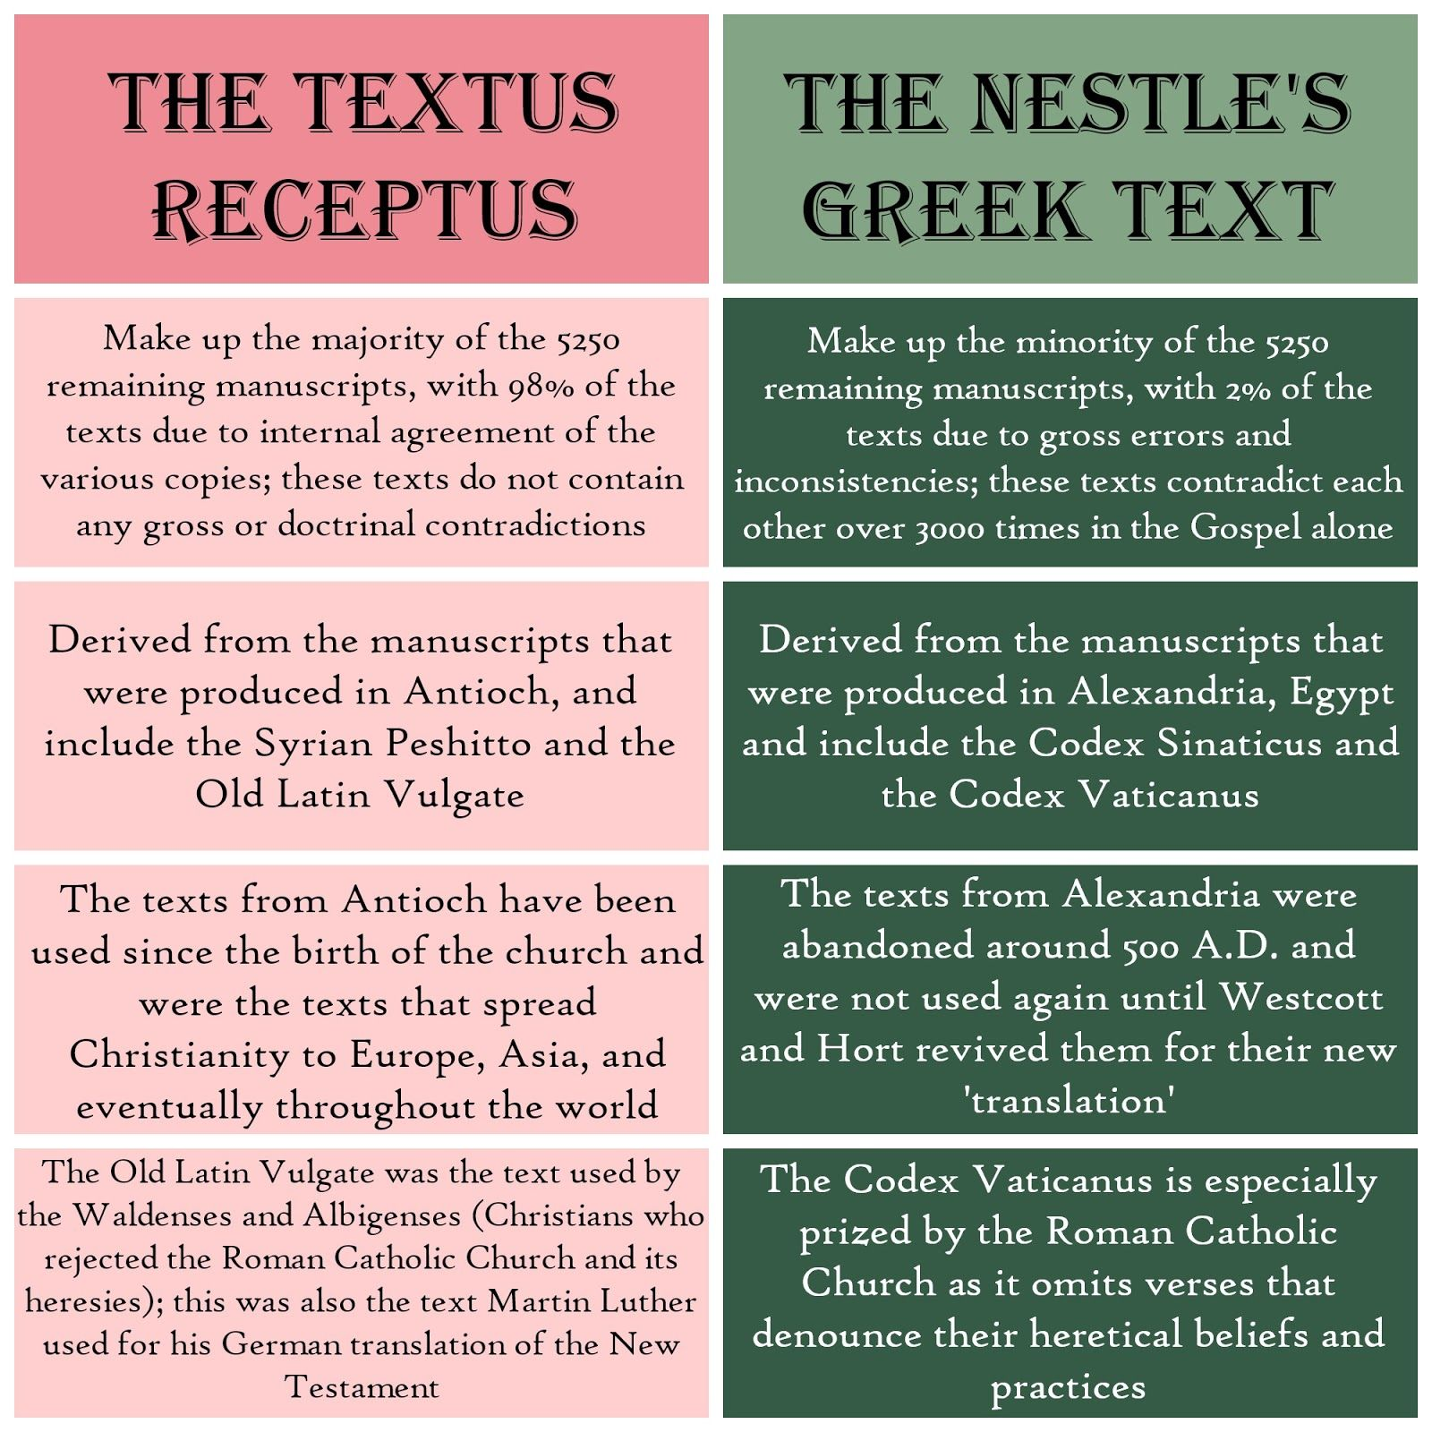

Slide 27
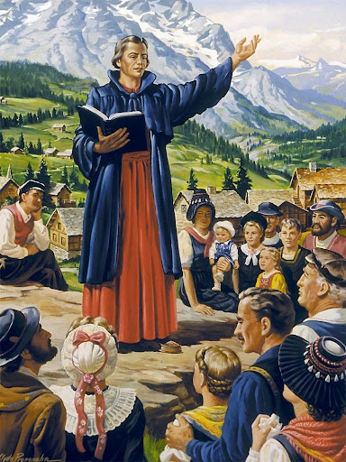
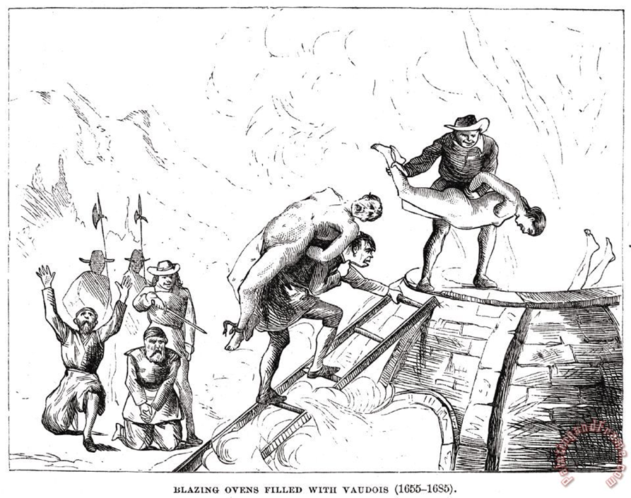
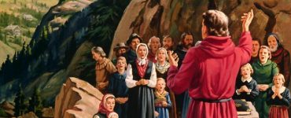
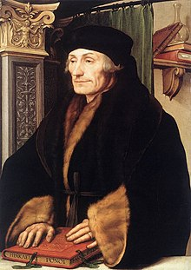
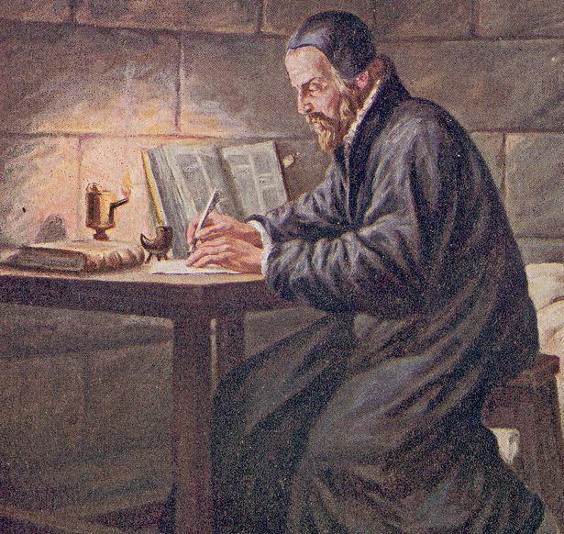
The Waldenses always rejected the false doctrines of the Papacy. They hid in the mountains of Northern Italy to escape persecution. However, over 900,000 (including women and children) were slain by the Roman Catholic Church for refusing to give up their Bibles and worshipping God according to the dictates of their own consciences. They were essentially the precursors to the Reformation movement. (See “History of the Waldenses”, J.A. Wylie)
Erasmus (1466-1536) was Scholar and Author within the Catholic Church. He was known for his criticism of the Church’s traditions and false teachings. He wrote the Greek New Testament based on the Bible that the Waldenses used.
William Tyndale (1494-1536) was strangled and burned at the stake for translating the Bible into English for the people of England. His translations served as a major source in the construction of the King James Version Bible. Tyndale used Erasmus’ Greek Text to create his translation. It is in the same stream as the Waldenses, Syrian, and early Christians.

Slide 29
Just Like the 1st Abomination of Desolation, it will be caused by Roman Sun Worship Idolatry!

Slide 30
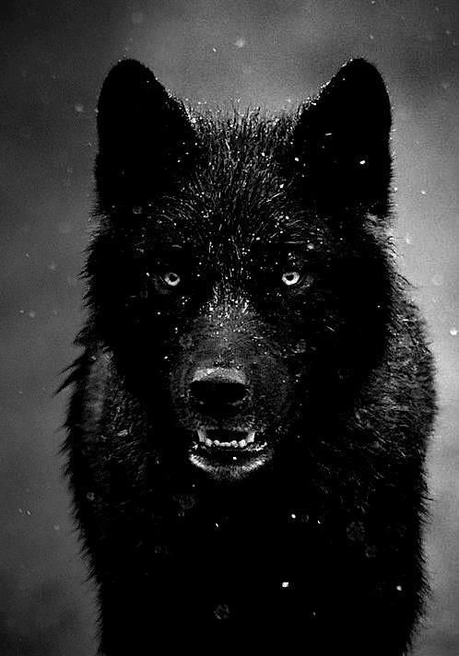
Acts 20:28-30 “Take heed therefore unto yourselves, and to all the flock, over the which the Holy Ghost hath made you overseers, to feed the church of God, which he hath purchased with his own blood. For I know this, that after my departing shall grievous wolves enter in among you, not sparing the flock. . . ”

Slide 31
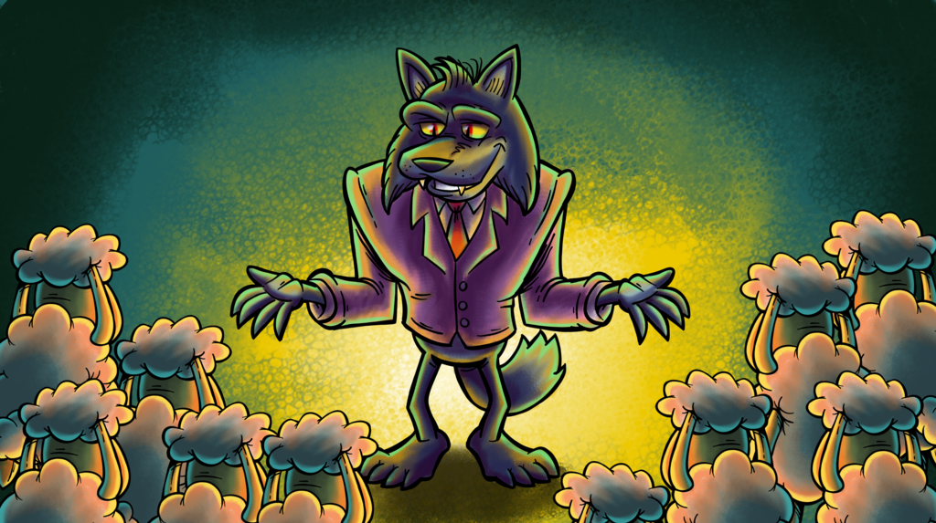
“ . . . Also of your own selves shall men arise, speaking perverse things, to draw away disciples after them”

Slide 32
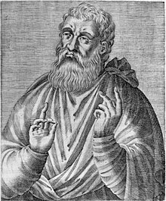
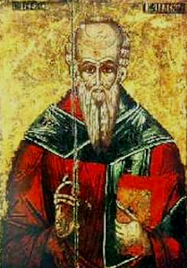
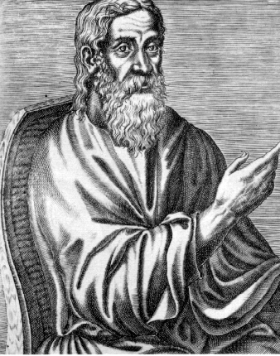
The Wolf Army: Destroyers of the Bible and Introducers of complicated theories and over plain Bible truths
Clement of Alexandria (150-215 AD) Highly influenced by Greek philosophy (Plato and Stoicism), his less-known works reveal his familiarity with Gnostic and occult doctrine
Justin Martyr (100-165 AD): Philosophy student and follower of Socrates and Plato; and stated that there philosophies were inspired by Christ. Promoted Sunday worship.
Origen (184-253) Pupil of Clement of Alexandria, Believed Christ’s death was a ransom to Satan, turning biblical events into allegories, preexistence of souls, and pre-Arian. Is known for working to produce a “correct” Greek Text of the Bible. (see later Eusebius and Augustine)
Tatian of Adiabene, or Tatian the Syrian/Assyrian (??-185 AD)-Philosopher and Gnostic Doctrinal Beliefs. Created a harmony of Gospels, pupil of Justin Martyr
(see “Our Authorized Bible Vindicated”, BG Wilkenson, p. 11-13)

Slide 33
The First Ecumenical Pioneers!! Set on Destruction of the Bible
Origen:
Wrote Hexapla, a massive 50 volume work, including 6 differing translations of the Bible

Slide 34
Eternal Torment??? Or One-Time Destruction in the “Lake of Fire”???

Slide 35
Essentially, there are only 2 streams of Bibles. The Majority Text/Textus Receptus from Jerusalem and Antioch, handed down from the Apostles, translated into the common language of the people and sparking the Reformation; the KJV being one of the most contemporary translations…And the Manuscripts mirroring the Alexandrian Texts, the Codex Vaticanus, Codex Sinaiticus, and further dating back to Justin Martyr’s and Origen’s translations, which culminated in the 50 ecumenical bibles created by Eusebius for Constantine. Almost all modern translations are based from these erroneous texts and NOT the Majority Text (see “Modern Bible Translations Unmasked”, Standish, 1996)

Slide 36
If you are going to usurp authority over God’s people, or replace His truth with your cunningly devised theories, you must remove or change the people’s primary line of defense—the Bible

Slide 37
By controlling the Bible translations, the Catholic Church and the Jesuits know they can easily deceive the people. The true word of God is our only safeguard!

Slide 38
The Council of Trent (1545-1563): The seat of the Counter-Reformation declared…
The Holy Scriptures contained all things necessary for salvation; it is impious to place apostolic tradition equal with Scripture—CONDEMNED, tradition is falsely declared equal with Scripture in the Catholic Church
2. Apocryphal works are not canonical—CONDEMNED, Vulgate only true translation, therefore all Deuterocanonical works upheld as inspired
“Making the word of God of none effect through your tradition, which ye have delivered” Mark 7:13
Sources:
1. Council of Trent, Apr., 1546: Fourth Session—Concilium Tridentinum diariorum, actorum, epistularum, tractutuum nova collection, ed. Societas Goerriesiana, 13 vols. (Freidberg: Herder, 1901-2001) 5:91
2. Jackson, Samuel Macauley, ed. (1914). "Trent, Council of". New Schaff–Herzog Encyclopedia of Religious Knowledge (third ed.). London and New York: Funk and Wagnalls.

Slide 39
Adding to the Word of God, +Books, +Extra Chapters

Slide 40
Other Declarations from the Council of Trent:
3. Corrupted Stream “Vulgate” only true translation of the Bible
4. Only the Church can understand and interpret the Bible infallibly
Sources:
3. Jackson, Samuel Macauley, ed. (1914). "Trent, Council of". New Schaff–Herzog Encyclopedia of Religious Knowledge (third ed.). London and New York: Funk and Wagnalls.
4. Catechism of the Catholic Church, paragraph 85, Part One, The Profession of Faith: The Magisterium of the Church
The Fruits of the KJV Bible Stream have been:
Strong middle class, missionary trips without forced conversions, YMCA, Salvation Army, no church rulership of state, Red Cross and other beneficial relief programs, growth of industry-inventions-science-technology, strengthened family units, personal ownership of land, life, liberty, pursuit of happiness

Slide 41
On the Other Hand, The Fruits of the supremacy of the Catholic Church have been:
Crusades, degradation of the poor, dictatorships, witch-hunts, holy wars, schisms, the Dark Ages, serfdom, Absolute Rule Monarchies, undermining of society and family, no middle class, rise of superstition, forced conversions, creation of Islam, deaths and massacres of hundreds of millions, Inquisitions, burning innocent “heretics”, God-like authority placed in one human man, false doctrines, loss of Bible to tradition, fear, indulgences, totalitarian rule of the Roman Church hierarchy, Church rulership over the state, assassinations, creation of secret orders, genocide, regicide, pedophilia, no property ownership, confusion, and man’s theories placed above God’s truth.
Catholic Vulgate Fruits
Protestant KJV/Received Text Fruits

Slide 42
Subtracting from the Greatest Sermon Ever Preached??
Matthew 6:13
King James Version:
And lead us not into temptation, but deliver us from evil: For thine is the kingdom, and the power, and the glory, for ever. Amen.
Douay 1582:
And lead us not into temptation, but deliver us from evil. Amen.

Slide 43
King James Version: Matt. 6:13
And lead us not into temptation, but deliver us from evil: For thine is the kingdom, and the power, and the glory, for ever. Amen.
Which One Do These Resemble More???
Revised Standard Version:
And lead us not into temptation, But deliver us from evil.
New American Standard Bible:
‘And do not lead us into temptation, but deliver us from evil. [For Yours is the kingdom and the power and the glory forever. Amen.’] (Brackets used to signify that this section is not in “the best” manuscripts)
Amplified Bible:
‘And do not lead us into temptation, but deliver us from evil. [For Yours is the kingdom and the power and the glory forever. Amen.]’ (Margin states: “This clause is not found in early manuscripts”)
New World Translation:
And do not bring us into temptation, but deliver us from the wicked one.’
English Standard Version:
And lead us not into temptation, but deliver us from evil.
Berean Study Bible:
And lead us not into temptation, but deliver us from the evil one.’
Christian Standard Bible:
And do not bring us into temptation, but deliver us from the evil one.
Good News Translation:
Do not bring us to hard testing, but keep us safe from the Evil One.'
American Revised Version:
And bring us not into temptation, but deliver us from the evil one.
New International Version:
And lead us not into temptation, but deliver us from the evil one.’
New Living Translation:
And don't let us yield to temptation, but rescue us from the evil one.
Is Your Bible Protestant or Catholic???

Slide 44
The Pope claims to be the temporal and spiritual ruler of the world. Who else is he claiming to be by sitting in between the Cherubims???
Ps. 99:1 “The LORD reigneth; let the people tremble: he sitteth between the cherubims; let the earth be moved.” (see also Is. 37:16; 1 Sam. 4:4; 2 Sam. 6:2; Ps. 80:1; Ex. 25:22)

Slide 45
Which One agrees with Jesuits and which One is the Word of God? Luke 2:33
King James Version:
“And Joseph and his mother marvelled at those things which were spoken of him.”
Douay [Jesuit Bible] 1582:
“And his father and mother were marveling at those things which were spoken concerning him.”
American Revised Version (1901):
“And his father and his mother were marveling at the things which were spoken concerning him.”
New Living Translation:
“Jesus' parents were amazed at what was being said about him.”
New International Version:
“The child's father and mother marveled at what was said about him.”
English Standard Version:
“And his father and his mother marveled at what was said about him.”

Slide 46
Joseph was by all accounts a good man, but he was NOT the “father” of Jesus: “’Then Mary said to the angel, “How can this be, since I do not know a man?’ And the angel answered and said to her, ‘The Holy Spirit will come upon you, and the power of the Highest will overshadow you; therefore, also, that Holy One who is to be born will be called the Son of God.‘” (Luke 1:34)

Slide 47
What’s Missing??? Luke 4:8
King James Version:
And Jesus answered and said unto him, Get thee behind me, Satan: for it is written, Thou shalt worship the Lord thy God, and him only shalt thou serve.
American Revised Version 1901:
And Jesus answered and said to him, it is written, Thou shalt worship the Lord thy God, and him only shalt thou serve.
New International Version:
Jesus answered, "It is written: 'Worship the Lord your God and serve him only’”
English Standard Version:
And Jesus answered him, “It is written, “‘You shall worship the Lord your God, and him only shall you serve.’”
[Jesuit] Douay 1582:
And Jesus answering said to him, it is written, Thou shalt adore the Lord thy God, and him only shalt thou serve.
WHY??? Because Jesus also Rebuked Peter in the Same Way, which a big problem for Catholicism, because Peter is incorrectly considered their first Pope (Peter would likely be horrified of this doctrine if he were still alive)

Slide 48
“But he turned, and said unto Peter, Get thee behind me, Satan: thou art an offence unto me: for thou savourest not the things that be of God, but those that be of men.” (Matt. 16:23)

Slide 49
1 Corinthians 5:7
King James Version:
Purge out therefore the old leaven, that ye may be a new lump, as ye are unleavened. For even Christ our passover is sacrificed for us:
[Jesuit] Douay 1582:
Purge the old leaven, that you may be a new paste, as you are unleavened. For our pasche Christ is immolated.
Draw your waters of life from the clean, uncorrupted river, not the polluted, filthy one

Slide 50
American Revised Version 1901:
Purge out the old leaven, that you may be a new lump, even as ye are unleavened. For our Passover also hath been sacrificed, even Christ.
New International Version:
Get rid of the old yeast, so that you may be a new unleavened batch--as you really are. For Christ, our Passover lamb, has been sacrificed.
King James Version:
Purge out therefore the old leaven, that ye may be a new lump, as ye are unleavened. For even Christ our passover is sacrificed for us:
ONLY ONE STANDS APART!!!

Slide 51
The Corrupted Streams do NOT purge out the “Leaven”, they purge out the “Bread”
English Standard Version:
Cleanse out the old leaven that you may be a new lump, as you really are unleavened. For Christ, our Passover lamb, has been sacrificed.
New American Standard Bible:
Clean out the old leaven so that you may be a new lump, just as you are in fact unleavened. For Christ our Passover also has been sacrificed.
Good News Translation:
You must remove the old yeast of sin so that you will be entirely pure. Then you will be like a new batch of dough without any yeast, as indeed I know you actually are. For our Passover Festival is ready, now that Christ, our Passover lamb, has been sacrificed.

Slide 55
For More Information… Please Consider these works as a supplement to your study…
Look What’s Missing
David W. Daniels
Our Authorized Bible Vindicated
BG Wilkinson
Our Authorized Bible: Answers to Objections
BG Wilkinson
The Influence of the Bible on Civilization
Ernst. Von Dobshutz
Modern Bible Translations Unmasked
Russel, Colin, and Celia Standish
King James Version Ditches Blind Guides
Gail A. Riplinger
Which Bible Can We Trust?
Les Garrett
Did the Catholic Church Give Us the Bible?
David W. Daniels
Hazardous Materials: Greek & Hebrew Study Dangers, The Voices of Strangers
Gail A. Riplinger

Slide 56
The Traditional Text of the Holy Gospels vol. 1
Dean J. W. Burgon
The Causes of Corruption of the Traditional Text vol. 2
Dean J. W. Burgon
The Revision Revised: A Defense of the Authorized Version
Dean J. W. Burgon
Let’s Weigh the Evidence: Which Bible is the Word of God?
Barry Burton
Is the World’s Oldest Bible a Fake?
David W. Daniels
Which Bible Would Jesus Use: The Bible Version Controversy Explained and Resolved
Jack McElroy
Final Authority: A Christian’s Guide to the King James Bible
Dr. William P. Grady
If the Foundations Be Destroyed
Chick Salliby
Gipp’s Understandable History of the Bible
Dr. Samuel Gipp

Slide 57
A Survey of the Authorized Version
Dr. Peter Ruckman
51 Reasons Why the King James: A Path From Doubt to Faith
David W. Daniels
Heresies of Westcott and Hort
Pastor D. A. Waite
Which Bible?
David Otis Fuller
True or False? (Sequel to “Which Bible?”)
David Otis Fuller
Counterfeit or Genuine? Mark 16? John 8?
David Otis Fuller
Which Bible is God’s Word?
Gail A. Riplinger
Answers to Your Bible Version Questions
David W. Daniels
Why They Changed the Bible: One World Bible for One World Religion
David W. Daniels

Slide 58
Battle of the Bibles
H. H. Myers
Mythological Septuagint
Dr. Peter Ruckman
The “Errors” in the King James Bible
Dr. Peter Ruckman
Causes of Corruption of the New Testament Text
Dean J. W. Burgon
In the Beginning: The Story of the King James Bible and How it Changed a Nation, a Language, and a Culture
Alister McGrath
The New King James Bible: Exposed
(Short Book by Hope International (NZ) 2005
Hope International,
PO Box 148 Rangiora
New Zealand
--also available from International Literature Ministry: 8140 N. Umpqua Hwy. Roseburg, OR 97470)
New Age Bible Versions: An Exhaustive Documentation Exposing the Message, Men and Manuscripts Moving Mankind to the Antichrist’s One World Religion
Gail A. Riplinger

Slide 59
Other Works, which also include sections, some major, some minor about the Bible Translations Include..
The Answer Book: A Helpbook for Christians
Dr. Samuel Gipp
The Alexandrian Cult Series
Dr. Peter Ruckman
Understanding the New Age
Roy Livesey
The Jesuits in History
Hector Macpherson
Life and Letters of Fenton John Anthony Hort
Arthur Fenton Hort
Life and Letters of Brooke Foss Westcott
Arthur Westcott

