Slide 1
Trump Walks on Thin Ice!!

Slide 2
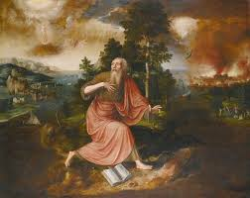
For over 150 years, Seventh-day Adventists have been telling the world that just before the coming of Christ, the United States, in fulfillment of the lamb-like beast of Revelation 13:11-18, would repudiate her liberties and would force religion upon its people!! I believe, friend, that this is happening today!! Prophecy, from Revelation 13 and the Great Controversy masterpiece by Ellen White predicted these things and they are unfolding before our eyes!!

Slide 3
Speaking as a Dragon
“The lamblike horns and dragon voice of the symbol point to a striking contradiction between the professions and the practice of the nation thus represented. The “speaking” of the nation is the action of its legislative and judicial authorities. By such action it will give the lie to those liberal and peaceful principles which it has put forth as the foundation of its policy. The prediction that it will speak “as a dragon” and exercise “all the authority of the first beast” plainly foretells a development of the spirit of intolerance and persecution that was manifested by the nations represented by the dragon and the leopardlike beast. And the statement that the beast with two horns “causes the earth and those who dwell in it to worship the first beast” indicates that the authority of this nation is to be exercised in enforcing some observance which shall be an act of homage to the papacy. Such action would be directly contrary to the principles of this government, to the genius of its free institutions, to the direct and solemn avowals of the Declaration of Independence, and to the Constitution. The founders of the nation wisely sought to guard against the employment of secular power on the part of the church, with its inevitable result—intolerance and persecution. The Constitution provides that “Congress shall make no law respecting an establishment of religion, or prohibiting the free exercise thereof,” and that “no religious test shall ever be required as a qualification to any office of public trust under the United States.” Only in flagrant violation of these safeguards to the nation’s liberty, can any religious observance be enforced by civil authority. But the inconsistency of such action is no greater than is represented in the symbol. It is the beast with lamblike horns—in profession pure, gentle, and harmless—that speaks as a dragon.” GC, pgs. 442,443

Slide 4

Brushing Aside Separation of Church and State
Trump, brushing aside separation of church and state, establishes religious liberty commission.
“We’re bringing religion back to our country, and it’s a big deal,” the president said.
President Donald Trump on Thursday signed an executive order establishing a presidential commission on religious liberty, openly questioning the separation of church and state in an escalation of the White House’s increasing fervor for Christianity.
“They say separation between church and state … I said, ‘All right, let’s forget about that for one time,’” the president said during a Rose Garden event celebrating National Prayer Day. Politico, May 1, 2025

Slide 5
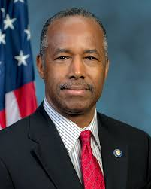
The commission will be chaired by Texas Lt. Gov. Dan Patrick. Ben Carson, Trump’s term-one Housing and Urban Development secretary, will serve as vice chair.
“There’s never been a president who’s invoked the name of Jesus more than you,” Patrick told the president…. “Prayer is not a religious act, it’s a national necessity,” said Paula White, Trump’s senior adviser who oversees the Faith Office.
In a prayer, she asked God to grant Trump “wisdom beyond human understanding and capability, and … divine dreams.”
“We call for a spiritual reset in our nation, a return to what is right, a reverence for what is sacred, a real alignment with your divine purpose,” she said.

Slide 6
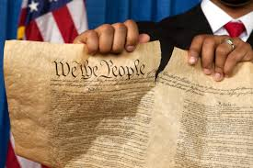
Ripping it Away!!
Carson was speaking at the Academy’s National Character and Leadership Symposium and during a question period told the crowd, “And those people that like to criticize America – criticize people in America – and always talking about separation of church and state, which is not in the Constitution, by the way –…” April 3, 2022

Slide 7
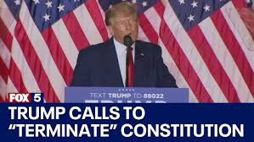
Pushing the Pendulum to the Far Right
In order to counteract the Jesuit liberalism of Biden, the conservative, Jesuit arm under Trump is pushing the pendulum far to the right. The Hegelian Dielectric at work and SDA Ben Carson tells us that separation of church and state is not definitely implied in the 1st Amendment. In Carson’s mind, not in the Great Controversy, the church and state can join together!! WOW!!

Slide 8

Nearly 50% of Project 2025 Established
In 3 months, Trump has implemented nearly 50% of Project 2025 of the Heritage Foundation. Even though, President Trump repeatedly distanced himself from Project 2025 on the campaign trail, saying he had "nothing to do with" the initiative spearheaded by the Heritage Foundation, had not read it and didn't have any plans to. Does the plan of the Heritage Foundation go any deeper than knocking down the wall of separation between church and state?

Slide 9
Push People Back to Church
Meanwhile in his chapter on the U.S. Department of Labor, Jonathan Berry frames his proposals as part of divine history. “The Judeo-Christian tradition, stretching back to Genesis, has always recognized fruitful work as integral to human dignity, as service to God, neighbor, and family,” he writes, while claiming the Biden administration “has been hostile to people of faith.”
Berry worries that “God ordained the Sabbath as a day of rest, and until very recently the Judeo-Christian tradition sought to honor that mandate by moral and legal regulation of work on that day” and blames consumerism and secularism for the decline in Sabbath observance.
But he’s not content to reminisce about the good ol’ days when Americans went to church. He wants the federal government to push people back to church, and calls on Congress to “encourage communal rest by amending the Fair Labor Standards Act (FLSA) to require that workers be paid time and a half for hours worked on the Sabbath.” Berry argues this would lead to higher costs that would reduce work on the Sabbath.

Slide 10
Trump and Project 2025 Together!!
“So far, more than half of all Trump’s executive orders across all sectors of government align with recommendations from the Heritage Foundation, according to The Wall Street Journal. And the former Project 2025 director told Politico in March that Trump’s agenda so far has been “beyond [his] wildest dreams.”
Everything that they’ve done so far within their power—and I would say some of it exceeding their power—has been very much in line with what Project 2025 has called for.”
—Wesley Whistle, higher ed project director at New America

Slide 11
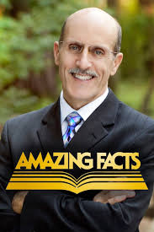
Is This a Nothing Burger too, Doug??
Doug Bachelor / Project 2025: Legitimate Concern or 'Nothing Burger’?
Doug Bachelor weighed in on Project 2025. Part of this Project is a return to Sunday worship. In fact, when Jonathan Berry discusses Labor and Rest, he urges Congress to push people back to church!! Doug Bachelor calls this a ‘Nothing Burger’!!
Are you smoking something, Doug??

Slide 12
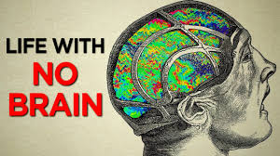
A Nothing Burger?????
"Nothing burger" is a term used to describe something that is hyped up or given significant attention, but turns out to be of little to no real importance or significance. It's essentially a situation where the appearance or initial hype doesn't match the substance.
So, according to Doug Bachelor, Trump following nearly 50% of Project 2025 is a nothing burger?? Project 2025 urges people back to church and this is a nothing burger??

Slide 13
Beware!!
“With rapid steps we are approaching this period. When Protestant churches shall unite with the secular power in sustaining a false religion, for opposing which their ancestors endured the fiercest persecution, then will the papal Sabbath be enforced by the combined authority of church and State. There will be a national apostasy [Apostasy is defined as the abandonment of biblical Truths], which will end in national ruin.” E.G. White, The Signs of the Times, Pacific Press, {ST, November 8, 1899 par. 6}
“Our land is in jeopardy. The time is drawing on when its legislators shall so abjure the principles of Protestantism as to give countenance to Romish [Catholic] apostasy. The people for whom God has so marvelously wrought, strengthening them to throw off the galling yoke of popery, will, by a national act, give vigor to the corrupt faith of Rome, and thus arouse the tyranny which only waits for a touch to start again into cruelty and despotism. With rapid steps are we already approaching this period. When Protestant churches shall seek the support of the secular power, thus following the example of that apostate church, for opposing which their ancestors endured the fiercest persecution, then will there be a national apostasy which will end only in national ruin.” . E.G. White, The Signs of the Times, Pacific Press, {ST, July 4, 1899 par. 11}

Slide 14
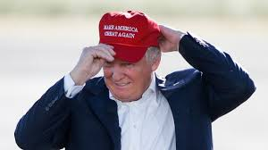
Stop Right Where You Are!!!
There is no wall of separation between church and state??
Setting up religious commissions??
Following the Heritage Foundation and Project 2025 ???
Making America great again??
These are steps that will lead to America’s destruction! Stop right where you are before America is destroyed!! This is not making America great again- this is eating the heart out of this great nation!!

