Slide 1
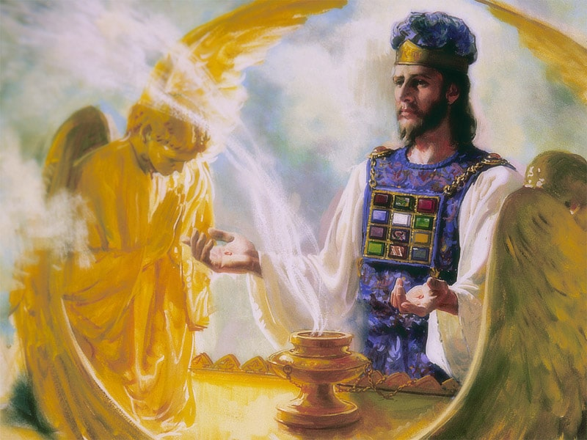
The Sanctuary pt 69: The Day of Atonement 16: The Second Coming and the Third Coming

Slide 2
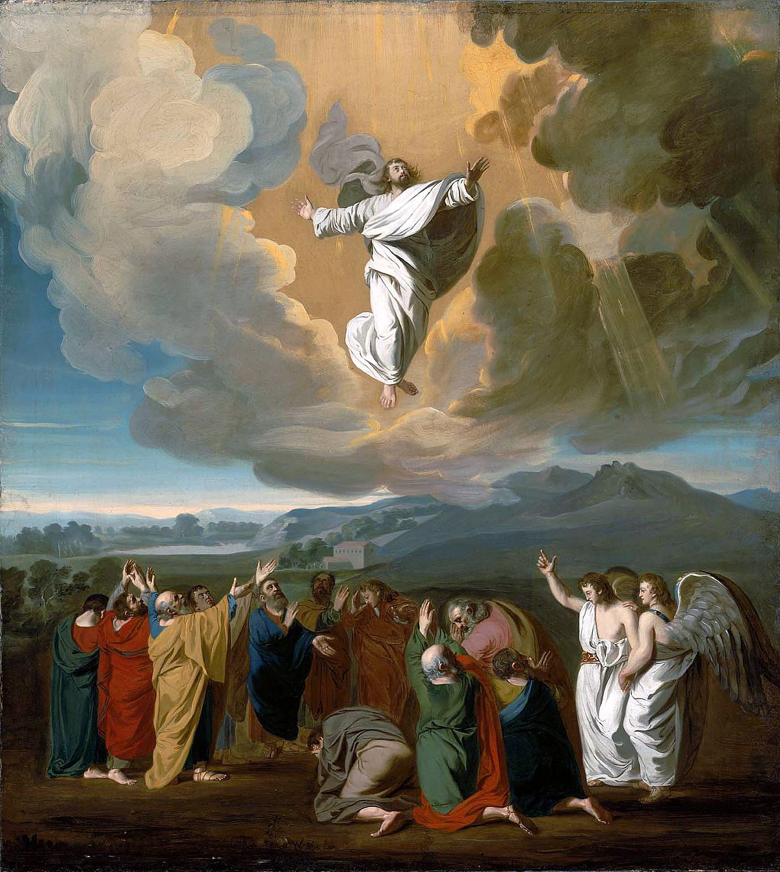
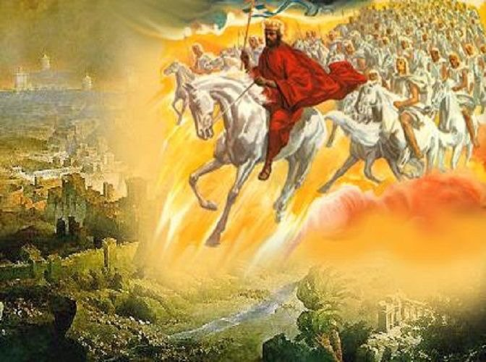
Destroyed At His Coming!
Rev. 19:11-18 “And I saw heaven opened, and behold a white horse; and he that sat upon him was called Faithful and True, and in righteousness he doth judge and make war. His eyes were as a flame of fire, and on his head were many crowns; and he had a name written, that no man knew, but he himself. And he was clothed with a vesture dipped in blood: and his name is called The Word of God. And the armies which were in heaven followed him upon white horses, clothed in fine linen, white and clean. And out of his mouth goeth a sharp sword, that with it he should smite the nations: and he shall rule them with a rod of iron: and he treadeth the winepress of the fierceness and wrath of Almighty God. And he hath on his vesture and on his thigh a name written, King Of Kings, And Lord Of Lords. And I saw an angel standing in the sun; and he cried with a loud voice, saying to all the fowls that fly in the midst of heaven, Come and gather yourselves together unto the supper of the great God; That ye may eat the flesh of kings, and the flesh of captains, and the flesh of mighty men, and the flesh of horses, and of them that sit on them, and the flesh of all men, both free and bond, both small and great.”

Slide 3
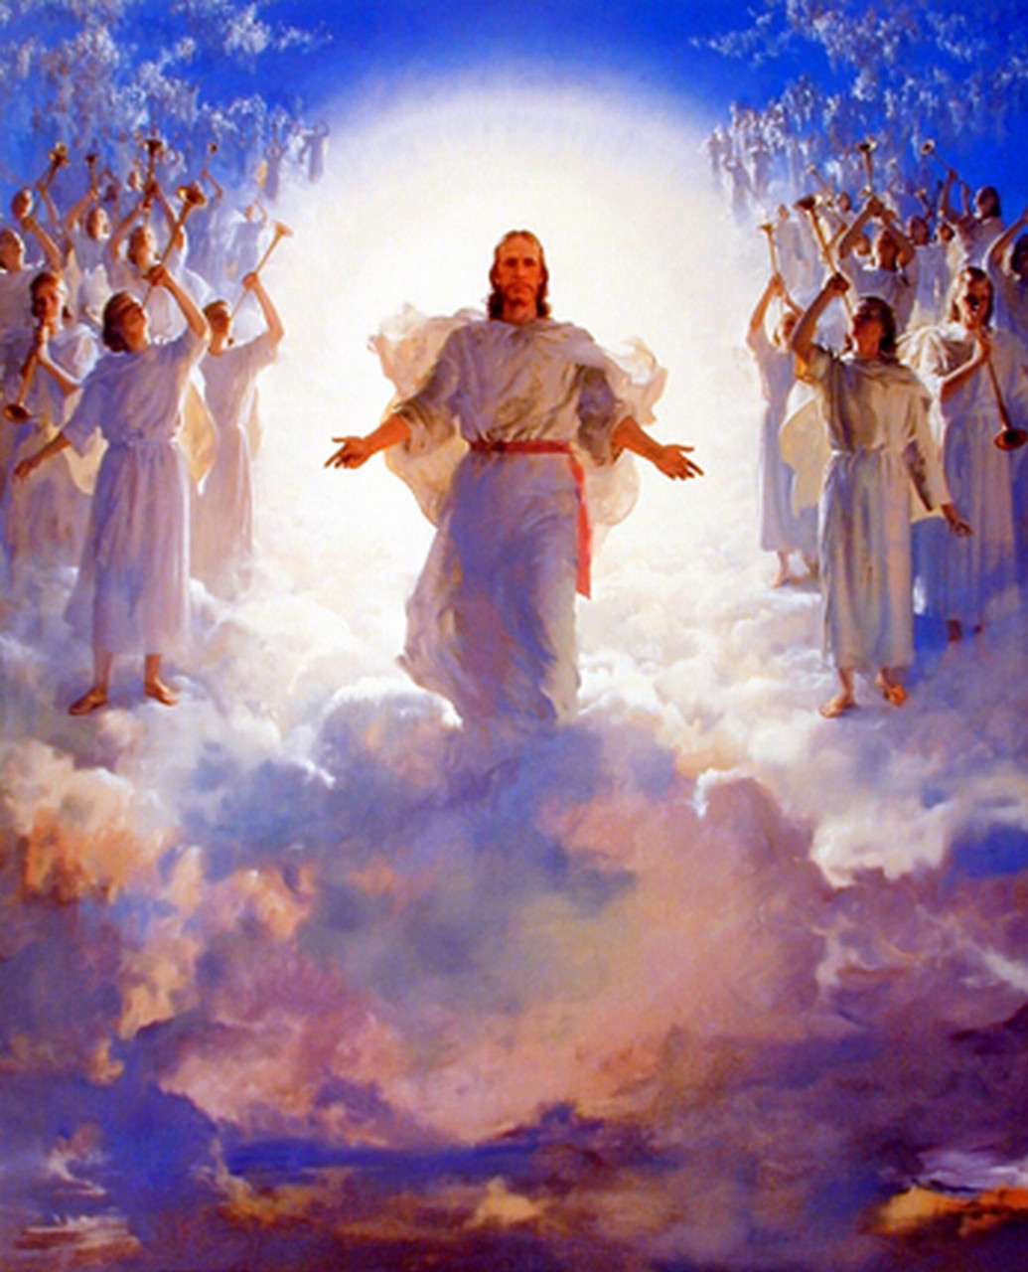
The Biblical Second Coming…
2 Thess 1:7-10 “And to you who are troubled rest with us, when the Lord Jesus shall be revealed from heaven with his mighty angels, In flaming fire taking vengeance on them that know not God, and that obey not the gospel of our Lord Jesus Christ: Who shall be punished with everlasting destruction from the presence of the Lord, and from the glory of his power; When he shall come to be glorified in his saints, and to be admired in all them that believe (because our testimony among you was believed) in that day.”

Slide 4
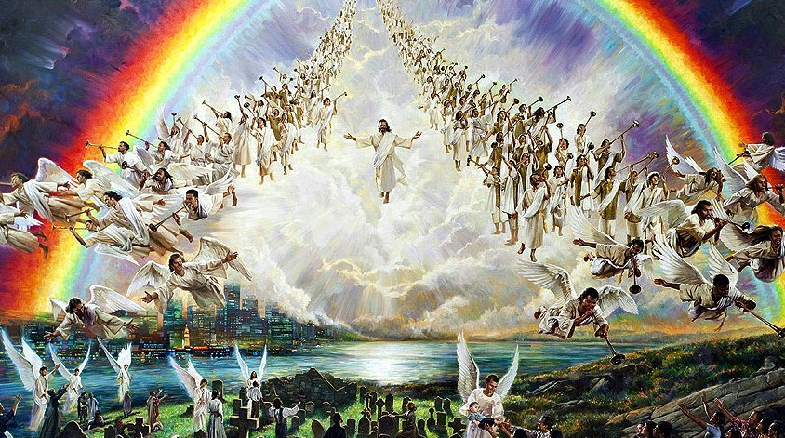
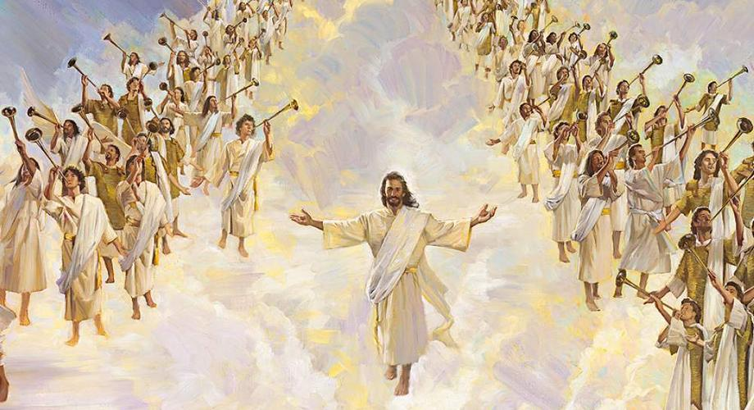
The End
“The 144,000 were all sealed and perfectly united. On their foreheads was written, God, New Jerusalem, and a glorious star containing Jesus' new name. At our happy, holy state the wicked were enraged, and would rush violently up to lay hands on us to thrust us into prison, when we would stretch forth the hand in the name of the Lord, and they would fall helpless to the ground. Then it was that the synagogue of Satan knew that God had loved us who could wash one another's feet and salute the brethren with a holy kiss, and they worshiped at our feet. Soon our eyes were drawn to the east, for a small black cloud had appeared, about half as large as a man's hand, which we all knew was the sign of the Son of man. We all in solemn silence gazed on the cloud as it drew nearer and became lighter, glorious, and still more glorious, till it was a great white cloud.” EW, p. 15

Slide 5
The Bride Saved!
“The bottom appeared like fire; a rainbow was over the cloud, while around it were ten thousand angels, singing a most lovely song; and upon it sat the Son of man. His hair was white and curly and lay on His shoulders; and upon His head were many crowns. His feet had the appearance of fire; in His right hand was a sharp sickle; in His left, a silver trumpet. His eyes were as a flame of fire, which searched His children through and through. Then all faces gathered paleness, and those that God had rejected gathered blackness. Then we all cried out, "Who shall be able to stand? Is my robe spotless?" Then the angels ceased to sing, and there was some time of awful silence, when Jesus spoke: "Those who have clean hands and pure hearts shall be able to stand; My grace is sufficient for you." At this our faces lighted up, and joy filled every heart. And the angels struck a note higher and sang again, while the cloud drew still nearer the earth. Then Jesus' silver trumpet sounded, as He descended on the cloud, wrapped in flames of fire. He gazed on the graves of the sleeping saints, then raised His eyes and hands to heaven, and cried, "Awake! awake! awake! ye that sleep in the dust, and arise." Then there was a mighty earthquake. The graves opened, and the dead came up clothed with immortality. The 144,000 shouted, "Alleluia!" as they recognized their friends who had been torn from them by death, and in the same moment we were changed and caught up together with them to meet the Lord in the air.” EW, p.15-16

Slide 6
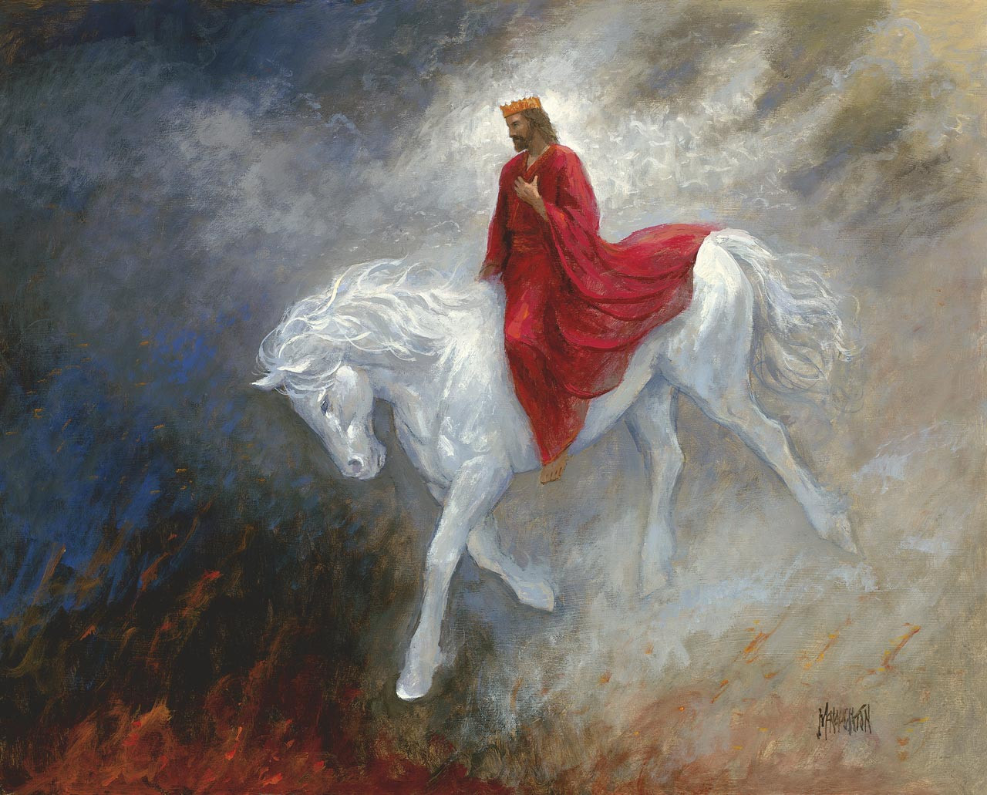
To Meet the Lord in the Air…
2 Thess 4:13-17 “But I would not have you to be ignorant, brethren, concerning them which are asleep, that ye sorrow not, even as others which have no hope. For if we believe that Jesus died and rose again, even so them also which sleep in Jesus will God bring with him. For this we say unto you by the word of the Lord, that we which are alive and remain unto the coming of the Lord shall not prevent them which are asleep. For the Lord himself shall descend from heaven with a shout, with the voice of the archangel, and with the trump of God: and the dead in Christ shall rise first: Then we which are alive and remain shall be caught up together with them in the clouds, to meet the Lord in the air: and so shall we ever be with the Lord.”

Slide 7
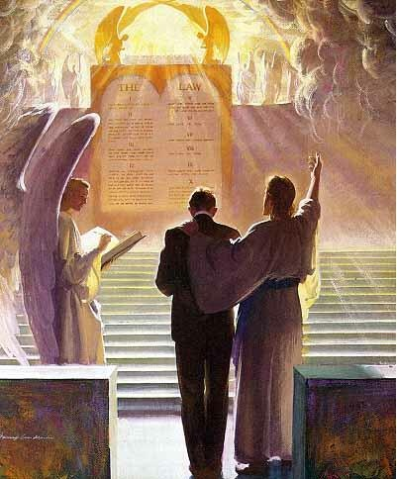
A Vision of the End…
Rev. 20:4-5 “And I saw thrones, and they sat upon them, and judgment was given unto them: and I saw the souls of them that were beheaded for the witness of Jesus, and for the word of God, and which had not worshipped the beast, neither his image, neither had received his mark upon their foreheads, or in their hands; and they lived and reigned with Christ a thousand years. But the rest of the dead lived not again until the thousand years were finished. This is the first resurrection.”

Slide 8
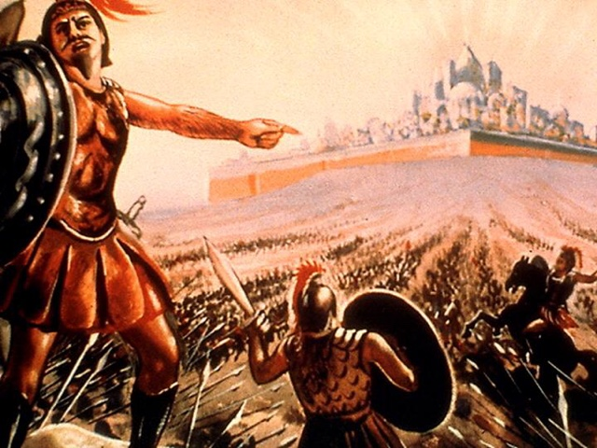
Rev. 20:7-9 “And when the thousand years are expired, Satan shall be loosed out of his prison, And shall go out to deceive the nations which are in the four quarters of the earth, Gog, and Magog, to gather them together to battle: the number of whom is as the sand of the sea. And they went up on the breadth of the earth, and compassed the camp of the saints about, and the beloved city: and fire came down from God out of heaven, and devoured them.”

Slide 9
“Now the event takes place foreshadowed in the last solemn service of the Day of Atonement. When the ministration in the holy of holies had been completed, and the sins of Israel had been removed from the sanctuary by virtue of the blood of the sin offering, then the scapegoat was presented alive before the Lord; and in the presence of the congregation the high priest confessed over him "all the iniquities of the children of Israel, and all their transgressions in all their sins, putting them upon the head of the goat." Leviticus 16:21. In like manner, when the work of atonement in the heavenly sanctuary has been completed, then in the presence of God and heavenly angels and the hosts of the redeemed the sins of God's people will be placed upon Satan; he will be declared guilty of all the evil which he has caused them to commit. And as the scapegoat was sent away into a land not inhabited, so Satan will be banished to the desolate earth, an uninhabited and dreary wilderness.” GC, p. 658

Slide 10
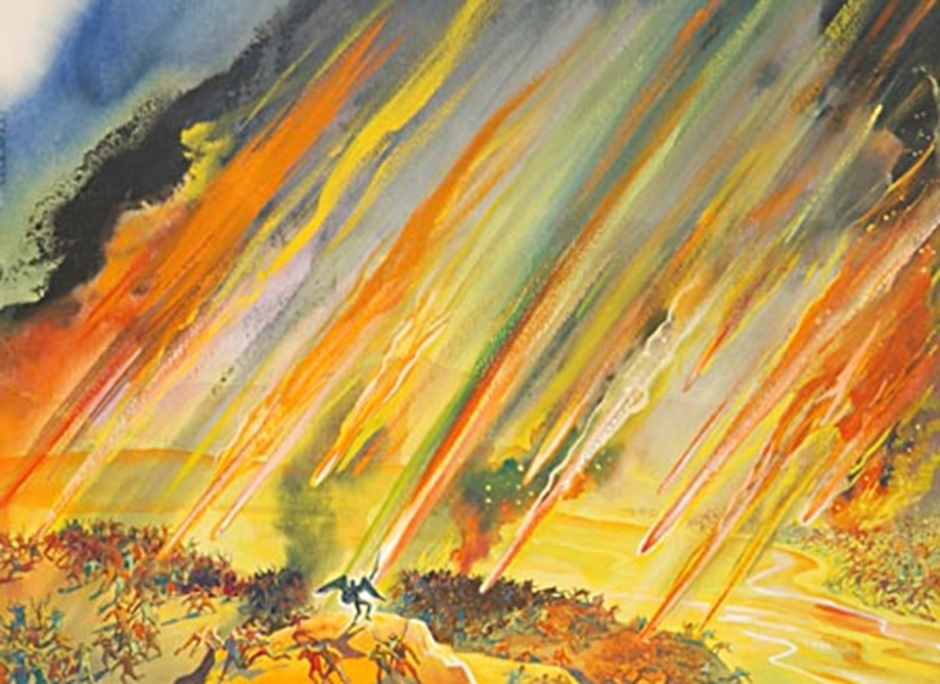
Rev. 20:10-12 “And the devil that deceived them was cast into the lake of fire and brimstone, where the beast and the false prophet are, and shall be tormented day and night for ever and ever. And I saw a great white throne, and him that sat on it, from whose face the earth and the heaven fled away; and there was found no place for them. And I saw the dead, small and great, stand before God; and the books were opened: and another book was opened, which is the book of life: and the dead were judged out of those things which were written in the books, according to their works.”

Slide 11
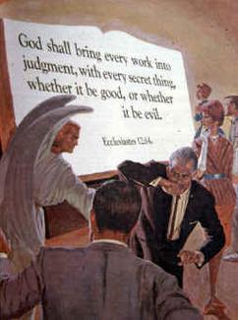
Rev. 20:13-15 “and they were judged every man according to their works. And death and hell were cast into the lake of fire. This is the second death. And whosoever was not found written in the book of life was cast into the lake of fire
What works will I be judged on??
Rom. 2:12 “For as many as have sinned without law shall also perish without law: and as many as have sinned in the law shall be judged by the law; (For not the hearers of the law are just before God, but the doers of the law shall be justified.”

Slide 12
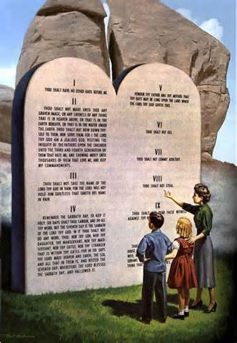
The Law of God is the Standard
James 2:12 “So speak ye, and so do, as they that shall be judged by the law of liberty.”
Ecclesiastes 12:13-14 “Let us hear the conclusion of the whole matter: Fear God, and keep his commandments: for this is the whole duty of man. For God shall bring every work into judgment, with every secret thing, whether it be good, or whether it be evil.

Slide 13
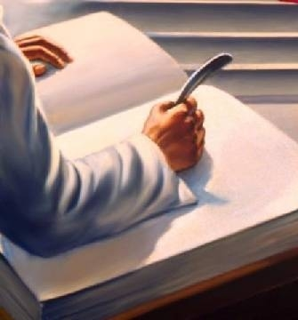
Mrs. White Puts it This Way
Every man's work passes in review before God, and is registered for faithfulness or unfaithfulness. Opposite each name in the books of heaven is entered, with terrible exactness, every wrong word, every selfish act, every unfulfilled duty, and every secret sin, with every artful dissembling. Heaven-sent warnings or reproofs neglected, wasted moments, unimproved opportunities, the influence exerted for good or for evil, with its far-reaching results, all are chronicled by the recording angel. The law of God is the standard by which the characters and the lives of men will be tested in the judgment. GC, 482

Slide 14
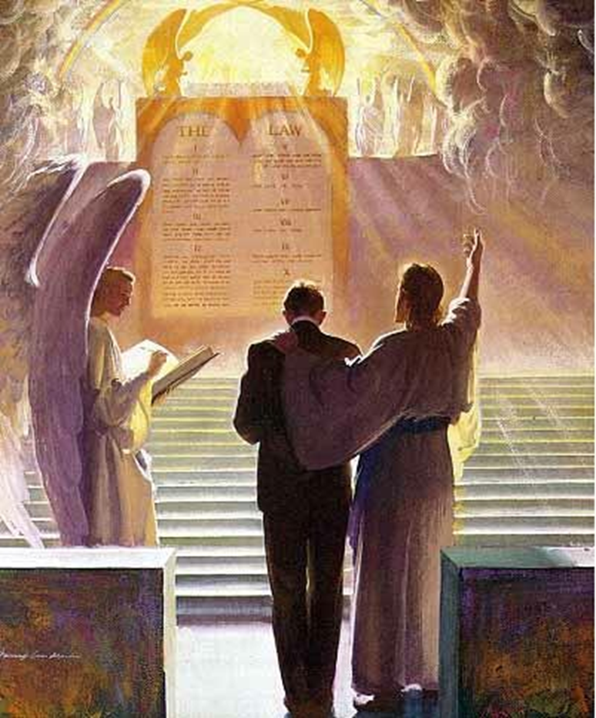
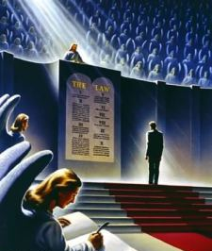

Slide 15
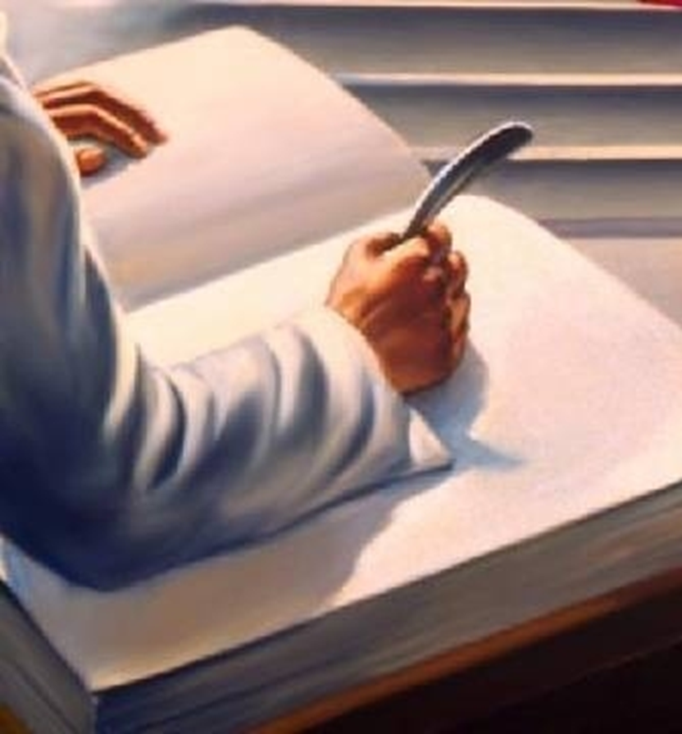
A New Judgment Takes Place
1 Cor. 6:2-4 “Do ye not know that the saints shall judge the world? and if the world shall be judged by you, are ye unworthy to judge the smallest matters? Know ye not that we shall judge angels? how much more things that pertain to this life? If then ye have judgments of things pertaining to this life, set them to judge who are least esteemed in the church.”

Slide 16
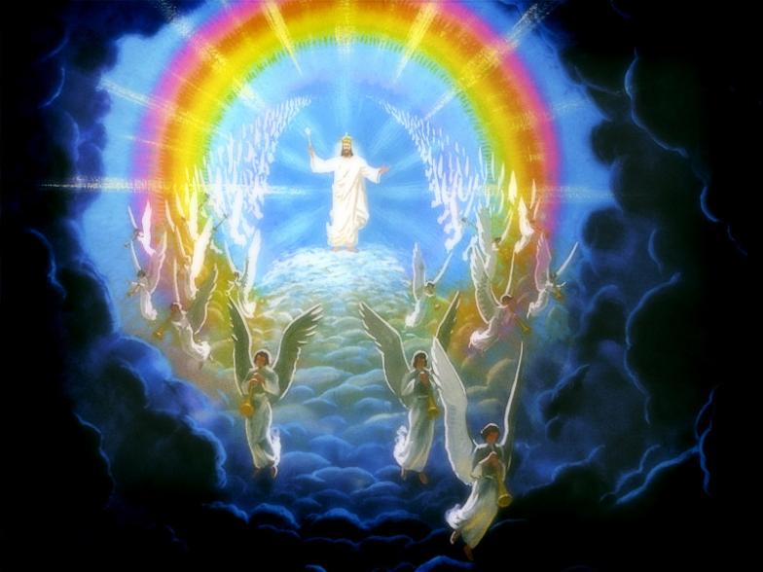
The Third Coming…
Zech. 14:1-4 “Behold, the day of the Lord cometh, and thy spoil shall be divided in the midst of thee. For I will gather all nations against Jerusalem to battle; and the city shall be taken, and the houses rifled, and the women ravished; and half of the city shall go forth into captivity, and the residue of the people shall not be cut off from the city. Then shall the Lord go forth, and fight against those nations, as when he fought in the day of battle. And his feet shall stand in that day upon the mount of Olives, which is before Jerusalem on the east, and the mount of Olives shall cleave in the midst thereof toward the east and toward the west, and there shall be a very great valley; and half of the mountain shall remove toward the north, and half of it toward the south.”

Slide 17
The Final Judgment
Jesus called forth the wicked dead; and they came up with the same feeble, sickly bodies that went into the grave. What a spectacle! What a scene! At the first resurrection all came forth in immortal bloom, but at the second the marks of the curse are visible on all. The kings and noblemen of the earth, the mean and low, the learned and unlearned, come forth together. All behold the Son of man; and those very men who despised and mocked Him, who put the crown of thorns upon His sacred brow and smote Him with the reed, behold Him in all His kingly majesty . . . And they know that He is the very one whom they crucified and derided in His expiring agony. And then there arises one long protracted wail of agony, as they flee to hide from the presence of the King of kings and Lord of lords. All are seeking to hide in the rocks, to shield themselves from the terrible glory of Him whom they once despised. And, overwhelmed and pained with His majesty and exceeding glory, they with one accord raise their voices, and with terrible distinctness exclaim, "Blessed is He that cometh in the name of the Lord!“—Story of Redemption, p. 418-419

Slide 18
Now Satan prepares for a last mighty struggle for the supremacy. . . as the wicked dead are raised and he sees the vast multitudes upon his side, his hopes revive, and he determines not to yield the great controversy. He will marshal all the armies of the lost under his banner and through them endeavor to execute his plans. The wicked are Satan's captives. In rejecting Christ they have accepted the rule of the rebel leader. They are ready to receive his suggestions and to do his bidding. Yet, true to his early cunning, he does not acknowledge himself to be Satan. He claims to be the prince who is the rightful owner of the world and whose inheritance has been unlawfully wrested from him. He represents himself to his deluded subjects as a redeemer, assuring them that his power has brought them forth from their graves and that he is about to rescue them from the most cruel tyranny. The presence of Christ having been removed, Satan works wonders to support his claims. He makes the weak strong and inspires all with his own spirit and energy. He proposes to lead them against the camp of the saints and to take possession of the City of God. With fiendish exultation he points to the unnumbered millions who have been raised from the dead and declares that as their leader he is well able to overthrow the city and regain his throne and his kingdom.—GC, p. 662

Slide 19
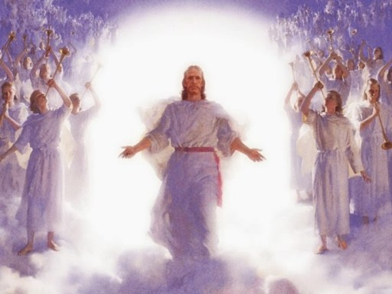
By command of Jesus, the gates of the New Jerusalem are closed, and the armies of Satan surround the city and make ready for the onset. Now Christ again appears to the view of His enemies. Far above the city, upon a foundation of burnished gold, is a throne, high and lifted up. Upon this throne sits the Son of God, and around Him are the subjects of His kingdom. The power and majesty of Christ no language can describe, no pen portray.—GC, p. 664-665

Slide 20
As soon as the books of record are opened, and the eye of Jesus looks upon the wicked, they are conscious of every sin which they have ever committed. They see just where their feet diverged from the path of purity and holiness, just how far pride and rebellion have carried them in the violation of the law of God. The seductive temptations which they encouraged by indulgence in sin, the blessings perverted, the messengers of God despised, the warnings rejected, the waves of mercy beaten back by the stubborn, unrepentant heart--all appear as if written in letters of fire. Above the throne is revealed the cross; and like a panoramic view appear the scenes of Adam's temptation and fall, and the successive steps in the great plan of redemption. The Saviour's lowly birth; His early life of simplicity and obedience; His baptism in Jordan; the fast and temptation in the wilderness; His public ministry, unfolding to men heaven's most precious blessings; the days crowded with deeds of love and mercy, the nights of prayer and watching in the solitude of the mountains; the plottings of envy, hate, and malice which repaid His benefits; the awful, mysterious agony in Gethsemane beneath the crushing weight of the sins of the whole world; His betrayal into the hands of the murderous mob—GC, 666-667

Slide 21
There are papist priests and prelates, who claimed to be Christ's ambassadors, yet employed the rack, the dungeon, and the stake to control the consciences of His people. There are the proud pontiffs who exalted themselves above God and presumed to change the law of the Most High. Those pretended fathers of the church have an account to render to God from which they would fain be excused. Too late they are made to see that the Omniscient One is jealous of His law and that He will in no wise clear the guilty. They learn now that Christ identifies His interest with that of His suffering people; and they feel the force of His own words: "Inasmuch as ye have done it unto one of the least of these My brethren, ye have done it unto Me." Matthew 25:40. The whole wicked world stand arraigned at the bar of God on the charge of high treason against the government of heaven. They have none to plead their cause; they are without excuse; and the sentence of eternal death is pronounced against them.—GC, 668

Slide 22
It is now evident to all that the wages of sin is not noble independence and eternal life, but slavery, ruin, and death. The wicked see what they have forfeited by their life of rebellion. The far more exceeding and eternal weight of glory was despised when offered them; but how desirable it now appears. "All this," cries the lost soul, "I might have had, but I chose to put these things far from me. Oh, strange infatuation! I have exchanged peace, happiness, and honor for wretchedness, infamy, and despair.“—SR, p. 425
Notwithstanding Satan has been constrained to acknowledge God's justice, and to bow to the supremacy of Christ, his character remains unchanged. The spirit of rebellion, like a mighty torrent, against bursts forth. Filled with frenzy, he determines not to yield the great controversy. The time has come for a last desperate struggle against the King of heaven. He rushes into the midst of his subjects and endeavors to inspire them with his own fury and arouse them to instant battle. But of all the countless millions whom he has allured into rebellion, there are none now to acknowledge his supremacy. His power is at an end. The wicked are filled with the same hatred of God that inspires Satan; but they see that their case is hopeless, that they cannot prevail against Jehovah. Their rage is kindled against Satan and those who have been his agents in deception. With the fury of demons they turn upon them, and there follows a scene of universal strife. –SR, 427-428

Slide 23
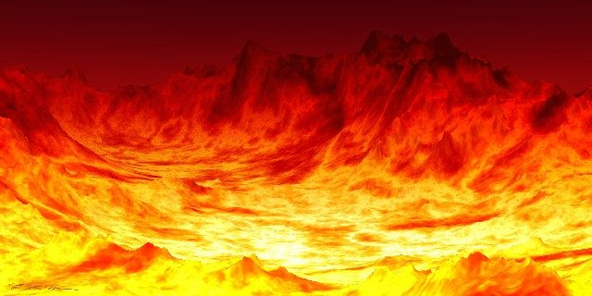
Fire comes down from God out of heaven. The earth is broken up. The weapons concealed in its depths are drawn forth. Devouring flames burst from every yawning chasm. The very rocks are on fire. The day has come that "shall burn as an oven." Mal. 4:1. The elements melt with fervent heat, the earth also and the works that are therein are burned up. (2 Peter 3:10.) . . . Some are destroyed as in a moment, while others suffer many days. All are punished according to their deeds. The sins of the righteous have been transferred to Satan, the originator of evil, who must bear their penalty. Thus he is made to suffer, not only for his own rebellion, but for all the sins which he has caused God's people to commit. His punishment is to be far greater than that of those whom he has deceived—SR 428,429

