Slide 1
Beginning of Daniel 11
Seen This Before!!!

Slide 2
Sound Familiar??
Also I in the first year of Darius the Mede, even I, stood to confirm and to strengthen him. And now will I shew thee the truth. Behold, there shall stand up yet three kings in Persia; and the fourth shall be far richer than they all: and by his strength through his riches he shall stir up all against the realm of Grecia. And a mighty king shall stand up, that shall rule with great dominion, and do according to his will. And when he shall stand up, his kingdom shall be broken, and shall be divided toward the four winds of heaven; and not to his posterity, nor according to his dominion which he ruled: for his kingdom shall be plucked up, even for others beside those.” Daniel 11:1-4

Slide 3
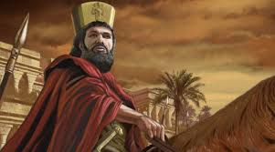
Four Kings in Media-Persia
1. Cambyses 530-522 BC
2. False Smerdis 522 BC
3. Darius 1 ruled 522-485
4. Ahasuerus (Esther’s husband) most wealthy of all the Medo-Persian kings. Ruled 485-465 BC. He sought to wipe out the Greeks around 480, 479 BC!

Slide 4
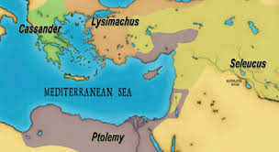
Greece Rises!
A mighty Greek king rises after Medo-Persia falls. This clearly is Alexander. Daniel 11:4 then describes the divisions of his empire among his 4 leading generals. Cassander, Lysimachus, Seleucids, and Ptolemy.

Slide 5
Repeat, and Repeat
Daniel 11 is following a similar pattern as did Daniel 2,7, 8 and now Daniel 11. The preceding chapters, with slight variations, covers the 3 kingdoms of Babylon, Medo-Persia, Greece and its 4 divisions, Pagan and Papal Rome and then the deliverance of God’s people! This is repeated in greater detail here in Daniel 11!

Slide 6
Detail, Detail, and Detail
Daniel 11:5-15 discusses clashes between the Seleucid’s kingdom, called the king of the north, covering Syria, Babylon and the land to the east, and the Ptolemaic kingdom, covering Egypt, called the king of the south.
“And in the end of years they shall join themselves together; for the king's daughter of the south shall come to the king of the north to make an agreement: but she shall not retain the power of the arm; neither shall he stand, nor his arm: but she shall be given up, and they that brought her, and he that begat her, and he that strengthened her in these times.” Daniel 11:6

Slide 7
Frailty of Man!
“The Holy Spirit has so shaped matters, both in the giving of the prophecy and in the events portrayed, as to teach that the human agent is to be kept out of sight, hid in Christ, and that the Lord God of heaven and His law are to be exalted. Read the book of Daniel. Call up, point by point, the history of the kingdoms there represented. Behold statesmen, councils, powerful armies, and see how God wrought to abase the pride of men, and lay human glory in the dust.” TM, pg. 112

Slide 8
From Greece to Pagan Rome!
“But he that cometh against him shall do according to his own will, and none shall stand before him: and he shall stand in the glorious land, which by his hand shall be consumed. He shall also set his face to enter with the strength of his whole kingdom, and upright ones with him; thus shall he do: and he shall give him the daughter of women, corrupting her: but she shall not stand on his side, neither be for him. After this shall he turn his face unto the isles, and shall take many: but a prince for his own behalf shall cause the reproach offered by him to cease; without his own reproach he shall cause it to turn upon him. Then he shall turn his face toward the fort of his own land: but he shall stumble and fall, and not be found. Then shall stand up in his estate a raiser of taxes in the glory of the kingdom: but within few days he shall be destroyed, neither in anger, nor in battle.” Daniel 11:16-20

Slide 9
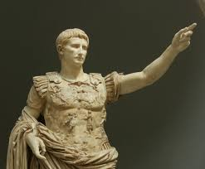
The Raiser of Taxes!
“And it came to pass in those days, that there went out a decree from Caesar Augustus, that all the world should be taxed. (And this taxing was first made when Cyrenius was governor of Syria.) And all went to be taxed, every one into his own city.” Luke 2:1-3

Slide 10
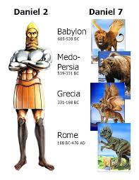
Following a Similar Path as Daniel 2,7,and 8
Following the path we have seen before, Daniel 11 begins with Medo-Persia, then Greece, and now Pagan Rome. The next power we will see will be Papal Rome. The transfer from Pagan to Papal Rome seems to come around verse 27. Papal Rome seems to be zeroed in on as the one who assaults the Holy Covenant.

Slide 11
Transition from Pagan to Papal Rome
“And in his estate shall stand up a vile person, to whom they shall not give the honour of the kingdom: but he shall come in peaceably, and obtain the kingdom by flatteries. And with the arms of a flood shall they be overflown from before him, and shall be broken; yea, also the prince of the covenant. And after the league made with him he shall work deceitfully:…and shall become strong with a small people. He shall enter peaceably even upon the fattest places of the province; and he shall do that which his fathers have not done, nor his fathers' fathers; he shall scatter among them the prey, and spoil, and riches: yea, and he shall forecast his devices against the strong holds, even for a time. And he shall stir up his power and his courage against the king of the south with a great army; and the king of the south shall be stirred up to battle with a very great and mighty army; but he shall not stand...Yea, they that feed of the portion of his meat shall destroy him, and his army shall overflow: and many shall fall down slain. And both these kings' hearts (Pagan and Papal Rome) shall be to do mischief,” Daniel 11:21,22

Slide 12
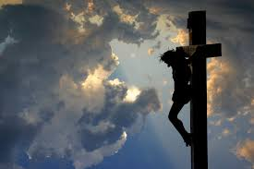
Messiah Broken during Pagan Rome’s Rule
“When Pilate saw that he could prevail nothing, but that rather a tumult was made, he took water, and washed his hands before the multitude, saying, I am innocent of the blood of this just person: see ye to it. Then answered all the people, and said, His blood be on us, and on our children. Then released he Barabbas unto them: and when he had scourged Jesus, he delivered him to be crucified.” Matthew 27:24-26

Slide 13
Papal Rome Attacks the Covenant
Then shall he return into his land with great riches; and his heart shall be against the holy covenant; and he shall do exploits, and return to his own land. At the time appointed he shall return, and come toward the south; but it shall not be as the former, or as the latter. For the ships of Chittim shall come against him: therefore he shall be grieved, and return, and have indignation against the holy covenant: so shall he do; he shall even return, and have intelligence with them that forsake the holy covenant. And arms shall stand on his part, and they shall pollute the sanctuary of strength, and shall take away the daily sacrifice, and they shall place the abomination that maketh desolate. And such as do wickedly against the covenant shall he corrupt by flatteries: but the people that do know their God shall be strong, and do exploits.” Daniel 11:28-32

Slide 14
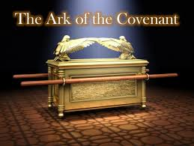
The 10 Commandments
Everyone of God’s covenants had as its base the 10 commandments. “Now therefore, if ye will obey my voice indeed, and keep my covenant, then ye shall be a peculiar treasure unto me above all people: for all the earth is mine:” Ex. 19:5 The papacy detests God’s law! 2 Thess. 2, Daniel 7, etc.

Slide 15
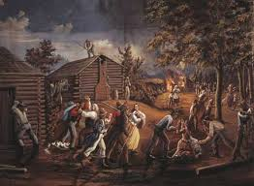
Persecution of the Saints
“And they that understand among the people shall instruct many: yet they shall fall by the sword, and by flame, by captivity, and by spoil, many days. Now when they shall fall, they shall be holpen with a little help: but many shall cleave to them with flatteries. And some of them of understanding shall fall, to try them, and to purge, and to make them white, even to the time of the end: because it is yet for a time appointed.” Daniel 11:33-35

Slide 16
Blasphemer!
“And the king shall do according to his will; and he shall exalt himself, and magnify himself above every god, and shall speak marvelous things against the God of gods, and shall prosper till the indignation be accomplished: for that that is determined shall be done. Neither shall he regard the God of his fathers, nor the desire of women, nor regard any god: for he shall magnify himself above all.” Daniel 11:36,37

Slide 17
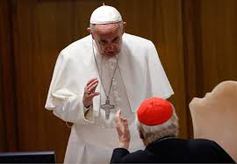
Sounds Familiar!!
“And he shall speak great words against the most High, and shall wear out the saints of the most High, and think to change times and laws:” Dan. 7:25
“Who opposeth and exalteth himself above all that is called God, or that is worshipped; so that he as God sitteth in the temple of God, shewing himself that he is God.” 2Thess. 2:4

Slide 18
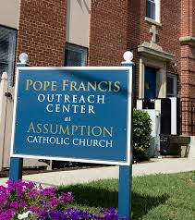
Papal Assumption
“But in his estate shall he honour the God of forces: and a god whom his fathers knew not shall he honour with gold, and silver, and with precious stones, and pleasant things. Thus shall he do in the most strong holds with a strange god, whom he shall acknowledge and increase with glory: and he shall cause them to rule over many, and shall divide the land for gain.” Daniel 11:38,39

Slide 19
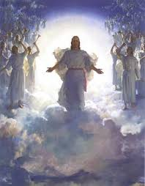
He Will Make it All Right!

