Slide 1
2520
Importance for Today

Slide 2
The What?
When asked to do a talk on the 2520, my response was, “The what?” I promised the person I would and began to do research on the 2520. The following is what I found…………………………………………………………….

Slide 3
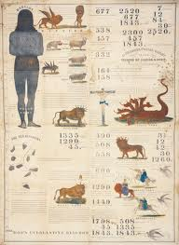
1843 Chart of the Millerites

Slide 4
Right Corner
The upper right corner of this prophetic chart makes reference to a 2,520 year period. Ellen White supported this chart too. “ I have seen that the 1843 chart was directed by the hand of the Lord, and that it should not be altered; that the figures were as He wanted them; that His hand was over and hid a mistake in some of the figures, so that none could see it, until His hand was removed. [This applies to the chart used during the 1843 movement, and has special reference to the calculation of the prophetic periods as it appeared on that chart. The next sentence explains that there was an inaccuracy which in the providence of God was suffered to exist. But this does not preclude the publication of a chart subsequently which would correct the mistake, after the 1843 movement was past, and the calculation as then made had served its purpose].” EW, pg. 74

Slide 5
Support
. “All the messages given from 1840-1844 are to be made forcible now, for there are many people who have lost their bearings. The messages are to go to all the churches. Christ said, `Blessed are your eyes, for they see; and your ears, for they hear. For verily I say unto you, That many prophets and righteous men have desired to see those things which ye see, and have not seen them; and to hear those things which ye hear, and have not heard them' [Matthew 13:16, 17]. Blessed are the eyes which saw the things that were seen in 1843 and 1844. The message was given. And there should be no delay in repeating the message, for the signs of the times are fulfilling; the closing work must be done. A great work will be done in a short time. A message will soon be given by God's appointment that will swell into a loud cry. Then Daniel will stand in his lot, to give his testimony.“ Manuscript Releases, volume 21, 437.

Slide 6
Conclusions Drawn
The Millerites preached about a 2,520 year time prophecy.
Ellen White ‘apparently’ endorsed it. Did she really?
Since we are Protestant Seventh day Adventists, then we must have a clear, Biblical basis for this doctrine. EGW’s ‘apparent’ endorsement of a doctrine is not a basis for any teaching!! The chart mentions Leviticus 26 as the basis for the teaching of the 2,520 year time period. Let us see what it says……..

Slide 7
4 Times Mentioned
Leviticus 26:18 “And if ye will not yet for all this hearken unto me, then I will punish you seven times more for your sins.”
Leviticus 26:21 “And if ye walk contrary unto me, and will not hearken unto me; I will bring seven times more plagues upon you according to your sins.”
Leviticus 26:24 “Then will I also walk contrary unto you, and will punish you yet seven times for your sins.”
Leviticus 26:28 “Then I will walk contrary unto you also in fury; and I, even I, will chastise you seven times for your sins.”

Slide 8
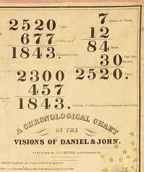
A Time Period? Or Severity of Punishment?
The four references in Leviticus 26 in context seemed to indicate the severity of judgment rather than a time period. William Miller and folk today believe this 7 times is a prophetic time period of 2,520 years. What does the Hebrew say and the Greek Septuagint?

Slide 9
Comments on Lev. 26
“In references to the Hebrew, we learn from the Hebrew Concordance that the expression, seven times, in Lev. xxvi, comes from sheh-vag; and this word is expressly set down by Gesenius, in those texts, as an adverb, also in Ps. cxix, 164; Prov. xxiv, 16. In Dan. iv, 16, 25, the expression, seven times, twice occurs, where beyond question it means duration. Nebuchadnezzar was to be driven from men, and make his dwelling with the beasts of the field, until seven times should pass over him. There can be no mistaking that here the expression means a certain space of time; but here we find, not the adverb as in Lev. xxvi, but the noun, gid-dahn, defined by Gesenius, "Time, in prophetic language, for a year."

Slide 10
Continued
“In Dan. vii, 25, where a prophetic period is brought to view in the expression, "a time and times and the dividing of time," the same word is used. In Dan. xii, 7, where the same period is again brought to view, and in about the same language, we have another word, moh-gehd, defined by Gesenius, "Appointment of time. Spoken of a space of time, appointed and definite. In the prophetic style for a year." It will be seen by this definition, that this word is synonymous with the one used in Dan. vii, 25, as above referred to. Now if a period of time is meant by the expression, seven times, in Lev. xxvi, one of these words should and would most assuredly have been used. And the fact that neither of these words is there used, but another word, and that an adverb, places it beyond question that no such period is there intended.” James White

Slide 11
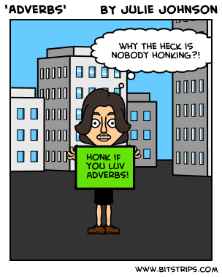
Article by James White
That commentary was done by James White in the Adventist Review, Jan. 26, 1864. White’s point is thus: Lev. 26 is not discussing a time period at all; it is declaring the intensity of punishment to be given for continual disobedience! Leviticus 26, the phrase for seven times is an ADVERB; seven times in Daniel 4 is a NOUN!!!

Slide 12
How About Daniel 3?
“Then was Nebuchadnezzar full of fury, and the form of his visage was changed against Shadrach, Meshach, and Abednego: therefore he spake, and commanded that they should heat the furnace one seven times more than it was wont to be heated.” verse 19 Is this a time period or is this showing intensity of the heat? Guess what? Daniel 3 uses the same wording as Leviticus 26!!!!

Slide 13
White Summarizes
“The Greek is equally definite. The Septuagint has in Lev. xxvi, heptakis, which is an adverb, signifying seven times. In Dan. iv, 16, 25, for Nebuchadnezzar's seven times we have not heptakis, the adverb, but heptakairoi, a noun and its adjective. And in all cases where the word time occurs, denoting a prophetic period, as in Dan. vii, 25; xii, 7; Rev. xii, 14, it is from the noun kairos. Such a thing as a prophetic period based on an adverb is not to be found.
So then, there is no prophetic period in Lev. xxvi; and those who imagine that such a thing exists, and are puzzling themselves over the adjustment of its several dates, are simply beating the air. To ignore, or treat with neglect, a prophetic period where one is plainly given, is censurable in the extreme. It is an equally futile, though not so heinous, a course, to endeavor to create one where none exists. “ James White, Review and Herald, 1-26-1864

Slide 14
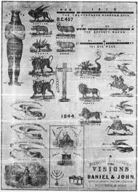
2520 Left out of 1863 Chart

Slide 15
Wait a Minute!
Ellen White endorsed the chart. She said, “I have seen that the 1843 chart was directed by the hand of the Lord, and that it should not be altered; that the figures were as He wanted them; that His hand was over and hid a mistake in some of the figures, so that none could see it, until His hand was removed.” Because the Lord directed the chart, does that mean everything on the chart was right?

Slide 16
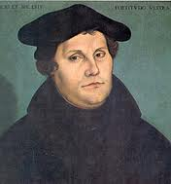
Luther
“Luther was the man for his time; through him God accomplished a great work for the reformation of the church and the enlightenment of the world…Angels of heaven were by his side, and rays of light from the throne of God revealed the treasures of truth to his understanding. He had ever feared to offend God, but now the deep conviction of his condition as a sinner took hold upon him as never before.” GC, pgs. 120,122

Slide 17
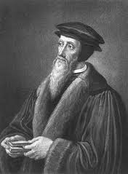
Calvin ?
Since angels were by Luther, guiding him into the truth, does that mean we are now to accept everything he taught:
Sunday?
Immortality of the soul?
Persecute those who don’t agree with us?
How about Calvin?
Predestination?

Slide 18
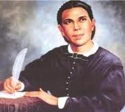
NEVER ONCE
In Ellen White’s 70 years of ministry, she never once specifically mentioned 2520. In her masterpiece, the Great Controversy, in chapters 18-24 on the life of William Miller and his work, she never once mentioned the 2520. I think her example should be followed!

Slide 19
The Longest Time Prophecy
“The experience of the disciples who preached the "gospel of the kingdom" at the first advent of Christ, had its counterpart in the experience of those who proclaimed the message of His second advent. As the disciples went out preaching, "The time is fulfilled, the kingdom of God is at hand," so Miller and his associates proclaimed that the longest and last prophetic period brought to view in the Bible was about to expire, that the judgment was at hand, and the everlasting kingdom was to be ushered in. The preaching of the disciples in regard to time was based on the seventy weeks of Daniel 9. The message given by Miller and his associates announced the termination of the 2300 days of Daniel 8:14, of which the seventy weeks form a part. The preaching of each was based upon the fulfillment of a different portion of the same great prophetic period.” GC., pg. 351

Slide 20
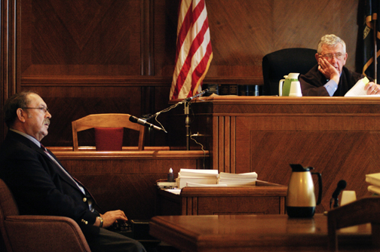
The Case of the Judge
The lawyer walks into the courtroom without his client. He tells the judge there are 9 reasons why his client couldn’t be there. “The first one judge is because my client is dead.” The judge responded, “No more reasons are necessary.”

Slide 21
Summary
1. The 2520 is not a time period at all, but rather a phrase denoting severity of punishment.
2. Ellen White endorsed most of the 1843 chart. However, she never once mentioned the 2520 in her 70 years of ministry. To say that she supported the 2520 because she endorsed the chart is to say she endorsed Sunday, immortality of the soul, and predestination because she endorsed Luther and Calvin.
3. 2520 is a distraction of the devil to keep us occupied from teaching the 3 Angels Messages of Revelation 14!

