Slide 1
Romans, pt. 15
No Condemnation

Slide 2
Summary of Romans 7:13-25
1. The first husband, the carnal nature, offers us bondage, slavery, and death.
2. The second husband, Jesus Christ, offers us peace, power, freedom from guilt, and the controlling power of sin.
3. The law of God points out sin and can do nothing more or less.
4. Submission to Christ is perfect freedom and peace.

Slide 3
Romans 8:1,2
“There is therefore now no condemnation to them which are in Christ Jesus, who walk not after the flesh, but after the Spirit. For the law of the Spirit of life in Christ Jesus hath made me free from the law of sin and death.”
There is no condemnation for those who are in submission to Jesus Christ. There is total condemnation for those who are living in rebellion to Jesus Christ. If we are choosing to do something that we know is wrong, then we are under condemnation because the law can’t change!

Slide 4

Old man vs. New man
When Christ is the Lord of our lives, we are free to walk in harmony with the law of God. When Christ is not controlling us, then the law does what it does; it condemns sin wherever it is found!
“Then said Jesus to those Jews which believed on him, If ye continue in my word, then are ye my disciples indeed; And ye shall know the truth, and the truth shall make you free.” John 8:31,32

Slide 5
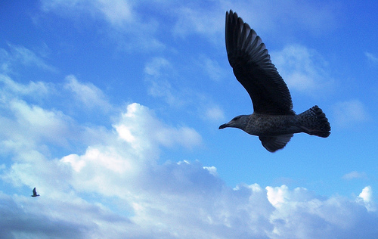
Free as a Bird
“Every soul that refuses to give himself to God is under the control of another power. He is not his own. He may talk of freedom, but he is in the most abject slavery. He is not allowed to see the beauty of truth, for his mind is under the control of Satan. While he flatters himself that he is following the dictates of his own judgment, he obeys the will of the prince of darkness. Christ came to break the shackles of sin-slavery from the soul. "If the Son therefore shall make you free, ye shall be free indeed." "The law of the Spirit of life in Christ Jesus" sets us "free from the law of sin and death." Rom. 8:2. DA, pg. 466

Slide 6
Romans 8:3,4
No man ever perfectly kept the law of God. No one had ever answered Satan’s charge that the law of God could not be obeyed. To refute Satan’s charge, Christ came in our carnal nature and perfectly lived in obedience to the law by faith in the power of His Father.
“For what the law could not do, in that it was weak through the flesh, God sending his own Son in the likeness of sinful flesh, and for sin, condemned sin in the flesh: That the righteousness of the law might be fulfilled in us, who walk not after the flesh, but after the Spirit.”

Slide 7

The Seed of Abraham
“Forasmuch then as the children are partakers of flesh and blood, he also himself likewise took part of the same; that through death he might destroy him that had the power of death, that is, the devil; And deliver them who through fear of death were all their lifetime subject to bondage. For verily he took not on him the nature of angels; but he took on him the seed of Abraham. Wherefore in all things it behoved him to be made like unto his brethren, that he might be a merciful and faithful high priest in things pertaining to God, to make reconciliation for the sins of the people. For in that he himself hath suffered being tempted, he is able to succour them that are tempted.” Hebrews 2:14-18

Slide 8
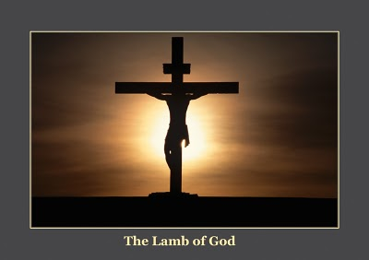
His perfect obedience
Christ lived a life of perfect obedience thru faith in His Father. He did this so that He could give this to us that we could live a life of obedience thru faith.
He showed us how this could be done.
“And when the tempter came to him, he said, If thou be the Son of God, command that these stones be made bread. But he answered and said, It is written, Man shall not live by bread alone, but by every word that proceedeth out of the mouth of God.”
Matthew 4:3,4

Slide 9
Christ Kept the law in our Flesh
Th e law always condemned sin. He that believeth not, is condemned already. Christ is the justifier. Since the law condemns man, it is evident that it cannot justify him, for it is impossible for it to condemn and justify at the same time. But what the law could not do, Christ came in the likeness of sinful flesh to do. How did He do it? By keeping the law when He was in the flesh.

Slide 10
Glory!
“For Christ has left us no excuse; He has condemned sin in the flesh; by His life He has shown that sin in the flesh is condemned, and He has destroyed it, for in Him the body of sin is destroyed, and we are new creatures in Christ. By His exceeding great and precious promises we are made partakers of the divine nature. He has taken away this sinful nature, taken it upon Himself that we might be delivered from it.’ Wagoneer, Romans, pgs. 69,70

Slide 11
Romans 8:5-8
“Now the works of the flesh are manifest, which are these; Adultery, fornication, uncleanness, lasciviousness, Idolatry, witchcraft, hatred, variance, emulations, wrath, strife, seditions, heresies, Envyings, murders, drunkenness, revellings, and such like: of the which I tell you before, as I have also told you in time past, that they which do such things shall not inherit the kingdom of God.” Galatians 5:19-21
“For they that are after the flesh do mind the things of the flesh; but they that are after the Spirit the things of the Spirit. For to be carnally minded is death; but to be spiritually minded is life and peace. Because the carnal mind is enmity against God: for it is not subject to the law of God, neither indeed can be. So then they that are in the flesh cannot please God.”

Slide 12

The Lie
We walk in the flesh, cling to the flesh, cherish the flesh, fulfill the flesh, and then say that we are walking with Christ; away with such talk!! “Because the carnal mind is enmity against God: for it is not subject to the law of God, neither indeed can be. So then they that are in the flesh cannot please God.” Romans 8:7,8

Slide 13
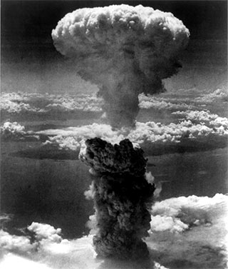
The War to be Fought
The carnal mind is at war with the law of God. If we are following the dictates of the carnal nature, then we are in the worst of bondage. We can talk of Christ; we can claim any thing we want, but if we are following the dictates of our flesh and fulfilling what it says to do in disobedience to God, then we are at war with God and hate God’s law which condemns our sins! We can talk of ‘religion’ , ‘theology’, ‘the Sabbath’, diet, or dress. These amount to nothing apart from submission to Jesus Christ!

Slide 14
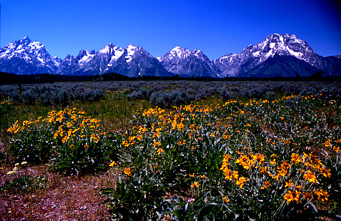
The Indwelling Christ
The flesh never is converted. The flesh never stops warring against God. The flesh remains to taunt, torment, and tantalize us into believing any of a number of sundry lies. All the flesh wants for us is to submit to its authority and control. This is where Christ comes in and helps. “The only defense against evil is the indwelling of Christ in the heart through faith in His righteousness. Unless we become vitally connected with God, we can never resist the unhallowed effects of self-love, self-indulgence, and temptation to sin.” DA, pg. 324

Slide 15

We Will be Resurrected
“But ye are not in the flesh, but in the Spirit, if so be that the Spirit of God dwell in you. Now if any man have not the Spirit of Christ, he is none of his. And if Christ be in you, the body is dead because of sin; but the Spirit is life because of righteousness. But if the Spirit of him that raised up Jesus from the dead dwell in you, he that raised up Christ from the dead shall also quicken your mortal bodies by his Spirit that dwelleth in you.” Romans 8:9-11

Slide 16

Christ in You
If the Spirit is allowed to control our mind, then we are one with God. If the Spirit is not allowed to control the mind, then we are in rebellion to God. If the Spirit controls, then the flesh does not live and Christ lives in the life. This is the glorious privilege of the Christian. “To whom God would make known what is the riches of the glory of this mystery among the Gentiles; which is Christ in you, the hope of glory:’ Col. 1:27

Slide 17
Ephesians 3:16-21
“That he would grant you, according to the riches of his glory, to be strengthened with might by his Spirit in the inner man; That Christ may dwell in your hearts by faith; that ye, being rooted and grounded in love, May be able to comprehend with all saints what is the breadth, and length, and depth, and height; And to know the love of Christ, which passeth knowledge, that ye might be filled with all the fullness of God. Now unto him that is able to do exceeding abundantly above all that we ask or think, according to the power that worketh in us, Unto him be glory in the church by Christ Jesus throughout all ages, world without end. Amen.”

Slide 18
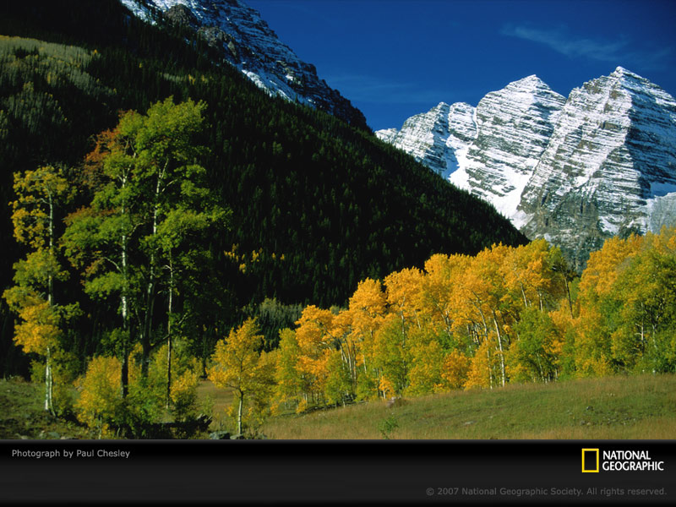
Resurrection to Life
The same Spirit that raised Christ from the dead will raise us from the dead as well. If we allow Him to raise us up from sin and evil, then He will raise us up from the dead.
From the curse of sin
From the curse of death
This is the assurance of eternal life!!!
This is the glorious assurance for the surrendered man or woman. There is no assurance for the person that is letting the flesh reign.

Slide 19
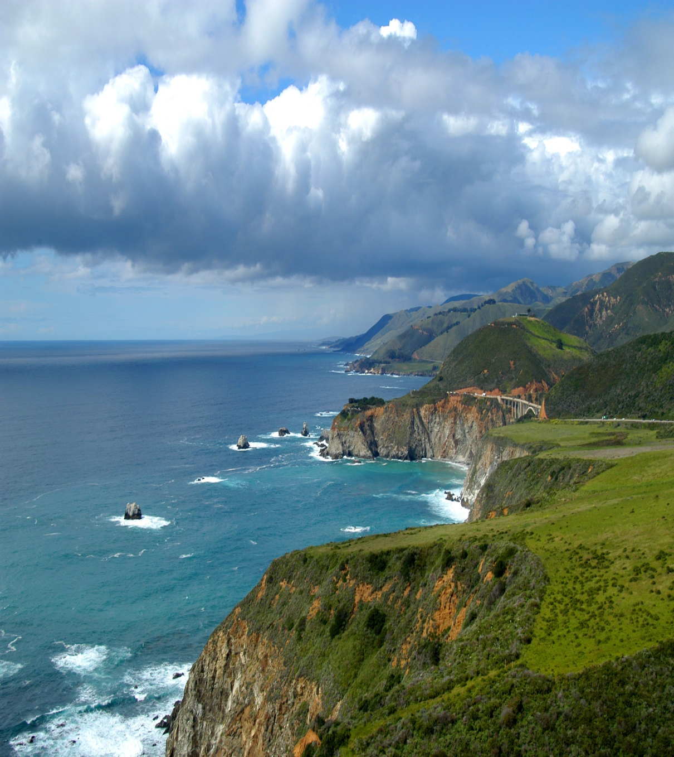
Slain by the Spirit
“For if ye live after the flesh, ye shall die: but if ye through the Spirit do mortify the deeds of the body, ye shall live. For as many as are led by the Spirit of God, they are the sons of God.” Romans 8:13,14
To be slain by the Spirit is to allow the Holy Spirit to kill the flesh when it lifts up its ugly head.

Slide 20
Victory
“In describing to His disciples the office work of the Holy Spirit, Jesus sought to inspire them with the joy and hope that inspired His own heart. He rejoiced because of the abundant help He had provided for His church. The Holy Spirit was the highest of all gifts that He could solicit from His Father for the exaltation of His people. The Spirit was to be given as a regenerating agent, and without this the sacrifice of Christ would have been of no avail. The power of evil had been strengthening for centuries, and the submission of men to this satanic captivity was amazing. Sin could be resisted and overcome only through the mighty agency of the Third Person of the Godhead, who would come with no modified energy, but in the fullness of divine power. It is the Spirit that makes effectual what has been wrought out by the world's Redeemer. It is by the Spirit that the heart is made pure. Through the Spirit the believer becomes a partaker of the divine nature. Christ has given His Spirit as a divine power to overcome all hereditary and cultivated tendencies to evil, and to impress His own character upon His church.” DA, pg. 671

