Slide 1
What is the Difference Between Mormons, Jehovah’s Witnesses, and Seventh-day Adventists? pt 14

Slide 2
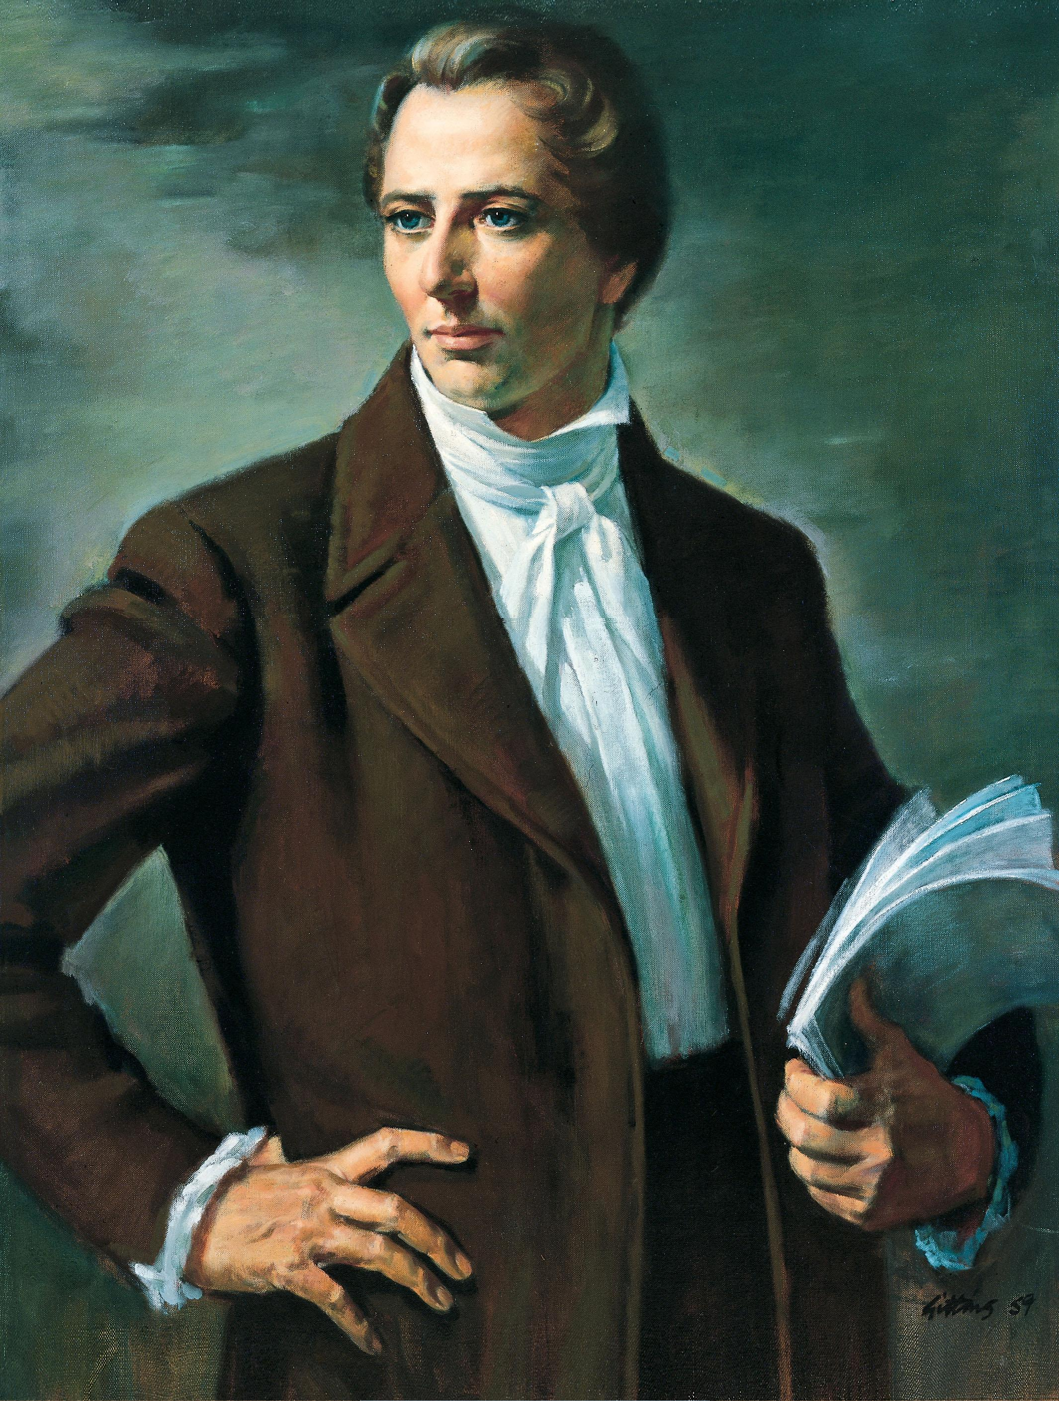
Joseph Smith: True or False Prophet???
Jer. 5:31 “A wonderful and horrible thing is committed in the land; The prophets prophesy falsely, and the priests bear rule by their means; and my people love to have it so: and what will ye do in the end thereof?”
Jer. 23:20-21 “The anger of the Lord shall not return, until he have executed, and till he have performed the thoughts of his heart: in the latter days ye shall consider it perfectly. I have not sent these prophets, yet they ran: I have not spoken to them, yet they prophesied.”

Slide 3
Evidence Thus Far…
Joseph Smith practices witchcraft
Joseph Smith is dishonest and defrauded people through treasure-digging
Joseph Smith communicates with treasure guardians (demons) and holds to an unbiblical understanding of the state of the dead (spiritualism
Joseph Smith and the golden plates: Alvin, differing stories, not enough room on the plates write the BoM, no one but his closest followers ever ‘witness’ the plates
Book of Mormon: 116 lost pages, racist, DNA, archeology, horses
D&C: Changes, polygamy, Lectures on Faith removed,
Book of Abraham: Totally false and made up
JST: Archeological evidence proves the JST is inaccurate, changes to the Bible to make a works-based religion
Joseph Smith always gets what he wants and others always have to sacrifice—polygamy, (BoM), Fraud in Kirtland, Mormon War in MO, Freemasonry co-opted, teaches incorrect Bibles stories, weak God

Slide 4
Mormons VS Muslims
-Spiritualistic view of the state of the dead
-They are restoring the only true religion
-New Scripture because the Bible has been corrupted
-pre-eminence of their prophet
-polygamy
-underage wives
-constantly at war
-Prophets powers are always increased not decreased
-Establish a works-based religion
-Second coming of Mohammed
-Spiritualistic view of the state of the dead
-They are restoring the only true religion
-New Scripture because the Bible has been corrupted
-pre-eminence of their prophet
-polygamy
-underage wives
-constantly at war
-Prophets powers are always increased not decreased
-Establish a works-based religion
-Second coming of Mohammed

Slide 5
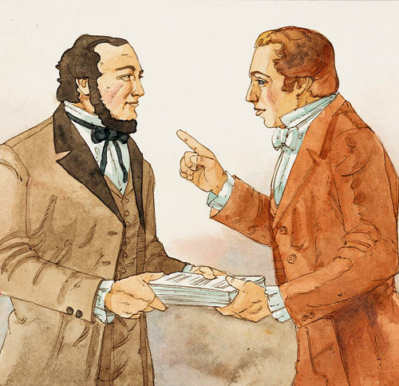
Everyone Must Sacrifice for Joseph Smith
"Therefore I command you to repent—repent, lest I smite you by the rod of my mouth, and by my wrath, and by my anger, and your sufferings be sore—how sore you know not, how exquisite you know not, yea, how hard to bear you know not… And again, I command thee that thou shalt not covet thine own property, but impart it freely to the printing of the Book of Mormon…" (D&C 19:15, 26)

Slide 6
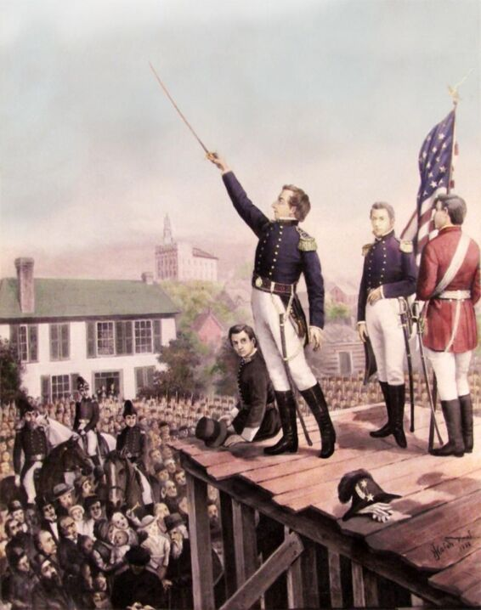
Now Sell the Copyright
“I grant unto my servent a privelige that he may sell a copyright through you speaking after the manner of men for the four Provinces if the People harden not their hearts against the enticeings of my spirit & my word for Behold it lieth in themselves to their condemnation {or} th{eir} salvation”—Joseph Smith Papers, Revelation Book 1, p. 31, josephsmithpapers.org

Slide 7
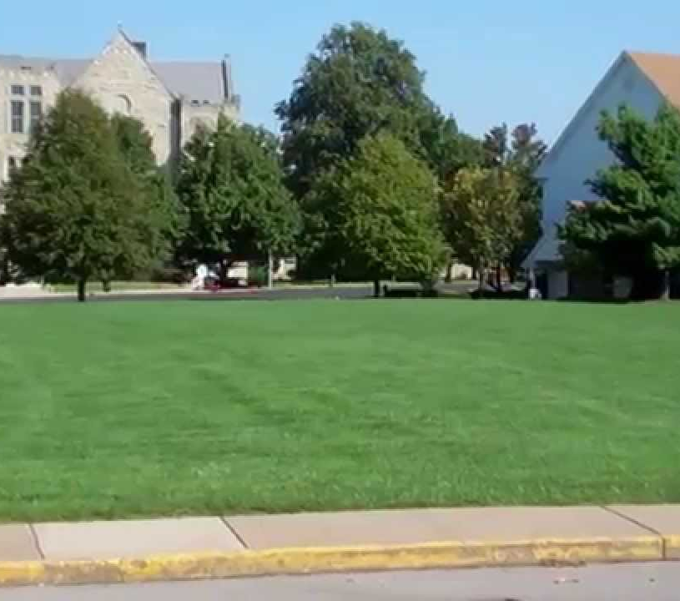
Missouri Temple Mount
1832: “Yea, the word of the Lord concerning his church, established in the last days for the restoration of his people, as he has spoken by the mouth of his prophets, and for the gathering of his saints to stand upon Mount Zion, which shall be the city of New Jerusalem. Which city shall be built, beginning at the temple lot, which is appointed by the finger of the Lord, in the western boundaries of the State of Missouri, and dedicated by the hand of Joseph Smith, Jun., and others with whom the Lord was well pleased. Verily, this is the word of the Lord, that the city New Jerusalem shall be built by the gathering of the saints, beginning at this place, even the place of the temple, which temple shall be reared in this generation. For verily this generation shall not all pass away until an house shall be built unto the Lord, and a cloud shall rest upon it, which cloud shall be even the glory of the Lord, which shall fill the house.” (D&C 84:2-5)

Slide 8
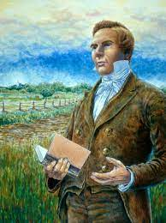
False Second Coming
In February 1835 in Kirtland, Joseph Smith said the following:
“President Smith arose and stated the reason why this meeting was called. It was this. God had commanded it and it was made known to him by vision and by the Holy Spirit. He then gave a relation of some of the circumstances attending us while journeying to Zion, our trials, sufferings, etc. He said God had not designed all this for nothing, but he had it in remembrance yet, and those who went to Zion, with a determination to lay down their lives, if necessary, it was the Will of God, that they should be ordained to the ministry and go forth to prune the vineyard for the last time, or the coming of the Lord, which was nigh, even fifty six years, should wind up the scene.” (Joseph Smith Papers, Minute Book 1, josephsmithpapers.org)

Slide 9
March 1836: Joseph Smith and Oliver Cowdery in Kirtland Temple

Slide 10
In Need of Money
1836: “I, the Lord your God, am not displeased with your coming this journey, notwithstanding your follies. I have much treasure in this city for you, for the benefit of Zion, and many people in this city, whom I will gather out in due time for the benefit of Zion, through your instrumentality. Therefore, it is expedient that you should form acquaintance with men in this city, as you shall be led, and as it shall be given you. And it shall come to pass in due time that I will give this city into your hands, that you shall have power over it, insomuch that they shall not discover your secret parts; and its wealth pertaining to gold and silver shall be yours. Concern not yourselves about your debts, for I will give you power to pay them. (D&C 111:1-5)

Slide 11
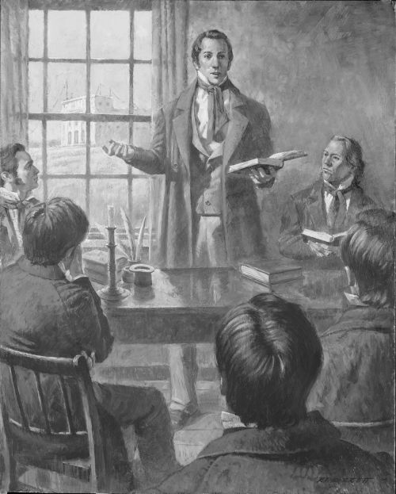
The Unfortunate Story of David W Patten
On April 17, 1838, Joseph Smith counseled David W. Patten via Revelation that he must go on a mission in the next spring:
“Verily, thus saith the Lord: It is wisdom in my servant David W. Patten, that he settle up all his business as soon as he possibly can, and make a disposition of his merchandise, that he may perform a mission unto me next spring, in company with others, even twelve including himself, to testify of my name and bear glad tidings unto the world. (D&C 114:1)
David W. Patten died in October of 1838—He was never able to fulfill this calling…

Slide 12
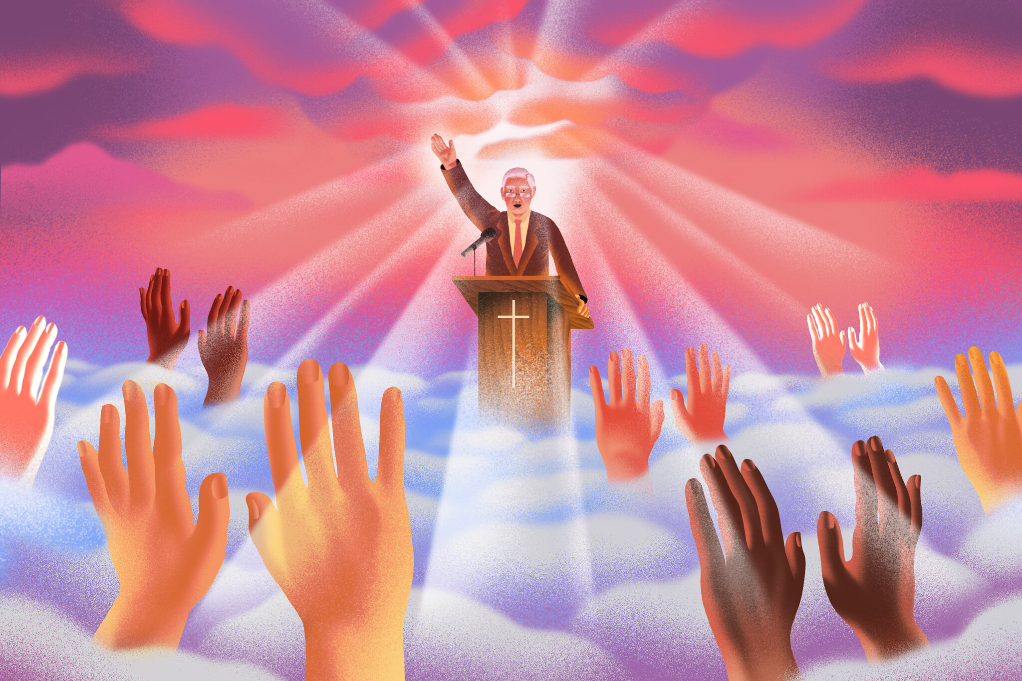
What Does the Bible Say About False Prophecies?
Deut. 18:21-22 “And if thou say in thine heart, How shall we know the word which the Lord hath not spoken? When a prophet speaketh in the name of the Lord, if the thing follow not, nor come to pass, that is the thing which the Lord hath not spoken, but the prophet hath spoken it presumptuously: thou shalt not be afraid of him.”

Slide 13
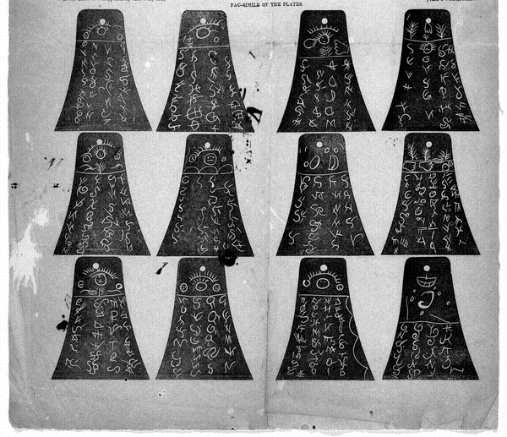
The False Translator: the Kinderhook Plates
In 1843, a man named Robert Wiley began an excavation in Kinderhook, IL—it was all a rouse to trick Joseph Smith into translating false “ancient artifacts”. Joseph Smith took the bait. We read from William Clayton:
“I insert fac-similes of the six brass plates found near Kinderhook... I have translated a portion of them, and find they contain the history of the person with whom they were found.He was a descendant of Ham, through the loins of Pharaoh, King of Egypt, and that he received his Kingdom from the ruler of heaven and earth." (History of the Church of Jesus Christ of Later Day Saints, Vol. 5, pg 372)

Slide 14
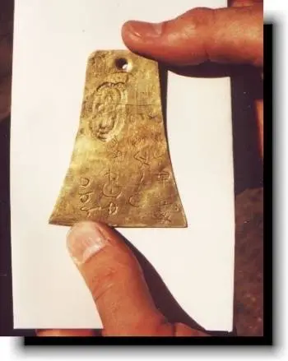
Clung to the Lie Until 1981!
From the August 1981 Ensign: "A recent electronic and chemical analysis of a metal plate (one of six original plates) brought in 1843 to the Prophet Joseph Smith in Nauvoo, Illinois, appears to solve a previously unanswered question in Church history, helping to further evidence that the plate is what its producers later said it was—a nineteenth-century attempt to lure Joseph Smith into making a translation of ancient-looking characters that had been etched into the plates."

Slide 15
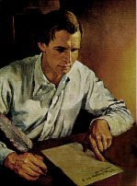
U.S. Government Prophecy of Destruction
By 1843, the U.S. Government and the Mormons did not get along. Joseph Smith revealed a prophecy about the United States if they did not correct the “wrongs” which they made to the LDS Church:
“I prophecy in the name of the Lord God of Israel, unless the United States redress the wrongs committed upon the Saints in the state of Missouri and punish the crimes committed by her officers that in a few years the government will be utterly overthrown and wasted, and there will not be so much as a potsherd left for their wickedness in permitting the murder of men, women and children, and the wholesale plunder and extermination of thousands of her citizens to go unpunished.” (History of the Church of Jesus Christ of Latter Day Saints, Vol. 5, page 394)

Slide 16
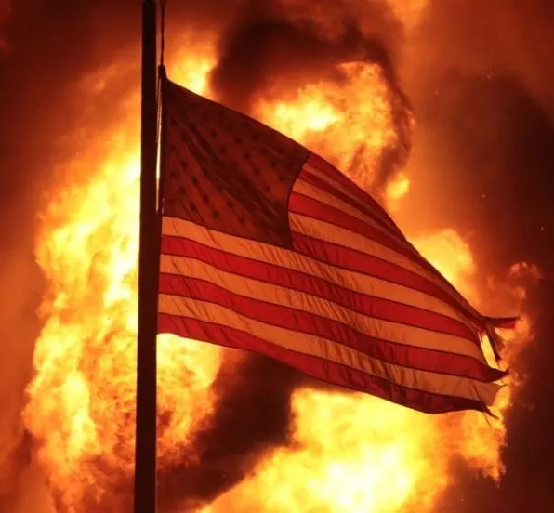
Doubles-Down!
“While discussing the petition to Congress, I prophesied, by virtue of the holy Priesthood vested in me, and in the name of the Lord Jesus Christ, that, if Congress will not hear our petition and grant us protection, they shall be broken up as a government, and God shall damn them, and there shall be nothing left of them - not even a grease spot.” (Millennial Star, Vol. 22, p. 455)

Slide 17
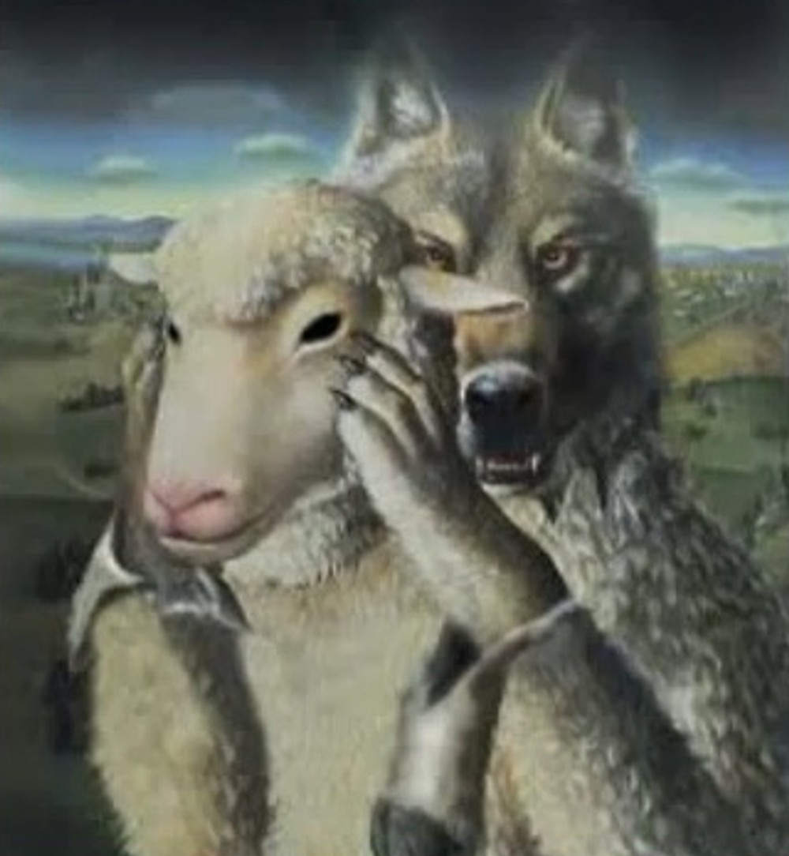
Ravening Wolves
Matt. 7:15 “Beware of false prophets, which come to you in sheep's clothing, but inwardly they are ravening wolves.”

Slide 18
Time-setting Again! 1975
"Choosing the Best Way of Life". The Watchtower. March 15, 1980. pp. 17–18. With the appearance of the book Life Everlasting—in Freedom of the Sons of God, ... considerable expectation was aroused regarding the year 1975. ... there were other statements published that implied that such realization of hopes by that year was more of a probability than a mere possibility. It is to be regretted that these latter statements apparently overshadowed the cautionary ones and contributed to a buildup of the expectation already initiated. ... persons having to do with the publication of the information ... contributed to the buildup of hopes centered on that date.
"What will the 1970's Bring?". Awake!. Watch Tower Society. October 8, 1968. p. 14. Does this mean that the above evidence positively points to 1975 as the complete end of this system of things? Since the Bible does not specifically state this, no man can say... If the 1970s should see intervention by Jehovah God to bring an end to a corrupt world drifting toward ultimate disintegration, that should surely not surprise us.
"How Are You Using Your Life?". Our Kingdom Ministry. May 1, 1974. p. 63. Reports are heard of brothers selling their homes and property and planning to finish out the rest of their days in this old system in the pioneer service. Certainly, this is a fine way to spend the short time remaining before the wicked world's end.

Slide 19
Decline of the Watch Tower After Death
Chicago Daily Tribune October 30, 1949 pg 18: "Pastor Russell died in 1916. In the 33 years since, the methods of this sect have deviated completely from those of Pastor Russell and his manner of teaching."

