Slide 1
The ‘Called Out’ Ones
‘Ecclesia’

Slide 2


Words, Words, Words
Gay?
Or Gay?

Slide 3
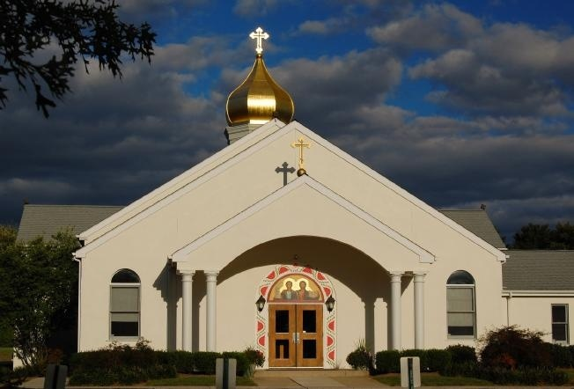
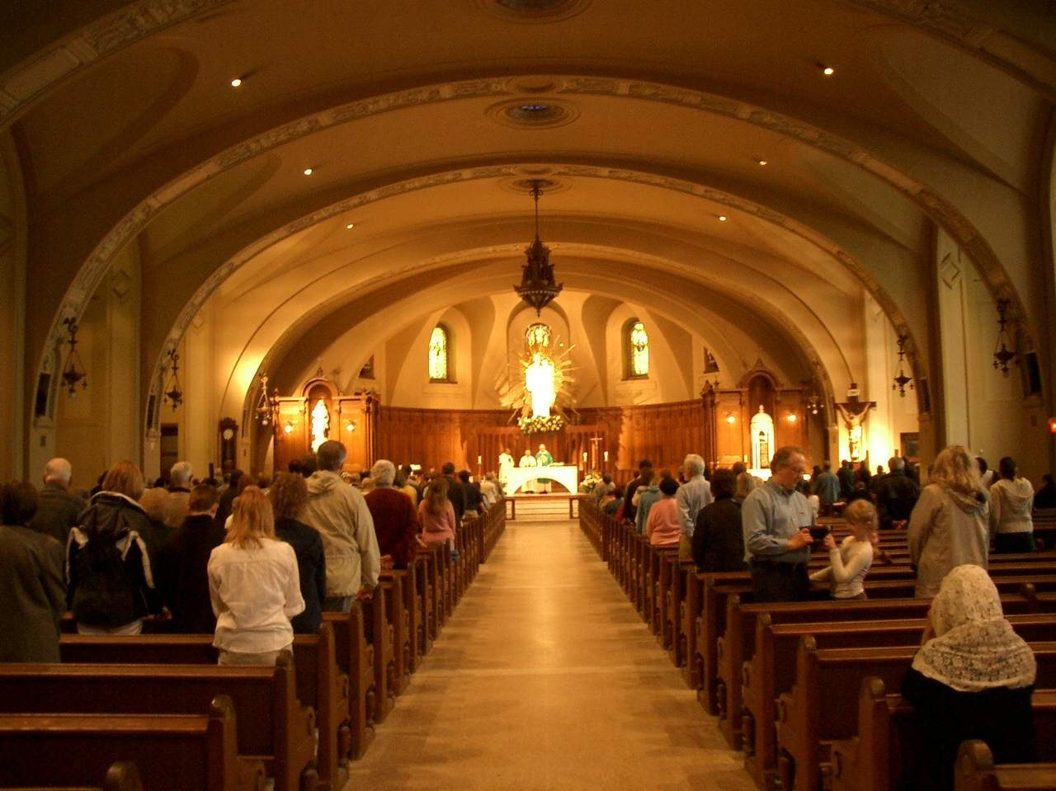
Meanings are Different
Church?
Or Church?

Slide 4
Christ’s Church
“When Jesus came into the coasts of Caesarea Philippi, he asked his disciples, saying, Whom do men say that I the Son of man am? And they said, Some say that thou art John the Baptist: some, Elias; and others, Jeremias, or one of the prophets. He saith unto them, But whom say ye that I am?
And Simon Peter answered and said, Thou art the Christ, the Son of the living God. And Jesus answered and said unto him, Blessed art thou, Simon Barjona: for flesh and blood hath not revealed it unto thee, but my Father which is in heaven. And I say also unto thee, That thou art Peter, and upon this rock I will build my church; and the gates of hell shall not prevail against it.” Matthew 16:13-18

Slide 5
Ecclesia
from a compound of ek - ek 1537 and a derivative of kalew - kaleo 2564; a calling out,
Christ’s church are His ‘called out’ ones. From what are they called out?
“But ye are a chosen generation, a royal priesthood, an holy nation, a peculiar people; that ye should shew forth the praises of him who hath called you out of darkness into his marvellous light:” 1 Peter 2:9

Slide 6
Called Out of Darkness
It is a calling out from darkness into the light of truth. If we are still accepting darkness in any form, then we are not a part of Christ’s church. The greatest deception of all would be the idea that one is part of Christ’s church simply because one attends church services.
The Jews’ Sabbath keeping, lip service to the Spirit of Prophecy, following some health laws, and giving some money didn’t make them Christ’s called out ones. It only made their crime worse!!

Slide 7
From darkness to light
“And I said, Who art thou, Lord? And he said, I am Jesus whom thou persecutest. But rise, and stand upon thy feet: for I have appeared unto thee for this purpose, to make thee a minister and a witness both of these things which thou hast seen, and of those things in the which I will appear unto thee; Delivering thee from the people, and from the Gentiles, unto whom now I send thee, To open their eyes, and to turn them from darkness to light, and from the power of Satan unto God, that they may receive forgiveness of sins, and inheritance among them which are sanctified by faith that is in me.” Acts 26:15-18

Slide 8
A Hebrew Parallelism
A common literary feature of Hebrew poetry in the Old Testament is called parallelism, in which the words of two or more lines of text are directly related in some way. This feature can be found in any poetic passage, and sometimes even in narrative, although it is more common in the Psalms and Proverbs.
Synonymous
This phenomena is the repetition of an identical thought using different words. The second line repeats what the first line states. Both lines mean the same thing.
Notice how this works.
“The fear of the Lord/that is wisdom.
“To depart from evil/is understanding.” Job 28:28
The fear of the Lord and departing from evil are the same thing. Likewise, wisdom and understanding are the same thing as well.
The apostle Paul used the same thing in Acts 26:18.
“turn them from darkness to light, and from the power of Satan unto God”. Note:
Darkness to light
Satan to God

Slide 9
Darkness of Despair
The devil is allowed to throw these things at us to test our faith. So often, we allow things to knock us down. However, it need not be so.
“Fear thou not; for I am with thee: be not dismayed; for I am thy God: I will strengthen thee; yea, I will help thee; yea, I will uphold thee with the right hand of my righteousness.’ Isaiah 41:10
“Throughout the history of God's people great mountains of difficulty, apparently insurmountable, have loomed up before those who were trying to carry out the purposes of Heaven. Such obstacles are permitted by the Lord as a test of faith. When we are hedged about on every side, this is the time above all others to trust in God and in the power of His Spirit… It is thus that the soul becomes a conquering power. Before the demand of faith, the obstacles placed by Satan across the pathway of the Christian will disappear; for the powers of heaven will come to his aid. "Nothing shall be impossible unto you." Matthew 17:20. PK, 594,595

Slide 10
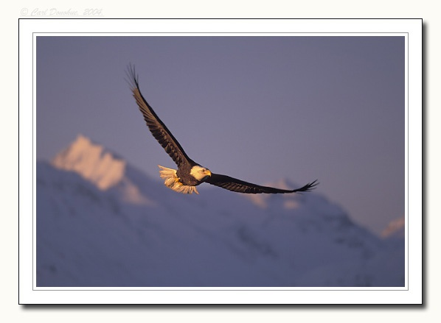
With Eagle’s Wings
“The eagle of the Alps is sometimes beaten down by the tempest into the narrow defiles of the mountains. Storm clouds shut in this mighty bird of the forest, their dark masses separating her from the sunny heights where she has made her home. Her efforts to escape seem fruitless. She dashes to and fro, beating the air with her strong wings, and waking the mountain echoes with her cries. At length, with a note of triumph, she darts upward, and, piercing the clouds, is once more in the clear sunlight, with the darkness and tempest far beneath. So we may be surrounded with difficulties, discouragement, and darkness. Falsehood, calamity, injustice, shut us in. There are clouds that we cannot dispel. We battle with circumstances in vain. There is one, and but one, way of escape. The mists and fogs cling to the earth; beyond the clouds God's light is shining. Into the sunlight of His presence we may rise on the wings of faith.” ED. Pg 118,119

Slide 11
Darkness of Deception
“Take heed that no man deceive you.”(verse 4)… “For many shall come in my name, saying, I am Christ; and shall deceive many.”(verse 5)…“And many false prophets shall rise, and shall deceive many.”(Verse 11)… “For there shall arise false Christs, and false prophets, and shall shew great signs and wonders; insomuch that, if it were possible, they shall deceive the very elect.” (verse 24)
Christ warned four times against deception. One of the great deceptions of our day is that there is not an international conspiracy, run by the papacy/Jesuits, to regain control of this planet for sinister purposes.

Slide 12
A Conspiracy?
“ ‘The Enemy Unmasked’, however, goes far beyond that to link many groups and individuals into a world-wide conspiracy that we do not believe is correct, and in fact, is very inflammatory and damaging to the efforts of Christian brotherhood and goodwill. I enjoy very much my fellowship with all Christian pastors and believers in my community, and I deeply regret that this book was printed and distributed anywhere. I believe it is harmful to the cause of Christ and does not represent the mission of the Seventh-day Adventist Church.” This is what one SDA pastor declared.
An agreement to perform together an illegal, wrongful, or subversive act.
2. A group of conspirators.
3. Law An agreement between two or more persons to commit a crime or accomplish a legal purpose through illegal action.
4. A joining or acting together, as if by sinister design:
a secret plan to carry out an illegal or harmful act

Slide 13
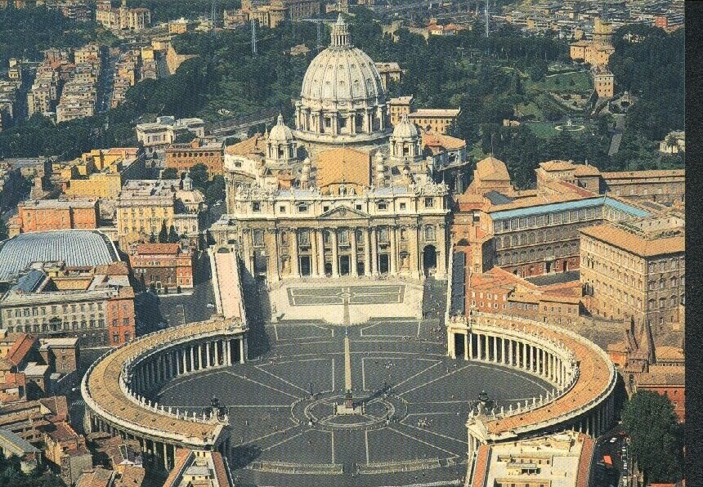
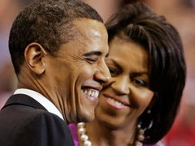
A Conspiracy? Is The Papacy Linked with others?

Slide 14
A Conspiracy?
““With whom the kings of the earth have committed fornication.” Rev. 17:2
“And the woman which thou sawest is that great city which reigneth over the kings of the earth.” Rev.17:18
“And the merchants of the earth shall weep and mourn over her; for no man buyeth their merchandise any more: The merchandise of gold, and silver, and precious stones... The merchants of these things, which were made rich by her,” Rev. 18:11,12, and 15
Do we have a conspiracy yet?!?!?

Slide 15
A Conspiracy?!?!?!?
Revelation 17:5
“And on her forehead was a name written, ‘Mystery, Babylon the Great, the Mother of harlots and abominations of the earth.”
“ ‘The Enemy Unmasked’,… is very inflammatory and damaging to the efforts of Christian brotherhood and goodwill. I enjoy very much my fellowship with all Christian pastors and believers in my community, …I believe it is harmful to the cause of Christ and does not represent the mission of the Seventh-day Adventist Church.” The Enemy Unmasked disrupts this Seventh-day Adventist pastor’s relationship with other Christian groups.

Slide 16


Is Seventh-day Adventism Involved in this Conspiracy?

Slide 17
Take Heed, that no man Deceive you
1. There is a conspiracy.
2. There are four groups united together to achieve a sinister end.
3. The groups are the papacy, the political leaders of earth, the business people of earth, and the churches of earth.
George Bush had every reason to lie when he said there was no conspiracy.
The Adventist pastor in Silverton, OR lied as well to cover his church’s involvement in this international conspiracy. What are we supporting? Where are we standing today?

Slide 18

Darkness of Defeat
It doesn’t have to be!!!
“I can do all things through Christ which strengtheneth me.” Phil. 4:13 “But thanks be to God, which giveth us the victory through our Lord Jesus Christ.” 1Cor. 15:57 “Thine, O LORD, is the greatness, and the power, and the glory, and the victory, and the majesty: for all that is in the heaven and in the earth is thine; thine is the kingdom, O LORD, and thou art exalted as head above all. Both riches and honour come of thee, and thou reignest over all; and in thine hand is power and might; and in thine hand it is to make great, and to give strength unto all. Now therefore, our God, we thank thee, and praise thy glorious name.” 1Chron. 29:11-13

Slide 19
In Heaven’s Eyes
A fervent prayer rose up to heaven, a fragile soul is losing ground. Sorting through this earthly babble, heaven heard the sound. This was a life with no distinction, no successes, only tries. Yet gazing down on this unlovely one, there was love in heaven`s eyes.
In heaven`s eyes, there are no losers, in heaven`s eyes no hopeless cause
Only people like you with feelings like me amazed by the grace we can find In heaven`s eyes
A restless child, a wayward father, a lonely traveler in the rain; When life goes on and no one bothers, heaven feels the pain. Looking down, He sees each heart ache, knows each sorrow, hears each cry. And looking up, we see compassion`s fire ablaze in heaven`s eyes.
In heaven`s eyes, there are no losers, in heaven`s eyes there is no hopeless cause
Only people like you with feelings like me amazed by the grace we can find
In heaven`s eyes.

Slide 20
The Challenge
“Satan has an accurate knowledge of the sins that he has tempted God's people to commit, and he urges his accusations against them, declaring, that by their sins they have forfeited divine protection, and claiming that he has the right to destroy them. He pronounces them just as deserving as himself of exclusion from the favor of God. "Are these," he says, "the people who are to take my place in heaven, and the place of the angels who united with me? They profess to obey the law of God; but have they kept its precepts? Have they not been lovers of self more than lovers of God? Have they not placed their own interests above His service? Have they not loved the things of the world? Look at the sins that have marked their lives. Behold their selfishness, their malice, their hatred of one another. Will God banish me and my angels from His presence, and yet reward those who have been guilty of the same sins? Thou canst not do this, O Lord, in justice. Justice demands that sentence be pronounced against them……………………………………………………………………………………….."

Slide 21
Concluded
…But while the followers of Christ have sinned, they have not given themselves up to be controlled by the satanic agencies. They have repented of their sins and have sought the Lord in humility and contrition, and the divine Advocate pleads in their behalf. He who has been most abused by their ingratitude, who knows their sin and also their penitence, declares: "The Lord rebuke thee, O Satan. I gave My life for these souls. They are graven upon the palms of My hands. They may have imperfections of character; they may have failed in their endeavors; but they have repented, and I have forgiven and accepted them." The assaults of Satan are strong, his delusions are subtle; but the Lord's eye is upon His people. Their affliction is great, the flames of the furnace seem about to consume them; but Jesus will bring them forth as gold tried in the fire. Their earthliness will be removed, that through them the image of Christ may be perfectly revealed.” PK, pgs. 588, 589

Slide 22
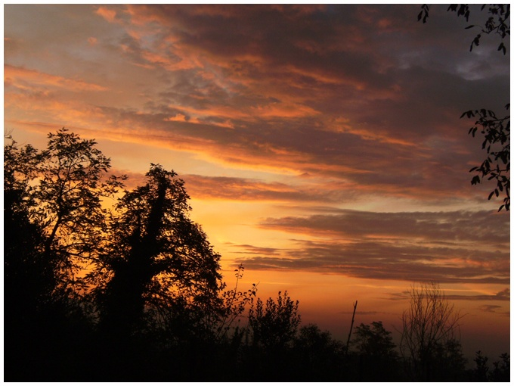
‘Ecclesia’
The Called out Ones
Called out from the darkness of discouragement. Called out from the darkness of deception. Called out from the darkness of defeat. Called out of darkness into His marvelous light.

