Slide 1
Jesus Life, pt. 18 “Depart From Me”

Slide 2
The Story
“And it came to pass, that, as the people pressed upon him to hear the word of God, he stood by the lake of Gennesaret, And saw two ships standing by the lake: but the fishermen were gone out of them, and were washing their nets. And he entered into one of the ships, which was Simon's, and prayed him that he would thrust out a little from the land. And he sat down, and taught the people out of the ship. Now when he had left speaking, he said unto Simon, Launch out into the deep, and let down your nets for a draught. And Simon answering said unto him, Master, we have toiled all the night, and have taken nothing: nevertheless at thy word I will let down the net. And when they had this done, they enclosed a great multitude of fishes: and their net brake. And they beckoned unto their partners, which were in the other ship, that they should come and help them. And they came, and filled both the ships, so that they began to sink. When Simon Peter saw it, he fell down at Jesus' knees, saying, Depart from me; for I am a sinful man, O Lord. For he was astonished, and all that were with him, at the draught of the fishes which they had taken: And so was also James, and John, the sons of Zebedee, which were partners with Simon. And Jesus said unto Simon, Fear not; from henceforth thou shalt catch men.” Luke 5:1-10

Slide 3
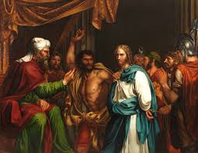
A Defining Moment
Things were not going well. The world was in total upheaval. The Romans were a corrupt power that were also ruthless. Bloody messes seemed to bring new rulers to the throne. The SDA Church was in a mess. They already wanted to kill their Messiah! He didn’t feel comfortable at headquarters. John the Baptist was in prison. Everything seemed to be against Jesus and the disciples. And now, even their former occupation hadn’t produced any results! What would be next?

Slide 4
Dark Forebodings
“But Peter was disheartened. All night he had taken nothing. During the lonely hours he had thought of the fate of John the Baptist, who was languishing alone in his dungeon. He had thought of the prospect before Jesus and His followers, of the ill success of the mission to Judea, and the malice of the priests and rabbis. Even his own occupation had failed him; and as he watched by the empty nets, the future had seemed dark with discouragement.” DA, pg. 245

Slide 5
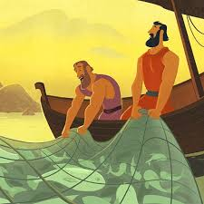
Jesus Says, ‘Try Again’
“Night was the only favorable time for fishing with nets in the clear waters of the lake. After toiling all night without success, it seemed hopeless to cast the net by day; but Jesus had given the command, and love for their Master moved the disciples to obey. Simon and his brother together let down the net. As they attempted to draw it in, so great was the quantity of fish enclosed that it began to break. They were obliged to summon James and John to their aid. When the catch was secured, both the boats were so heavily laden that they were in danger of sinking.” DA, pg. 246

Slide 6
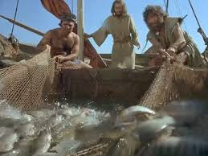
Our Efforts Are Futile
Jesus command seemed impossible. Peter and the others had tried to catch fish. They gave every effort for success. They tried their best, but their efforts had proved futile. Out of love for Jesus, they would try again. They didn't want to hurt Him! “ Master, we have toiled all the night, and have taken nothing: nevertheless at thy word I will let down the net.”
How often are our efforts to obey absolutely futile because we attempt to obey the commandments in our own strength?

Slide 7
Nothing in Me Good!
“For I know that in me (that is, in my flesh,) dwelleth no good thing: for to will is present with me; but how to perform that which is good I find not. For the good that I would I do not: but the evil which I would not, that I do.” Romans 7:18,19
“Because the carnal mind is enmity against God: for it is not subject to the law of God, neither indeed can be. So then they that are in the flesh cannot please God.” Romans 8:7,8
“Is the law then against the promises of God? God forbid: for if there had been a law given which could have given life, verily righteousness should have been by the law. But the scripture hath concluded all under sin, that the promise by faith of Jesus Christ might be given to them that believe. But before faith came, we were kept under the law, shut up unto the faith which should afterwards be revealed. Wherefore the law was our schoolmaster to bring us unto Christ, that we might be justified by faith. But after that faith is come, we are no longer under a schoolmaster.” Galatians 3:21-25

Slide 8
When He is Near!
“During that sad night on the lake, when they were separated from Christ, the disciples were pressed hard by unbelief, and weary with fruitless toil. But His presence kindled their faith, and brought them joy and success. So it is with us; apart from Christ, our work is fruitless, and it is easy to distrust and murmur. But when He is near, and we labor under His direction, we rejoice in the evidence of His power. It is Satan's work to discourage the soul; it is Christ's work to inspire with faith and hope. The deeper lesson which the miracle conveyed for the disciples is a lesson for us also,—that He whose word could gather the fishes from the sea could also impress human hearts, and draw them by the cords of His love, so that His servants might become “fishers of men.” DA, pg. 249

Slide 9
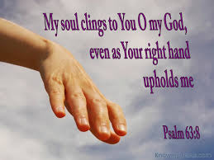
Depart from me!
“And they beckoned unto their partners, which were in the other ship, that they should come and help them. And they came, and filled both the ships, so that they began to sink. When Simon Peter saw it, he fell down at Jesus' knees, saying, Depart from me; for I am a sinful man, O Lord.” Luke 5:7,8

Slide 10
Overwhelmed!
“But Peter was unmindful now of boats or lading. This miracle, above any other he had ever witnessed, was to him a manifestation of divine power. In Jesus he saw One who held all nature under His control. The presence of divinity revealed his own unholiness. Love for his Master, shame for his own unbelief, gratitude for the condescension of Christ, above all, the sense of his uncleanness in the presence of infinite purity, overwhelmed him. While his companions were securing the contents of the net, Peter fell at the Saviour's feet, exclaiming, “Depart from me; for I am a sinful man, O Lord.” It was the same presence of divine holiness that had caused the prophet Daniel to fall as one dead before the angel of God. He said, “My comeliness was turned in me into corruption, and I retained no strength.” So when Isaiah beheld the glory of the Lord, he exclaimed, “Woe is me! for I am undone; because I am a man of unclean lips, and I dwell in the midst of a people of unclean lips: for mine eyes have seen the King, the Lord of hosts.” Daniel 10:8; Isaiah 6:5. Humanity, with its weakness and sin, was brought in contrast with the perfection of divinity, and he felt altogether deficient and unholy. Thus it has been with all who have been granted a view of God's greatness and majesty.” DA, pg. 246

Slide 11
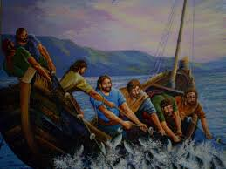
The Presence of Divinity!
“During that sad night on the lake, when they were separated from Christ, the disciples were pressed hard by unbelief, and weary with fruitless toil. But His presence kindled their faith, and brought them joy and success. So it is with us; apart from Christ, our work is fruitless, and it is easy to distrust and murmur. But when He is near, and we labor under His direction, we rejoice in the evidence of His power. It is Satan's work to discourage the soul; it is Christ's work to inspire with faith and hope. The deeper lesson which the miracle conveyed for the disciples is a lesson for us also,—that He whose word could gather the fishes from the sea could also impress human hearts, and draw them by the cords of His love, so that His servants might become “fishers of men.”” DA, pg. 249

Slide 12
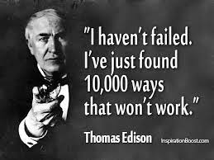
Spending Time with Jesus
The presence of Jesus brought the blessing, turning failure into victory, turning sadness into joy, turning defeat into victory! In our lives, the presence of Christ alone brings the blessing. No matter how fruitless or discouraging our circumstances, Christ can bring the victory to us when we look to Him in faith and remain in His presence!

Slide 13
Get Up, Look to Jesus!
1. Abraham Lincoln
While today he is remembered as one of the greatest leaders of the United States, Lincoln’s life wasn’t so easy. In his youth he went to war a captain and returned a private (if you’re not familiar with military ranks, just know that private is as low as it gets). Lincoln didn’t stop there, however. He started numerous failed businesses, went bankrupt twice, and was defeated in 26 campaigns he made for public office.
3. Ludwig van Beethoven
In his formative years, young Beethoven was incredibly awkward on the violin and was often so busy working on his own compositions that he neglected to practice. Despite his love of composition, his teachers felt he was hopeless at it and would never succeed with the violin or in composing. In fact, his music teacher told his parents he was too stupid to be a music composer.

Slide 14
Failure Leads to Success
5. Michael Jordan It’s hard to believe that the man commonly lauded as the best basketball player of all time was actually cut from his high school basketball team. Luckily, Jordan didn’t let this setback stop him from playing the game, and as he once stated in a famous ad, “I have missed more than 9,000 shots in my career. I have lost almost 300 games. On 26 occasions I have been entrusted to take the game-winning shot, and I missed. I have failed over and over and over again in my life. And that is why I succeed.”
9. Vincent Van Gogh
During his lifetime, Van Gogh sold only one painting, and this was to a friend and only for a very small amount of money. While Van Gogh was never a success during his life, he plugged on with painting, sometimes starving to complete his over 800 known works. Today, some are worth hundreds of millions of dollars each.

Slide 15
In His Presence!
“Though I might also have confidence in the flesh. If any other man thinketh that he hath whereof he might trust in the flesh, I more: Circumcised the eighth day, of the stock of Israel, of the tribe of Benjamin, an Hebrew of the Hebrews; as touching the law, a Pharisee; Concerning zeal, persecuting the church; touching the righteousness which is in the law, blameless. But what things were gain to me, those I counted loss for Christ. Yea doubtless, and I count all things but loss for the excellency of the knowledge of Christ Jesus my Lord: for whom I have suffered the loss of all things, and do count them but dung, that I may win Christ, And be found in him, not having mine own righteousness, which is of the law, but that which is through the faith of Christ, the righteousness which is of God by faith: That I may know him, and the power of his resurrection, and the fellowship of his sufferings, being made conformable unto his death;” Philippians 3:4-10

Slide 16
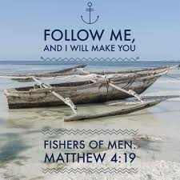
Fisherman!
“And so was also James, and John, the sons of Zebedee, which were partners with Simon. And Jesus said unto Simon, Fear not; from henceforth thou shalt catch men.” Luke 5:10
Fishers of men; not theological giants!
Spreading the truth; not hiding it under a bushel or bed!
Sharing with others; not wasting time on theological controversy!
What say you?

